Slide 1
Jig and Fixture Design
Tool Design Review-2
Utkarsh Rawat(16BME1251)

Slide 2
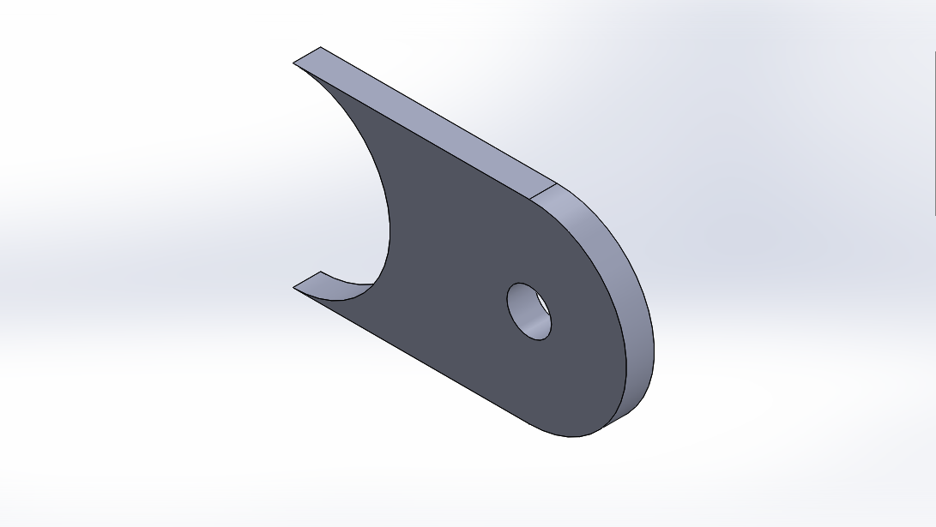
Choice of work piece
Work piece chosen for the drilling operation is an mount.

Slide 3
Reason for choice
I was in automotive club where use of this size mount was very common .
Main issue arise during manufacturing is clamping a plate of 5mm thickness then drilling a hole on such small size work piece.
So a simple and light weight jig design was appropriate solution to overcome this issue

Slide 4
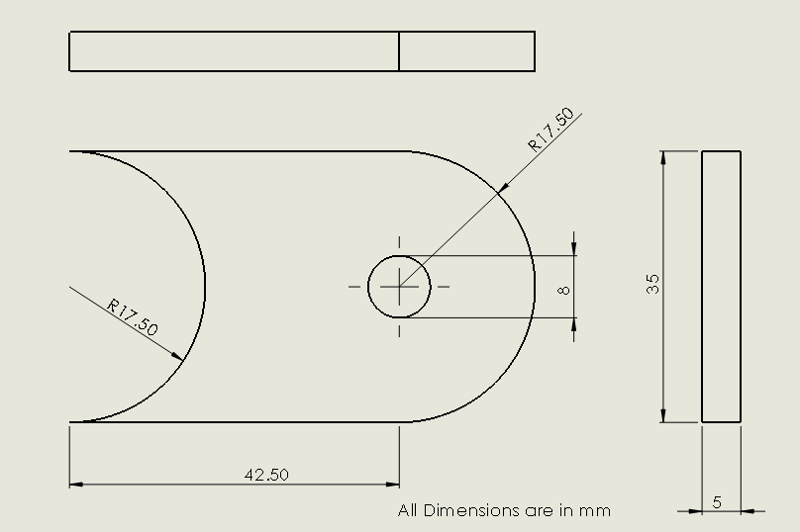
Dimensions

Slide 5
Drill Parameters and Feed Calculation
Depth of hole=5mm
Tool diameter= 7.935(mm)(HSS)
Cutting speed= 508(mm/s)
Spindle speed= (cutting speed*12/tool dia*pi)=1222(rpm)
Feed rate= cutting feed * spindle speed=202.0316(mm/min)
Cut time=cut length*feed rate=0.025(min)
Torque= 2.434 N-m
Thrust Force= 613N

Slide 6
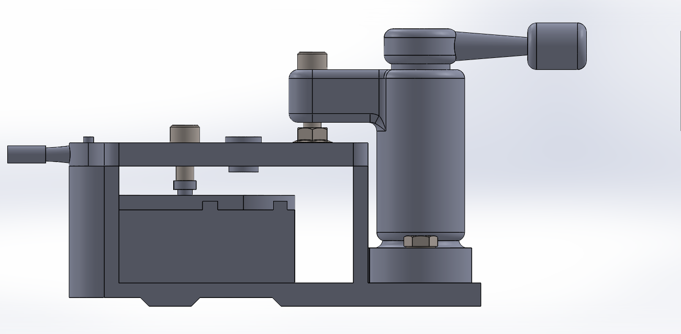
CAD Model(front view)

Slide 7
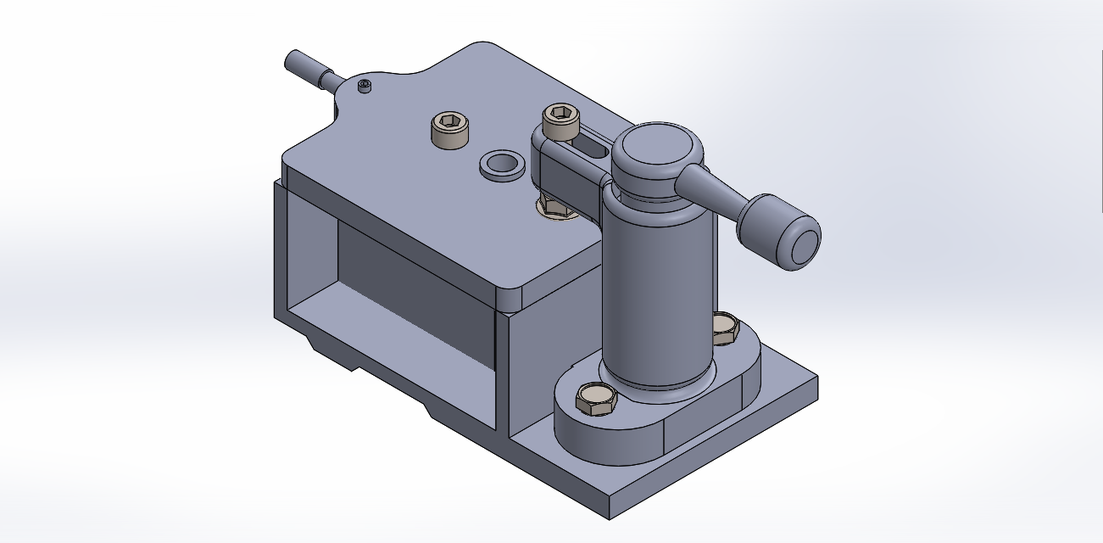
CAD Model(Isometric View)

Slide 8
BOM
ITEM NO. | PART NUMBER | MATERIAL | QTY.
1 | Jig body | Cast Iron | 1
2 | Latch plate | Mild Steel | 1
3 | Cam clamp | Carbon Steel | 1
4 | Locator(work piece) | Mild Steel | 1
5 | Workpiece(mount) | Mild Steel | 1
6 | AFBMA 12.1.4.1 - 0025- 6 - 10,SI,NC,10_68 | Plain Carbon steel | 1
7 | Socket head cap screw_am3 | Plain Carbon steel | 1
8 | B18.2.3.2M - Formed hex screw, M6 x 1.0 x 10 --10WN | Plain Carbon steel | 2
9 | B18.2.2.4M - Hex flange nut, M6 x 1 –N | Plain Carbon steel | 1
10 | Stud(latch_plate) | Mild Steel | 1
11 | Bush | Silicone Rubber | 1
12 | Locator(Top) | Mild Steel | 1
13 | Socket head cap screw_am3 | Plain Carbon steel | 1

Slide 9
Work to be done
Force analysis
Modification as per results from analysis
Final design.

Slide 10
References
Cam Clamp design(HYPERLINK)
Force Calculations(HYPERLINK)

