Slide 1
Jig and Fixture Design
Tool Design Review-3
Utkarsh Rawat(16BME1251)

Slide 2
Abstract
This project is based on design of fixture and mainly concentrate on reducing loading unloading time and stress of worker
Usage of cam clamp and various other method to do so.
Reducing cost of manufacturing by accommodating various types of work pieces on work piece holder.
Performing manual calculation and analysis for same.

Slide 3
Introduction
Fixtures also allow for a higher degree of operator safety by reducing the concentration and effort required to hold a piece steady. Economically speaking the most valuable function of a fixture is to reduce labor costs.

Slide 4
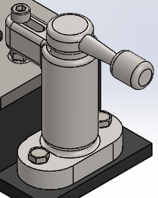
Cam clamp
these provide fast efficient and simple way to hold the work.
Cam clamps: apply pressure directly on the work and are not used when there is a strong vibration.

Slide 5
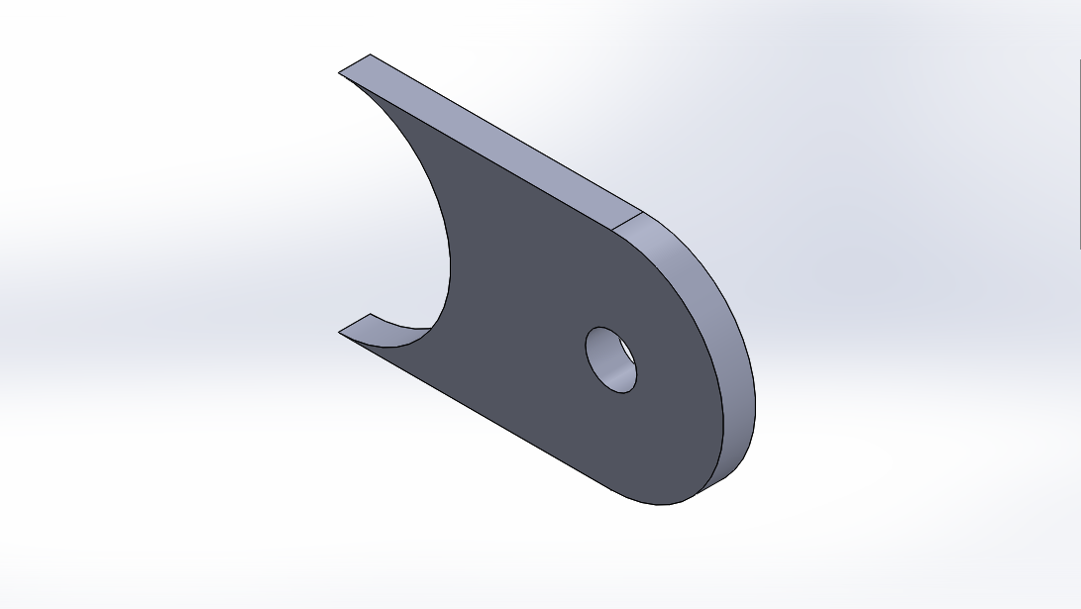
Choice of work piece
Work piece chosen for the drilling operation is an mount.

Slide 6
Reason for choice
I was in automotive club where use of this size mount was very common .
Main issue arise during manufacturing is clamping a plate of 5mm thickness then drilling a hole on such small size work piece.
So a simple and light weight jig design was appropriate solution to overcome this issue

Slide 7
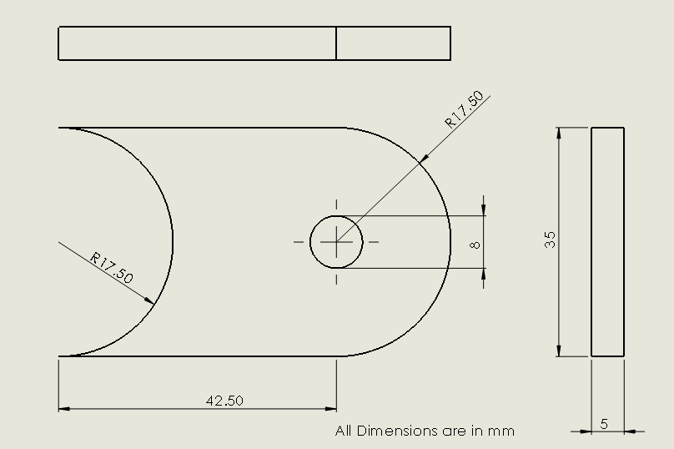
Dimensions

Slide 8
Drill Parameters and Feed Calculation
Depth of hole=5mm
Tool diameter= 7.935(mm)(HSS)
Cutting speed= 508(mm/s)
Spindle speed= (cutting speed*12/tool dia*pi)=1222(rpm)
Feed rate= cutting feed * spindle speed=202.0316(mm/min)
Cut time=cut length*feed rate=0.025(min)
Torque= 2.434 N-m
Thrust Force= 613N

Slide 9
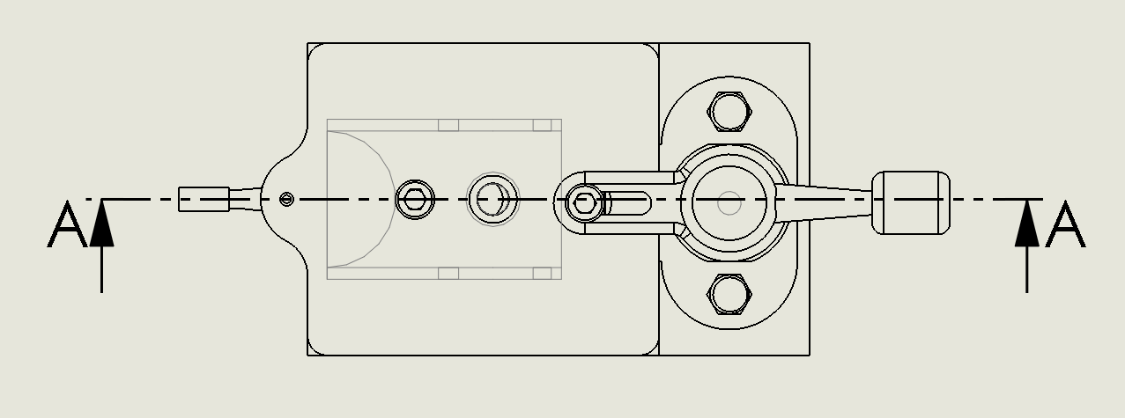
Drawings

Slide 10
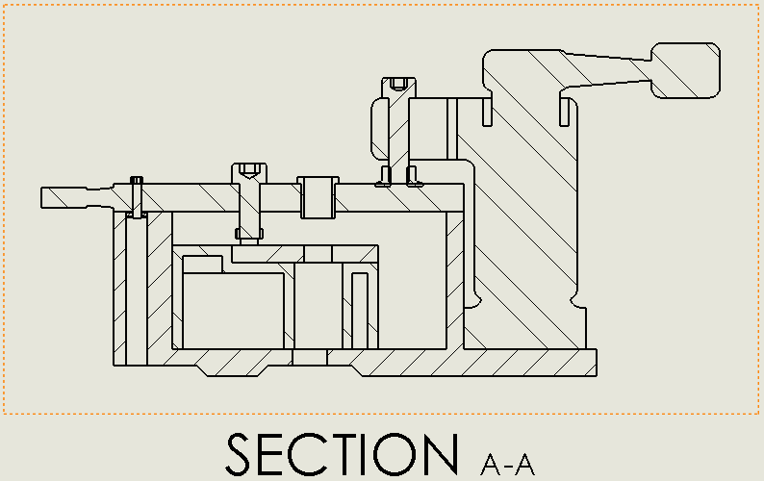
Drawing(section view)

Slide 11
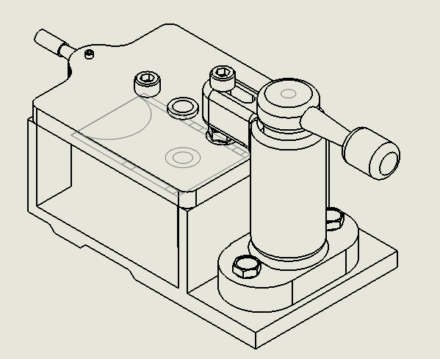
Drawing(Isometric view)

Slide 12
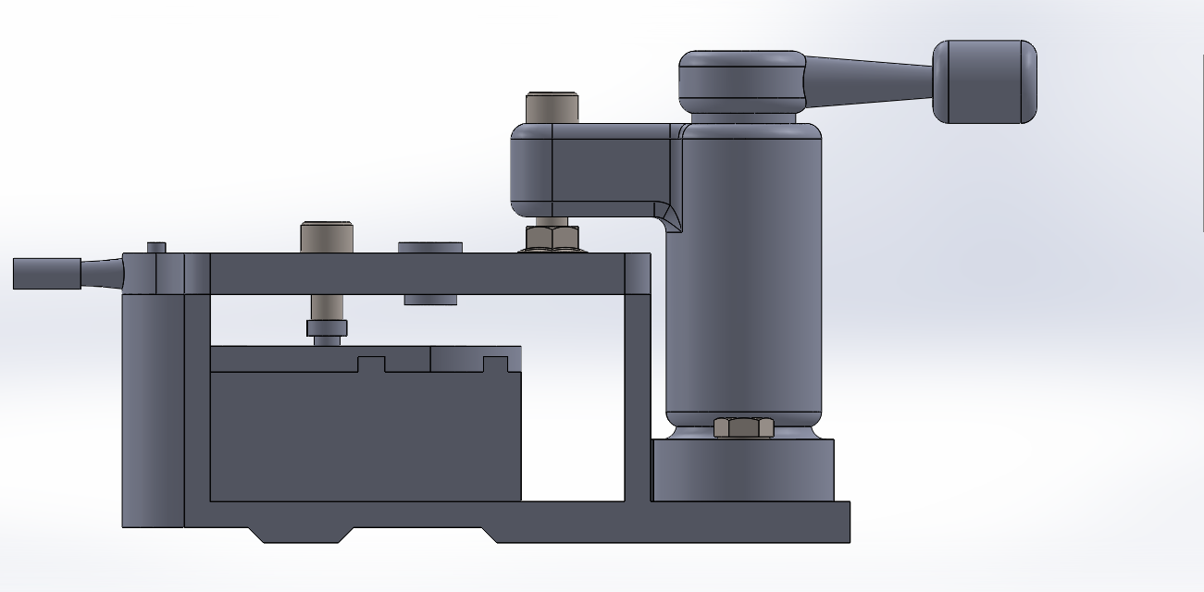
CAD Model(front view)

Slide 13
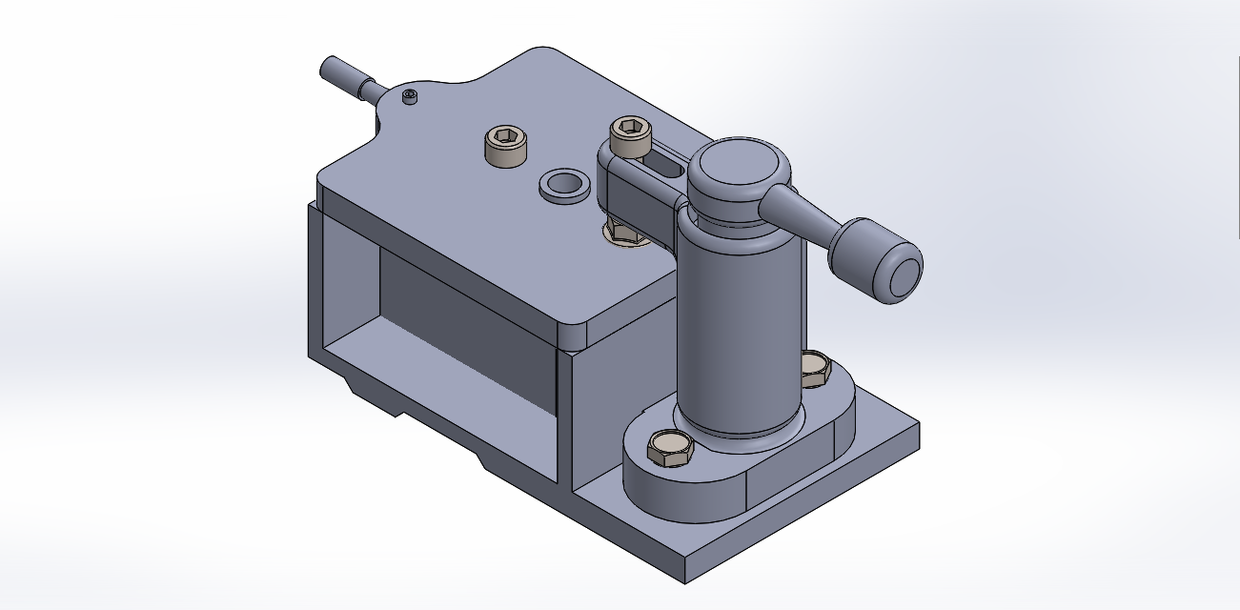
CAD Model(Isometric View)

Slide 14
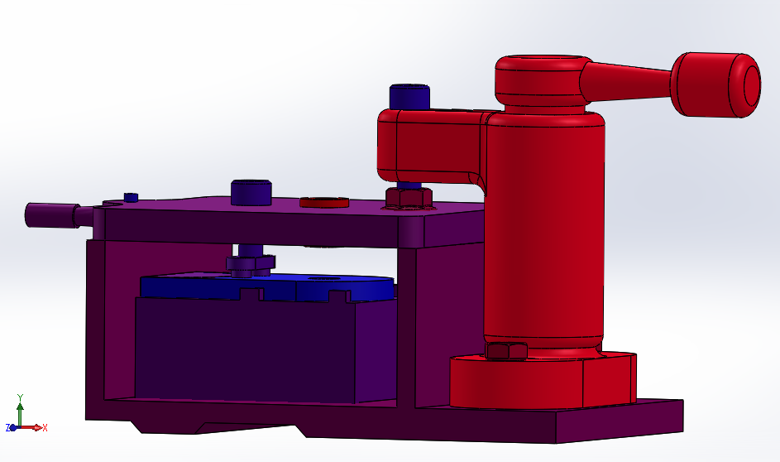
Assembly View

Slide 15
BOM
ITEM NO. | PART NUMBER | MATERIAL | QTY.
1 | Jig body | Cast Iron | 1
2 | Latch plate | Mild Steel | 1
3 | Cam clamp | Carbon Steel | 1
4 | Locator(work piece) | Mild Steel | 1
5 | Workpiece(mount) | Mild Steel | 1
6 | AFBMA 12.1.4.1 - 0025- 6 - 10,SI,NC,10_68 | Plain Carbon steel | 1
7 | Socket head cap screw_am3 | Plain Carbon steel | 1
8 | B18.2.3.2M - Formed hex screw, M6 x 1.0 x 10 --10WN | Plain Carbon steel | 2
9 | B18.2.2.4M - Hex flange nut, M6 x 1 –N | Plain Carbon steel | 1
10 | Stud(latch_plate) | Mild Steel | 1
11 | Bush | Silicone Rubber | 1
12 | Locator(Top) | Mild Steel | 1
13 | Socket head cap screw_am3 | Plain Carbon steel | 1

Slide 16
Analysis
Sr.no | Title
1 2 3 4 5 6 7 8 | Description Assumptions Model Information Material Properties Loads and Fixtures Mesh information Study Results Conclusion

Slide 17
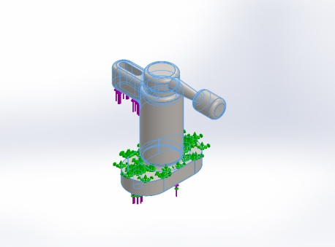
Model Properties
File name | Treated As | Volumetric Properties
cam clamp-1-solid1 | Solid Body | Mass:0.639885 kg Volume:8.20365e-005 m^3 Density:7800 kg/m^3 Weight:6.27087 N
Model | Properties
 | Name: | Cast Carbon Steel
 | Model type: | Linear Elastic Isotropic
 | Default failure criterion: | Max von Mises Stress
 | Yield strength: | 248.168 N/mm^2
 | Tensile strength: | 482.549 N/mm^2

Slide 18
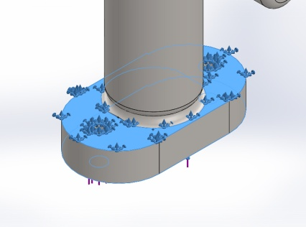
Fixture
Fixture name | Fixture Image | Fixture Details
Fixed-1 |  | Entities: | 2 face(s)
 |  | Type: | Fixed Geometry

Slide 19
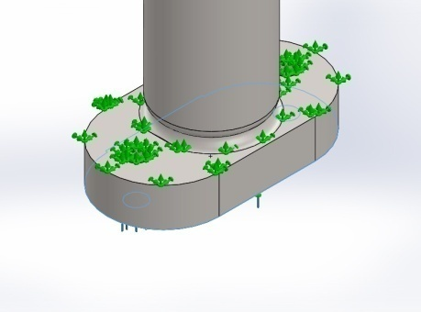
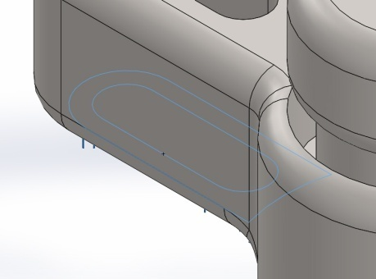
Load
Load name | Load Image | Load Details
Force-1 |  | Entities: | 1 face(s)
 |  | Type: | Apply normal force
 |  | Value: | 613 N
Load name | Load Image | Load Details
Force-2 |  | Entities: | 1 face(s)
 |  | Type: | Apply normal force
 |  | Value: | 613 N

Slide 20
Mesh
Mesh type | Solid Mesh
Mesher Used: | Standard mesh
Automatic Transition: | Off
Include Mesh Auto Loops: | Off
Jacobian points | 4 Points
Element Size | 4.3465 mm
Tolerance | 0.217325 mm
Mesh Quality | High
Total Nodes | 14199
Total Elements | 8753
Maximum Aspect Ratio | 15.809

Slide 21
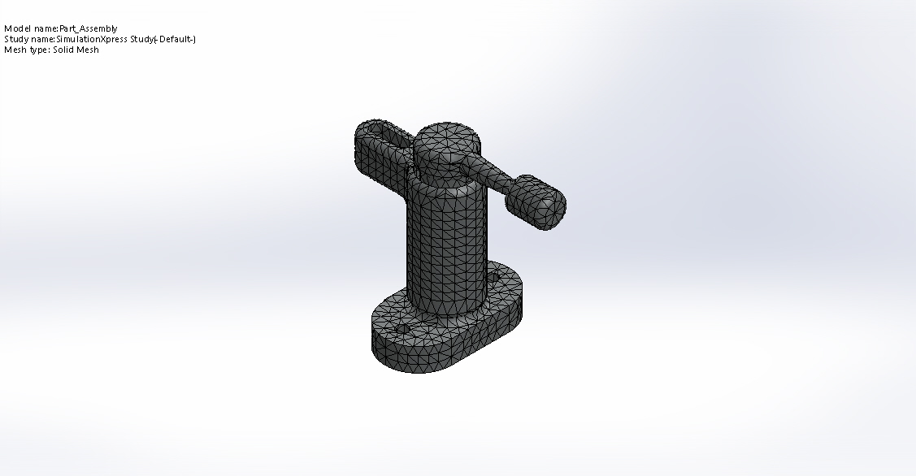
Mesh

Slide 22
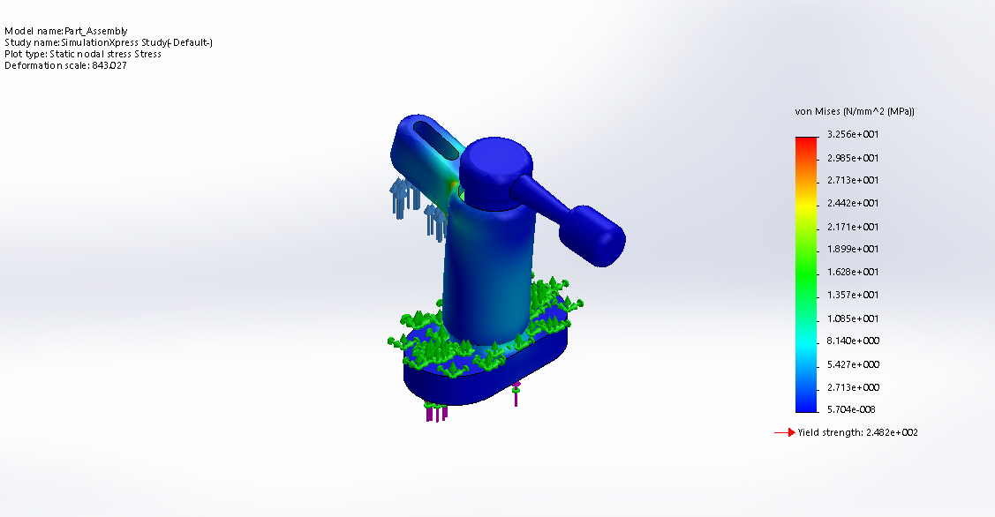
Von-Mises Stress
Name | Type | Min | Max
Stress | VON: von Mises Stress | 5.70371e-008 N/mm^2 (MPa) Node: 4020 | 32.5611 N/mm^2 (MPa) Node: 7838

Slide 23
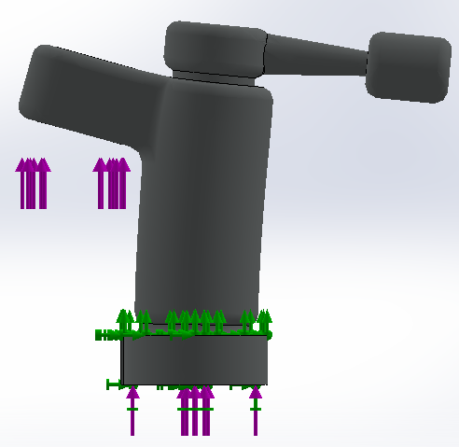
Max Deformation

Slide 24
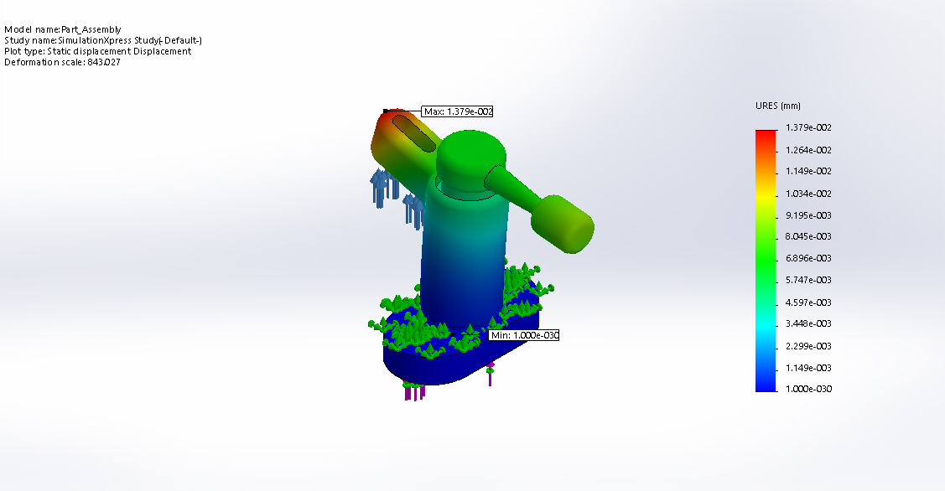
Resultant Displacement
Name | Type | Min | Max
Displacement | URES: Resultant Displacement | 0 mm Node: 1 | 0.0137922 mm Node: 12231

Slide 25
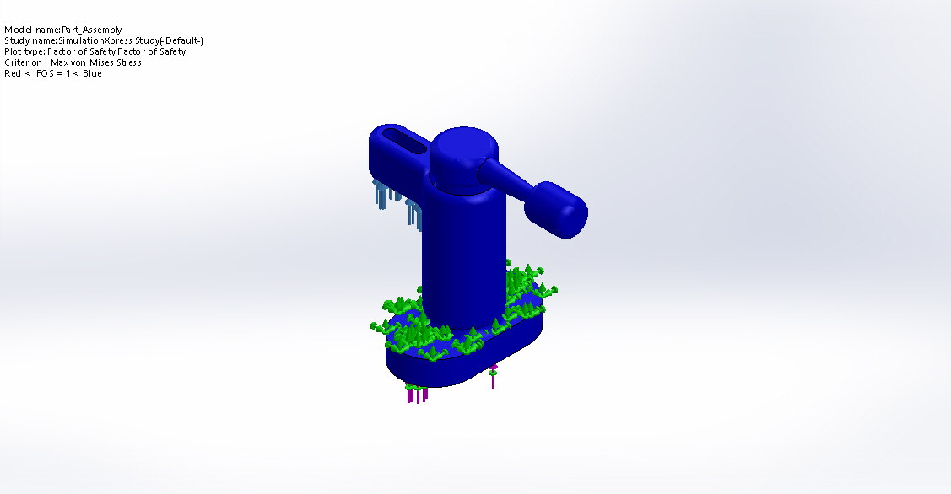
Factor of safety
Name | Type | Min | Max
Factor of Safety | Max von Mises Stress | 7.62161 Node: 7838 | 4.35099e+009 Node: 4020

Slide 26
Conclusion
Developed design reduced the clamping and loading time by using cam clamp and it further used and rotating plate to reduce loading time.
It is found to be safe for calculated value of thrust force and fix position.
Factor of safety vary from 1-1.15 for design.

Slide 27
References
Cam Clamp design(HYPERLINK)
Force Calculations(HYPERLINK)

