Slide 1
Global Infrastructure and Reliability
Module 3
Notes:
In this module, you will learn about the AWS Global Infrastructure and ways to interact with AWS services.

Slide 2
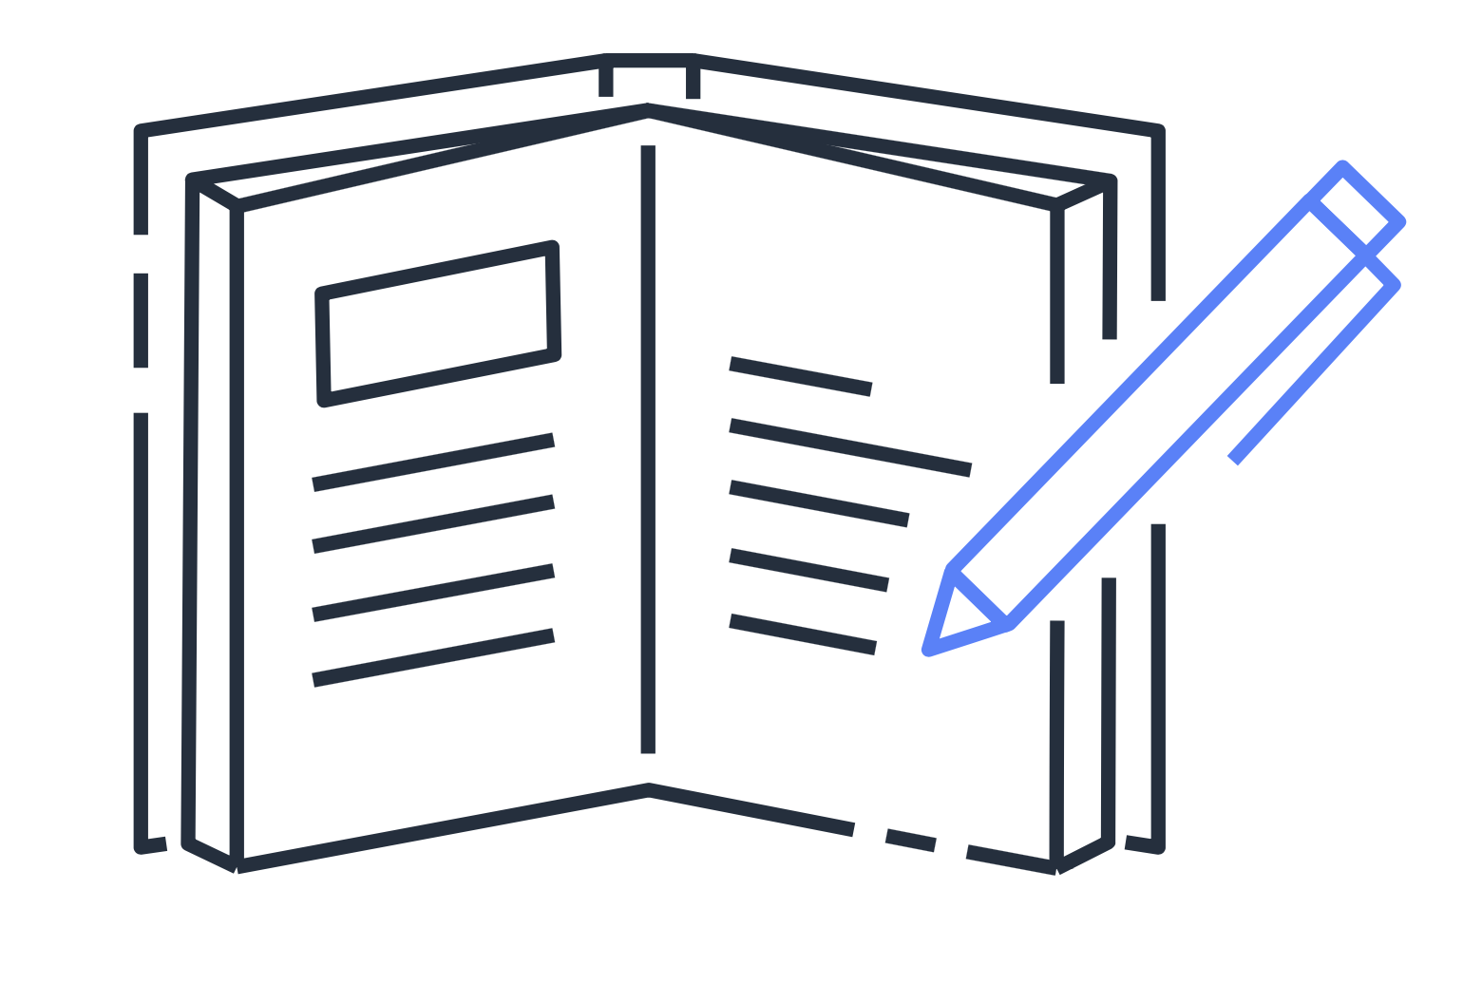
Module 3 objectives
In this module, you will learn how to:
Summarize the AWS Global Infrastructure benefits
Describe Availability Zones
Describe the benefits of Amazon CloudFront and edge locations.
Compare methods for provisioning AWS services.
Notes:
In this module, you will learn how to:
Summarize the benefits of the AWS Global Infrastructure
Describe the basic concept of Availability Zones
Describe the benefits of Amazon CloudFront and edge locations
Compare different methods for provisioning AWS services

Slide 3
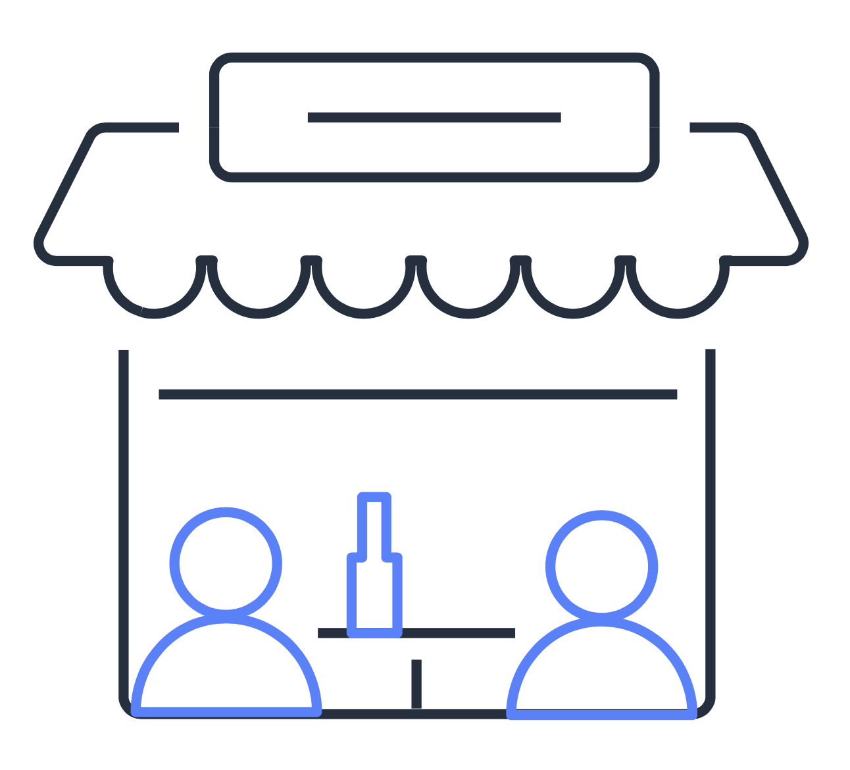


Build a global footprint
Parade route
Notes:
To understand the AWS Global Infrastructure, begin with an example from the coffee shop. Customers are unable to get to the coffee shop because a parade is blocking the road.
If an event such as a parade, flood, or power outage impacts one location, customers can still get their coffee by visiting a different location only a few blocks away.
This is similar to how the AWS Global Infrastructure works.

Slide 4
Demo: Explore the AWS Global Infrastructure
Notes:
Around the world, AWS builds Regions closest to where the business traffic demands. Each Region contains multiple data centers that have all the components necessary to run your applications. Examples include compute, storage, networking, and security services.
Each Region connects to other Regions through fiber controlled by AWS. These connections enable your application components to run in separate Regions but still communicate with each other throughout the AWS Global Infrastructure.
When deploying applications on AWS, you choose which Region or Regions your applications will run in. You must consider four business factors when selecting a Region.

Slide 5
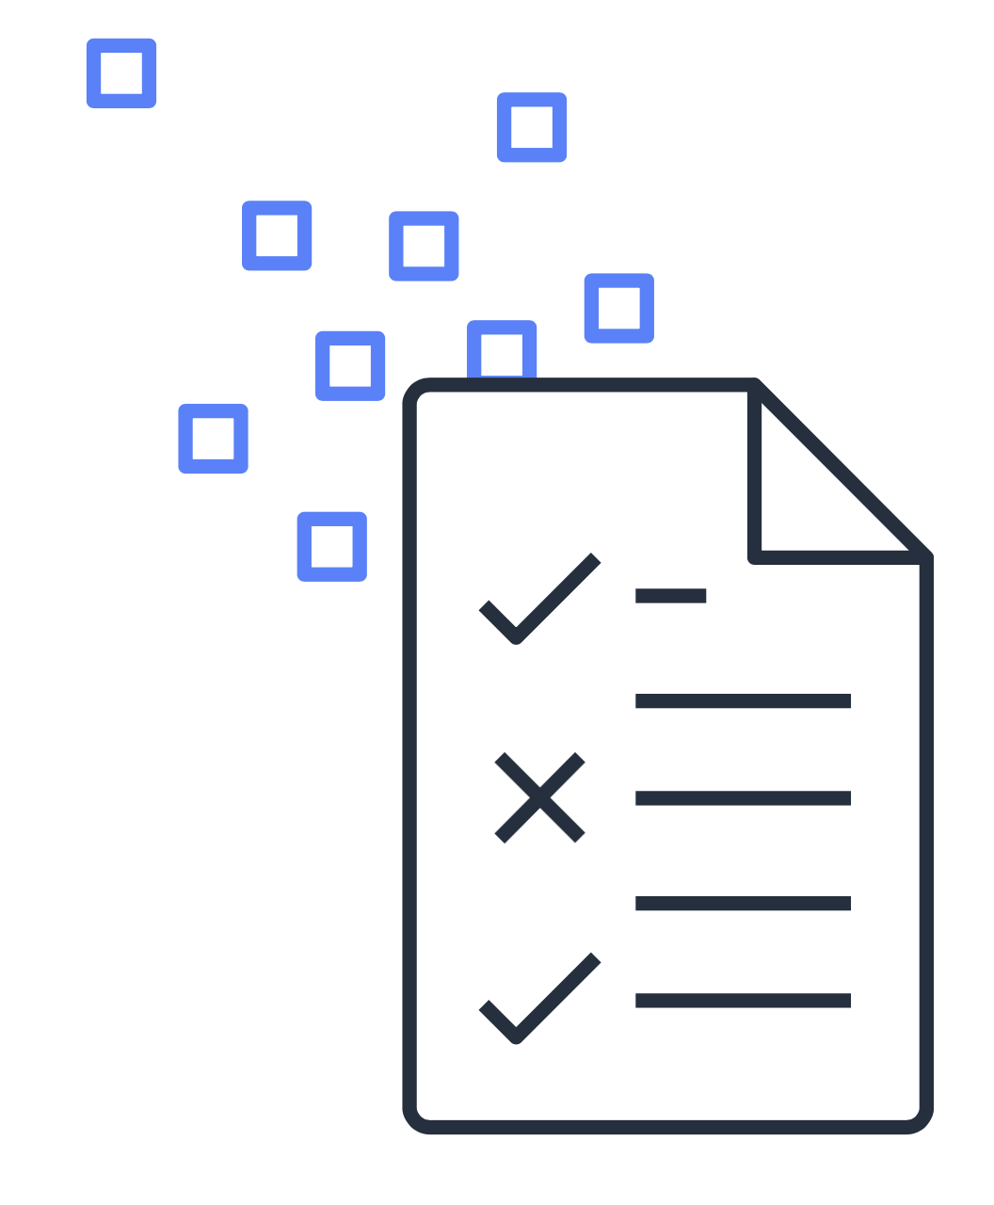
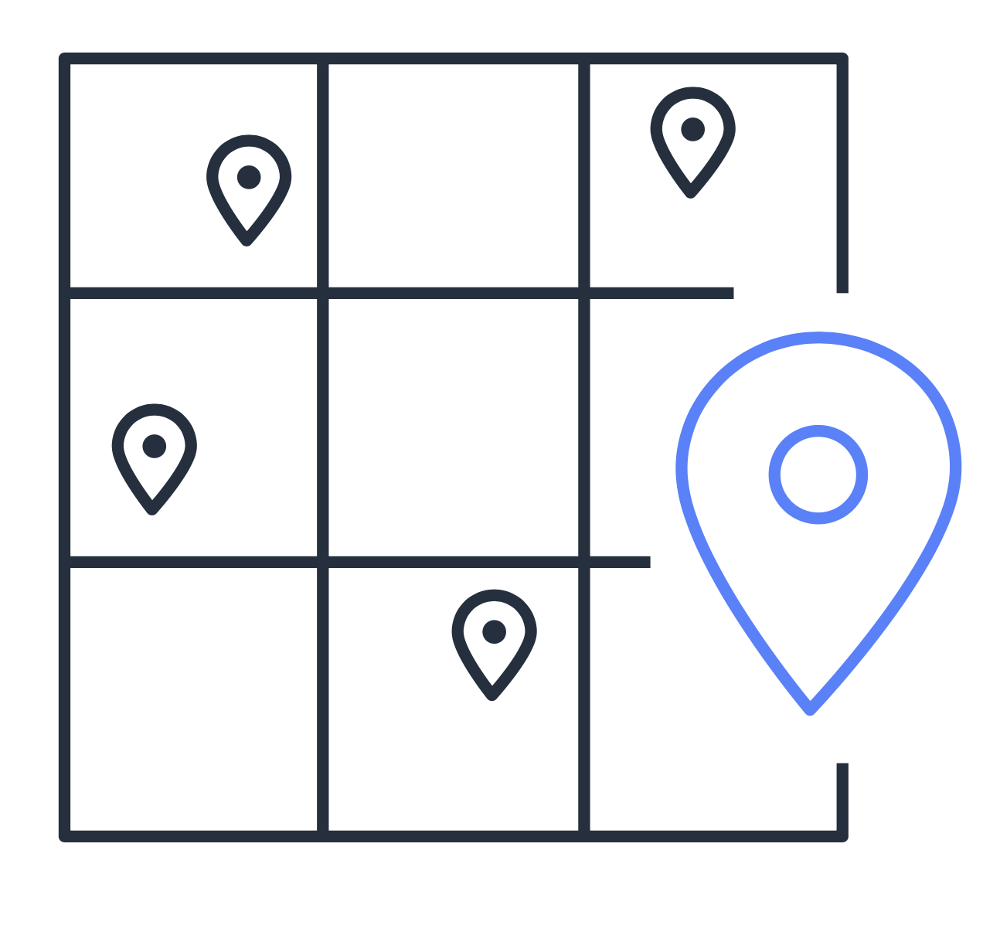


Select a Region
Determine the right Region for your services, data, and applications based on:
Compliance with data governance and legal requirements
Proximity to your customers
Available services within a Region
Pricing
Notes:
When determining the right Region for your services, data, and applications, consider these four business factors:
Compliance with data governance and legal requirements – Depending on your company and location, you might need to run your data out of specific areas. For example, if your company requires all of its data to reside within the boundaries of the UK, you would choose the London Region. Not all companies have location-specific data regulations, so you might need to focus more on the other three factors.
Proximity to your customers – Selecting a Region that is close to your customers will help you to get content to them faster. For example, your company is based in Washington, DC, and many of your customers live in Singapore. You might consider running your infrastructure in the Northern Virginia Region to be close to company headquarters, and run your applications from the Singapore Region.
Available services within a Region – Sometimes, the closest Region might not have all the features that you want to offer to customers. AWS is frequently innovating by creating new services and expanding on features within existing services. However, making new services available around the world sometimes requires AWS to build out physical hardware one Region at a time. Suppose that your developers want to build an application that uses Amazon Braket (AWS quantum computing platform). As of this course, Amazon Braket is not yet available in every AWS Region around the world, so your developers would have to run it in one of the Regions that already offers it.
Pricing – Suppose that you are considering running applications in both the United States and Brazil. The way Brazil’s tax structure is set up, it might cost 50% more to run the same workload out of the São Paulo Region compared to the Oregon Region. You will learn in more detail that several factors determine pricing, but for now know that the cost of services can vary from Region to Region.
Spanning multiple Regions helps to keep your applications and data safe from disasters. However, this isn’t the only way to get high availability and fault tolerance in the AWS Global Infrastructure. Regions are made up of multiple Availability Zones.

Slide 6
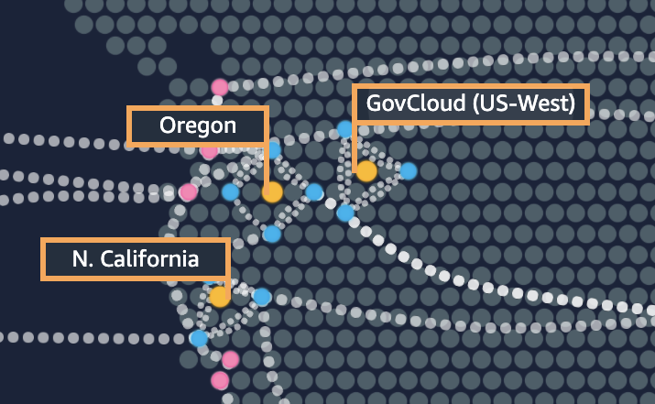

Availability Zones
us-west-1
N. California
Data centers
Data centers
us-west-1a
us-west-1b
Data centers
us-west-1c
Regions
Availability Zones
Notes:
An Availability Zone is a single data center or a group of data centers within a Region. If a disaster occurs in one part of the Region, the geographical distance helps to ensure that not all Availability Zones are affected. Availability Zones are located tens of miles apart from each other. This helps them to provide interconnectivity to support the services and applications that run within a Region.
Even though Availability Zones are close enough to have low latency (the time between when content is requested and received), they are not built directly next to one another.

Slide 7

Amazon EC2 instances in multiple AZs
us-west-1
N. California
Instance
Instance
us-west-1a
us-west-1b
us-west-1c
Regions
Availability Zones
Notes:
Here’s an example. Suppose that you’re running an application on a single Amazon EC2 instance in the Northern California Region. The instance is running in the us-west-1a Availability Zone. If us-west-1a were to fail, you would lose your instance.
A best practice is to run applications across at least two Availability Zones in a Region. In this example, you might choose to run a second Amazon EC2 instance in us-west-1b. If us-west-1a were to fail, your application would still be running in us-west-1b.

Slide 8
Discussion
What is the relationship between Regions and Availability Zones?
Notes:
Regions consist of two or more Availability Zones. Each Availability Zone includes one or more data centers.
After you have selected a Region for your applications, as a best practice, run applications in multiple Availability Zones. This helps to ensure that your applications can continue to run if one Availability Zone fails.

Slide 9
Get closer to your customers
Notes:
In this section, you will examine how to use AWS services to get closer to your customers.

Slide 10


Global content delivery
Coffee shop
Customer
Notes:
Suppose that the coffee shop’s online store has attracted customers from all over the world. The coffee shop ships its products worldwide. However, it can take a long time for these products to be delivered to customers who live far away from the shop.

Slide 11
Global content delivery
Coffee shop
Customer
Notes:
To reduce the time it takes to deliver products to customers, the coffee shop opens a new location that is closer to customers in other parts of the world. Customers are able to receive the same products as before, but at quicker speeds because of their proximity to the new shop.
This is similar to how content is delivered throughout the AWS Global Infrastructure. Instead of shipping coffee beans to your customers, you might provide them with images, videos, webpages, and other types of electronic data.

Slide 12
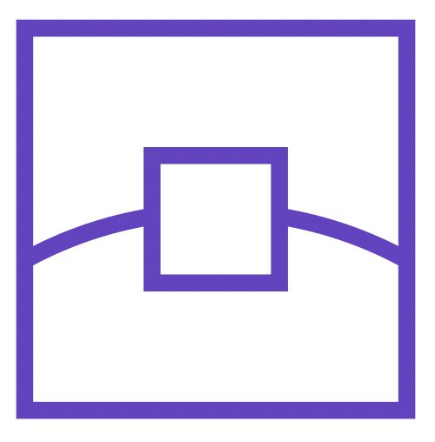


Amazon CloudFront delivers content
Edge location
Cache
Customer
Amazon EC2 instance
Notes:
Opening new stores is similar to using edge locations to bring content closer to your customers. An edge location is a site that Amazon CloudFront uses to store cached copies of your content for faster delivery to customers.
For example, suppose that your company’s data is stored in Brazil, and you have customers who live in China. To provide content to these customers, you don’t need to move all the content to one of the Chinese Regions. Instead of requiring your customers to get their data from Brazil, you can cache a copy locally at an edge location that is close to your customers in China.
When a customer in China requests one of your files, Amazon CloudFront retrieves the file from the cache in the edge location and delivers the file to the customer. The file is delivered to the customer faster because it came from the edge location near China rather than from the original source in Brazil.

Slide 13
AWS Outposts
Notes:
In this section, you will learn about AWS Outposts.

Slide 14

Get products from the coffee shop
Notes:
Suppose that a company is located a few blocks away from the coffee shop. Employees from the company frequently visit the coffee shop and bring back their items to work.
However, the employees would prefer not to leave their building to get coffee. Leaving the building requires them to take time away from their data-intensive and time-sensitive workloads, such as real-time data processing, controlling onsite equipment, and so on.

Slide 15
Get products from the coffee shop
Notes:
The company owners decide to open an operational coffee shop in their building. The main coffee shop now has a link to the new onsite shop within the company. Only the company’s employees, who can now complete their work and get coffee without needing to leave their building, will use this new location.
The main coffee shop location remains open and operational. If the company’s employees stop by the main coffee shop location on their way to work or on the way home, all of their personal information (such as their order history, rewards information, and so on) is accessible there. The personal information remains in sync with the onsite shop’s records.
This is an example of the functionality that AWS Outposts provides.

Slide 16
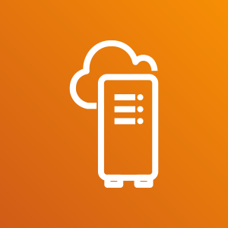
AWS Outposts
AWS Outposts
Extend AWS infrastructure and services to your on-premises data center
Notes:
AWS Outposts is a service that you can use to run AWS infrastructure, services, and tools within your own on-premises data center in a hybrid cloud approach.
AWS Outposts allows you to support workloads with data-intensive or time-sensitive requirements. Examples include the ones mentioned in the coffee shop scenario (real-time data processing and controlling onsite equipment). You can think of the products that the coffee shop provides as AWS resources, such as Amazon EC2 instances, AWS Lambda functions, and so on.
When an Outpost installs at your on-premises location, it connects to the nearest AWS Region. You continue to access, monitor, and manage your AWS services just as you would if your applications were running in the cloud.
Whether AWS Outposts meets your company’s needs for a hybrid cloud deployment, consider your company’s network connectivity. To access your AWS services and resources, your on-premises location must maintain ongoing connectivity to the nearest AWS Region. AWS Outposts are not designed for environments with limited to no connectivity.

Slide 17
Discussion
When choosing an AWS Region for your services, data, and applications, why should you consider a Region’s proximity to your customers?
Notes:
So far, in this module, you have explored several aspects of the AWS Global Infrastructure: Regions, Availability Zones, and edge locations. Now, you will work through a scenario to put these pieces together.
In this scenario, you are a business leader who is researching options for how to deliver content to your customers.
Discussion question: When choosing an AWS Region for your services, data, and applications, why should you consider a Region’s proximity to your customers?

Slide 18
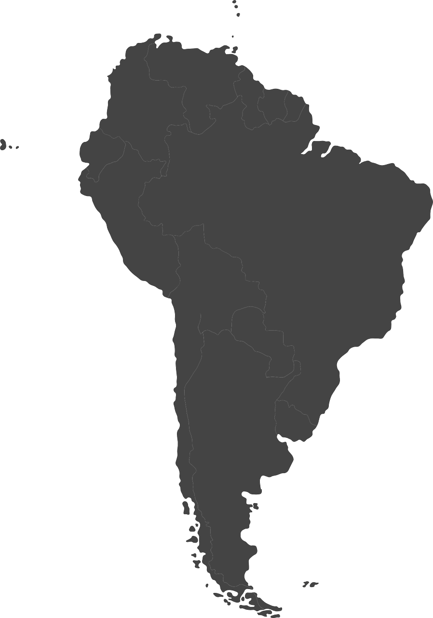
Review: AWS Global Infrastructure
Region:
São Paulo
Customer
sa-east-1
Availability Zones:
sa-east-1a
sa-east-1b
sa-east-1c
1a
1b
1c
Edge locations
Notes:
Choosing a Region that is close to your customers helps deliver content to them faster.
In this scenario, suppose that you are deploying an application used by your customers in Brazil.
First, you choose to deploy your application in the São Paulo Region (sa-east-1) because this is the closest Region to your customers in Brazil.
The São Paulo Region includes three Availability Zones: sa-east-1a, sa-east-1b, and sa-east-1c.
Discussion question: Why is it a best practice to deploy applications and resources in more than one Availability Zone?
Suppose that your application is being supported by one Availability Zone, sa-east-1a. If sa-east-1a went down, your customers wouldn’t be able to access your application.
Now, suppose that two Availability Zones are supporting your application: sa-east-1a and sa-east-1b. In this case, if sa-east-1a went down, your application would remain operational because sa-east-1b was unaffected.
Finally, you can use Amazon CloudFront to store cached copies of your content at edge locations that are close to your customers. When your customers request content, it travels across a short distance and is delivered to them quickly.

Slide 19
Interact with AWS services
Notes:
In this section, you will learn about ways to interact with AWS services.

Slide 20
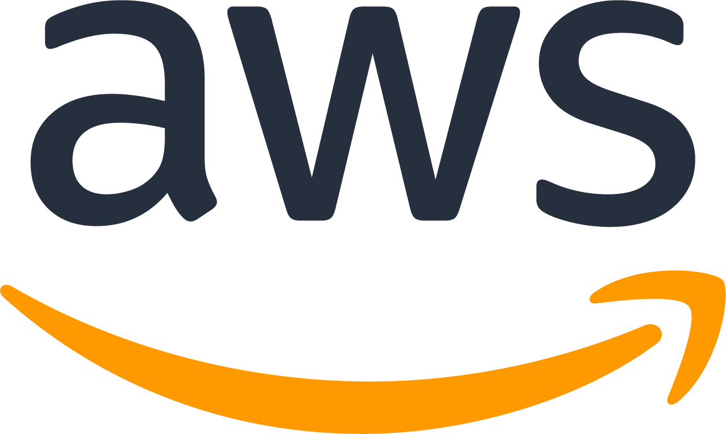
Perform actions through API requests
Order a cup of coffee.
Launch an Amazon EC2 instance.
Ask for a refill.
Create a load balancer.
Check your rewards balance.
Invoke an AWS Lambda function.
Notes:
Take a moment to think about some of the actions that you might perform when you are in a coffee shop. Some of these actions might include:
Order a cup of coffee.
Ask for a refill.
Check your rewards balance, and so on.
In AWS, some of the actions that you could take to interact with services might include:
Launch an Amazon EC2 instance.
Create a load balancer.
Invoke an AWS Lambda function, and so on.
These AWS actions are examples of application programming interface (API) requests. API requests are predetermined ways for you to interact with AWS services. You can use API requests to provision, manage, and configure your AWS resources.
You can access and interact with AWS services in three ways: the AWS Management Console, the AWS Command Line Interface (AWS CLI), and software development kits (SDKs).

Slide 21
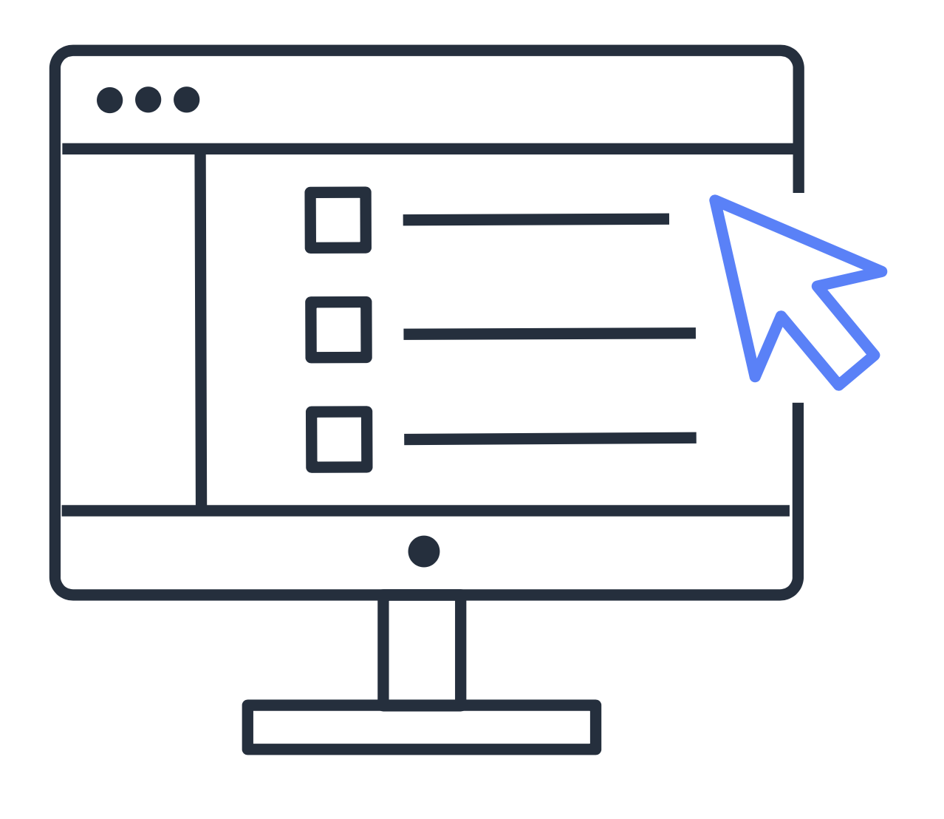
Interact with AWS services
aws> _
< / >
AWS Management Console
AWS Command Line Interface (AWS CLI)
Software development kits (SDKs)
Notes:
The AWS Management Console is a web-based interface for accessing and managing AWS services. You can quickly access recently used services and search for other services by name, keyword, or acronym. The console includes wizards and automated workflows that can simplify the process of completing tasks. You can also use the AWS Management Console mobile application to perform tasks such as monitoring resources, viewing alarms, and accessing billing information. Multiple identities can stay logged into the AWS Management Console mobile app at the same time.
Next, to save time when making API requests, you can use the AWS Command Line Interface (AWS CLI). AWS CLI helps you control multiple AWS services directly from the command line within one tool. AWS CLI is available for users on Windows, macOS, and Linux.
By using AWS CLI, you can automate the actions that your services and applications perform through scripts. For example, you can use commands to launch an Amazon EC2 instance, connect an Amazon EC2 instance to a specific Auto Scaling group, and more.
Another option for accessing and managing AWS services is the software development kits (SDKs). SDKs make it easier for you to use AWS services through an API designed for your programming language or platform. SDKs helps you use AWS services with your existing applications or create entirely new applications that will run on AWS.
To help you get started with using SDKs, AWS provides documentation and sample code for each supported programming language. Supported programming languages include C++, Java, .NET, and more.

Slide 22
Demo: AWS Management Console
Notes:
The demo is a high-level overview of how to navigate through the AWS Management Console, including:
Opening the list of all services
Accessing recently visited services
Finding a service by name, keyword, or acronym
Browsing through the “Build a solution” and “Learn to build” sections at the bottom of the AWS Management Console home page
Creating service shortcuts in the Console toolbar
It includes services that have been covered up to this point in the course, such as Amazon EC2, AWS Lambda, Elastic Load Balancing, and so on.

Slide 23
Knowledge check
Module 3
Notes:
There are no notes on this slide.

Slide 24

Knowledge check question 1
Which of the following is TRUE for the AWS Global Infrastructure?
An Availability Zone consists of a single Region.
An Availability Zone consists of two or more Regions.
A Region consists of a single Availability Zone.
A Region consists of two or more Availability Zones.
Notes:
Which of the following statements is TRUE for the AWS Global Infrastructure?
An Availability Zone consists of a single Region.
An Availability Zone consists of two or more Regions.
A Region consists of a single Availability Zone.
A Region consists of two or more Availability Zones.

Slide 25
Knowledge check answer 1
Which of the following is TRUE for the AWS Global Infrastructure?
An Availability Zone consists of a single Region.
An Availability Zone consists of two or more Regions.
A Region consists of a single Availability Zone.
A Region consists of two or more Availability Zones. (correct)
Notes:
The correct response option is D. A Region consists of two or more Availability Zones.
For example, the South America (São Paulo) Region is sa-east-1. It includes three Availability Zones: sa-east-1a, sa-east-1b, and sa-east-1c.

Slide 26
Knowledge check question 2
Which factors should be considered when selecting a Region? (Select TWO.)
Compliance with data governance and legal requirements
Proximity to your customers
Access to 24/7 technical support
Ability to assign custom permissions to different users
Access to the AWS Command Line Interface (AWS CLI)
Notes:
Which factors should be considered when selecting a Region? (Select TWO.)
Compliance with data governance and legal requirements
Proximity to your customers
Access to 24/7 technical support
Ability to assign custom permissions to different users
Access to the AWS Command Line Interface (AWS CLI)

Slide 27
Knowledge check answer 2
Which factors should be considered when selecting a Region? (Select TWO.)
Compliance with data governance and legal requirements (correct)
Proximity to your customers (correct)
Access to 24/7 technical support
Ability to assign custom permissions to different users
Access to the AWS Command Line Interface (AWS CLI)
Notes:
The correct two response options are:
A. Compliance with data governance and legal requirements
B. Proximity to your customers
Two other factors to consider when selecting a Region are pricing and the services that are available in a Region.
The other response options are incorrect because:
C. The level of support that you choose is not determined by Region. AWS Support plans are explored later in this course.
D. Assigning custom permissions to different users is a feature that is possible in all AWS Regions.
E. The AWS Command Line Interface (AWS CLI) is available in all AWS Regions.

Slide 28
Knowledge check question 3
Which statement best describes Amazon CloudFront?
A service that allows you to run infrastructure in a hybrid cloud approach
A serverless compute engine for containers
A service that allows you to send and receive messages between software components through a queue
A global content delivery service
Notes:
Which statement best describes Amazon CloudFront?
A service that allows you to run infrastructure in a hybrid cloud approach
A serverless compute engine for containers
A service that allows you to send and receive messages between software components through a queue
A global content delivery service

Slide 29
Knowledge check answer 3
Which statement best describes Amazon CloudFront?
A service that allows you to run infrastructure in a hybrid cloud approach
A serverless compute engine for containers
A service that allows you to send and receive messages between software components through a queue
A global content delivery service (correct)
Notes:
The correct response option is D: A global content delivery service.
Amazon CloudFront is a content delivery service. It uses a network of edge locations to cache content and deliver content to customers all over the world. When content is cached, it is stored locally as a copy. This content might be video files, photos, webpages, and so on.
The other response options are incorrect because:
A. AWS Outposts is a service that allows you to run infrastructure in a hybrid cloud approach.
B. AWS Fargate is a serverless compute engine for containers.
C. Amazon Simple Queue Service (Amazon SQS) is a service that allows you to send, store, and receive messages between software components through a queue.

Slide 30
Knowledge check question 4
Which site does Amazon CloudFront use to cache copies of content for faster delivery to users at any location?
Edge location
Region
Availability Zone
Origin
Notes:
Which site does Amazon CloudFront use to cache copies of content for faster delivery to users at any location?
Edge location
Region
Availability Zone
Origin

Slide 31
Knowledge check answer 4
Which site does Amazon CloudFront use to cache copies of content for faster delivery to users at any location?
Edge location (correct)
Region
Availability Zone
Origin
Notes:
The correct response option is A. Edge location.
The other response options are incorrect because:
B. A Region is a separate geographical location with multiple locations that are isolated from each other.
C. An Availability Zone is a fully isolated portion of the AWS Global Infrastructure.
D. An origin is the server from which CloudFront gets your files. Examples of CloudFront origins include Amazon Simple Storage Service (Amazon S3) buckets and web servers. (Note: Amazon S3 is explored later in this course.)

Slide 32
Knowledge check question 5
Which actions can you perform with AWS Outposts?
Automate actions for AWS services and applications through scripts
Access wizards and automated workflows to perform tasks in AWS services
Extend AWS infrastructure and services to your on-premises data center
Develop AWS applications in supported programming languages
Notes:
Which actions can you perform with AWS Outposts?
Automate actions for AWS services and applications through scripts
Access wizards and automated workflows to perform tasks in AWS services
Extend AWS infrastructure and services to your on-premises data center
Develop AWS applications in supported programming languages

Slide 33
Knowledge check answer 5
Which actions can you perform with AWS Outposts?
Automate actions for AWS services and applications through scripts
Access wizards and automated workflows to perform tasks in AWS services
Extend AWS infrastructure and services to your on-premises data center (correct)
Develop AWS applications in supported programming languages
Notes:
The correct response option is C: Extend AWS infrastructure and services to your on-premises data center.
The other response options are incorrect because:
A. The AWS Command Line Interface (AWS CLI) is used to automate actions for AWS services and applications through scripts.
B. The AWS Management Console includes wizards and workflows that you can use to complete tasks in AWS services.
D. Software development kits (SDKs) allow you to develop AWS applications in supported programming languages.

Slide 34
Module 3 summary
In this module, you learned about:
Three aspects of the AWS Global Infrastructure
Four factors to consider when selecting an AWS Region
Three ways to interact with AWS services
Notes:
In this module, you examined three aspects of the AWS Global Infrastructure:
Regions
Availability Zones
Amazon CloudFront edge locations
You also explored four factors that you should consider when selecting a Region for your AWS applications and resources:
Compliance with data governance and legal requirements
Proximity to your customers
Available services within a Region
Pricing
Finally, you learned about the three ways to interact with AWS services:
AWS Management Console
AWS Command Line Interface (AWS CLI)
Software development kits (SDKs)
The next module explores some of the networking services that AWS offers.

