Slide 1
Networking
Module 4
Notes:
In this module, you will learn about Amazon Virtual Private Cloud (Amazon VPC), network access control lists (ACLs), security groups, and Amazon Route 53.

Slide 2
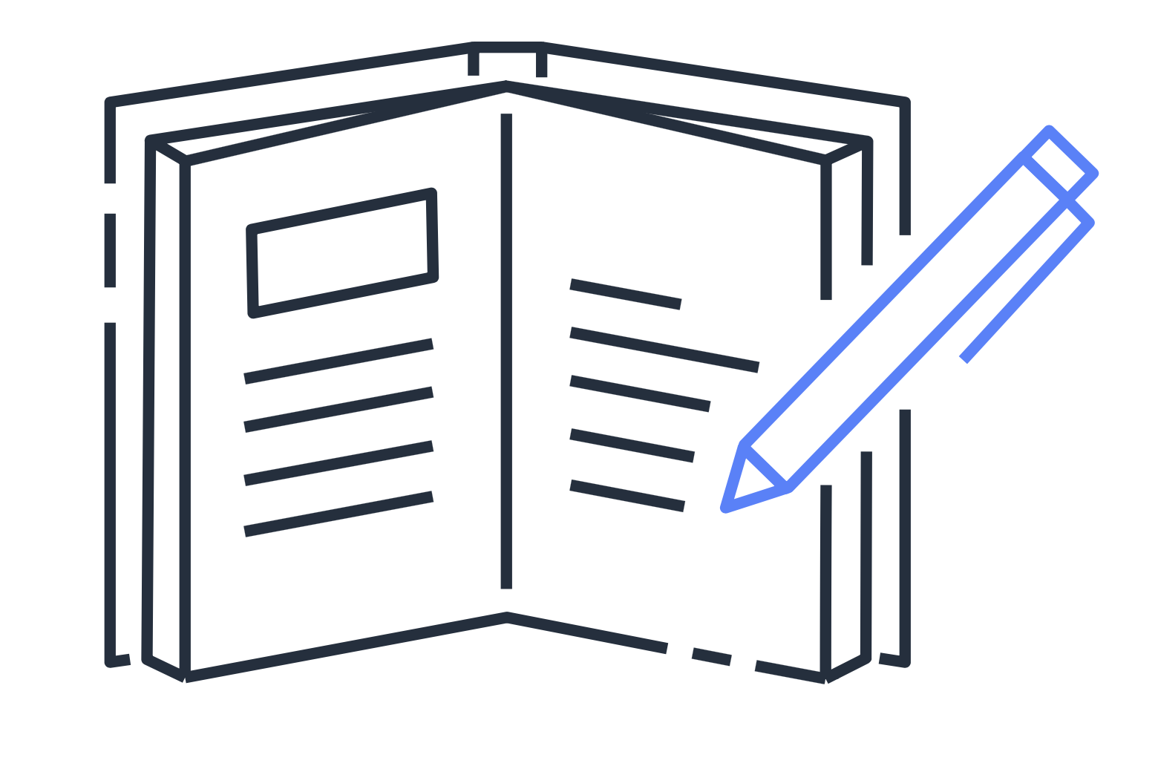
Module 4 objectives
In this module, you will learn how to:
Describe basic networking concepts
Describe the differences between public and private networking resources
Explain a virtual private gateway using a real-life scenario
Explain a VPN using a real-life scenario
Describe AWS Direct Connect benefits
Describe hybrid deployment benefits
Describe the layers of security in an IT strategy
Describe the services customers use to interact with the AWS global network
Notes:
In this module, you will learn how to:
Describe the basic concepts of networking
Describe the differences between public and private networking resources
Explain a virtual private gateway using a real life scenario
Explain a virtual private network (VPN) using a real life scenario
Describe AWS Direct Connect benefits
Describe hybrid deployment benefits
Describe the layers of security in an IT strategy
Describe the services customers use to interact with the AWS global network

Slide 3





Traffic in the coffee shop
Cashier
Customers give their orders to the cashier.
Customers
Barista
Customers try to give their orders directly to the barista.
Notes:
This section explores AWS networking services, beginning with an example from the coffee shop.
First, customers give their orders to the cashier. The cashier then passes the orders to the barista. This process allows the line to keep running smoothly as more customers come in.
Suppose that some customers try to skip the cashier line and give their orders directly to the barista. This disrupts the flow of traffic and results in customers accessing a part of the coffee shop that is off limits to them.

Slide 4

Traffic in the coffee shop
Cashier
Customers give their orders to the cashier.
Customers
Barista
Customers are prevented from giving their orders to the barista.
Notes:
To fix this, the owners of the coffee shop divide the counter area by placing the cashier and the barista in separate workstations. The cashier’s workstation is public facing and designed to receive customers. The barista’s area is private. The barista can still receive orders from the cashier but not directly from customers.
This is similar to how you can use AWS networking services to isolate resources and determine exactly how network traffic flows.
Imagine the millions of customers who use AWS services. Also, imagine the millions of resources that these customers have created, such as Amazon EC2 instances. Without boundaries around all of these resources, network traffic would be able to flow between them, unrestricted.
A networking service that you can use to establish boundaries around your AWS resources is Amazon Virtual Private Cloud (Amazon VPC).

Slide 5
Amazon Virtual Private Cloud (Amazon VPC)
Notes:
In this section, you will learn about Amazon VPC.

Slide 6
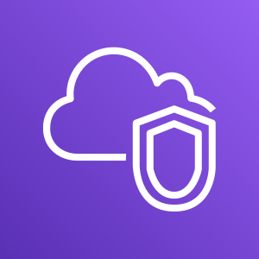
Amazon VPC
Counter area
Public workstation
Cashier
Amazon Virtual Private Cloud (Amazon VPC) enables you to launch resources in a virtual network that you define.
Private workstation
Barista
Notes:
Amazon VPC enables you to provision an isolated section of the AWS Cloud. In this isolated section, you can launch resources in a virtual network that you define. Within a virtual private cloud (VPC), you can organize your resources into subnets. A subnet is a section of a VPC that can contain resources such as Amazon EC2 instances.
In the coffee shop, you can think of the counter area as a VPC. The counter area divides into two separate areas for the cashier’s workstation and the barista’s workstation.

Slide 7

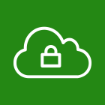



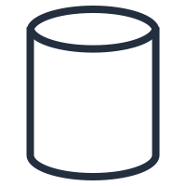
Subnets
AWS Cloud
VPC
Public subnet
A subnet is a section in a VPC in which you can place groups of isolated resources.
A subnet can be public or private.
Amazon EC2 instances
Private subnet
Databases
Notes:
Subnets can be public or private.
Public subnets contain resources that need to be accessible by the public, such as an online store’s website.
Private subnets contain resources that should be accessible only through your private network, such as a database that contains customers’ personal information and order histories.
Within a VPC, subnets can communicate with each other. For example, you might have an application that involves Amazon EC2 instances in a public subnet communicating with databases that are located in a private subnet.
Next, you will see how to access public resources within a VPC.

Slide 8
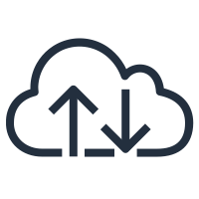

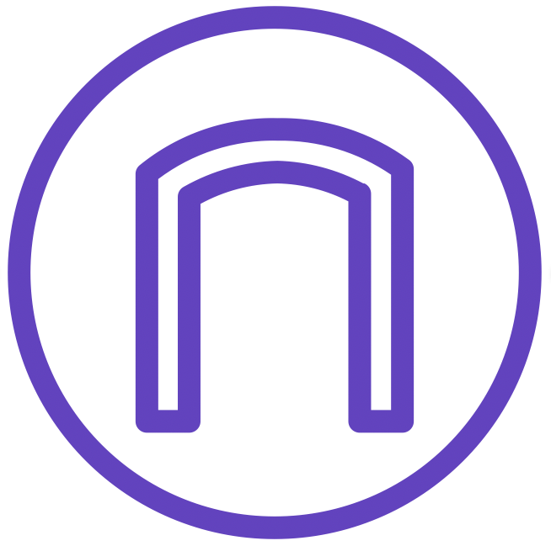
Internet gateway
AWS Cloud
VPC
Internet
Public subnet
A client sends a request through the internet and into the VPC.
Internet gateway
Client
Amazon EC2 instances
Notes:
To allow public traffic from the internet to access your VPC, you attach an internet gateway to the VPC.
An internet gateway is a connection between a VPC and the internet. You can think of an internet gateway as being similar to a doorway that customers use to enter the coffee shop. Without an internet gateway, no one can access the resources within your VPC.
Next, what if you want to communicate with resources that are in a private subnet?

Slide 9

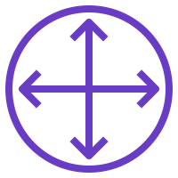

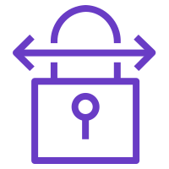
Virtual private gateway
AWS Cloud
VPC
Corporate data center
Internet
Private subnet
VPN connection
Virtual private gateway
Content router/
firewall
Databases
Notes:
To access private resources in a VPC, you can use a virtual private gateway.
Here’s an example of how a virtual private gateway works. You can think of the internet as the road between your home and the coffee shop. Suppose that you are traveling on this road with a bodyguard to protect you. You are still using the same road as other customers, but with an extra layer of protection.
The bodyguard is like a VPN connection that encrypts (or protects) your internet traffic from all the other requests around it.
The virtual private gateway is the component that allows protected internet traffic to enter into the VPC.
Even though your connection to the coffee shop has extra protection, traffic jams are possible because you’re using the same road as other customers.
A virtual private gateway enables you to establish a virtual private network (VPN) connection between your VPC and a private network, such as an on-premises data center or internal corporate network. A virtual private gateway allows traffic into the VPC only if it is coming from an approved network.
Another option that you can use to get from your private network to the VPC is AWS Direct Connect.

Slide 10
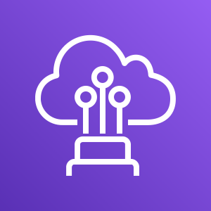
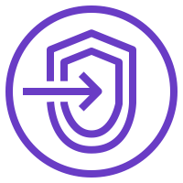
AWS Direct Connect
AWS Cloud
VPC
Public subnet
AWS Direct Connect location
Corporate data center
Amazon EC2 instances
Customer or Partner router
AWS Direct Connect endpoint
Virtual private gateway
Private subnet
Content router/
firewall
Databases
Notes:
AWS Direct Connect is a service that enables you to establish a dedicated private connection between your data center and VPC.
Suppose that there is an apartment building with a hallway directly linking the building to the coffee shop. Only the residents of the apartment building are allowed to travel through this hallway.
This private hallway provides the same type of dedicated connection as AWS Direct Connect. Residents are able to get into the coffee shop without needing to use the public road that is shared with other customers.
The private connection that AWS Direct Connect provides helps you to reduce network costs and increase the amount of bandwidth that can travel through your network.

Slide 11
Match: VPC components
Isolate databases containing customers’ personal information
Public subnet
Create a VPN connection between the VPC and the internal corporate network
Private subnet
Support a customer-facing website
Virtual private gateway
Establish a dedicated connection between an on-premises data center and the VPC
AWS Direct Connect
Notes:
For this review exercise, imagine that your company is launching an online photo storage application. Help determine which VPC component should be used for certain aspects of the application.
---
When customers create an account in the application, they must provide personal information such as their email address and date of birth. Which VPC component should you use to isolate the databases that contain customers’ personal information?

Slide 12
Match: VPC components
Isolate databases containing customers’ personal information
Public subnet
Create a VPN connection between the VPC and the internal corporate network
Private subnet
Support a customer-facing website
Virtual private gateway
Establish a dedicated connection between an on-premises data center and the VPC
AWS Direct Connect
Notes:
Use a private subnet to isolate databases containing customers’ personal information. Private subnets contain resources that should be accessible only through your private network.
---
Your company has an internal corporate network that needs to communicate with the VPC. Which component should you use to create a VPN connection between the VPC and the internal corporate network?

Slide 13
Match: VPC components
Isolate databases containing customers’ personal information
Public subnet
Create a VPN connection between the VPC and the internal corporate network
Private subnet
Support a customer-facing website
Virtual private gateway
Establish a dedicated connection between an on-premises data center and the VPC
AWS Direct Connect
Notes:
Use a virtual private gateway to create a VPN connection between the VPC and your company’s internal network.
---
The Amazon EC2 instances that support the customer-facing website must be able to connect to the internet and be reached by the internet. Which VPC component should you use for these instances?

Slide 14
Match: VPC components
Isolate databases containing customers’ personal information
Public subnet
Create a VPN connection between the VPC and the internal corporate network
Private subnet
Support a customer-facing website
Virtual private gateway
Establish a dedicated connection between an on-premises data center and the VPC
AWS Direct Connect
Notes:
Use a public subnet to support the customer-facing website. Public subnets contain resources that must be accessible by the public.
---
The online photo storage application will use substantial bandwidth, so your company wants to create a dedicated connection to the VPC. Which option should you use to establish a dedicated connection between your on-premises data center and the VPC?

Slide 15
Match: VPC components
Isolate databases containing customers’ personal information
Public subnet
Create a VPN connection between the VPC and the internal corporate network
Private subnet
Support a customer-facing website
Virtual private gateway
Establish a dedicated connection between an on-premises data center and the VPC
AWS Direct Connect
Notes:
Use AWS Direct Connect to establish a dedicated connection between your on-premises data center and the VPC.

Slide 16
Network access control lists and security groups
Notes:
So far, in this module, you have learned about methods for securing the entire perimeter around a VPC.
This section describes two additional features for securing the resources within a VPC: network access control lists (ACLs) and security groups.

Slide 17


Network traffic in a VPC
AWS Cloud
VPC
Public subnet
Network access control list
Internet
Security group
Security group
Packet
Internet gateway
Client
Amazon EC2 instances
Notes:
This section explores how resources in a VPC can communicate through the internet.
When a customer requests data from an application that is hosted in the AWS Cloud, this request is sent as a packet. A packet is a unit of data sent over the internet or a network.
It enters into a VPC through an internet gateway. Before a packet can enter into a subnet or exit from a subnet, it checks for permissions. These permissions indicate who sent the packet and how the packet is trying to communicate with the resources within a subnet.
The VPC component that checks packet permissions for subnets is a network access control list (ACL).

Slide 18
Network access control lists
A network access control list (network ACL) is a virtual firewall for a subnet. By default:
The default network ACL allows all inbound and outbound traffic.
Custom network ACLs deny all inbound and outbound traffic.
Network access control list
Public subnet
Notes:
A network access control list (ACL) is a virtual firewall that controls inbound and outbound traffic at the subnet level.
For this example, step outside of the coffee shop and imagine that you are in an airport. In the airport, travelers are trying to enter into a different country. You can think of the travelers as packets and the passport control officer as a network ACL. The passport control officer checks travelers’ credentials when they are both entering and exiting out of the country. If a traveler is on an approved list, they are able to get through. However, if they are not on the approved list or are explicitly on a list of banned travelers, they cannot come in.
Each AWS account includes a default network ACL. When configuring your VPC, you can use your account’s default network ACL or create custom network ACLs.
By default, your account’s default network ACL allows all inbound and outbound traffic, but you can modify it by adding your own rules. For custom network ACLs, all inbound and outbound traffic is denied until you add rules to specify which traffic should be allowed. Additionally, all network ACLs have an explicit deny rule. This rule ensures that if a packet doesn’t match any of the other rules on the list, the packet is denied.

Slide 19


Stateless packet filtering
Network ACLs perform stateless packet filtering.
Before a packet can exit a subnet, it must be checked against the outbound rules.
I want to enter.
I want to exit.
I will check to see if you’re on the list.
I will check to see if you’re on the list.
Traveler
Passport control officer
Traveler
Passport control officer
Notes:
Network ACLs perform stateless packet filtering. They remember nothing and check packets that cross the subnet border each way: both inbound and outbound.
Recall the previous example of a traveler who wants to enter into a different country. This is similar to sending a request out from an Amazon EC2 instance and to the internet.
When a packet response for that request comes back to the subnet, the network ACL does not remember your previous request. The network ACL checks the packet response against its list of rules to determine whether it is allowed or denied.
After a packet has entered a subnet, it must have its permissions evaluated for resources within the subnet, such as Amazon EC2 instances. The VPC component that checks packet permissions for an Amazon EC2 instance is a security group.

Slide 20
Security groups
Security group
A security group is a virtual firewall for an Amazon EC2 instance.
By default, a security group denies all inbound traffic and allows all outbound traffic.
Amazon EC2 instance
Notes:
A security group is a virtual firewall that controls inbound and outbound traffic for an Amazon EC2 instance.
By default, a security group denies all inbound traffic and allows all outbound traffic. You can add custom rules to configure which traffic should be allowed or denied.
For this example, suppose that you are in an apartment building with a door attendant who greets guests in the lobby. You can think of the guests as packets and the door attendant as a security group. As guests arrive, the door attendant checks a list to ensure they can enter the building. However, the door attendant does not check the list again when guests are exiting the building.
If you have multiple Amazon EC2 instances within a subnet, you can associate them with the same security group or use different security groups for each instance.

Slide 21

Stateful packet filtering
Security groups perform stateful packet filtering.
They remember previous decisions that were made for incoming packets.
I am leaving, but I will be back!
Hi, again. I’m back!
Okay! I will see you when you get back.
I remember you! Go ahead.
Guest
Door attendant
Guest
Door attendant
Notes:
Security groups perform stateful packet filtering. They remember previous decisions that were made for incoming packets.
Consider the same example of sending a request out from an Amazon EC2 instance to the internet.
When a packet response for that request comes back to the instance, the security group remembers your previous request and allows the response to proceed, regardless of inbound security group rules.

Slide 22
Network traffic in a VPC
AWS Cloud
VPC
Public subnet
Network access control list
Internet
Security group
Security group
Packet
Internet gateway
Client
Amazon EC2 instances
Notes:
You learned how packets travel into a virtual private cloud (VPC). A packet is a request from the internet. Packets come into a VPC through an internet gateway. Before a packet can enter into a subnet, it is evaluated against rules in a network ACL. Then if the packet wants to access an Amazon EC2 instance, its permissions are evaluated by a security group.
Both network ACLs and security groups enable you to configure custom rules for the traffic in your VPC. As you continue to learn more about AWS security and networking, make sure to understand the differences between network ACLs and security groups.

Slide 23

Knowledge check
What are the differences between network access control lists and security groups?
Notes:
What are the differences between network access control lists and security groups?

Slide 24
Knowledge check
Network access control lists are virtual firewalls for subnets. They perform stateless packet filtering.
Security groups are virtual firewalls for Amazon EC2 instances. They perform stateful packet filtering.
Notes:
Network access control lists (ACLs) evaluate network traffic at the subnet level. They are stateless. ACLs do not remember previous traffic patterns or flows when evaluating packet permissions.
Security groups evaluate network traffic at the instance level. They are stateful. Security groups remember previous decisions that were made for incoming packets.

Slide 25
Interact with the AWS global network
Notes:
Throughout this module, you have learned how you can interact with AWS by designing and deploying applications. Now you will examine how your customers can interact with AWS by accessing your applications.

Slide 26
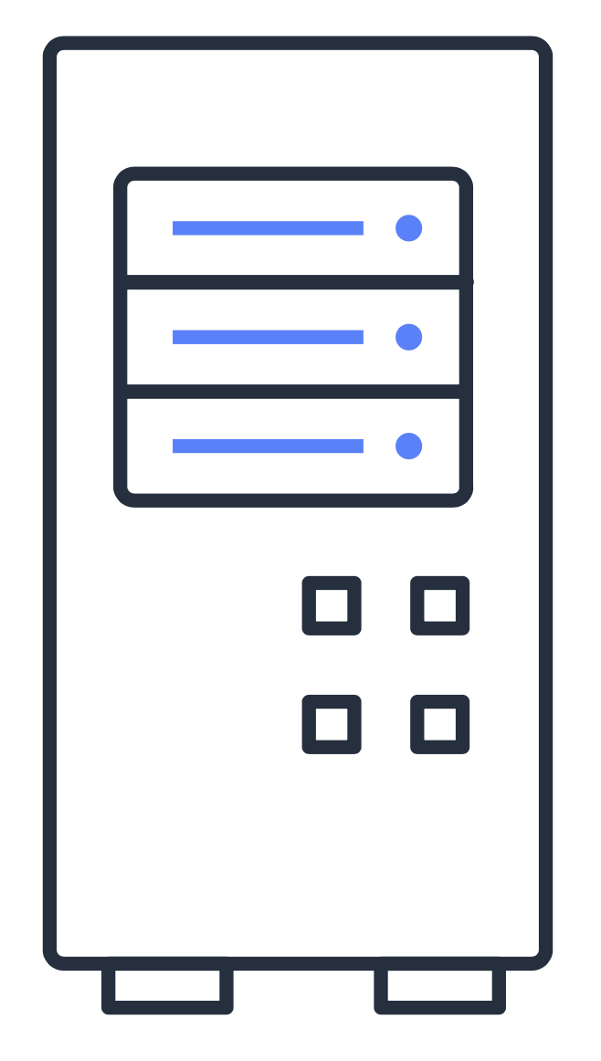
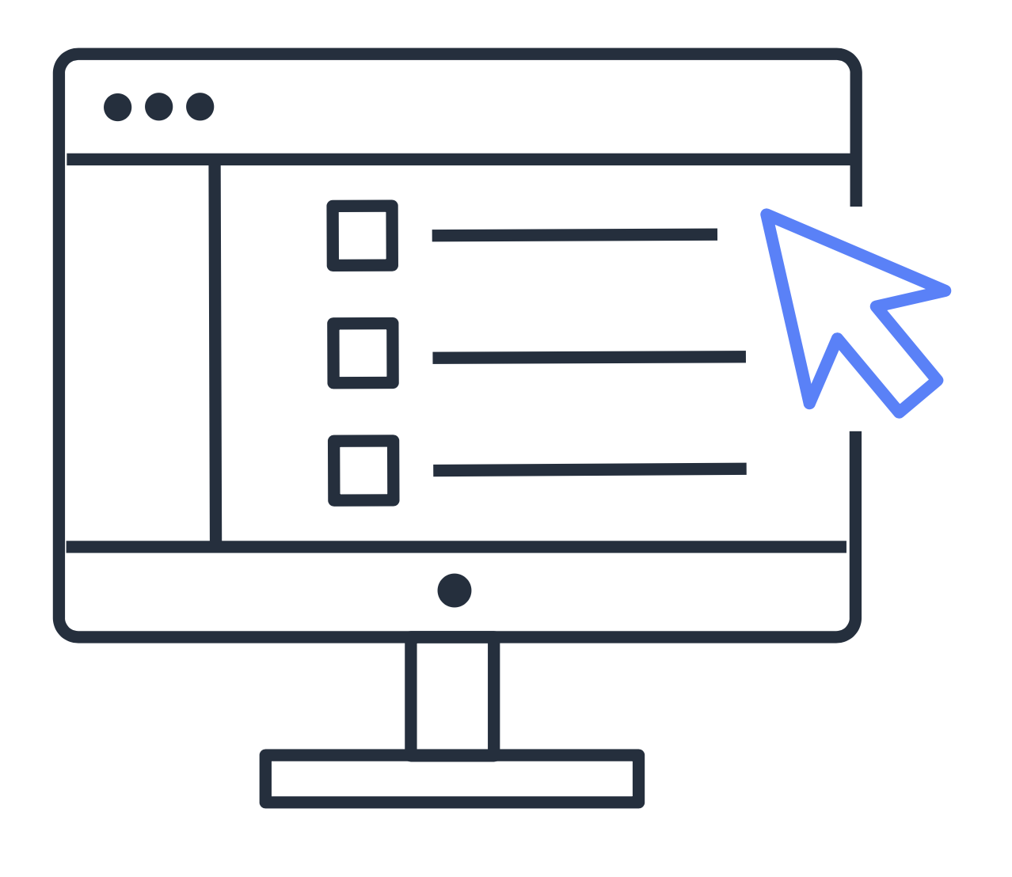
Domain Name System (DNS)
What is the IP address for AnyCompany’s website?
Customer and PC
Customer DNS resolver
192.0.2.0
Company DNS server
Notes:
Suppose that AnyCompany has a website hosted in the AWS Cloud. Customers enter the web address into their browser, and they are able to access the website. This happens because of Domain Name System (DNS) resolution. DNS resolution involves a customer DNS resolver communicating with a company DNS server.
You can think of DNS as being the phone book of the internet. DNS resolution is the process of translating a domain name to an IP address.
For example, suppose that you want to visit AnyCompany’s website. When you enter the domain name into your browser, this request is sent to a customer DNS resolver.
The customer DNS resolver asks the company DNS server for the IP address that corresponds to AnyCompany’s website.
The company DNS server responds by providing the IP address for AnyCompany’s website, 192.0.2.0.
Amazon Route 53 is the AWS service that provides DNS capabilities.

Slide 27
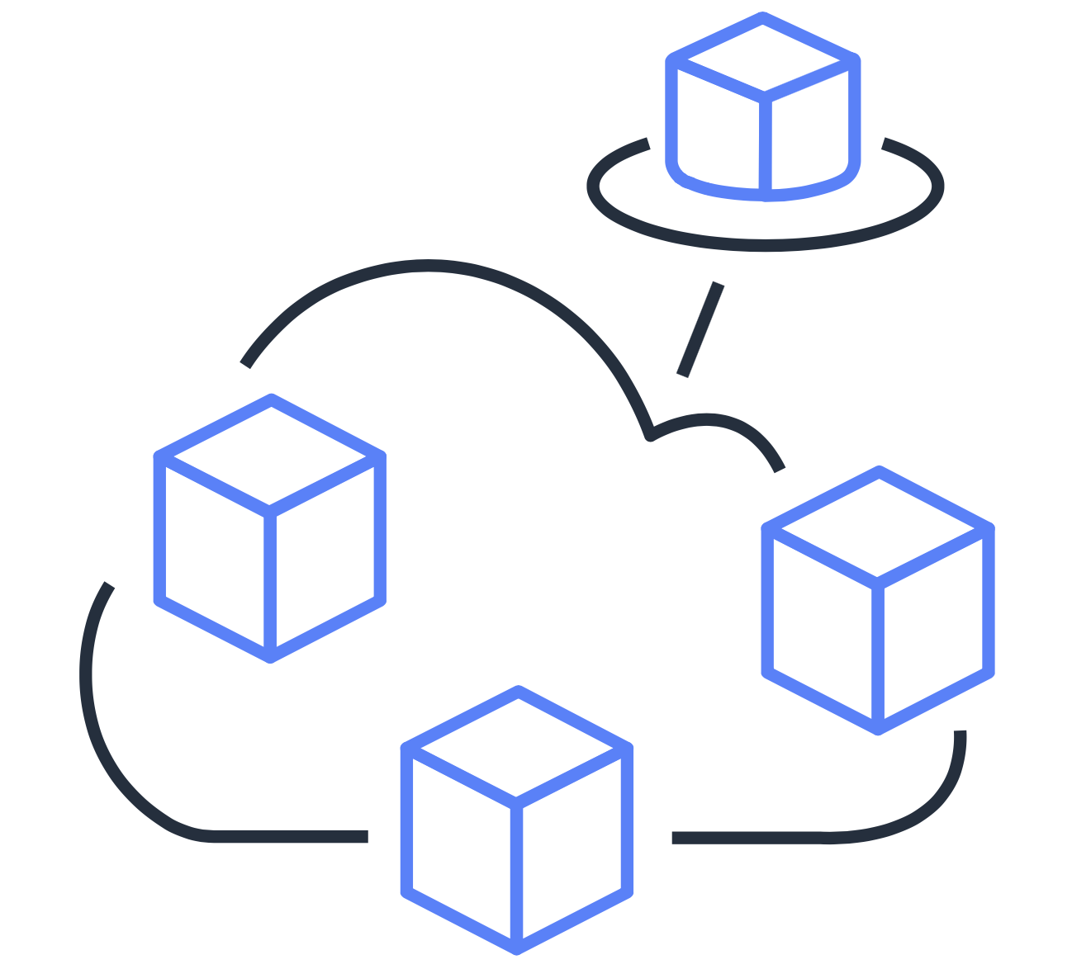
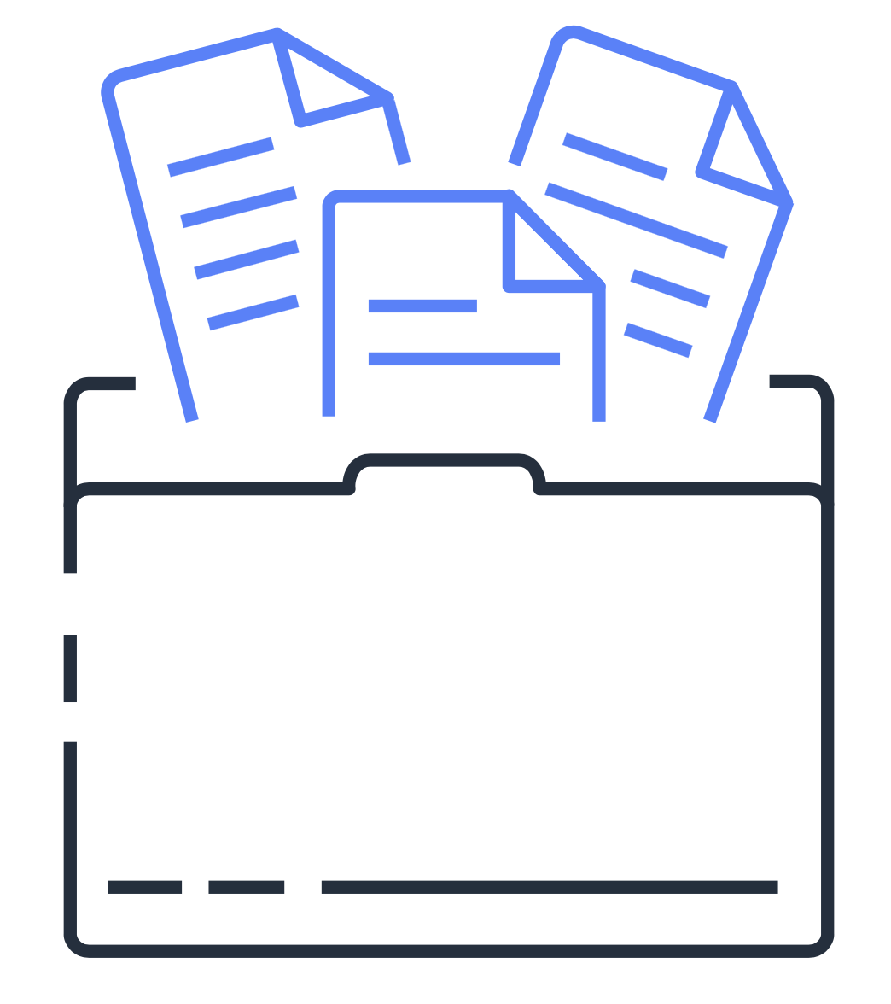
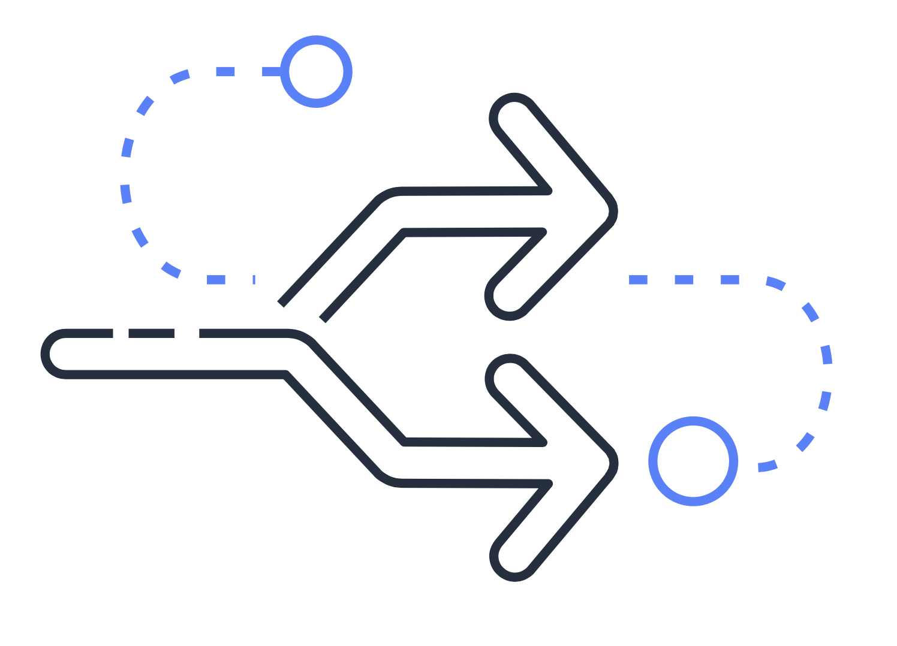
Amazon Route 53
Connect user requests to infrastructure in AWS and outside of AWS
Route users to internet applications
Manage DNS records for domain names
Notes:
Amazon Route 53 is a DNS web service. It gives developers and businesses a reliable way to route end users to internet applications hosted in AWS.
Amazon Route 53 connects user requests to infrastructure running in AWS (such as Amazon EC2 instances and load balancers). It can route users to infrastructure outside of AWS.
Another feature of Route 53 is the ability to manage the DNS records for domain names. You can register new domain names directly in Route 53. You can also transfer DNS records for existing domain names managed by other domain registrars. This enables you to manage all of your domain names within a single location.
In the previous module, you learned about Amazon CloudFront, a content delivery service. The following example describes how Route 53 and Amazon CloudFront work together to deliver content to customers.

Slide 28
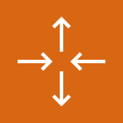
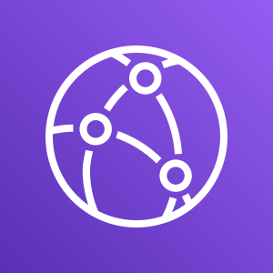
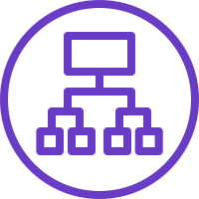
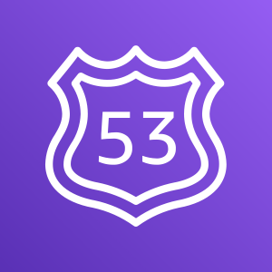
Amazon Route 53 and CloudFront
AWS Cloud
Auto Scaling group
Amazon CloudFront
Application Load Balancer
Amazon EC2 instances
Client
Amazon Route 53
Notes:
Suppose that AnyCompany’s application is running on several Amazon EC2 instances. These instances are in an Auto Scaling group that attaches to an Application Load Balancer.
A customer requests data from the application by going to AnyCompany’s website.
Amazon Route 53 uses DNS resolution to identify the AnyCompany website corresponding IP address, 192.0.2.0. This information is sent back to the customer.
The customer’s request routes to the nearest edge location through Amazon CloudFront.
Amazon CloudFront connects to the Application Load Balancer, which sends the incoming packet to an Amazon EC2 instance.

Slide 29
Knowledge check
Module 4
Notes:
There are no notes on this slide.

Slide 30
Knowledge check question 1
Which component or service can be used to establish a private dedicated connection between a company’s data center and AWS?
Private subnet
DNS
AWS Direct Connect
Amazon CloudFront
Notes:
Which component or service can be used to establish a private dedicated connection between a company’s data center and AWS?
Private subnet
DNS
AWS Direct Connect
Amazon CloudFront

Slide 31
Knowledge check answer 1
Which component or service can be used to establish a private dedicated connection between a company’s data center and AWS?
Private subnet
DNS
AWS Direct Connect (correct)
Amazon CloudFront
Notes:
The correct response option is C. AWS Direct Connect.
The other response options are incorrect because:
A. A private subnet is a section of a VPC in which you can group resources that should be accessed only through your private network. Although it is private, it is not used for establishing a connection between a data center and AWS.
B. DNS stands for Domain Name System, which is a directory used for matching domain names to IP addresses.
D. Amazon CloudFront is a content delivery service. You can use CloudFront to store cached copies of your content at edge locations that are close to your customers.

Slide 32
Knowledge check question 2
Which statement describes security groups?
They are stateful and allow all inbound traffic by default.
They are stateful and deny all inbound traffic by default.
They are stateless and allow all inbound traffic by default.
They are stateless and deny all inbound traffic by default.
Notes:
Which statement describes security groups?
They are stateful and allow all inbound traffic by default.
They are stateful and deny all inbound traffic by default.
They are stateless and allow all inbound traffic by default.
They are stateless and deny all inbound traffic by default.

Slide 33
Knowledge check answer 2
Which statement describes security groups?
They are stateful and allow all inbound traffic by default.
They are stateful and deny all inbound traffic by default. (correct)
They are stateless and allow all inbound traffic by default.
They are stateless and deny all inbound traffic by default.
Notes:
The correct response option is B. Security groups are stateful and deny all inbound traffic by default.
Security groups are stateful. This means that they use previous traffic patterns and flows when evaluating new requests for an instance.
By default, security groups deny all inbound traffic, but you can add custom rules to fit your operational and security needs.

Slide 34
Knowledge check question 3
Which component is used to connect a VPC to the internet?
Internet gateway
Public subnet
Edge location
Security group
Notes:
Which component is used to connect a VPC to the internet?
Internet gateway
Public subnet
Edge location
Security group

Slide 35
Knowledge check answer 3
Which component is used to connect a VPC to the internet?
Internet gateway (correct)
Public subnet
Edge location
Security group
Notes:
The correct response option is. A. Internet gateway.
The other response options are incorrect because:
B. A public subnet is a section of a VPC that contains public-facing resources.
C. An edge location is a site that Amazon CloudFront uses to store cached copies of your content for faster delivery to customers.
D. A security group is a virtual firewall that controls inbound and outbound traffic for an Amazon EC2 instance.

Slide 36
Knowledge check question 4
Which service is used to manage the DNS records for domain names?
Amazon Virtual Private Cloud
AWS Direct Connect
Amazon CloudFront
Amazon Route 53
Notes:
Which service is used to manage the DNS records for domain names?
Amazon Virtual Private Cloud
AWS Direct Connect
Amazon CloudFront
Amazon Route 53

Slide 37
Knowledge check answer 4
Which service is used to manage the DNS records for domain names?
Amazon Virtual Private Cloud
AWS Direct Connect
Amazon CloudFront
Amazon Route 53 (correct)
Notes:
The correct response option is D. Amazon Route 53.
Amazon Route 53 is a DNS web service. It gives developers and businesses a reliable way to route end users to internet applications that host in AWS.
Another feature of Route 53 is the ability to manage the DNS records for domain names. You can transfer DNS records for existing domain names managed by other domain registrars. You can also register new domain names directly in Route 53.
The other response options are incorrect because:
A. Amazon Virtual Private Cloud (Amazon VPC) is a service that enables you to provision an isolated section of the AWS Cloud. In this isolated section, you can launch resources in a virtual network that you define.
B. AWS Direct Connect is a service that enables you to establish a dedicated private connection between your data center and VPC.
C. Amazon CloudFront is a content delivery service. It uses a network of edge locations to cache content and deliver content to customers all over the world.

Slide 38
Knowledge check question 5
Which statement describes DNS resolution?
Launching resources in a customer-defined virtual network
Storing local copies of content at edge locations around the world
Connecting a VPC to the internet
Translating a domain name to an IP address
Notes:
Which statement describes DNS resolution?
Launching resources in a customer-defined virtual network
Storing local copies of content at edge locations around the world
Connecting a VPC to the internet
Translating a domain name to an IP address

Slide 39
Knowledge check answer 5
Which statement describes DNS resolution?
Launching resources in a customer-defined virtual network
Storing local copies of content at edge locations around the world
Connecting a VPC to the internet
Translating a domain name to an IP address (correct)
Notes:
The correct response option is D. Translating a domain name to an IP address.
For example, if you want to visit AnyCompany’s website, you enter the domain name into your PC and this request is sent to a DNS server. Next, the DNS server asks the web server for the IP address that corresponds to AnyCompany’s website. The web server responds by providing the IP address for AnyCompany’s website, 192.0.2.0.

Slide 40
Module 4 summary
In this module, you learned about:
Structuring and connecting to a VPC
Securing VPC resources with network access control lists and security groups
Using Amazon Route 53 and Amazon CloudFront to deliver content
Notes:
In this module, you learned about several tools for structuring and connecting to a VPC, including:
Public and private subnets
Internet gateways
Virtual private gateways
AWS Direct Connect
You also explored methods for securing VPC resources with network access control lists and security groups.
Finally, you examined how to use Amazon Route 53 with Amazon CloudFront to deliver content to your customers.
In the next module, you will explore AWS storage and database services.

