Slide 1
Pricing and Support
Module 8
Notes:
In this module, you will learn about AWS pricing concepts, tools, and examples. You will also explore AWS Support plans and learn about the benefits of AWS Marketplace.

Slide 2

Module 8 objectives
In this module, you will learn how to:
Describe AWS pricing and support models
Describe the AWS Free Tier
Describe key benefits of AWS Organizations and consolidated billing
Explain AWS Budgets benefits
Explain AWS Cost Explorer benefits
Explain AWS Pricing Calculator benefits
Distinguish among the AWS Support plans
Describe AWS Marketplace benefits
Notes:
In this module, you will learn how to:
Describe AWS pricing and support models
Describe the AWS Free Tier
Describe key benefits of AWS Organizations and consolidated billing
Explain AWS Budgets benefits
Explain AWS Cost Explorer benefits
Explain AWS Pricing Calculator benefits
Distinguish among the AWS Support plans
Describe AWS Marketplace benefits

Slide 3

AWS pricing and support
How can I budget and pay for AWS services?
Where can I find support and third-party software?
Notes:
Throughout this course, you have learned about a wide range of AWS services and resources that can help you to develop innovative solutions for your company.
At this point, you might be wondering about the pricing and support options that AWS offers for these services.
In this module, you will learn about some of the tools that you can use for AWS pricing and support. These tools can help you answer these questions and provide new opportunities for optimizing your costs while using AWS services.

Slide 4
AWS pricing
Notes:
This section examines AWS pricing models, beginning with the AWS Free Tier.

Slide 5



AWS Free Tier categories
Always free
12 months free
Trials
Notes:
The AWS Free Tier lets you begin using certain services without incurring costs for the specified period.
Three types of offers are available:
Always Free: These offers do not expire and are available to all AWS customers. For example, AWS Lambda allows 1 million free requests and up to 3.2 million seconds of compute time per month. Amazon DynamoDB allows 25 GB of free storage per month.
12 Months Free: These offers are free for 12 months following your initial sign-up date to AWS. Examples include specific amounts of Amazon S3 Standard Storage, thresholds for monthly hours of Amazon Elastic Compute Cloud (Amazon EC2) compute time, and amounts of Amazon CloudFront data transfer out.
Trials: Short-term free trial offers start from the date you activate a particular service. The length of each trial might vary by number of days or the amount of usage in the service. For example, Amazon Inspector offers a 90-day free trial. Amazon Lightsail (a service that you can use to run virtual private servers) offers 750 free hours of usage over a 30-day period.
For each AWS Free Tier offer, review the specific details about exactly which resource types are included.
After you use AWS services for a while, you might go beyond what is included in the Free Tier. You should know how AWS pricing works, which described next.

Slide 6
AWS pricing concepts
Pay as you go
Pay less when you reserve
Pay less with volume-based discounts
Pay only for the resources that you use without provisioning capacity in advance
Reduce costs by reserving capacity in services such as Amazon Elastic Compute Cloud (Amazon EC2) and Amazon Relational Database Service (Amazon RDS)
Receive savings through volume-based discounts as your usage increases
Notes:
AWS offers a range of cloud computing services with pay-as-you-go pricing.
Pay for what you use: For each service, you pay for exactly the amount of resources that you actually use, without requiring long-term contracts or complex licensing.
Pay less when you reserve: Some services offer reservation options that provide a significant discount compared to On-Demand Instance pricing. For example, suppose that your company is using Amazon EC2 instances for a workload that needs to run continuously. You might choose to run this workload on Amazon EC2 Instance Savings Plans, because the plan allows you to save up to 72% over the equivalent On-Demand Instance capacity.
Pay less with volume-based discounts: Some services offer tiered pricing, so the per-unit cost is incrementally lower with increased usage. For example, the more Amazon S3 storage space you use, the less you pay for it per GB.

Slide 7
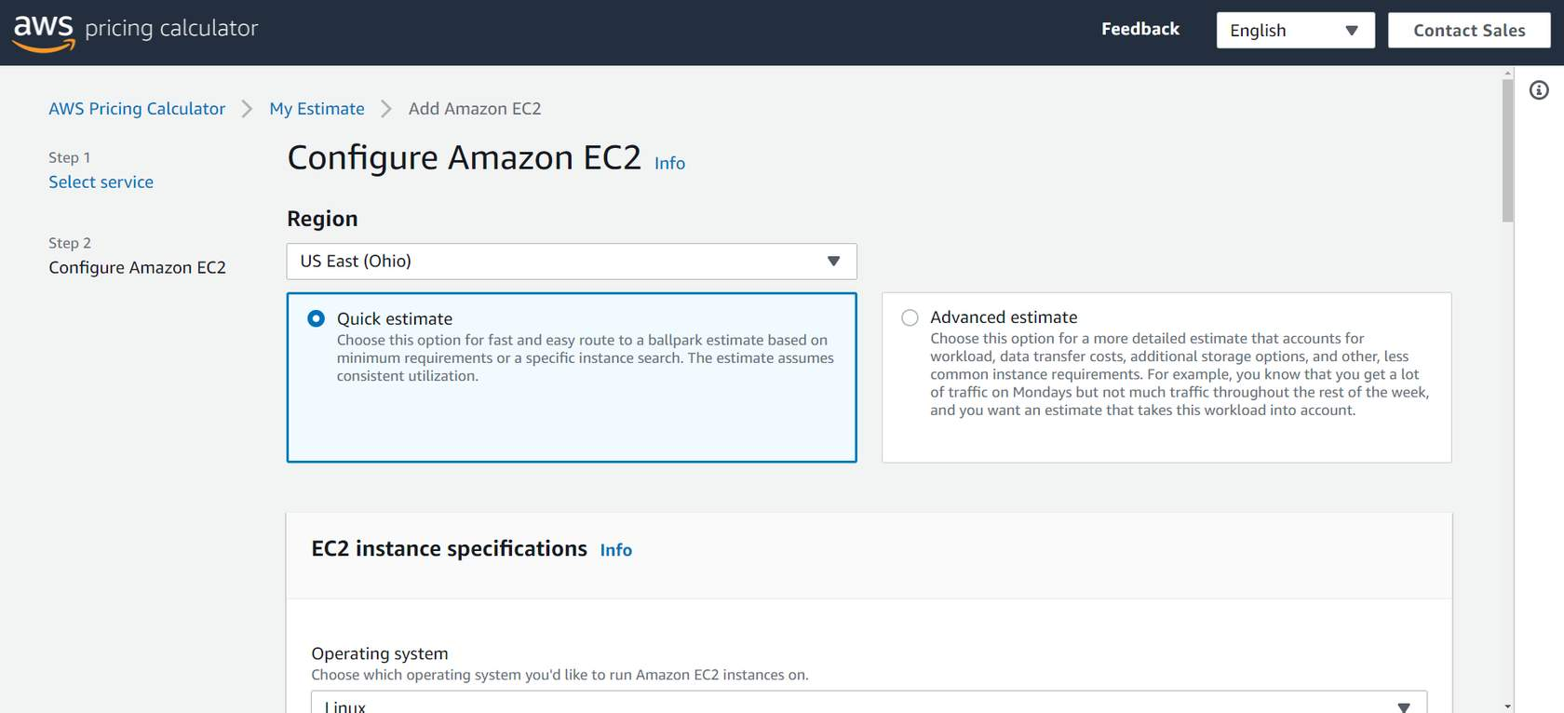
AWS Pricing Calculator
Notes:
The AWS Pricing Calculator lets you explore AWS services and create an estimate for the cost of your use cases on AWS. You can organize your AWS estimates by groups that you define. A group can reflect how your company is organized, such as provide estimates by cost center.
When you create an estimate, you can save it and generate a link to share with others.
Suppose that your company is interested in using Amazon EC2. However, you are not yet sure which AWS Region or instance type would be the most cost-efficient for your use case. In the AWS Pricing Calculator, you can enter details such as the kind of operating system you need, memory requirements, and input/output (I/O) requirements. By using the AWS Pricing Calculator, you can review an estimated comparison of different EC2 instance types across AWS Regions.
Next, you will explore three examples of pricing in AWS services.

Slide 8

AWS Lambda pricing
Pay only for the compute time you use
Pay for the number of requests for your functions
Save by signing up for Compute Savings Plans
AWS Lambda
Notes:
For AWS Lambda, you are charged based on the number of requests for your functions and the amount of time that they run.
AWS Lambda allows 1 million free requests and up to 3.2 million seconds of compute time per month.
You can save on AWS Lambda costs by signing up for Compute Savings Plans. Compute Savings Plans offer lower compute costs in exchange for committing to a consistent amount of usage over a 1-year or 3-year term. This is an example of paying less when you reserve.

Slide 9
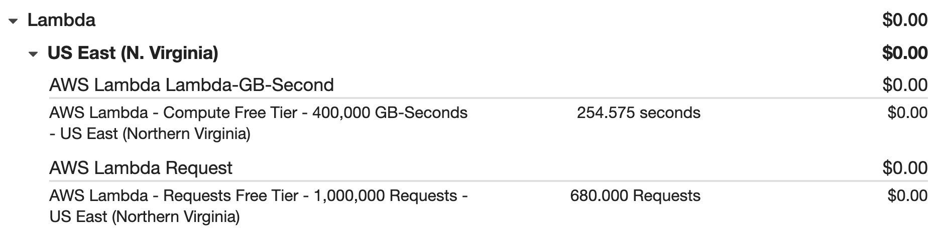
Example: AWS Lambda service charges
Notes:
If you use AWS Lambda in multiple AWS Regions, you can view the itemized charges by Region on your bill.
In this example, all the AWS Lambda usage occurred in the Northern Virginia Region. The bill lists separate charges for the number of requests for functions and their duration.
Both the number of requests and the total duration of requests are under the thresholds in the AWS Free Tier, so the account owner does not have to pay for any AWS Lambda usage in this month.

Slide 10

Amazon EC2 pricing
Pay only for the time that your On-Demand Instances run
Reduce costs by using Spot Instances for recommended use cases
Save by signing up for Compute Savings Plans
Amazon EC2 pricing: https://aws.amazon.com/ec2/pricing
Amazon Elastic Compute Cloud
Notes:
With Amazon EC2, you pay for only the compute time that you use while your On-Demand Instances are running.
For some workloads, you can significantly reduce Amazon EC2 costs by using Spot Instances. For example, suppose that you are running a batch processing job that can be interrupted. Using a Spot Instance would provide up to a 90% discount over the On-Demand Instance price.
You can find additional cost savings for Amazon EC2 by considering Savings Plans and Reserved Instances.
Amazon EC2 pricing is based on the type of instances that you are running. For more information on Amazon EC2 pricing, review https://aws.amazon.com/ec2/pricing/.

Slide 11
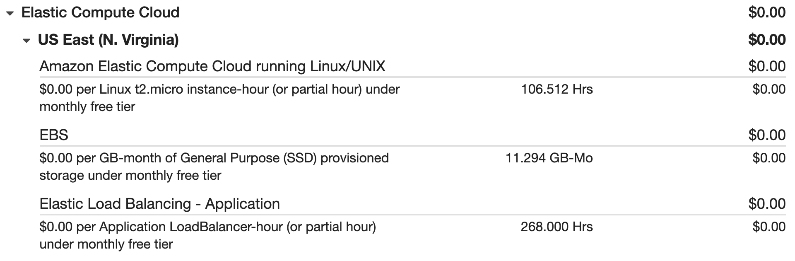
Example: Amazon EC2 service charges
Notes:
The service charges in this example include details for the following items:
Each Amazon EC2 instance type in use
Amount of Amazon Elastic Block Store (Amazon EBS) storage space provisioned
Length of time Elastic Load Balancing was used
In this example, all the usage amounts are under the thresholds in the AWS Free Tier, so the account owner does not have to pay for any Amazon EC2 usage in this month.

Slide 12

Amazon S3 pricing
Amazon S3 pricing is based on four factors:
Storage
Requests and data retrievals
Data transfer
Management and replication
Amazon Simple Storage Service
Notes:
For Amazon S3 pricing, consider the following cost components:
Storage: You pay for only the storage that you use. You are charged the rate to store objects in your Amazon S3 buckets based on your objects’ sizes, storage classes, and length of storage for each object during the month.
Requests and data retrievals: You pay for requests made to your Amazon S3 objects and buckets. For example, suppose that you are storing photo files in Amazon S3 buckets and hosting them on a website. Every time a visitor requests the website that includes the photo files, this counts towards requests you must pay for.
Data transfer: There is no cost to transfer data between different Amazon S3 buckets or from Amazon S3 to other services in the same AWS Region. However, you pay for data that you transfer into and out of Amazon S3, with a few exceptions. Data transferred into Amazon S3 from the internet or out to Amazon CloudFront incurs no cost. In addition, data transferred out to an Amazon EC2 instance in the same AWS Region as the Amazon S3 bucket incurs no cost.
Management and replication: You pay for the storage management features that you enabled on your account’s Amazon S3 buckets. These features include Amazon S3 inventory, analytics, and object tagging.

Slide 13
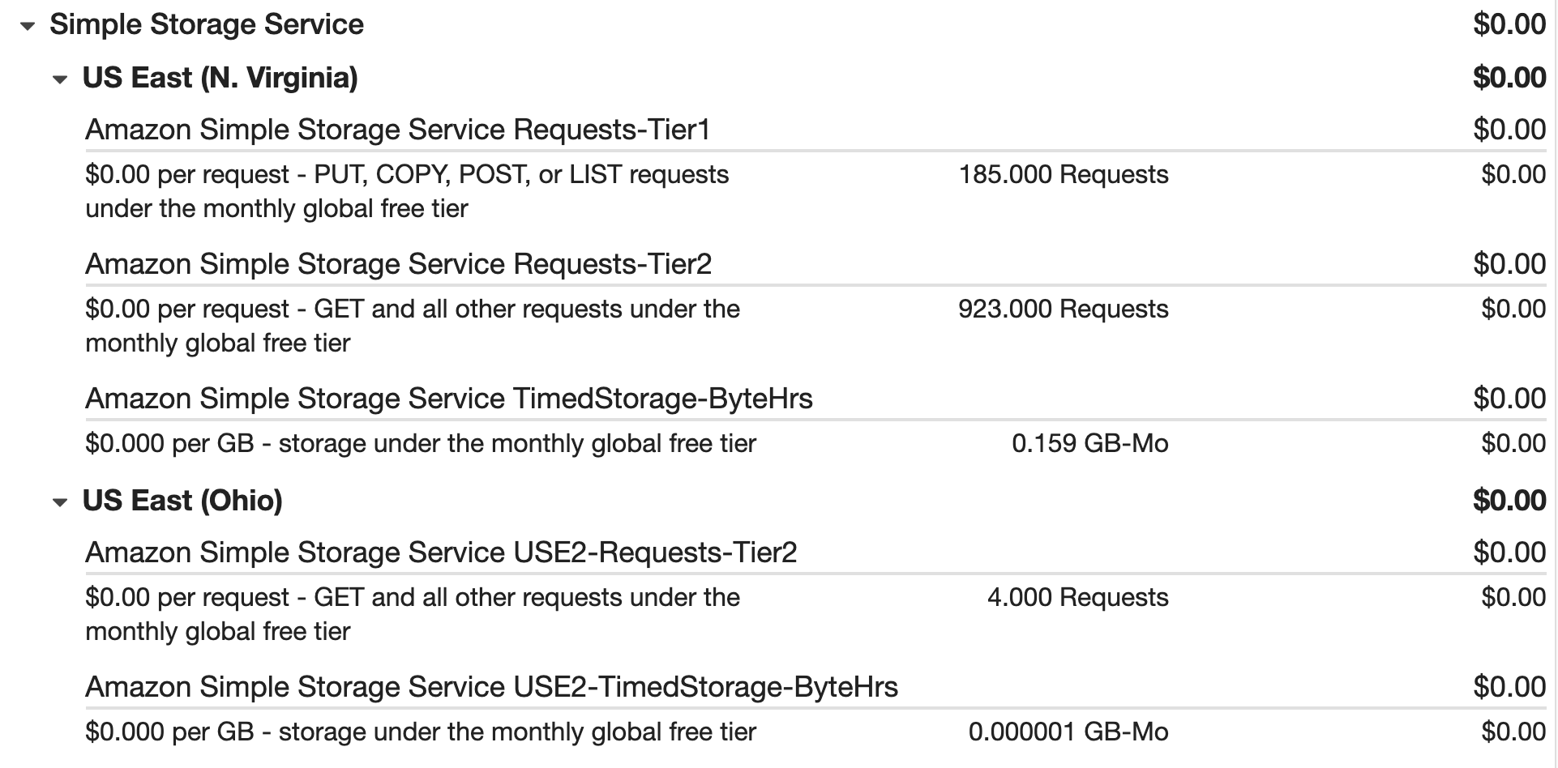
Example: Amazon S3 service charges
Notes:
The AWS account in this example uses Amazon S3 in two Regions: Northern Virginia and Ohio. For each Region, itemized charges are based on the following factors:
Number of requests to add or copy objects into a bucket
Number of requests to retrieve objects from a bucket
Amount of storage space used
All the usage for Amazon S3 in this example is under the AWS Free Tier limits, so the account owner does not have to pay for any Amazon S3 usage in this month.

Slide 14
Demo: Billing dashboard in the AWS Management Console
Notes:
This demo includes:
Searching for “Billing” in the Services menu.
Reviewing your AWS bill, including:
Service costs by Region
Month to date spend
Top services being used
Current and forecasted amounts
Top Free Tier services by usage
Accessing other billing tools, such as Cost Explorer, Budgets, and Budgets Reports.

Slide 15

Knowledge check question
The AWS Free Tier includes offers that are available to new AWS customers for a certain period of time following their AWS sign-up date. What is the duration of this period?
3 months
6 months
9 months
12 months
Notes:
The AWS Free Tier includes offers that are available to new AWS customers for a certain period of time following their AWS sign-up date. What is the duration of this period?
3 months
6 months
9 months
12 months

Slide 16
Knowledge check answer
The AWS Free Tier includes offers that are available to new AWS customers for a certain period of time following their AWS sign-up date. What is the duration of this period?
3 months
6 months
9 months
12 months (correct)
Notes:
The correct response option is D. 12 months.
The AWS Free Tier consists of three types of offers that allow customers to use AWS services without incurring costs: Always Free, 12 Months Free, and Trials.
For 12 months after you first sign up for an AWS account, you can use offers in the 12 Months Free category. Examples of offers in this category include specific amounts of Amazon S3 Standard Storage, thresholds for monthly hours of Amazon EC2 compute time, and amounts of Amazon CloudFront data transfer out.

Slide 17
Consolidated billing
Notes:
In an earlier module, you learned about AWS Organizations, a service that you can use to manage multiple AWS accounts from a central location. AWS Organizations also provides the option for consolidated billing.

Slide 18



Consolidated billing
Receive a single bill for all the AWS accounts in your organization
Review itemized charges that have been incurred by each account
Share savings across the accounts in your organization
Notes:
The consolidated billing feature of AWS Organizations allows you to receive a single bill for all AWS accounts in your organization. By consolidating, you can track the combined costs of all the linked accounts in your organization. The default maximum number of accounts allowed for an organization is four, but you can contact AWS Support to increase your quota, if needed.
On your monthly bill, you can review itemized charges incurred by each account. This provides transparency into your organization’s accounts while maintaining the convenience of receiving a single monthly bill.
Another benefit of consolidated billing is the ability to share bulk discount pricing, Savings Plans, and Reserved Instances across the accounts in your organization. For instance, one account might not have enough monthly usage to qualify for discount pricing. However, when multiple accounts are combined, their aggregated usage might result in a benefit that applies across all accounts in the organization.

Slide 19
Example: Consolidated billing
Monthly Consolidated Bill
Management Account | $14.14
Account 1 | $19.64
Account 2 | $19.96
Account 3 | $20.06
Total charged to paying account: | $73.80
Management Account
Account 1
Account 2
Account 3
$19.64
$19.96
$20.06
Notes:
Suppose that you are the business leader who oversees your company’s AWS billing.
Your company has three AWS accounts used for separate departments. Instead of paying each location’s monthly bill separately, you decide to create an organization and add the three accounts.
You manage the organization through the management account.
Each month, AWS charges your management payer account for all the linked accounts in a consolidated bill. Through the management account, you can also get a detailed cost report for each linked account.
The monthly consolidated bill also includes the account usage costs incurred by the management account. This cost is not a premium charge for having a management account.
The consolidated bill shows the costs associated with any actions of the management account (such as storing files in Amazon S3 or running Amazon EC2 instances).
Fun trivia note: The dollar values on this slide correspond to significant years in Amazon’s history:
1964 is the year in which Jeff Bezos was born.
1996 is the year in which Amazon was founded.
2006 is the year in which AWS was founded.

Slide 20
Example: Volume pricing in Amazon S3
Account 1
Account 2
Account 3
2 TB
5 TB
7 TB
Notes:
Consolidated billing also lets you share volume pricing discounts across accounts.
Some AWS services, such as Amazon S3, provide volume pricing discounts that give you lower prices the more that you use the service. In Amazon S3, after customers transfer 10 TB of data in a month, they pay a lower per-GB transfer price for the next 40 TB of data transferred.
In this example, three separate AWS accounts transferred different amounts of data in Amazon S3 during the current month:
Account 1 transferred 2 TB of data.
Account 2 transferred 5 TB of data.
Account 3 transferred 7 TB of data.
Because no single account passed the 10 TB threshold, none of them is eligible for the lower per-GB transfer price for the next 40 TB of data transferred.

Slide 21
Example: Volume pricing in Amazon S3
Management Account
Account 1
Account 2
Account 3
2 TB
+
5 TB
+
7 TB
=
14 TB
Notes:
Now, suppose that the three accounts are linked in a single AWS organization and use consolidated billing.
When the Amazon S3 usage for the three linked accounts is combined (2+5+7), it results in a combined data transfer amount of 14 TB. This exceeds the 10-TB threshold.
With consolidated billing, AWS combines the usage from all accounts to determine which volume pricing tiers to apply, giving customers a lower overall price whenever possible. AWS then allocates each linked account a portion of the overall volume discount based on the account's usage.
In this example, Account 3 would receive a greater portion of the overall volume discount because at 7 TB, it transferred more data than Account 1 (at 2 TB) and Account 2 (at 5 TB).

Slide 22
AWS pricing tools
Notes:
Next, you will examine pricing tools that you can use for budgeting and analyzing your AWS costs.

Slide 23
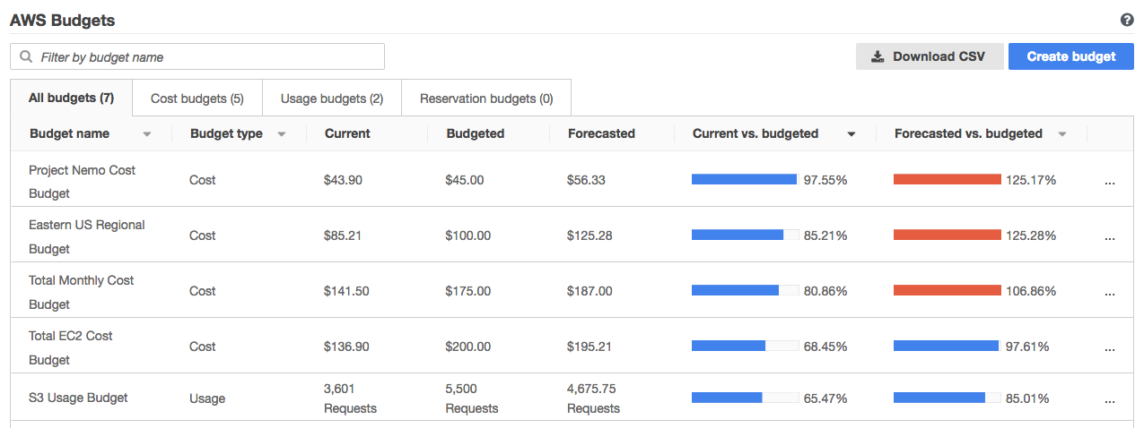
AWS Budgets
AWS Budgets is a tool that you can use to set thresholds for your AWS service usage and costs.
Notes:
In AWS Budgets, you can create budgets to plan your service usage, service costs, and instance reservations.
The information in AWS Budgets updates three times a day. This helps you to accurately determine how close your usage is to your budgeted amounts or to the AWS Free Tier limits.
In AWS Budgets, you can also set custom alerts when your usage exceeds (or is forecasted to exceed) the budgeted amount.
Suppose that you set a budget for Amazon EC2. You want to ensure that your company’s usage of Amazon EC2 does not exceed $200 for the month.
In AWS Budgets, you could set a custom budget to notify you when your usage reaches half of this amount ($100). You would receive an alert and then decide how to proceed.
This sample budget includes the following details:
Current cost that you have incurred for Amazon EC2 so far this month ($136.90)
Forecasted cost for the month ($195.21), based on usage patterns
You can also compare your current and budgeted usage, and forecasted and budgeted usage. For example, in the top row of this sample budget, the forecasted vs. budgeted bar is at 125.17%. The reason for the increase is that the forecasted amount ($56.33) exceeds the amount budgeted for that item for the month ($45.00).

Slide 24
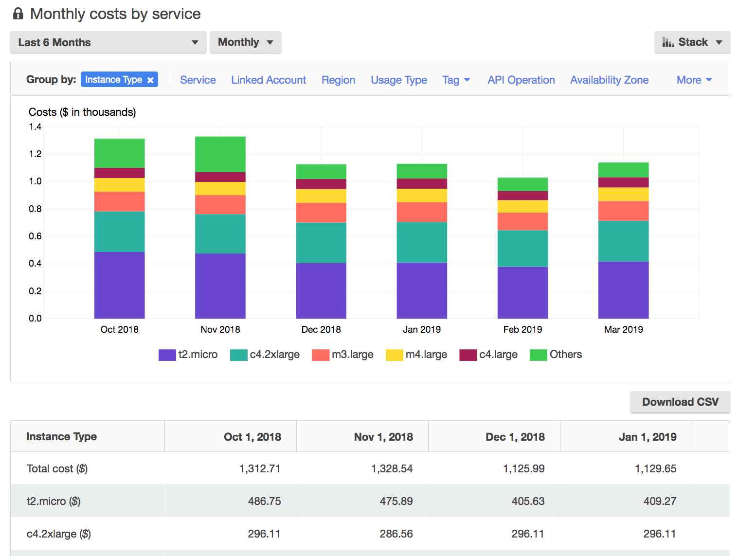
AWS Cost Explorer
AWS Cost Explorer is a tool that you can use to visualize, understand, and manage your AWS costs and usage over time.
Notes:
AWS Cost Explorer is a tool that you can use to visualize, understand, and manage your AWS costs and usage over time.
AWS Cost Explorer includes a default report of the costs and usage for your top five cost-accruing AWS services. You can apply custom filters and groups to analyze your data. For example, you can view resource usage at the hourly level.
This example of the AWS Cost Explorer dashboard displays monthly costs for Amazon EC2 instances over a 6-month period. The bar for each month separates the costs for different Amazon EC2 instance types (such as t2.micro or m3.large).
By analyzing your AWS costs over time, you can make informed decisions about future costs and how to plan your budgets.

Slide 25
AWS Support plans
Notes:
This section examines AWS Support plans. AWS offers four Support plans to help you troubleshoot issues, lower costs, and efficiently use AWS services. You can choose from the following Support plans to meet your company’s needs: Basic, Developer, Business, and Enterprise.

Slide 26
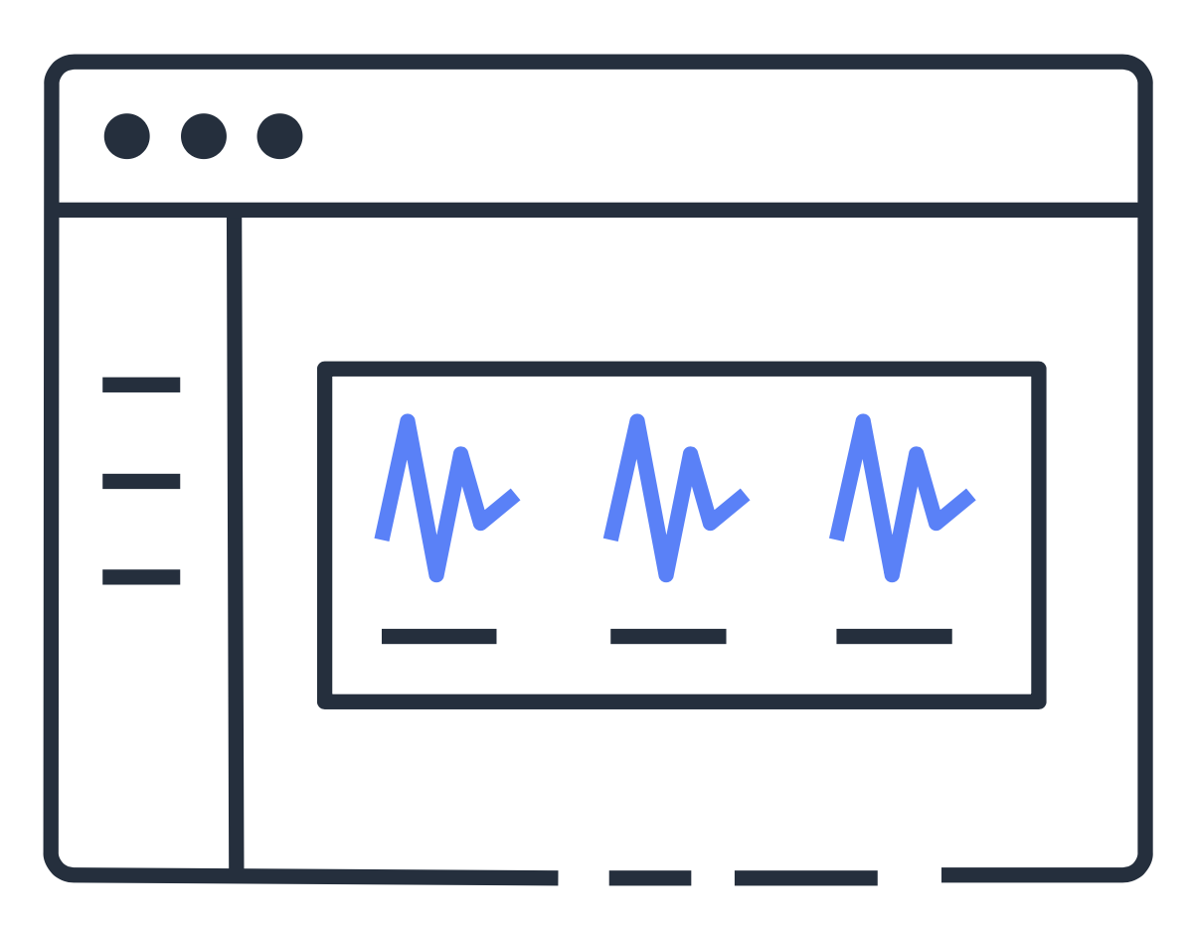
Basic Support
Basic Support is free for all AWS customers and includes access to:
Technical papers, documentation, and support communities
AWS Personal Health Dashboard
A limited selection of AWS Trusted Advisor checks
Notes:
Basic Support is free for all AWS customers. It includes access to technical papers, documentation, and support communities. With Basic Support, you can also contact AWS for billing questions and service limit increases.
With Basic Support, you have a limited selection of AWS Trusted Advisor checks. Additionally, you can use the AWS Personal Health Dashboard, a tool that provides alerts and remediation guidance when AWS is experiencing events that might affect you.
If your company needs additional support, consider purchasing Developer, Business, or Enterprise Support.

Slide 27
AWS Support plans
Developer
Business
Enterprise
Best-practice guidance
Client-side diagnostic tools
Building-block architecture support
Use-case guidance
All AWS Trusted Advisor checks
Limited support for third-party software
Application architecture guidance
Infrastructure event management
Technical Account Manager (TAM)
Notes:
The Developer, Business, and Enterprise Support plans include all the benefits of Basic Support, in addition to the ability to open an unrestricted number of technical support cases. These three plans have pay-by-the-month pricing and require no long-term contracts.
The information in this course highlights only a selection of details for each plan. A complete overview of what is included in each plan, including pricing, is available on the AWS Support site.
In general, for pricing, the Developer plan has the lowest cost, the Business plan is in the middle, and the Enterprise plan has the highest cost.
Customers in the Developer Support plan have access to features such as:
Best practice guidance
Client-side diagnostic tools
Building-block architecture support, which consists of guidance for how to use AWS offerings, features, and services together
For example, suppose that your company is exploring AWS services. You are unsure of how to use AWS services together to build applications that can address your company’s needs. In this scenario, the building-block architecture support that is included with the Developer Support plan could help you identify opportunities for combining specific services and features.
Customers with a Business Support plan have access to additional features, including:
Use-case guidance to identify AWS offerings, features, and services that can support your specific needs
All AWS Trusted Advisor checks
Limited support for third-party software, such as common operating systems and application stack components
Suppose that your company has the Business Support plan and wants to install a common third-party operating system onto your Amazon EC2 instances. You could contact AWS Support for assistance with installing, configuring, and troubleshooting the operating system. For advanced topics such as optimizing performance, using custom scripts, or resolving security issues, you might need to contact the third-party software provider directly.
In addition to all the features included in the Basic, Developer, and Business Support plans, customers with an Enterprise Support plan have access to features such as:
Application architecture guidance, which is a consultative relationship to support your company’s specific use cases and applications
Infrastructure event management (A short-term engagement with AWS Support that helps your company gain a better understanding of your use cases. This also provides your company with architectural and scaling guidance.)
Technical Account Manager

Slide 28

Technical Account Manager (TAM)
The Technical Account Manager is your primary point of contact at AWS.
Technical Account Managers are included only with the Enterprise Support plan.
They provide guidance, technical expertise, and best practices.
Notes:
The Enterprise Support plan includes access to a Technical Account Manager (TAM).
If your company has an Enterprise Support plan, the TAM is your primary point of contact at AWS. They provide guidance, architectural reviews, and ongoing communication with your company as you plan, deploy, and optimize your applications.
Your TAM provides expertise across the full range of AWS services. They help you design solutions that efficiently use multiple services together through an integrated approach.
For example, suppose that you are interested in developing an application that uses several AWS services together. Your TAM could provide insights into how to use the services together. They achieve this, while aligning with the specific needs that your company is hoping to address through the new application.

Slide 29
Knowledge check question
Which of the following is the lowest-cost AWS Support plan that includes all AWS Trusted Advisor checks?
Business
Developer
Enterprise
Basic
Notes:
Which of the following is the lowest-cost AWS Support plan that includes all AWS Trusted Advisor checks?
Business
Developer
Enterprise
Basic

Slide 30
Knowledge check answer
Which of the following is the lowest-cost AWS Support plan that includes all AWS Trusted Advisor checks?
Business (correct)
Developer
Enterprise
Basic
Notes:
The correct answer is A. Business.
Only the Business and Enterprise Support plans include all AWS Trusted Advisor checks. Of these two Support plans, the Business Support plan has a lower cost.

Slide 31
AWS Marketplace
Notes:
As you continue to explore AWS services, you might consider using them together with third-party software. This might include software that you are already using and want to integrate into AWS services, or new software that can help you create innovative solutions for your customers.
To find third-party software that you can use with AWS services, visit the AWS Marketplace.

Slide 32


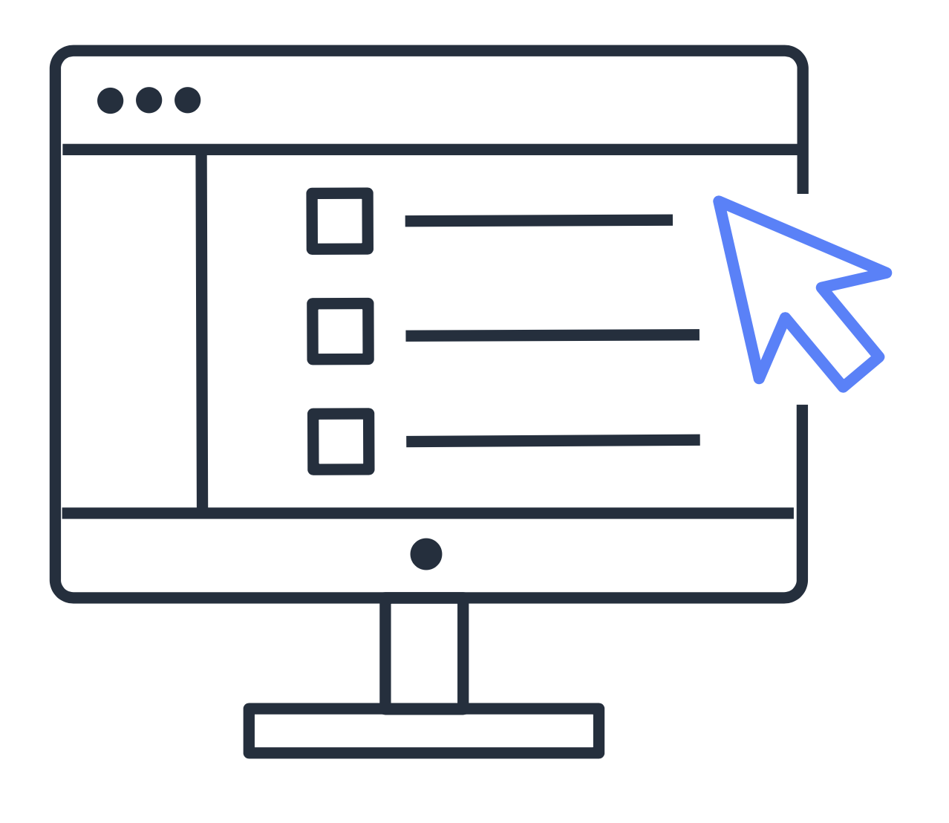
AWS Marketplace
AWS Marketplace is a digital catalog that provides listings of third-party software that runs on AWS.
Discover thousands of software products that run on AWS
Access detailed information and reviews for each product listing
Explore software solutions by industry and use case
Notes:
AWS Marketplace is a digital catalog that includes thousands of software listings from independent software vendors. You can use AWS Marketplace to find, test, and buy software that runs on AWS.
For each listing in AWS Marketplace, you can access detailed information on pricing options, available support, and reviews from other AWS customers.
You can also explore software solutions by industry and use case. For example, suppose that your company is in the healthcare industry. In the AWS Marketplace, you can review use cases that software helps you address, such as implement solutions to protect patient records, or use machine learning models to analyze a patient’s medical history and predict possible health risks.

Slide 33






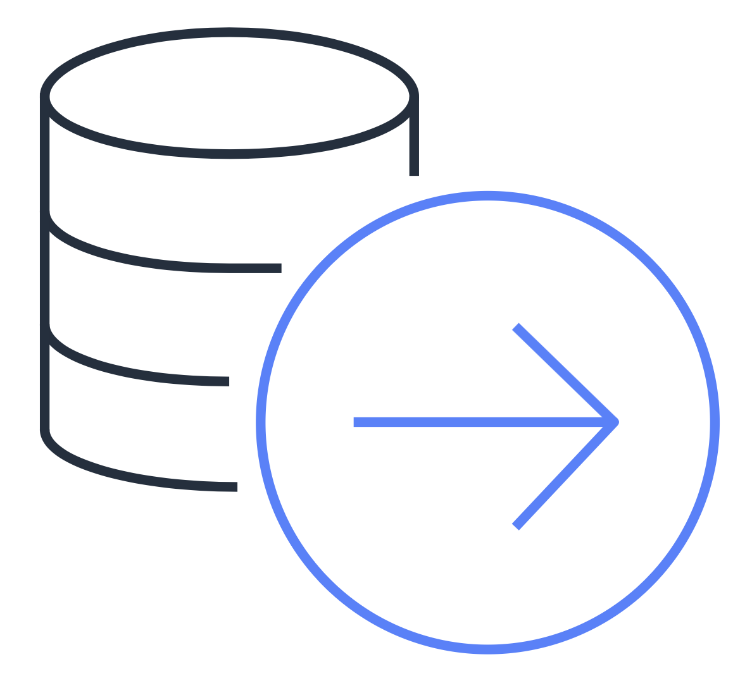

AWS Marketplace categories
Business Applications
Data and Analytics
DevOps
Infrastructure Software
Internet of Things (IoT)
Machine Learning
Migration
Security
Notes:
AWS Marketplace offers products in several categories, such as Infrastructure Products, Business Applications, Data Products, and DevOps.
In each category, you can browse through product listings in subcategories. For example, subcategories in the DevOps category include areas such as Application Development, Monitoring, and Testing.

Slide 34
Knowledge check
Module 8
Notes:
There are no notes on this slide.

Slide 35
Knowledge check question 1
Which action can a customer perform with consolidated billing?
Review how much cost predicted AWS usage will incur by the end of the month
Create an estimate for the cost of use cases on AWS
Combine usage across accounts to receive volume pricing discounts
Visualize and manage AWS costs and usage over time
Notes:
Which action can a customer perform with consolidated billing?
Review how much cost predicted AWS usage will incur by the end of the month
Create an estimate for the cost of use cases on AWS
Combine usage across accounts to receive volume pricing discounts
Visualize and manage AWS costs and usage over time

Slide 36
Knowledge check answer 1
Which action can a customer perform with consolidated billing?
Review how much cost predicted AWS usage will incur by the end of the month
Create an estimate for the cost of use cases on AWS
Combine usage across accounts to receive volume pricing discounts (correct)
Visualize and manage AWS costs and usage over time
Notes:
The correct response option is C. Combine usage across accounts to receive volume pricing discounts.
The other response options are incorrect because:
A. You can perform this action in AWS Budgets.
B. You can perform this action in AWS Pricing Calculator.
D. You can perform this action in AWS Cost Explorer.

Slide 37
Knowledge check question 2
Which pricing tool is used to visualize, understand, and manage AWS costs and usage over time?
AWS Pricing Calculator
AWS Budgets
AWS Cost Explorer
AWS Free Tier
Notes:
Which pricing tool is used to visualize, understand, and manage AWS costs and usage over time?
AWS Pricing Calculator
AWS Budgets
AWS Cost Explorer
AWS Free Tier

Slide 38
Knowledge check answer 2
Which pricing tool is used to visualize, understand, and manage your AWS costs and usage over time?
AWS Pricing Calculator
AWS Budgets
AWS Cost Explorer (correct)
AWS Free Tier
Notes:
The correct response option is C. AWS Cost Explorer.
AWS Cost Explorer includes a default report of the costs and usage for your top five cost-accruing AWS services. You can apply custom filters and groups to analyze your data. For example, you can view resource usage at the hourly level.
The other response options are incorrect because:
A. You can use AS Pricing Calculator to create an estimate for the cost of your use cases on AWS.
B. AWS Budgets lets you create budgets to plan your service usage, service costs, and instance reservations. In AWS Budgets, you can also set custom alerts when your usage exceeds (or is forecasted to exceed) the budgeted amount.
D. The AWS Free Tier is a program that consists of three types of offers that allow customers to use AWS services without incurring costs: Always Free, 12 Months Free, and Trials.

Slide 39
Knowledge check question 3
Which pricing tool can a customer use to receive alerts when their service usage exceeds a customer-defined threshold?
Billing dashboard in the AWS Management Console
AWS Budgets
AWS Free Tier
AWS Cost Explorer
Notes:
Which pricing tool can a customer use to receive alerts when their service usage exceeds a customer-defined threshold?
Billing dashboard in the AWS Management Console
AWS Budgets
AWS Free Tier
AWS Cost Explorer

Slide 40
Knowledge check answer 3
Which pricing tool can a customer use to receive alerts when their service usage exceeds a customer-defined threshold?
Billing dashboard in the AWS Management Console
AWS Budgets (correct)
AWS Free Tier
AWS Cost Explorer
Notes:
The correct response option is B. AWS Budgets.
In AWS Budgets, you can set custom alerts that will notify you when your service usage exceeds (or is forecasted to exceed) the amount that you have budgeted.
Your budget can be based on costs or usage. For example, you can set an alert that will notify you when you have incurred $100.00 of costs in Amazon EC2 or 500,000 requests in AWS Lambda.
The other response options are incorrect because:
A. From the billing dashboard in the AWS Management Console, you can view details on your AWS bill, such as service costs by Region, month to date spend, and more. However, you cannot set alerts from the billing dashboard.
C. The AWS Free Tier is a program that consists of three types of offers that allow customers to use AWS services without incurring costs: Always Free, 12 Months Free, and Trials.
D. AWS Cost Explorer is a tool that you can use to visualize, understand, and manage your AWS costs and usage over time.

Slide 41
Knowledge check question 4
A company wants to receive support from an AWS Technical Account Manager (TAM). Which support plan should they choose?
Developer
Basic
Enterprise
Business
Notes:
A company wants to receive support from an AWS Technical Account Manager (TAM). Which support plan should they choose?
Developer
Basic
Enterprise
Business

Slide 42
Knowledge check answer 4
A company wants to receive support from an AWS Technical Account Manager (TAM). Which support plan should they choose?
Developer
Basic
Enterprise (correct)
Business
Notes:
The correct response option is C. Enterprise.
A Technical Account Manager (TAM) is available only to AWS customers with an Enterprise Support plan. A TAM provides guidance, architectural reviews, and ongoing communication with your company as you plan, deploy, and optimize your applications.

Slide 43
Knowledge check question 5
Which service or resource is used to find third-party software that runs on AWS?
AWS Marketplace
AWS Free Tier
AWS Support
Billing dashboard in the AWS Management Console
Notes:
Which service or resource is used to find third-party software that runs on AWS?
AWS Marketplace
AWS Free Tier
AWS Support
Billing dashboard in the AWS Management Console

Slide 44
Knowledge check answer 5
Which service or resource is used to find third-party software that runs on AWS?
AWS Marketplace (correct)
AWS Free Tier
AWS Support
Billing dashboard in the AWS Management Console
Notes:
The correct response option is A. AWS Marketplace.
AWS Marketplace is a digital catalog that includes thousands of software listings from independent software vendors. You can use AWS Marketplace to find, test, and buy software that runs on AWS.
The other response options are incorrect because:
B. The AWS Free Tier consists of offers that allow customers to use AWS services without incurring costs. These offers are related to AWS services, not third-party software that can be used on AWS.
C. AWS Support is a resource that can answer questions about best practices, assist with troubleshooting issues, help you to identify ways to optimize your use of AWS services, and so on.
D. You can use the billing dashboard in the AWS Management Console to view details such as service costs by Region, the top services being used by your account, and forecasted billing costs. From the billing dashboard, you can also access other AWS billing tools, such as AWS Cost Explorer, AWS Budgets, and AWS Budgets Reports.

Slide 45
Module 8 summary
In this module, you learned about:
AWS Free Tier
Consolidated billing
Tools for planning, estimating, and reviewing AWS costs
AWS Support plans
AWS Marketplace benefits
Notes:
In this module, you learned about the following concepts:
Three types of offers included in the AWS Free Tier: Always Free, 12 Months Free, and Trials
Benefits of consolidated billing in AWS Organizations
Tools for planning, estimating, and reviewing AWS costs
Differences between the four AWS Support plans: Basic, Developer, Business, and Enterprise
Benefits of AWS Marketplace
The next module examines migration and innovation in the AWS Cloud.

