Slide 1
Migration and Innovation
Module 9
Notes:
In this module, you will learn about migration and innovation on AWS. This includes migration services, cloud migration strategies, and the AWS Cloud Adoption Framework.

Slide 2
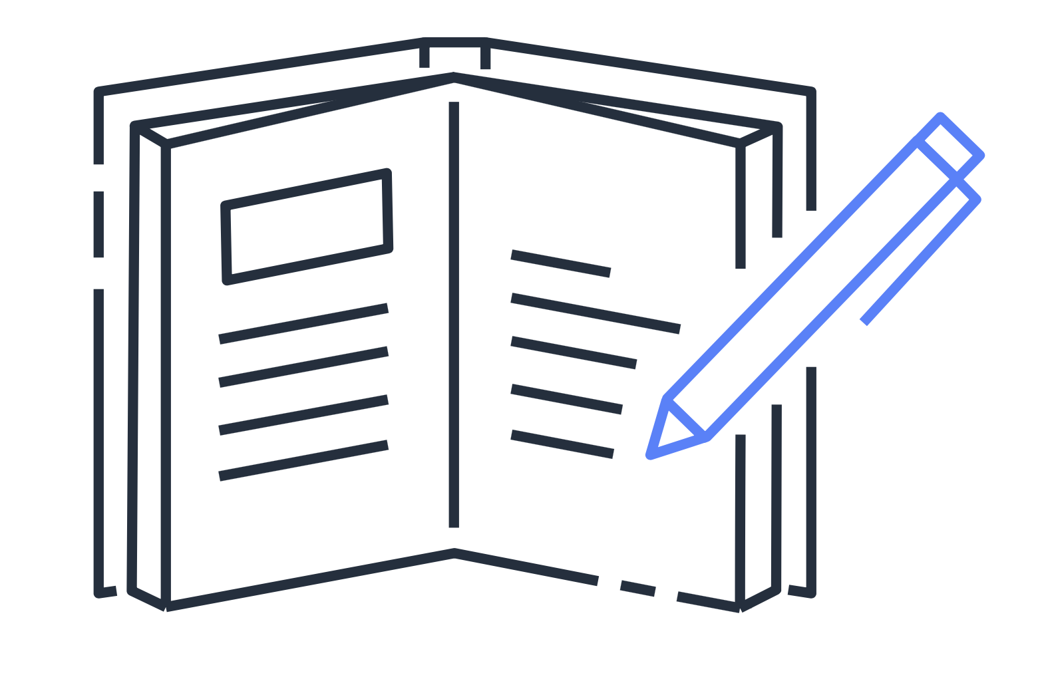
Module 9 objectives
In this module, you will learn how to:
Describe migration and innovation in the AWS Cloud
Summarize the AWS Cloud Adoption Framework (AWS CAF)
Summarize the six key factors of a cloud migration strategy
Describe the benefits of AWS data migration solutions
Summarize the broad scope of innovative solutions that AWS offers
Summarize the five pillars of the AWS Well-Architected Framework
Notes:
In this module, you will learn how to:
Describe migration and innovation in the AWS Cloud
Summarize the AWS Cloud Adoption Framework (AWS CAF)
Summarize the six key factors of a cloud migration strategy
Describe the benefits of AWS data migration solutions
Summarize the broad scope of innovative solutions that AWS offers
Summarize the five pillars of the AWS Well-Architected Framework

Slide 3
AWS Cloud Adoption Framework
Notes:
In this section, you will explore the AWS Cloud Adoption Framework, which provides guidance to support organizational change throughout the cloud adoption process.

Slide 4
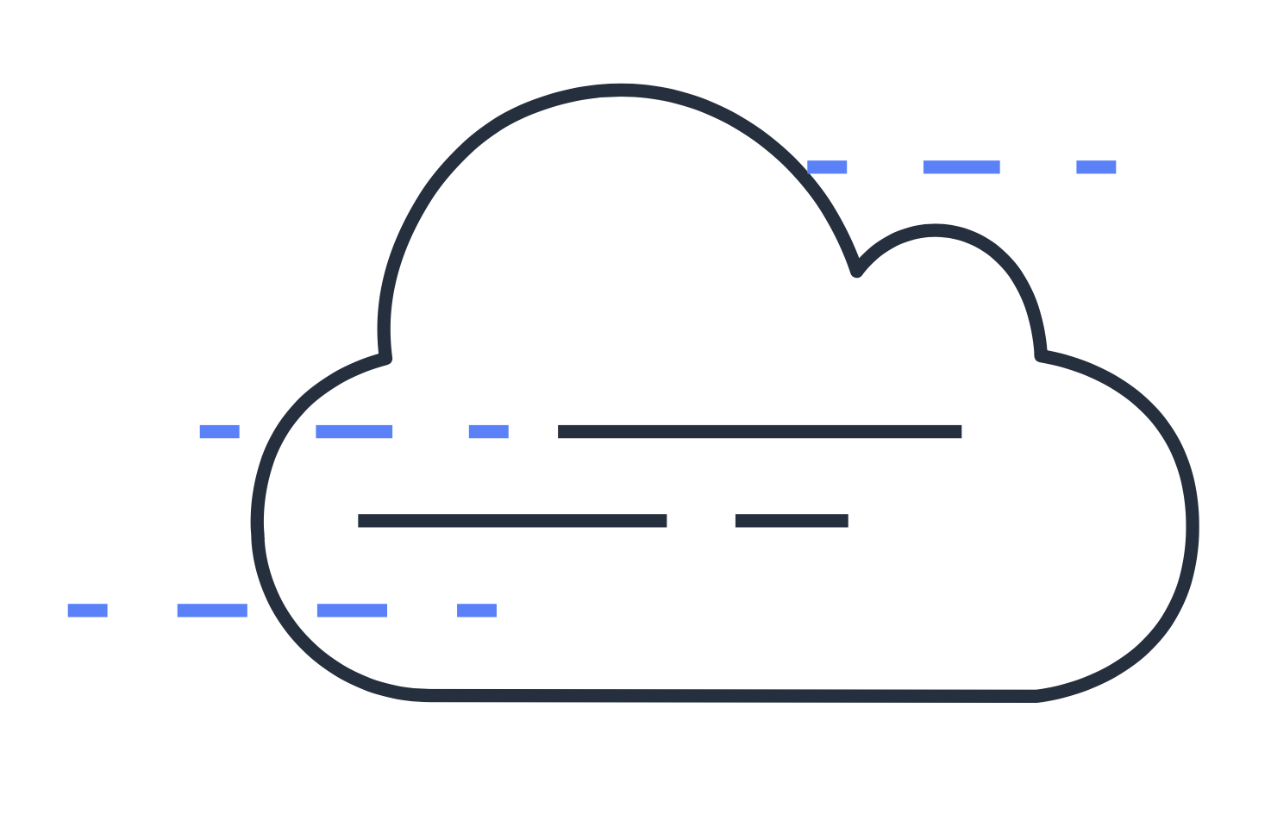
AWS Cloud Adoption Framework
Provides advice to your company to enable a quick and smooth migration to AWS
Organizes guidance into six areas of focus, called perspectives
Notes:
Migrating to the cloud is a process. You don't snap your fingers and have everything magically hosted in AWS. Migrating applications takes effort, and a successful cloud migration requires expertise.
Fortunately, many people have successfully migrated to AWS, and a lot of knowledge about the process has been captured and shared.
That being said, the position you hold in your organization will impact what you need to know and how you can help with a migration. If you are a developer, your role and viewpoint will be much different than a cloud architect, business analyst, or financial analyst. Different types of people bring different perspectives to the table for a migration. You want to harness those different perspectives and make sure that everyone has the same focus.
You also want to ensure that you have the right talent to help support your migration. HR will need to hire at the correct rate to enable your migration. This can be a lot to track, and someone new to the cloud might not think of all the different people who need to be involved.
The AWS Professional Services team created the AWS Cloud Adoption Framework (AWS CAF) to help you manage this process. The Cloud Adoption Framework provides advice to your company to enable a smooth migration to AWS.
At the highest level, the AWS CAF organizes guidance into six areas of focus, called perspectives. Each perspective addresses distinct responsibilities. The planning process helps the right people across the organization prepare for the changes ahead.

Slide 5





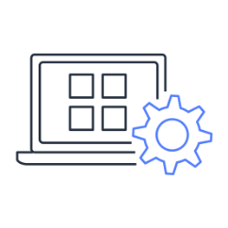
Perspectives
Business
People
Governance
Business
capabilities
Technical
capabilities
Platform
Security
Operations
Notes:
Each perspective of the AWS CAF addresses distinct responsibilities. The planning process helps the right people across the organization prepare for the changes ahead. In general, the Business, People, and Governance perspectives focus on business capabilities, whereas the Platform, Security, and Operations perspectives focus on technical capabilities. For example, someone who is a business or finance analysts is part of the Business perspective, HR is part of the People perspective, and a cloud architect is part of the Platform perspective.
Each perspective uncovers gaps in your skills and processes, which are then recorded as inputs. The inputs are then used as the basis for creating an AWS Cloud Adoption Framework Action Plan. You can use the action plan to guide your organization's change management as you journey to the cloud. Having an action plan that makes sense for your organization can help keep you on track towards achieving your desired outcomes.

Slide 6
Business perspective
Business
People
Governance
Goal
Ensures that IT aligns with business needs and IT investments link to key business results
Common roles
Business managers
Finance managers
Budget owners
Strategy stakeholders
Platform
Security
Operations
Notes:
The Business perspective ensures that IT aligns with business needs and IT investments link to key business results.
Use the Business perspective to create a strong business case for cloud adoption and prioritize cloud adoption initiatives. Ensure that your business strategies and goals align with your IT strategies and goals.
Common roles in the Business perspective include:
Business managers
Finance managers
Budget owners
Strategy stakeholders

Slide 7
People perspective
Business
People
Governance
Goal
Supports development of an organization-wide change management strategy for successful cloud adoption
Common roles
Human resources
Staffing
People managers
Platform
Security
Operations
Notes:
The People perspective supports development of an organization-wide change management strategy for successful cloud adoption.
Use the People perspective to evaluate organizational structures and roles, new skill and process requirements, and identify gaps. This helps prioritize training, staffing, and organizational changes.
Common roles in the People perspective include:
Human resources
Staffing
People managers

Slide 8
Governance perspective
Business
People
Governance
Goal
Focuses on the skills and processes to align IT strategy with business strategy
Common roles
Chief information officer (CIO)
Program managers
Enterprise architects
Business analysts
Portfolio managers
Platform
Security
Operations
Notes:
The Governance perspective focuses on the skills and processes to align IT strategy with business strategy. This ensures that you maximize the business value and minimize risks.
Use the Governance perspective to understand how to update the staff skills and processes necessary to ensure business governance in the cloud. Manage and measure cloud investments to evaluate business outcomes.
Common roles in the Governance perspective include:
Chief information officer (CIO)
Program managers
Enterprise architects
Business analysts
Portfolio managers

Slide 9
Platform perspective
Business
People
Governance
Goal
Includes principles and patterns for implementing new solutions in the cloud, and migrating on-premises workloads to the cloud
Common roles
Chief technology officer (CTO)
IT managers
Solutions architects
Platform
Security
Operations
Notes:
The Platform perspective includes principles and patterns for implementing new solutions in the cloud, and migrating on-premises workloads to the cloud.
Use a variety of architectural models to understand and communicate the structure of IT systems and their relationships. Describe the architecture of the target state environment in detail.
Common roles in the Platform perspective include:
Chief technology officer (CTO)
IT managers
Solutions architects

Slide 10
Security perspective
Business
People
Governance
Goal
Ensures that the organization meets security objectives for visibility, auditability, control, and agility
Common roles
Chief information security officer (CISO)
IT security managers
IT security analysts
Platform
Security
Operations
Notes:
The Security perspective ensures that an organization meets security objectives for visibility, auditability, control, and agility.
Use the AWS CAF to structure the selection and implementation of security controls that meet the organization’s needs.
Common roles in the Security perspective include:
Chief information security officer (CISO)
IT security managers
IT security analysts

Slide 11
Operations perspective
Business
People
Governance
Goal
Helps you to enable, run, use, operate, and recover IT workloads to the level agreed on with your business stakeholders
Common roles
IT operations managers
IT support managers
Platform
Security
Operations
Notes:
The Operations perspective helps you to enable, run, use, operate, and recover IT workloads to the level agreed on with your business stakeholders.
Define how day-to-day, quarter-to-quarter, and year-to-year business is conducted. Align with and support the operations of the business. The AWS CAF helps stakeholders define current operating procedures and identify the process changes and training needed to implement successful cloud adoption.
Common roles in the Operations perspective include:
IT operations managers
IT support managers
Migrating to the cloud can be complicated, but you are not alone in this. You have access to many resources that can help you get started, and the AWS Cloud Adoption Framework is a helpful place to look.

Slide 12

Knowledge check question
Which AWS Cloud Adoption Framework perspective helps customers design, implement, and optimize their AWS solution based on their business goals and perspectives?
Business perspective
Platform perspective
Operations perspective
People perspective
Notes:
Which AWS Cloud Adoption Framework perspective helps customers design, implement, and optimize their AWS solution based on their business goals and perspectives?
Business perspective
Platform perspective
Operations perspective
People perspective

Slide 13
Knowledge check answer
Which AWS Cloud Adoption Framework perspective helps customers design, implement, and optimize their AWS solution based on their business goals and perspectives?
Business perspective
Platform perspective (correct)
Operations perspective
People perspective
Notes:
The correct response option is B. Platform perspective.
The Platform perspective of the AWS Cloud Adoption Framework also includes principles for implementing new solutions and migrating on-premises workloads to the cloud.
The other response options are incorrect because:
A. The Business perspective helps you move from a model that separates business and IT strategies into a business model that integrates IT strategy.
C. The Operations perspective focuses on operating and recovering IT workloads to meet the requirements of business stakeholders.
D. The People perspective helps Human Resources employees prepare their teams for cloud adoption by updating organizational processes and staff skills to include cloud-based competencies.

Slide 14
Migration strategies
Notes:
This section examines six strategies that you can consider implementing when preparing for a cloud migration.

Slide 15


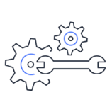

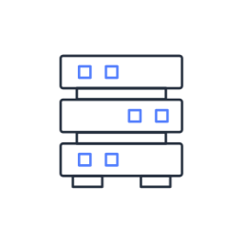





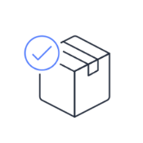

Six migration strategies
Rehost
Replatform
Refactor/Rearchitect
Repurchase
Applications to migrate
Discovery phase
Retain
Retire
Notes:
Suppose that you want to migrate from your on-premises deployment to AWS. Ideally, you could snap your fingers and instantly have all the elements from your existing on-premises data center magically appear on AWS, optimized and efficient. However, migrating doesn't work that way.
Every application (or application groups, if they're tightly coupled) has six possible options for a migration. These are known as the six Rs of migration. Once you complete the discovery phase and know exactly what is present in your existing environment, decide which of the six Rs might be the best option, based on factors such as time, cost, priority, and criticality.
When migrating applications to the cloud, six of the most common migration strategies that you can implement are:
Rehosting
Replatforming
Refactoring/re-architecting
Repurchasing
Retaining
Retiring
Rehosting (also known as lift and shift) involves moving applications without changes. In the scenario of a large legacy migration, in which the company is looking to implement its migration and scale quickly to meet a business case, the majority of applications are rehosted.
Replatforming (also known as lift, tinker, and shift) involves making a few cloud optimizations to realize a tangible benefit. Optimization is achieved without changing the core architecture of the application.
Refactoring (also known as rearchitecting) involves reimagining how an application is architected and developed by using cloud-native features. Refactoring is driven by a strong business need to add features, scale, or performance that would otherwise be difficult to achieve in the application’s existing environment.
Repurchasing involves moving from a traditional license to a software as a service model. For example, a business might choose to implement the repurchasing strategy by migrating from a customer relationship management (CRM) system to Salesforce.com.
The final two strategies, retaining and retiring, do not involve moving applications to the cloud.
Retaining consists of keeping applications that are critical for the business in the source environment. This might include applications that require major refactoring before they can be migrated, or, work that can be postponed until a later time.
Retiring is the process of removing applications that are no longer needed.

Slide 16
Knowledge check question
Which migration strategy involves moving from a traditional license to a software as a service model?
Refactoring
Retiring
Replatforming
Repurchasing
Notes:
Which migration strategy involves moving from a traditional license to a software as a service model?
Refactoring
Retiring
Replatforming
Repurchasing

Slide 17
Knowledge check answer
Which migration strategy involves moving from a traditional license to a software as a service model?
Refactoring
Retiring
Replatforming
Repurchasing (correct)
Notes:
The correct response option is D: Repurchasing.
Repurchasing involves replacing an existing application with a cloud-based version, such as software found in AWS Marketplace.
The other response options are incorrect because:
A. Refactoring involves changing how an application is architected and developed, typically by using cloud-native features.
B. Retiring involves removing an application that is no longer used or that can be turned off.
C. Replatforming involves selectively optimizing aspects of an application to achieve benefits in the cloud without changing the core architecture of the application. It is also known as lift, tinker, and shift.

Slide 18
AWS Snow Family
Notes:
Suppose that you have a large amount of data that you need to transfer into the AWS Cloud. For this type of workload, you can use devices that are part of the AWS Snow Family. The AWS Snow Family is a collection of physical devices that help to physically transport up to exabytes of data into and out of AWS.

Slide 19
AWS Snow Family
AWS Snowcone
AWS Snowball devices
AWS Snowmobile
Small, rugged, and secure edge computing and data transfer device
Features 8 TB of usable storage
AWS Snowball Edge Storage Optimized
AWS Snowball Edge Compute Optimized
Exabyte-scale data transfer service for moving large amounts of data to AWS
Transfers up to 100 PB of data
Notes:
The AWS Snow Family is composed of AWS Snowcone, AWS Snowball, and AWS Snowmobile. These devices offer different capacity points, and most include built-in computing capabilities. AWS owns and manages the Snow Family devices and integrates with AWS security, monitoring, storage management, and computing capabilities.
AWS Snowcone is a small, rugged, and secure edge computing and data transfer device. It features 2 CPUs, 4 GB of memory, and 8 TB of usable storage.
AWS offers two types of AWS Snowball devices:
Snowball Edge Storage Optimized devices are well suited for large-scale data migrations and recurring transfer workflows, in addition to local computing with higher capacity needs.
Storage: 80 TB of hard disk drive (HDD) capacity for block volumes and Amazon S3 compatible object storage; 1 TB of SATA solid state drive (SSD) for block volumes
Compute: 40 vCPUs; 80 GiB of memory to support Amazon EC2 sbe1 instances (equivalent to C5)
Snowball Edge Compute Optimized provides powerful computing resources for use cases such as machine learning, full motion video analysis, analytics, and local computing stacks.
Storage: 42-TB usable HDD capacity for Amazon S3 compatible object storage or Amazon EBS compatible block volumes; 7.68 TB of usable NVMe SSD capacity for Amazon EBS compatible block volumes
Compute: 52 vCPUs; 208 GiB of memory; optional NVIDIA Tesla V100 GPU; run Amazon EC2 sbe-c and sbe-g instances, which are equivalent to C5, M5a, G3, and P3 instances
AWS Snowmobile is an exabyte-scale data transfer service used to move large amounts of data to AWS. You can transfer up to 100 petabytes of data per Snowmobile, which is a 45-foot long ruggedized shipping container, pulled by a semitrailer truck.

Slide 20
Innovation with AWS
Notes:
The next section of this module examines innovation with AWS.

Slide 21

Innovation with AWS
Driving innovation in the cloud involves clearly articulating the following conditions:
Current state
Desired state
Problems you are trying to solve
Notes:
When examining how to use AWS services, focus on the desired outcomes. You are properly equipped to drive innovation in the cloud if you can clearly articulate the following:
Current state
Desired state
Problems you are trying to solve
Consider some of the paths you might explore in the future as you continue on your cloud journey.

Slide 22
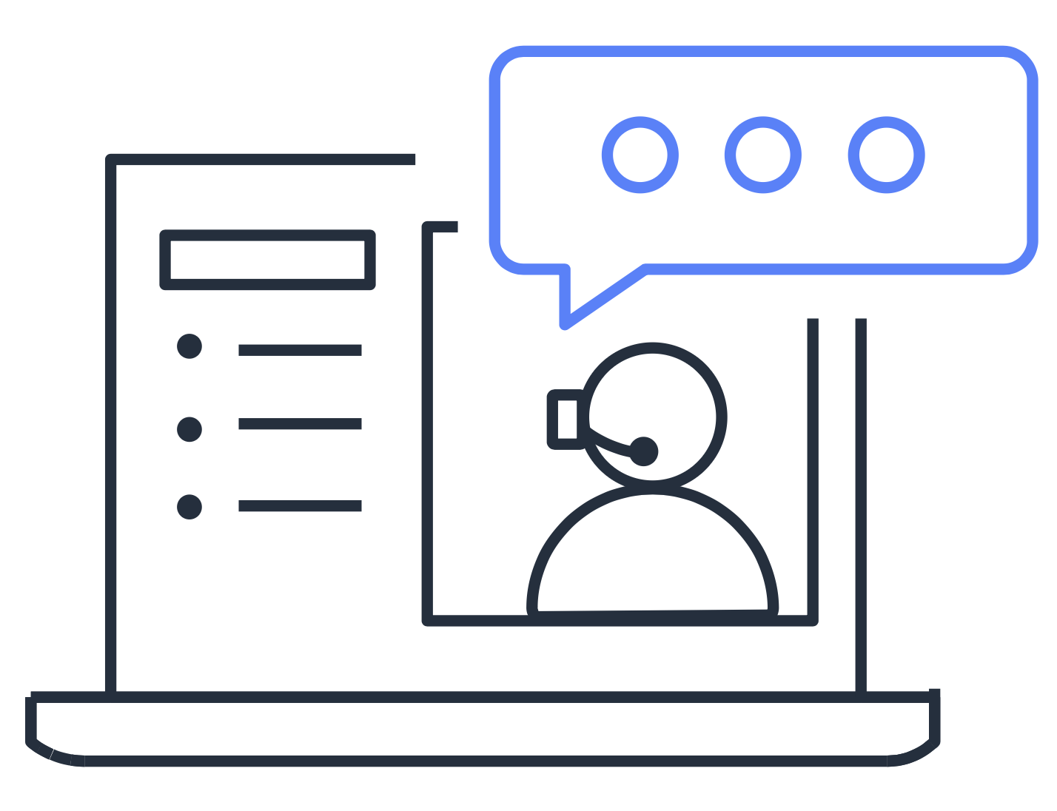
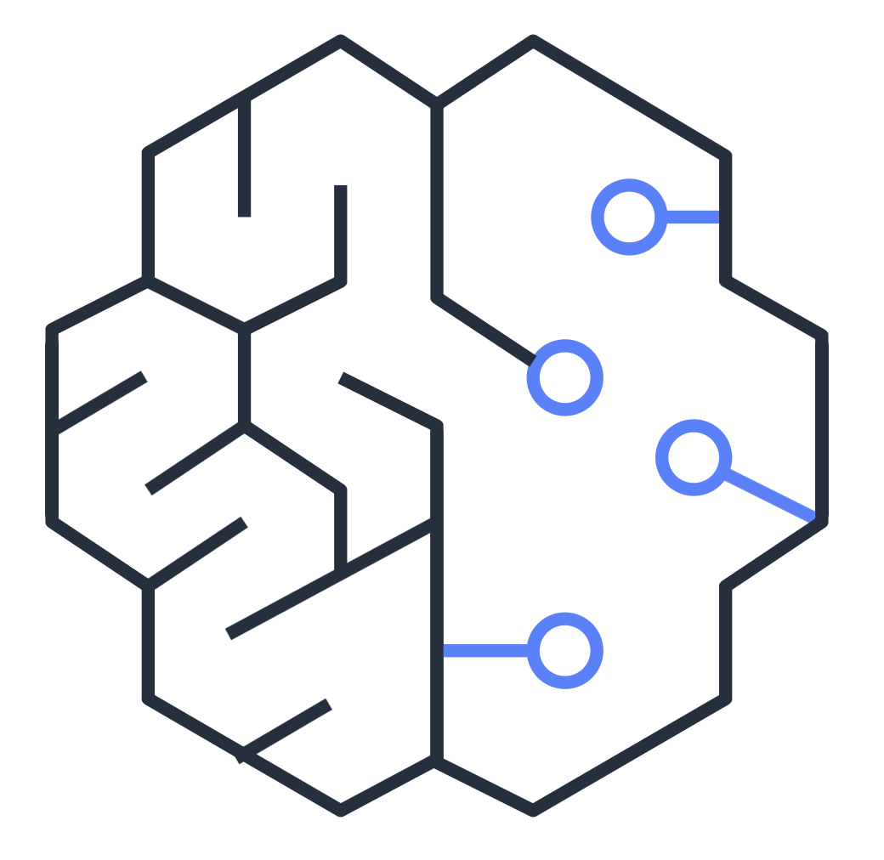
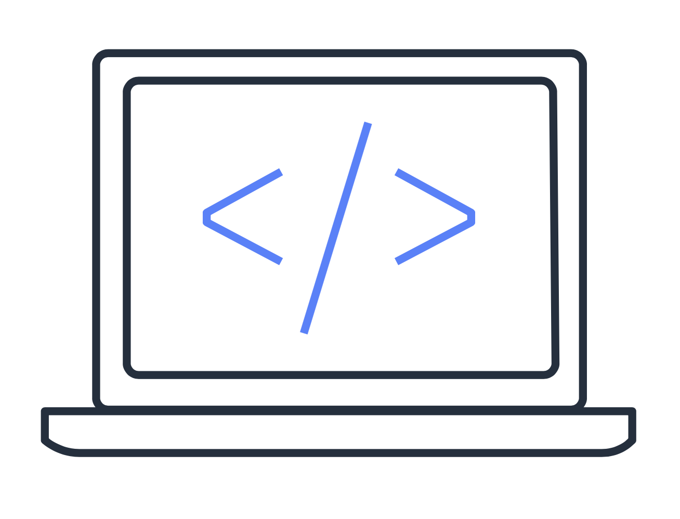
Innovation paths
Consider some of the following innovation paths as you continue on your cloud journey.
Serverless applications
Artificial intelligence (AI)
Machine learning (ML)
Notes:
Serverless applications: With AWS, serverless refers to applications that don’t require you to provision, maintain, or administer servers. AWS handles fault tolerance and availability for you.
AWS Lambda is an example of a service that you can use to run serverless applications. If you design your architecture to trigger Lambda functions to run your code, you can bypass the need to manage a fleet of servers. Building your architecture with serverless applications helps developers focus on their core product instead of managing and operating servers.
Artificial intelligence (AI): AWS offers a variety of services powered by AI. For example, you can:
Convert speech to text with Amazon Transcribe
Discover patterns in text with Amazon Comprehend
Identify potentially fraudulent online activities with Amazon Fraud Detector
Build voice and text chatbots with Amazon Lex
Machine learning (ML): Traditional machine learning development is complex, expensive, time consuming, and error prone. AWS offers Amazon SageMaker to remove the difficult work from the process and empower you to build, train, and deploy ML models quickly. You can use ML to analyze data, solve complex problems, and predict outcomes.

Slide 23
AWS Well-Architected Framework
Notes:
Throughout this course, you have learned about a wide range of AWS services. You can use these services as building blocks for your cloud architecture. To help you evaluate how well your architecture aligns with best practices, you can use the Well-Architected Framework.

Slide 24

Well-Architected Framework
The Well-Architected Framework helps you understand how to design and operate reliable, secure, efficient, and cost-effective systems in the AWS Cloud.
It is based on five pillars:
Operational excellence
Security
Reliability
Performance efficiency
Cost optimization
Notes:
The Well-Architected Framework helps you understand how to design and operate reliable, secure, efficient, and cost-effective systems in the AWS Cloud. It provides a way for you to consistently measure your architecture against best practices and design principles and identify areas for improvement.
The Well-Architected Framework is based on five pillars:
Operational excellence
Security
Reliability
Performance efficiency
Cost optimization

Slide 25
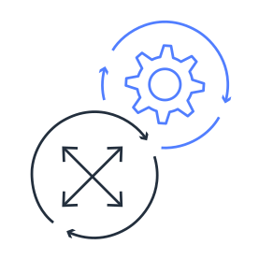
Operational excellence
Run and monitor systems to deliver business value and to continually improve supporting processes and procedures
Perform operations as code
Annotate documentation
Anticipate failure
Refine operations procedures frequently
Make frequent, small, reversible changes
Notes:
The first pillar is operational excellence. It focuses on running and monitoring systems to deliver business value, and with that, continually improving processes and procedures. For example, automating changes with deployment pipelines, or responding to events that are triggered.
Design principles for operational excellence in the cloud include performing operations as code, annotating documentation, anticipating failure, and frequently making small, reversible changes.

Slide 26
Security
Protect information, systems, and assets while delivering business value through risk assessments and mitigation strategies
Automate security best practices
Apply security at all layers
Protect data in transit and at rest
Notes:
The security pillar is the ability to protect information, systems, and assets while delivering business value through risk assessments and mitigation strategies.
When considering the security of your architecture, apply these best practices:
Automate security best practices when possible
Apply security at all layers
Protect data in transit and at rest

Slide 27

Reliability
Test recovery procedures, scale horizontally to increase aggregate system availability, and automatically recover from failure
Recover from infrastructure or service disruptions
Dynamically acquire computing resources to meet demand
Mitigate disruptions such as misconfigurations or transient network issues
Notes:
Reliability is the ability of a system to do the following:
Recover from infrastructure or service disruptions
Dynamically acquire computing resources to meet demand
Mitigate disruptions such as misconfigurations or transient network issues
Reliability includes testing recovery procedures, scaling horizontally to increase aggregate system availability, and automatically recovering from failure.

Slide 28

Performance efficiency
Use computing resources efficiently to meet system requirements and maintain that efficiency as demand changes and technologies evolve
Experiment more often
Use serverless architectures
Go global in minutes
Notes:
Performance efficiency is the ability to use computing resources efficiently to meet system requirements, and maintain that efficiency as demand changes and technologies evolve. An example of performance efficiency is choosing the right Amazon EC2 instance type for an application.
Evaluating the performance efficiency of your architecture includes experimenting more often, using serverless architectures, and designing systems to be able to go global in minutes.

Slide 29

Cost optimization
Run systems to deliver business value at the lowest price point
Adopt a consumption model
Analyze and attribute expenditure
Use managed services to reduce cost of ownership
Notes:
Cost optimization is the ability to run systems to deliver business value at the lowest price point. For example, suppose that you are analyzing your Amazon EC2 compute usage. If you have overestimated your compute needs, you could lower your costs by choosing a more cost-effective instance type.
Cost optimization includes adopting a consumption model, analyzing and attributing expenditure, and using managed services to reduce the cost of ownership.

Slide 30
Knowledge check
Module 9
Notes:
There are no notes on this slide.

Slide 31
Knowledge check question 1
Which AWS Cloud Adoption Framework perspective helps you structure the selection and implementation of permissions?
Governance perspective
Security perspective
Operations perspective
Business perspective
Notes:
Which AWS Cloud Adoption Framework perspective helps you structure the selection and implementation of permissions?
Governance perspective
Security perspective
Operations perspective
Business perspective

Slide 32
Knowledge check answer 1
Which AWS Cloud Adoption Framework perspective helps you structure the selection and implementation of permissions?
Governance perspective
Security perspective (correct)
Operations perspective
Business perspective
Notes:
The correct response option is B. Security perspective.
The Security perspective of the AWS Cloud Adoption Framework also helps you identify areas of non-compliance and plan ongoing security initiatives.
The other response options are incorrect because:
A. Governance perspective helps you identify and implement best practices for IT governance and support business processes with technology.
C. Operations perspective focuses on operating and recovering IT workloads to meet the requirements of business stakeholders.
D. Business perspective helps you move from a model that separates business and IT strategies into a business model that integrates IT strategy.

Slide 33
Knowledge check question 2
Which strategies are included in the six strategies for application migration? (Select TWO.)
Revisiting
Retaining
Remembering
Redeveloping
Rehosting
Notes:
Which strategies are included in the six strategies for application migration? (Select TWO.)
Revisiting
Retaining
Remembering
Redeveloping
Rehosting

Slide 34
Knowledge check answer 2
Which strategies are included in the six strategies for application migration? (Select TWO.)
Revisiting
Retaining (correct)
Remembering
Redeveloping
Rehosting (correct)
Notes:
The two correct response options are:
B. Retaining
E. Rehosting
The application migration strategies are rehosting, replatforming, refactoring/rearchitecting, repurchasing, retaining, and retiring.

Slide 35
Knowledge check question 3
What is the storage capacity of AWS Snowmobile?
40 PB
60 PB
80 PB
100 PB
Notes:
What is the storage capacity of AWS Snowmobile?
40 PB
60 PB
80 PB
100 PB

Slide 36
Knowledge check answer 3
What is the storage capacity of AWS Snowmobile?
40 PB
60 PB
80 PB
100 PB (correct)
Notes:
The correct response option is D. 100 PB.
AWS Snowmobile is a service that is used for transferring up to 100 PB of data to AWS. Each Snowmobile is a 45-foot long shipping container that is pulled by a semitrailer truck.

Slide 37
Knowledge check question 4
What is the storage capacity of Snowball Edge Storage Optimized?
40 TB
60 TB
80 TB
100 TB
Notes:
What is the storage capacity of Snowball Edge Storage Optimized?
40 TB
60 TB
80 TB
100 TB

Slide 38
Knowledge check answer 4
What is the storage capacity of Snowball Edge Storage Optimized?
40 TB
60 TB
80 TB (correct)
100 TB
Notes:
The correct response option is C. 80 TB.
Snowball Edge Storage Optimized is a device that you can use to transfer large amounts of data into and out of AWS. It provides 80 TB of usable HDD storage.

Slide 39
Knowledge check question 5
Which AWS Well-Architected Framework pillar includes the ability to recover from infrastructure or service disruptions?
Cost optimization
Operational excellence
Performance efficiency
Reliability
Notes:
Which AWS Well-Architected Framework pillar includes the ability to recover from infrastructure or service disruptions?
Cost optimization
Operational excellence
Performance efficiency
Reliability

Slide 40
Knowledge check answer 5
Which AWS Well-Architected Framework pillar includes the ability to recover from infrastructure or service disruptions?
Cost optimization
Operational excellence
Performance efficiency
Reliability (correct)
Notes:
The correct response option is D. Reliability.
The other response options are incorrect because:
The cost optimization pillar focuses on the ability to run systems to deliver business value at the lowest price point.
The operational excellence pillar focuses on running and monitoring systems to deliver business value, and with that, continually improving processes and procedures.
The performance efficiency pillar focuses on using computing resources efficiently to meet system requirements, and maintain that efficiency as demand changes and technologies evolve.

Slide 41
Module 9 summary
In this module, you learned about:
AWS Cloud Adoption Framework
Six strategies for migration
AWS Snow Family
Innovation with AWS services
Five pillars of the AWS Well-Architected Framework
Notes:
In this module, you learned about the following concepts:
AWS Cloud Adoption Framework (AWS CAF), which consists of six perspectives:
Business perspective
People perspective
Governance perspective
Platform perspective
Security perspective
Operations perspective
Six strategies for migration:
Rehosting
Replatforming
Refactoring/Rearchitecting
Repurchasing
Retaining
Retiring
AWS Snow Family, which consists of AWS Snowcone, AWS Snowball, and AWS Snowmobile
Innovation with AWS services through areas such as serverless applications, artificial intelligence (AI), and machine learning (ML)
Five pillars of the AWS Well-Architected Framework:
Operational excellence
Security
Reliability
Performance efficiency
Cost optimization
The next module provides an overview of the AWS Certified Cloud Practitioner exam.

