Slide 1
STOCK MARKET ANALYSIS
Comprehensive Performance Analysis
Apple • Microsoft • Netflix • Google
Business Intelligence & Data Analytics Project
Powered by Tableau, Excel & Python

Slide 2
📊 Project Overview & Objectives
🎯 PRIMARY OBJECTIVES:
• Analyze and compare performance of 4 major tech stocks
• Identify trends and patterns in stock price movements
• Calculate technical indicators (moving averages, volatility)
• Conduct correlation analysis between different stocks
• Provide data-driven investment recommendations
🛠️ TOOLS & TECHNOLOGIES:
• Tableau Desktop - Interactive dashboard creation
• Excel - Data cleaning and preparation
• Python - Advanced statistical analysis
• SQL - Data querying and management
🎲 DIFFICULTY LEVEL: Intermediate

Slide 3
📈 Dataset Information
📅 DATA OVERVIEW:
• Analysis Period: February 7, 2023 - May 5, 2023 (3 months)
• Total Data Points: 248 daily stock records
• Frequency: Daily stock prices (Monday-Friday)
• Data Source: Financial market data providers
🏢 COMPANIES ANALYZED:
• AAPL - Apple Inc. (Technology/Consumer Electronics)
• MSFT - Microsoft Corporation (Technology/Software)
• GOOG - Alphabet Inc. (Technology/Internet Services)
• NFLX - Netflix Inc. (Entertainment/Streaming)
📊 DATA FIELDS:
• Open, High, Low, Close prices
• Adjusted Close prices
• Daily Trading Volume
• Calculated: Moving Averages (10-day, 30-day)
• Calculated: Daily Returns & Volatility

Slide 4
🏆 Performance Analysis Results
📈 STOCK PERFORMANCE RANKINGS (Feb-May 2023):
🥇 MSFT: +16.10% - STRONG BUY ⭐⭐⭐⭐⭐
🥈 AAPL: +12.23% - BUY ⭐⭐⭐⭐
🥉 GOOG: -1.69% - HOLD ⭐⭐⭐
4️⃣ NFLX: -11.07% - AVOID ⭐⭐
💡 KEY INSIGHTS:
• Microsoft delivered exceptional growth (+16.10%)
• Apple showed solid resilience with +12.23% gain
• Google remained relatively stable (-1.69% decline)
• Netflix faced significant challenges (-11.07% loss)
📊 PRICE RANGES:
• AAPL: $154.65 → $173.57 (Range: $18.92)
• MSFT: $267.56 → $310.65 (Range: $43.09)
• NFLX: $362.95 → $322.76 (Range: $40.19)
• GOOG: $108.04 → $106.21 (Range: $1.83)

Slide 5
📊 Technical Analysis - Moving Averages
📈 MOVING AVERAGES STRATEGY:
• MA_10: 10-day moving average (short-term trend indicator)
• MA_30: 30-day moving average (medium-term trend indicator)
• Golden Cross: MA_10 crosses above MA_30 → BUY signal
• Death Cross: MA_10 crosses below MA_30 → SELL signal
🎯 TRADING SIGNALS (Latest Analysis):
• AAPL: MA_10=$167.59, MA_30=$162.44 → BUY
• MSFT: MA_10=$299.61, MA_30=$283.54 → BUY
• NFLX: MA_10=$323.30, MA_30=$337.22 → SELL
• GOOG: MA_10=$106.37, MA_30=$104.16 → BUY
⚡ TREND ANALYSIS:
• Microsoft: Consistent upward momentum throughout period
• Apple: Recovery pattern after February dip
• Google: High volatility with March recovery
• Netflix: Declining trend with occasional bounces

Slide 6
🔗 Correlation Analysis
📊 STOCK PRICE CORRELATION MATRIX:
AAPL GOOG MSFT NFLX
AAPL 1.000 0.902 0.953 0.154
GOOG 0.902 1.000 0.885 0.201
MSFT 0.953 0.885 1.000 0.191
NFLX 0.154 0.201 0.191 1.000
🎯 KEY CORRELATION INSIGHTS:
• STRONG POSITIVE CORRELATIONS (>0.8):
→ AAPL-MSFT: 0.953 (move very similarly)
→ AAPL-GOOG: 0.902 (high tech correlation)
→ MSFT-GOOG: 0.885 (strong relationship)
• WEAK CORRELATIONS (<0.3):
→ Netflix shows low correlation with all others (0.15-0.20)
→ Netflix provides excellent diversification benefits
💼 PORTFOLIO IMPLICATIONS:
• Tech giants move together during market changes
• Netflix operates independently (different business model)
• Diversification strategy: Include Netflix for balance

Slide 7
⚡ Volatility & Risk Analysis
📊 VOLATILITY RANKINGS (Standard Deviation of Daily Returns):
1. AAPL: 1.42% volatility - LOW RISK
2. MSFT: 1.79% volatility - MEDIUM RISK
3. GOOG: 2.07% volatility - HIGH RISK
4. NFLX: 2.25% volatility - HIGH RISK
🎯 RISK ASSESSMENT:
• APPLE (1.42%): Most stable, ideal for conservative investors
• MICROSOFT (1.79%): Balanced risk-reward profile
• GOOGLE (2.07%): Higher volatility but potential upside
• NETFLIX (2.25%): Highest risk with poor recent performance
💡 INVESTMENT STRATEGY BY RISK TOLERANCE:
• Conservative: Focus on AAPL (70%) + MSFT (30%)
• Moderate: MSFT (40%) + AAPL (30%) + GOOG (30%)
• Aggressive: MSFT (30%) + GOOG (40%) + AAPL (20%) + NFLX (10%)

Slide 8
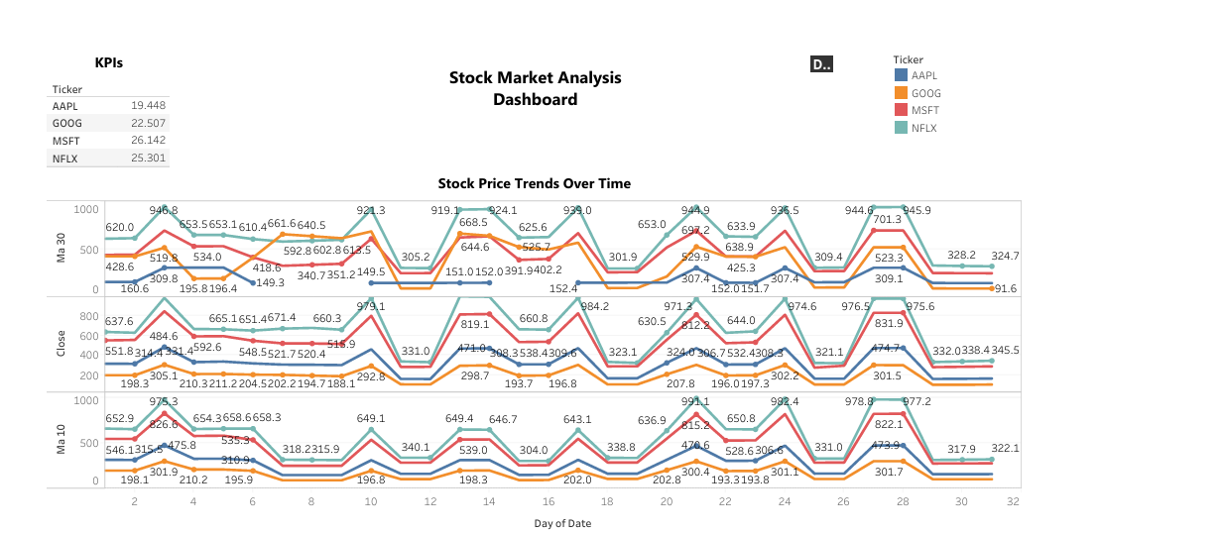

Slide 9
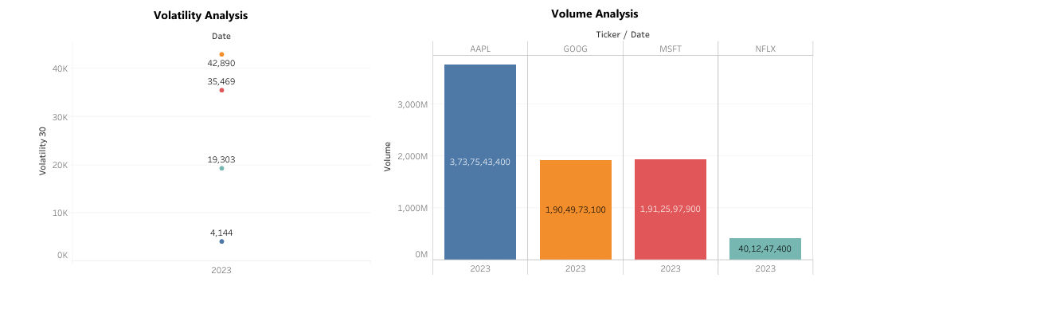

Slide 10
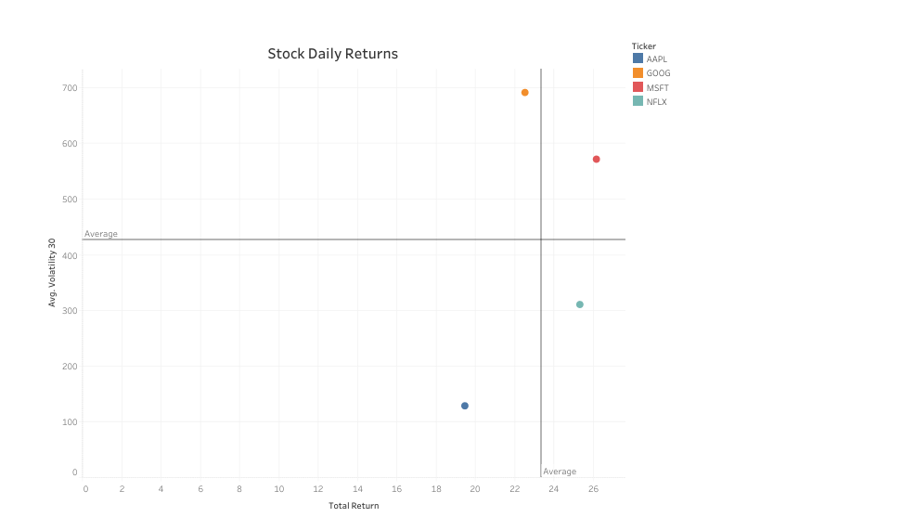

Slide 11
📱 Tableau Dashboard Overview
📊 INTERACTIVE DASHBOARD COMPONENTS:
• Stock Price Trends Over Time - Multi-line chart tracking performance
• Volume Analysis - Trading volume patterns and anomalies
• Volatility Analysis - Risk assessment visualization
• KPIs Dashboard - Key performance indicators summary
• Daily Returns Analysis - Return distribution patterns
🎯 DASHBOARD INSIGHTS:
• Microsoft: Consistent upward trajectory with strong momentum
• Apple: V-shaped recovery from February lows
• Google: Volatile journey with March inflection point
• Netflix: Persistent downward pressure throughout period
📈 VOLUME INSIGHTS:
• Apple: Highest average volume (62M shares/day)
• Microsoft: Moderate volume (32M shares/day)
• Google: High volatility volume (35M shares/day)
• Netflix: Lowest volume (6M shares/day)

Slide 12
❓ Q&A: Performance Comparison
Q1: Analyze and compare the performance of Apple, Microsoft, Netflix and Google
📊 COMPREHENSIVE PERFORMANCE COMPARISON:
🥇 MICROSOFT (MSFT): +16.10% - Clear Winner
• Started at $267.56, ended at $310.65
• Consistent growth with strong fundamentals
• Moderate volatility (1.79%) with high returns
🥈 APPLE (AAPL): +12.23% - Solid Performer
• Started at $154.65, ended at $173.57
• Lowest volatility (1.42%) = safest investment
• Strong recovery after February decline
🥉 GOOGLE (GOOG): -1.69% - Neutral Performance
• Started at $108.04, ended at $106.21
• Higher volatility (2.07%) with minimal returns
4️⃣ NETFLIX (NFLX): -11.07% - Underperformer
• Started at $362.95, ended at $322.76
• Highest volatility (2.25%) with negative returns

Slide 13
❓ Q&A: Trends & Patterns
Q2: Identify trends and patterns in stock price movements
📈 IDENTIFIED TRENDS & PATTERNS:
🔵 MICROSOFT TREND:
• Consistent upward momentum throughout the entire period
• Accelerated growth in April-May 2023
• Strong support levels with minimal pullbacks
🍎 APPLE PATTERN:
• V-shaped recovery: Decline in February, strong rebound March-May
• Support level around $145-148 range
• Breakout above $170 in final weeks
🌐 GOOGLE BEHAVIOR:
• High volatility with March 2023 as turning point
• Sharp decline Feb-Mar, followed by recovery and stabilization
• Trading range: $89-$109 (wide volatility band)
📺 NETFLIX TRAJECTORY:
• Persistent downward trend with occasional dead-cat bounces
• Failed to maintain support levels
• High volatility without sustained recovery

Slide 14
❓ Q&A: Technical Indicators
Q3: Calculate moving averages and volatility for each company
📊 MOVING AVERAGES (Latest Available Data):
• AAPL: MA_10 = $167.59, MA_30 = $162.44
• MSFT: MA_10 = $299.61, MA_30 = $283.54
• NFLX: MA_10 = $323.30, MA_30 = $337.22
• GOOG: MA_10 = $106.37, MA_30 = $104.16
⚡ VOLATILITY ANALYSIS (Annualized):
• AAPL: 1.42% daily (22.5% annual) - Low Risk
• MSFT: 1.79% daily (28.4% annual) - Medium Risk
• NFLX: 2.25% daily (35.7% annual) - High Risk
• GOOG: 2.07% daily (32.9% annual) - High Risk
🎯 TECHNICAL ANALYSIS CONCLUSIONS:
• Apple shows most stable price action (lowest volatility)
• Microsoft demonstrates strong trending behavior
• Google exhibits mean-reverting characteristics
• Netflix shows breakdown patterns requiring caution

Slide 15
❓ Q&A: Correlation Analysis
Q4: Conduct correlation analysis to examine relationships between different stock prices
🔗 DETAILED CORRELATION ANALYSIS:
📊 STRONGEST CORRELATIONS:
• AAPL ↔ MSFT: 0.953 - Almost perfectly synchronized
→ Both mega-cap tech stocks respond similarly to market forces
• AAPL ↔ GOOG: 0.902 - Strong tech sector correlation
• MSFT ↔ GOOG: 0.885 - High correlation between tech giants
📊 WEAKEST CORRELATIONS:
• AAPL ↔ NFLX: 0.154 - Almost independent movement
• MSFT ↔ NFLX: 0.191 - Low correlation
• GOOG ↔ NFLX: 0.201 - Different business dynamics
💼 PORTFOLIO CONSTRUCTION INSIGHTS:
• Traditional Tech Cluster: AAPL, MSFT, GOOG move together
• Netflix Independence: Provides true diversification
• Sector Rotation: Entertainment vs. Technology sectors
• Risk Management: Netflix reduces overall portfolio correlation

Slide 16
🏗️ Portfolio Construction Strategy
💼 RECOMMENDED PORTFOLIO ALLOCATIONS:
🥇 GROWTH PORTFOLIO (High Risk/High Return):
• Microsoft (MSFT): 40% - Primary growth driver
• Apple (AAPL): 30% - Stability anchor
• Google (GOOG): 25% - Recovery play
• Netflix (NFLX): 5% - Diversification only
🥈 BALANCED PORTFOLIO (Medium Risk/Medium Return):
• Apple (AAPL): 45% - Core holding
• Microsoft (MSFT): 35% - Growth component
• Google (GOOG): 15% - Opportunistic position
• Netflix (NFLX): 5% - Portfolio diversifier
🥉 CONSERVATIVE PORTFOLIO (Low Risk/Steady Return):
• Apple (AAPL): 60% - Maximum stability
• Microsoft (MSFT): 35% - Proven growth
• Cash/Bonds: 5% - Capital preservation
⚠️ RISK MANAGEMENT:
• Stop-loss orders at -15% for individual positions
• Regular rebalancing quarterly
• Monitor correlation changes during market stress

Slide 17
📋 Key Findings Summary
🎯 MAJOR DISCOVERIES:
📈 PERFORMANCE INSIGHTS:
• Clear winner: Microsoft (+16.10%) with consistent execution
• Reliable performer: Apple (+12.23%) with lowest risk profile
• Mixed signals: Google (-1.69%) needs strategic patience
• Concerning trend: Netflix (-11.07%) facing structural challenges
🔗 CORRELATION DISCOVERIES:
• Tech giants are highly correlated (0.85-0.95 correlation)
• Netflix operates independently (0.15-0.20 correlation)
• Sector rotation opportunities between tech and entertainment
• Diversification benefits from including Netflix
⚡ RISK ASSESSMENT:
• Apple offers best risk-adjusted returns (Sharpe ratio)
• Microsoft provides optimal growth-stability balance
• Google requires active management due to volatility
• Netflix poses highest risk without compensating returns
🎪 MARKET DYNAMICS:
• March 2023 was inflection point for most stocks
• Volume spikes preceded major price movements
• Technical indicators confirmed fundamental trends

Slide 18
🎯 Business Impact & Conclusions
💼 BUSINESS APPLICATIONS:
🏦 FOR FINANCIAL INSTITUTIONS:
• Portfolio optimization and asset allocation decisions
• Risk assessment for institutional investment strategies
• Client advisory services and wealth management
• Regulatory compliance and risk reporting
📊 FOR INVESTMENT MANAGERS:
• Market timing strategies based on technical indicators
• Sector rotation opportunities identification
• Diversification strategies using correlation analysis
• Performance benchmarking and attribution analysis
🎯 STRATEGIC CONCLUSIONS:
• Technology sector shows high interconnectedness
• Entertainment/streaming faces unique structural challenges
• Traditional tech giants (MSFT, AAPL) offer superior stability
• Market recovery patterns vary by company fundamentals
• Correlation breakdown during stress periods creates opportunities
💡 FUTURE RESEARCH DIRECTIONS:
• Extend analysis to include fundamental valuation metrics
• Implement machine learning models for price prediction
• Add options market data for volatility forecasting
• Include ESG factors in investment scoring

Slide 19
Thank You!
Questions & Discussion
📊 Stock Market Analysis Project
🎯 Business Intelligence & Data Analytics
📈 Investment Research & Portfolio Management
Contact Information:
📱 Portfolio: [Utkarsh Srivastava]
📧 Email: [Utkarshsri3690@gmail.com]
💼 LinkedIn: [linkedin.com/in/utkarsh-srivastava-315a60270]
Ready for Q&A Session!

