Slide 1




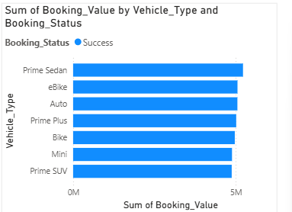
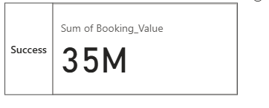



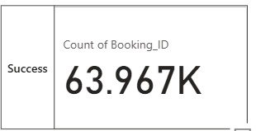

Overall
Vehicle Type
Revenue
Cancellation
Ratings

Slide 2









Vehicle Type | Total Booking Value | Success Booking Value | Avg. Distance Travelled | Total Distance Travelled
Prime Sedan | **** | 5.2M | 15.76 | 234k
Prime SUV | **** | 4.8M | 15.27 | 223k
Prime Plus | **** | 5M | 15.45 | 227k
Mini | **** | 4.8M | 15.51 | 225k
Auto | **** | 5M | 6.24 | 92k
Bike | **** | 4.9M | 15.53 | 227k
E-Bike | **** | 5M | 15.58 | 230k
Overall
Vehicle Type
Revenue
Cancellation
Ratings

Slide 3
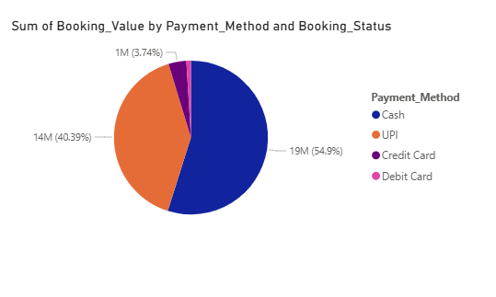

Overall
Vehicle Type
Revenue
Cancellation
Ratings

Slide 4
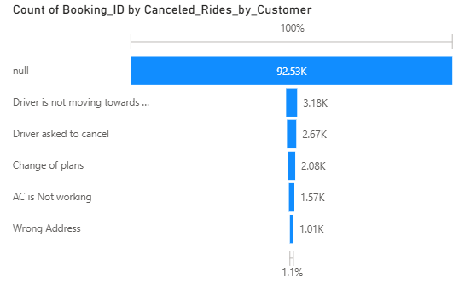
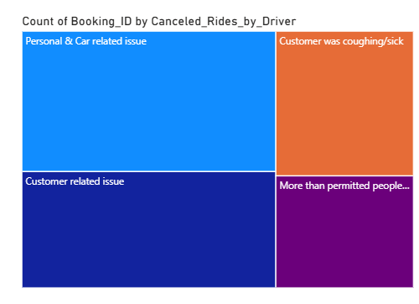

Overall
Vehicle Type
Revenue
Cancellation
Ratings

Slide 5

Overall
Prime Sedan | Prime SUV | Prime Plus | Mini | Auto | Bike | E-Bike
**** | **** | **** | **** | **** | **** | ****
Vehicle Type
Revenue
Cancellation
Ratings

