Slide 1

Profile Overview

Slide 2
Seasoned Data Scientist with 11 years of experience in enabling data led decision making. Passionate about telling stories from data. Keen to utilize my analytics solution building exposure in enabling business transformation
Profile:
Name: Utkarsh Tripathi
Organization: Micron Technology
Location: Hyderabad
Designation: Principal Data Scientist
Experience: 11+ years
Education:
Bachelor of Engineering, ECE, IPS Academy
PG Diploma in AI & ML from IIIT-Bangalore
MS in AI & ML from Liverpool John Moore's University
Organizations Worked:
Robert Bosch: Oct 2014 – Feb 2018
Times Internet: Mar 2018 – Nov 2018
Publicis Sapient: Dec 2018 – May 2020
Fidelity International: May 2020 – April 2021
Micron Technology: April 2021- Present
Chegg Inc. - Subject Matter Expert Statistics and Probability (part-time): April 2018 – Dec 2019
Profile Link
LinkedIn: https://www.linkedin.com/in/utkarsh-tripathi/
GitHub: https://github.com/utkarsh1993

Slide 3
Agenda

Slide 4
Achievements and Extra-Curricular Activities
AI & ML Projects
  Cost 360 Assistant
  Text2SQL using RAG
  Attrition Predictor
  Ad Unit Segmentation

Slide 5
Achievements and Extra-Curricular Activities

Slide 6
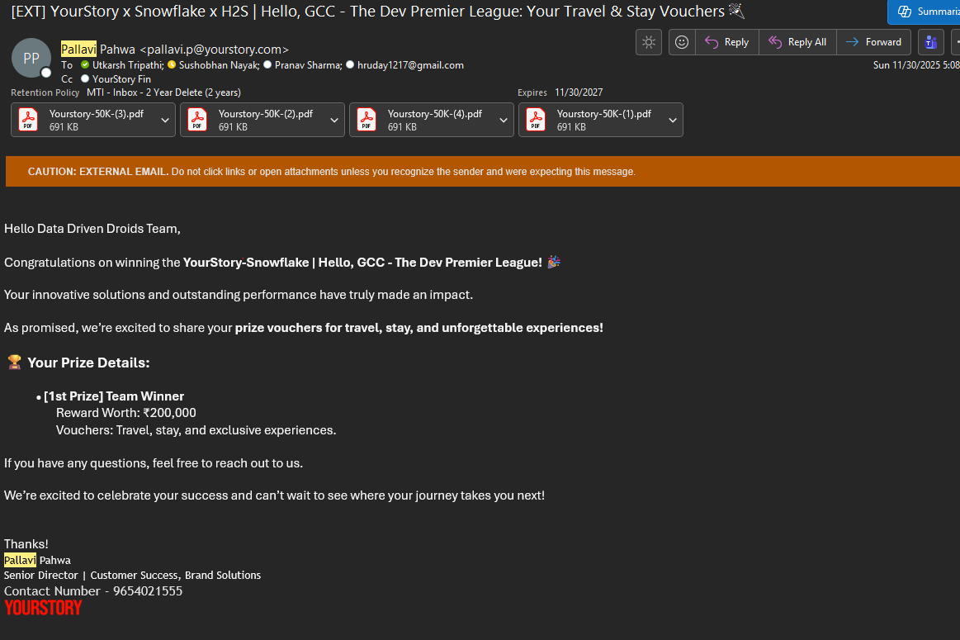
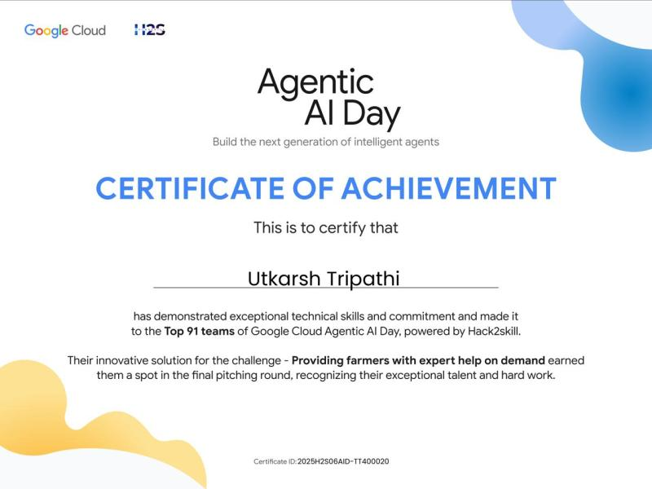
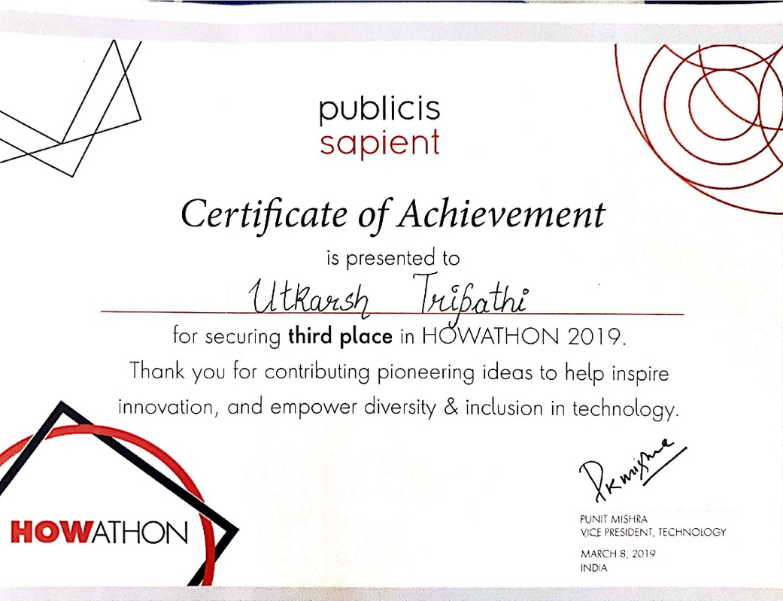
Achievements
Extra Curricular Activities
Published paper titled “Database Search: Text2SQL using dynamic few-shot prompting with self-consistency using LLM” in Journal Lattice (Volume 6) and MLDS 2025 conference organized by AIM
Led the team and won 1st Prize in hackathon Dev Premier League – Organized by Hack2Skill and Snowflake
Secured Place in Top 91 (Top 1%) teams in Google Agentic AI day – presented by Google and Hack2skill
Second Runner Up In Howathon and Sapient Expo India 2019
Kaggle Competitions Expert: 2 Bronze and 1 Silver medal
Multiple certifications from Coursera on AI, Machine Learning and Deep Learning
Participated in Gen AI Exchange Hackathon
Oracle Certified Java Programmer –Professional SE6

Slide 7
Cost360 Assistant

Slide 8
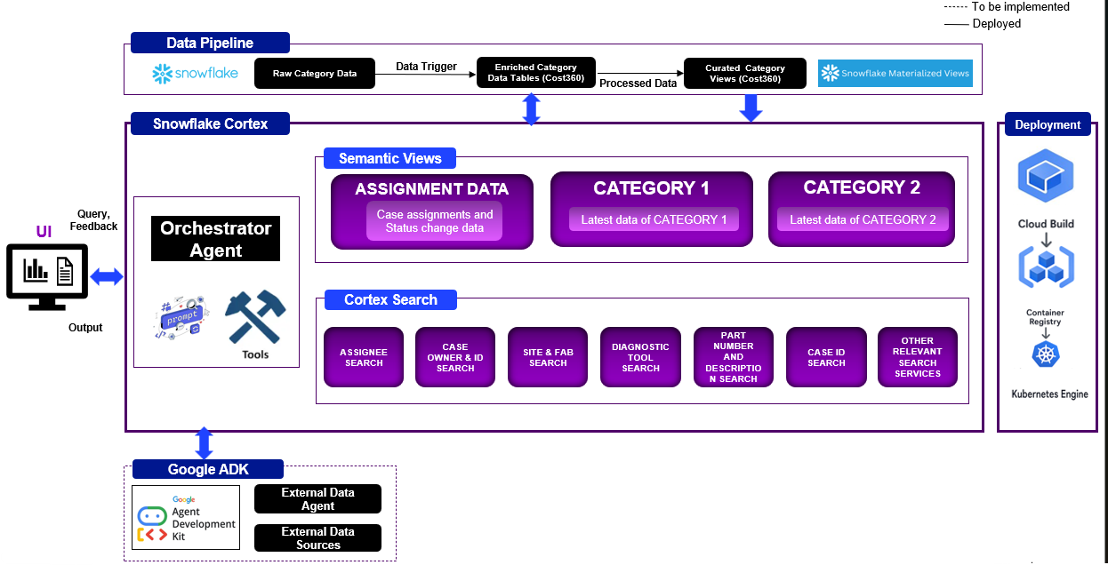
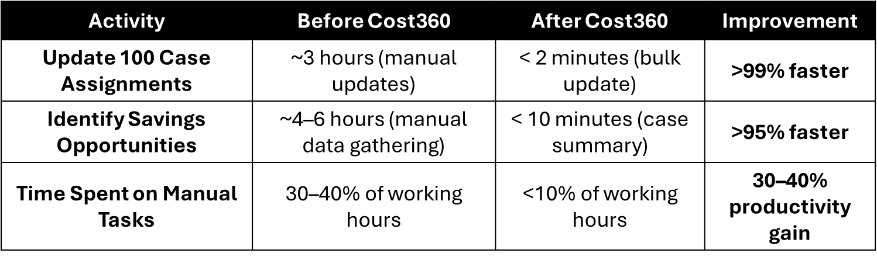
High Level Architecture
Cost360 Assistant leverages Snowflake Cortex and Agentic AI to streamline procurement cost management. Cortex Agents autonomously gather and process data, enabling natural language updates and real-time insights. Combined with Cortex Analyst and Search Service, this system simplifies workflows, accelerates analysis, and empowers procurement teams with actionable intelligence and seamless control.

Slide 9
Text2SQL Using RAG

Slide 10
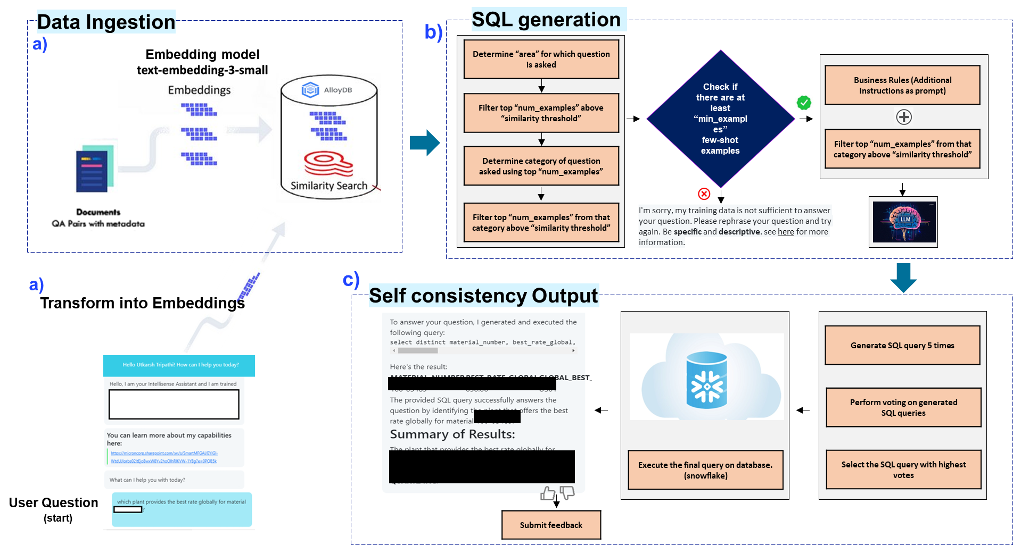
High Level Architecture
Text2SQL enables non-experts to query relational databases using natural language. Traditional fine-tuning risks overfitting, while LLM-based prompting improves adaptability. Our dynamic RAG framework scales across multiple tables using few-shot examples, business rules, and self-consistency voting. It integrates seamlessly into analytical platforms, delivering accurate SQL queries, results, and summaries for faster decision-making.

Slide 11
Attrition Predictor

Slide 12
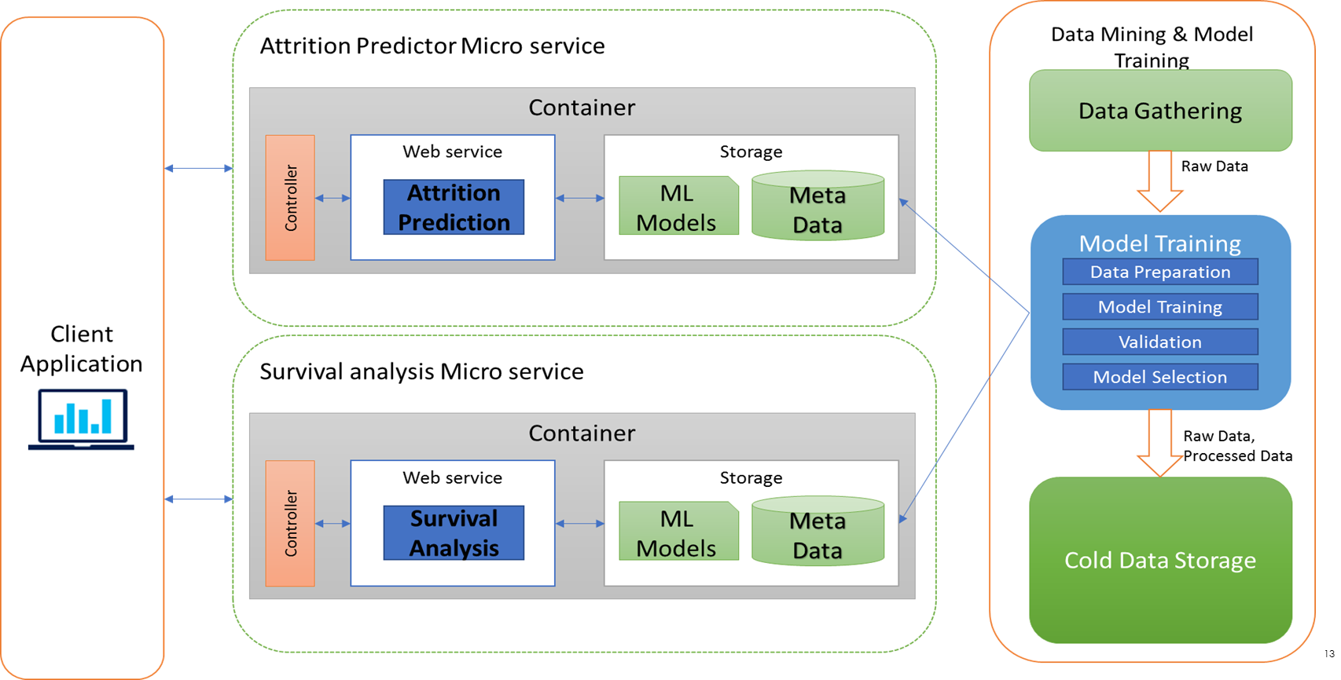
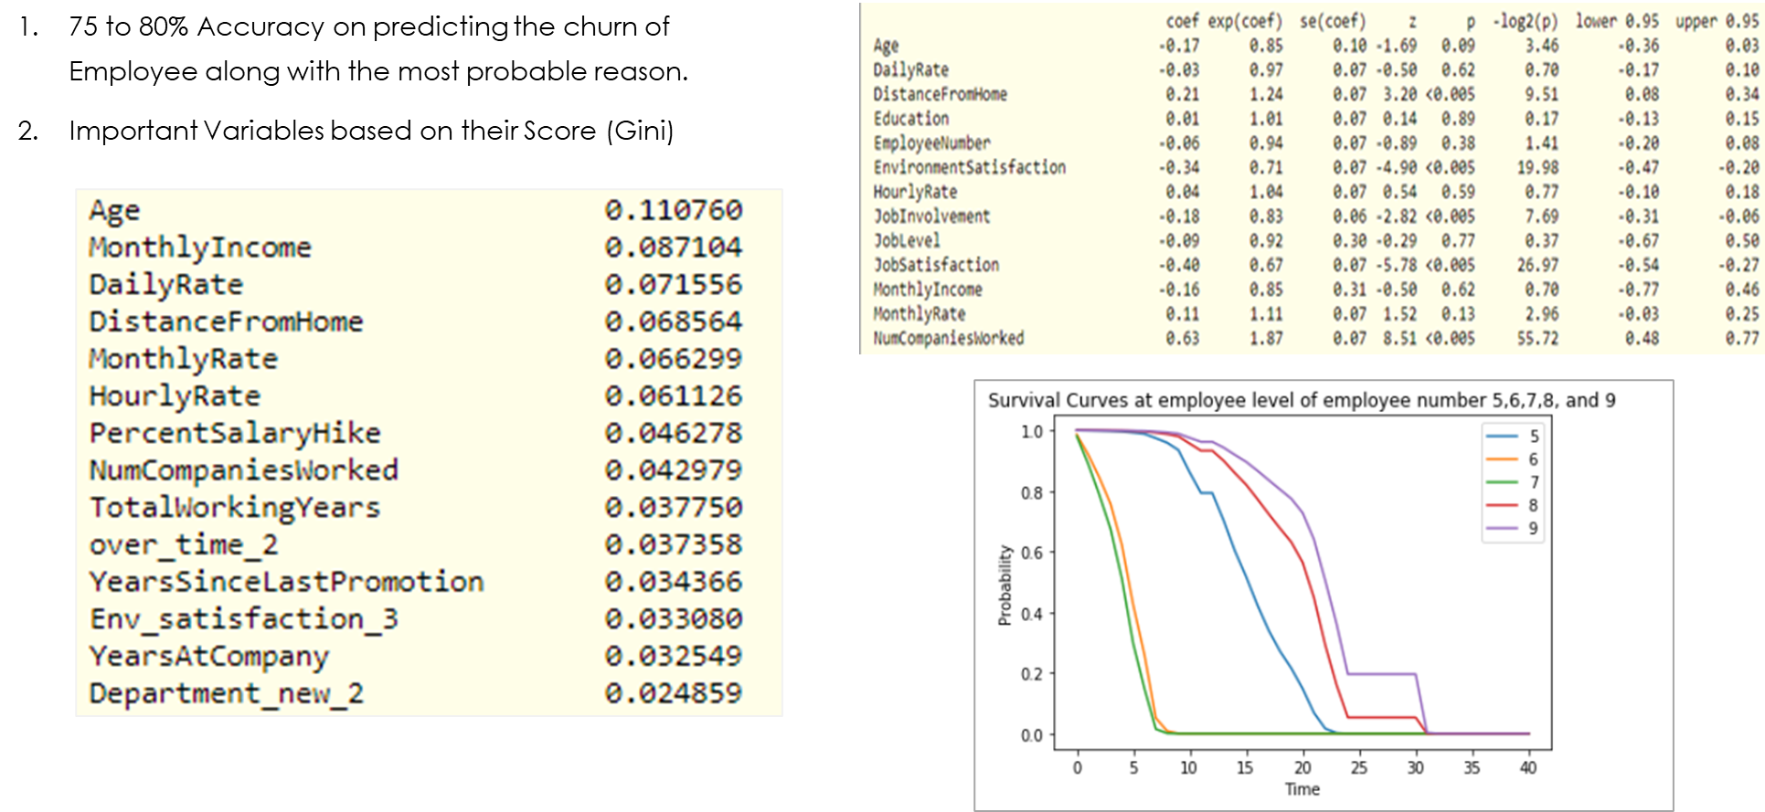
High Level Architecture
Objective
To create a system which can improve on the attrition rate by
Predicting the probability that an employee will leave
Suggest the most probable reasons for an employee leaving the organization
Identify the survival rate of employees in the organization
      Solution Implemented
Attrition Predictor is a simple web app to identify the probability of an employee leaving the company along with the most likely reasons.
Web application has following features:
Dashboard showing current attrition rate and the top 5 contributing factors for attrition
Upload a new file with employee data to get attrition probability for each employee along with a probable reason,
Upload a new file with employee data to get the survival analysis outcome for 0.5, 1 and 2 year
Upload historical data to retrain the model
Framework reusable for attrition prediction on different data sets & customer churn analysis

Slide 13
Ad Unit Segmentation

Slide 14
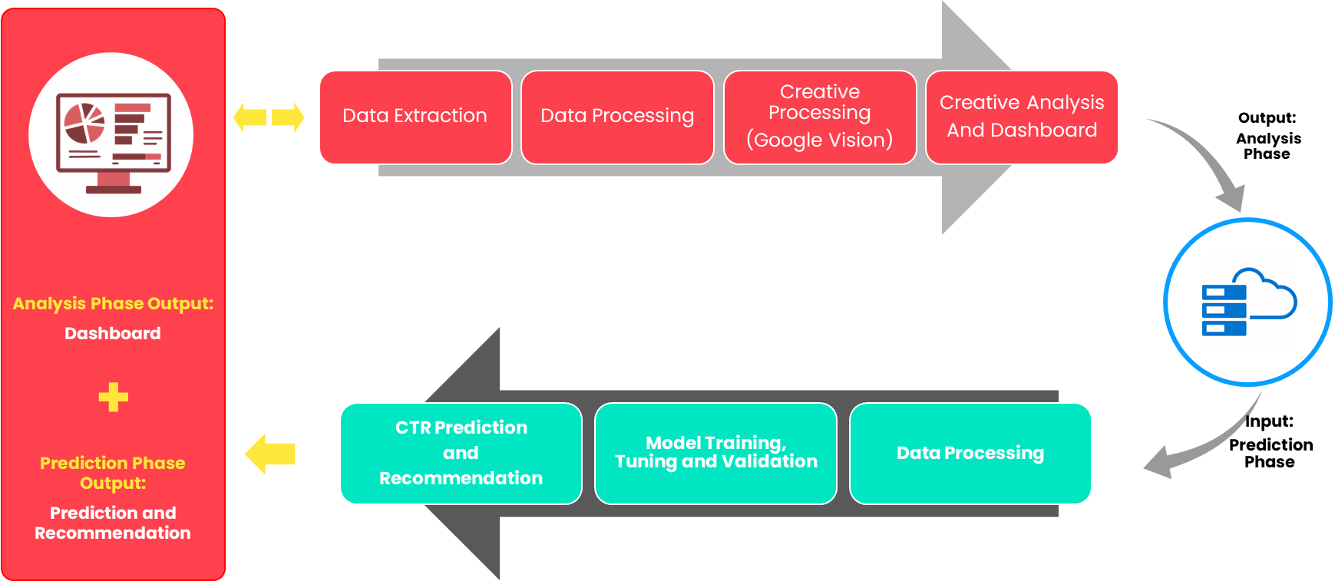
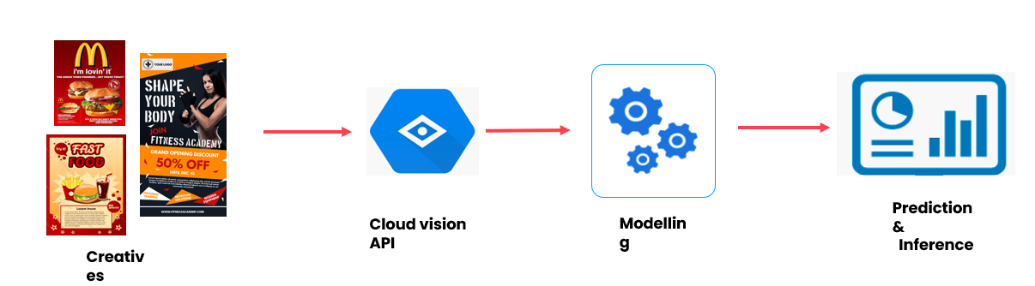
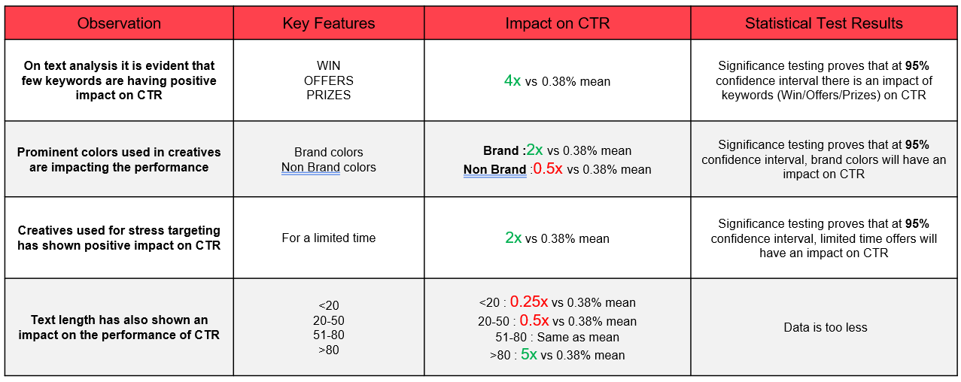
High Level Architecture
Objective
Objective was to group various Ad units-based present on different Web sites and Mobile Apps based on their properties
      Solution Implemented
Around 0.1 million Ad units are there from different products like Mobile App, Website and FB Pages
Derived new features like Position of Ad units, Cost per million etc.
Later, Clustering was performed for Ad units generating Revenue of more than 0.1 million INR in 3 months
Clustered Ad units helped in defining Strategy and pricing for each group

Slide 15
Thank You

