Slide 1
Monday list: which accounts to work this week, and why
A ranked list per CSM with reasons that trace to raw events, and a nightly agent that tasks, escalates and logs.
Fello GTM AI take-home · live at 136-83-131-193.sslip.io · October 2026
Notes:
This is the short deck of what I built and where it diverged from my brief. The brief itself is the first commit in the repo, written before any code.

Slide 2
The ask was a health score; the problem is prioritisation
What was asked
A red / yellow / green score per account, and an email to the customer when it goes red.
What the CSM needs on Monday
Which few accounts to work this week, in order, and why. The two lost renewals had the data in Zendesk and usage. Nobody joined it.
120
accounts per CSM
~8
a CSM can work properly in a week
5
systems, five different keys per customer
Notes:
The reframing is the core of the brief. A score per account does not tell a CSM what to do on Monday. A short ranked list with reasons does.

Slide 3
What shipped, and is live
Monday list
A fitted model
A nightly agent
Ranked per CSM by expected ARR at risk. Colour derived from rank. Thin accounts in their own bucket, never green.
Global LightGBM on 3 years of renewal cycles. Reasons from SHAP contributions that add up to the margin.
Runs at 02:00 UTC unattended. Transitions, anti-flap policy, tasks, escalation, briefings, all logged.
Multi-tenant
Traceable
Messy synthetic data
5 organisations. Postgres FORCE row-level security, tenant set in one place, wrong-tenant ids return 404.
Every number links back: raw event, match, snapshot, score, model version, task and the run that made it.
5,000 accounts, 192k events: replays, drift, late arrivals, identity breaks, thin accounts. Measured, not hoped.
Notes:
Each of the five non-negotiables maps to a card. The live URL runs all of it on one GCP VM for about 21 dollars a month.

Slide 4
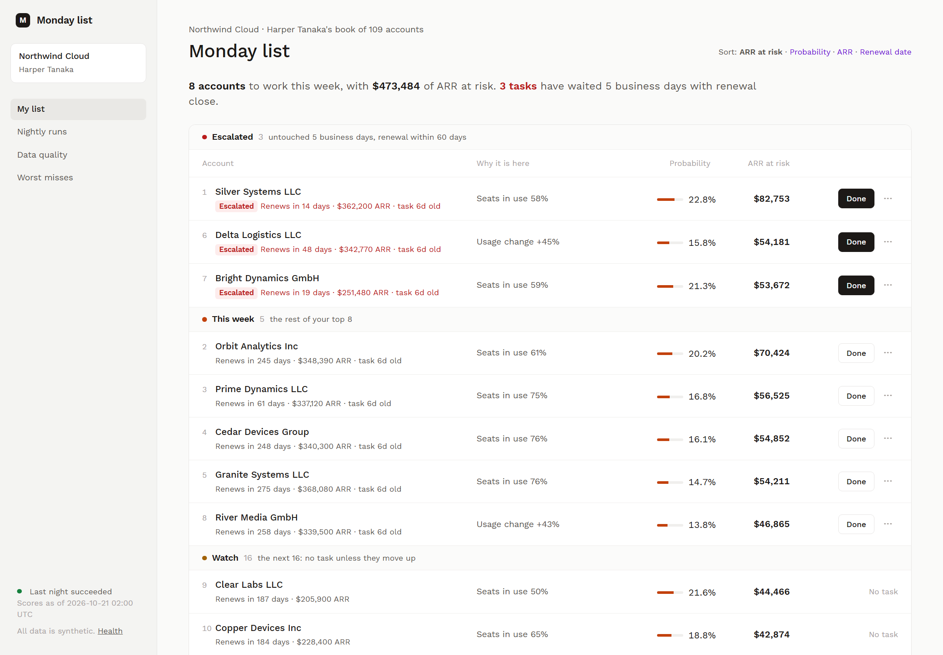
What a CSM opens on Monday
Ranked by ARR at risk
Probability × ARR. One click re-sorts by probability, ARR or renewal date.
Reasons on the row
The model's own top factors, with their values. Small pushes stay on the score page.
Tasks that cannot slip
Untouched for 5 business days near renewal: escalated and pinned first.
Notes:
This is the real page, from a local run a week after launch, so three tasks have escalated and sit at the top. Every probability is a link to the next slide's page.

Slide 5
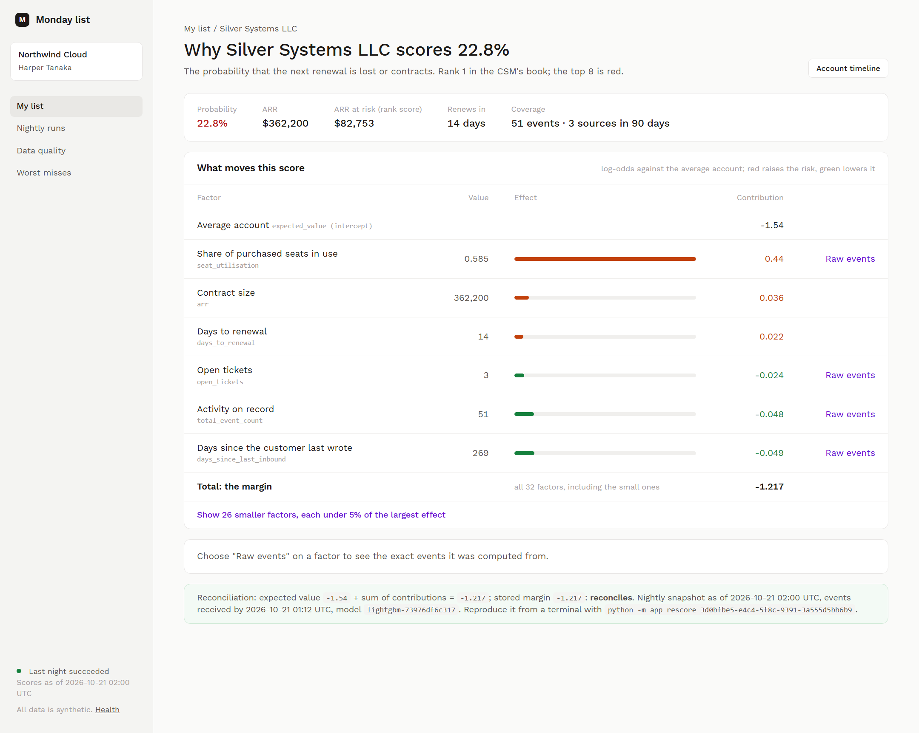
Every number traces back to raw events
Factor by factor
Each contribution, largest first, from the same model that scored.
Checked on the page
Expected value + contributions = the stored margin. rescore <score_id> reproduces it.
Down to the events
"raw events" shows the exact rows a factor counted, received before the snapshot.
Notes:
Traceability in one screen: the snapshot and model that made the score, the reconciliation, and a link from every factor to the raw events it was computed from.

Slide 6
Where I disagreed with the request
No auto-email
Colour from rank
Rank by ARR at risk
Wrong recipient: the champion may have left. Wrong message: a backlog and a failed payment need different calls. Wrong trigger: scores near a line flip weekly.
Instead: a task, escalated after 5 business days near renewal. Nothing goes unseen.
Red is the top 8 of the CSM's book, yellow the next 16. Every CSM always has a week of red.
Fixed probability bands drift with every retrain. Probability and ARR stay visible as columns.
A $2k account at 60% should not outrank a $200k account at 50%. Rank score is probability x ARR, with one-click re-sort.
Label: the next renewal's outcome, so accounts far from renewal still get early warning.
Notes:
These three disagreements were argued in the brief before any code. The build kept all three.

Slide 7
Where the build diverged from the plan, honestly
Planned | Built | Why
Railway | One GCP VM, same Docker Compose | Asked for GCP; keeps the worker awake for ~$21 a month
LightGBM clearly ahead | Within noise of logistic regression | Kept by a margin rule I set after the first run showed a tie; either is defensible
LLM paragraph in briefings | A 2-sentence summary, every number checked | Runs after the night, sees only the reasons; off until a key is set
10 planted cases caught | 7 of 10 in time, 9 of 10 for the right reason | Churn is noisy by design; reported, not tuned away
All reasons shown | Only actionable signals | 'Contract size' is true but not a reason to call
Notes:
Every divergence is in docs/decisions with the measurement behind it. The model choice rule was set after seeing validation numbers, and the log says so.

Slide 8
Beats rules and the calendar; ties logistic regression
21.8%
recall@8 per CSM-week (rules 14.8%)
+0.009
LightGBM minus LR, 95% CI −0.009 to +0.028
0.8%
share of the model that is days to renewal
0.48
shuffled-label AUC: no leakage
Notes:
The oracle ranks by the generator's hidden health and reaches only 0.65, because a fifth of churn has no visible signal by design. It is a reference, not a ceiling: it ignores organisation-level churn rates, so on recall@8 the models are level with it. Days to renewal alone is flat, so that row ranks by ARR. These numbers validate the pipeline and ranking on data whose generator is known; they are not evidence about real churn.

Slide 9
The night runs itself, and every step is a row
Ingest
Snapshot
Score
Gate
Transitions
Policy + tasks
Escalation
A tripped data-quality gate rolls the night back: nothing after it is published, and the list keeps the last good night with a warning.
02:00 UTC, 17 Oct 2026 · trigger = schedule
All five tenants succeeded in 21 s: 999 new events ingested, 18 quarantined, 12 replays rejected, mean probability moved < 0.002.
Rerun safe
A succeeded night is a no-op; a failed one is re-claimed; every write is keyed.
No flapping
A task needs three nights outside the top 8 first; at most 8 new tasks per CSM per night.
Notes:
This is the agentic part as the exercise defines it: it runs without a human, decides with a policy, and leaves an audit trail. The LLM is nowhere in the ranking path. When a key is set, it writes a two-sentence summary after the night commits, from the reason list only, and any number it invents gets the summary rejected.

Slide 10
What breaks first at 10x, measured
10x events
10x accounts
10x tenants
~40 min
~4.5 GB
~3.5 min
for one tenant's anchor build on the VM; peaks near 0.9 GB. Breaks first, on memory.
of snapshots, plus ~3 GB of scores a month. Disk binds within weeks.
for the nightly loop: fine. Bootstrap and training memory bind instead.
Today: the whole night takes 21 s. Snapshot ~0.05 ms per event, scoring ~1 ms per account. The plan's hypothesis held, sharpened: the weekly anchor rebuild is O(weeks x events) and runs out of memory before time. Fix: incremental anchors from running aggregates, then retention and a per-tenant queue.
Notes:
All of these are linear extrapolations from the live stage timings and a local memory profile, written up in docs/decisions/step-7-10x.md.

Slide 11
With real data, the first four steps
1. Refit and re-baseline on real renewal outcomes; report the same holdout tables.
2. Use CSM dismissal reasons as labels and as a precision signal for K.
3. Build anchors incrementally, so history scales with events, not weeks x events.
4. Add identity confidence, and connectors that write the same raw-event shape.
Notes:
The synthetic evaluation validates the mechanics. The first real-data step is to refit on actual renewals and see what the dismissal reasons say.

