Slide 1

Cash on Delivery Return Prediction
11th July 2017

Slide 2
Problem Statement
Business Problem :
On an average 17 % of the total COD shipments are returned.
Returned shipments have higher probability of getting lost.
This leads to additional cost and wastage of time for both the clients and the business.
Objective :
To reduce the percentage of returned shipments and to avoid unwanted wastage of resources the probability of a COD shipment being returned needs to be predicted.
So the objective here is to predict the probability of each shipment of being returned.

Slide 3
Factors affecting COD Return
Demographic Data
Client Data
Shipment Detail
Customer Data
Location
Population
Literacy Rate
Percentage of COD Returns for each client
Percentage of Shipments of each client
Category
Quantity
Price
Delay
Time Taken
History
Fraud Phone Number

Slide 4
Hypothesis Generation

Slide 5
Hypothesis Generation
Demographic Data :
Location - Higher return probability of shipments in Metros followed by Tier-I, II , III, IV
Population - Higher the population of the city, more the number of returns
Literacy Rate - More COD return rate expected with area having higher literacy rate
Shipment Details :
Category of the Shipment – Certain categories will have higher return rates compared to others.
Quantity of the Shipment in each delivery – Cod return will be higher on the days when the number of shipments is more compared to the average
Price of the Shipment – More is the price of the shipment, higher will be probability of its return
Time taken – If the Time taken is higher then the shipment is likely to be returned
Delay – If there is delay, then shipment is likely to be returned

Slide 6
Contd.
Client Data :
Percentage of COD Returns for each client - Higher the COD return percentage, higher the return probability of its shipment.
Percentage of Shipments of each client – Higher is the Percentage, higher the return probability of its shipment.
Customer Data :
History of the Customer – If the customer has had high returns then return probability of its shipment will be higher
Fraud Phone Number – If a fraud number is given by a customer then return probability of its shipment will be higher.

Slide 7
Exploratory Data Analysis

Slide 8
Clients – Volume Distribution and Return Rates
Buckets | %Returned | No.of clients
HIGH | 0.25 | 346
MEDIUM | 0.14 | 170
LOW | 0.09 | 1219
Findings:
Buckets are divided on the basis of return rates of each client
Low contains clients with return rate less than 13%, Medium between 13% to 19% and High more than 19%
Findings :
C, E, F, Medium and Lontailed clients have high return rates even though their contribution to the total COD shipments are less.
Medium contains 15 Clients with contribution between 0.75% to 2.5% and Longtailed contains 1800 Clients with contribution less than 075%

Slide 9
Zones- Volume Distribution and Return Rates
High – A, B, C, S2, S4, S5
Low – E, S1, S3, S6, Others
Findings:
Maximum contribution to the total shipments - D, S4, at the same time they even have high return rates
Findings:
Buckets are formed on the basis of their return rate and volume distribution.

Slide 10
Tier - Volume Distribution and Return Rates
Findings:
Metros have less return rate than all other tiers.
Tier 3 has the highest contribution to the total shipments.

Slide 11
Categories - Volume Distribution and Return Rates
Findings:
Categories like Computers, Mobile phones, Watches and books have high return rates.
Apparel and accessories have the highest contribution to the total shipments

Slide 12
COD Amount - Volume Distribution and Return Rates
Very Low < 300
300< Low < 1000
1000< Medium <2500
2500< High <6000
6000< Very High
Findings:
COD amount has no effect on the return rate

Slide 13
Time Taken / Delay - Volume Distribution and Return Rates
Time Taken for shipment to reach the customer
Very Low < 1 day
1 day< Low < 2 days
2 days < Medium < 5 days
5 days < High < 10 days
10 days < Very High
Affect of delay on return rate
S.No. | Delay | Total | Returned | %Returned | % Total Shipments
1 | FALSE | 4824272 | 830052 | 0.17 | 0.87
2 | TRUE | 699890 | 129621 | 0.19 | 0.13
Findings:
Time taken has no effect on the return rate.
Delay has small a impact on the return rate.

Slide 14
Model Building

Slide 15
Approach to model building
The data set given is an unbalanced data set.
25% of the Delivered data was combined with the RTO data in order to have balanced data set (Undersampling).
Next a random sample of half the data entries was taken from the combined balanced dataset
It was divided in the ratio 70:30 into training and testing dataset

Slide 16
Variables considered for First iteration
COD amount
Tier
Delay
Time taken
Client buckets based on COD return %age (High, Medium, Low)
Client buckets based on volume distribution
Category buckets based on COD return %age (High, Medium, Low)
Zone buckets based on COD return %age (D,High,S4, Low)
Fraud Phone Numbers

Slide 17
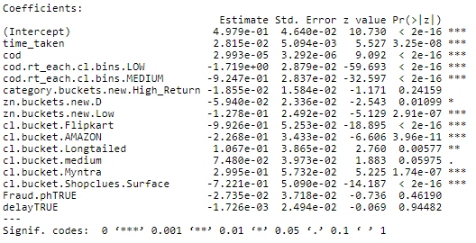
Model (First Iteration) – Logistic Regression
RTO.Log = glm(cs.ss ~ time_taken + cod + cod.rt_each.cl.bins.LOW + cod.rt_each.cl.bins.MEDIUM + category.buckets.new.High_Return + zn.buckets.new.D + zn.buckets.new.Low + cl.bucket.Flipkart + cl.bucket.AMAZON + +cl.bucket.Longtailed + cl.bucket.medium + cl.bucket.Myntra + cl.bucket.Shopclues.Surface + Fraud.ph + delay, data = df_sample.train, family = binomial)

Slide 18
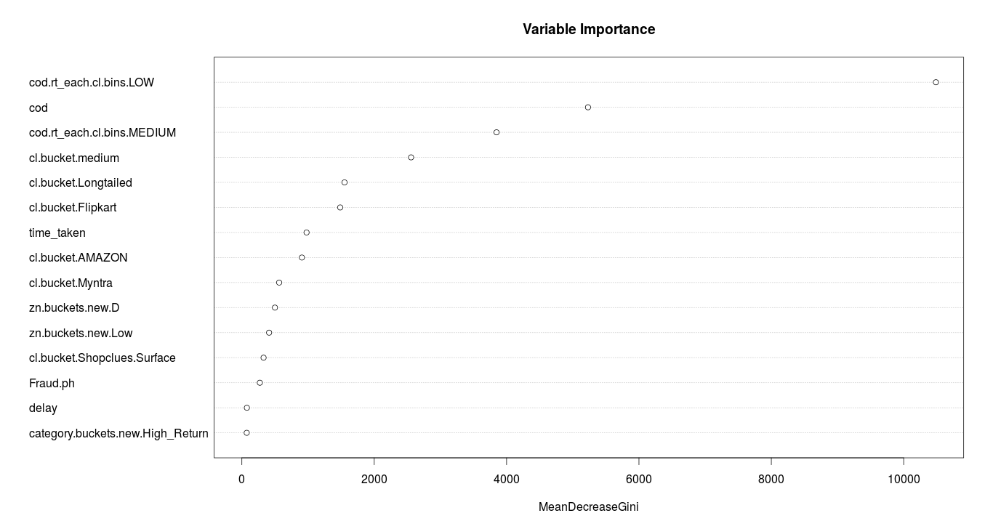
Model(First Iteration) – Random Forest
RTO.rf = randomForest(cs.ss ~ time_taken + cod + cod.rt_each.cl.bins.LOW + cod.rt_each.cl.bins.MEDIUM + category.buckets.new.High_Return + zn.buckets.new.D + zn.buckets.new.Low + cl.bucket.Flipkart + cl.bucket.AMAZON + cl.bucket.Myntra + cl.bucket.Longtailed + cl.bucket.medium+cl.bucket.Shopclues.Surface + delay + Fraud.ph, data = df_sample.train, nodesize = 20, ntree = 200,trControl = control)

Slide 19
Final Variables Considered
Time taken
COD amount
Client bucket (having low return rate)
Client bucket (having medium return rate)
High return categories
Zn(D)
Zn(Low )
Client (Flipkart, Amazon, Myntra, Shopclues, Longtailed)
Delay
Fraud phone no.

Slide 20
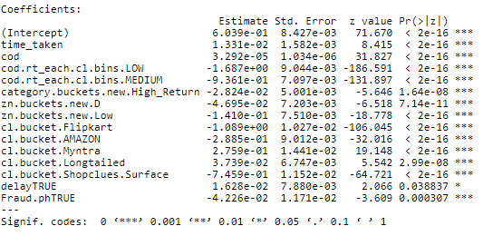
Model (Final Iteration) – Logistic Regression
RTO.Log = glm(cs.ss ~ time_taken + cod + cod.rt_each.cl.bins.LOW + cod.rt_each.cl.bins.MEDIUM + category.buckets.new.High_Return + zn.buckets.new.D + zn.buckets.new.Low + cl.bucket.Flipkart + cl.bucket.AMAZON +cl.bucket.Myntra+cl.bucket.Longtailed + cl.bucket.Shopclues.Surface + delay + Fraud.ph , data = df_sample.train, family = binomial)

Slide 21
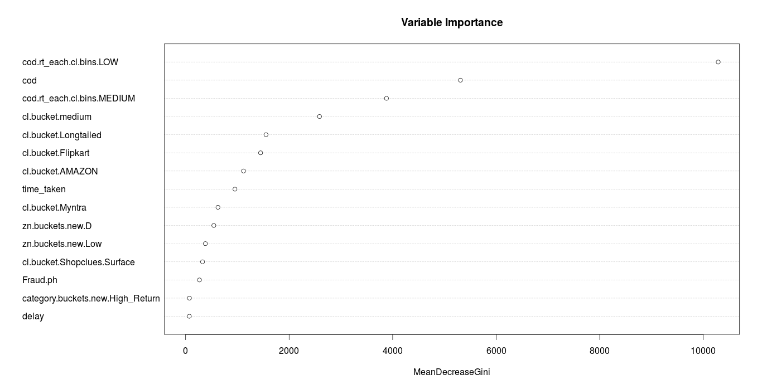
Model(Final Iteration) – Random Forest
RTO.rf = randomForest(cs.ss ~ time_taken + cod + cod.rt_each.cl.bins.LOW + cod.rt_each.cl.bins.MEDIUM + category.buckets.new.High_Return + zn.buckets.new.D + zn.buckets.new.Low + cl.bucket.Flipkart + cl.bucket.AMAZON + cl.bucket.Longtailed + cl.bucket.medium + cl.bucket.Myntra + cl.bucket.Shopclues.Surface + Fraud.ph + delay, data = df_sample.train, nodesize = 20, ntree = 200,trControl = control)

Slide 22
Confusion matrix –
TRUE - RTO
FALSE - Delivered
Test Dataset
Logistic Regression
Random Forest
 | Predicted
Actual | FALSE | TRUE
FALSE | 139345 | 31824
TRUE | 83342 | 60609
 | Predicted
Actual | FALSE | TRUE
FALSE | 142163 | 29006
TRUE | 84637 | 59314
Accuracy = 64%
Precision = 67%
Sensitivity = 42%
Specificity = 18%
Accuracy - 64%
Precision - 67%
Sensitivity - 41%
Specificity - 16%

Slide 23
TRUE - RTO
FALSE - Delivered
Training Data
Logistic Regression
Random Forest
 | Predicted
Actual | FALSE | TRUE
FALSE | 93811 | 77358
TRUE | 49069 | 94882
 | Predicted
Actual | FALSE | TRUE
FALSE | 331227 | 68166
TRUE | 197900 | 137985
Accuracy = 60%
Precision = 55%
Sensitivity = 66%
Specificity = 45%
Accuracy – 64%
Precision – 67%
Sensitivity – 41%
Specificity – 17%

Slide 24
THANK YOU

