Slide 1


Cybersecurity Internship Portfolio
Documenting practical and theoretical knowledge across cybersecurity fundamentals, virtual environment configuration, network reconnaissance, and active exploitation — from security theory to real-world intelligence gathering.
5 CORE TASKS
ENTRY-LEVEL PORTFOLIO
Notes:
1

Slide 2
TASK 1
Cybersecurity Fundamentals
🔒 CIA Triad
⚠️ Threat Landscape
👤 Actor Types
Confidentiality: Encryption & access controls
Integrity: Hashing & digital signatures
Availability: Hardware maintenance & DDoS protection
Malware: System instability
Phishing: Credential theft & unauthorized access
Ransomware: Operational paralysis & financial damage
Black Hat: Malicious data theft
White Hat: Authorized security improvements
Gray Hat: Unauthorized but non-malicious
Notes:
2

Slide 3
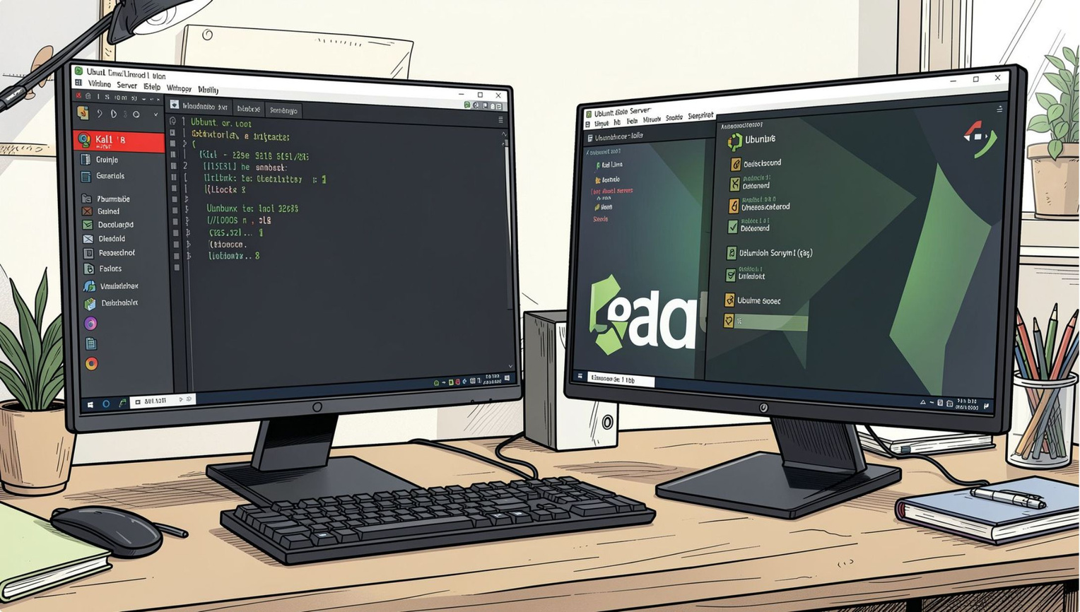
TASK 2
Virtual Lab Environment
Infrastructure
Deployed Kali Linux as the primary attacking machine and Metasploitable (Ubuntu 14.04 LTS) as the deliberately vulnerable target for safe, controlled exploitation practice.
Resource Allocation
Configured VMs with 2–4 vCPU cores and a minimum of 2048 MB RAM to ensure stability during heavy tool execution and concurrent scanning.
Network Isolation
Used Host-Only and Bridged Adapters to establish direct local communication while keeping all ethical hacking activity contained and legally isolated.
Notes:
3

Slide 4

TASK 3
Networking & Reconnaissance
Passive OSINT
Protocol Analysis
Whois, DNS dig, subdomain mapping
IPv4/IPv6, TCP/UDP, A AAAA MX NS
Active Probing
ICMP discovery, Nmap -sC -sV -p- -T4
Reconnaissance progresses from non-intrusive passive collection to active network probing — each phase deepening the attacker's understanding of the target without unnecessary exposure.
Notes:
4

Slide 5
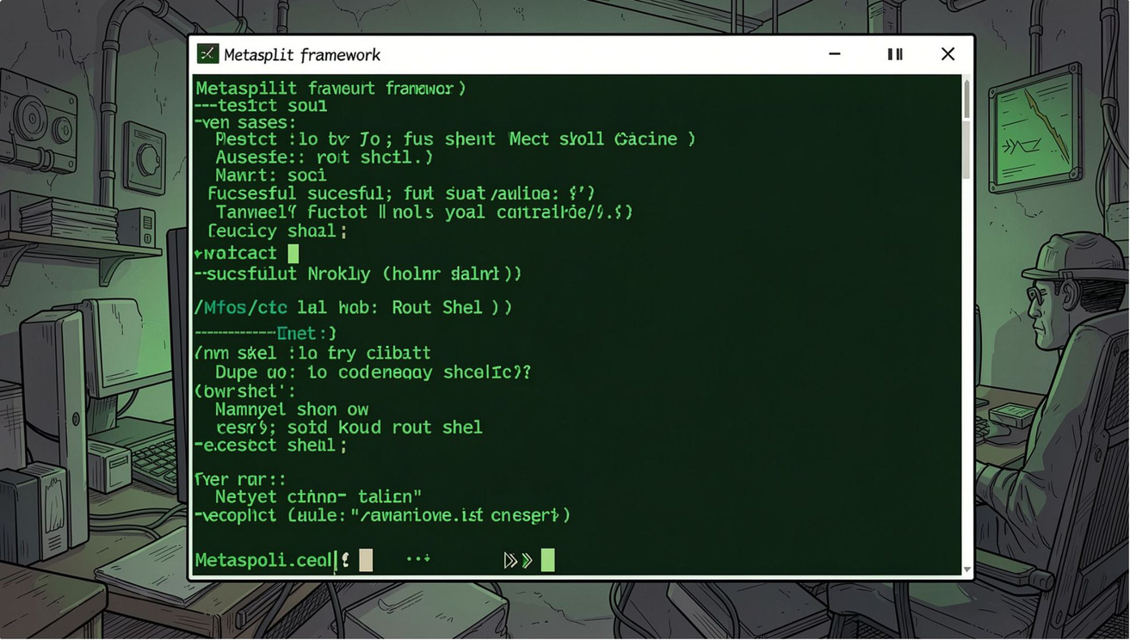
TASK 4
Penetration Testing Simulation
Step-by-Step Exploitation
01
Vulnerability Identification
Scanned target 10.96.12.193 and identified an exposed FTP server running vsftpd 2.3.4 — known for a backdoor command execution flaw.
02
Exploitation
Used Metasploit's msfconsole to configure and fire the exploit/unix/ftp/vsftpd_234_backdoor payload against the target.
03
Post-Exploitation
Confirmed root access by spawning a command shell and validating with whoami and uname -a.
Notes:
5

Slide 6
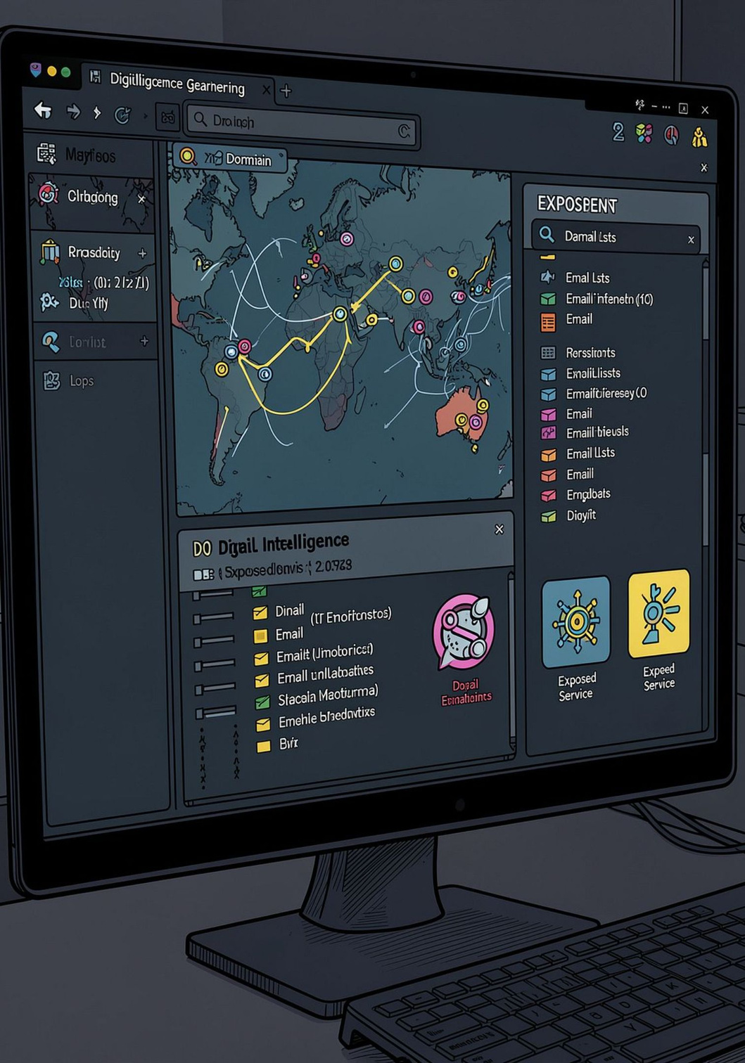



TASK 5
OSINT Investigation
Digital Footprinting
Mapped external attack surfaces using sublist3r to enumerate hidden subdomains and audit certificate transparency logs.
Credential Harvesting
Deployed theHarvester to locate employee emails across public sources and cross-referenced them with HaveIBeenPwned for known breach exposure.
Infrastructure Discovery
Used Shodan queries (e.g., port 3389) to identify exposed RDP interfaces tied to the target organization's IP ranges.
Notes:
6

