Slide 1
Classification
Explain the concept of classification
Describe the Decision Tree method
Describe the Naïve Bayes method
Discuss Accuracy of classification method and how accuracy may be improved

Slide 2
Classification
Classical problem in statistics and machine learning.
Separation of objects or ordering of objects into classes. Usually a set of classes are pre-defined. A set of training samples are used for building class models.
Each new object is then assigned to one of the classes using the model.
Typical Applications: credit approval, treatment effectiveness analysis

Slide 3
Apriori Classification
The classification based on training samples with class labels known is called supervised learning. New data is classified based on the model developed during training.
Each object has a number of attributes. One special attribute is the class label called the output or dependent attribute. Value known for the training sample but not for others. Other attributes are independent attributes.
Attributes may be numerical (e.g. income) or categorical (ordered e.g. course grade or unordered e.g. gender, job title, race). The class label is categorical.

Slide 4
Posteriori Classification
No training data with known class labels available. May be classes not known apriori.
Usually clustering is used in such situations although some unsupervised classification techniques do exist.

Slide 5
Classification
Classification is a prediction technique. Given the values of the independent attributes the class can be predicted.
Regression is another prediction technique.
Classification is used to predict categorical values while regression is used to predict continuous or ordered values.

Slide 6
Two Phases
Model construction phase:
  Each training sample belongs to a predefined class given by the class label attribute. A model is built.
Usage and testing phase:
  Each test object (not used for training) is classified
  Accuracy of the model is estimated
    If the class label of some test samples is known, it is compared with the result from the model
    Accuracy rate is the percentage of test samples correctly classified by the model

Slide 7
Quality evaluation
Many quality measures. Han and Kambler list these:
Predictive accuracy
Efficiency or speed to construct model and to use
Robustness in handling noise and missing values
Scalability
  efficiency in handling large disk-resident data
Interpretability:
  understanding and insight provided by the model
Goodness of rules (size, compactness of model)

Slide 8
Decision Tree
A decision tree is an approach like that needed to support the game of twenty questions where each internal node of the tree denotes a question or a test on the value of an independent attribute, each branch represents an outcome of the test, and each leaf represents a class.
Assume that each object has a number of independent attributes and a dependent attribute.

Slide 9
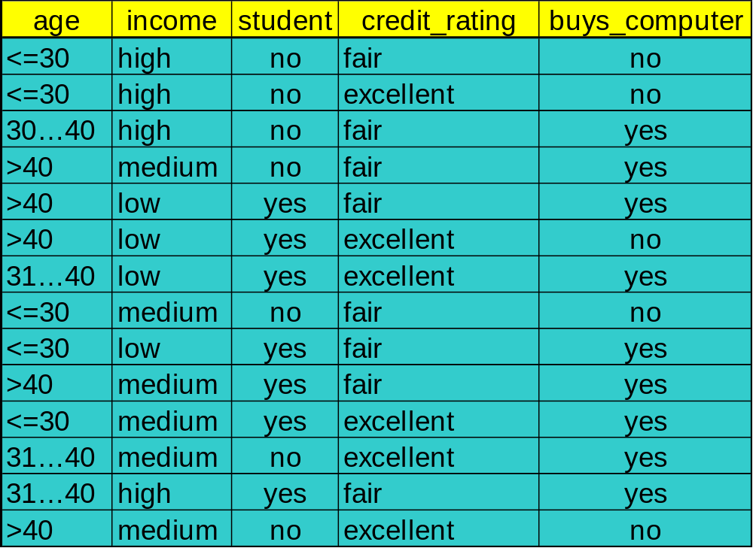
Example (From Han and Kamber)

Slide 10
A decision Tree (From Han and Kamber)
age?
<=30
overcast
>40
30..40
student?
yes
credit rating?
no
yes
excellent
fair
no
yes
no
yes

Slide 11
Decision Tree
To classify an object, the appropriate attribute value is used at each node, starting from the root, to determine the branch taken. The path found by tests at each node leads to a leaf node which is the class the model believes the object belongs to.
Decision tree is an attractive technique since the results are easy to understand. The rules can often be expressed in natural language e.g. if the student has GPA > 3.0 and class attendance > 90% then the student is likely to get a D.

Slide 12
Basic Algorithm
  The training data is S. Discretise all continuous-valued attributes. Let the root node contain S.
  If all objects S in the root node belong to the same class then stop.
  Split the next leaf node by selecting an attribute A from amongst the independent attributes that best divides or splits the objects in the node into subsets and create a decision tree node.
  Split the node according to the values of A.
  Stop if any of the following conditions is met otherwise continue with 3.
        -- data in each subset belongs to a single class.
    -- there are no remaining attributes on which the sample may be further divided.

Slide 13
Building A Decision Tree
The aim is to build a decision tree consisting of a root node, a number of internal nodes, and a number of leaf nodes. Building the tree starts with the root node and then splitting the data into two or more children nodes and splitting them in lower level nodes and so on until the process is complete.
The method uses induction based on the training data. We illustrate it using a simple example.

Slide 14
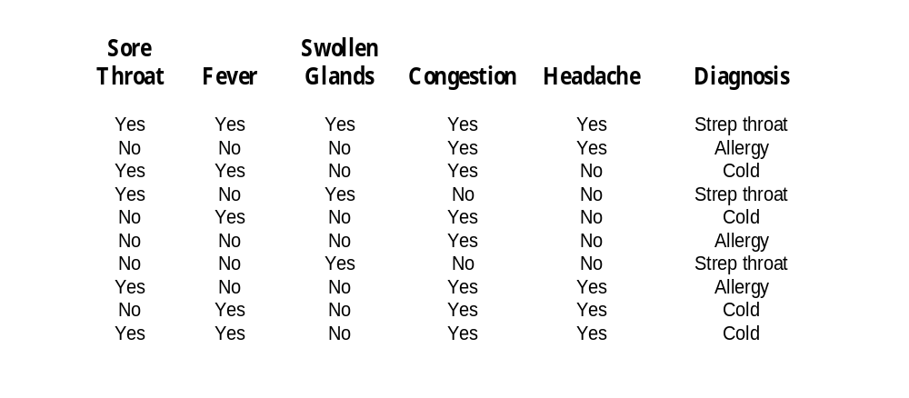
An Example (from the text)
First five attributes are symptoms and the last attribute is diagnosis. All attributes are categorical.
Wish to predict the diagnosis class.

Slide 15
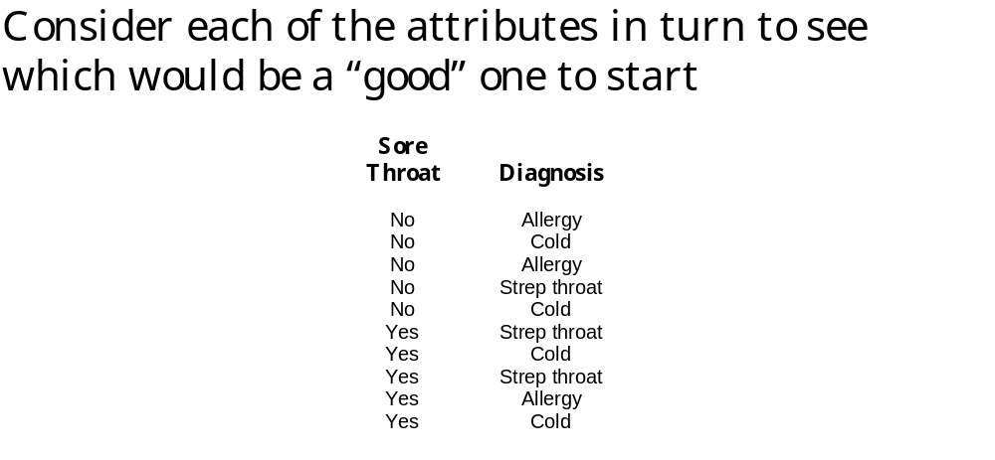
An Example (from the text)
Sore throat does not predict diagnosis.

Slide 16
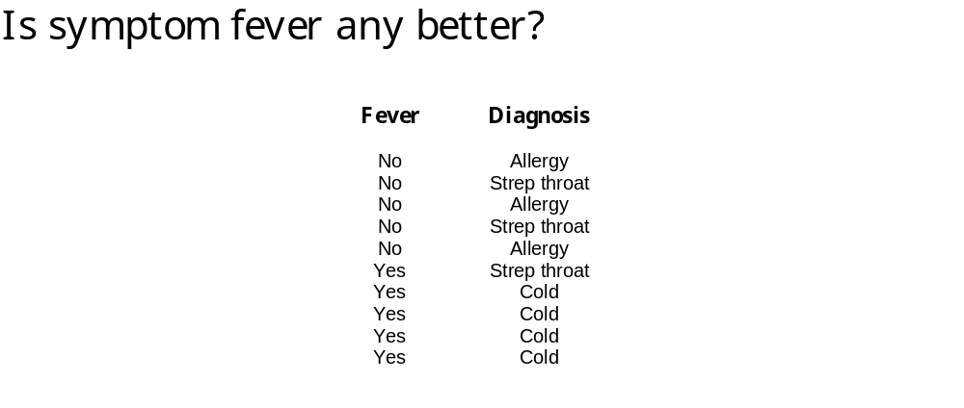
An Example (from the text)
Fever is better but not perfect.

Slide 17
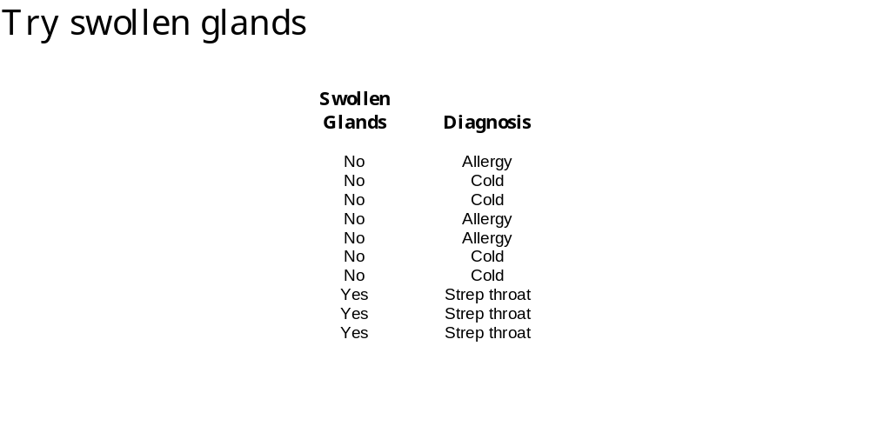
An Example (from the text)
Good. Swollen glands = yes means Strep Throat

Slide 18
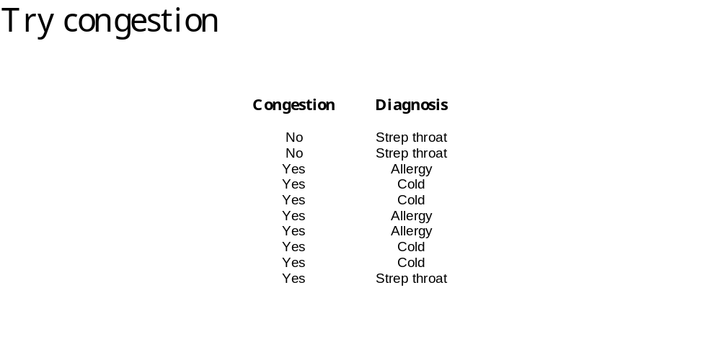
An Example (from the text)
Not helpful.

Slide 19
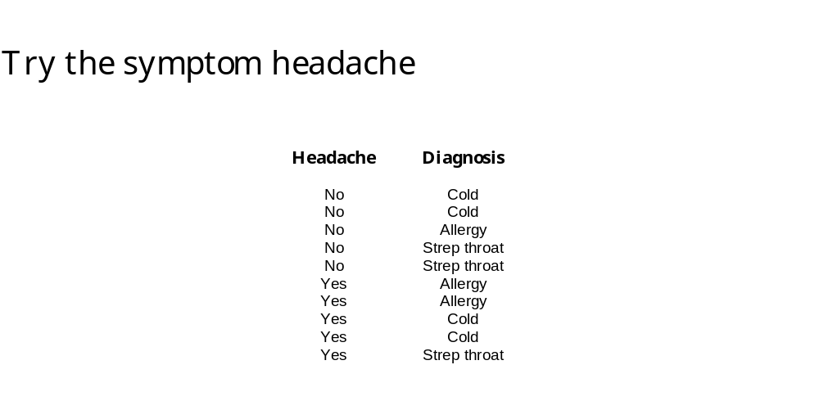
An Example (from the text)
Not helpful.

Slide 20
An Example
This approach does not work if there are many attributes and a large training set. Need an algorithm to select an attribute that best discriminates among the target classes as the split attribute.
How do we find the attribute that is most influential in determining the dependent attribute?
The tree continues to grow until it is no longer possible to find better ways to split the objects.

Slide 21
Finding the Split
One approach involves finding the data’s diversity (or uncertainty) and choosing a split attribute that minimises diversity amongst the children nodes or maximises the following:
diversity(before split) - diversity(left child) - diversity(right child)
We discuss two approaches. One is based on information theory and the other is based on the work of Gini who devised a measure for the level of income inequality in a country.

Slide 22
Finding the Split
Since our aim is to find nodes that belong to the same class (called pure), a term impurity is sometime used to measure how far the node is from being pure.
The aim of the split then is to reduce impurity:
impurity(before split) - impurity(left child) - impurity(right child)
Impurity is just a different term. Information theory or the Gini index may be used to find the split attribute that reduces impurity by the largest amount.

Slide 23
Information Theory
value x or value y.
If s is going to be always x then there is no information and there is no uncertainty.
What about at p(x) = 0.9 and p(y) = 0.1?
What about p(x) = 0.5 and p(y) = 0.5?
The measure of information is
Suppose there is a variable s that can take either a
I = – sum (p_{i} log(p_{i}))

Slide 24
Information
Information is defined as –pi*log(pi) where pi is the probability of some event.
pi is always less than 1, so log(pi) is always negative and –pi*log(pi) is always positive.
Note that log of 1 is always zero, the log of any number greater than 1 is always positive and the log of any number smaller than 1 is always negative.

Slide 25
Information Theory
I = 2*(– 0.5 log (0.5))
This comes out to 1.0 and is the max information for an event with two possible values. Also called entropy. A measure of the minimum number of bits required to encode the information.
Consider a dice with six possible outcomes with equal probability. The information is:
I = 6 * (– (1/6) log (1/6)) = 2.585
Therefore three bits are required to represent the outcome of rolling a dice.

Slide 26
Information Theory
Why is information lower if a toss is more likely to get a head than a tail?
If a loaded dice had much more chance of getting a 6, say 50% or even 75%, does the roll of the dice has less or more information?
The information is:
50% I = 5 * (– (0.1) log (0.1)) – 0.5*log(0.5)
75% I = 5 * (– (0.05) log (0.05)) – 0.75*log(0.75)
How many bits are required to represent the outcome of rolling the loaded dice?

Slide 27
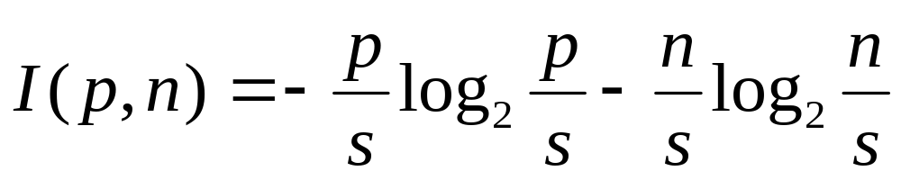
Information Gain
Select the attribute with the highest information gain
Assume the training data S has two classes, P and N
  Let S contain a total of s objects, p of class P and n of class N (so p + n = s)
  The amount of information in S given the two class P and N is

Slide 28
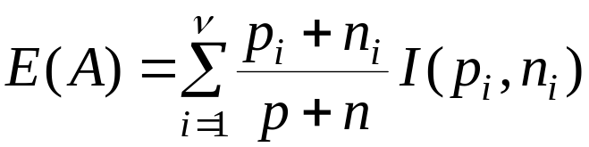

Information Gain
Assume that using an attribute A the set S is partitioned into {S₁, S₂ , …, S_{v}}
  If S_{i} contains p_{i} examples of P and n_{i} examples of N, the entropy, or the expected information needed to classify objects in all subtrees S_{i} is
  The encoding information that would be gained by branching on A

Slide 29
Back to the Example
There are 10 (s = 10) samples and three classes.
      Strep throat = t = 3
      Cold = c = 4
      Allergy = a = 3
Information = 2*(– 3/10 log(3/10)) – (4/10 log(4/10)) = 1.57
Let us now consider using the various symptoms to split the sample.

Slide 30
Example
Sore Throat
Yes has t = 2, c = 2, a =1, total 5
No has t = 1, c = 2, a = 2, total 5
    I(y) = 2*(–2/5 log(2/5)) – (1/5 log(1/5)) = 1.52
    I(n) = 2*(–2/5 log(2/5)) – (1/5 log(1/5)) = 1.52
Information = 0.5*1.52 + 0.5*1.52 = 1.52
Fever
Yes has t = 1, c = 4, a =0, total 5
No has t = 2, c = 0, a = 3, total 5
    I(y) = –1/5 log(1/5)) – 4/5 log(4/5)
    I(n) = –2/5 log(2/5)) – 3/5 log(3/5)
Information = 0.5 I(y) + 0.5 I(n) = 0.846

Slide 31
Example
Swollen Glands
Yes has t = 3, c = 0, a =0, total 3
No has t = 0, c = 4, a = 3, total 7
    I(y) = 0
    I(n) = – 4/7 log(4/7)) – (3/7 log(3/7))
Information = 0.3*I(y) + 0.7*I(n) = 0.69
Congestion
Yes has t = 1, c = 4, a =3, total 8
No has t = 2, c = 0, a = 0, total 2
    I(y) = –1/8 log(1/8)) – 4/8 log(4/8) – 3/8 log(3/8)
    I(n) = 0
Information = 0.8 I(y) + 0.2 I(n) = 1.12

Slide 32
Example
Headache
Yes has t = 2, c = 2, a =1, total 5
No has t = 1, c = 2, a = 2, total 5
    I(y) = 2*(–2/5 log(2/5)) – (1/5 log(1/5)) = 1.52
    I(n) = 2*(–2/5 log(2/5)) – (1/5 log(1/5)) = 1.52
Information = 0.5*1.52 + 0.5*1.52 = 1.52
So the values for information are:
    Sore Throat 1.52
    Fever 0.85
    Swollen Glands 0.69
    Congestion 1.12
    Headache 1.52

Slide 33
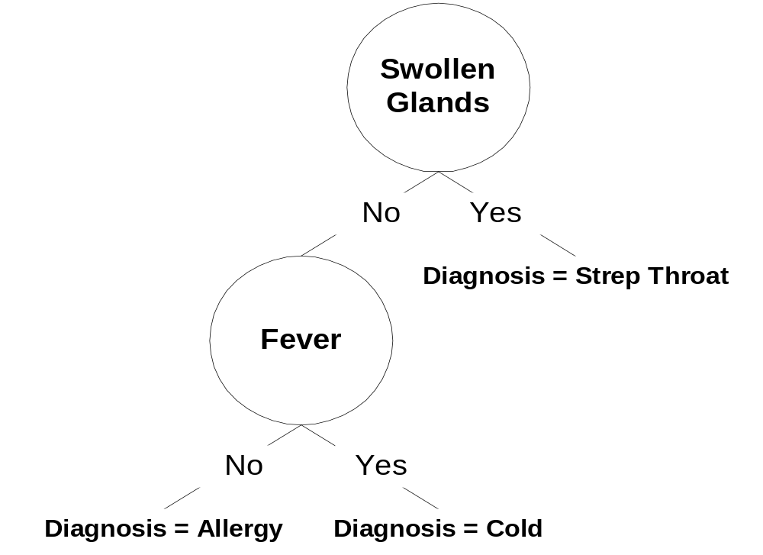
Decision Tree
Continuing the process
one more step will find
Fever as the next split
attribute and the final
Result as shown.

Slide 34
Information Gain
Assume that using an attribute A the set S is partitioned into {S₁, S₂ , …, S_{v}}
  If S_{i} contains p_{i} samples of class P and n_{i} of N, the entropy, or the expected information needed to classify objects in all subtrees S_{i} is
  The information gain by branching on A

