Slide 1
Data Mining :Classification (cont’d)

Slide 2
Recap
So far:
Supervised Classification - Decision tree – using information theory
Next
Decision tree using Gini Index (today)
Decision tree summary (today)
Classification using Bayes Method (today)
Unsupervised Classification – Clustering

Slide 3
Decision Tree
Have considered information theory approach. Used in well known software C4.5. Another commonly used approach is called the Gini index. Used in CART and IBM Intelligent Miner.
Both approaches are concave measures. The total value of the measure is never less than the total value of the branch nodes. Information gain is always nonnegative.
Small entropy or small Gini Index does not guarantee a small classification error.

Slide 4
Gini Index
Measure of resource inequality in a population. Varies from 0 to 1, zero means no inequality and 1 maximum possible inequality.
Based on the Lorenz curve, which plots cumulative family income against the number of families from poorest to the richest.

Slide 5
Lorenz Curve
The Gini Index is the ratio of the area between the Lorenz curve and the 45-degree line to the area under the 45-degree line.
Smaller the ratio, the more evenly distributed the wealth.
The example shows wide variation in the wealth distribution in various countries.
Brazil | 61
Mexico | 53
Malaysia | 49
Thailand, USA | 41
China, Russia | 40
India | 38
UK | 37
Australia | 35
Canada, Indonesia | 32
Sweden, Japan | 25

Slide 6

Queensland Crime Data
Stealing from Homes | 0.17
Unlawful entry shops | 0.21
Drug offences | 0.22
Assault | 0.23
Fraud | 0.26
Motor Vehicle theft | 0.30
Kidnapping | 0.33
Armed robbery | 0.38
Liquor offences | 0.52
Prostitution offences | 0.65
Queensland Government has analysed crime data using the Gini Index to find how different types of crimes are distributed in the state.

Slide 7
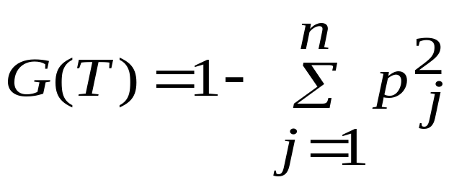
Gini Index
Varies from 0 to 1, zero means no inequality and 1 maximum possible inequality.
p_{j} is the relative frequency of class j in S. Consider tossing a coin:
G = 1 – 0.5*0.5 – 0.5*0.5 = 0.5
This comes out to 0.5 and is the maximum value for an event with two possible values.

Slide 8
Gini Index
Consider a loaded coin with 70% chance of a head and another coin with heads on both sides.
G = 1 – 0.7*0.7 – 0.3*0.3 = 0.42
G = 1 – 1.0*1.0 = 0
The Gini Index for a dice with six possible outcomes with equal probability is:
G = 1 - 6 * (1/6) * (1/6) = 5/6 = 0.833

Slide 9
Gini Index
If a loaded dice had much more chance of getting a 6, say 50% or even 75%, does the roll of the dice has lower or higher Gini Index? The Index is given by:
50% G = 1 – 5 * (0.1 * 0.1) – 0.5 * 0.5 = 0.70
75% I = 1 – 5 * (0.05 * 0.05) – 0.75 * 0.75 = 0.425
Clearly the index is largest with the largest uncertainty.

Slide 10
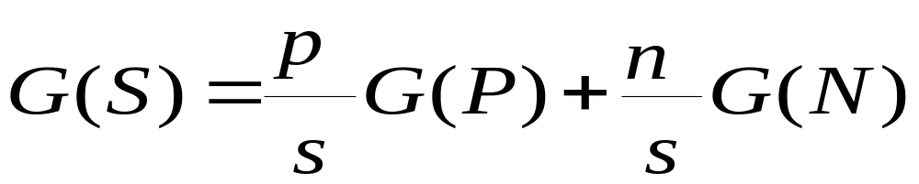
Gini Index
If a data set S is split into two subsets P and N with sizes p and n respectively, the Gini index of the split data contains examples from 2 classes, the Gini Index is defined as

Slide 11
Split attribute
Once we have computed the Gini Index for all the attributes, how do we select the attribute to split the data?
In the case of information theory we selected the attribute with the highest information gain.

Slide 12
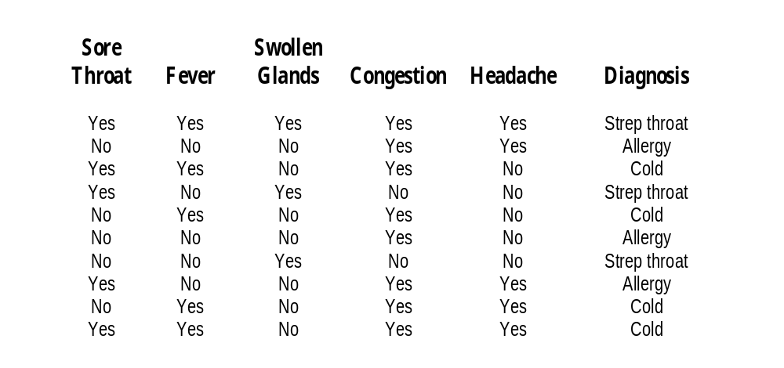
Back to the Example

Slide 13
Back to the Example
There are 10 (s = 10) samples and three classes.
      Strep throat = t = 3
      Cold = c = 4
      Allergy = a = 3
G = 1 – 2*(3/10 * 3/10) – (4/10 * 4/10) = 0.66
Let us now consider using the various symptoms to split the sample.

Slide 14
Example
Sore Throat
Yes has t = 2, c = 2, a =1, total 5
No has t = 1, c = 2, a = 2, total 5
    G(y) = 1 –2*(2/5 * 2/5) – (1/5 * 1/5) = 0.64
    G(n) = G(y) = 0.64
G = 0.5*0.64 + 0.5*0.64 = 0.64
Fever
Yes has t = 1, c = 4, a =0, total 5
No has t = 2, c = 0, a = 3, total 5
    G(y) = 1 – 1/5 * 1/5 – 4/5 * 4/5 = 0.32
    G(n) = 1 – 2/5 * 2/5 – 3/5 * 3/5 = 0.48
G = 0.5 G(y) + 0.5 G(n) = 0.40

Slide 15
Example
Swollen Glands
Yes has t = 3, c = 0, a =0, total 3
No has t = 0, c = 4, a = 3, total 7
    G(y) = 1 – 1 = 0
    G(n) = 1 – 4/7 * 4/7 – 3/7 * 3/7 = 0.511
G = 0.3*G(y) + 0.7*G(n) = 0.358
Congestion
Yes has t = 1, c = 4, a =3, total 8
No has t = 2, c = 0, a = 0, total 2
    G(y) = 1 –1/8 * 1/8 – 4/8 * 4/8 – 3/8 * 3/8 = 0.594
    G(n) = 0
G = 0.8 * G(y) + 0.2 * G(n) = 0.475

Slide 16
Example
Headache
Yes has t = 2, c = 2, a =1, total 5
No has t = 1, c = 2, a = 2, total 5
    G(y) = 1 - 2*(2/5 * 2/5) – (1/5 * 1/5) = 0.64
    G(n) = G(y)
G = 0.5*0.64 + 0.5*0.64 = 0.64
So the values for the Gini Index are:
    Sore Throat 0.64
    Fever 0.40
    Swollen Glands 0.358
    Congestion 0.475
    Headache 0.64

Slide 17
Example
We select the attribute with the smallest value of the index as the split attribute. So the attribute is Swollen Glands.
We can now take “Swollen Glands” out of consideration and take the three instances where the Swollen Glands symptom value was Yes also out of consideration since they have already been classified.
Next we look at the remaining data and remaining attributes and find the next split attribute.

Slide 18
Understanding Decision Trees
Decision trees may be easily represented by rules.
One rule is created for each path from the root to a leaf.
Each internal node is a test and the leaf node gives the class prediction
Example
  IF swollen glands = yes THEN diagnosis = strep throat
  IF swollen glands = no and fever = yes then ??
Each class may have a number of rules

Slide 19
Overfitting
A decision tree may overfit the training data. A tree overfits the data if an alternative tree has higher accuracy over data other than training data.
Overfit trees tend to have too many branches, some due to outliers
Overfit trees tend to result in poor accuracy for data other than training data
To avoid overfitting it may be desirable to stop some node splits if the split is not really helping classification.

Slide 20
Overfitting
Another approach is to build a final tree and then remove branches that do not appear useful. We thus obtain a number of less specific decision trees.
Usually data other than training data is required to test such trees obtained by postpruning.
Do not have time to get into more details.

Slide 21
Testing
One approach is to divide training data into two parts: one used for building the tree and other for testing the tree.
The data may be randomly divided several times providing several trees and several set of tests.
Statistical tests may be applied if all the data is used for training.

Slide 22
Large Datasets
We have assumed that the datasets are main memory based. What if the data is large and cannot be stored in the main memory?
In some applications the training data may be quite large with many attributes.
New methods have been designed to handle large volumes of data

Slide 23
Decision Tree - Summary
A simple popular method of supervised classification
A decision tree is based on the assumption that there is only one dependent variable i.e. we are trying to predict only one variable.
A decision tree is based on the assumption that all data is categorical. No continuous variable values are used.
Bias – split procedures are often biased towards choosing attributes that have many values.

Slide 24
Bayesian Classification
A different approach: Does not require building of a decision tree. Assume hypothesis that given data belongs to a given class. Calculate probabilities for the hypothesis. This is among the most practical approaches for certain types of problems.
Each training example can incrementally increase/decrease the probability that a hypothesis is correct.

Slide 25
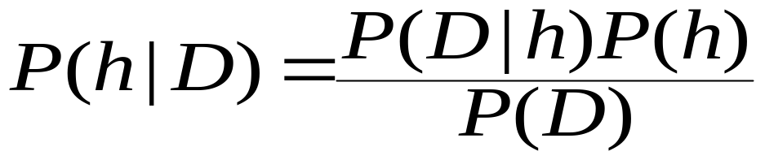
Bayes Theorem
A very important theorem.
Hypothesis is that a given data belongs to class C. Without any information about the data, let the probability of any data belonging to C be P(C). This is called apriori probability of the hypothesis.
Given data D, posteriori probability of a hypothesis h, that is D is in class C, is written as P(h|D). It is given by the Bayes theorem

Slide 26
Bayes Theorem
Consider the Bayes theorem again
P(h|D) is probability of h being true (that is D belongs to class C) given that D is known.
P(D|h) is probability of obtaining data D if we knew the hypothesis was correct i.e. D belongs to class C.
P(h) is just the probability of h without any information
P(D) is just the probability of obtaining D without any information

Slide 27
Back to the Example

Slide 28
Bayes Theorem
Suppose the data D is {yes, yes, no, yes, no}
The hypothesis h is that D has cold.
P(h|D) is probability of D having cold knowing D.
P(D|h) is probability of obtaining data D if we knew D had cold.
P(h) is just the probability of having cold without any information
P(D) is just the probability of obtaining D without any information

Slide 29
Bayes Theorem
What can we compute? P(h|D), P(D|h), P(h) and P(D)?
To compute P(h|D) we need to compute the RHS.
Actually what we really need is to compute P(h|D) for h = cold, for h = strep throat and for h = allergy. We then choose the diagnosis that has the highest probability.
Since we are comparing we don’t need to worry about P(D) which we cannot compute.

Slide 30
Bayes Theorem
Compute the maximum posteriori hypothesis by computing P(D|h)P(h) for each of the three hypothesis.
There are 10 (s = 10) samples and three classes.
      Strep throat = t = 3
      Cold = c = 4
      Allergy = a = 3
P(ST) = 0.3, P(C) = 0.4 and P(A) = 0.3
P(D|h) = P({yes, yes, no, yes, no}|h) = P(sore throat = yes|h)*P(fever=yes|h) * P(swollen glands=no|h) * P(congestion=yes|h) * P(headache=no| h)

Slide 31
Example
We compute P(D|h)P(h) for each of the three hypothesis given P(ST) = 0.3, P(C) = 0.4 and P(A) = 0.3.
P(D|h) = P({yes, yes, no, yes, no}|h)
P(sore throat = yes|h)
P(fever = yes|h)
P(swollen glands = no|h)
P(congestion = yes|h)
P(headache = no| h)

Slide 32
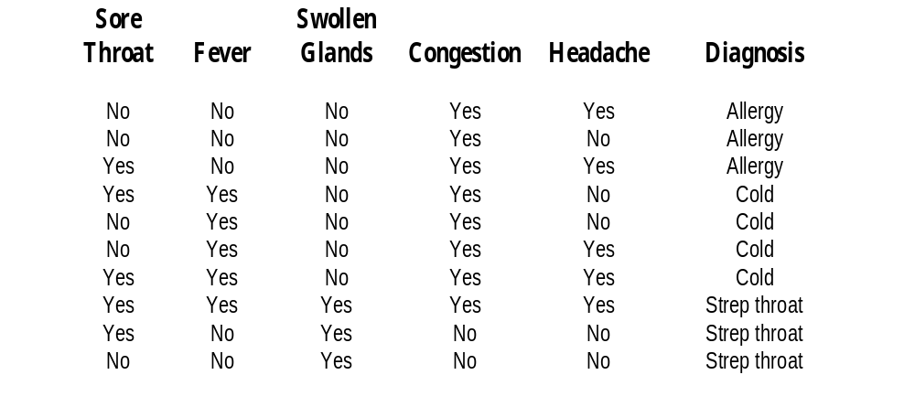
Example

Slide 33
Cold
Sore Throat | Fever | Swollen Glands | Congestion | Headache
Y | Y | N | Y | N
N | Y | N | Y | N
N | Y | N | Y | Y
Y | N | N | Y | Y
0.5 | 0.75 | 0.0 | 1.0 | 0.5

Slide 34
Strep Throat
Sore Throat | Fever | Swollen Glands | Congestion | Headache
Y | Y | Y | Y | Y
Y | N | Y | N | N
N | N | Y | N | N
2/3 | 1/3 | 1.0 | 1/3 | 1/3

Slide 35
Allergy
Sore Throat | Fever | Swollen Glands | Congestion | Headache
N | N | N | Y | Y
N | N | N | Y | N
Y | N | N | Y | Y
1/3 | 0.0 | 0.0 | 1.0 | 2/3

Slide 36
P(D|h)P(h)
P(D|h) = P({yes, yes, no, yes, no}|h) = P(sore throat = yes|h)*P(fever=yes|h) * P(swollen glands=no|h) * P(congestion=yes|h) * P(headache=no| h)
P(D|Allergy) = 0
P(D|Strep Throat) = 2/81
P(D|Cold) = 0.19
Values of P(D|h)P(h) are 0, 2/81*0.3 and 0.19*0.4
The diagnosis therefore is cold.

Slide 37
Assumptions
Assuming that attributes are independent
Assuming that the training sample is a good sample to estimate probabilities.
These assumptions are often not true in practice, as attributes are often correlated.
Other techniques have been designed to overcome this limitation.

Slide 38
Summary
Supervised classification
Decision tree using information measure and Gini Index
Pruning and Testing
Bayes Theorem

