Slide 1
Introduction to Data

Slide 2
What is Data?
Collection of data objects and their attributes
An attribute is a property or characteristic of an object
Examples: eye color of a person, temperature, etc.
Attribute is also known as variable, field, characteristic, or feature
A collection of attributes describe an object
Object is also known as record, point, case, sample, entity, or instance
Attributes
Objects

Slide 3
Attribute Values
Attribute values are numbers or symbols assigned to an attribute
Distinction between attributes and attribute values
Same attribute can be mapped to different attribute values
Example: height can be measured in feet or meters
Different attributes can be mapped to the same set of values
Example: Attribute values for ID and age are integers
But properties of attribute values can be different
ID has no limit but age has a maximum and minimum value

Slide 4
Measurement of Length
The way you measure an attribute is somewhat may not match the attributes properties.

Slide 5
Types of Attributes
There are different types of attributes
Nominal
Examples: ID numbers, eye color, zip codes
Ordinal
Examples: rankings (e.g., taste of potato chips on a scale from 1-10), grades, height in {tall, medium, short}
Interval
Examples: calendar dates, temperatures in Celsius or Fahrenheit.
Ratio
Examples: temperature in Kelvin, length, time, counts

Slide 6
Properties of Attribute Values
The type of an attribute depends on which of the following properties it possesses:
Distinctness: = ≠
Order: < >
Addition: + -
Multiplication: * /
Nominal attribute: distinctness
Ordinal attribute: distinctness & order
Interval attribute: distinctness, order & addition
Ratio attribute: all 4 properties

Slide 7
Attribute Type
Description
Examples
Operations
Nominal
The values of a nominal attribute are just different names, i.e., nominal attributes provide only enough information to distinguish one object from another. (=, ≠)
zip codes, employee ID numbers, eye color, sex: {male, female}
mode, entropy, contingency correlation, χ² test
Ordinal
The values of an ordinal attribute provide enough information to order objects. (<, >)
hardness of minerals, {good, better, best}, grades, street numbers
median, percentiles, rank correlation, run tests, sign tests
Interval
For interval attributes, the differences between values are meaningful, i.e., a unit of measurement exists. (+, - )
calendar dates, temperature in Celsius or Fahrenheit
mean, standard deviation, Pearson's correlation, t and F tests
Ratio
For ratio variables, both differences and ratios are meaningful. (*, /)
temperature in Kelvin, monetary quantities, counts, age, mass, length, electrical current
geometric mean, harmonic mean, percent variation

Slide 8
Attribute Level
Transformation
Comments
Nominal
Any permutation of values
If all employee ID numbers were reassigned, would it make any difference?
Ordinal
An order preserving change of values, i.e., new_value = f(old_value) where f is a monotonic function.
An attribute encompassing the notion of good, better best can be represented equally well by the values {1, 2, 3} or by { 0.5, 1,10}.
Interval
new_value =a * old_value + b where a and b are constants
Thus, the Fahrenheit and Celsius temperature scales differ in terms of where their zero value is and the size of a unit (degree).
Ratio
new_value = a * old_value
Length can be measured in meters or feet.

Slide 9
Discrete and Continuous Attributes
Discrete Attribute
Has only a finite or countably infinite set of values
Examples: zip codes, counts, or the set of words in a collection of documents
Often represented as integer variables.
Note: binary attributes are a special case of discrete attributes
Continuous Attribute
Has real numbers as attribute values
Examples: temperature, height, or weight.
Practically, real values can only be measured and represented using a finite number of digits.
Continuous attributes are typically represented as floating-point variables.

Slide 10
Types of data sets
Record
Data Matrix
Document Data
Transaction Data
Graph
World Wide Web
Molecular Structures
Ordered
Spatial Data
Temporal Data
Sequential Data
Genetic Sequence Data

Slide 11
Important Characteristics of Structured Data
Dimensionality
Curse of Dimensionality
Sparsity
Only presence counts
Resolution
Patterns depend on the scale

Slide 12
Record Data
Data that consists of a collection of records, each of which consists of a fixed set of attributes

Slide 13
Data Matrix
If data objects have the same fixed set of numeric attributes, then the data objects can be thought of as points in a multi-dimensional space, where each dimension represents a distinct attribute
Such data set can be represented by an m by n matrix, where there are m rows, one for each object, and n columns, one for each attribute

Slide 14
Document Data
Each document becomes a `term' vector,
each term is a component (attribute) of the vector,
the value of each component is the number of times the corresponding term occurs in the document.

Slide 15
Transaction Data
A special type of record data, where
each record (transaction) involves a set of items.
For example, consider a grocery store. The set of products purchased by a customer during one shopping trip constitute a transaction, while the individual products that were purchased are the items.

Slide 16
Graph Data
Examples: Generic graph and HTML Links

Slide 17
Chemical Data
Benzene Molecule: C6H6

Slide 18
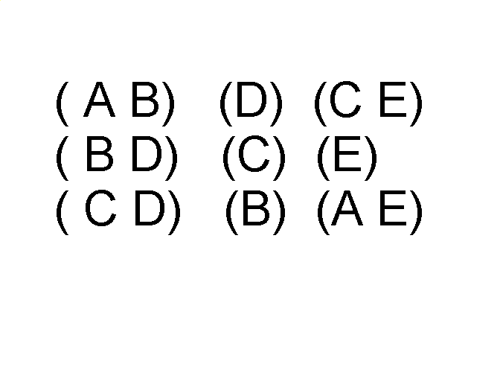
Ordered Data
Sequences of transactions
Items/Events
An element of the sequence

Slide 19
Ordered Data
Genomic sequence data

Slide 20
Ordered Data
Spatio-Temporal Data
Average Monthly Temperature of land and ocean

Slide 21
Data Quality
What kinds of data quality problems?
How can we detect problems with the data?
What can we do about these problems?
Examples of data quality problems:
Noise and outliers
missing values
duplicate data

Slide 22
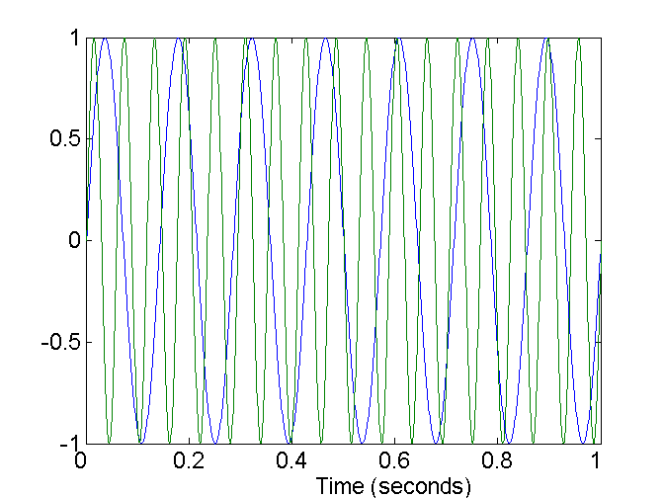
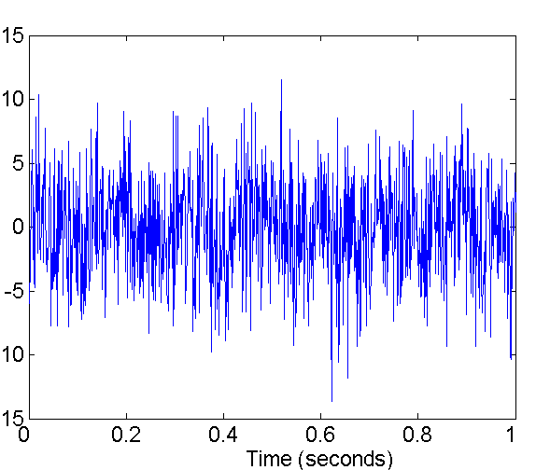
Noise
Noise refers to modification of original values
Examples: distortion of a person’s voice when talking on a poor phone and “snow” on television screen
Two Sine Waves
Two Sine Waves + Noise

Slide 23
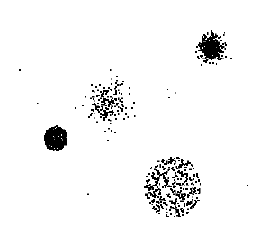
Outliers
Outliers are data objects with characteristics that are considerably different than most of the other data objects in the data set

Slide 24
Missing Values
Reasons for missing values
Information is not collected (e.g., people decline to give their age and weight)
Attributes may not be applicable to all cases (e.g., annual income is not applicable to children)
Handling missing values
Eliminate Data Objects
Estimate Missing Values
Ignore the Missing Value During Analysis
Replace with all possible values (weighted by their probabilities)

Slide 25
Duplicate Data
Data set may include data objects that are duplicates, or almost duplicates of one another
Major issue when merging data from heterogeous sources
Examples:
Same person with multiple email addresses
Data cleaning
Process of dealing with duplicate data issues

Slide 26
Data Preprocessing
Aggregation
Sampling
Dimensionality Reduction
Feature subset selection
Feature creation
Discretization and Binarization
Attribute Transformation

Slide 27
Aggregation
Combining two or more attributes (or objects) into a single attribute (or object)
Purpose
Data reduction
Reduce the number of attributes or objects
Change of scale
Cities aggregated into regions, states, countries, etc
More “stable” data
Aggregated data tends to have less variability

Slide 28
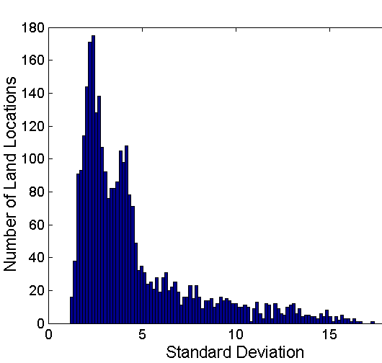
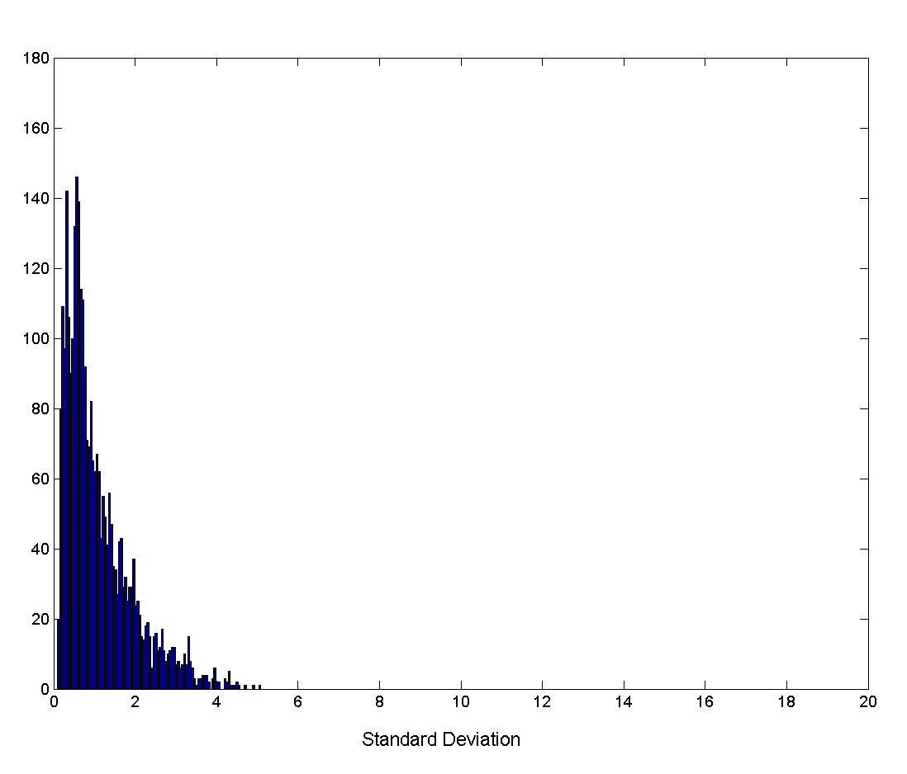
Aggregation
Variation of Precipitation in Australia
Standard Deviation of Average Monthly Precipitation
Standard Deviation of Average Yearly Precipitation

Slide 29
Sampling
Sampling is the main technique employed for data selection.
It is often used for both the preliminary investigation of the data and the final data analysis.
Statisticians sample because obtaining the entire set of data of interest is too expensive or time consuming.
Sampling is used in data mining because processing the entire set of data of interest is too expensive or time consuming.

Slide 30
Sampling …
The key principle for effective sampling is the following:
using a sample will work almost as well as using the entire data sets, if the sample is representative
A sample is representative if it has approximately the same property (of interest) as the original set of data

Slide 31
Types of Sampling
Simple Random Sampling
There is an equal probability of selecting any particular item
Sampling without replacement
As each item is selected, it is removed from the population
Sampling with replacement
Objects are not removed from the population as they are selected for the sample.
In sampling with replacement, the same object can be picked up more than once
Stratified sampling
Split the data into several partitions; then draw random samples from each partition

Slide 32

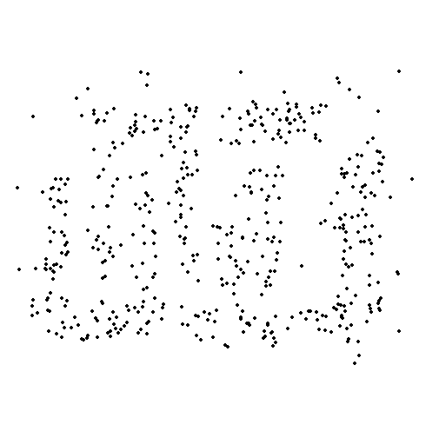
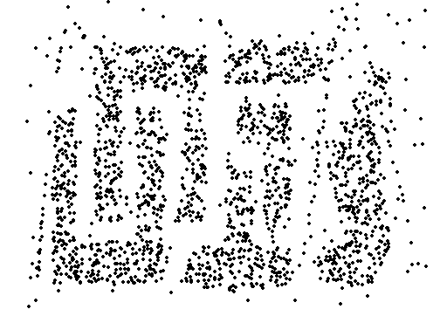
Sample Size
8000 points 2000 Points 500 Points

Slide 33
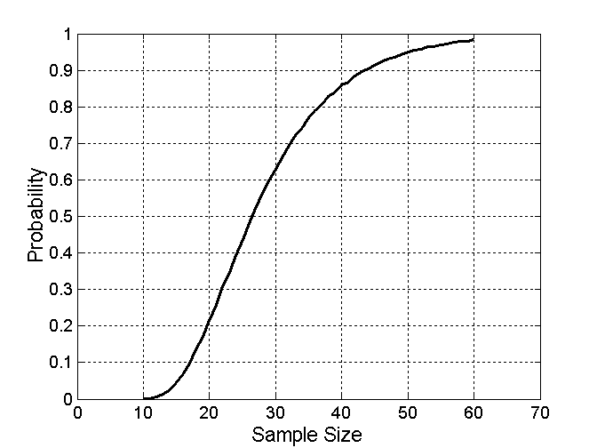

Sample Size
What sample size is necessary to get at least one object from each of 10 groups.

Slide 34
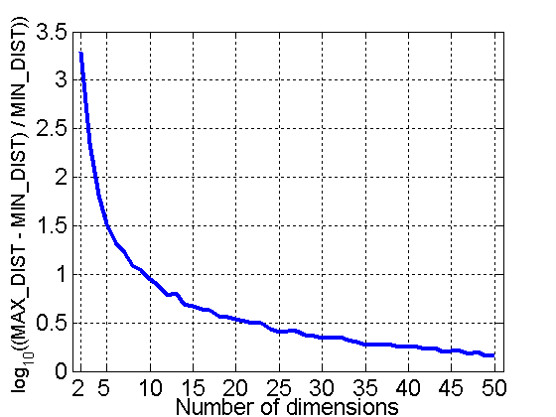
Curse of Dimensionality
When dimensionality increases, data becomes increasingly sparse in the space that it occupies
Definitions of density and distance between points, which is critical for clustering and outlier detection, become less meaningful
Randomly generate 500 points
Compute difference between max and min distance between any pair of points

Slide 35
Dimensionality Reduction
Purpose:
Avoid curse of dimensionality
Reduce amount of time and memory required by data mining algorithms
Allow data to be more easily visualized
May help to eliminate irrelevant features or reduce noise
Techniques
Principle Component Analysis
Singular Value Decomposition
Others: supervised and non-linear techniques

Slide 36
Dimensionality Reduction: PCA
Goal is to find a projection that captures the largest amount of variation in data
x₂
e
x₁

Slide 37
Dimensionality Reduction: PCA
Find the eigenvectors of the covariance matrix
The eigenvectors define the new space
x₂
e
x₁

Slide 38
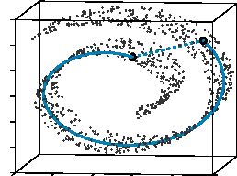
Dimensionality Reduction: ISOMAP
Construct a neighbourhood graph
For each pair of points in the graph, compute the shortest path distances – geodesic distances
By: Tenenbaum, de Silva, Langford (2000)

Slide 39
Dimensionality Reduction: PCA

Slide 40
Feature Subset Selection
Another way to reduce dimensionality of data
Redundant features
duplicate much or all of the information contained in one or more other attributes
Example: purchase price of a product and the amount of sales tax paid
Irrelevant features
contain no information that is useful for the data mining task at hand
Example: students' ID is often irrelevant to the task of predicting students' GPA

Slide 41
Feature Subset Selection
Techniques:
Brute-force approch:
Try all possible feature subsets as input to data mining algorithm
Embedded approaches:
Feature selection occurs naturally as part of the data mining algorithm
Filter approaches:
Features are selected before data mining algorithm is run
Wrapper approaches:
Use the data mining algorithm as a black box to find best subset of attributes

Slide 42
Feature Creation
Create new attributes that can capture the important information in a data set much more efficiently than the original attributes
Three general methodologies:
Feature Extraction
domain-specific
Mapping Data to New Space
Feature Construction
combining features

Slide 43


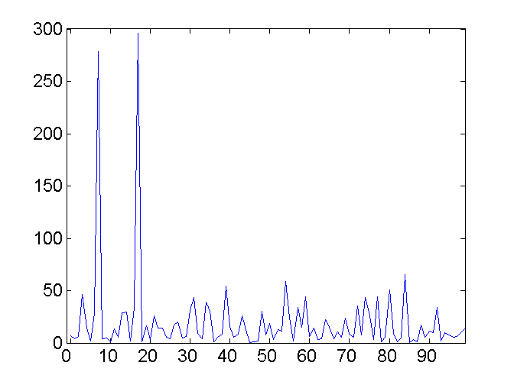
Mapping Data to a New Space
Fourier transform
Wavelet transform
Two Sine Waves
Two Sine Waves + Noise
Frequency

Slide 44
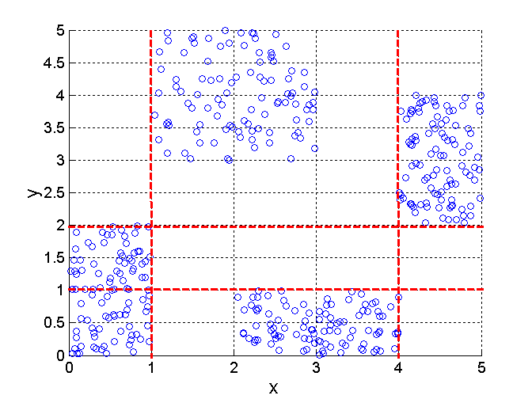
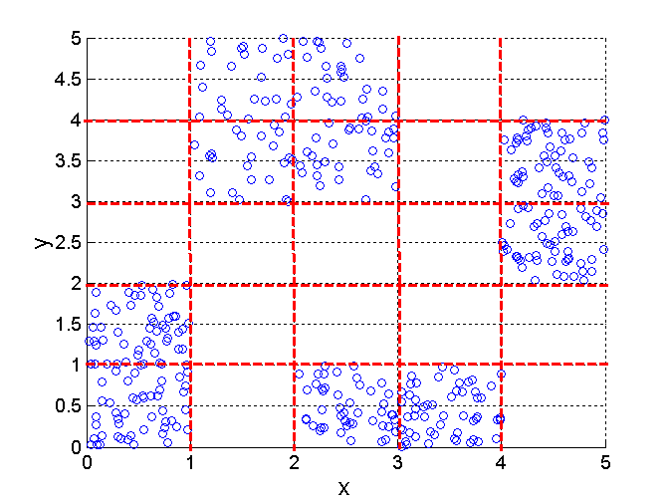
Discretization Using Class Labels
Entropy based approach
3 categories for both x and y
5 categories for both x and y

Slide 45
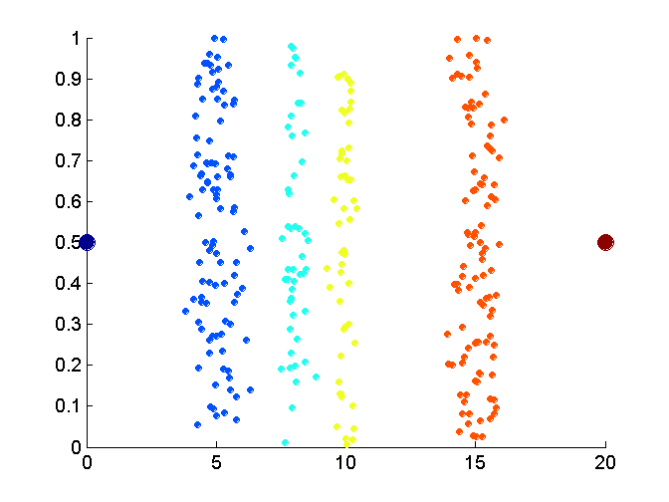
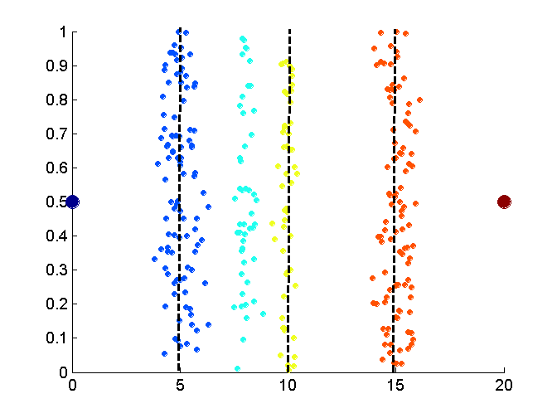
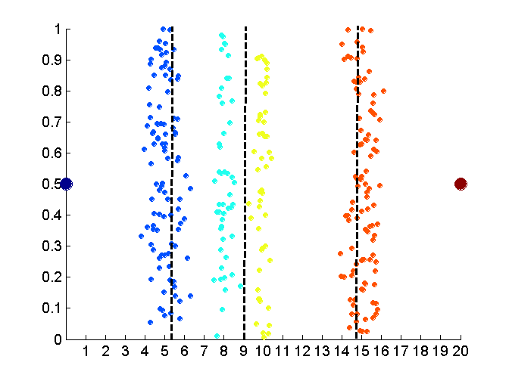
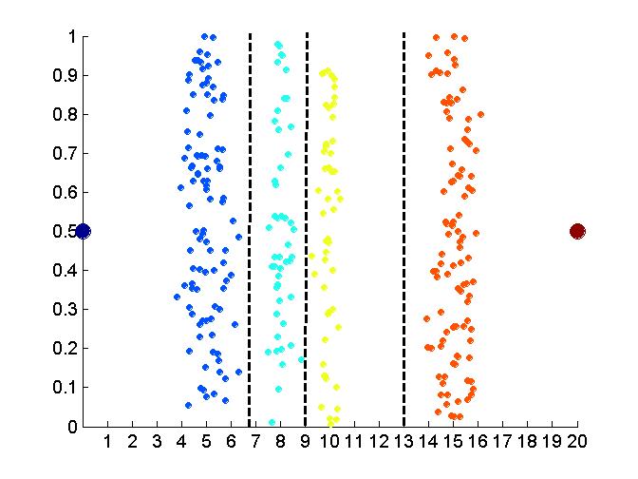
Discretization Without Using Class Labels
Data
Equal interval width
Equal frequency
K-means

Slide 46
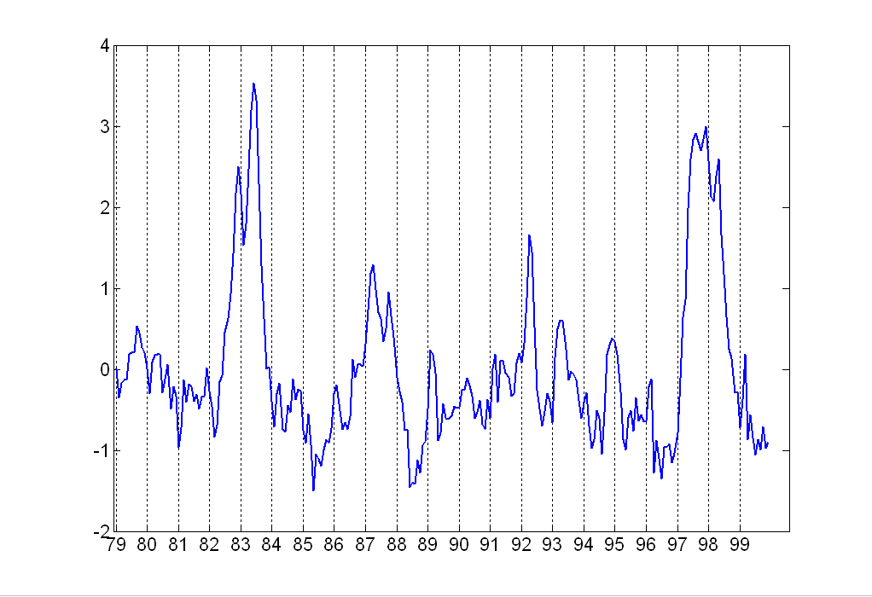
Attribute Transformation
A function that maps the entire set of values of a given attribute to a new set of replacement values such that each old value can be identified with one of the new values
Simple functions: xk, log(x), ex, |x|
Standardization and Normalization

Slide 47
Similarity and Dissimilarity
Similarity
Numerical measure of how alike two data objects are.
Is higher when objects are more alike.
Often falls in the range [0,1]
Dissimilarity
Numerical measure of how different are two data objects
Lower when objects are more alike
Minimum dissimilarity is often 0
Upper limit varies
Proximity refers to a similarity or dissimilarity

Slide 48
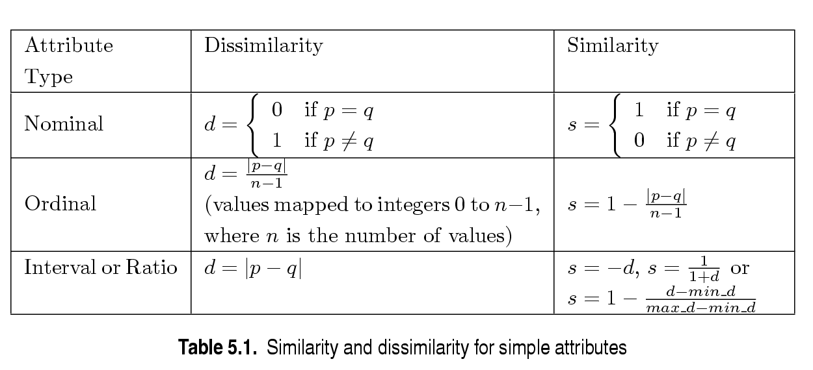
Similarity/Dissimilarity for Simple Attributes
p and q are the attribute values for two data objects.

Slide 49
Euclidean Distance
Euclidean Distance
Where n is the number of dimensions (attributes) and pk and qk are, respectively, the kth attributes (components) or data objects p and q.
Standardization is necessary, if scales differ.

Slide 50
Euclidean Distance
Distance Matrix

Slide 51
Minkowski Distance
Minkowski Distance is a generalization of Euclidean Distance
Where r is a parameter, n is the number of dimensions (attributes) and pk and qk are, respectively, the kth attributes (components) or data objects p and q.

Slide 52
Minkowski Distance: Examples
r = 1. City block (Manhattan, taxicab, L1 norm) distance.
A common example of this is the Hamming distance, which is just the number of bits that are different between two binary vectors
r = 2. Euclidean distance
r → ∞. “supremum” (Lmax norm, L∞ norm) distance.
This is the maximum difference between any component of the vectors
Do not confuse r with n, i.e., all these distances are defined for all numbers of dimensions.

Slide 53
Minkowski Distance
Distance Matrix

Slide 54
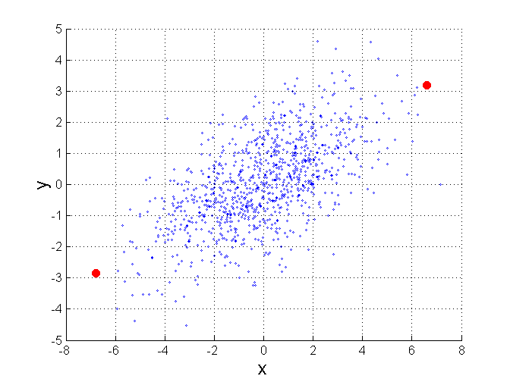
Mahalanobis Distance
Σ is the covariance matrix of the input data X
For red points, the Euclidean distance is 14.7, Mahalanobis distance is 6.

Slide 55
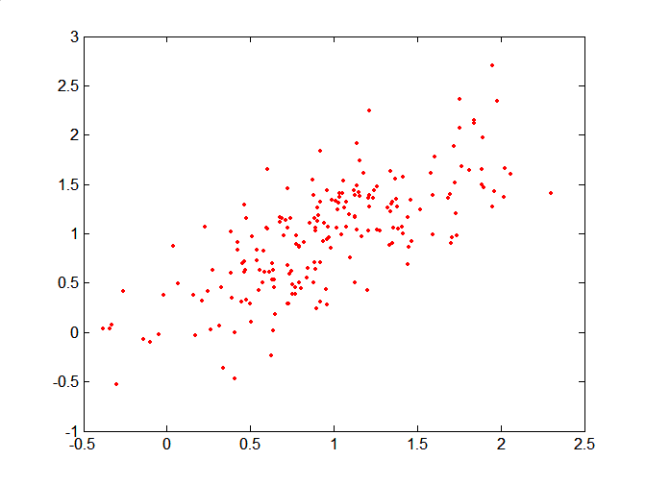
Mahalanobis Distance
Covariance Matrix:
C
B
A: (0.5, 0.5)
B: (0, 1)
C: (1.5, 1.5)
Mahal(A,B) = 5
Mahal(A,C) = 4
A

Slide 56
Common Properties of a Distance
Distances, such as the Euclidean distance, have some well known properties.
d(p, q) ≥ 0 for all p and q and d(p, q) = 0 only if p = q. (Positive definiteness)
d(p, q) = d(q, p) for all p and q. (Symmetry)
d(p, r) ≤ d(p, q) + d(q, r) for all points p, q, and r. (Triangle Inequality)
where d(p, q) is the distance (dissimilarity) between points (data objects), p and q.
A distance that satisfies these properties is a metric

Slide 57
Common Properties of a Similarity
Similarities, also have some well known properties.
s(p, q) = 1 (or maximum similarity) only if p = q.
s(p, q) = s(q, p) for all p and q. (Symmetry)
where s(p, q) is the similarity between points (data objects), p and q.

Slide 58
Similarity Between Binary Vectors
Common situation is that objects, p and q, have only binary attributes
Compute similarities using the following quantities
M01 = the number of attributes where p was 0 and q was 1
M10 = the number of attributes where p was 1 and q was 0
M00 = the number of attributes where p was 0 and q was 0
M11 = the number of attributes where p was 1 and q was 1
Simple Matching and Jaccard Coefficients
SMC = number of matches / number of attributes
= (M11 + M00) / (M01 + M10 + M11 + M00)
J = number of 11 matches / number of not-both-zero attributes values
= (M11) / (M01 + M10 + M11)

Slide 59
SMC versus Jaccard: Example
p = 1 0 0 0 0 0 0 0 0 0
q = 0 0 0 0 0 0 1 0 0 1
M01 = 2 (the number of attributes where p was 0 and q was 1)
M10 = 1 (the number of attributes where p was 1 and q was 0)
M00 = 7 (the number of attributes where p was 0 and q was 0)
M11 = 0 (the number of attributes where p was 1 and q was 1)
SMC = (M11 + M00)/(M01 + M10 + M11 + M00) = (0+7) / (2+1+0+7) = 0.7
J = (M11) / (M01 + M10 + M11) = 0 / (2 + 1 + 0) = 0

Slide 60
Cosine Similarity
If d1 and d2 are two document vectors, then
cos( d1, d2 ) = (d1 • d2) / ||d1|| ||d2|| ,
where • indicates vector dot product and || d || is the length of vector d.
Example:
d1 = 3 2 0 5 0 0 0 2 0 0
d2 = 1 0 0 0 0 0 0 1 0 2
d1 • d2= 3*1 + 2*0 + 0*0 + 5*0 + 0*0 + 0*0 + 0*0 + 2*1 + 0*0 + 0*2 = 5
||d1|| = (3*3+2*2+0*0+5*5+0*0+0*0+0*0+2*2+0*0+0*0)0.5 = (42) 0.5 = 6.481
||d2|| = (1*1+0*0+0*0+0*0+0*0+0*0+0*0+1*1+0*0+2*2) 0.5 = (6) 0.5 = 2.245
cos( d1, d2 ) = .3150

Slide 61
Extended Jaccard Coefficient (Tanimoto)
Variation of Jaccard for continuous or count attributes
Reduces to Jaccard for binary attributes

Slide 62
Correlation
Correlation measures the linear relationship between objects
To compute correlation, we standardize data objects, p and q, and then take their dot product

Slide 63
Visually Evaluating Correlation
Scatter plots showing the similarity from –1 to 1.

Slide 64
General Approach for Combining Similarities
Sometimes attributes are of many different types, but an overall similarity is needed.

Slide 65
Using Weights to Combine Similarities
May not want to treat all attributes the same.
Use weights wk which are between 0 and 1 and sum to 1.

Slide 66
Density
Density-based clustering require a notion of density
Examples:
Euclidean density
Euclidean density = number of points per unit volume
Probability density
Graph-based density

Slide 67
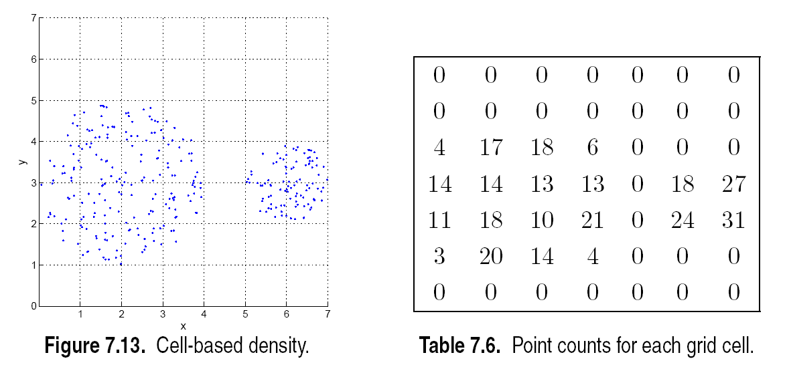
Euclidean Density – Cell-based
Simplest approach is to divide region into a number of rectangular cells of equal volume and define density as # of points the cell contains

Slide 68
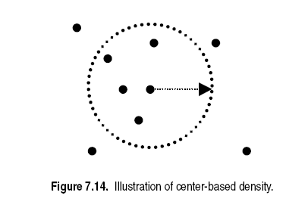
Euclidean Density – Center-based
Euclidean density is the number of points within a specified radius of the point

