Slide 1
Principle Component Analysis
Dimensionality Reduction Technique
Utkarsh Sharma
Asst. Prof CSE Dept.
JUET(M.P.) India

Slide 2
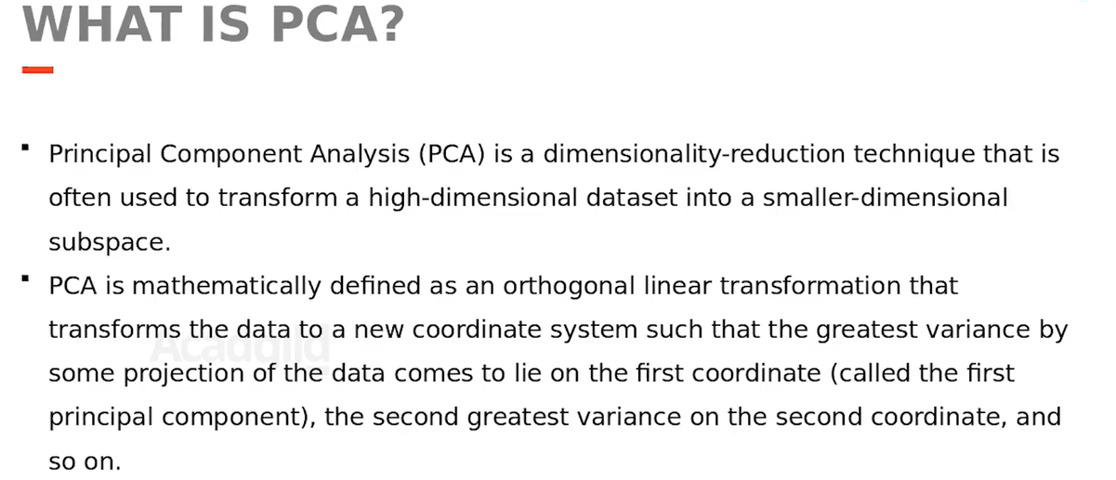

Slide 3
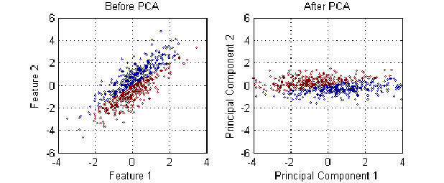
Representation of PCA

Slide 4
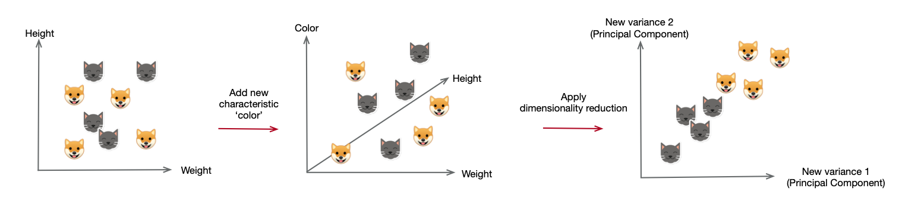
Another Representation(A Simpler one…)

Slide 5
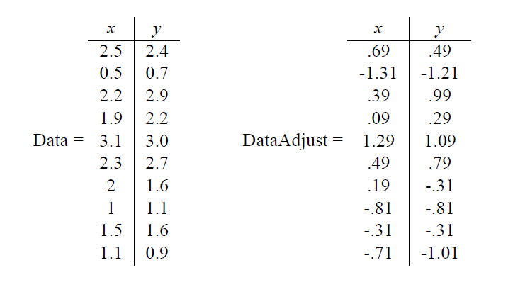
Consider the data
X- Mean(X)
Y- Mean(Y)

Slide 6
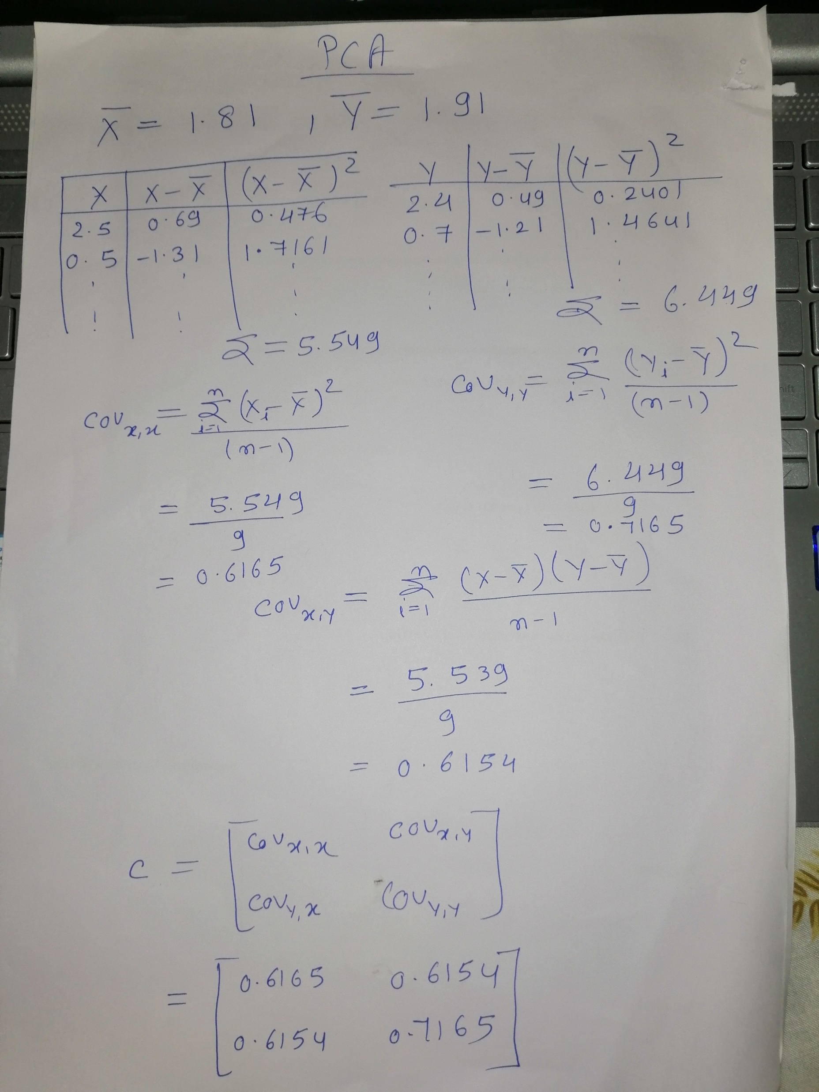
Calculate the C0 variance Matrix

Slide 7
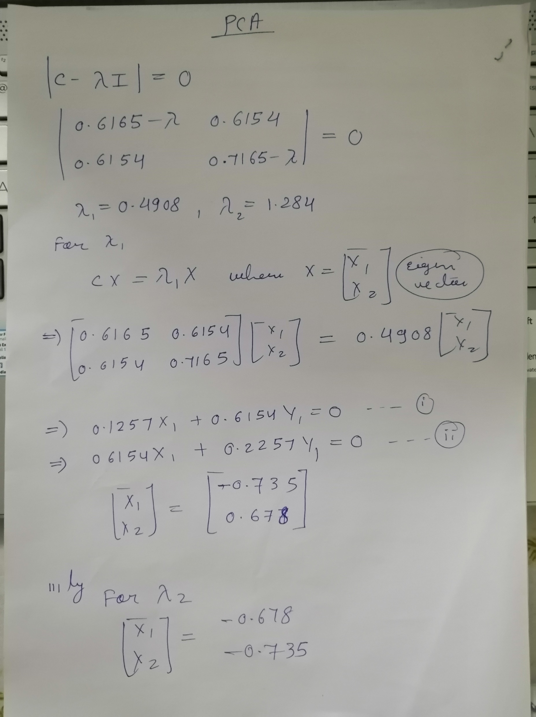
Calculate the Eigen vectors

Slide 8
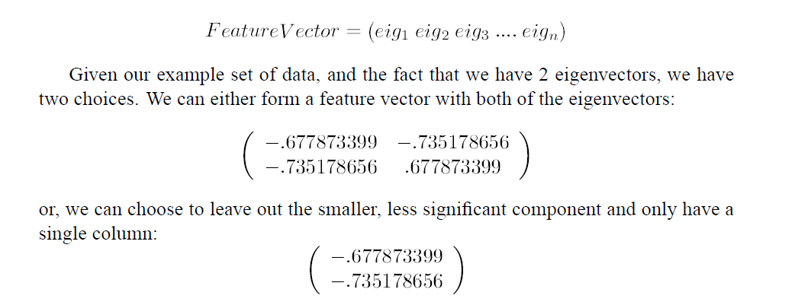
Choose Principle Component

Slide 9
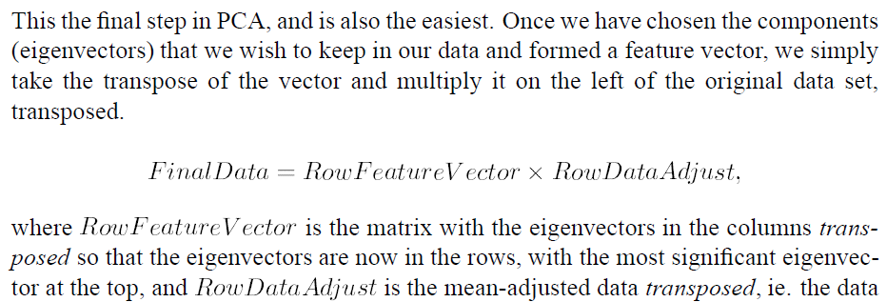
Deriving the final data

Slide 10
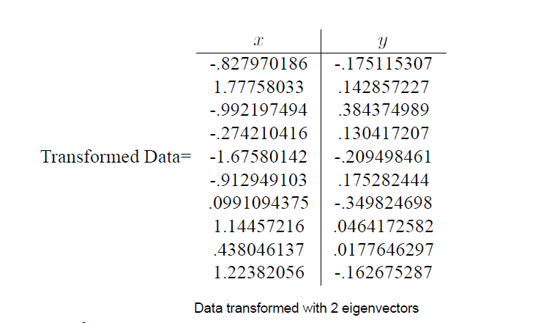
Final data with two eigen vectors

Slide 11
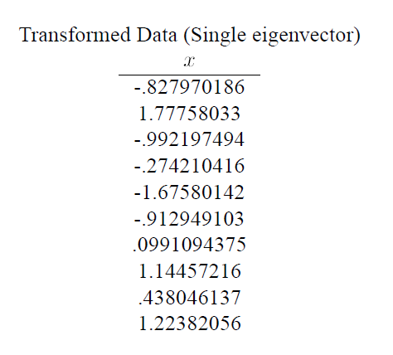
Final data with one eigen vector

Slide 12
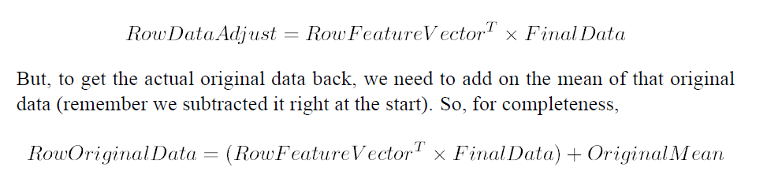
Recover the original data

