Slide 1
FACE DETECTION AND EXPRESSION ANALYSIS
Chinmai S Naregal 19BPS1021
Pratyush Raj Das 19BPS1022
Utkarsh Yadav 19BPS1100

Slide 2
INTRODUCTION
The goal is to design and implement a novel face detection and expression recognition system using available technology and define its importance in modern image processing which enhances human - computer interactions for various smart applications and to study how contextually aware systems or robots can enhance our day to day life.
The face detection and expression recognition system should be able to take live video input from the robot’s camera ( in this case the webcam ) and read the video frame by frame and detect the facial features such as left eye, right eye and nose/mouth , using the classifiers and correctly identify the facial expression of the person. A CNN model will be built to study the training set in order to accurately predict the facial expression.
The system will have an experimental method of workflow and the following conditions are considered favorable for the correct detection of a particular individual’s face and recognition of the person’s expression so it is assumed as such:
The user is in a well lit surrounding
The user is in a neutral background
The CNN model has been sufficiently trained and tested.

Slide 3
PROPOSED WORK
The project will take live video input from the user’s webcam and parses frame by frame image to the program. Using the Haar Cascade classifier we will be able to identify distinct facial features like eyes, nose and mouth. The trained CNN model is loaded onto the system. This test image of detected face is sent the loaded CNN model for expression analysis and classification and the predicted emotion is shown in the output.
Face Detection process:
Each live video frame is converted to grayscale after loading it. The majority of the images we encounter are RGB channel images (Red, Green, Blue). As a result, when OpenCV reads an RGB image, it stores it in the BGR (Blue, Green, Red) channel. This BGR channel must be converted to grey channel for image
recognition purposes. The reason for this is because grey channel is simple to process and computationally less intensive because it just has one black-and-white channel.

Slide 4
METHODOLOGIES USED
The system will be built using the Python language for its simplicity and its wide availability of packages that supports the pre-processing necessary for the working of the system and the reusability and scalability it provides for constant updating.
OpenCV
OpenCV is an open-source library.
TensorFlow
TensorFlow APIs use Keras to allow users to make their own machine learning models.
Neural Networks
Classification Models

Slide 5
LINK FOR IMAGE DATASET
https://www.kaggle.com/jonathanoheix/face-expression-recognition-dataset
Notes:
With this dataset, we can prepare our training and validation sets. In order to do the same, we need to do some image augmentation first, essentially the image needs to be resampled. So they undergo zoom change, shear change, rotation change, rescaling.

Slide 6
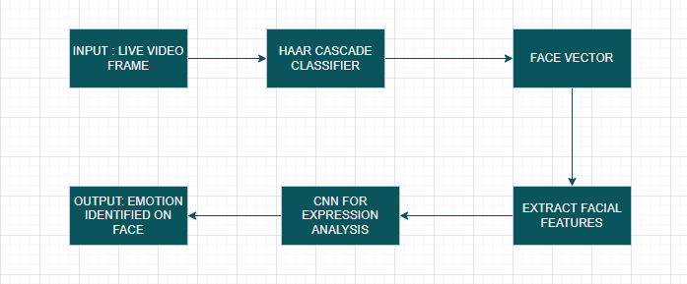
FLOWCHART

Slide 7
LITERATURE SURVEY
S.No. | Title | Journal/year of publication | Data set used | Methodologies used | Metrics used | Interpretation of Results
1. | Facial Expression Recognition with LBP and ORB Features | Hindawi Computational Intelligence and Neuroscience Volume 2021 | JAFFE database | Feature selection - LBP and ORB, CNN,SVM | Accuracy,K - fold validation | The experimental results showed that the proposed framework(LBP + ORB)performed better than some widely used methods based on the JAFFE database, CK+ database, and MMI database.
2. | An Analytical Appraisal for Supervised Classifiers’ Performance on Facial Expression Recognition Based on Relief-F Feature Selection | ICMAICT 2020, Maiwan B. Abdulrazaq J. Phys.: Conference Series | CK+ dataset | KNN,RBF,SVM,MLP,RFFeature selection - Relief -F | Confusion matrix, f-measure, accuracy,precision, recall | The precisedclassifier is KNN with 94.93 % of accuracy ratio in facial expression recognition according to CK+ dataset. Meanwhile, RF is considered as the nearest classifier to KNN with the accuracy ratio of 93.95%. J48 with the accuracy ratio of 92.27% is in the middle among the other classifiers.
3. | An improved face recognition algorithm and its application in attendancemanagement system | ArrayVolume 5/March 2020 | There are three datasets each having many orientations and conditions of faces that are confined to 181 pixels: dataset [I], dataset [II], and dataset [III] | Dual Cross Pattern (DCP), LBP and Support VectorMachine (SVM) | Accuracy | We obtained higherpixel and threshold values.After applying equationsto the original input images, we obtained an improved high quality images using our method, which implies better image quality that will expose better image features and enabled more accurate image histograms for facial image comparison, thus resulted in an improved LBP codes, that will stimulate the overall face recognition accuracy.

Slide 8
4. | Facial Emotion Recognition: A Brief Review | International Conference on Sustainable Engineering, Technology and Management (ICSETM -2018), Dec. 20, 2018 | A variety of dataset available currently (Cohn Kanada (CK+), JAFFE, MMI etc). | Local Binary Pattern (LBP), Linear Discriminant Analysis (LDA), Fisher Face Method, (PCA), (CNN), Line Edge Map (LEM), (SVM), Bayesian Network (BN), Sparse Representation Method (SRM), Hidden Markov Model (HMM) | Accuracy | Here, the authors have set out to do a comparison and the comparison is made randomly based on the expressions compared, methods and techniques used for face detection, feature extraction and expression classifications. The expressions are lumped into groups such as (Anger, Contempt, Disgust, Fear, Happy, Sadness, Surprise, Neutral) based on the ability of the algorithms to detect said facial expressions. Based on the results, we can decide that “Define Distance between Two Centers of Both Eyes” (face detection) + “Wavelet Entropy” (feature extraction) + “Jaya Algorithm ” (expression classification ) has an accuracy of about 96.8% and is the most accurate combination of expressions.
Notes:
From the papers we have studied, most emotion recognition projects use 4 conv2D layers with varying filter sizes. Currently, we are also pursuing the same as we felt it was superior to other projects of the nature.

Slide 9
Thank you

