Slide 1
Lec 3

Slide 2
Micromort: chance of death in one million → Value for life
Russian Barrel: For one micromort → people are demanding millions
Car purchase → the car is reducing the micromort to half, you won’t spend 1 million $ more to purchase it.
Qualy →

Slide 3
Utility of Money
Monotonic Preference: It will usually be the case that an agent prefers more money to less, all other things being equal. We say that the agent exhibits a monotonic preference for more money. This does not mean that money behaves as a utility function, because it says nothing about preferences between lotteries involving money.

Slide 4
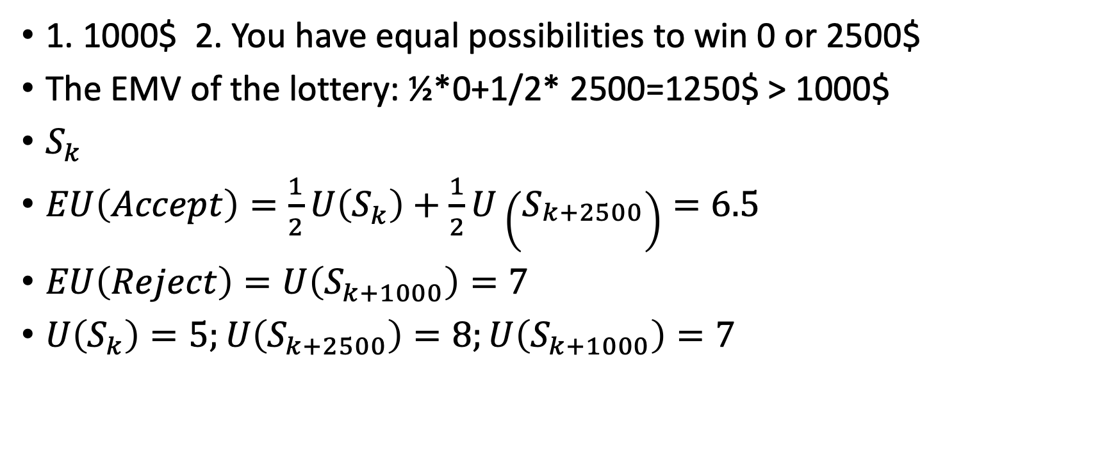
Expected Monetory Value (EMV)
1. 1000$ 2. You have equal possibilities to win 0 or 2500$
The EMV of the lottery: ½*0+1/2* 2500=1250$ > 1000$
$S_{k}$
$EU\left(Accept\right)=\frac{1}{2}U\left(S_{k}\right)+\frac{1}{2}U\left(S_{\begin{aligned}k+2500 \\ \end{aligned}}\right)=6.5$
$EU\left(Reject\right)=U\left(S_{k+1000}\right)=7$
$U\left(S_{k}\right)=5;U\left(S_{k+2500}\right)=8;U\left(S_{k+1000}\right)=7$

Slide 5
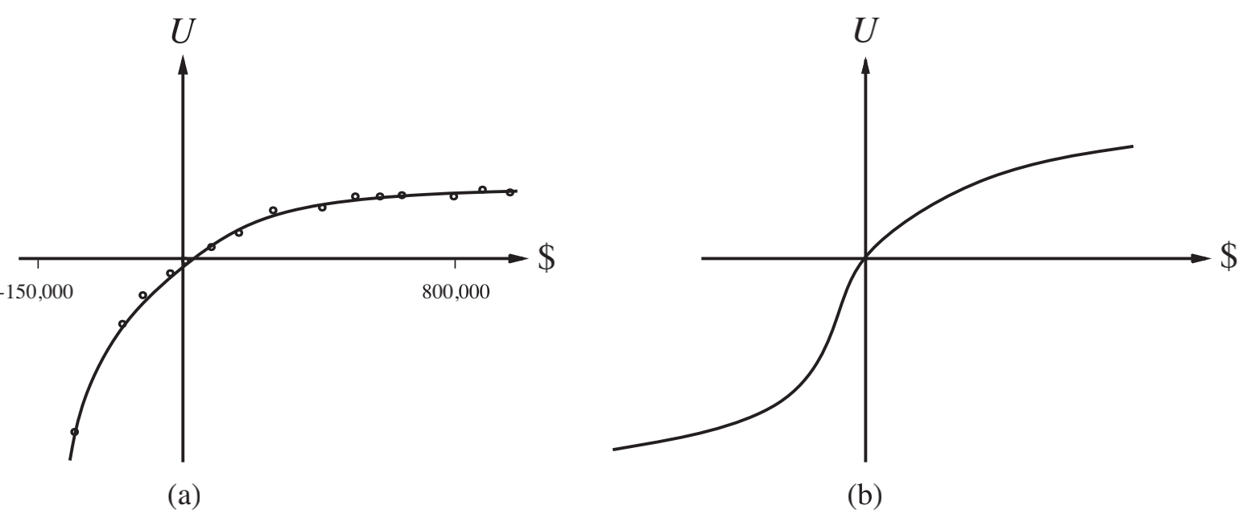
Utility of Money

Slide 6
Value of the lottery → Certainty equivalent → the value the agent will accept in lieu of the lottery
$400 in exchange of a lottery 0 & 1000$ with equal probability
Insurance premium = EMV – Certainty equivalent

Slide 7
Human Judgement Systems and Irrationality
Optimizer’s curse:
Normative theory Descriptive theory
A: 80% chance of $4000 C: 20% chance of $ 4000
B: 100% chance of $3000. D: 25% chance of $3000
U(3000)>U(4000)
B over A. C over D. U(4000)>U(3000)
Certainty effect

Slide 8
Human Judgement Systems and Irrationality
Black. Red : 1/3 Yellow
A: $100 for red ball A: $ 100 for red & yellow
B: $ 100 for black ball B: $100 for black and yellow
A over B B over A
Ambiguity Aversion

Slide 9
Framing effect:
Anchoring effect: 500; 2000 1000

Slide 10
Multiattribute Utility Function
Money+ Human lives
X={X₁,…., X_{n}} → Survival of human lives
Dominance:
{cost, noise pollution, safety}
S1 and S2 → Strict dominance

Slide 11
Preference Structure and multiattribute utility
Qualitative probabilistic n/ws:
n: attributes d: dimensions
U(x1,…, xn)= F[f1(x1),…,fn(xn)]
Preference without uncertainty:

Slide 12
Basic regularity
Preference independence
X1, X2, X3 iff: {x1,x2,x3} and {x1’, x2’, x3}
{noise, cost, death}
A: 20000 people lives cost 4billion $. Safety level 0.06
B: 70000 “ “ cost 3.7 billion $ Safety level 0.06
{cost, death} → noise
{noise, death}→ cost
Mutual Preference Independence

Slide 13
EU(accept)=(1/2)(U(S_{k-400}+S_{k+1000})
EU(Decline)=U(S_k)
U(S_{k-400})=1; U(S_k)=6; U(S_{k+100})=7
EU(Accept)=4; EU(Decline)=6

