Slide 1
Lecture 8

Slide 2
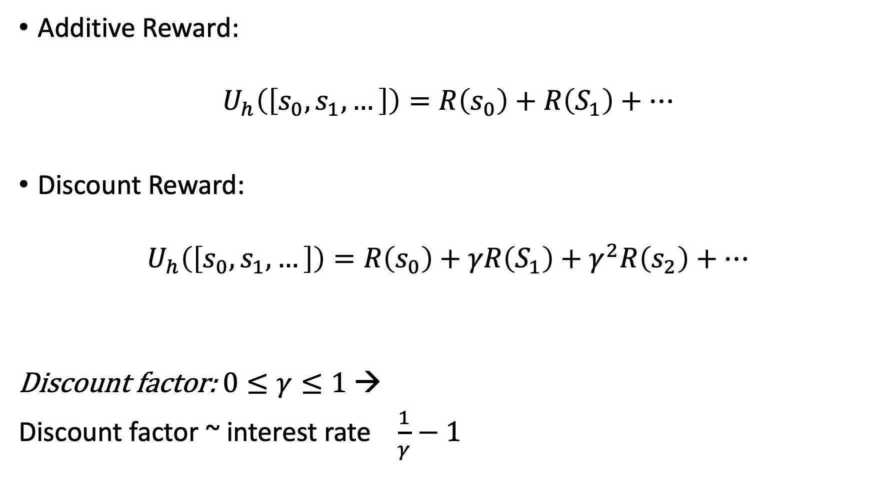
Additive Reward:
$$U_{h}\left(\left[s_{0}, s_{1},…\right]\right)=R\left(s_{0}\right)+R\left(S_{1}\right)+…$$
Discount Reward:
$$U_{h}\left(\left[s_{0}, s_{1},…\right]\right)=R\left(s_{0}\right)+γR\left(S_{1}\right)+γ^{2}R\left(s_{2}\right)+…$$
Discount factor: $0≤γ≤1$ →
Discount factor ~ interest rate $\frac{1}{γ}−1$

Slide 3
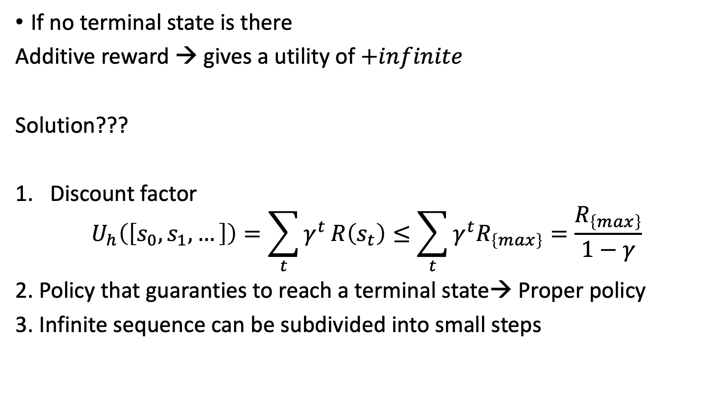
If no terminal state is there
Additive reward → gives a utility of $+infinite$
Solution???
Discount factor
$$U_{h}\left(\left[s_{0},s_{1},…\right]\right)=\sum_{t}{γ^{t}}R\left(s_{t}\right)≤\sum_{t}{{γ^{t}R}_{\left\{max\right\}}}=\frac{R_{\left\{max\right\}}}{1−γ}$$
2. Policy that guaranties to reach a terminal state→ Proper policy
3. Infinite sequence can be subdivided into small steps

Slide 4
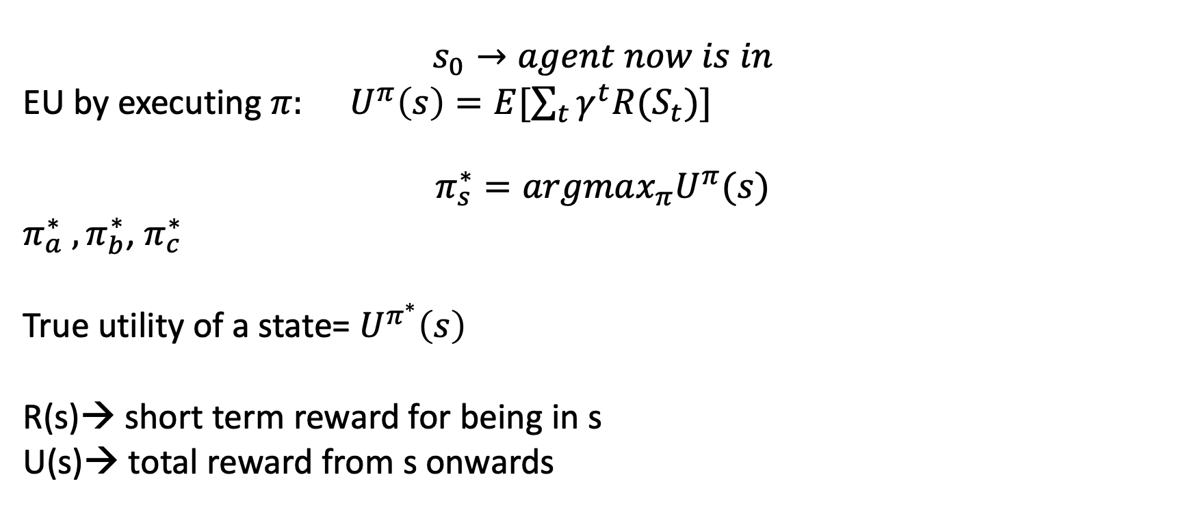
Optimal policies and Utilities of the States
$$s_{0}→agent now is in$$
EU by executing $π: U^{π}\left(s\right)=E[\sum_{t}{γ^{t}R(S_{t})}]$
$$π_{s}^{∗}=argmax_{π}U^{π}(s)$$
$π_{a}^{∗} ,π_{b}^{∗}$, $π_{c}^{∗}$
True utility of a state= $U^{π^{∗}}\left(s\right)$
R(s)→ short term reward for being in s
U(s)→ total reward from s onwards

Slide 5
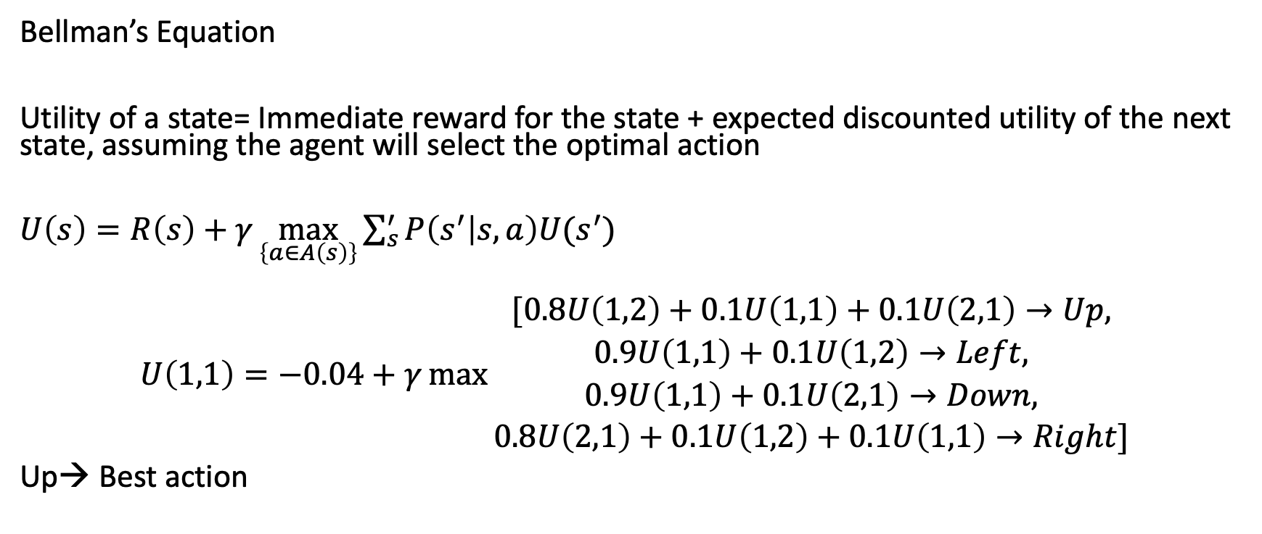
Value Iteration
3
2
1
 |  |  | +1
 |  |  | -1
START
Bellman’s Equation
Utility of a state= Immediate reward for the state + expected discounted utility of the next state, assuming the agent will select the optimal action
$U\left(s\right)=R\left(s\right)+γ\max_{\left\{a∈A\left(s\right)\right\}}{\sum_{s}^{′}{P\left(s^{′} | s,a\right)U(s^{′})}}$
$$U\left(1,1\right)=−0.04+γ\max{\begin{aligned}[0.8U\left(1,2\right)+0.1U\left(1,1\right)+0.1U\left(2,1\right)→Up, \\ 0.9U\left(1,1\right)+0.1U\left(1,2\right)→Left, \\ 0.9U\left(1,1\right)+0.1U\left(2,1\right)→Down, \\ 0.8U\left(2,1\right)+0.1U\left(1,2\right)+0.1U\left(1,1\right)→Right]\end{aligned}}$$
Up→ Best action
1 2 3 4

Slide 6
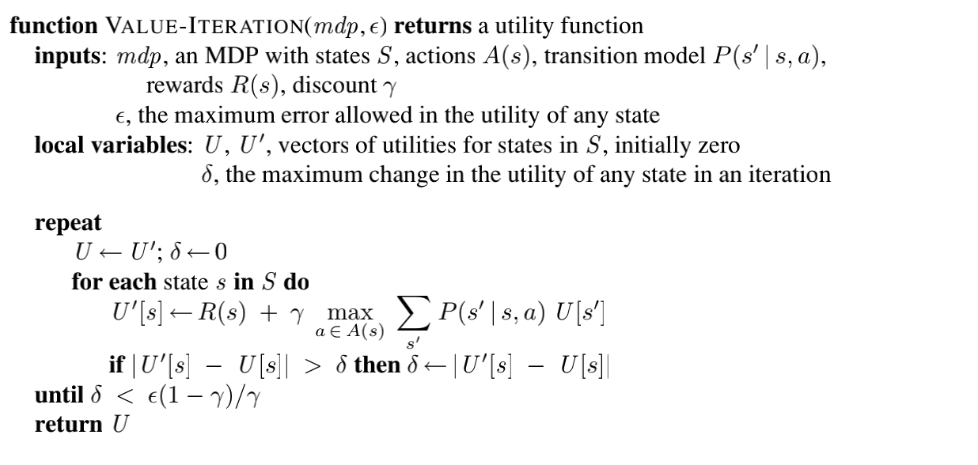

Value iteration algorithm
$$U_{i}\left(s\right)→utility value of state s in iteration i$$
Bellman Update:
$$U_{\left\{i+1\right\}}\left(s\right)←R\left(s\right)+γ\max_{\left\{a∈A\left(s\right)\right\}}{\sum_{s′}{P\left(s^{′} | s,a\right)U_{i}(s^{′})}}$$

Slide 7
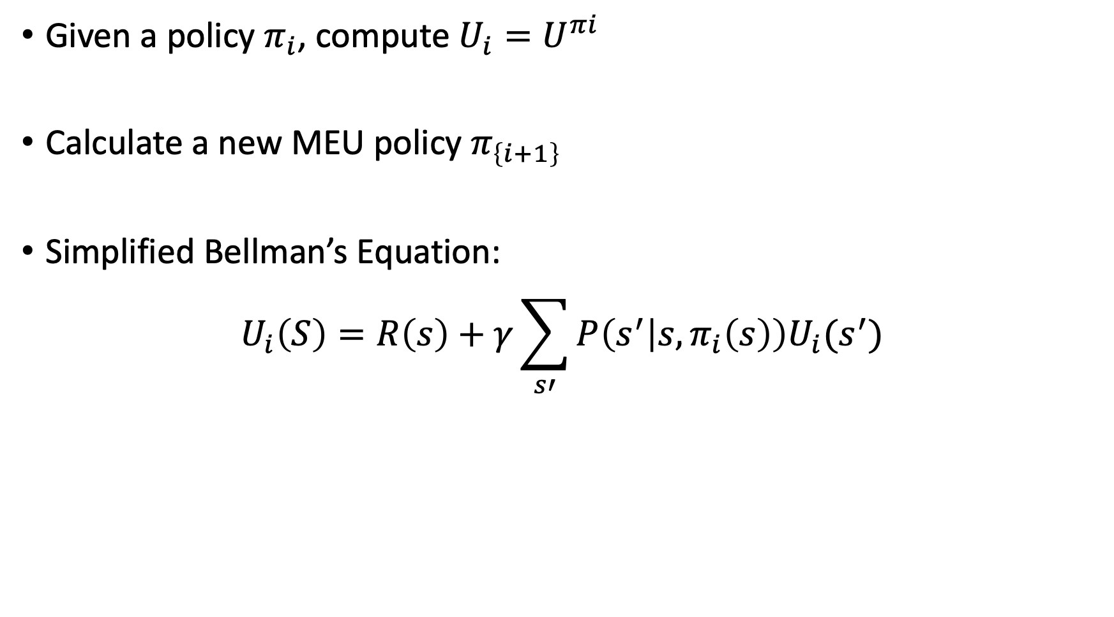
Policy Iteration
Given a policy $π_{i}$, compute $U_{i}=U^{πi}$
Calculate a new MEU policy $π_{\left\{i+1\right\}}$
Simplified Bellman’s Equation:
$$U_{i}\left(S\right)=R\left(s\right)+γ\sum_{s′}{P\left(s^{′} | s,π_{i}\left(s\right)\right)U_{i}(s^{′})}$$

Slide 8
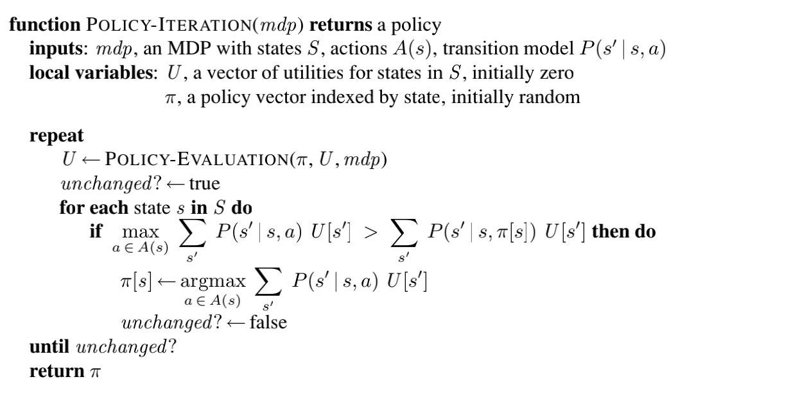
Policy Iteration Algorithm

Slide 9
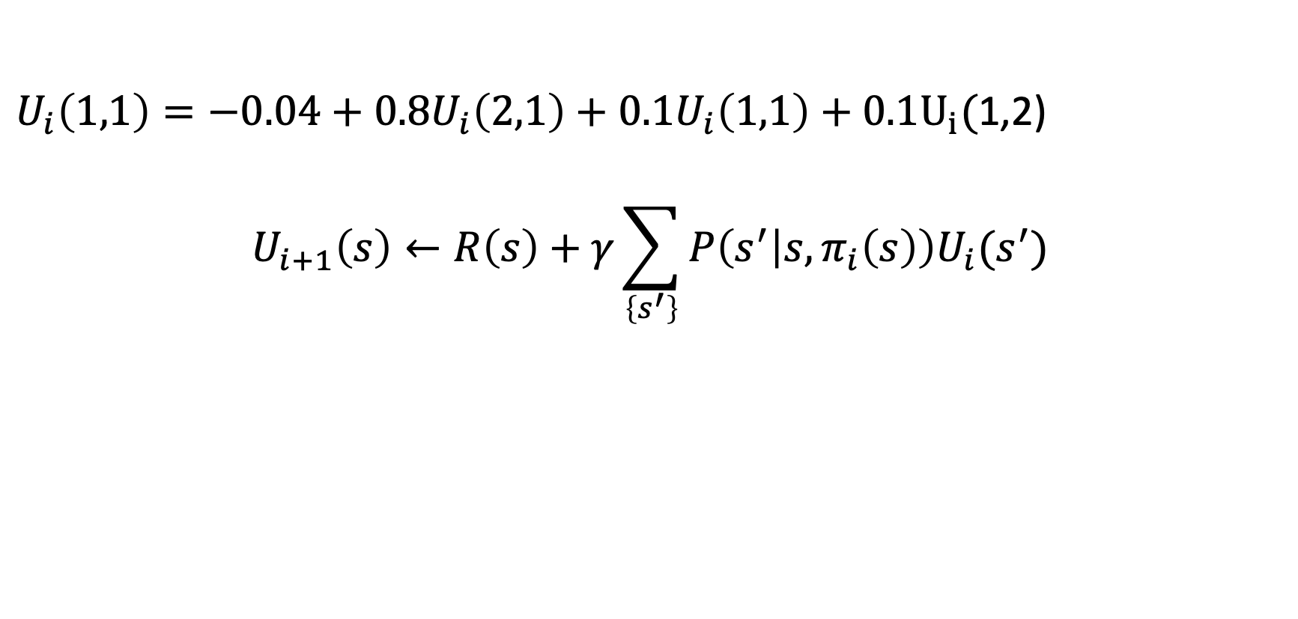
Example
$U_{i}\left(1,1\right)=−0.04+0.8U_{i}\left(2,1\right)+0.1U_{i}\left(1,1\right)+0.1U_{i}($1,2)
$$U_{i+1}\left(s\right)←R\left(s\right)+γ\sum_{\left\{s^{′}\right\}}{P\left(s^{′} | s,π_{i}\left(s\right)\right)U_{i}(s^{′})}$$
3
2
1
 |  |  | +1
 |  |  | -1
START
1 2 3 4

Slide 10
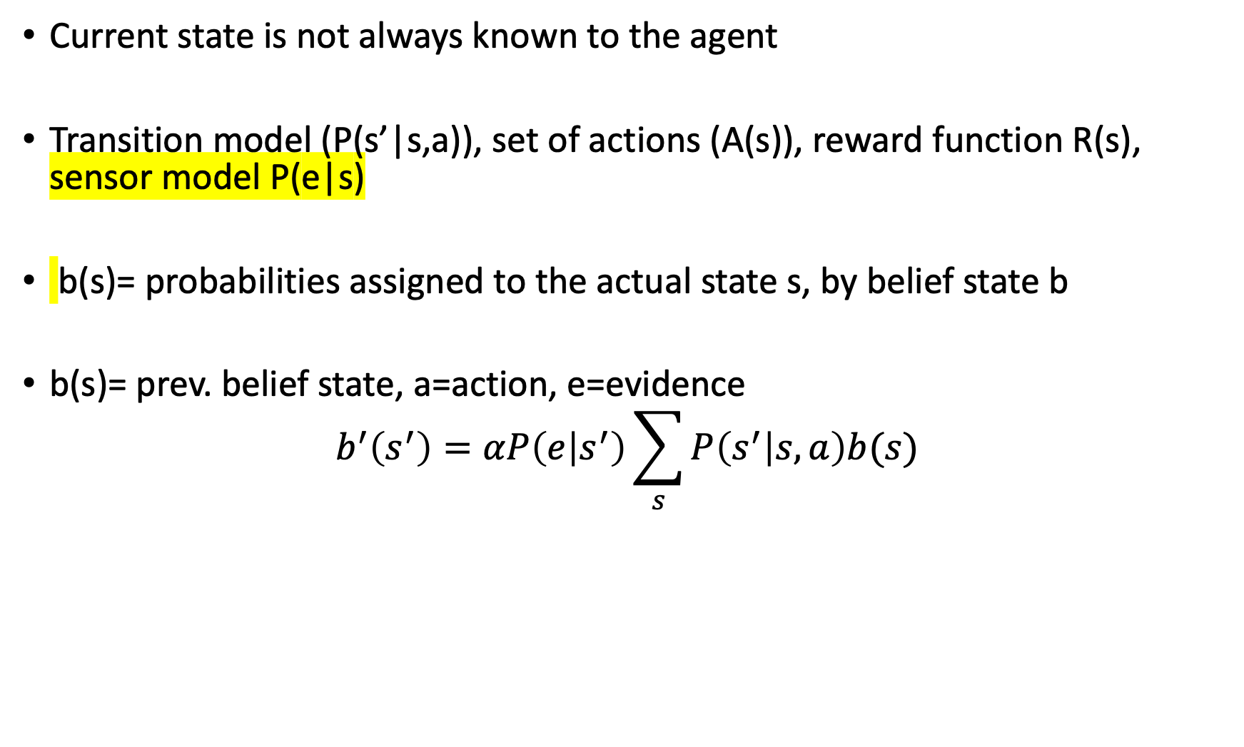
Partially Observable MDP (POMDP)
Current state is not always known to the agent
Transition model (P(s’|s,a)), set of actions (A(s)), reward function R(s), sensor model P(e|s)
b(s)= probabilities assigned to the actual state s, by belief state b
b(s)= prev. belief state, a=action, e=evidence
$$b^{′}\left(s^{′}\right)=αP\left(e | s^{′}\right)\sum_{s}{P\left(s^{′} | s,a\right)b(s)}$$

Slide 11
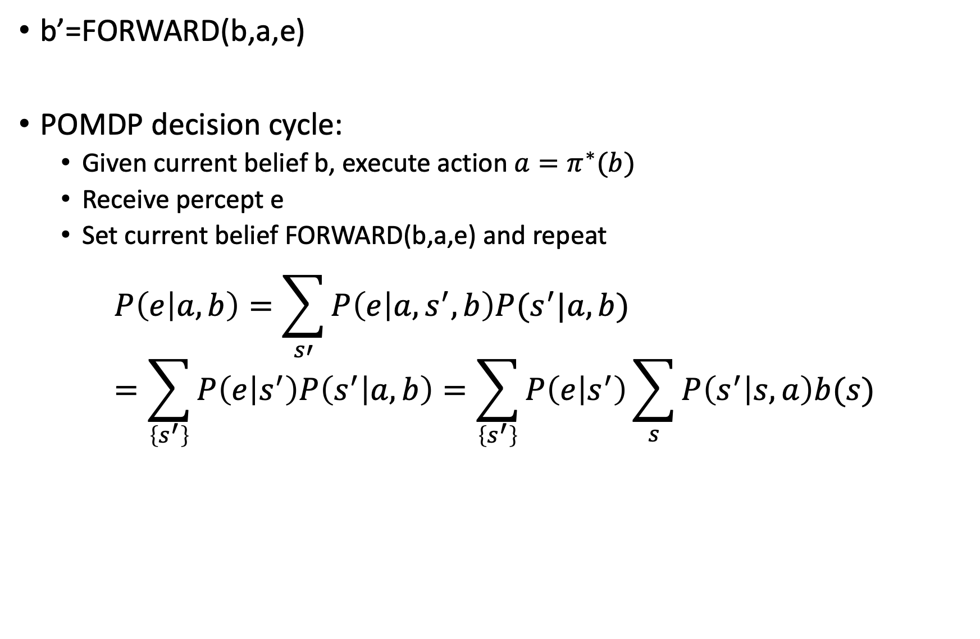
b’=FORWARD(b,a,e)
POMDP decision cycle:
Given current belief b, execute action $a=π^{∗}(b)$
Receive percept e
Set current belief FORWARD(b,a,e) and repeat
$$P\left(e | a,b\right)=\sum_{s′}{P\left(e | a,s^{′},b\right)P(s^{′}|a,b)}=\sum_{\left\{s^{′}\right\}}{P\left(e | s^{′}\right)P\left(s^{′} | a,b\right)=\sum_{\left\{s^{′}\right\}}{P\left(e | s^{′}\right)\sum_{s}{P\left(s^{′} | s,a\right)b(s)}}}$$

Slide 12
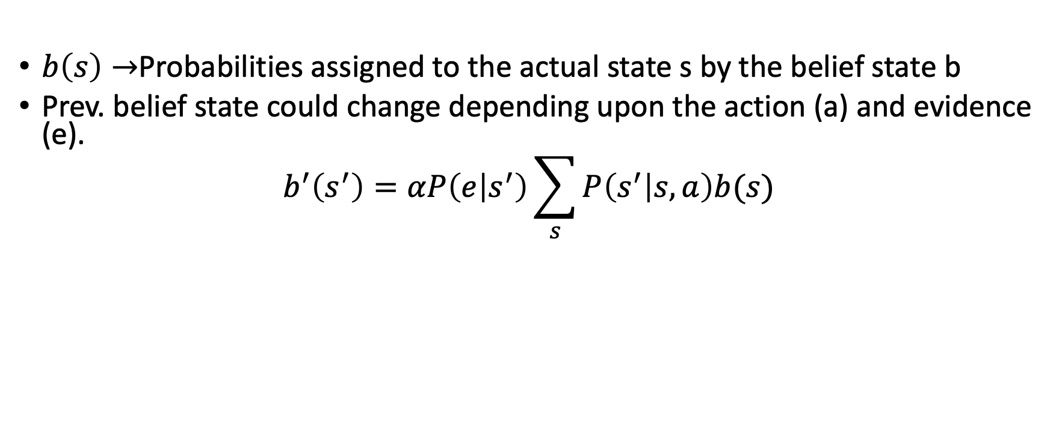
Partially Observable MDPs (POMDPs)
$b\left(s\right)→$Probabilities assigned to the actual state s by the belief state b
Prev. belief state could change depending upon the action (a) and evidence (e).
$$b^{′}\left(s^{′}\right)=αP\left(e | s^{′}\right)\sum_{s}{P\left(s^{′} | s,a\right)b(s)}$$
3
2
1
Y | X | Z | +1
A |  |  | -1
START | B
1 2 3 4

Slide 13
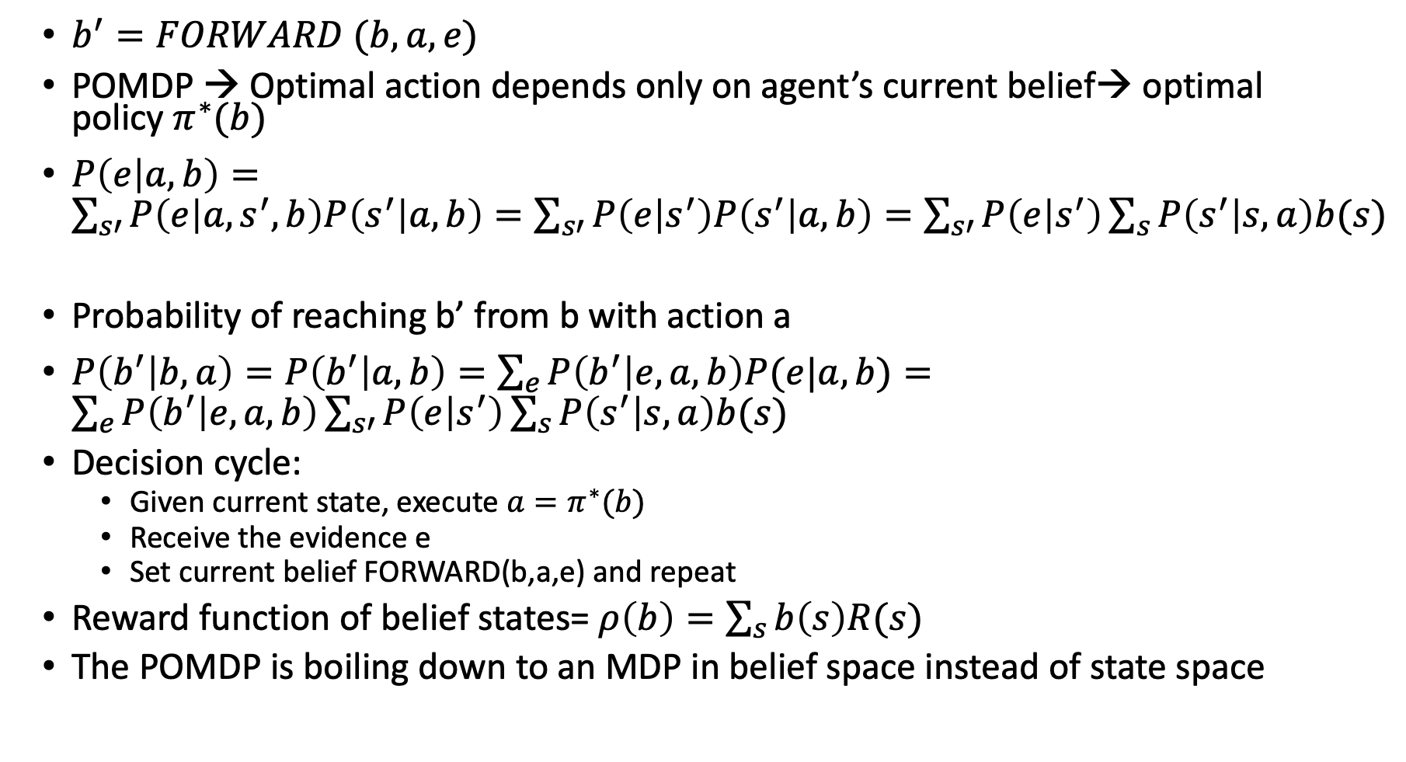
Partially Observable MDPs (POMDPs)
$b^{′}=FORWARD (b,a,e)$
POMDP → Optimal action depends only on agent’s current belief→ optimal policy $π^{∗}(b)$
$P\left(e | a,b\right)=\sum_{s′}{P\left(e | a,s^{′},b\right)P\left(s^{′} | a,b\right)=\sum_{s′}{P\left(e | s^{′}\right)P\left(s^{′} | a,b\right)=\sum_{s′}{P\left(e | s^{′}\right)\sum_{s}{P\left(s^{′} | s,a\right)b(s)}}}}$
Probability of reaching b’ from b with action a
$P\left(b^{′} | b,a\right)=P\left(b^{′} | a,b\right)=\sum_{e}{P\left(b^{′} | e,a,b\right)P(e|a,b)}=\sum_{e}{P\left(b^{′} | e,a,b\right)\sum_{s′}{P\left(e | s^{′}\right)\sum_{s}{P\left(s^{′} | s,a\right)b(s)}}}$
Decision cycle:
Given current state, execute $a=π^{∗}(b)$
Receive the evidence e
Set current belief FORWARD(b,a,e) and repeat
Reward function of belief states= $ρ\left(b\right)=\sum_{s}{b\left(s\right)R(s)}$
The POMDP is boiling down to an MDP in belief space instead of state space

Slide 14
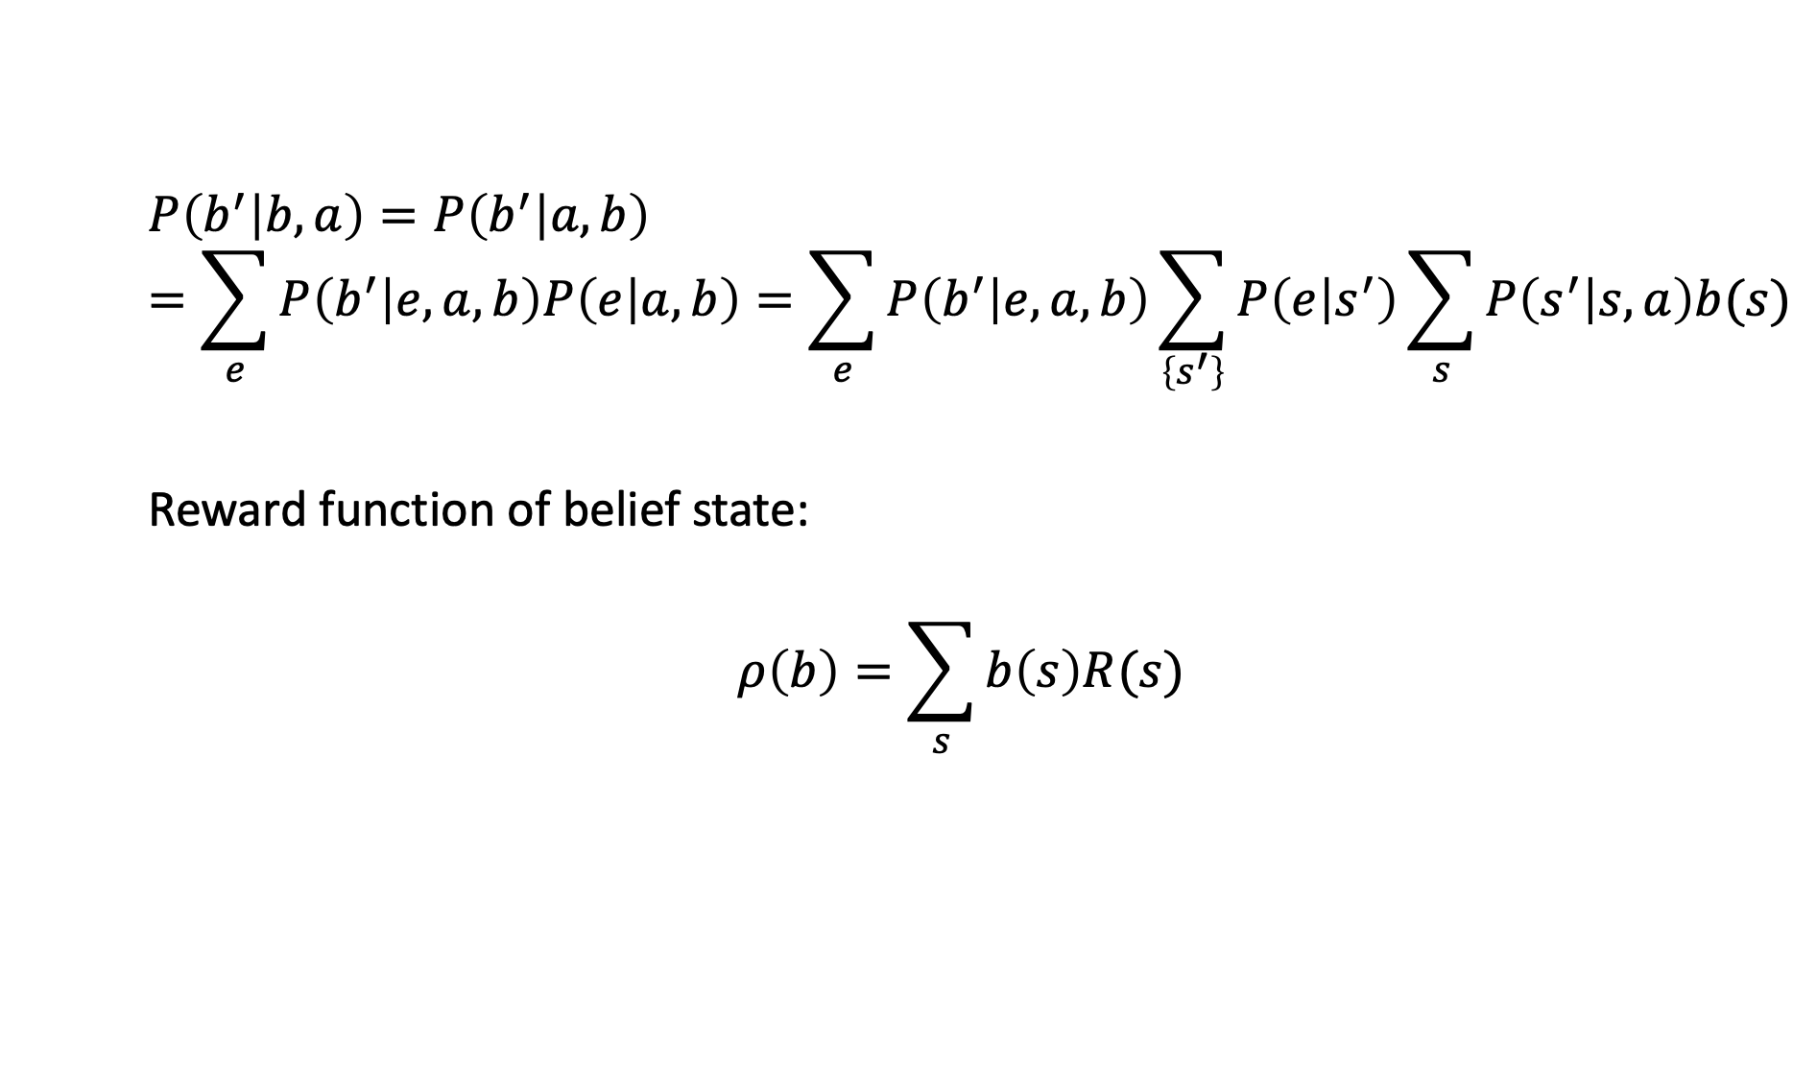
$$P\left(b^{′} | b,a\right)=P\left(b^{′} | a,b\right)=\sum_{e}{P\left(b^{′} | e,a,b\right)P\left(e | a,b\right)=\sum_{e}{P\left(b^{′} | e,a,b\right)\sum_{\left\{s^{′}\right\}}{P\left(e | s^{′}\right)\sum_{s}{P\left(s^{′} | s,a\right)b(s)}}}}$$
Reward function of belief state:
$$ρ\left(b\right)=\sum_{s}{b\left(s\right)R(s)}$$

Slide 15
Dynamic Decision network
A_{t-2}
A_{t-1}
X_t-1
X_t
E_t-1
E_t

Slide 16
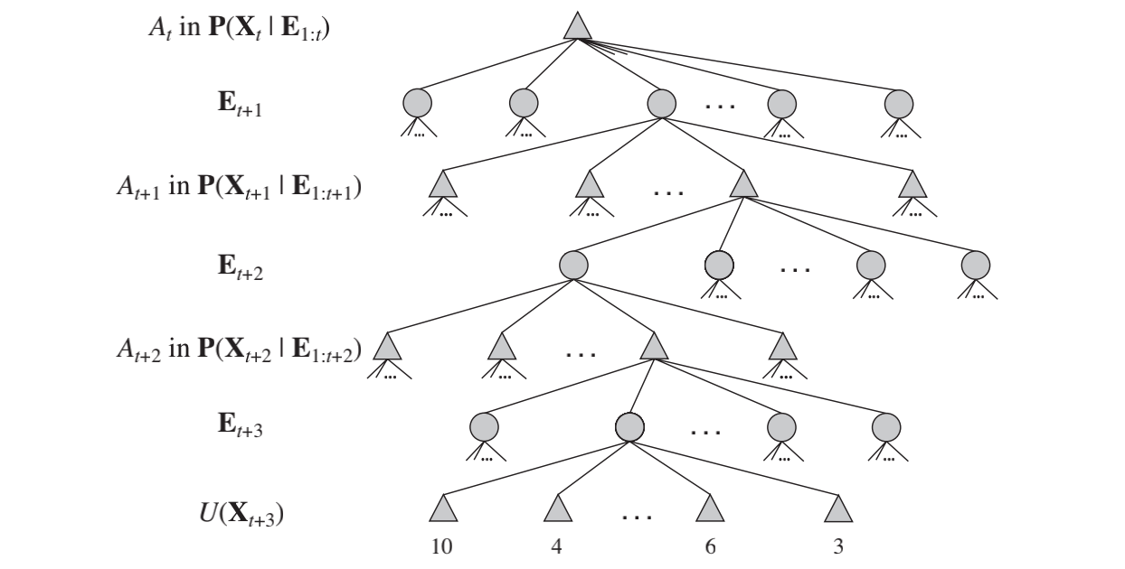
Look Ahead Solution of DDN

