Slide 1
Implement a congestion control algorithm for VANETs
Suresh BOJJAM (M20AIE313)
UTKARSH THUSOO (M20AIE318)

Slide 2
Problem statement
Congestion in VANET affects the performance, delays/drops in exchanging the emergency messages in particular when road accidents and high demand messages are delivered, causes unpredictable routing patterns and degrade the performance of the network. The traffic jams always lead to delays, fuel wastage and monetary loss therefore it is very important to have a centralized/de-centralized congestion control algorithm in place to avoid it.

Slide 3
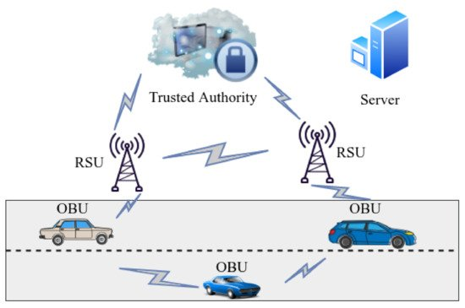
VANET
VANETs help in improving roadway protection and traffic efficiency leading to reduced road dangers for drivers, customers and ramblers.
There are multiple components which are involved when dealing with VANETS. Some of them are:
Vehicle-to-Vehicle (V2V) – Vehicle to Vehicle Communication which takes place between On-Board Units (OBUs)
Vehicle-to-Infrastructure (V2I) – occur amongst Road Side Units (RSUs) and OBUs

Slide 4
about
Quality of service (QoS) is one of the most important things we need to handle. One of the most important components under QoS is Congestion Control. Congestion Control can be broadly taken care under three main sections:
broadcast power control,
packet broadcast frequency control
packet period.

Slide 5
methodology
Types of Congestion control
Congestion control can be broadly characterized under two sections can be broadly characterized under two sections:
Open loop Congestion Policy: This deals with all the policies which are pre-emptive steps to avoid congestion i.e., before the congestion has actually taken place. Commonly used techniques under it are
Acknowledgement Policy
Discarding Policy
Retransmission Policy
Closed loop Congestion Policy: This deals with steps for dealing with congestion once it has occurred. Some of the techniques under this are:
Back pressure
Implicit signaling
Explicit Signaling

Slide 6
methodology
Reasons of Congestion
Traffic congestion due to accident.
Rate of transmission of packets.
The high density of nodes.
High volume information sharing over the limited bandwidth.
Topological dynamics of the VANet Or Rapid topology changes.

Slide 7
methodology
Proposed Solution
One of the main reasons for congestion is the Lack of central coordination and due to inefficiency of the algorithm like frequent broadcast messaging. The basic idea proposed in this model is that a centralized server with required information can be processed with the algorithm, available static info (bandwidth of the region, local maps and distances between different locations & etc) and take an action to avoid the congestion Or alert the nodes on congestion and take an alternative path. And a Localized decision mechanism for local decision making like computing power transmission and etc.

Slide 8
implementation
Parameters to consider in the algorithm
Node density
Given any point in time we can identify the number of nodes based on the beacon MAC header. Density can be determined based on the region and number of vehicles in the driven state.
Solution: increase /decreasing the bandwidth also can lead to better utilization of the network.

Slide 9
implementation
Parameters to consider in the algorithm
The oscillation between high power and low power transmissions
Power transmission can be computed based on the algorithm the number of beacons that failed /beacons sent)*100
single high power transmission can lead to congestion
same power transmission at different nodes.
Power transmission can be different at different nodes and should be oscillated based on the info like distance to travel, speed of travel and etc.

Slide 10
implementation
Parameters to consider in the algorithm
Centralized and localized data congestion control
Using machine learning clustering. k-means clustering algorithm.

Slide 11
implementation
Parameters to consider in the algorithm
Localized decision making
For certain decisions like computing the power transmission based on existing congestion, channel busy usage, reducing the rate of beacons transmission or sending only emergency messages on the busy channel.

Slide 12
implementation
Parameters to consider in the algorithm
Overall congestion percentage

Slide 13
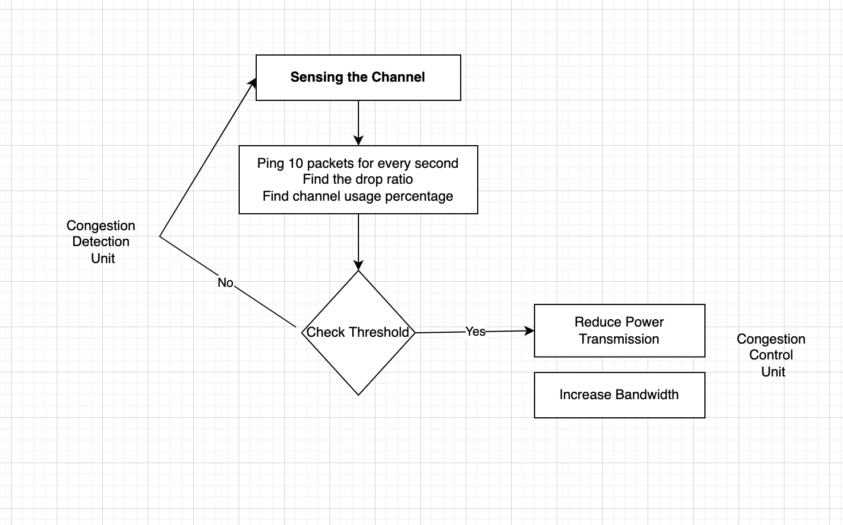
implementation

Slide 14
algorithm
The proposed procedure works with approaches with one working on server level while another working in a localized way at the RSU level. Below algorithm takes into account both Congestion detection and control.

Slide 15
algorithm
Centralized or Server Level Algorithm
load_static_info() <- region info, bandwidth and history of information, fetch meta-heuristics
compute_vehicle_density():
status := NO_DENSITY
// this can be get based
set current_vehicle_count := get_current_vehicle_count():on beacon and MAC header information and maintaining the count with TTL.
set max_vehicle_count: // this is based on region
if(current_vehicle_count >= max_vehicle_count):
status := DENSE
elif(current_vehicle_count >= max_vehicle_count/2):
status := MODERATE
if(status := DENSE):
//Increase bandwidth and reduce power transmission

Slide 16
algorithm
Decentralized or Local level Algorithm
compute_power_transmission():
// based on the past data and TTL
set cogention_identified := get_congestion_identified()
// 10 packets sent to neighbouring vehicles to identify the failure rate every 1 second
set beacon_failure_rate := get_beacon_failure_rate()
//compute decrease power transmission
// shouldn’t be <minimum power transmission to ensure safety message are to be delivered e
if(cogention_identified && time <= TTL):
if(not current_power_trasmission <= min_power_transmission)
else
compute based on and beacon_failure_rate

