Slide 1

Video Game Analysis
DV Project Submission
Suresh Bojjam (M20AIE313)
Utkarsh Thusoo (M20AIE318)

Slide 2






Video Game Analysis
Problem Definition
Find Games which are most popular in the market.
Most played genres in the market
Which generation of consoles belong to which category
Critic Ratings
Most Sales based on Genre and Rating

Slide 3
Video Game Analysis
Data Source
Year_of_Release | Genre | Publisher | NA_Sales | EU_Sales | JP_Sales | Other_Sales | Global_Sales | Critic_Score | Critic_Count | User_Score | User_Count | Developer | Rating
2006 | Sports | Nintendo | 41.36 | 28.96 | 3.77 | 8.45 | 82.53 | 76 | 51 | 8 | 322 | Nintendo | E
1985 | Platform | Nintendo | 29.08 | 3.58 | 6.81 | 0.77 | 40.24
2008 | Racing | Nintendo | 15.68 | 12.76 | 3.79 | 3.29 | 35.52 | 82 | 73 | 8.3 | 709 | Nintendo | E
2009 | Sports | Nintendo | 15.61 | 10.93 | 3.28 | 2.95 | 32.77 | 80 | 73 | 8 | 192 | Nintendo | E
1996 | Role-Playing | Nintendo | 11.27 | 8.89 | 10.22 | 1 | 31.37
1989 | Puzzle | Nintendo | 23.2 | 2.26 | 4.22 | 0.58 | 30.26
2006 | Platform | Nintendo | 11.28 | 9.14 | 6.5 | 2.88 | 29.8 | 89 | 65 | 8.5 | 431 | Nintendo | E
2006 | Misc | Nintendo | 13.96 | 9.18 | 2.93 | 2.84 | 28.92 | 58 | 41 | 6.6 | 129 | Nintendo | E
2009 | Platform | Nintendo | 14.44 | 6.94 | 4.7 | 2.24 | 28.32 | 87 | 80 | 8.4 | 594 | Nintendo | E
1984 | Shooter | Nintendo | 26.93 | 0.63 | 0.28 | 0.47 | 28.31
2005 | Simulation | Nintendo | 9.05 | 10.95 | 1.93 | 2.74 | 24.67
2005 | Racing | Nintendo | 9.71 | 7.47 | 4.13 | 1.9 | 23.21 | 91 | 64 | 8.6 | 464 | Nintendo | E
1999 | Role-Playing | Nintendo | 9 | 6.18 | 7.2 | 0.71 | 23.1
2007 | Sports | Nintendo | 8.92 | 8.03 | 3.6 | 2.15 | 22.7 | 80 | 63 | 7.7 | 146 | Nintendo | E
2010 | Misc | Microsoft Game Studios | 15 | 4.89 | 0.24 | 1.69 | 21.81 | 61 | 45 | 6.3 | 106 | Good Science Studio | E
2009 | Sports | Nintendo | 9.01 | 8.49 | 2.53 | 1.77 | 21.79 | 80 | 33 | 7.4 | 52 | Nintendo | E
2013 | Action | Take-Two Interactive | 7.02 | 9.09 | 0.98 | 3.96 | 21.04 | 97 | 50 | 8.2 | 3994 | Rockstar North | M
2004 | Action | Take-Two Interactive | 9.43 | 0.4 | 0.41 | 10.57 | 20.81 | 95 | 80 | 9 | 1588 | Rockstar North | M
1990 | Platform | Nintendo | 12.78 | 3.75 | 3.54 | 0.55 | 20.61
2005 | Misc | Nintendo | 4.74 | 9.2 | 4.16 | 2.04 | 20.15 | 77 | 58 | 7.9 | 50 | Nintendo | E
2006 | Role-Playing | Nintendo | 6.38 | 4.46 | 6.04 | 1.36 | 18.25
1989 | Platform | Nintendo | 10.83 | 2.71 | 4.18 | 0.42 | 18.14
1988 | Platform | Nintendo | 9.54 | 3.44 | 3.84 | 0.46 | 17.28
2013 | Action | Take-Two Interactive | 9.66 | 5.14 | 0.06 | 1.41 | 16.27 | 97 | 58 | 8.1 | 3711 | Rockstar North | M
2002 | Action | Take-Two Interactive | 8.41 | 5.49 | 0.47 | 1.78 | 16.15 | 95 | 62 | 8.7 | 730 | Rockstar North | M

Slide 4
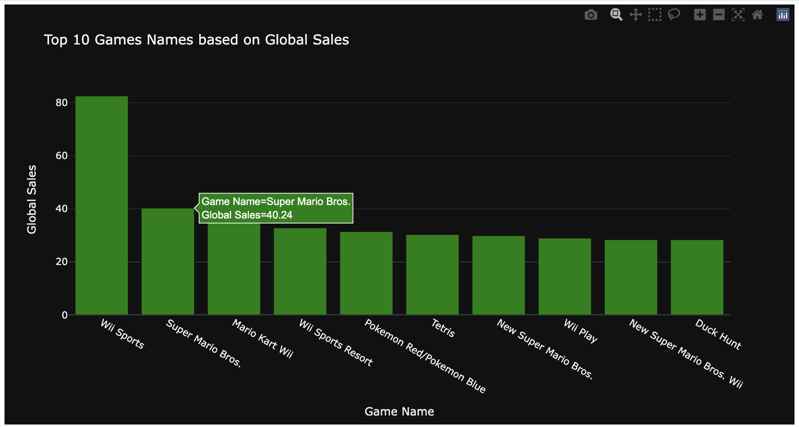
Visualizations
Top 10 Games based on global sales

Slide 5
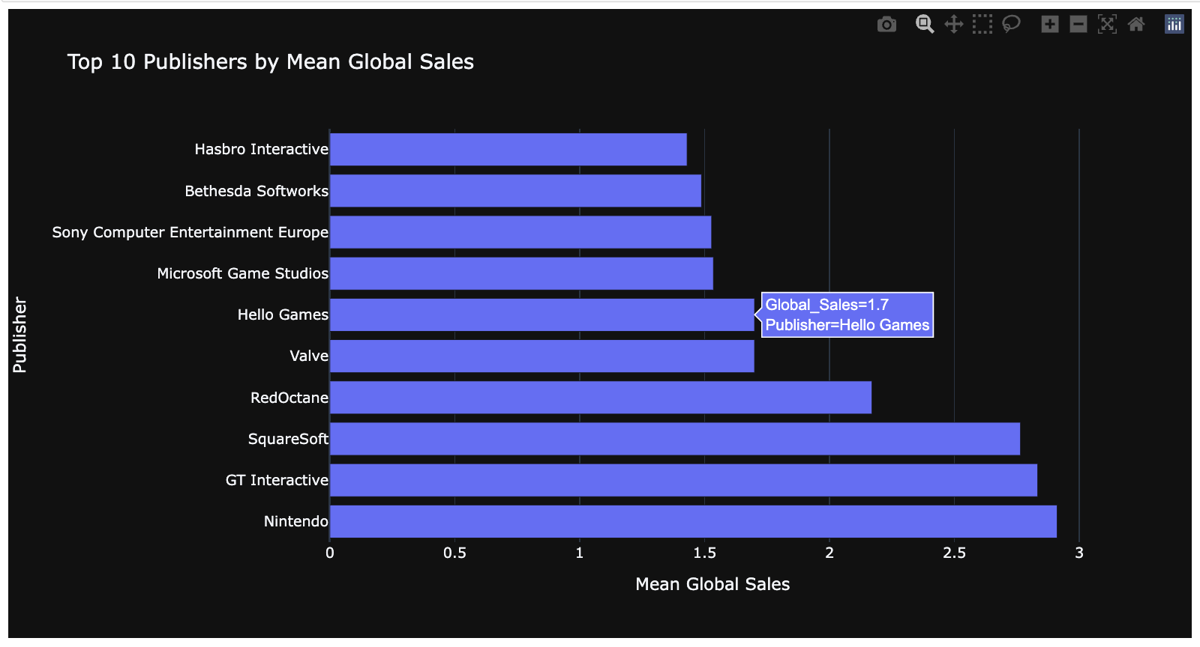
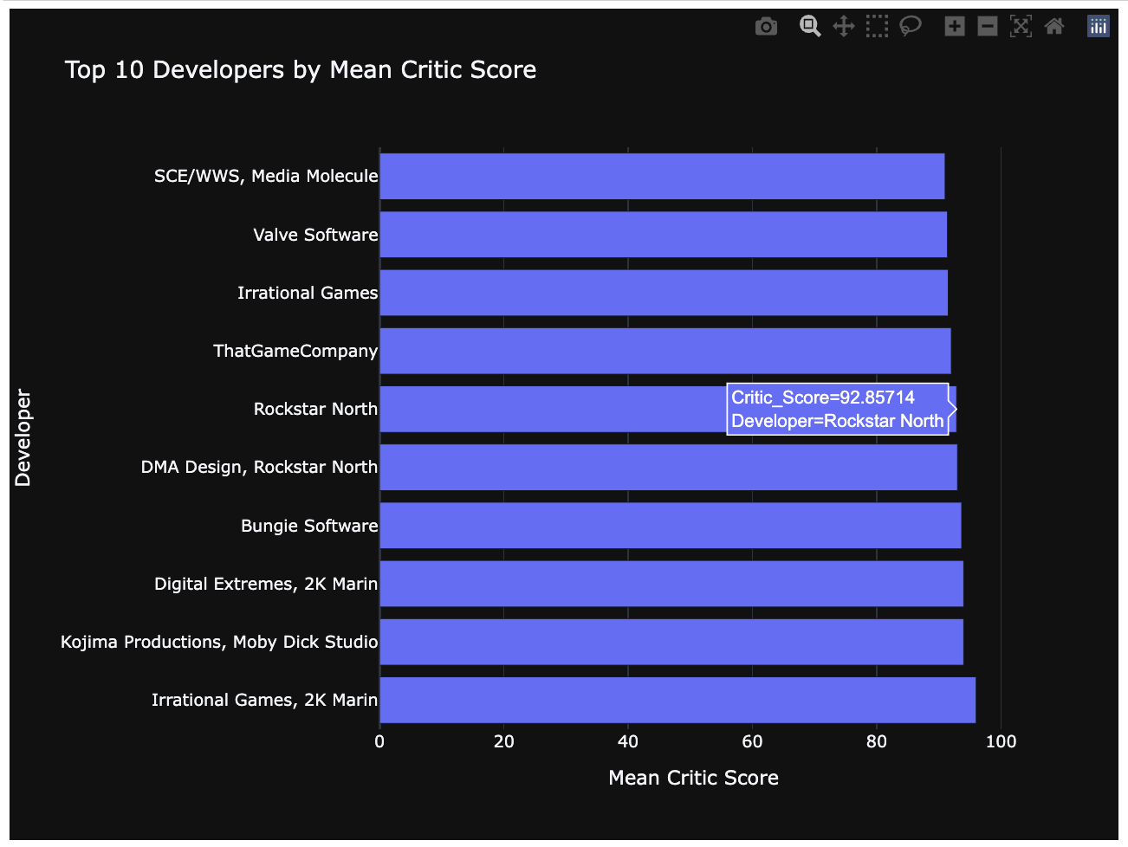
Visualizations
Top 10 Scores and Sales

Slide 6
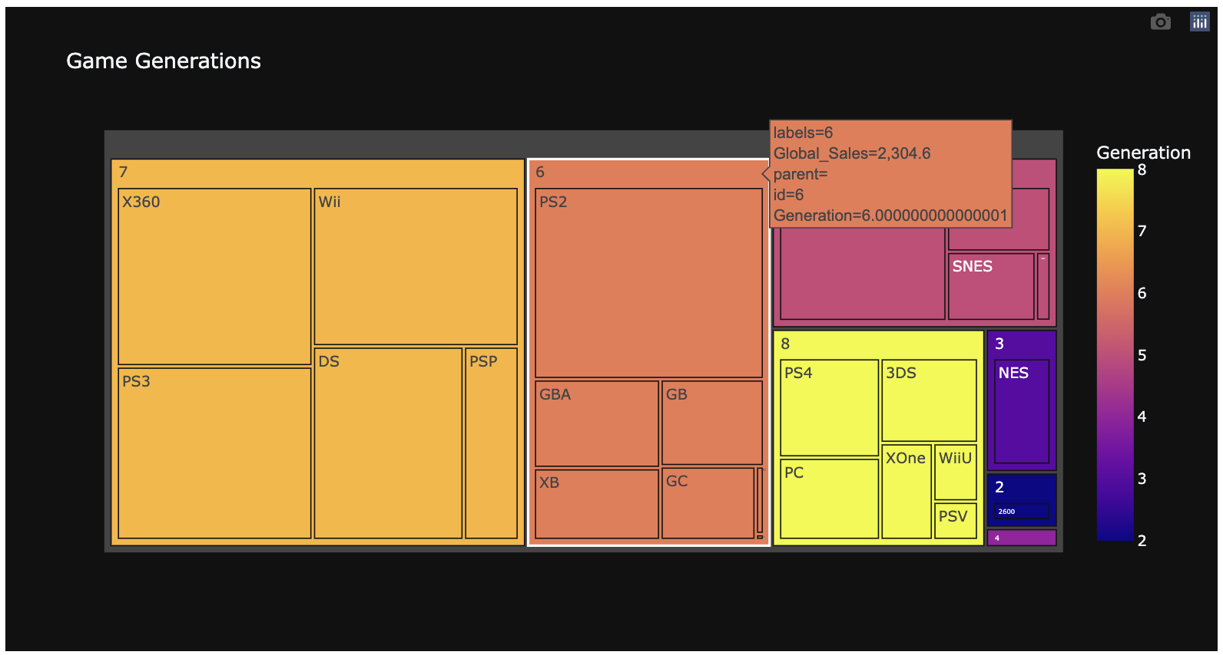
Visualizations
Console Generations

Slide 7
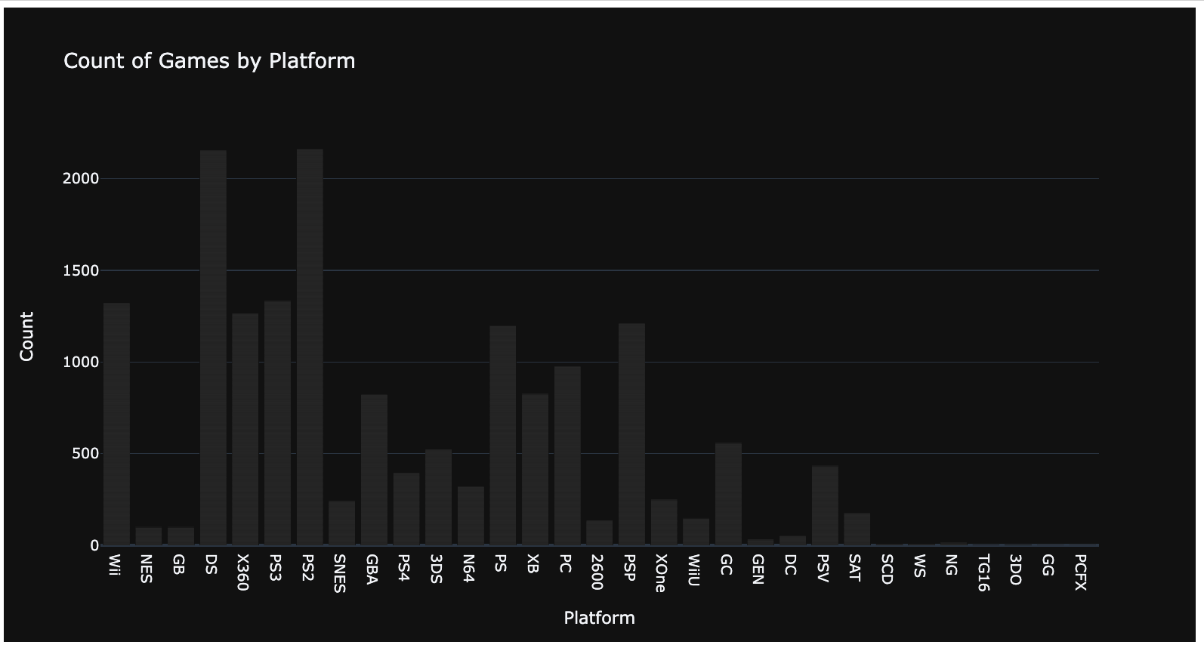
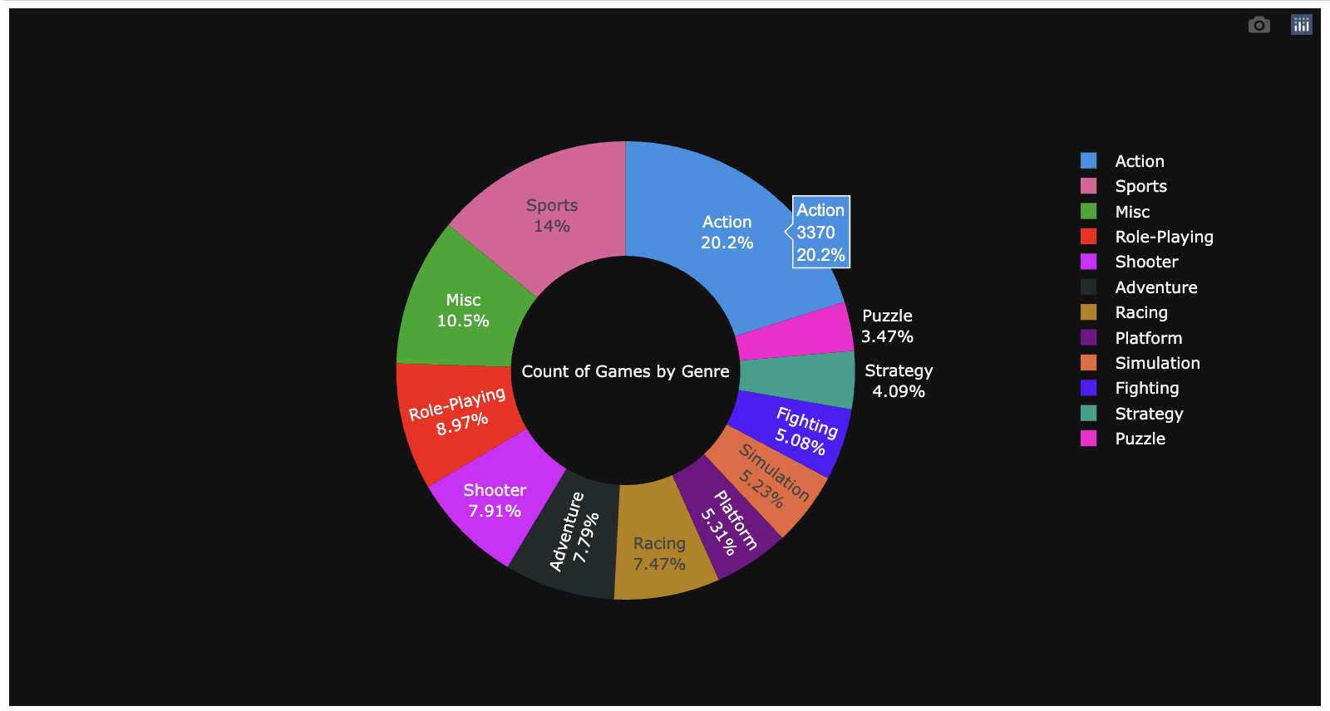
Visualizations
Number of Games based on Platform & Genre

Slide 8
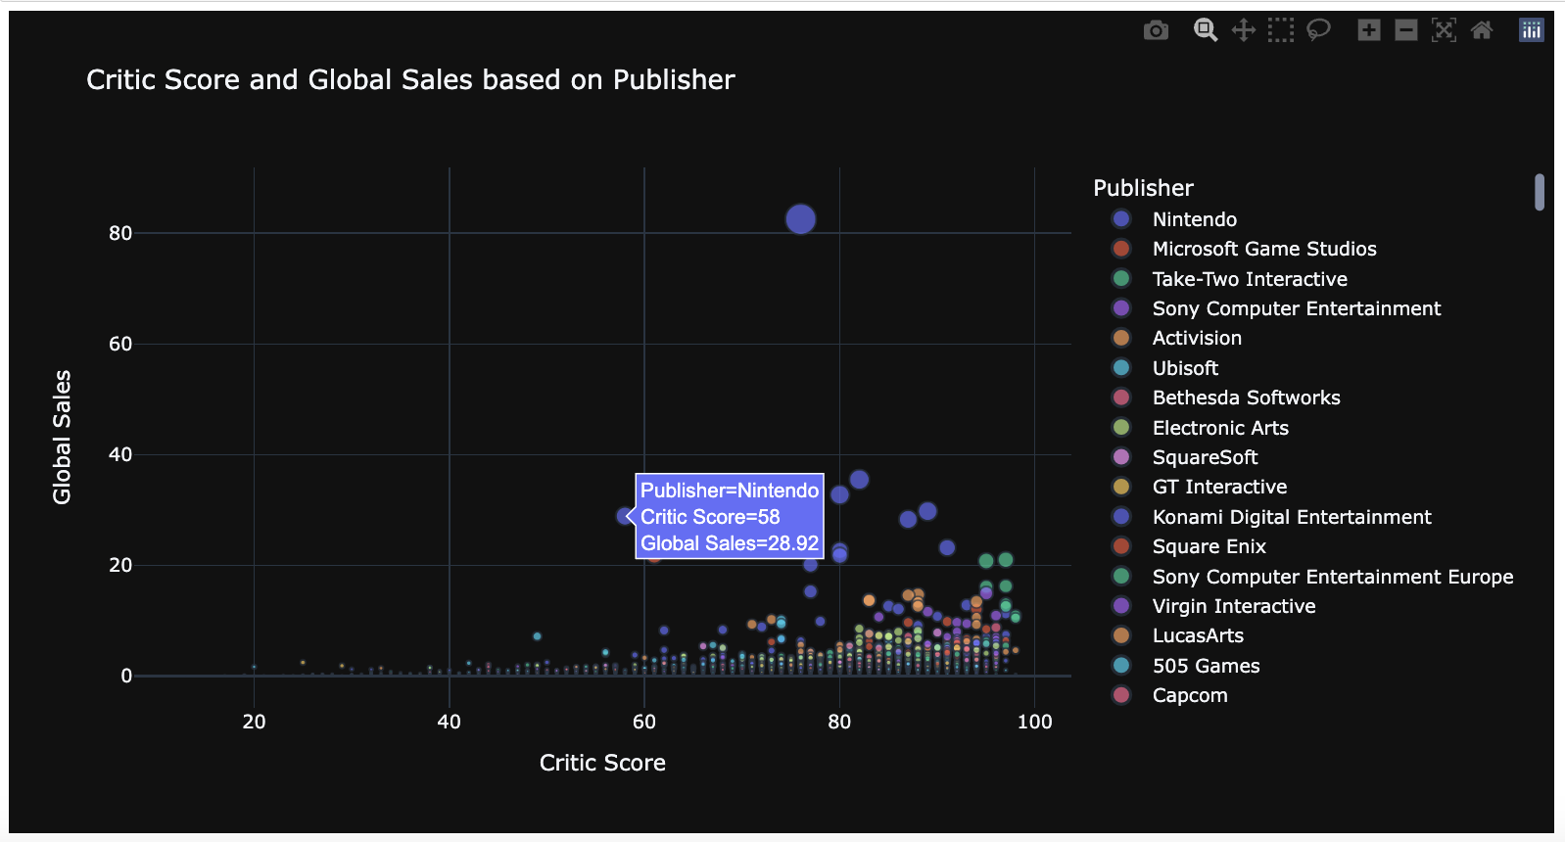
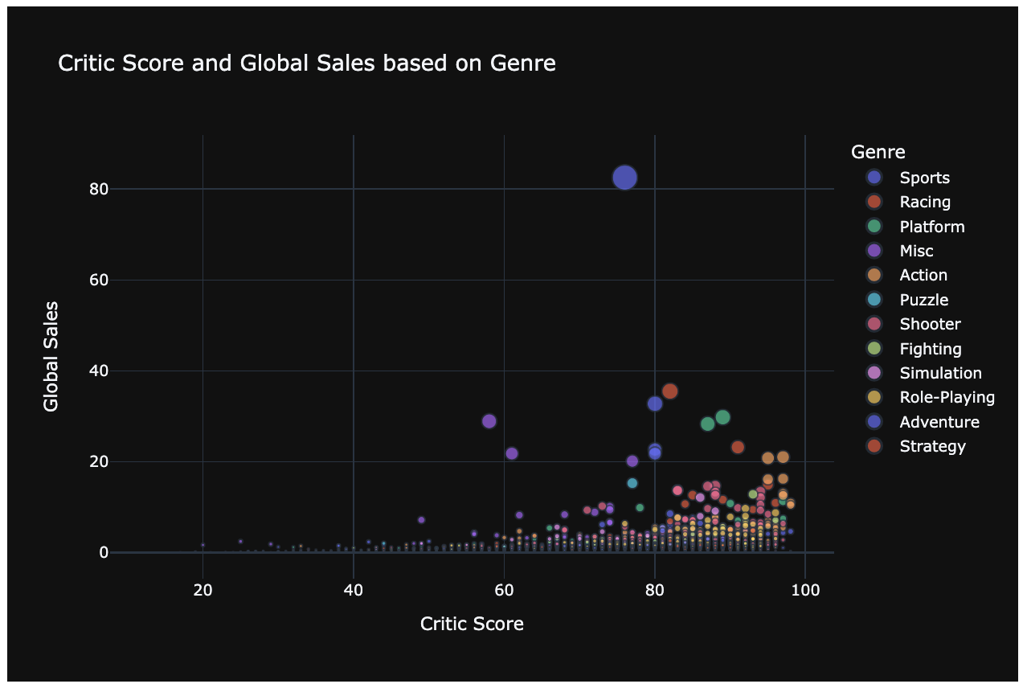
Visualizations
Critic Score and Sales / Publisher and Genre

Slide 9
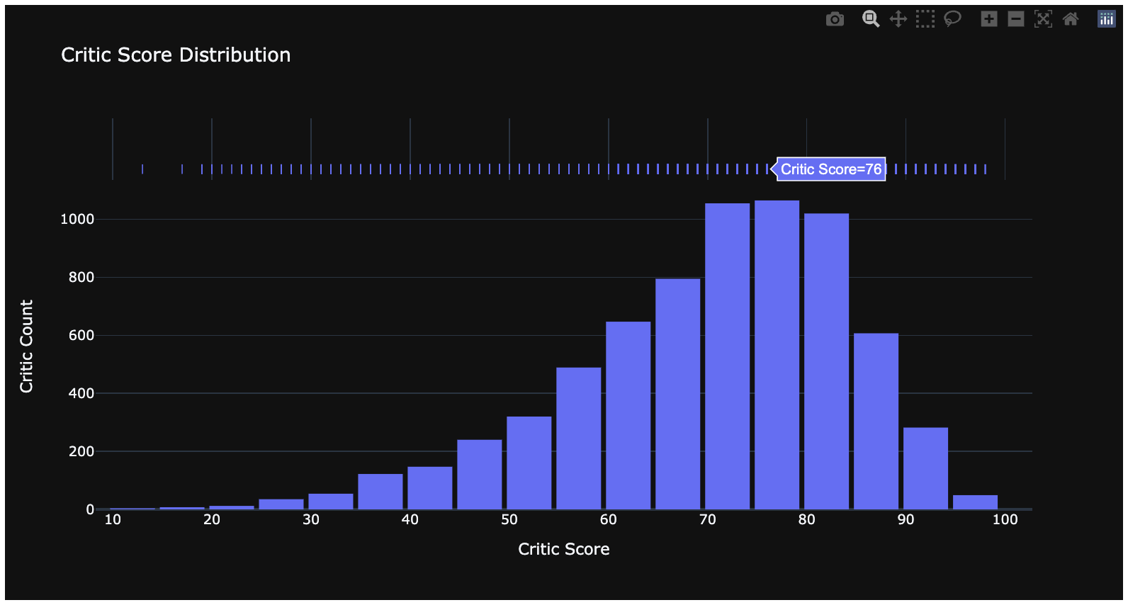
Visualizations
Critic Score Distribution

Slide 10
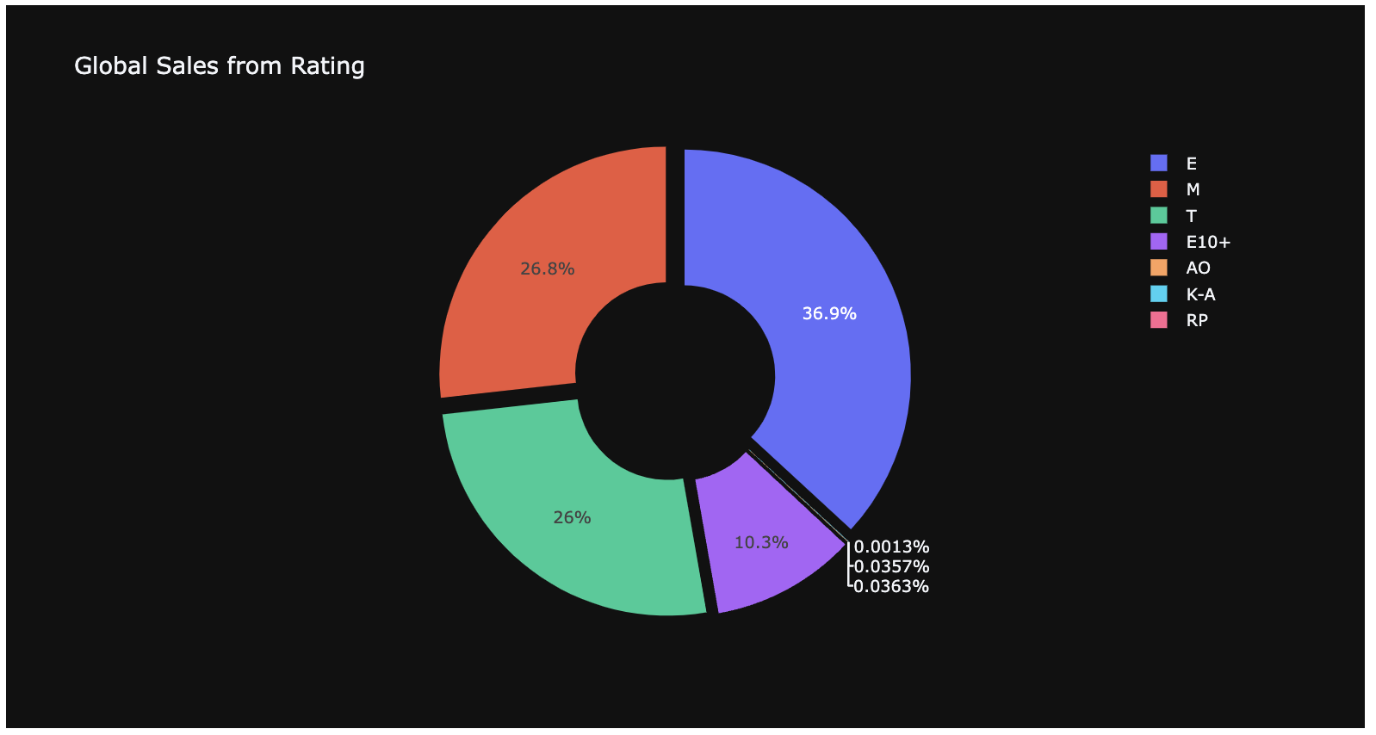
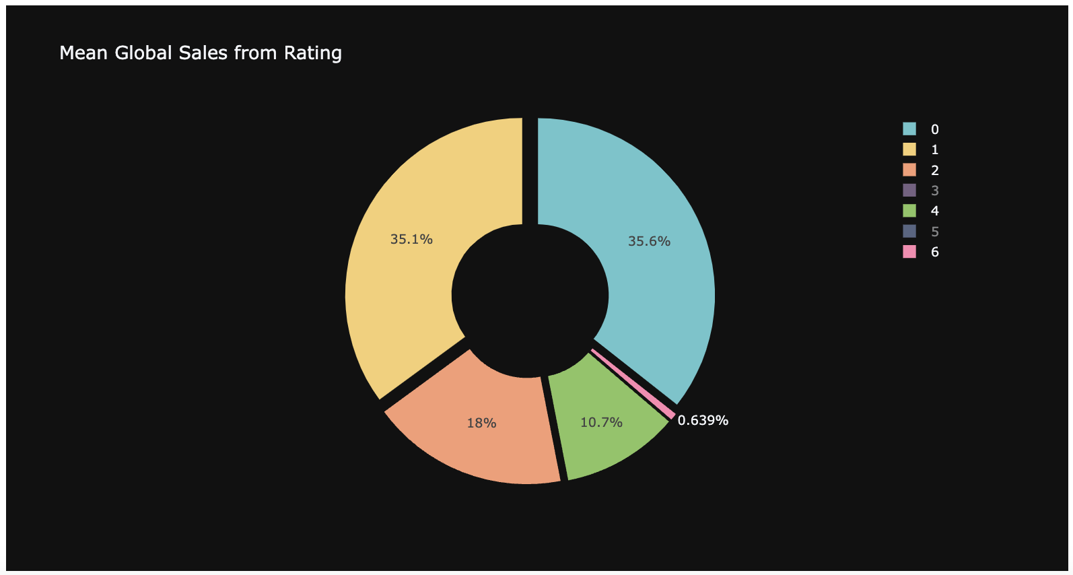
Visualizations
Sales based on rating

Slide 11
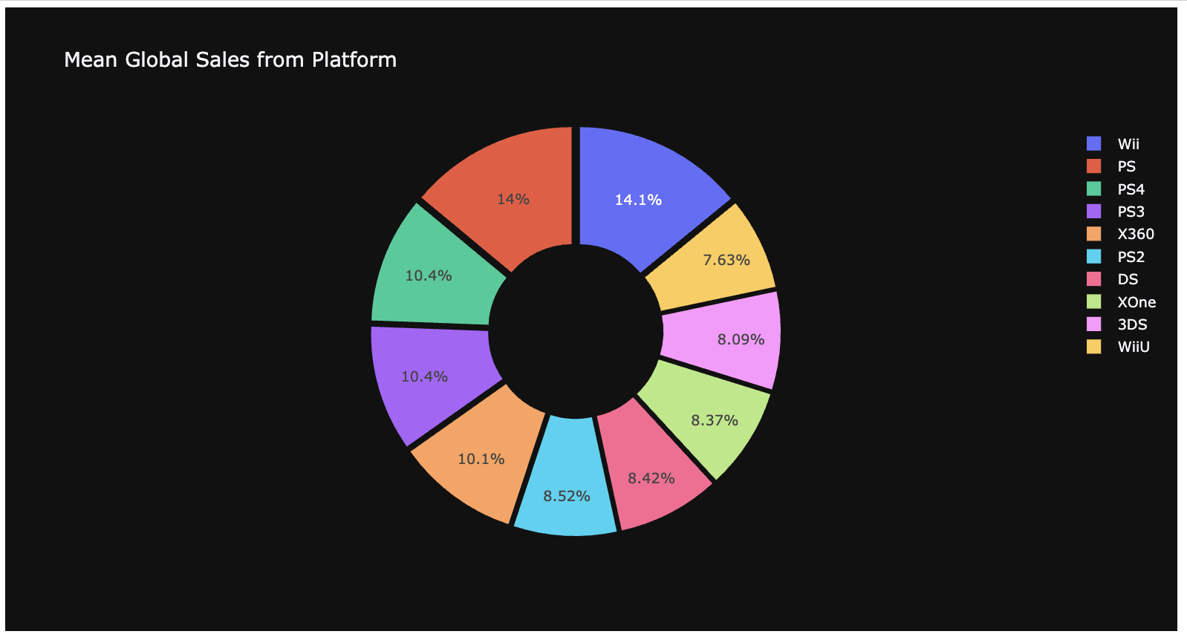
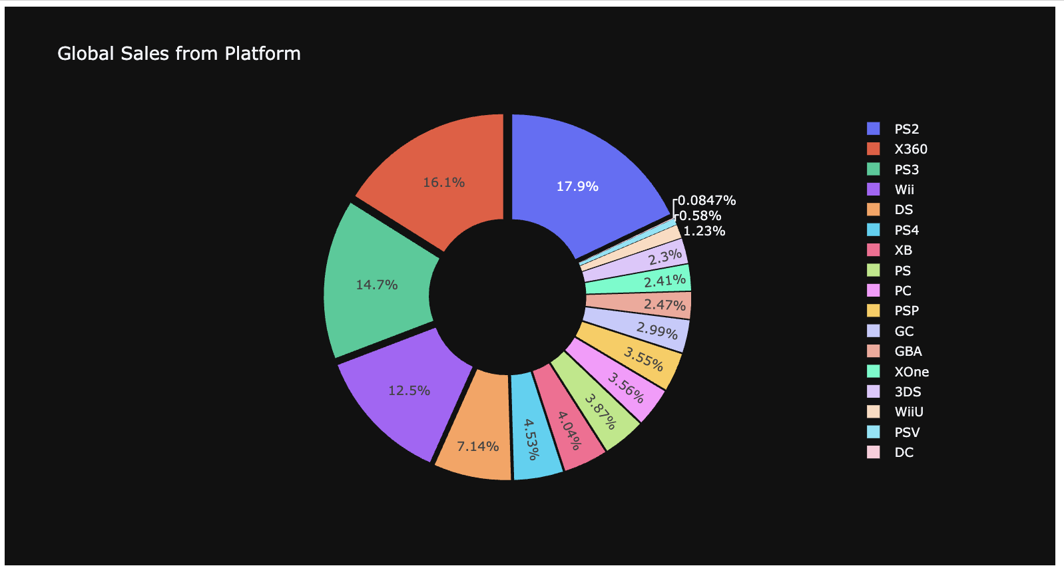
Visualizations
Sales based on platform

Slide 12
Insights
The pie chart reveals that only 36.9% of responses were graded E and 10.3% were graded E10+, indicating that there is ample room for improvement and a higher rating. This can be an action item, so investigate why AO, KA, and RP frequently receive lower ratings.
The visualisation allowed us to determine which platform is performing relatively poorly in terms of sales and to concentrate on what went wrong with those platforms. To investigate and locate the actionable items on these platforms, it may be necessary to devote additional attention.
From the distribution of critic scores, we can draw conclusions about the ratio of critic scores to the number of critics, revealing that there are more critics with high scores and fewer critics with low scores. In light of this, we should continue delivering high-quality content.
From the scatter diagram of critic score versus global sales, we can determine the relationship between sales volume and critic score, as well as the publisher. Therefore, we should provide quality content to increase global revenues. While we have excellent numbers in this area, there is still room for improvement. As an action item, we can compare fewer sales to a low critic score and identify common factors, such as genre, publisher, and so on, in order to cease selling these products on our platforms.
Number of games by platform and genre - we can provide information regarding the number of games by platform and genre. Currently, this is a piece of information; later, we can use it to compare sales so that we can concentrate on a particular platform and genre. Additionally, we can determine which genre has fewer/more publishers.

