Slide 1

Video Game Analysis
DV Project Submission
Suresh Bojjam (M20AIE313)
Utkarsh Thusoo (M20AIE318)

Slide 2
Video Game Analysis
Problem Definition

Slide 3
Video Game Analysis
Data Source
Year_of_Release | Genre | Publisher | NA_Sales | EU_Sales | JP_Sales | Other_Sales | Global_Sales | Critic_Score | Critic_Count | User_Score | User_Count | Developer | Rating
2006 | Sports | Nintendo | 41.36 | 28.96 | 3.77 | 8.45 | 82.53 | 76 | 51 | 8 | 322 | Nintendo | E
1985 | Platform | Nintendo | 29.08 | 3.58 | 6.81 | 0.77 | 40.24
2008 | Racing | Nintendo | 15.68 | 12.76 | 3.79 | 3.29 | 35.52 | 82 | 73 | 8.3 | 709 | Nintendo | E
2009 | Sports | Nintendo | 15.61 | 10.93 | 3.28 | 2.95 | 32.77 | 80 | 73 | 8 | 192 | Nintendo | E
1996 | Role-Playing | Nintendo | 11.27 | 8.89 | 10.22 | 1 | 31.37
1989 | Puzzle | Nintendo | 23.2 | 2.26 | 4.22 | 0.58 | 30.26
2006 | Platform | Nintendo | 11.28 | 9.14 | 6.5 | 2.88 | 29.8 | 89 | 65 | 8.5 | 431 | Nintendo | E
2006 | Misc | Nintendo | 13.96 | 9.18 | 2.93 | 2.84 | 28.92 | 58 | 41 | 6.6 | 129 | Nintendo | E
2009 | Platform | Nintendo | 14.44 | 6.94 | 4.7 | 2.24 | 28.32 | 87 | 80 | 8.4 | 594 | Nintendo | E
1984 | Shooter | Nintendo | 26.93 | 0.63 | 0.28 | 0.47 | 28.31
2005 | Simulation | Nintendo | 9.05 | 10.95 | 1.93 | 2.74 | 24.67
2005 | Racing | Nintendo | 9.71 | 7.47 | 4.13 | 1.9 | 23.21 | 91 | 64 | 8.6 | 464 | Nintendo | E
1999 | Role-Playing | Nintendo | 9 | 6.18 | 7.2 | 0.71 | 23.1
2007 | Sports | Nintendo | 8.92 | 8.03 | 3.6 | 2.15 | 22.7 | 80 | 63 | 7.7 | 146 | Nintendo | E
2010 | Misc | Microsoft Game Studios | 15 | 4.89 | 0.24 | 1.69 | 21.81 | 61 | 45 | 6.3 | 106 | Good Science Studio | E
2009 | Sports | Nintendo | 9.01 | 8.49 | 2.53 | 1.77 | 21.79 | 80 | 33 | 7.4 | 52 | Nintendo | E
2013 | Action | Take-Two Interactive | 7.02 | 9.09 | 0.98 | 3.96 | 21.04 | 97 | 50 | 8.2 | 3994 | Rockstar North | M
2004 | Action | Take-Two Interactive | 9.43 | 0.4 | 0.41 | 10.57 | 20.81 | 95 | 80 | 9 | 1588 | Rockstar North | M
1990 | Platform | Nintendo | 12.78 | 3.75 | 3.54 | 0.55 | 20.61
2005 | Misc | Nintendo | 4.74 | 9.2 | 4.16 | 2.04 | 20.15 | 77 | 58 | 7.9 | 50 | Nintendo | E
2006 | Role-Playing | Nintendo | 6.38 | 4.46 | 6.04 | 1.36 | 18.25
1989 | Platform | Nintendo | 10.83 | 2.71 | 4.18 | 0.42 | 18.14
1988 | Platform | Nintendo | 9.54 | 3.44 | 3.84 | 0.46 | 17.28
2013 | Action | Take-Two Interactive | 9.66 | 5.14 | 0.06 | 1.41 | 16.27 | 97 | 58 | 8.1 | 3711 | Rockstar North | M
2002 | Action | Take-Two Interactive | 8.41 | 5.49 | 0.47 | 1.78 | 16.15 | 95 | 62 | 8.7 | 730 | Rockstar North | M

Slide 4
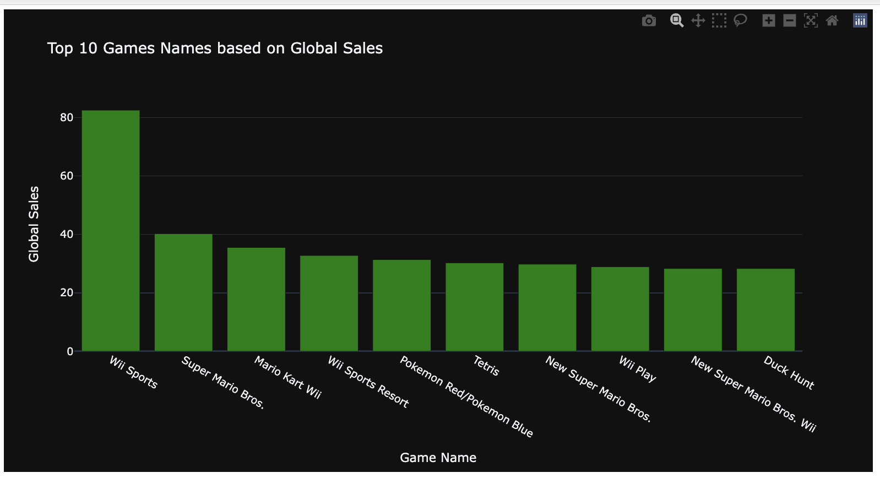
Video Game Analysis
Top 10 Games based on global sales

Slide 5
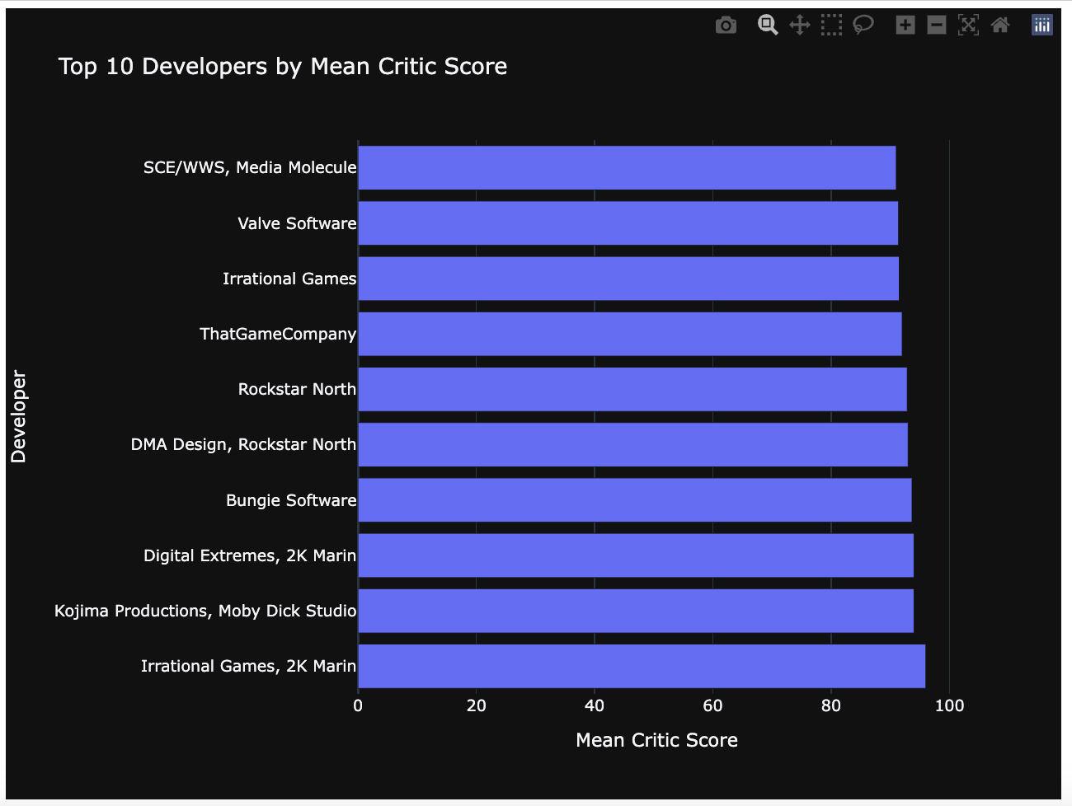
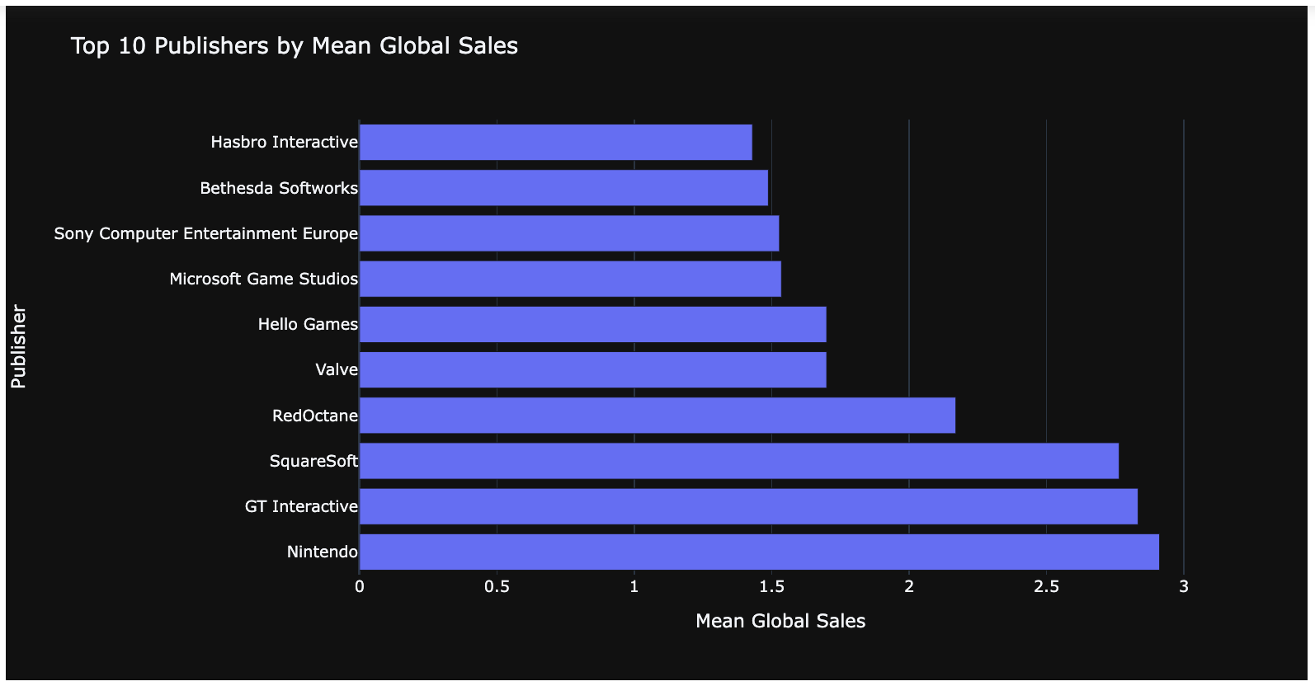
Video Game Analysis
Top 10 Scores and Sales

Slide 6
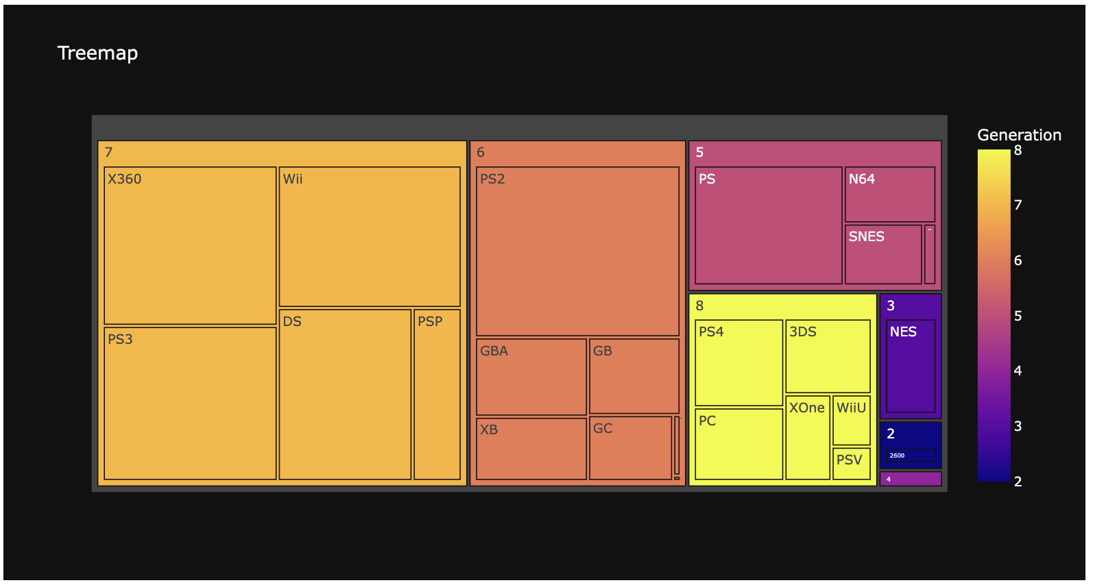
Video Game Analysis
Generation of Gaming Consoles

Slide 7
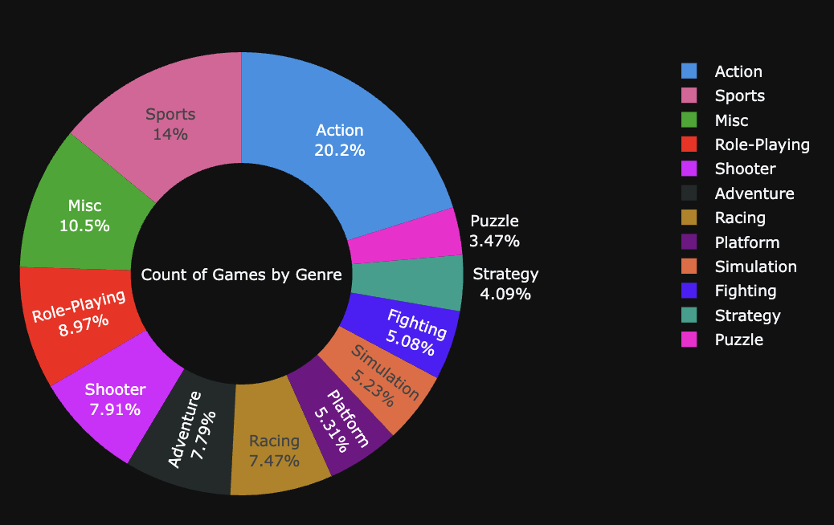
Video Game Analysis
Number of Games based on Genre

Slide 8
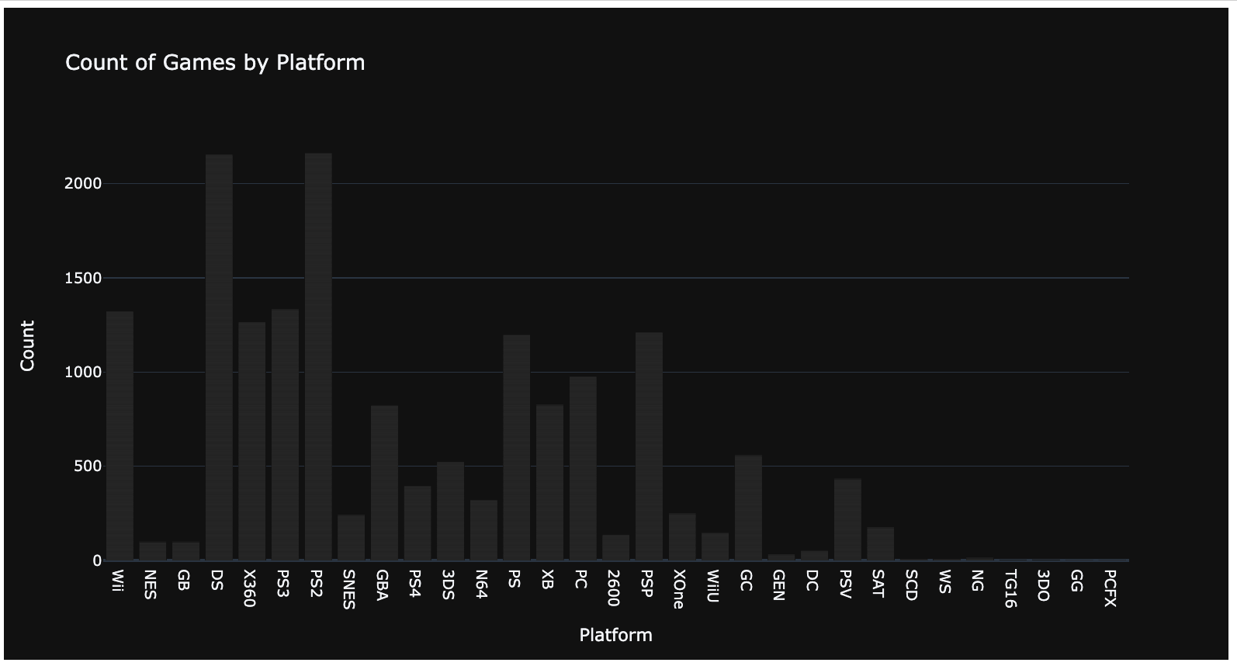
Video Game Analysis
Number of Games based on Platform

Slide 9
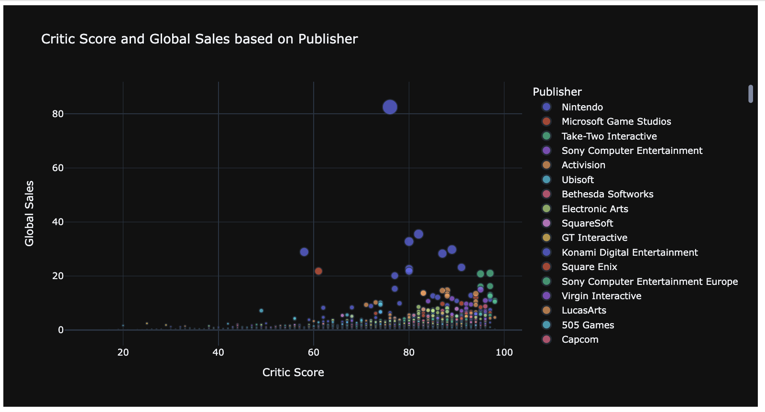
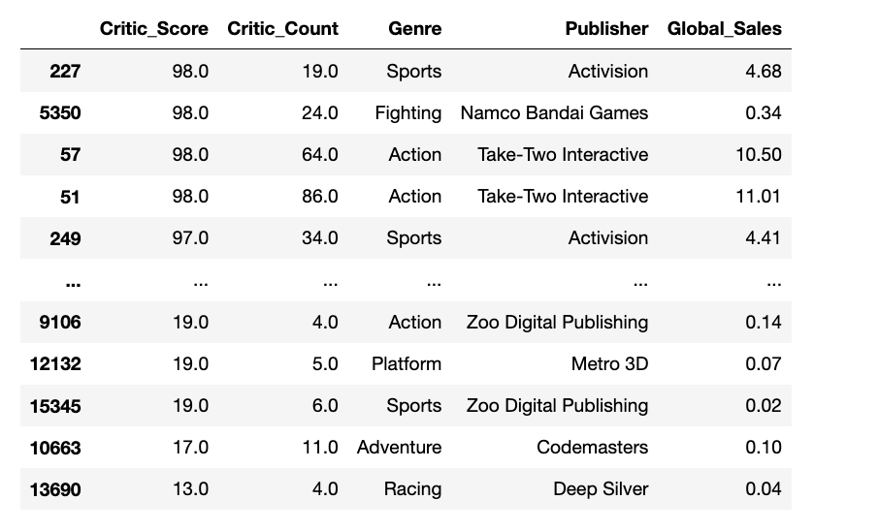
Video Game Analysis
Critic Score and Sales / Publisher

Slide 10
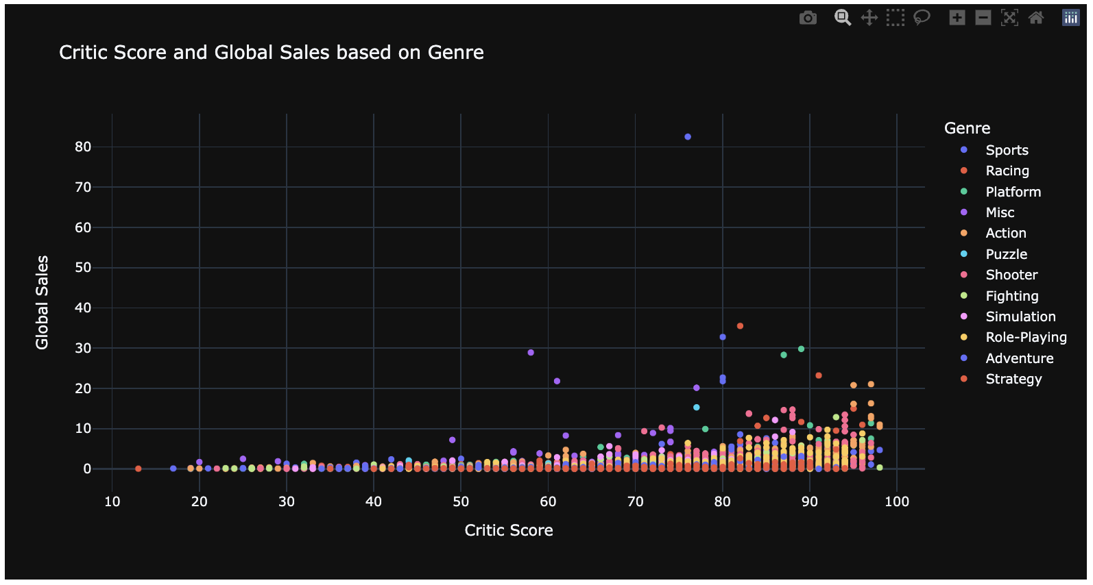
Video Game Analysis
Critic Score and Sales / Genre

Slide 11
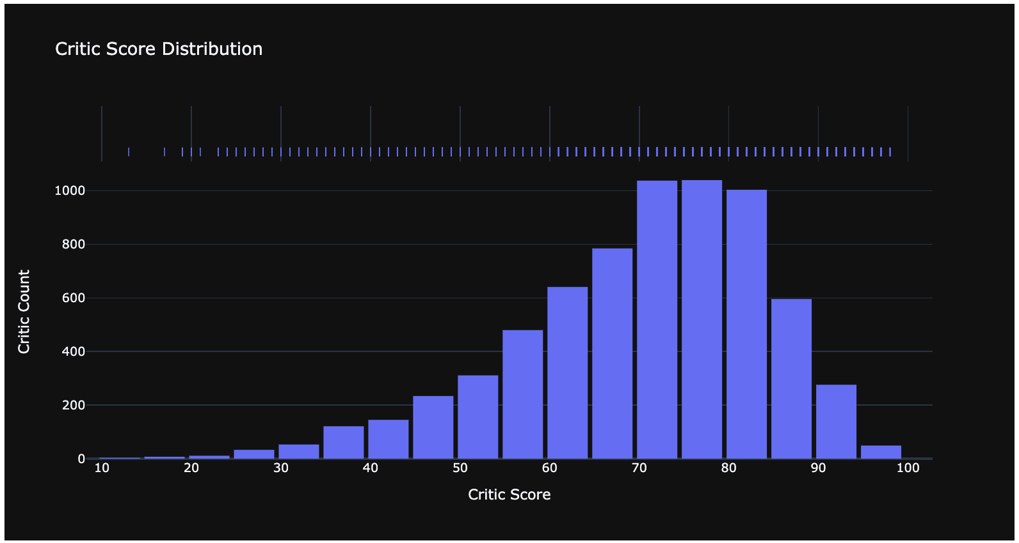
Video Game Analysis
Critic Score Distribution

Slide 12
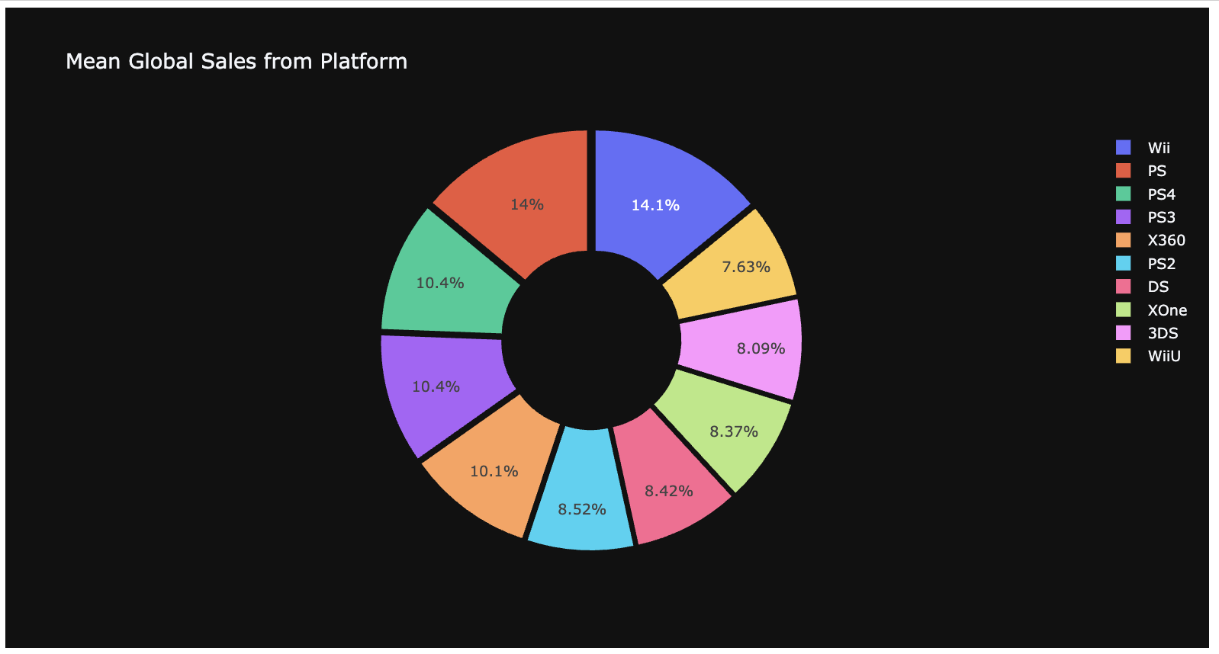
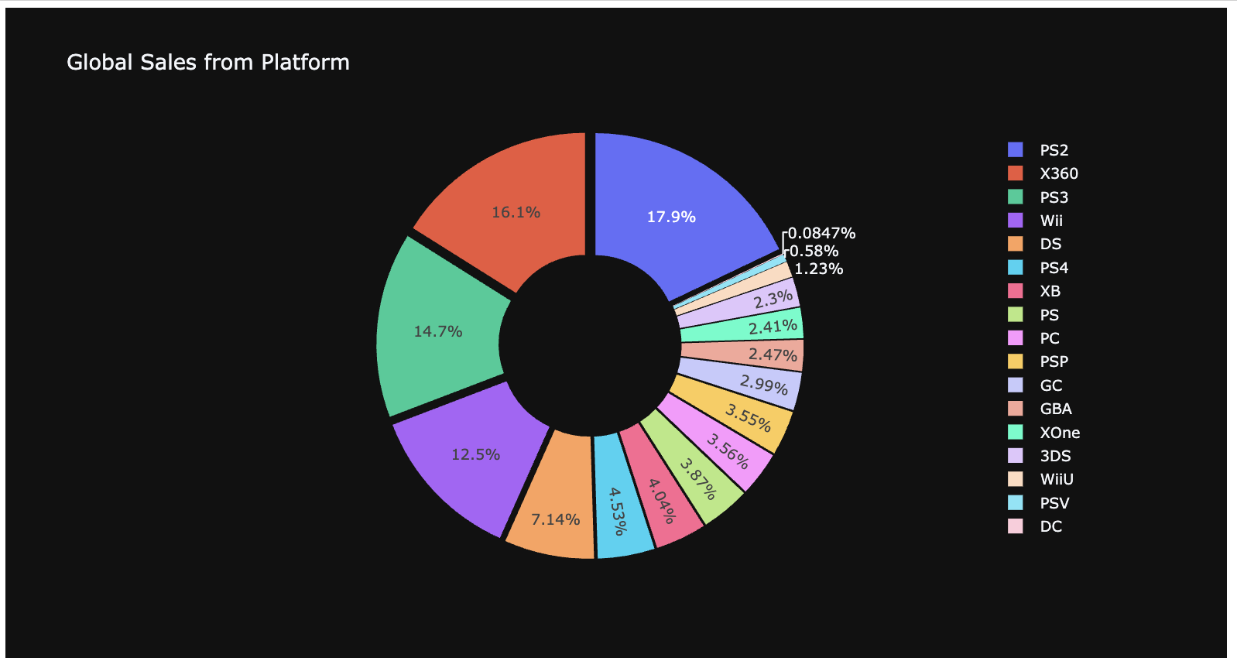
Video Game Analysis
Mean Sales & Sales / Platform

Slide 13
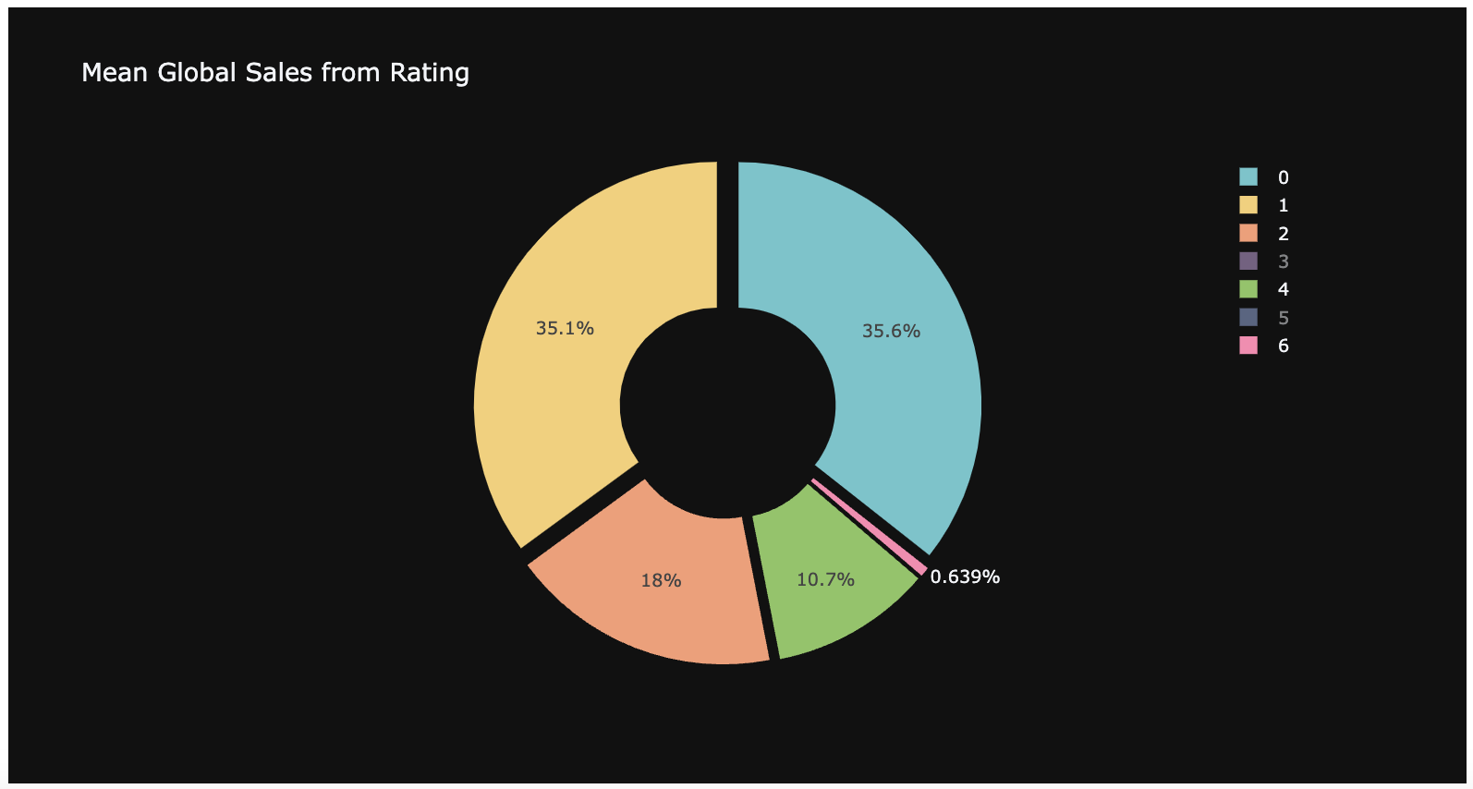
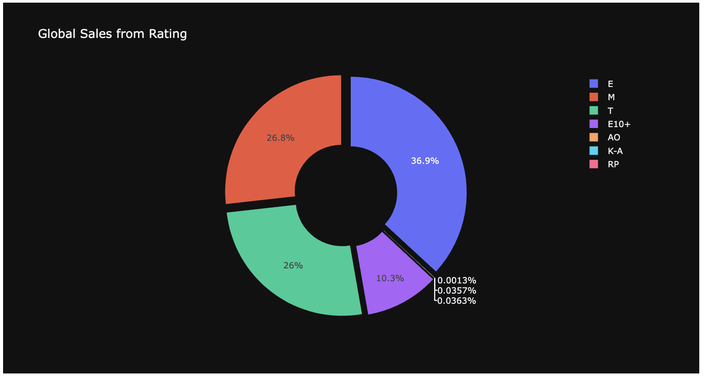
Video Game Analysis
Mean Sales & Sales / Rating

