Slide 1

Video Game Analysis
DV Project Submission
Suresh Bojjam (M20AIE313)
Utkarsh Thusoo (M20AIE318)

Slide 2






Video Game Analysis
Problem Definition
Find Games which are most popular in the market.
Most played genres in the market
Which generation of consoles belong to which category
Critic Ratings
Most Sales based on Genre and Rating

Slide 3
Video Game Analysis
Data Source
Year_of_Release | Genre | Publisher | NA_Sales | EU_Sales | JP_Sales | Other_Sales | Global_Sales | Critic_Score | Critic_Count | User_Score | User_Count | Developer | Rating
2006 | Sports | Nintendo | 41.36 | 28.96 | 3.77 | 8.45 | 82.53 | 76 | 51 | 8 | 322 | Nintendo | E
1985 | Platform | Nintendo | 29.08 | 3.58 | 6.81 | 0.77 | 40.24
2008 | Racing | Nintendo | 15.68 | 12.76 | 3.79 | 3.29 | 35.52 | 82 | 73 | 8.3 | 709 | Nintendo | E
2009 | Sports | Nintendo | 15.61 | 10.93 | 3.28 | 2.95 | 32.77 | 80 | 73 | 8 | 192 | Nintendo | E
1996 | Role-Playing | Nintendo | 11.27 | 8.89 | 10.22 | 1 | 31.37
1989 | Puzzle | Nintendo | 23.2 | 2.26 | 4.22 | 0.58 | 30.26
2006 | Platform | Nintendo | 11.28 | 9.14 | 6.5 | 2.88 | 29.8 | 89 | 65 | 8.5 | 431 | Nintendo | E
2006 | Misc | Nintendo | 13.96 | 9.18 | 2.93 | 2.84 | 28.92 | 58 | 41 | 6.6 | 129 | Nintendo | E
2009 | Platform | Nintendo | 14.44 | 6.94 | 4.7 | 2.24 | 28.32 | 87 | 80 | 8.4 | 594 | Nintendo | E
1984 | Shooter | Nintendo | 26.93 | 0.63 | 0.28 | 0.47 | 28.31
2005 | Simulation | Nintendo | 9.05 | 10.95 | 1.93 | 2.74 | 24.67
2005 | Racing | Nintendo | 9.71 | 7.47 | 4.13 | 1.9 | 23.21 | 91 | 64 | 8.6 | 464 | Nintendo | E
1999 | Role-Playing | Nintendo | 9 | 6.18 | 7.2 | 0.71 | 23.1
2007 | Sports | Nintendo | 8.92 | 8.03 | 3.6 | 2.15 | 22.7 | 80 | 63 | 7.7 | 146 | Nintendo | E
2010 | Misc | Microsoft Game Studios | 15 | 4.89 | 0.24 | 1.69 | 21.81 | 61 | 45 | 6.3 | 106 | Good Science Studio | E
2009 | Sports | Nintendo | 9.01 | 8.49 | 2.53 | 1.77 | 21.79 | 80 | 33 | 7.4 | 52 | Nintendo | E
2013 | Action | Take-Two Interactive | 7.02 | 9.09 | 0.98 | 3.96 | 21.04 | 97 | 50 | 8.2 | 3994 | Rockstar North | M
2004 | Action | Take-Two Interactive | 9.43 | 0.4 | 0.41 | 10.57 | 20.81 | 95 | 80 | 9 | 1588 | Rockstar North | M
1990 | Platform | Nintendo | 12.78 | 3.75 | 3.54 | 0.55 | 20.61
2005 | Misc | Nintendo | 4.74 | 9.2 | 4.16 | 2.04 | 20.15 | 77 | 58 | 7.9 | 50 | Nintendo | E
2006 | Role-Playing | Nintendo | 6.38 | 4.46 | 6.04 | 1.36 | 18.25
1989 | Platform | Nintendo | 10.83 | 2.71 | 4.18 | 0.42 | 18.14
1988 | Platform | Nintendo | 9.54 | 3.44 | 3.84 | 0.46 | 17.28
2013 | Action | Take-Two Interactive | 9.66 | 5.14 | 0.06 | 1.41 | 16.27 | 97 | 58 | 8.1 | 3711 | Rockstar North | M
2002 | Action | Take-Two Interactive | 8.41 | 5.49 | 0.47 | 1.78 | 16.15 | 95 | 62 | 8.7 | 730 | Rockstar North | M

Slide 4
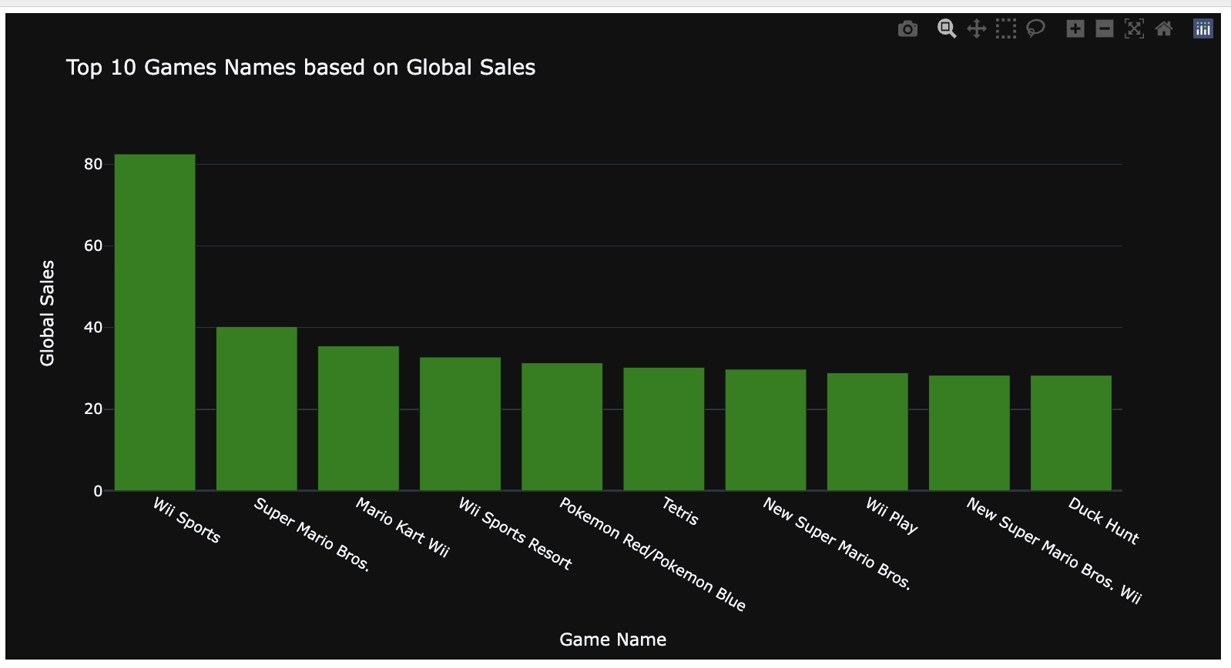
Visualizations
Top 10 Games based on global sales

Slide 5
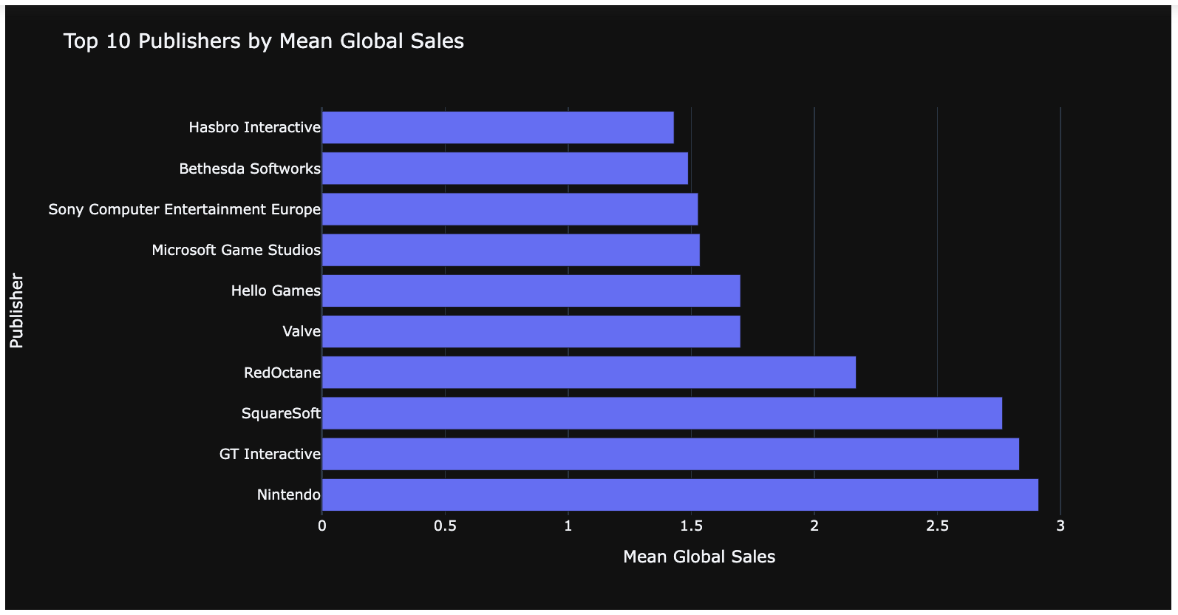
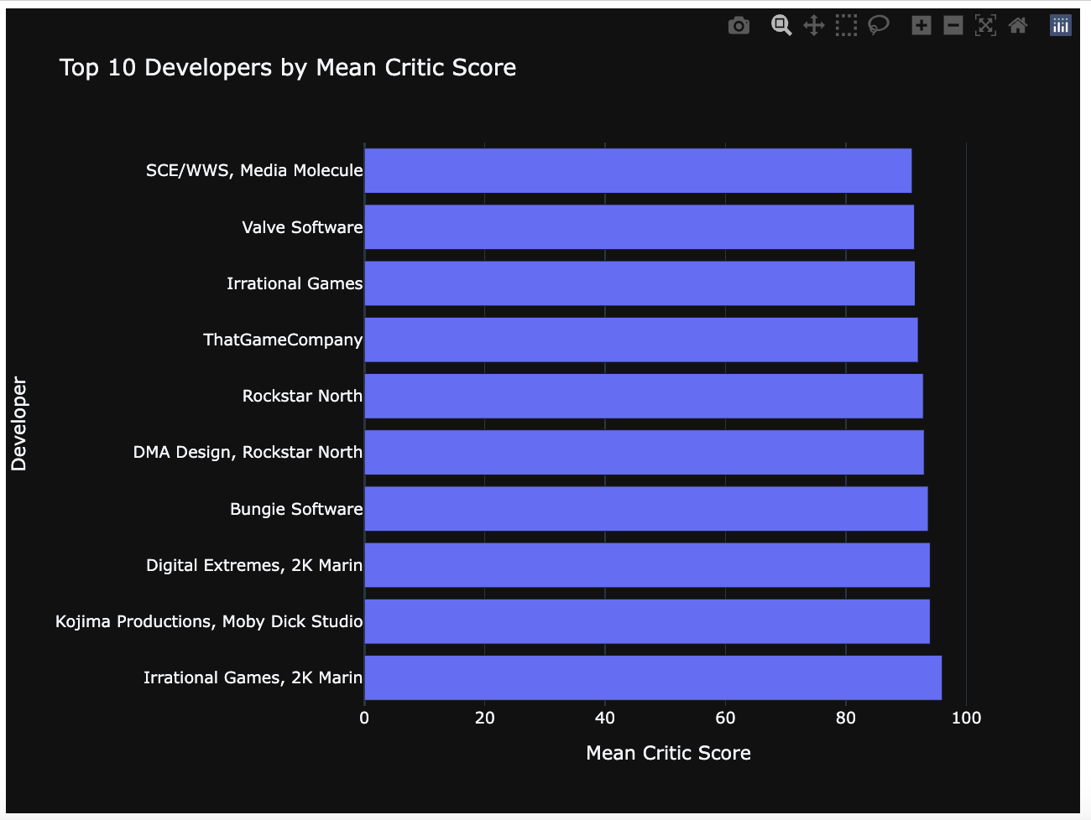
Visualizations
Top 10 Scores and Sales

Slide 6
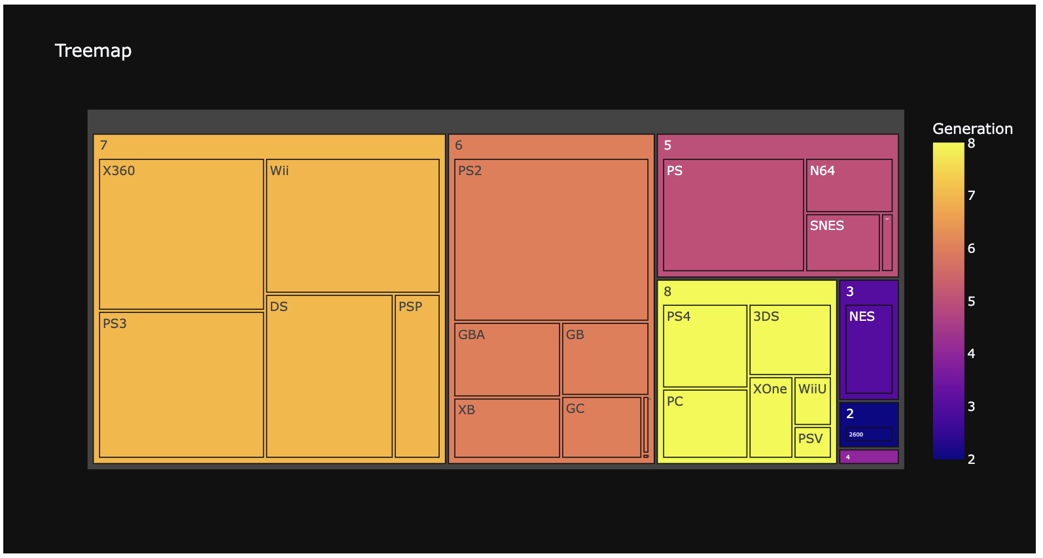
Visualizations
Console Generations

Slide 7
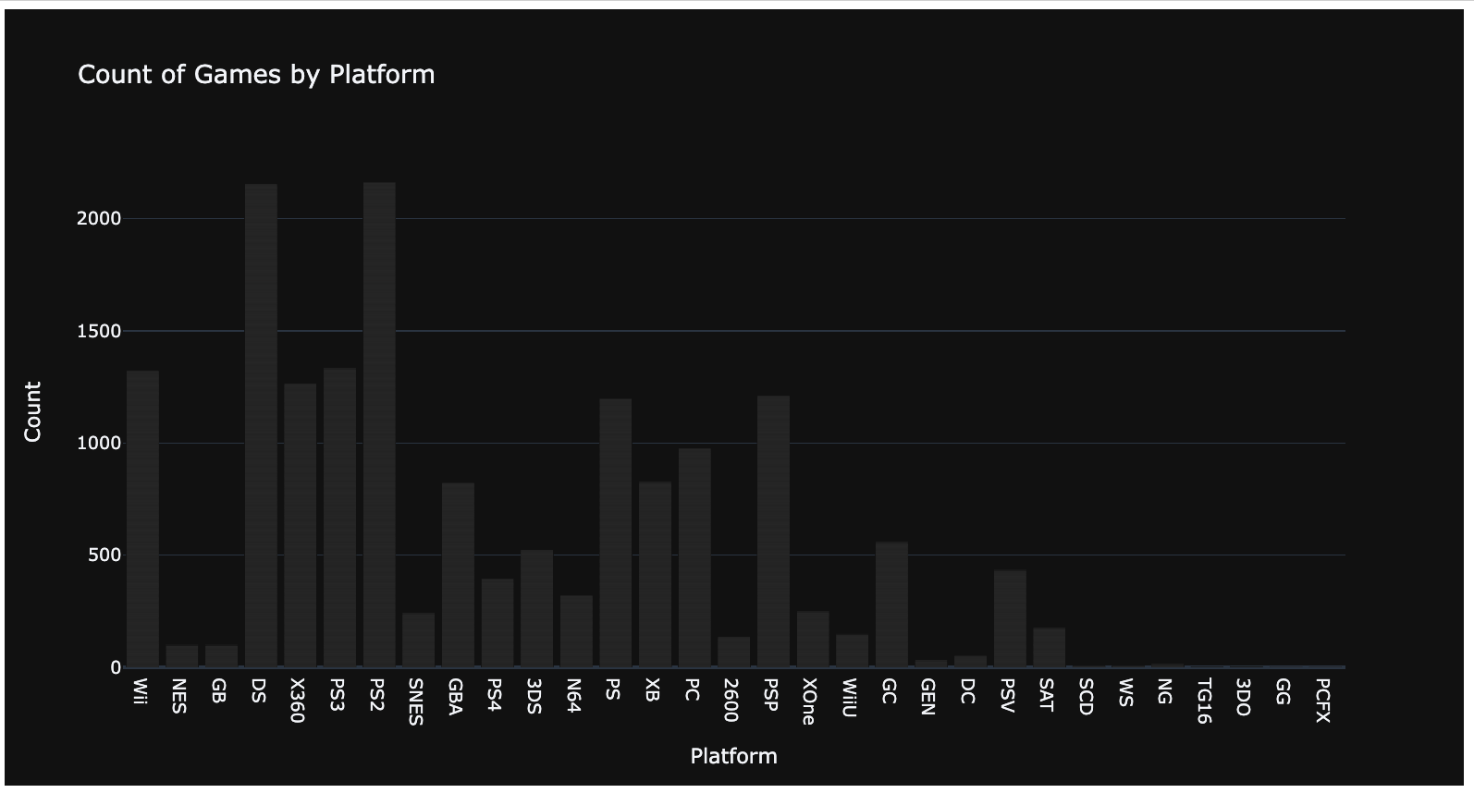
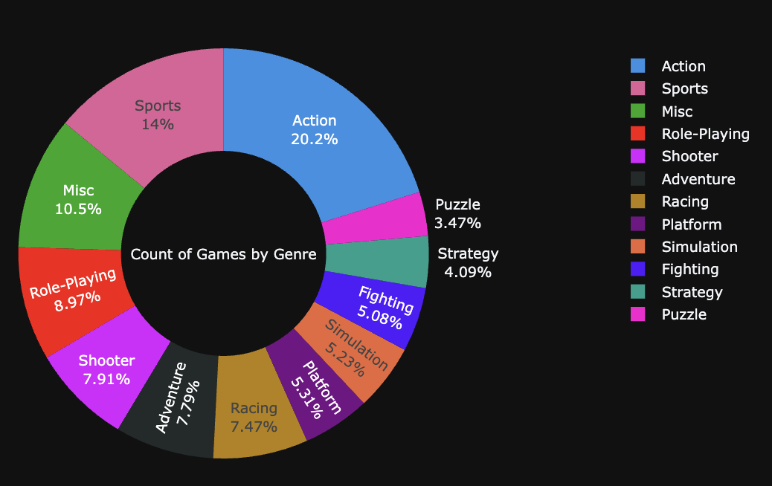
Visualizations
Number of Games based on Platform & Genre

Slide 8
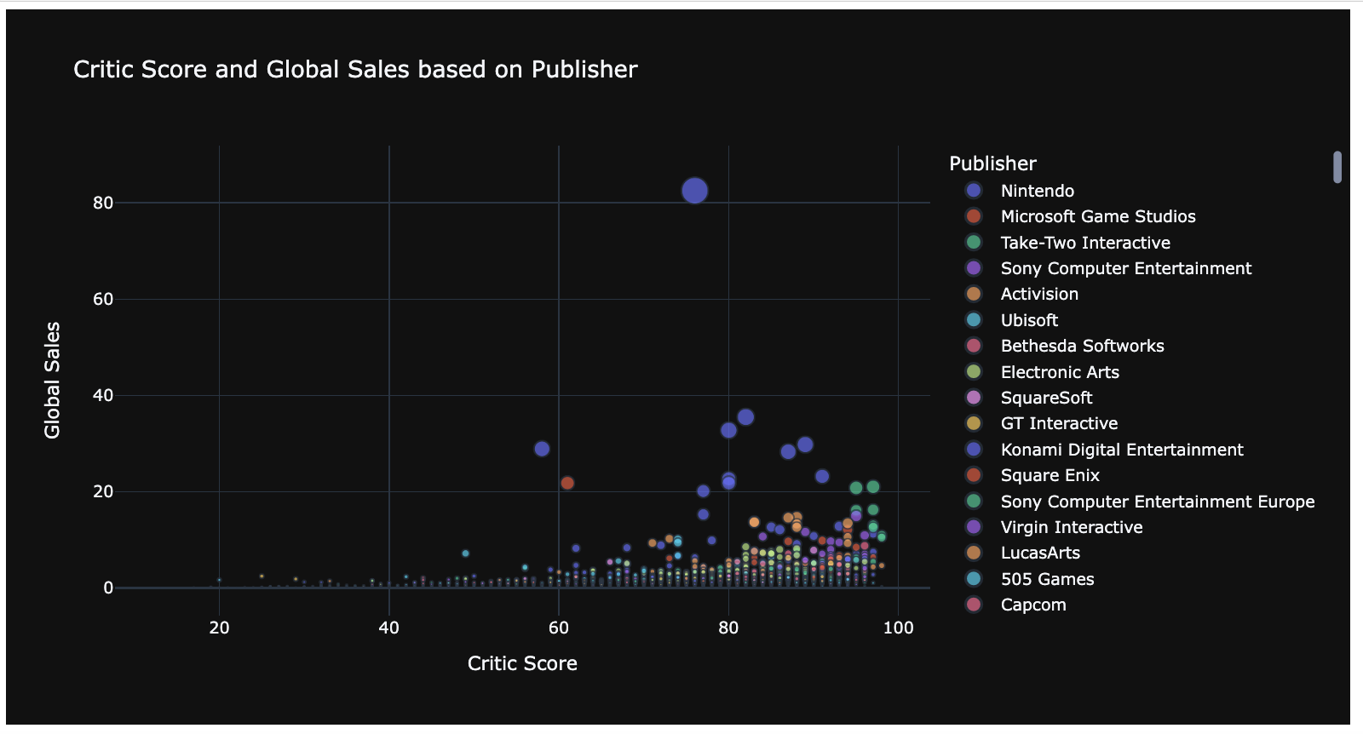
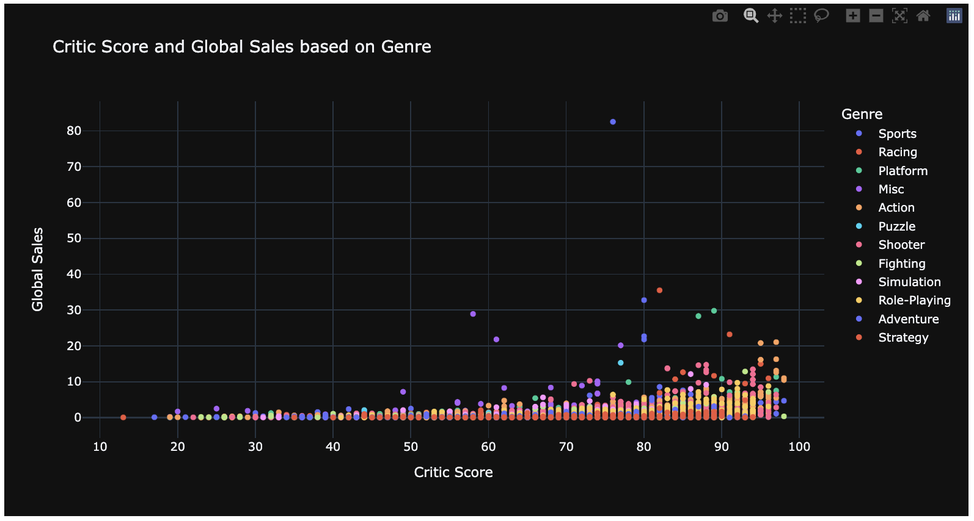
Video Game Analysis
Critic Score and Sales / Publisher and Genre

Slide 9
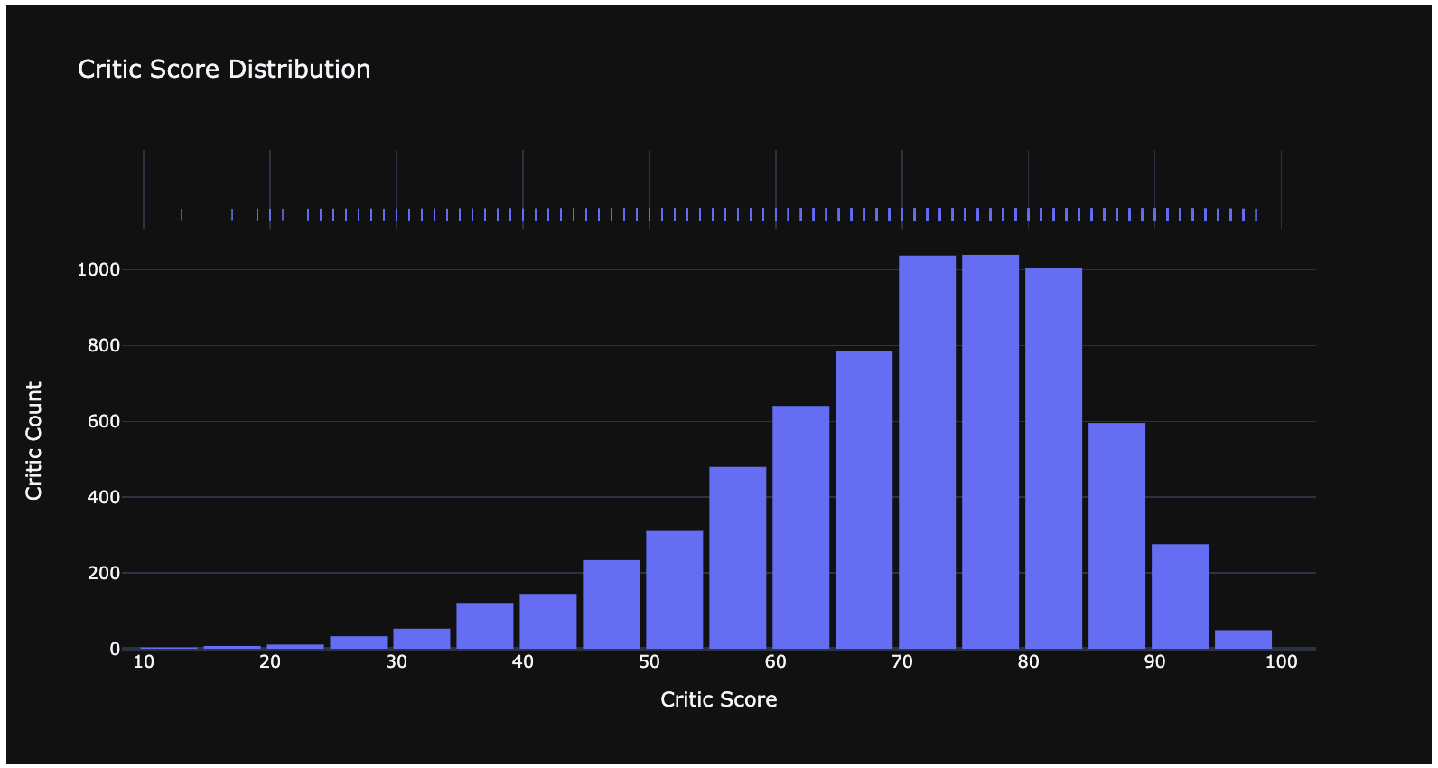
Visualizations
Critic Score Distribution

Slide 10
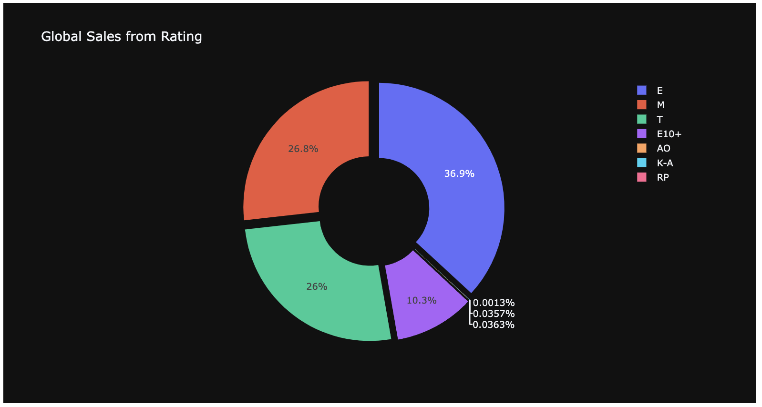
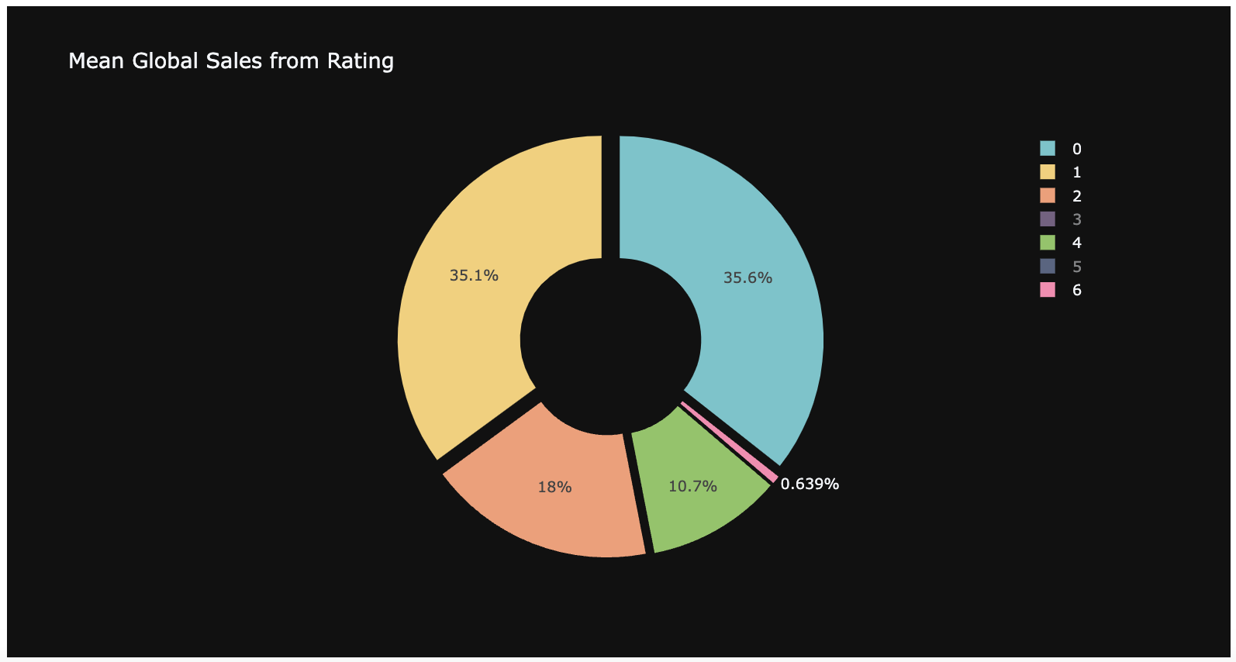
Visualizations
Sales based on rating

Slide 11
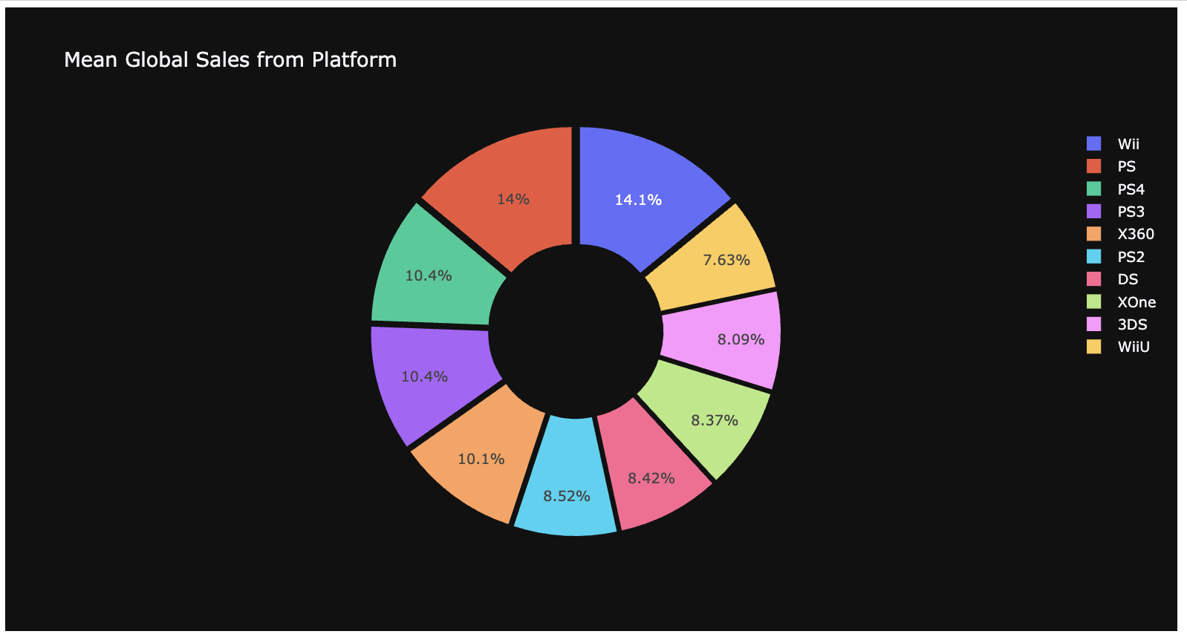
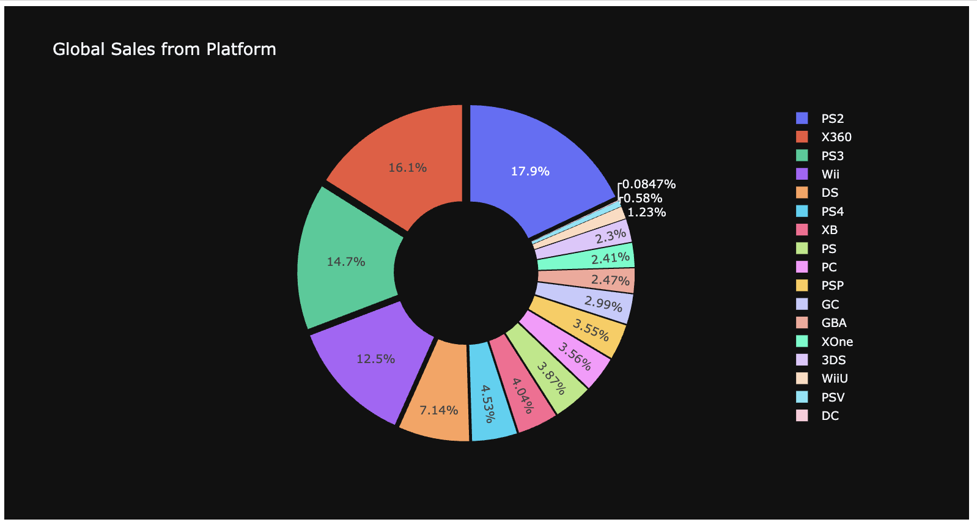
Visualizations
Sales based on platform

Slide 12
Visualizations
Sales based on platform

Slide 13
From the pie chart it is clear that only 36.9% E and 10.3% E10+ so we have lot of scope to improve and get better rating. This can be action item so investigate why less rating most of the times like AO, KA and RP.
From the visualization we could see which platform is not performing comparatively well in sales and focus on what not went well in those platforms. Special focus may required on these platforms to investigate and find the actionable items.
From the critic score distribution we can brought the insights of critic score vs count and we could see more critics with good score and less critic count with bad score. That said we are delivering the good content and we should continue doing it.
From the critic score vs global sales scatter plot we can see the relationship between good sales count vs good critic score and publisher. That said we should deliver the good content to increase the global sales. While we are having good numbers here we can still see lot of scope for the improvement. As an action item we can brough less sales vs low critic score and find the common factors like genre, publisher & etc so we can stop selling them in our platforms.
Number of games on platform and genre - we can brought the insights like number of games vs platform and Genre. At this point this is a piece of information, later we can use this comparing the sales too so that we can focus on specific platform and genre. On another note, we can see which genre has less/more publishers.

