Slide 1
Data Visualization
Assignment 1
Utkarsh Thusoo - M20AIE318

Slide 2
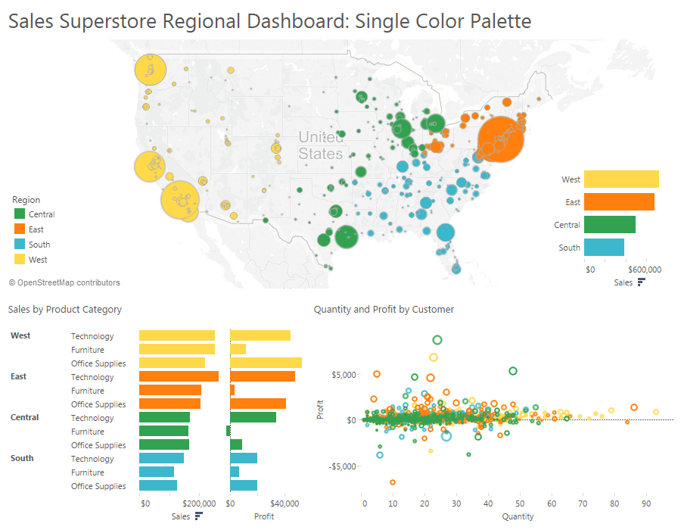
Visualization 1
Errors
Small shapes are notoriously challenging to color-code and map together.
The legends and explanation text are too large for the graphic.
It will be difficult for the reader to make sense of the visualizations due to the color combination and the choice of graphs.
Improvements
Too many graphs are cluttered together for Sales and Quantity graphs.
We should use bright colors like red to show critical items or losses while tamer colors like green should be used to profits or display business as usual items.
Bright colors should only be used to draw attention to important information.
Too many pictures or white spaces can lead to gaps and make it difficult to understand.
Given graph proper spaces should be provided and it looks clattered. Also use same colors for representing similar items across various graphs.

Slide 3
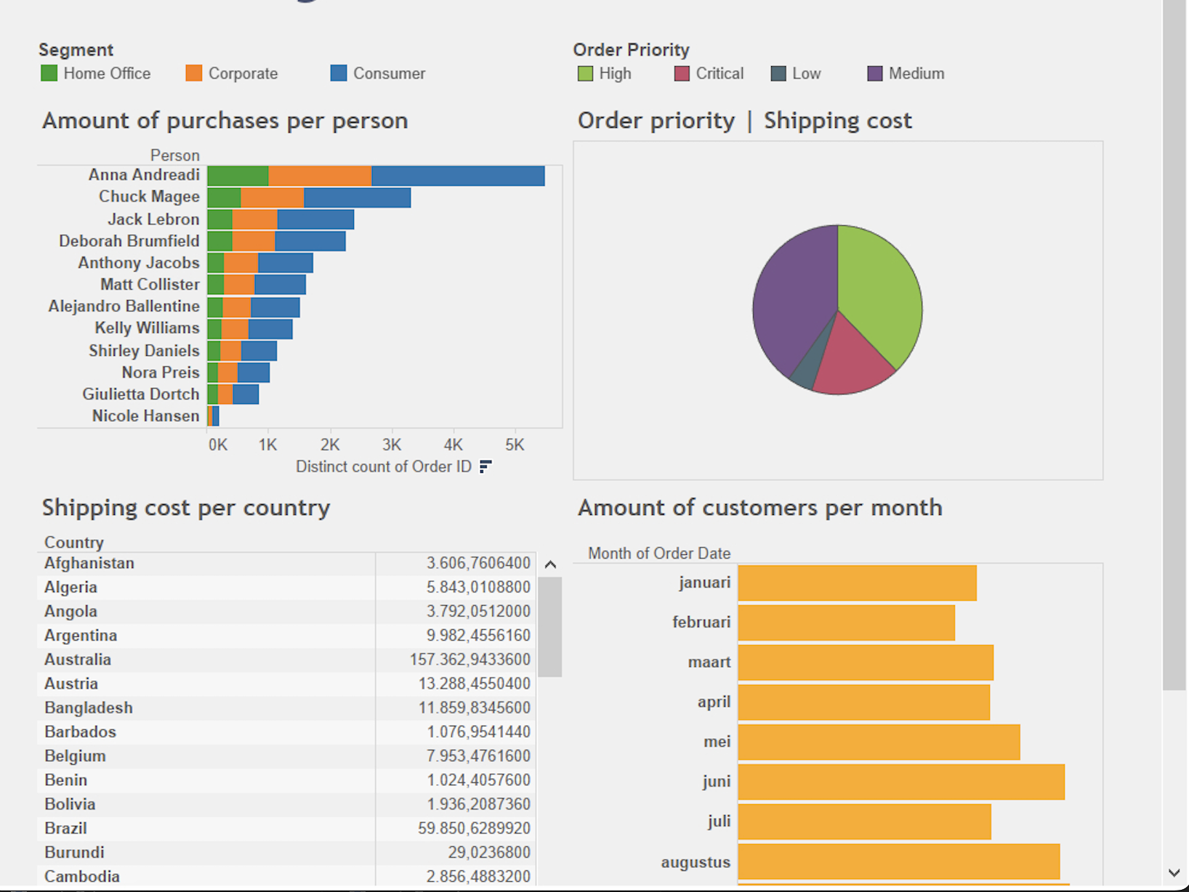
Visualization 2
Errors
Improvements
Scrollbar being part of the visualization.
The labels for the graphs need to be rethought ex Value for Shipping cost per country, Order Priority and amount of customers per month graph is missing
Choose the right chards ex having a pie chart for Priority for values is not making things consistent.
Colors that are used are not consistent and not even matching the behavior ex Order Priority pie chart has Green color for High.
Spelling mistakes ex month names in order date.
White spaces and background color needs to be improved as its not pleasing to the eyes.
Scrollbar should be avoided at all costs as the main idea behind a dashboard is everything should be visible in a single screen.
Try to have proper values present ex replace the values for the Shipping cost with the same currency value as in Amount of purchases per person and make it per thousand making it easily understandable to the viewer.
Try to reorganize to show same kind of a graph ex having Bar charts across all cases making overall behavior consistent.
Try to choose colors more pleasing to human eye and make sure they represent the tone in which that author wants to portray the information to the reader.
Make sure you use the proper spaces between graphs as symmetric data is clearly readable to the reader.

Slide 4
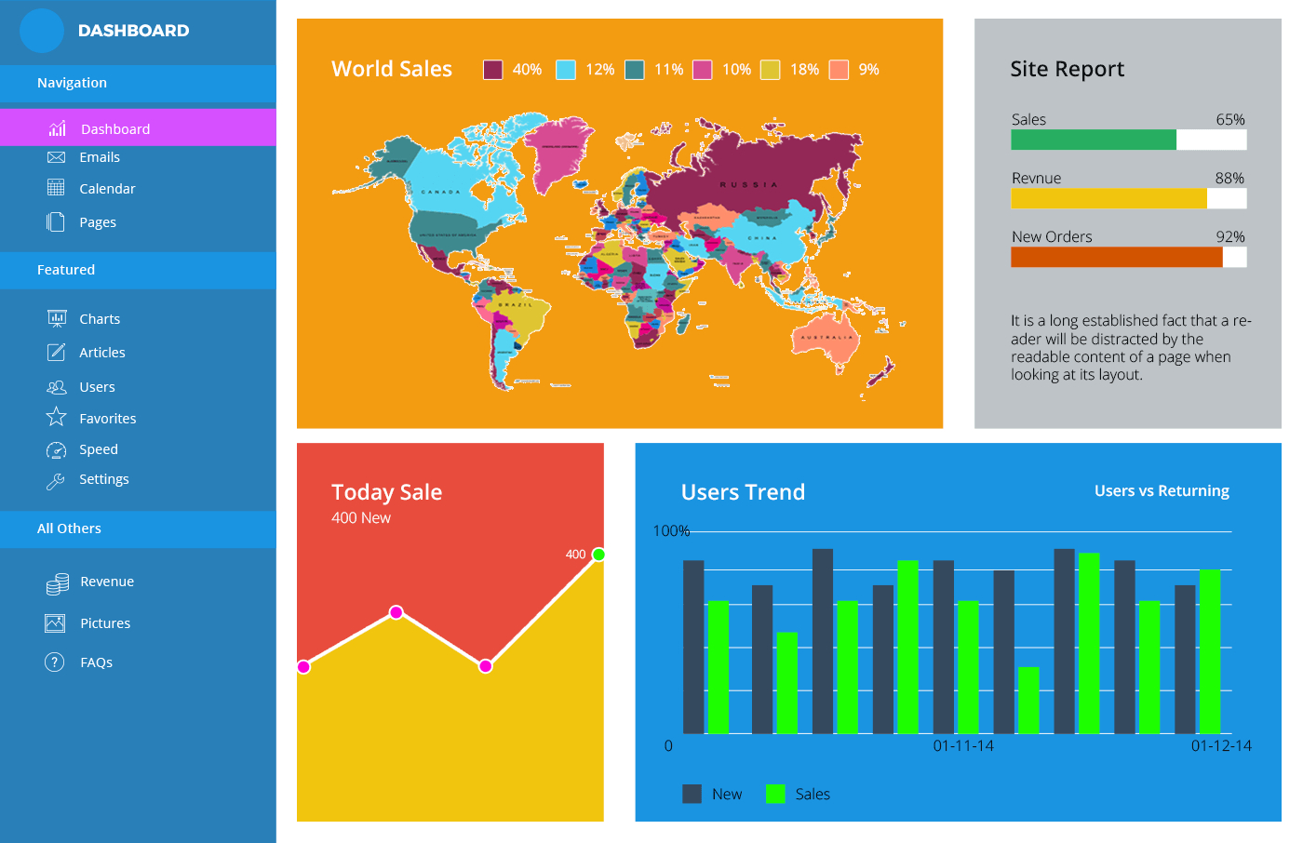
Visualization 3
Errors
There are almost 12 different colors which are used in the dashboard making it visual nightmare.
The navigation baris still open resulting in visualization getting cluttered together.
The use of spaces between the graph needs to be improved.
The titles have no proper legends making the graphs difficult to understand
Color choices for sales do not align with the actual idea that graph is supposed to represent.
Improvements
The choice of colors should be significantly reduced, and same theme should be propagated across graphs so that user can make better relationships between various items.
The navigation bar should close while the dashboard is open creating more space for the graphs
The graphs should have more spaces I between and theme should be maintained for various visualization options
Titles and legends should be added to the graphs so that its clearly visible.

