Slide 1
PAGE RANKING ALGORITHIM IIT Jodhpur
Suresh (M20AIE313)
Utkarsh (M20AIE318)
Pradeep (M20AIE275)

Slide 2
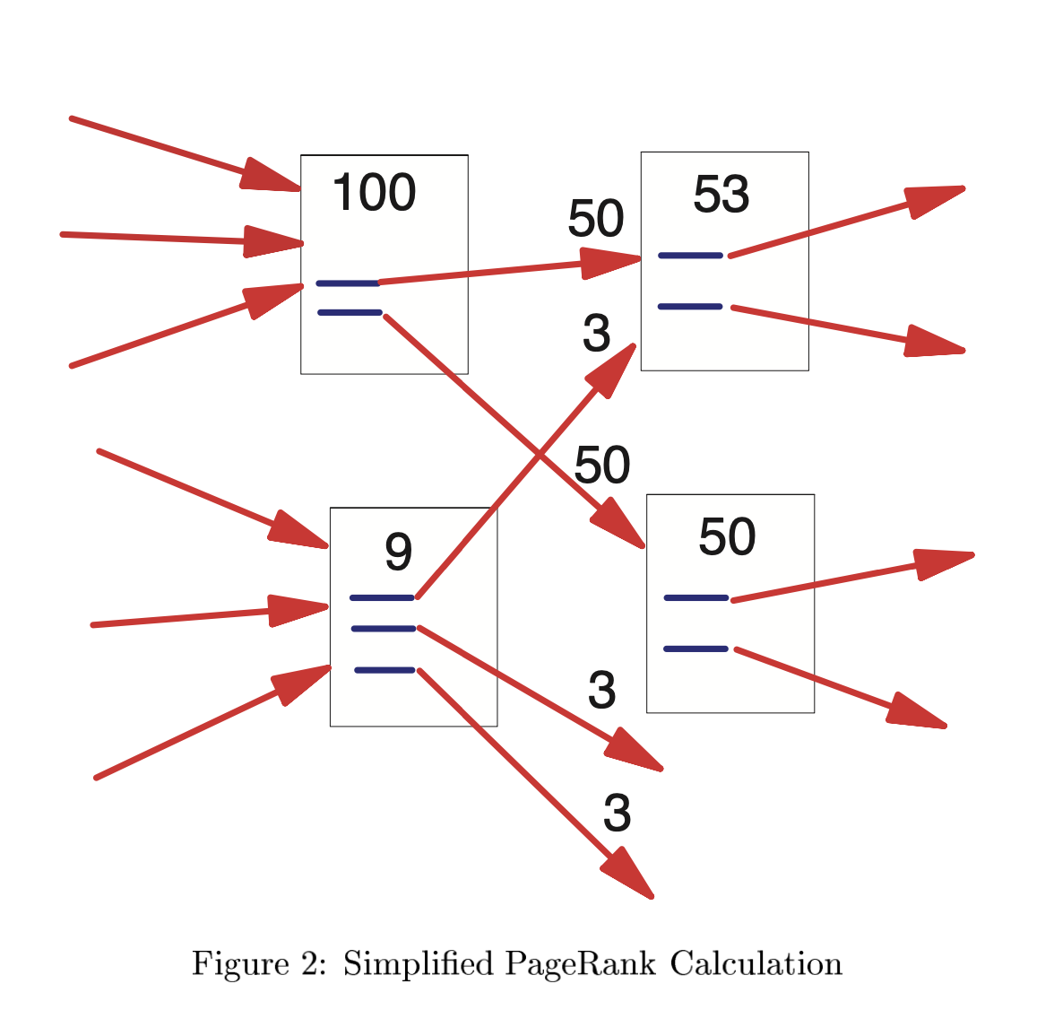
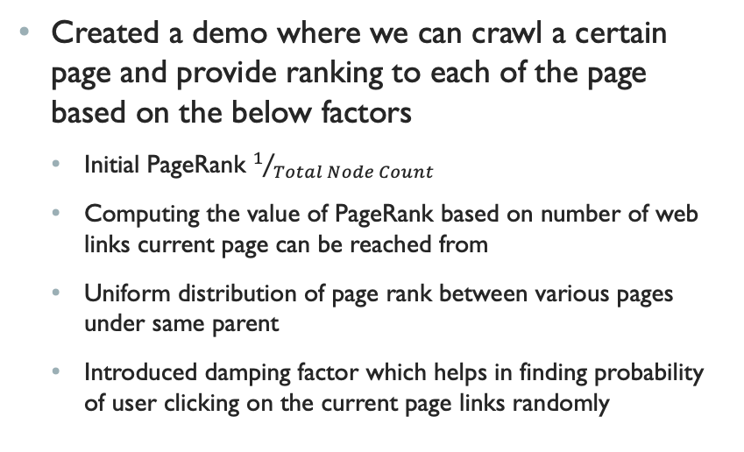
INTRODUCTION
Created a demo where we can crawl a certain page and provide ranking to each of the page based on the below factors
Initial PageRank $1/{Total Node Count}$
Computing the value of PageRank based on number of web links current page can be reached from
Uniform distribution of page rank between various pages under same parent
Introduced damping factor which helps in finding probability of user clicking on the current page links randomly

Slide 3
Definitions
Page Rank
Is an algorithm used by search engines to rank websites in their search engine results measuring the importance of website pages.
The algorithms returns a number between 0 and 1.
The term was first coined in Google after one of its founders Larry Page.

Slide 4
Definitions
Damping Factor
The random surfer on the internet will always end up with the dangling node (having no edges) and given any point in time the damping factor carried is d.
The probability of surfer choosing the random next link is d.
We assumed d = 0.85

Slide 5
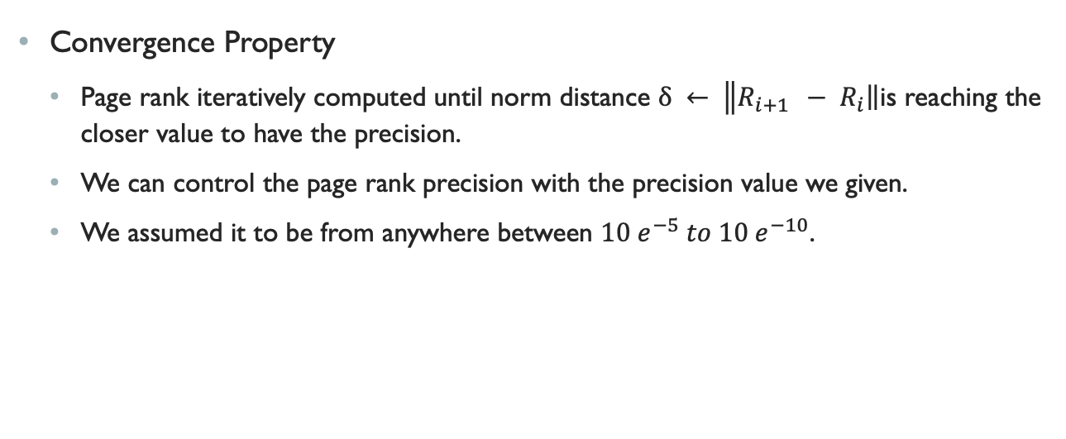
Definitions
Convergence Property
Page rank iteratively computed until norm distance $δ ← \left\|R_{i+1 }\right. − \left.R_{i}\right\|$is reaching the closer value to have the precision.
We can control the page rank precision with the precision value we given.
We assumed it to be from anywhere between $10 e^{−5} to 10 e^{−10}$.

Slide 6
Definitions
Damping Node and Rank
A node which has no out Degree is a dangling node.
Rank of a dangling node is called dangling rank.

Slide 7
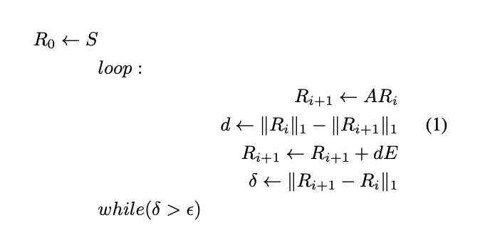
IMPLEMENTATION
Algorithm
Steps:
Collect the data by crawling the given link
Create a directed graph
compute the rank for each node
Iteratively compute the rank until we get precision

Slide 8
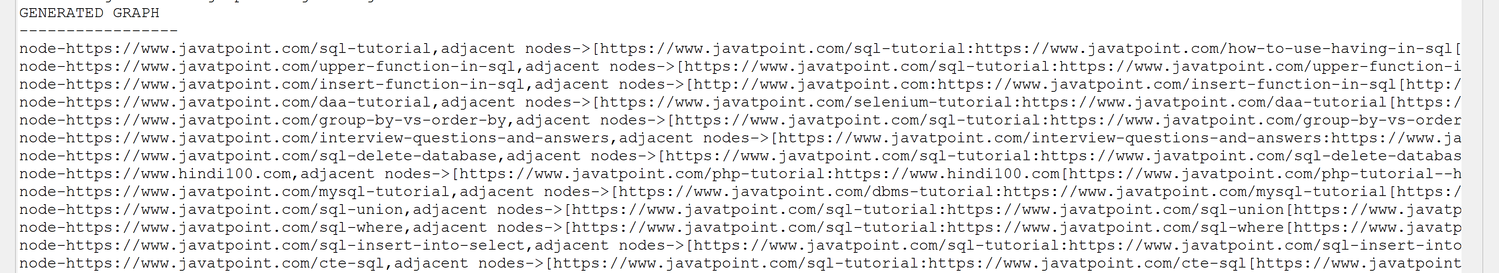
Actual dATA
Crawled Graph

Slide 9
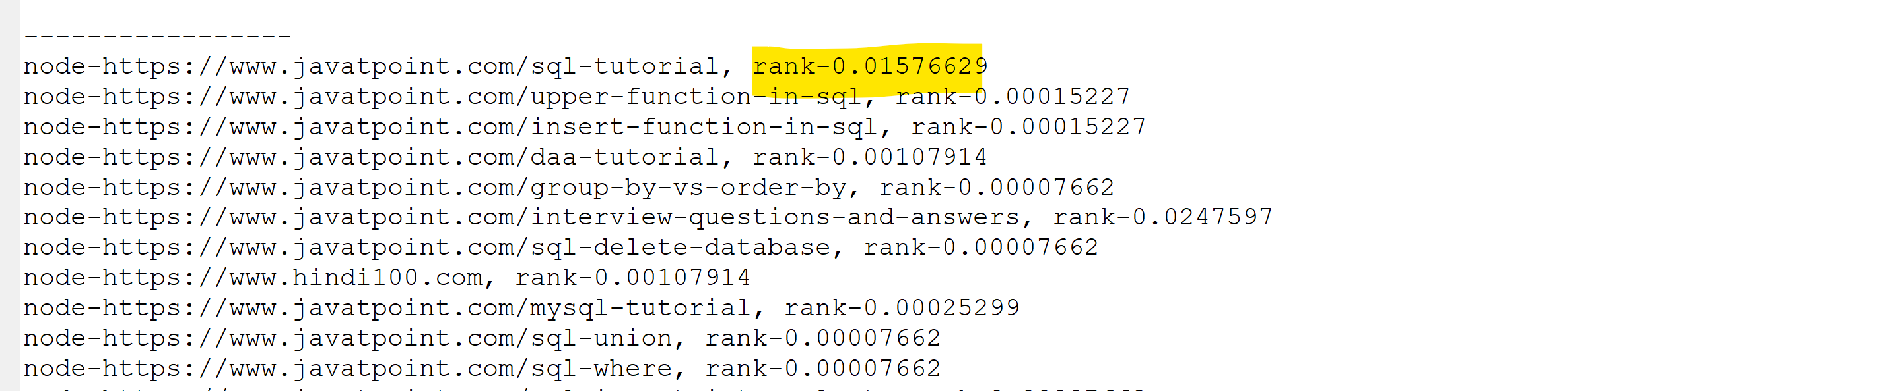
Actual dATA
Output Ranks

Slide 10
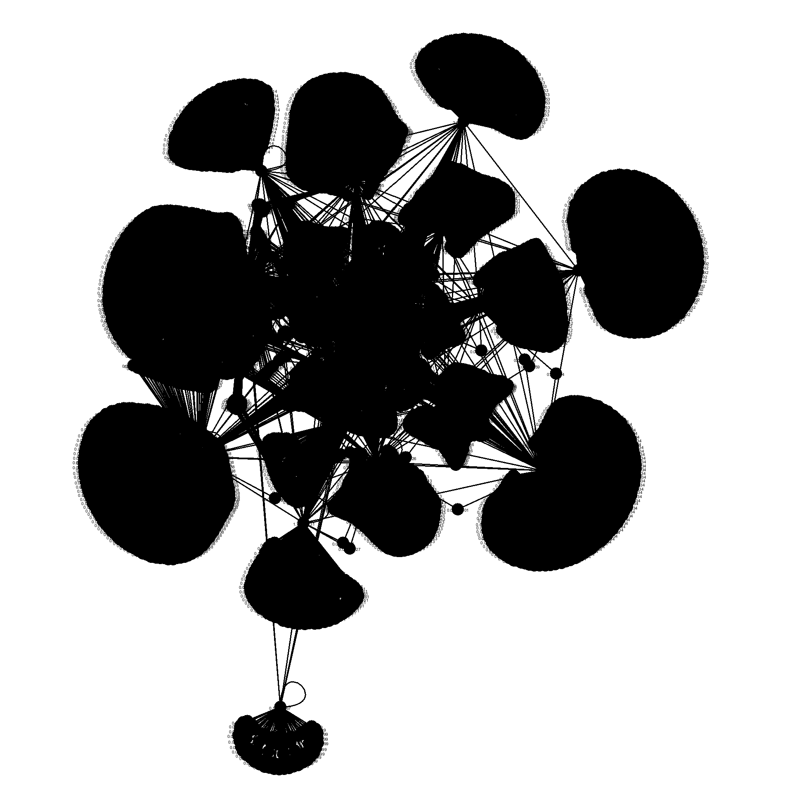
Actual dATA
Finalized Graph

