Slide 1
Flask
A python based lightweight web framework

Slide 2
What does it mean by ‘lightweight’?
Has nothing of its own.
Except for the framework, everything else is called using modules, libraries.

Slide 3
What does it mean by ‘framework’?
A set of rules/best practices/standards that are decided for the most optimized and error-free result.

Slide 4
What is flask?
Flask is a python based lightweight web-framework.

Slide 5
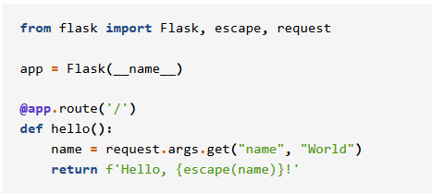
Hello World
Notes:
Image credits: https://www.palletsprojects.com/p/flask/

Slide 6
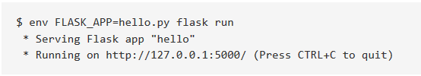
World, Hello
For Externally Visible Server
flask run --host=0.0.0.0

Slide 7
Environment: Societies and situations
What does it mean by “Environment”?
What is the difference between “Development env.” and “Production env.”?
What environment is your flask web application running in right now?

Slide 8
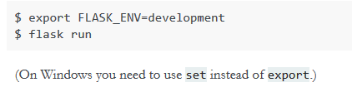
Let’s come home for now…
Switch to the development environment.

Slide 9
Adv. Of Flask Dev env
You get debugger on the browser.
You get hot-reload.

Slide 10
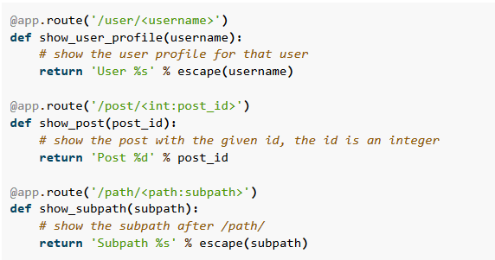
Routes

Slide 11
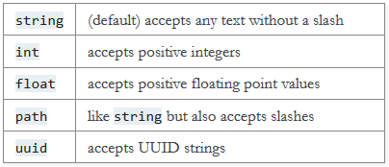
Routes – Converter Types

Slide 12
API (Application Programming Interface)
An API is a set of rules that allow programs to talk to each other.
The waiter analogy:
You talk in one language. (request)
The chef talks in another. (response)
Who is the mediator?

Slide 13
What is “REST” in REST API?
REST is nothing but a set of principles that make APIs easier to make, understand, maintain and share.
You can read about these principles here.
https://restfulapi.net/

Slide 14
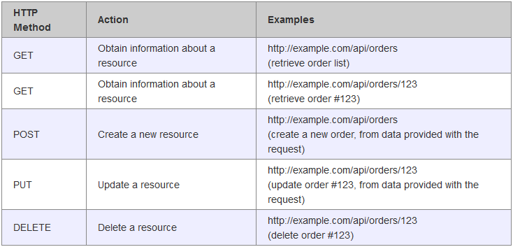
Things we can do with APIs

Slide 15
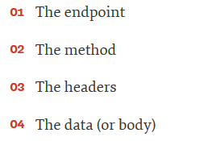
A bit about your request
A request consists of the below parts:

Slide 16
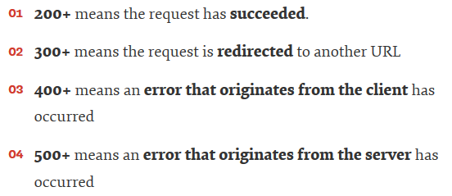
A bit about the response
The response that you get from the server is:
Along with 200, you also get the requested data, obviously.

Slide 17
Coming back to our need.
What all APIs might we need?
What all tables might we need?

Slide 18
(some help that I took)
What is REST? https://restfulapi.net/
How to user REST APIs? https://www.smashingmagazine.com/2018/01/understanding-using-rest-api/
Make RESTful APIs with Flask: https://blog.miguelgrinberg.com/post/designing-a-restful-api-with-python-and-flask
Flask documentation: https://flask.palletsprojects.com/en/1.1.x/quickstart

