Slide 1
Excel Final Assessment

Slide 2
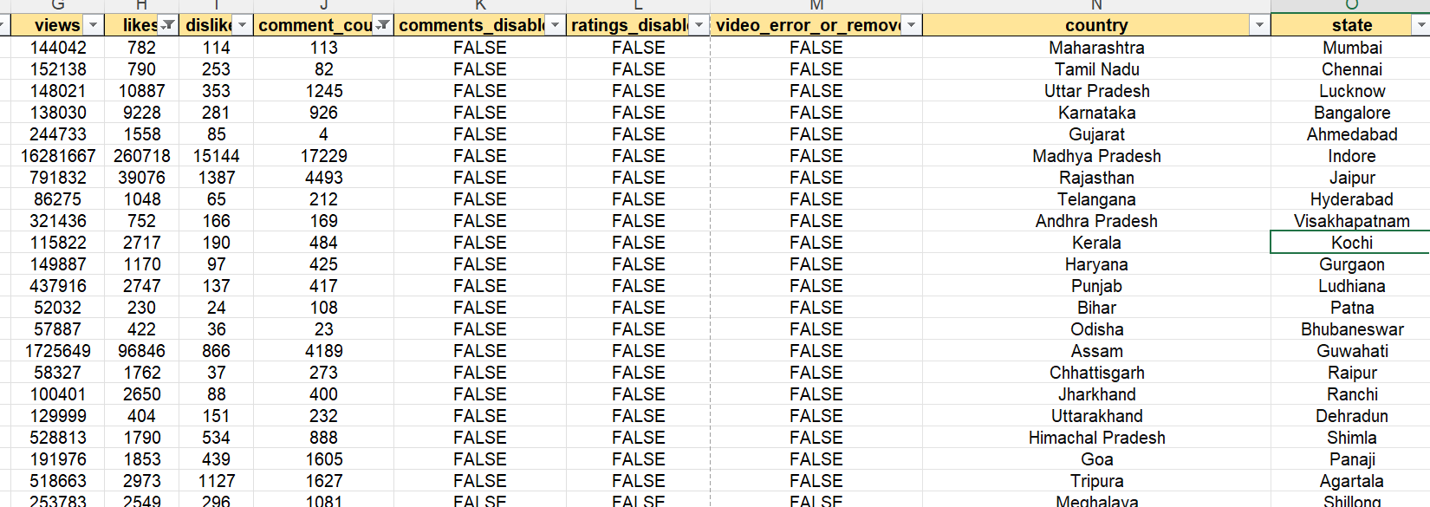
Q1
I have removed all the duplicates and null values using remove duplicate function and filtering the data which is not having 0 in that.

Slide 3
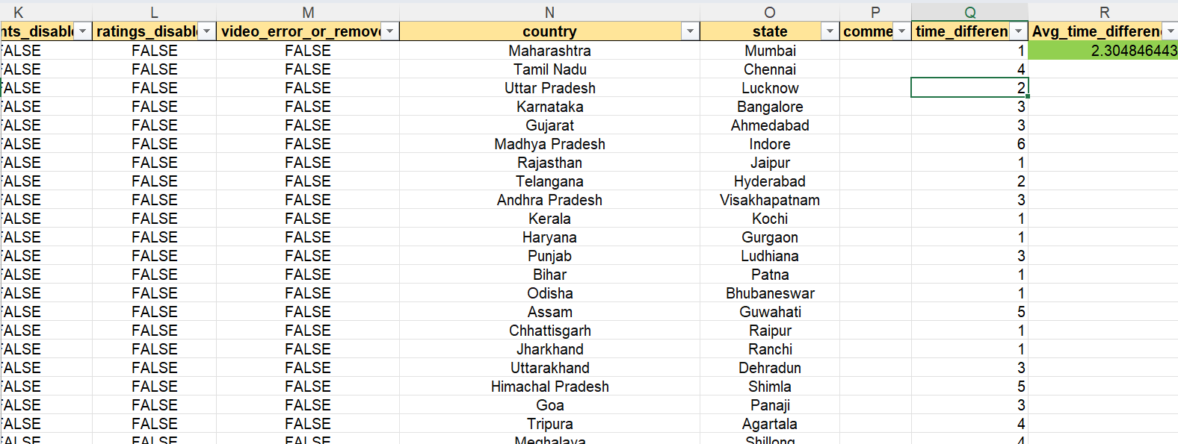
Q2
Here I haved taken the time_difference from the columns and then calculated the avg_time diff.

Slide 4
Q3

Slide 5
Q4

Slide 6
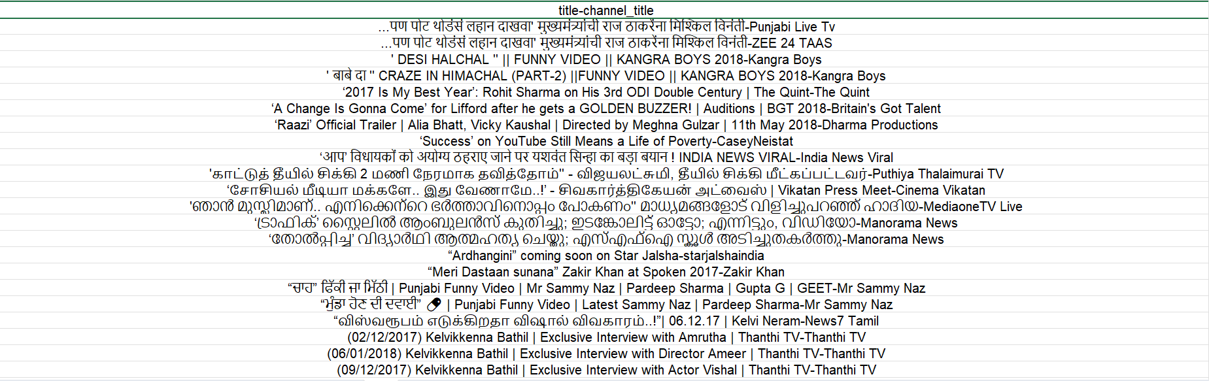
Q5
Added the textjoin and concat function

Slide 7
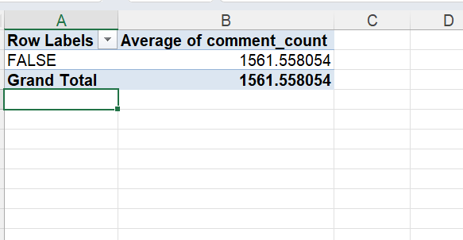
Q6

Slide 8
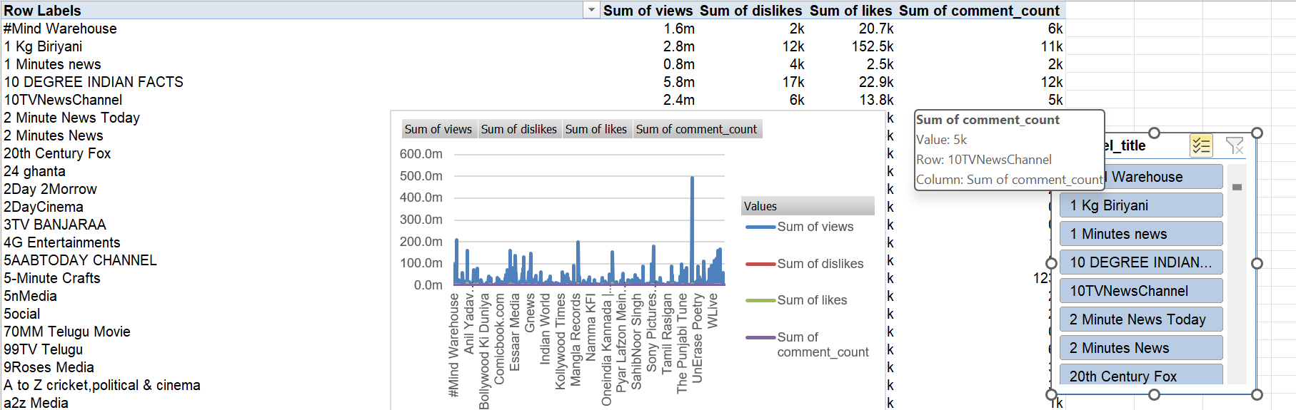
Q7

Slide 9
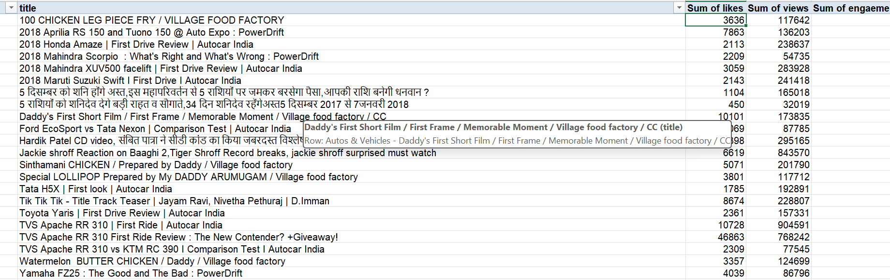
Q8

Slide 10
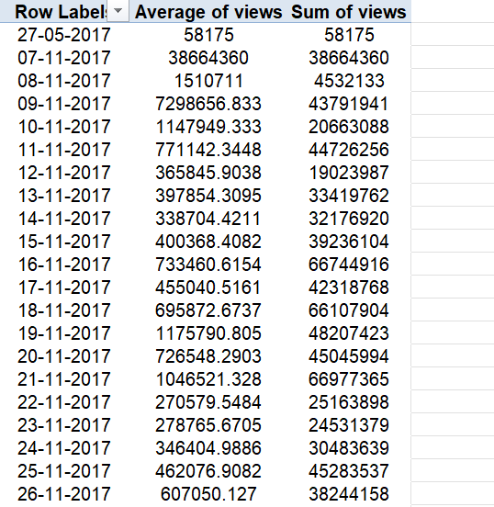
Q9

Slide 11
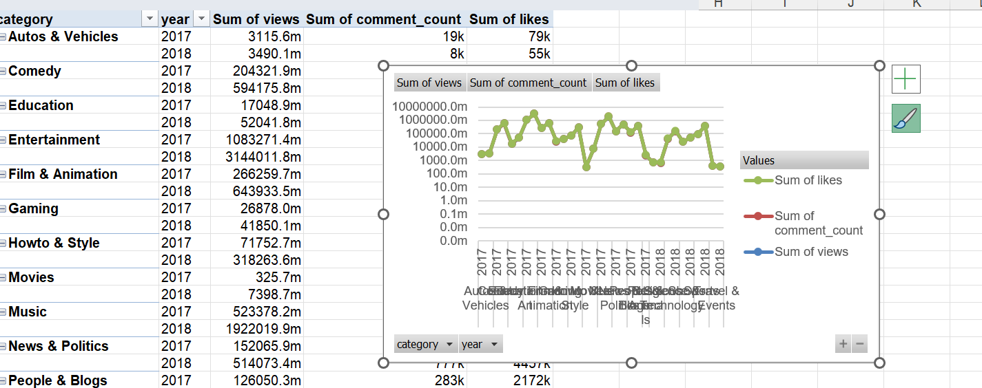
Q10

Slide 12
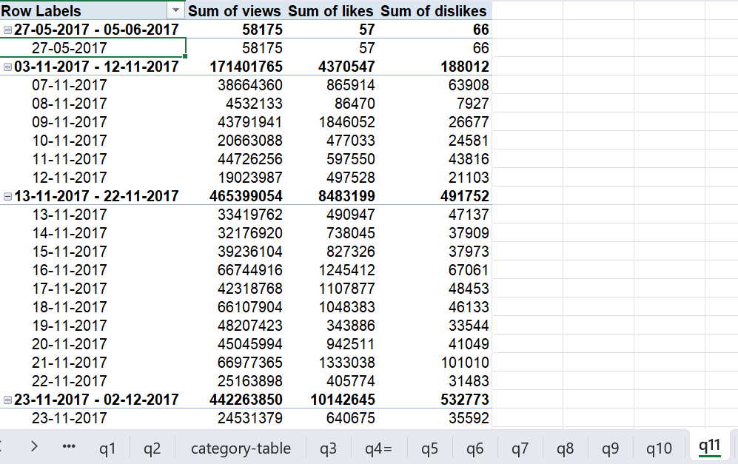
Q11

Slide 13
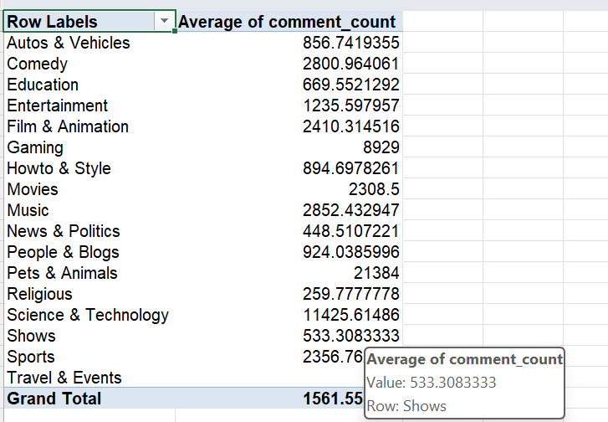
Q13

Slide 14
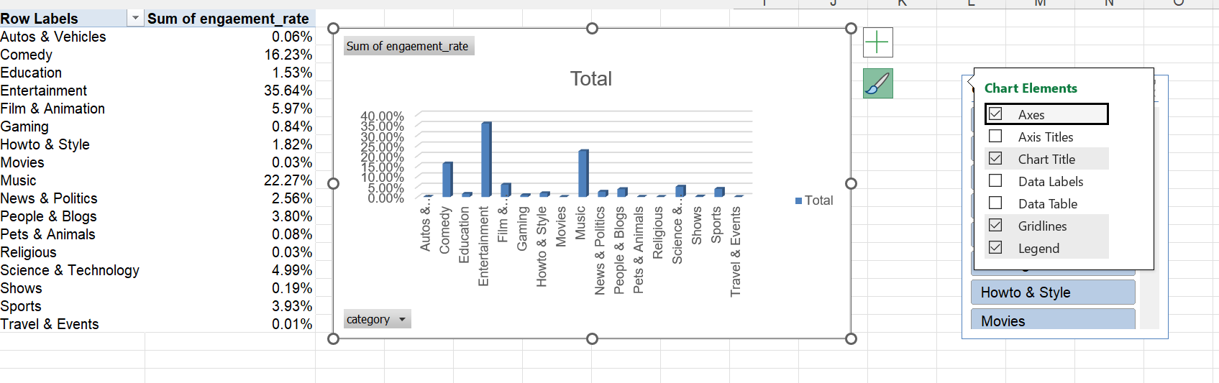
Q14

Slide 15
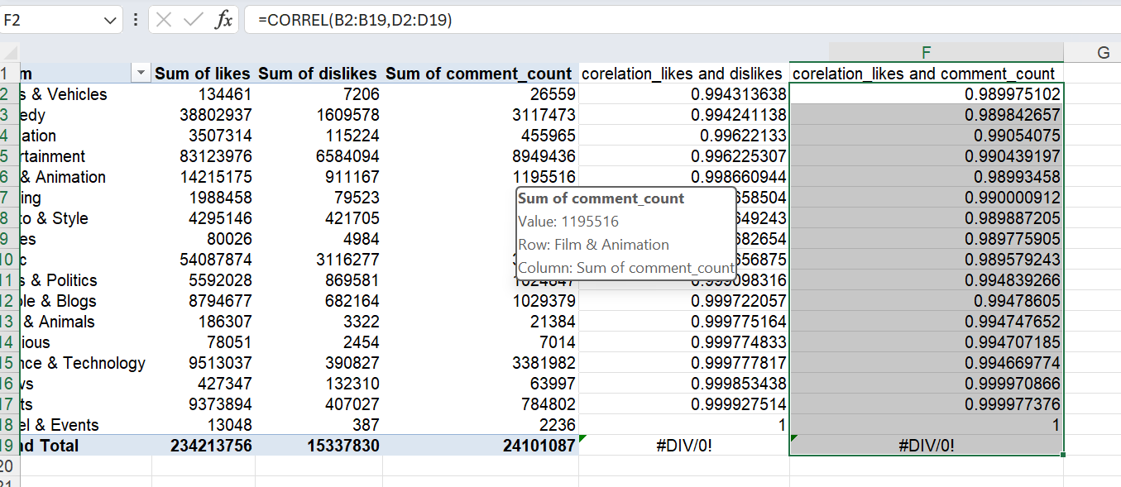
Q15

Slide 16
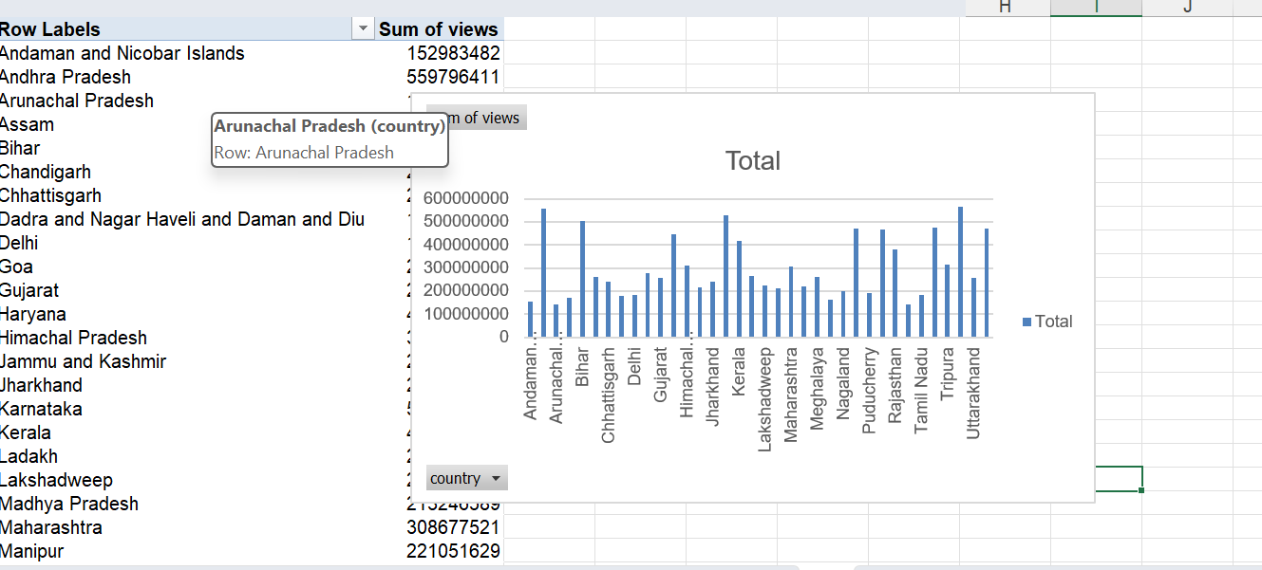
Q16

Slide 17
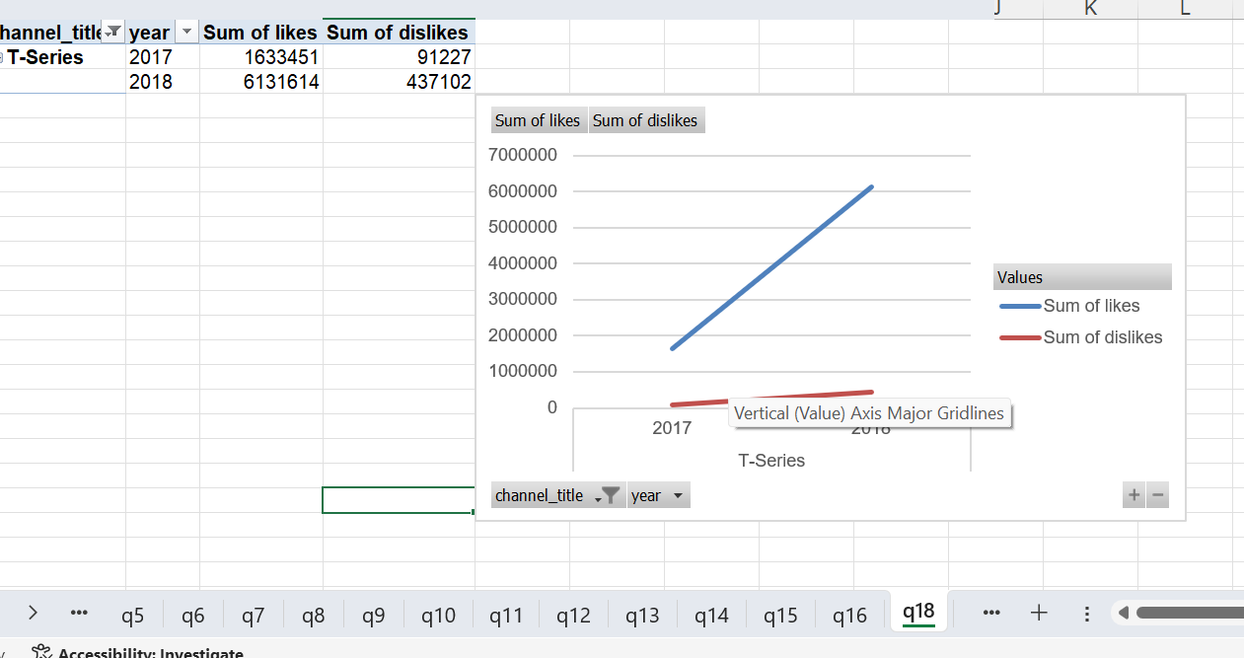
Q18

Slide 18
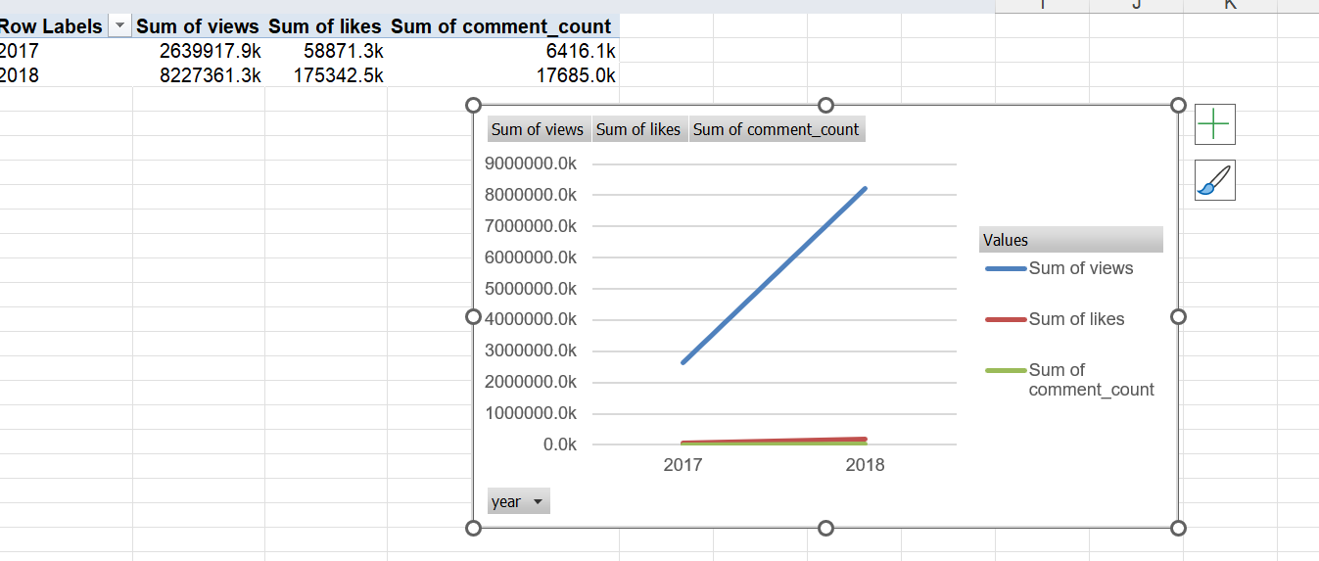
Q19

Slide 19
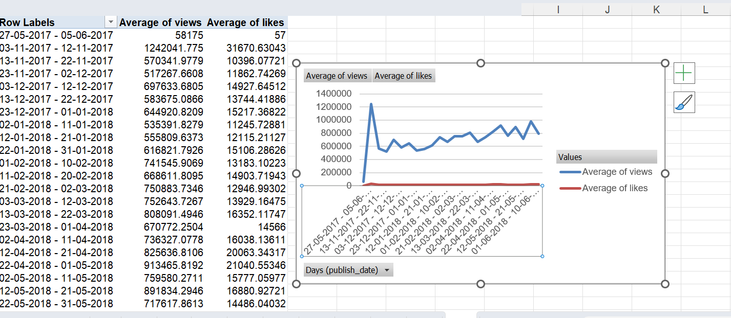
Q20

Slide 20
Q2

Slide 21
Q2

Slide 22
Q2

