Slide 1

Identifying and Characterizing Ad hominem Fallacy Usage in The Wild Utkarsh Patel Department of E&ECE, IIT Kharagpur Supervisors: Prof. Mainack Mondal and Prof. Animesh Mukherjee Co-supervisor: Prof. Amitalok Budkuley IIT Kharagpur

Slide 2
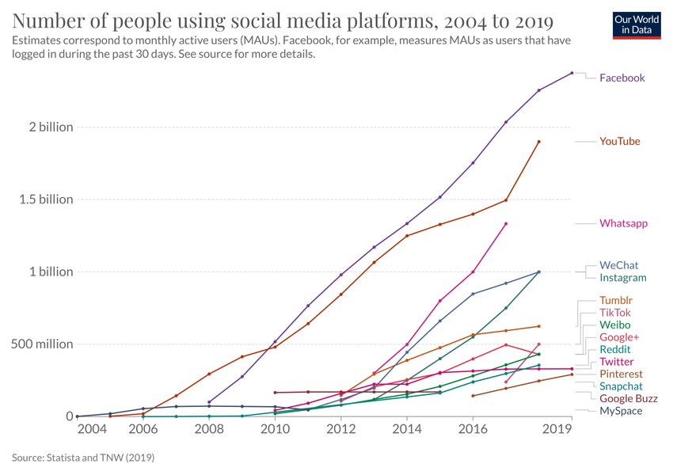
Abstract
Image credit: Our World in Data

Slide 3
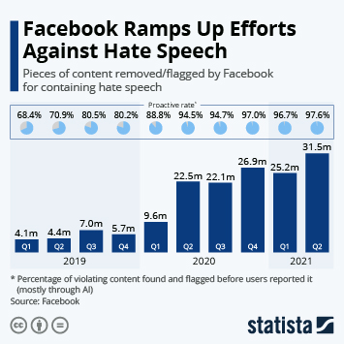
Abstract
Image credit: Statista

Slide 4
Introduction
Ad hominem arguments are perhaps the most famous fallacies in Web argumentation
They are based on feelings of bias (mostly irrelevant to the argumentation), rather than realities, reason, and rationale
They are often personal attacks on someone’s character or motive rather than an attempt to address the reasoning that they presented

Slide 5
Examples
But you can eat and drink maskless on a plane!!?? Wake up sheeple and grow a brain. Zero intelligence. Just follow like the good little sheep you are.

Slide 6
Examples
But you can eat and drink maskless on a plane!!?? Wake up sheeple and grow a brain. Zero intelligence. Just follow like the good little sheep you are.
Often have these triggers

Slide 7
Overview
Built powerful ad hominem detector using CMV dataset
Used it to classify comments scraped from CreateDebate
Validated our in-the-wild predictions via crowd-sourced surveys
Looked into users who were spurring ad hominem and observed their characteristics
Studied the temporal variation of ad hominem usage on CreateDebate

Slide 8
Semi-supervised learning is the key!
Though Transformer models like BERT perform exceptionally well on various NLP tasks, the large amount of annotated examples required for targeted tasks is the bottleneck
One possible solution is integrating BERT with GANs in semi-supervised setting (Goodfellow et al., 2014; Salimans et al., 2016)
Croce et al. (2020) showed GAN-BERT drastically reduces the number of annotated examples required for targeted tasks; even with 200 annotated examples, results are comparable with a fully supervised setting

Slide 9
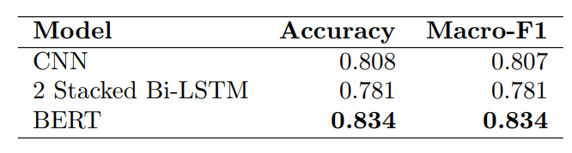
Building Powerful Ad hominem Detectors
We choose the Change My View dataset (Habernal et al., 2018) which contains 7242 labeled comments (3622+, 3620-) and evaluate performance of BERT against the baseline models using 10-fold cross-validation
We achieved a 2.6% absolute improvement in accuracy score against the baselines (CNN and 2-stacked BiLSTM)

Slide 10
What Makes Arguments Ad hominem?
As discussed in the beginning, ad hominem comments contain key-phrases which are responsible for flagging them as ad hominem
We used BERT to highlight those phrases of the comments and observed that it was really good in identifying these phrases

Slide 11
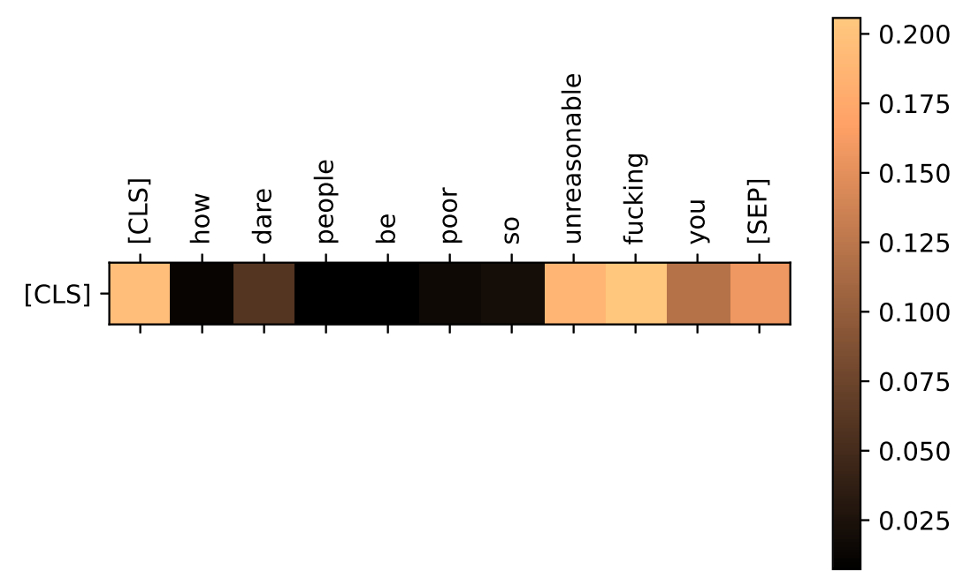
Highlighting Ad hominem Triggers
As [CLS] token is the aggregate representation of the input sequence for classification tasks, we used attention scores for [CLS] token to detect the triggers.

Slide 12
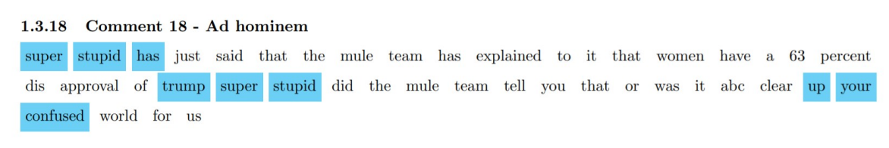
Highlighting Ad hominem Triggers
We greedily select top three tokens on the basis of attention scores so that the trigrams centered at those token don’t overlap and produce word weight heat maps for the comments

Slide 13
The Bottleneck
Annotating ad hominem arguments is a very costly task as they are difficult to comprehensively and objectively define
We explored approaches that would allow us to perform ad hominem detection on dataset with very low fraction as labeled instances (quality over quantity), but abundant unlabeled instances from same distribution (annotations are costly, Web scraping isn’t)
But, the results must be similar to BERT (or even outperform it)
Hence, we started experimenting with GANBERT

Slide 14
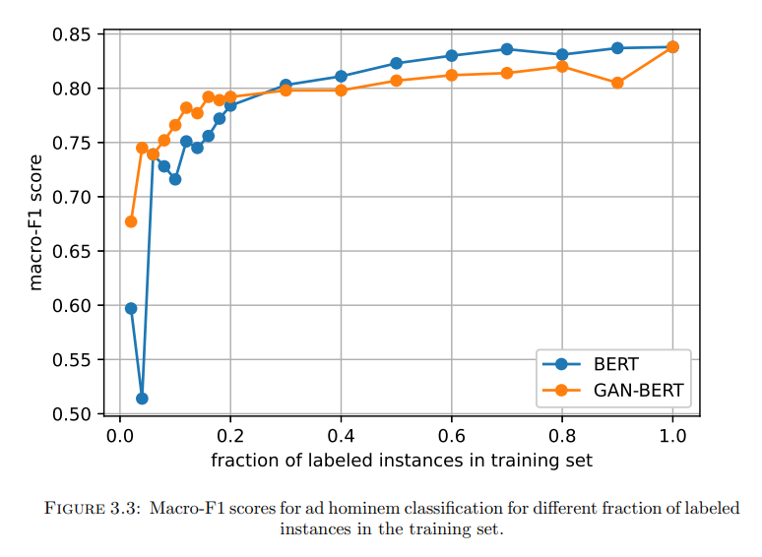
BERT vs. GANBERT

Slide 15
Create Debate
Create Debate is an online debate forum that calls itself ‘tool that democratizes the decision-making process through online debate’
It has 14 different topical subforums.
We collected 18k posts comprising 265k comments by 15k users uploaded over a period of 14 years for most popular subforums which includes Politics, Religion, World News, Law, Science and Technology.
Notes:
We then used the fine-tuned BERT to detect ad hominem comments in this dataset.

Slide 16
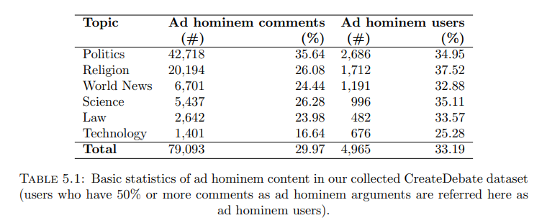
Create Debate
Notes:
From the table, we observe that one-third of the content on CreateDebate is ad hominem. This is alarmingly high when compared to CMV’s 0.02% ad hominem and 19.5% for regular debate forums. It is also very surprising to observe that one-third of the users are posting ad hominem comments more often than otherwise normal comments, and that the same trend is observed for topical subforums like Science and Law.

Slide 17
Validating In-The-Wild Predictions
We observed that for 94% of the randomly sampled comments, labels given by the participants were same as the predicted labels by the model.
Also, for 94.3% cases, the top three trigrams were selected by the users for deeming the comment to be ad hominem
Notes:
As our classifier model is fine-tuned on Change My View dataset, and CreateDebate being an entirely different platform, we were not very sure about the results we obtained for CreateDebate. To validate these, we carried out crowd-sourced surveys to get the gold labels for randomly sampled comment from CreateDebate and evaluated the results.

Slide 18
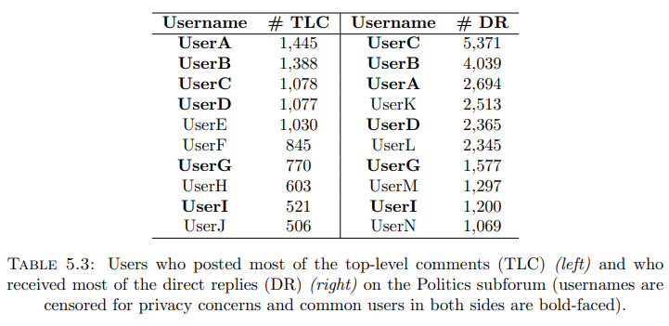
Who is posting the ad hominems?
Notes:
Owing to the fact that one third of the content on CreateDebate is ad hominem, an obvious question is – who is posting these comments? We extracted the top 10 users using the comment count and reply count. We observed that only the top 10 users have posted 26% of top-level comments and these are the users who also received most of replies. Thus signifying the possible influence of handful of users on the whole forum. Thus, we ask, do these users have any role in elevating the fraction of ad hominem arguments in CreateDebate.

Slide 19

Correlation b/w Activity & Ad hominem
Let $X\left(λ\right)$ denotes set of authors who wrote at least $λ$ top-level comments
Let $Y\left(μ\right)$ denotes set of authors who received at least $μ$ replies
We considered the set $S\left(λ,μ\right)=X\left(λ\right)∩Y\left(μ\right)$
Notes:
We try to understand the activity of users corresponding to different levels of \lambda and \rho. We start by creating directed graphs showing support and dispute between the authors in the set S. The thesis contains a more detailed information on how we constructed these networks.

Slide 20
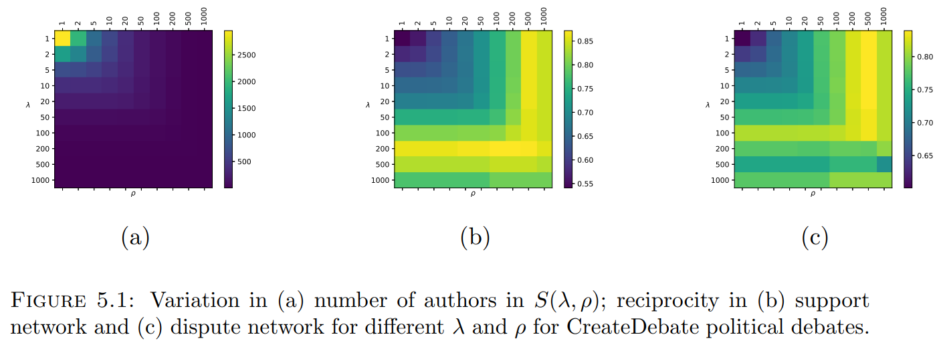
Correlation b/w Activity & Ad hominem
Notes:
We observed that as we increase the level of \lambda and \rho, the size of the set decreases, however, surprisingly, the reciprocity in the set increases. Our finding implies that the influential actors, who also happened to write most posts and receive most replies (high \lambda and \rho), participate in the debate not as an individual but as small-sized communites.

Slide 21
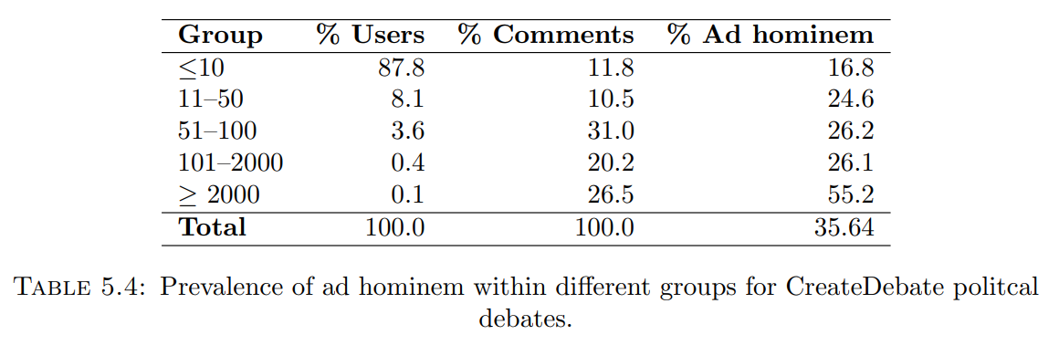
Influential users post high volume of ad hominem
Notes:
Our hypothesis is – the high percentage of ad hominem content on the forum is mostly generated by small communities of highly active users. These users always post together and reply to each other. To check whether this hypothesis holds, we grouped the users participating in political debates on the CreateDebate forum based on their comment count. And we compute fraction of ad hominem content for these groups.
From the table, it can be observed that the group of authors who posted at least 2000 comments only amount to 0.1% of user base, but they have posted 26.5% of total comments on the forum out of which an alarming 55.2% were flagged as ad hominem. This group’s activity is in stark contrast which other groups.

Slide 22
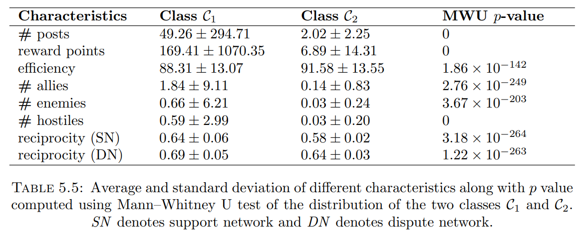
How can we detect such users?
Notes:
CreateDebate maintains profile pages for its users. These pages contain different metadata for each user, like reward points, efficiency, number of allies and enemies, etc. We collected these characteristics for the enite userbase and then partitioned the users into two classes:
C1 – those who users who have posted at least one ad hominem comment on the forum
C2 – those who haven’t
We compare these features in the given table. We can observe that the distribution of these features are statistically very different from each other (as noted with very low p-value from MW test). In a future work, one can use this features to predict which users will be posting ad hominem comments.

Slide 23
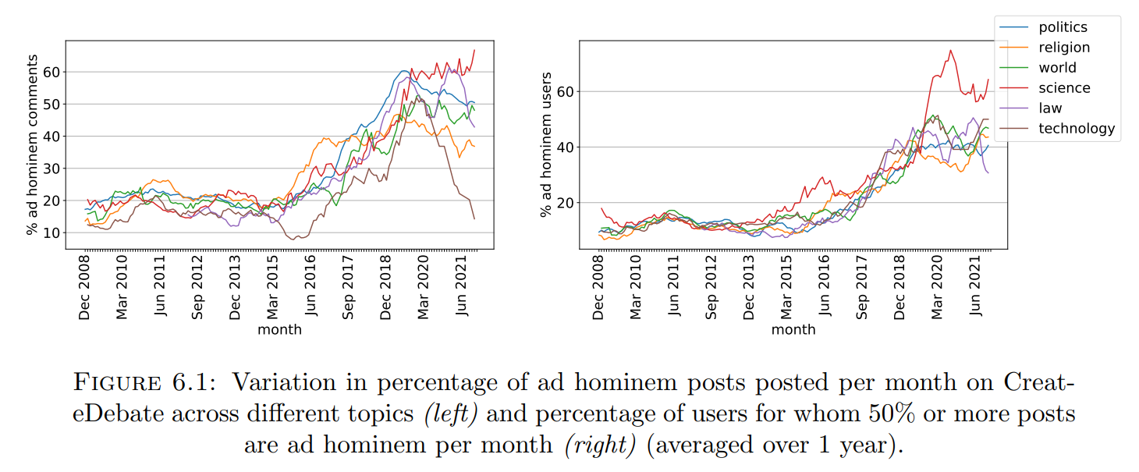
Temporal variations in Ad hominem Usage
Notes:
The figure shows the variation in the percentage of comments which were flagged as ad hominem and the percentage of users who were posting such comments for each month.
Interestingly, the plots for all the topical sub-forums follow a similar trend – initially they are stationary, then they show a steep rise and then they fall.

Slide 24
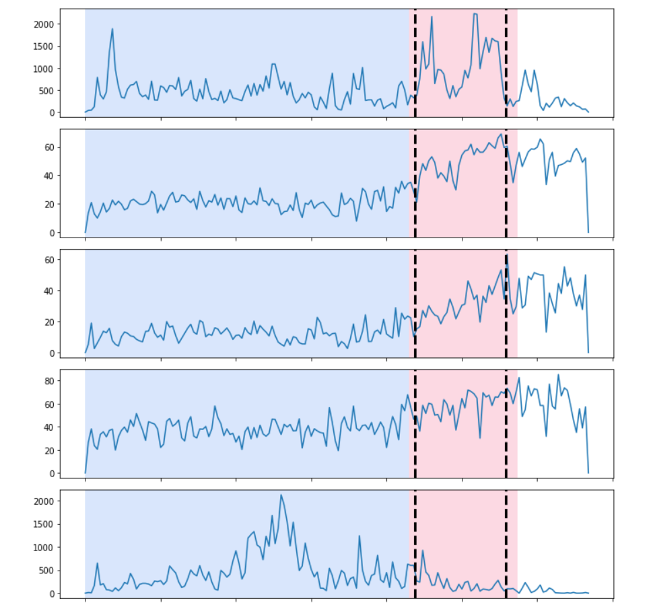



Change point detection
The Stationary
The Rise
The Fall
$$ℋ_{1}$$
$$ℋ_{2}$$
$$ℋ_{3}$$
March 2017
September 2019
Notes:
To understand what exactly triggered this sharp rise and fall, we performed change point detection experiments to quantitatively partition the corpus into three sub-corpora. The cutoffs for the partitions predicted by the algorithms were March 2017 and Sept 2019.

Slide 25
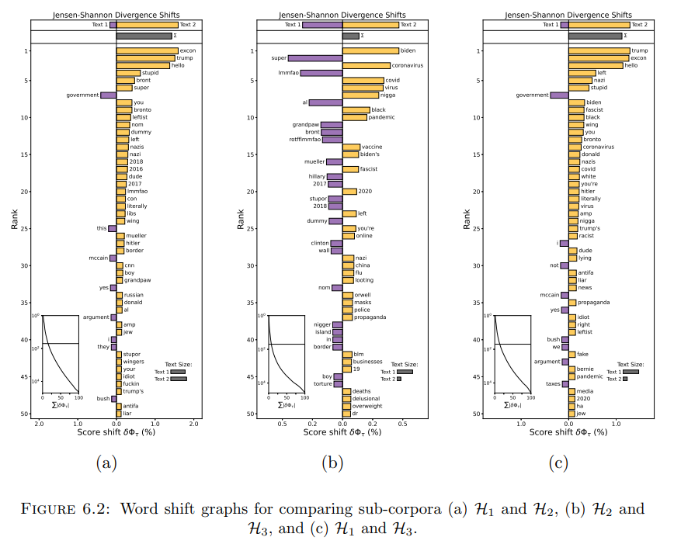
Word shift graphs
Notes:
We then compared these sub-copora by generating word-shift graphs using Jensen-Shannon Divergence. We observed that use of ad hominem trigger is very prominent in the corpus associated with the rise, as compared to the stationary.

Slide 26
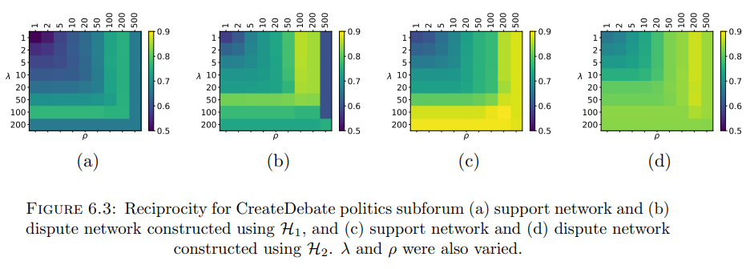
Change in Reciprocity
Notes:
We also observed that the reciprocity in support and dispute network increases for each group as we move from the stationary to the rise.

Slide 27
Role of US Elections and Covid-19
Interestingly, the cutoffs of the partitions predicted by the algorithm are very close to 2016 US Presidential election and Covid-19 outbreak.
Our hypothesis – use of ad hominem accelerated after the 2016 US Presidential election and the activity declined significantly after the Covid-19 outbreak.
Political debates are the root cause of alarming high percentage of ad hominem on CreateDebate

Slide 28
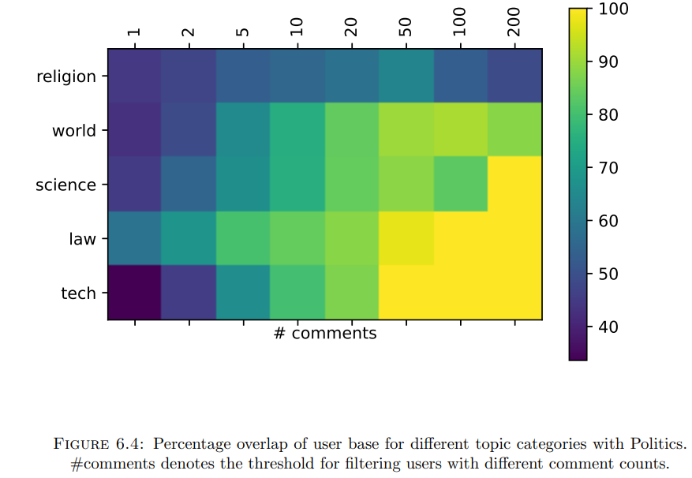
Overlap of users for Politics & other topics
Notes:
This claim is supported by the finding that there is a huge overlap in the userbase of Politics sub-forum and other subforum. And the overlap reaches 100% if we consider influential users, even for topics like science and tech.

Slide 29
Slur words within topical forums
The best way to differentiate between the linguistic style of various topical forum is to plot usage of different kinds of slur words.
Doing so, we will know what kind of slur words are frequently used for each forum
Notes:
This claim is supported by the finding that there is a huge overlap in the userbase of Politics sub-forum and other subforum. And the overlap reaches 100% if we consider influential users, even for topics like science and tech.

Slide 30
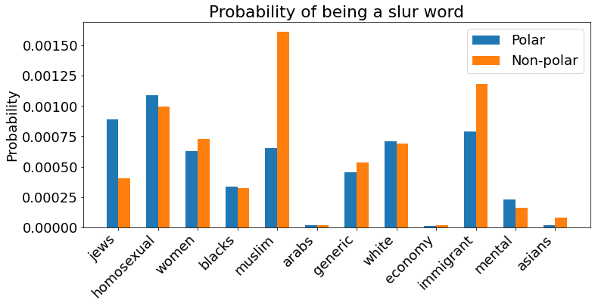
Slur words within topical forums
Notes:
This claim is supported by the finding that there is a huge overlap in the userbase of Politics sub-forum and other subforum. And the overlap reaches 100% if we consider influential users, even for topics like science and tech.

Slide 31
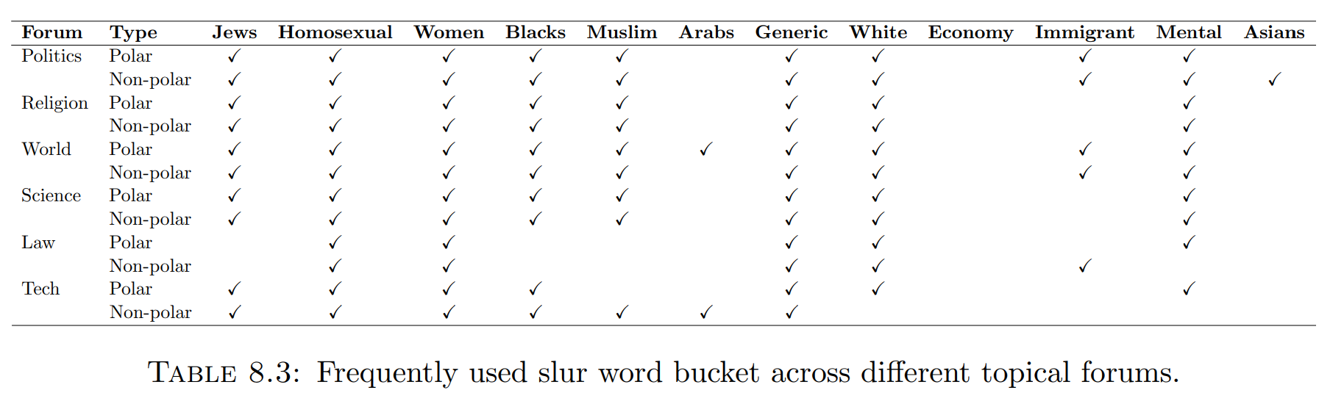
Slur words within topical forums
Notes:
This claim is supported by the finding that there is a huge overlap in the userbase of Politics sub-forum and other subforum. And the overlap reaches 100% if we consider influential users, even for topics like science and tech.

Slide 32
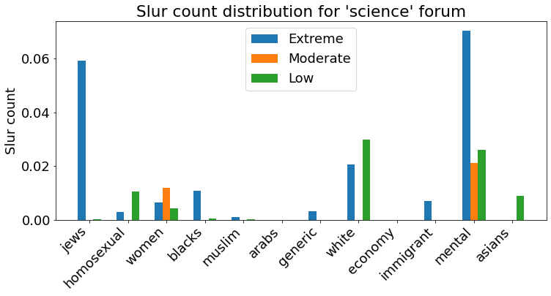
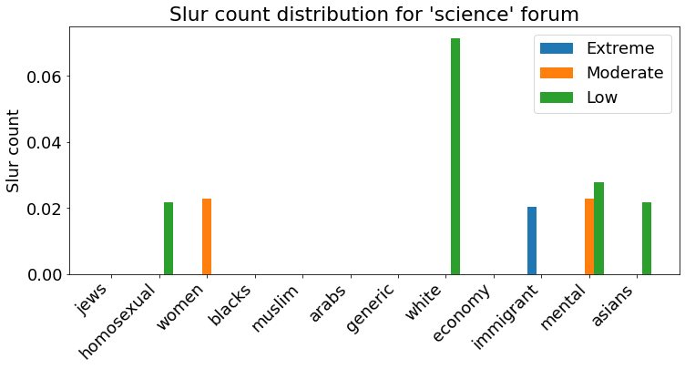
Migration of users within topical forums
Take-away
When users from Politics are removed, extreme group disappear for majority of slur groups.
After removing users from
Politics
Notes:
This claim is supported by the finding that there is a huge overlap in the userbase of Politics sub-forum and other subforum. And the overlap reaches 100% if we consider influential users, even for topics like science and tech.

Slide 33
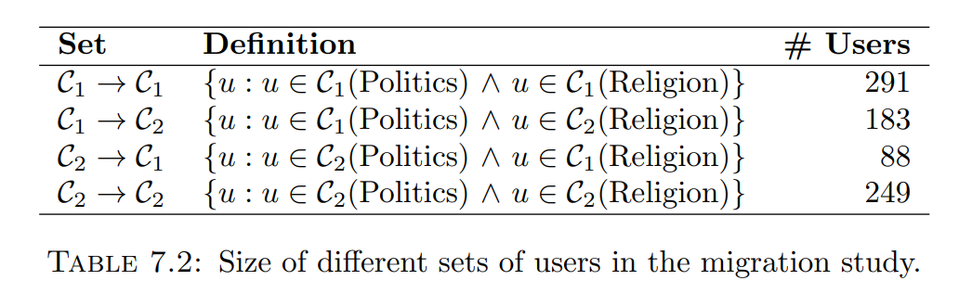
Migration of users within topical forums
Notes:
This claim is supported by the finding that there is a huge overlap in the userbase of Politics sub-forum and other subforum. And the overlap reaches 100% if we consider influential users, even for topics like science and tech.

Slide 34
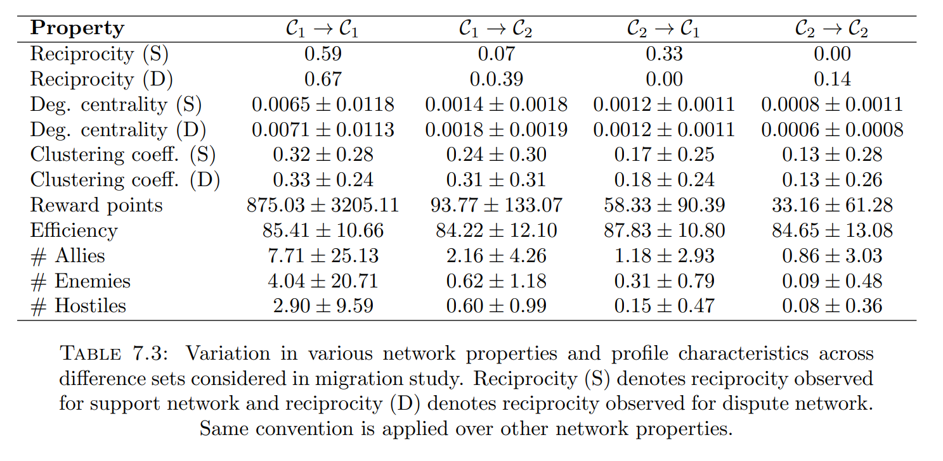
Migration of users within topical forums
Notes:
This claim is supported by the finding that there is a huge overlap in the userbase of Politics sub-forum and other subforum. And the overlap reaches 100% if we consider influential users, even for topics like science and tech.

Slide 35
Conclusion
Built high accuracy models for detecting ad hominem comments on debate forums
One-third of the content on CreateDebate is simply ad hominem
A cohort of influential users is responsible for this high ad hominem fraction

Slide 36
Implications
Defending against logical fallacies is becoming important
It is possible to detect and defend against these fallacies via automated means
Users need to be nudged to reduce the usage of these fallacies

Slide 37


