Slide 1

POWER BI PROJECT
Supply Chain Visibility System
With Optimization Analytics
End-to-End Logistics Dashboard using Power BI

Slide 2
Problem Statement
Organizations often face several challenges in managing modern, data-heavy supply chains — without a centralized analytics platform, these issues quietly erode efficiency and margin.
1
2
3
Lack of Centralized Visibility
Inventory Inefficiencies
Delayed Deliveries
Logistics data is scattered across systems, making it hard to see the full picture.
Overstocking and stockouts happen without clear turnover signals.
Regional bottlenecks go undetected until customers are already affected.
4
5
6
High Transportation Costs
Poor Supplier Monitoring
Warehouse Utilization Gaps
Route and carrier costs vary widely with little comparative insight.
Reliability and quality issues surface too late in the procurement cycle.
Some sites run near capacity while others are underused.
Supply Chain Visibility System With Optimization Analytics
2

Slide 3
Project Objectives
Together these objectives help organizations improve operational efficiency while reducing logistics costs.
Build an end-to-end Supply Chain Dashboard
Monitor inventory performance
1
2
Analyze supplier reliability
Evaluate transportation costs
3
4
Improve delivery performance
Optimize warehouse utilization
5
6
Generate executive-level Cards
Support faster decisions with interactive analytics
7
8
Supply Chain Visibility System With Optimization Analytics
3

Slide 4
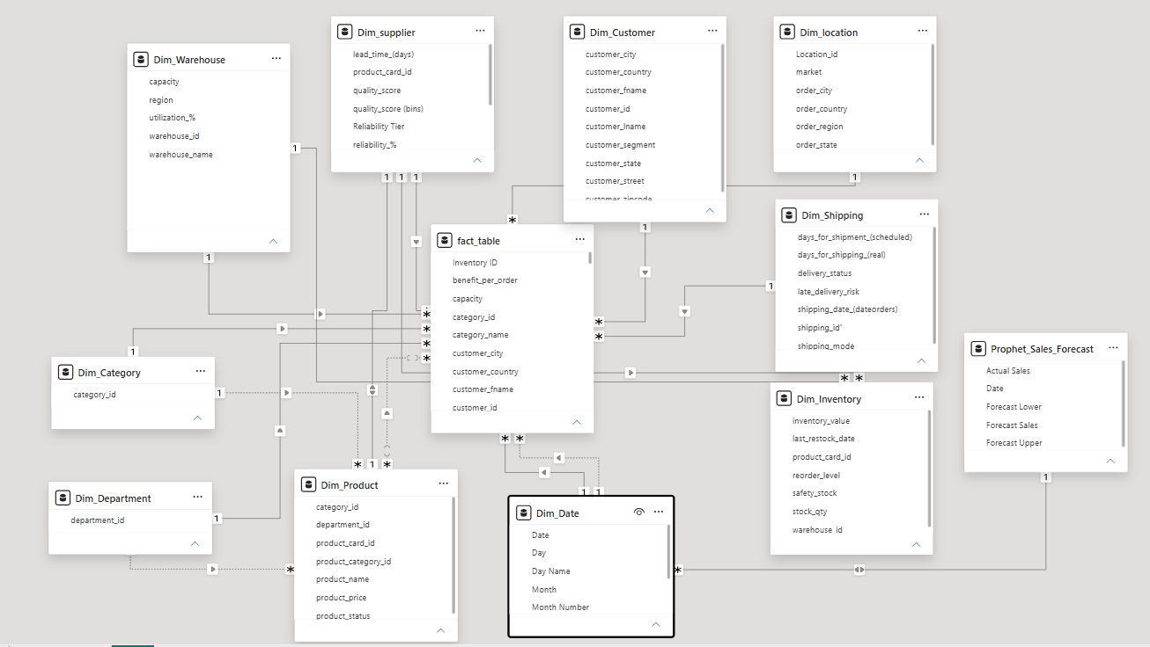
Dataset & Data Model
PRIMARY DATASET
DataCo Global Supply Chain Dataset
DATASET INCLUDES
Orders
Products
Customers
Shipments
Delivery Status
Geographic Locations
She
WHY A STAR SCHEMA
Fact table connect to multiple dimension tables, giving faster DAX calculations, cleaner relationships, and accurate KPI roll-ups across every module.
Supply Chain Visibility System With Optimization Analytics
4

Slide 5
Dashboard Architecture
ANALYTICAL MODULES
Raw Data
Executive Dashboard
Inventory Analytics
Delivery Performance
Supplier Performance
Transportation Analytics
Warehouse Analytics
Power Query
(Cleaning & Transformation)
Star Schema Data Model
DAX Measures & KPIs
Interactive Power BI Dashboard
Business Insights & Decisions
Supply Chain Visibility System With Optimization Analytics
5

Slide 6

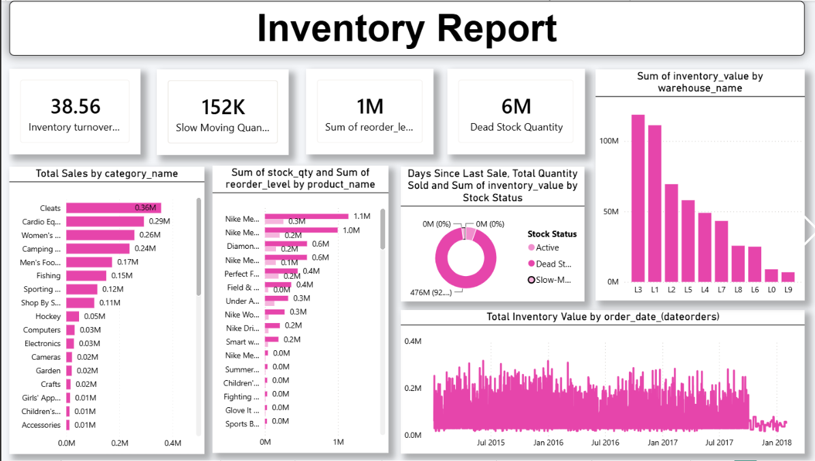

Inventory Analytics
Key Visualizations
Inventory Turnover Ratio
Product Category Performance
Slow Moving Products
Fast Moving Products
Dead Stock Identification
Stock Distribution
Warehouse-wise Inventory
Live Dashboard — Inventory Analysis
BUSINESS VALUE
Helps businesses maintain optimal inventory levels, reduce holding costs, and improve stock availability.
BUSINESS INSIGHT
76.7% of stock sits in slow-moving status against 23.2% active — with 1M units of dead stock, early markdowns could free up significant working capital.
Supply Chain Visibility System With Optimization Analytics
6

Slide 7
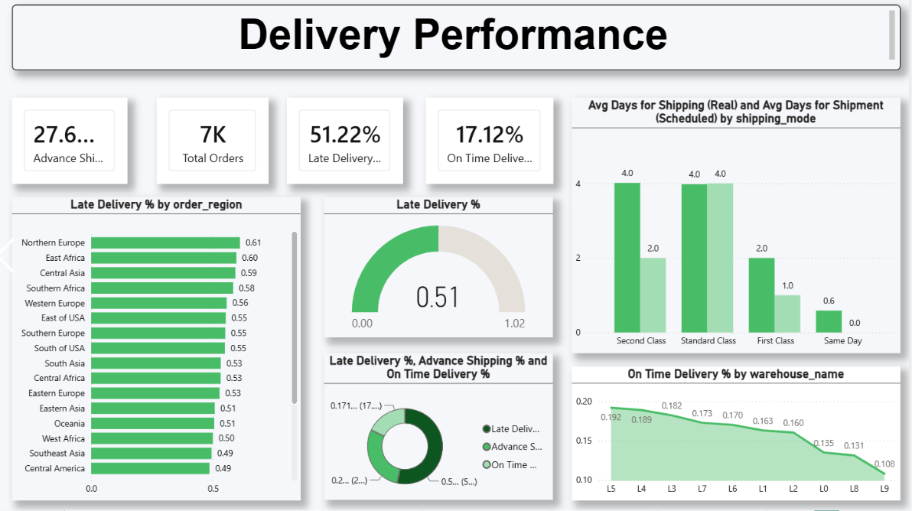
Delivery Performance
Key Visualizations
On-Time Deliveries
Delayed Deliveries
Delivery Lead Time
Customer Fulfillment Rate
Regional Delivery Performance
Delivery Trends
Live Dashboard — Delivery Performance
BUSINESS VALUE
Improves customer satisfaction by identifying delivery delays and optimizing logistics operations.
BUSINESS INSIGHT
On-time delivery sits at just 17.1% against a 51.2% late-delivery trend — on-time rates fall sharply for warehouses L8 and L9, pointing to a clear fulfillment bottleneck.
Supply Chain Visibility System With Optimization Analytics
7

Slide 8
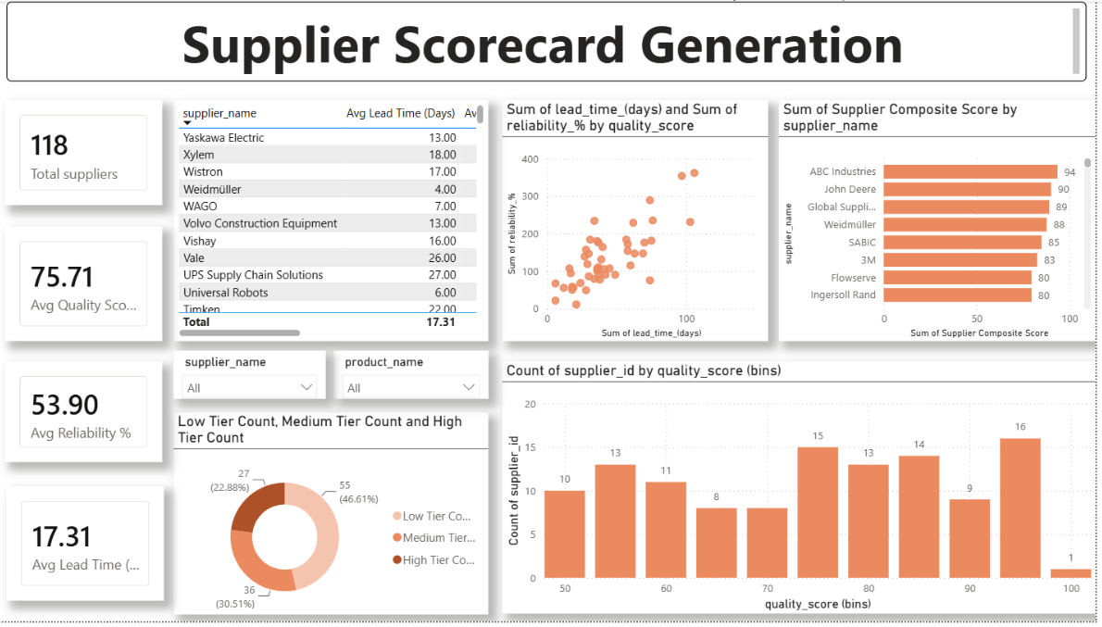
Supplier Performance
Key Visualizations
Supplier Reliability
Purchase Order Fulfillment
Supplier Quality Score
Supplier Ranking
Benchmark Analysis
Live Dashboard — Supplier Scorecard
BUSINESS VALUE
Supports better supplier selection, strengthens procurement strategies, and minimizes supply chain risks.
BUSINESS INSIGHT
Across 118 suppliers, average quality sits at 75.71 but reliability trails at 53.9% — the High Tier group (23%) consistently leads composite scores and is the safest bet for volume.
Supply Chain Visibility System With Optimization Analytics
8

Slide 9

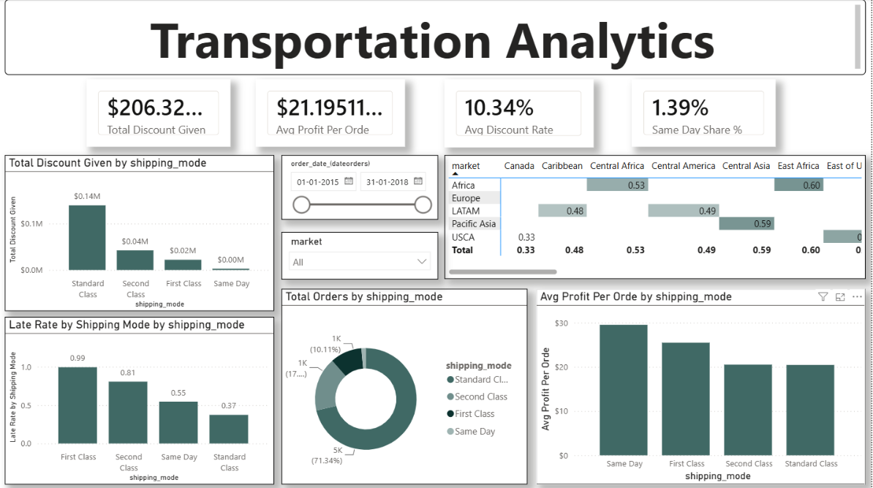

Transportation Analytics
Key Visualizations
Transportation Cost
Cost per Shipment
Route Performance
Carrier-wise Comparison
Fuel Cost Analysis
Logistics Expenses
Live Dashboard — Transportation Analytics
BUSINESS VALUE
Helps organizations reduce transportation costs and improve route efficiency.
BUSINESS INSIGHT
Standard Class carries the heaviest discount load ($206K total) yet late rates stay near 50% across every shipping mode — faster modes aren't buying better reliability.
Supply Chain Visibility System With Optimization Analytics
9

Slide 10
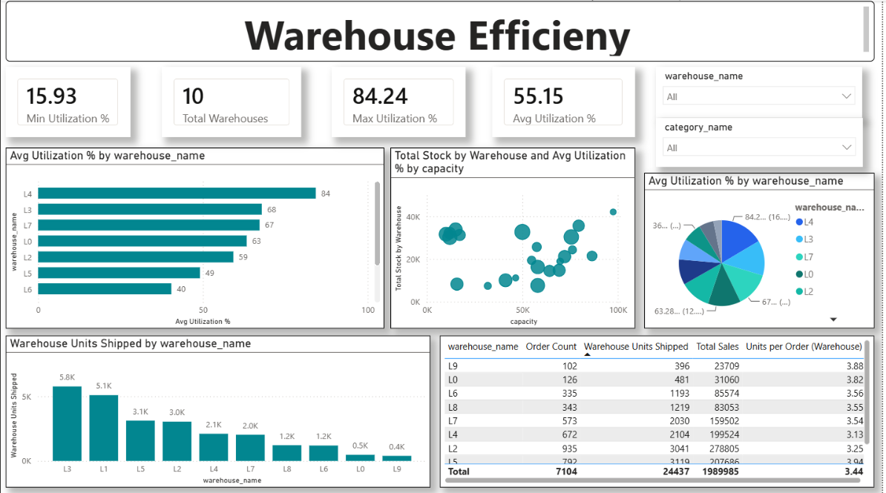
Warehouse Analytics
Key Visualizations
Warehouse Utilization
Throughput Analysis
Storage Efficiency
Capacity Planning
Warehouse Productivity
Live Dashboard — Warehouse Efficiency
BUSINESS VALUE
Optimizes warehouse operations while improving inventory handling and resource utilization.
BUSINESS INSIGHT
Utilization ranges from 15.9% to 84.2% across 10 sites — warehouses L3 and L1 ship the most volume, so rebalancing stock toward under-used sites like L6 and L9 could ease pressure.
Supply Chain Visibility System With Optimization Analytics
10

Slide 11
Glimpse of the Dashboard
DASHBOARD STORYTELLING LAYOUT
Executive Cards
Top: Executive Cards
Middle: Trend Charts & Comparisons
Bottom: Detailed Tables & Support
17.1%
7K
38.6x
75.7
On-Time %
Total Orders
Inventory Turns
Avg Supplier Score
INTERACTIVE FEATURES
Dynamic Filters
Slicers
Cross Filtering
Drill Down
Drill Through
Interactive Tooltips
Detailed Table — Order # | Region | Status | Delivery Days
10231 | West | Delivered | 3
10245 | South | In Transit | 5
10256 | North | Delayed | 7
Supply Chain Visibility System With Optimization Analytics
11

Slide 12
Key Insights
Instead of simply displaying numbers, the dashboard converts raw data into meaningful business insights.
1
2
3
4
Identify slow-moving inventory
Track fast-selling products
Monitor delivery delays
Compare supplier performance
5
6
7
8
Analyze transportation costs
Measure warehouse utilization
Detect operational bottlenecks
Support proactive business decisions
Supply Chain Visibility System With Optimization Analytics
12

Slide 13
Conclusion & Future Scope
CONCLUSION
FUTURE SCOPE
This project successfully integrates multiple supply chain operations into a single interactive Power BI dashboard. It enables organizations to monitor KPIs, improve operational efficiency, reduce logistics costs, and make informed business decisions through real-time analytics.
1
AI-based Demand Forecasting
2
Real-time IoT Integration
3
Predictive Inventory Management
4
Automated Supply Chain Alerts
5
ML for Supplier Risk Prediction
6
Cloud-Based Dashboard Deployment
Supply Chain Visibility System With Optimization Analytics
13

Slide 14
TEAM MEMBERS
Prudhvi Surla
Role: Inventory Analytics
Utkarsh Singh
Role: Delivery Performance
PS
US
Yatendra Kumar
Role: Supplier Performance
Kanak Gangwar
Role: Transportation Analytics
YK
KG
Trupti Jadhav
Role: Warehouse Analytics
Palak Kumari
Role: Warehouse Analytics
TJ
PK

Slide 15
THANK YOU

