Slide 1

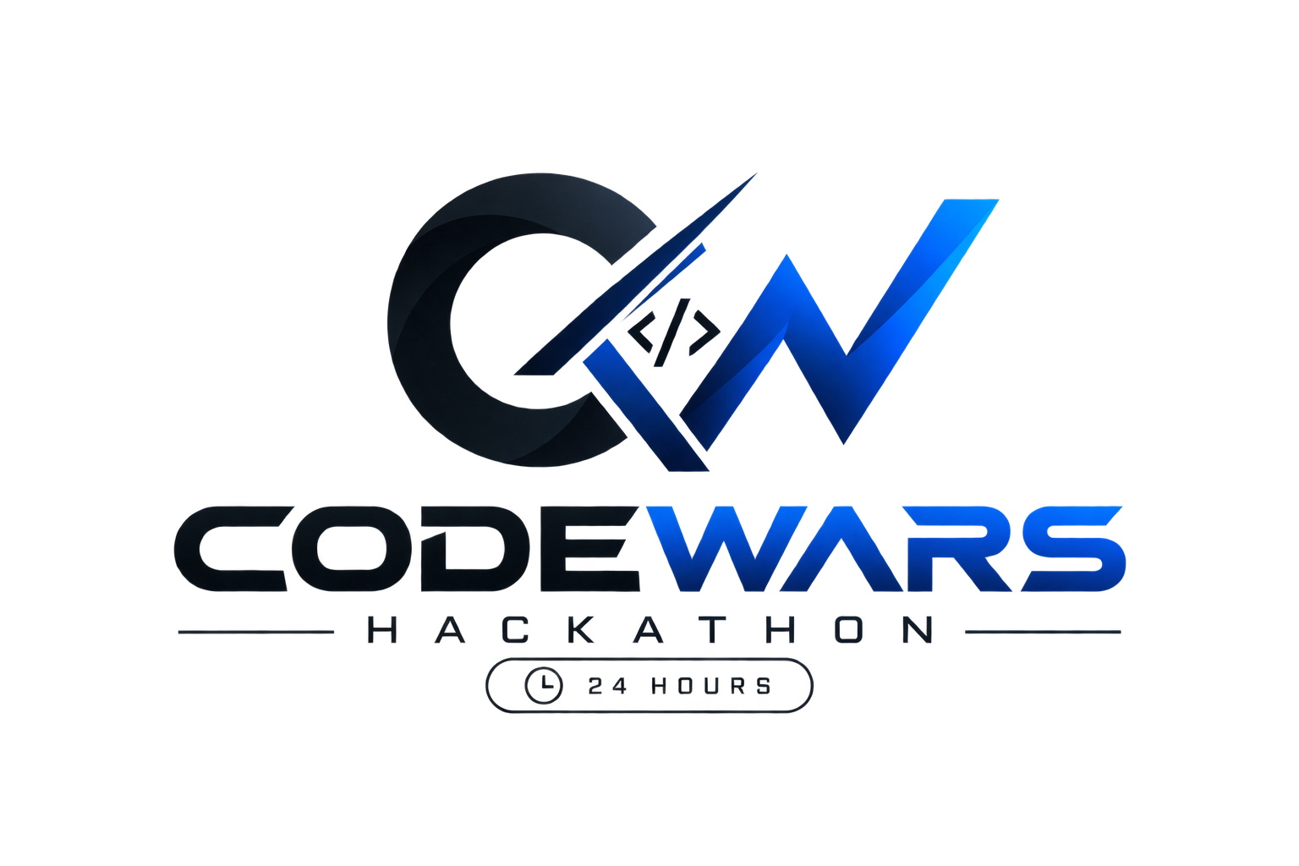
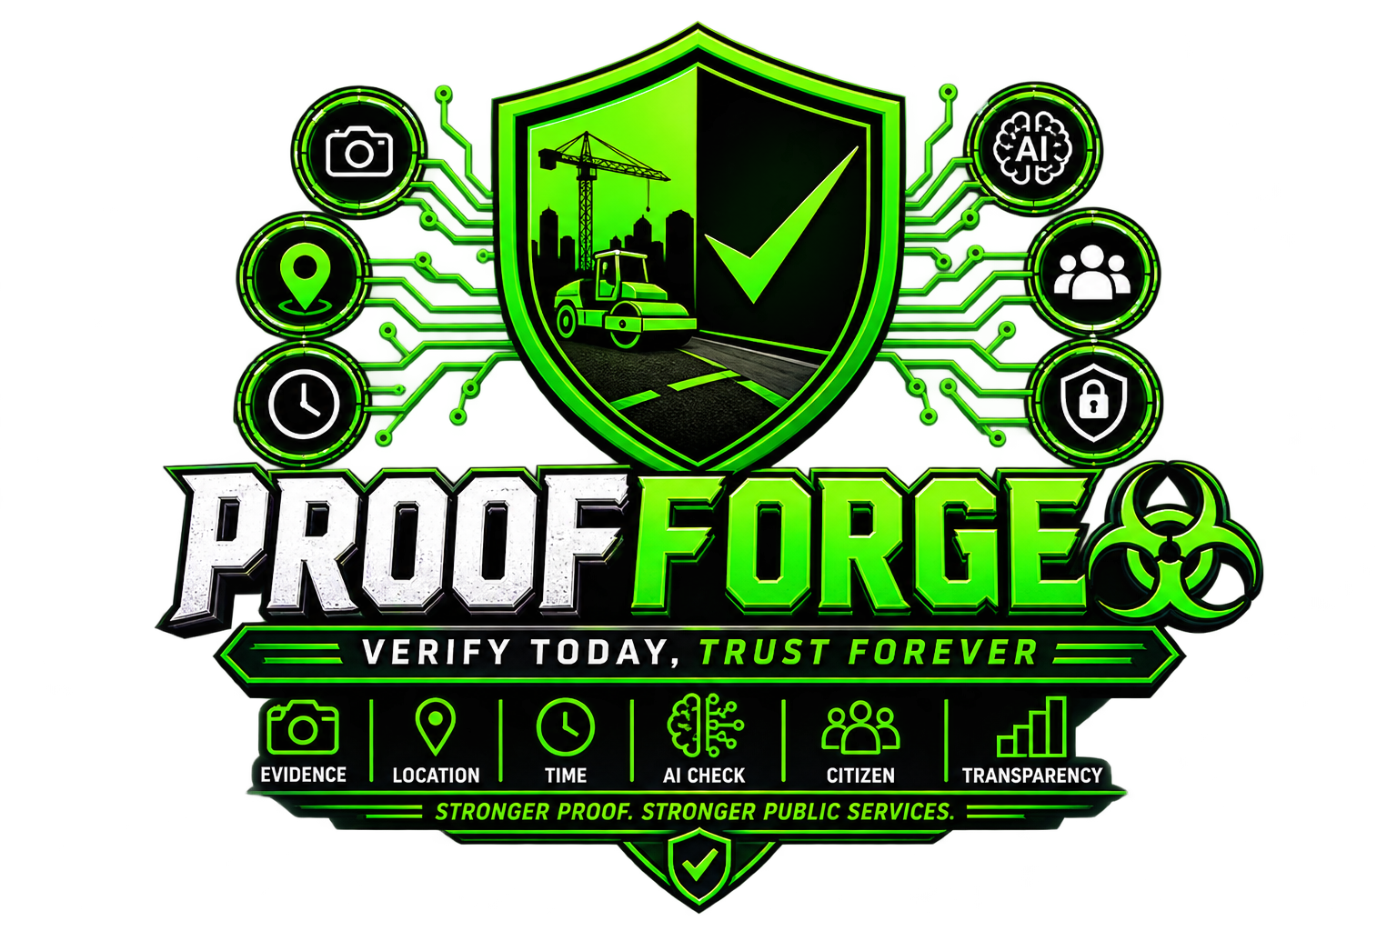
CODEWARS HACKATHON
PROOF OF WORK
AI-Powered Verification for Public Works
“Turning trust-based verification into evidence-based, AI-assisted,
citizen-verified verification.”
Group Name ProofForge
Team Utkarsh · Anjali · Sujal · Sarat
Stack React · Spring Boot · PostgreSQL · Python + OpenCV · Google Maps API

Slide 2
THE PROBLEM
Public Works Verification Today Is Broken
Fake Evidence
Completion photos are staged,
edited, or manipulated
Wrong Location
Photos submitted from a
different site than registered
Reused Photos
Old photographs passed off
as new completion evidence
No Transparency
Citizens cannot verify what
their taxes actually built
TRADITIONAL PROCESS — TRUST-BASED
Approve Work
Contractor Works
Submits Evidence
Manual Check
Marked Complete
⚠ Weakness: heavy dependence on manual inspection and contractor-submitted evidence — easily gamed, slow, and costly.
Manual inspection requires significant time and resources — and still misses fraud.
Proof-of-Work · 02 / 10

Slide 3
PROPOSED SOLUTION
A Multi-Layer Digital Verification Pipeline
Instead of trusting one photo, we verify where, when, what changed — and whether citizens confirm it.
Register Public Work
Before Photo
After Photo
GPS + Timestamp Check
Public Dashboard
Final Verification
Citizen Feedback
AI Image Verification
WHERE
GPS proximity check — evidence captured within an accepted radius of the registered site
WHEN
Timestamp consistency — after-image cannot predate the work start
WHAT
AI change detection — does the after photo show real, meaningful completion?
WHO
Citizen confirmation — the human layer on top of AI
Proof-of-Work · 03 / 10

Slide 4
AI VERIFICATION
Evidence Analysis Pipeline
Python + OpenCV · MVP priority: change detection + image quality + duplicate detection
Before / After Images
GPS CHECK — EXAMPLE
Registered: 28.4744, 77.5040
Evidence: 28.4748, 77.5037
Distance: ~40 meters
Result: PASS (within radius)
{
"status": "VERIFIED",
"confidence": 0.91,
"change_detected": true,
"image_quality": "good"
}
Image Analysis
Change Detection
Quality Checking
TIMESTAMP CHECK
Start 01 Aug · Before 02 Aug · After 28 Aug
→ VALID
After-image dated 25 July (before start)
→ SUSPICIOUS — flagged
Duplicate Detection
AI OUTPUT
Verification score feeds the
decision engine together with
GPS, timestamp & citizen votes.
Verification Score
Proof-of-Work · 04 / 10

Slide 5
SYSTEM ARCHITECTURE
Technology Stack & Data Flow
React Frontend
Dashboard · Uploads · Citizen UI
TECHNOLOGY STACK
Frontend React
Backend Spring Boot
Database PostgreSQL
AI / ML Python + OpenCV
Maps Google Maps API
REST API
Spring Boot Backend
APIs · Auth · Business Logic
PostgreSQL
works · evidence · users
Python AI Service
OpenCV · /verify-evidence
Why this stack: mature, hackathon-proven technologies with clean separation — React → Spring Boot → PostgreSQL, and Spring Boot → Python/OpenCV for AI.
Google Maps API
Image Analysis
Proof-of-Work · 05 / 10

Slide 6
DECISION ENGINE
Verification Logic & Live Dashboard Metrics
FINAL STATUS = fusion of all signals
GPS PASS + Timestamp VALID + AI score ≥ threshold + Citizen majority YES
→ ✅ VERIFIED
Any signal fails or is inconclusive → ⏳ PENDING or 🚩 FLAGGED
Verification rates: AI 87% · GPS 94% · Citizen 82%
Why it matters: a single manipulated photo cannot pass — it must survive four independent layers of verification.
91 of 128 works verified end-to-end
through the multi-layer pipeline — 71% pass rate
Proof-of-Work · 06 / 10

Slide 7
MARKET RESEARCH
Why Now — The GovTech Opportunity
Digital India
Nationwide push for digital public services and e-governance
Smart Cities Mission
100 cities, thousands of infrastructure projects needing monitoring
Public Capex
Massive annual infrastructure spending with limited verification tooling
Transparency Demand
Rising citizen expectations for accountability (RTI → digital verification)
Positioning: Verification-as-a-Service for municipalities and government departments.
Chart figures are directional / illustrative.
The Gap
No mainstream platform fusing AI + GPS + timestamps + citizen feedback
Proof-of-Work · 07 / 10

Slide 8
UNIQUE SELLING PROPOSITION
Not Just an AI Classifier — Multi-Layer Evidence Verification
Public Work
Manual
Single-AI
Proof-of-Work
Location check
Site visits
✗
✓ GPS radius
Image
GPS
Timestamp
Time check
Paperwork
✗
✓ Timestamps
Fraud detection
Limited
Partial
✓ Duplicates + change
AI Analysis
Public trust
Opaque
Opaque
✓ Citizen layer + dashboard
Citizen FeedBack
Final Status
“Proof-of-Work combines visual AI analysis, geolocation, timestamps, and citizen feedback into a multi-layer verification system for public infrastructure.”
Proof-of-Work · 08 / 10

Slide 9
LIVE DEMO
One Complete Story, End-to-End
1
Admin registers work
Road Construction · Greater Noida · ₹20 lakh
━━ PUBLIC WORK VERIFIED ━━
AI Score 91%
GPS PASS
Timestamp PASS
Citizen Feedback
FINAL STATUS: VERIFIED
2
Evidence uploaded
Before.jpg + After.jpg with GPS & timestamp
3
System checks
GPS ✓ · Timestamp ✓ · Quality ✓ · Duplicate ✓ · AI Change ✓
4
AI result
Verification score 91% → VERIFIED
5
Citizen confirms
“Is this work completed?” → YES
Proof-of-Work · 09 / 10

Slide 10
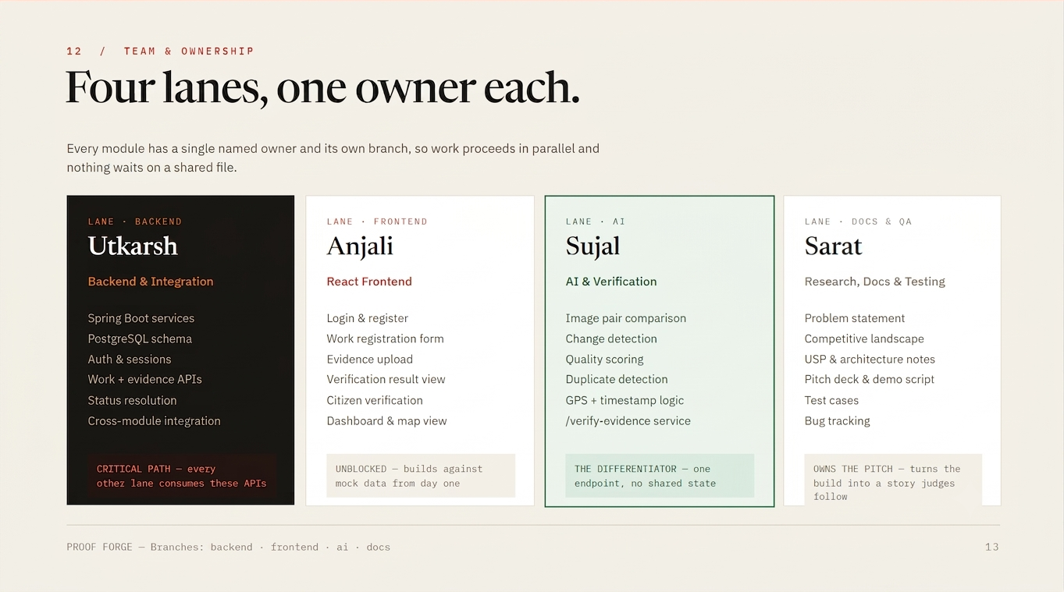

Slide 11
Future Opportunities & Business Potential
No Proof, No Payment
Government/authority releases payment only after required evidence is verified.
AI + GPS + timestamp + citizen validation create a stronger payment trigger.
Government & Smart-City Adoption
Municipal corporations and public departments can use the platform to monitor roads, drainage, sanitation, streetlights and other infrastructure.
Central dashboard for tracking contractors and project progress.
Contractor & Tender Management
Verification history can become part of contractor performance records.
Better-performing contractors can build a verified track record.
B2B / SaaS Opportunity
Offer Proof-of-Work as a verification-as-a-service platform to governments, infrastructure companies, NGOs and construction organizations. PIs can integrate verification directly into existing project-management systems.
Future Revenue Opportunities
Per-project verification fee Premium analytics & reporting
Third-party inspection / audit integrations
Proof-of-Work · 07 / 10

Slide 12
IMPACT & FUTURE
From Hackathon MVP to National Infrastructure
🏛️
Transparent public spending
🛡️
Fraud reduction in completion claims
🤝
Citizen trust & participation
⚡
Faster, cheaper audits
📈
Scalable across departments & states
Future scope: Blockchain evidence anchoring · Satellite imagery · Government API integration · Mobile app · Real-time alerts · Automated complaint generation
“Proof-of-Work turns public-work verification from a trust-based process
into an evidence-based, AI-assisted, and citizen-verified process.”
THANK YOU
Team: Utkarsh · Anjali · Sujal · Sarat

