Slide 1
PROJECT Myntra Dataset Cleaning
Intro:- This is a Data Analytics Project where I performed proper
Data cleaning on noisy data with lots of inconsistencies and more to handle.. Every step that I took will be shared and explained so it becomes easy to understand

Slide 2
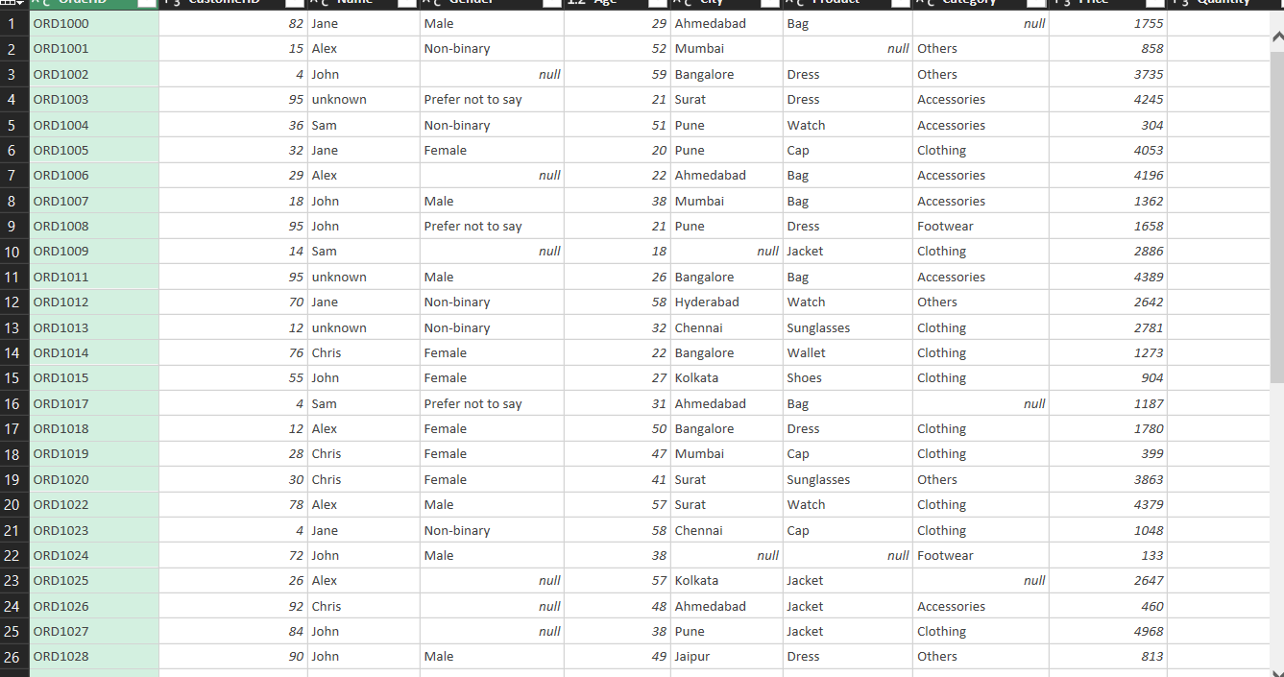
Preview of the Dataset before Cleaning and Preparation!
Intro:- This is a Data Analytics Project where I performed proper
Data cleaning on noisy data with lots of inconsistencies and more to handle.. Every step that I took will be shared and explained so it becomes easy to understand

Slide 3
Dataset Info!
It’s a sales dataset that contains product details, customer details, and other relevant information
The columns in the dataset are:-
Order id
Product
Name
Gender
City
Category
Price
Discount
Total Price after discount
Quantity
Payment method
Date -- Used Power Query to perform cleaning!

Slide 4
Let’s Start!
First of all it is very important to understand the need for the columns that are there, in this case all the columns are relevant for the overall analysis
This means we must keep the columns and handle blanks/nulls precisely without error. Keep further consideration in mind!
There are over 1050 columns and 12 rows!
After cleaning only 858 rows remains

Slide 5
Data types Columns and their data type!
Order id | Text
Product | Text
Name Gender | Text Text
City | Text
Category Age | Text Integer
Price | Integer
Discount | Integer
Total Price after discount Quantity | Decimal Integer
Payment method | Text
Date | Date

Slide 6

Let’s Start!
Handling Duplicates & Nulls
Check for duplicates and 57 duplicates were found so I deleted them based on the order id column ---
Step Taken:- Using conditions formatting and removing them using remove duplicates
Afterwards, we encountered there were some missing Order Id at the bottom
Step Taken:- as we only had missing order ID’s but there are other details associated with the Order Id, which are crucial, so we impute them with “unknown”
So I imputed all the null vales with most occurring values for text datatype, because removing will cause data loss, or compromised data integrity

Slide 7
Let’s Start!
Handling Duplicates & Nulls (Imputation/Removal)
Note:- We are adding a sequence/index column so that it doesn’t cause any problem while modelling data if necessary.
We moved to next column which customer id, no problem, no null are found
Next, name has some missing values
Step Taken:- we impute null values in name column with “unknown”
because the purchase has been made…
In City and Product column nulls are filled with the most occurring city and product!

Slide 8
Let’s Start!
Handling Duplicates & Nulls (Imputation/Removal)
Now two major things here,
Category:- the nulls in the category are filled with not specified because it we impute with most occurring it will cause an error, because the product may be specified with the category that it doesn’t even belong
Explanation:- we imputed the blank category to “Not Specified” for precision.

Slide 9

Let’s Start!
Problem with Product & their Category
As we can notice the products and their categories are mismatched one single product is associated with multiple categories, so we have two options
First:- impute them with most occurring, while others remain unchanged
Second:- Give each product a preferred category, for instance
Bag ---- Accessories
Shoes ---- Footwear
I chose the second option!

Slide 10
Let’s Start!
Handling Duplicates & Nulls (Imputation/Removal)
Now the payment method:- we also imputed the nulls in payment method with most occurring, but there is a twist..
Explanation:- I used (group by) to count the numbers and I found “cash on delivery” and “debit card appeared almost the same time, so I proportionally filled the null values with both (cod was 164, and debit card = 162),
The formula used =
= if [PaymentMethod] = null and [Index] <= 74 then “Cash on Delivery”
Else “Debit Card”
Else [PaymentMethod]

Slide 11
Let’s Start!
Transformation:-
Let’s convert the discount column from whole to percentage 11—11%,
First, add a column =cell reference/100, convert it to a percentage, and reduce the decimal point!
Let’s extract months from Date:- using =text(cell, “mmm”)

Slide 12
Let’s Start!
Preview:-
now we have nothing left for cleaning.
Our data is now consistently formatted, dates are properly formatted as dates
Text Columns: Verified consistent capitalization, spelling, and formatting (e.g., "Cash on Delivery" vs. "cash on delivery").
Date Columns: Ensured all dates follow the same format and are accurate.
Categorical Data: Verified consistent categories (e.g., "Male", "male", "M" should be standardized).
Product and Category:- The relation between product and category is fixed, each category now belongs to a preferred one!

Slide 13
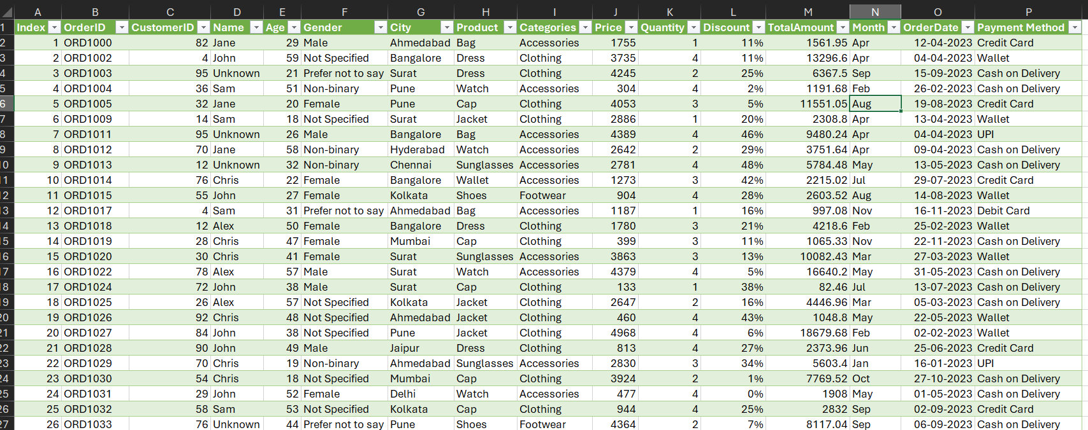
Now Preview of the dataset after Cleaning!

Slide 14

Now The dataset is ready for analysis
Here is the link to view the dataset:
Share your Opinions
Thanks!

