Slide 1
Intelligent Energy Demand Forecasting in US using EIA and Weather Data
Contributors:
Aishanee Sinha
Ketki Maddiwar
Leela Prasad Dammalapati
Utkarsh Tripathi
December 5, 2024

Slide 2


Objective
Analyze the impact of weather on electricity demand by integrating data from EIA and OpenMeteo, and to develop predictive models and interactive dashboards for optimizing energy planning and grid performance.
Problem Statement
Electricity demand fluctuates due to various factors, including weather conditions, making it challenging for providers to optimize resource allocation and maintain grid reliability.
There is a need for accurate forecasting models and actionable insights to predict energy consumption trends, mitigate operational costs, and implement effective demand-response strategies during peak or extreme weather events.

Slide 3
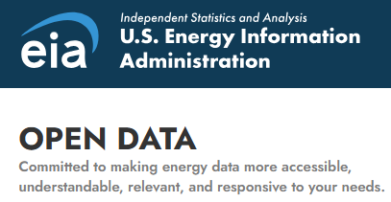

Data Sources and Description
.
Dataset: Electricity demand by sub region in CA
Time Period: 2022-present
Variables Description
Datasets used: Real time and forecast data
Time Period: 2022-present, 7 days forecast
Variables Used
Name | Variable Description
Period | Date
Subba | Subregion
Parent | Parent Organization
Value | Electricity consumption
Value Units | Megawatt hours
Period | Precipitation_sum
Max_temperature | Snowfall_sum
Min temperature | Windspeed_max
Avg temperature

Slide 4
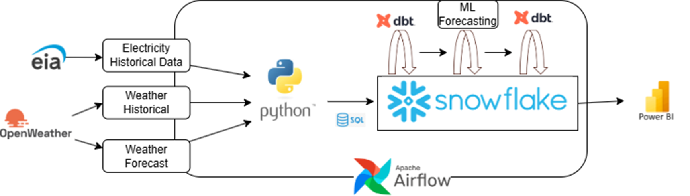
System Architecture

Slide 5
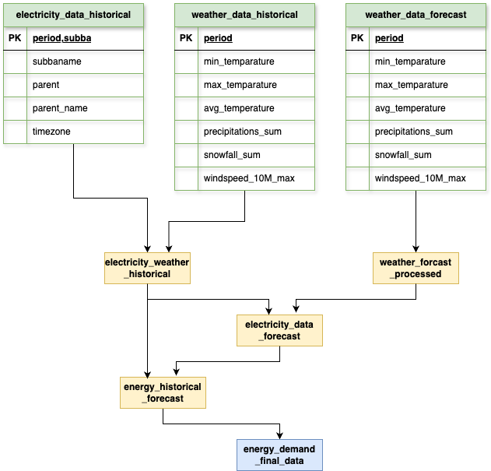
DB Schema
Combines electricity and weather historical datasets to generate accurate forecasts and insights.
Structured pipeline processes data through intermediate tables to ensure consistency and accuracy in the final output.
Aggregates into final table to support analytical models, demand forecasting, and energy planning across multiple regions

Slide 6
Airflow Pipeline (High Level)
Gather data from Weather and Electricity APIs.
Load raw data into Snowflake using automated pipelines.
Perform data cleaning, merging, and transformations with dbt.
Train a predictive model using historical merged data.
Evaluate weather's impact on energy generation and optimize predictions.

Slide 7

Data Storage and Forecasting in Snowflake
We are creating two tables in snowflake for batch insert with primary key constraints on period and sub region columns to store the electricity demand data obtained from EIA API. While the weather data is being loaded with a primary key constraint on period.
A view is created in Snowflake by selecting relevant data (electricity and weather metrics) from a training table
(train_input_table).

Slide 8

ETL Overview
The ETL pipeline in this project involves extracting electricity consumption and weather data from APIs using Airflow, setup on docker followed by transforming the data in Snowflake for further analysis.
The raw data is cleaned, integrated, and processed, including the creation of a machine learning model for predicting future electricity demand based on weather conditions.
The transformed data, along with the forecasted predictions, is stored in Snowflake for easy retrieval and analysis.

Slide 9
ETL Overview
Automated API calls to retrieve historical weather data for the past 7 days and forecast data for the next 7 days.
Automated API calls to fetch electricity generation and consumption data from the EIA API.
Load weather and electricity data into Snowflake for further analysis and integration.

Slide 10

Overview
dbt is used for additional data transformations, ensuring the data is in a suitable format for reporting or visualization.
Overall, this end-to-end ETL process integrates external data sources, performs complex transformations, and loads the results into a centralized data warehouse for further use.
The first set of tasks (dbt_run, dbt_test, dbt_snapshot) is for the main dbt project, which runs the dbt models, tests, and snapshots. The second set (dbt_run_2, dbt_test_2, dbt_snapshot_2) is for a secondary dbt project, also performing the same tasks of running models, testing, and snapshotting. Each task uses the BashOperator to execute the respective dbt command with the specified project directories and profiles, ensuring that the data transformation and testing processes are automated and streamlined.

Slide 11
ELT Processing using dbt
Merged the Electricity and Weather Historical Datasets on Period using dbt
Transformed the Electricity consumption value from MWh to GWh
Processed the weather forecast data. Performed a cross join to add subba to weather forecast data.
Stored the final merged and processed data under Analytics schema in Snowflake dev database.
Performed dbt test to check for null values in the merged dataset
Created snapshot on the merged table using check strategy checking on columns period and electricity consumption.

Slide 12
Machine Learning: Model Training
We retain only the necessary columns (PERIOD, ELECTRICITY_VALUE_GWH, SUBBA, MIN_TEMPERATURE, MAX_TEMPERATURE, AVG_TEMPERATURE, PRECIPITATION_SUM, SNOWFALL_SUM, WINDSPEED_10M_MAX) from electricity weather merged dataset as train input table.
We use the Snowflake.ML.Forecast function to train our model. The target variable is ELECTRICITY_VALUE_GWH
The series column is subba and period is converted to timestamp for model training
All the other weather variables are treated as exogenous variables.

Slide 13
Machine Learning: Model Prediction
We use the weather forecast processed data stored as an output of the dbt in earlier step as our predict input table. This contains the next 7 days weather forecast data.
We predict the ELECTRICITY_VALUE_GWH for the next 7 days using the trained model.

Slide 14
ELT Processing using dbt
Merged the Historical and Forecast Tables
Computed metrics temperature categories, wind speed categories, extreme weather indicator and predicted/actual flag in the final dataset
Performed dbt test -not null on the final dataset to ensure there are no null values in ELECTRICITY_VALUE_GWH
Created snapshots by ‘check’ strategy, checking on columns PERIOD AND ELECTRICITY_VALUE_GWH

Slide 15
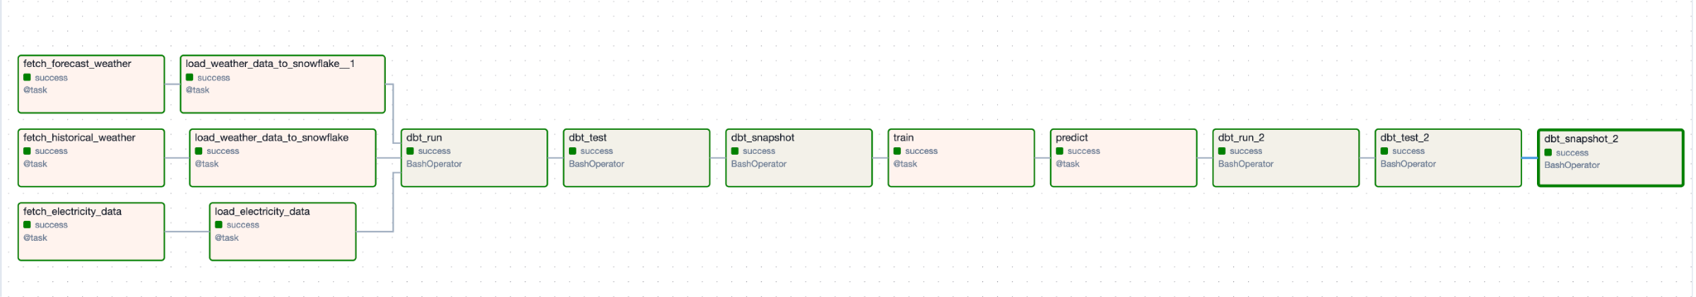
Airflow Pipeline (Detailed)

Slide 16
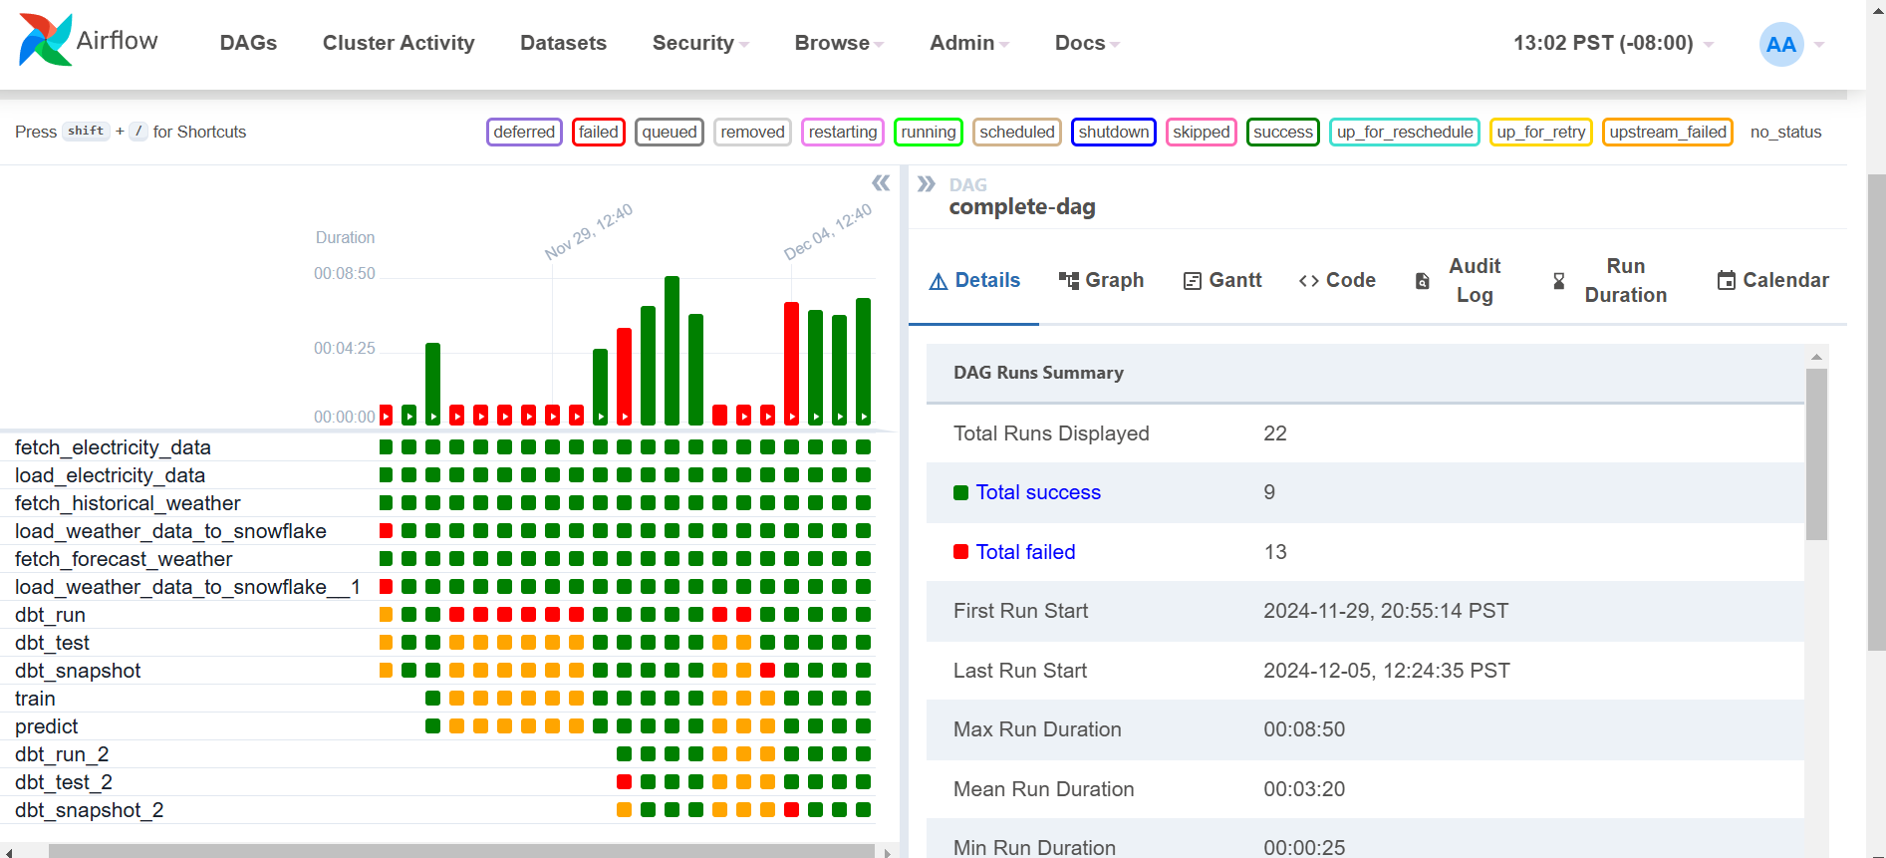
DAG Runs UI

Slide 17
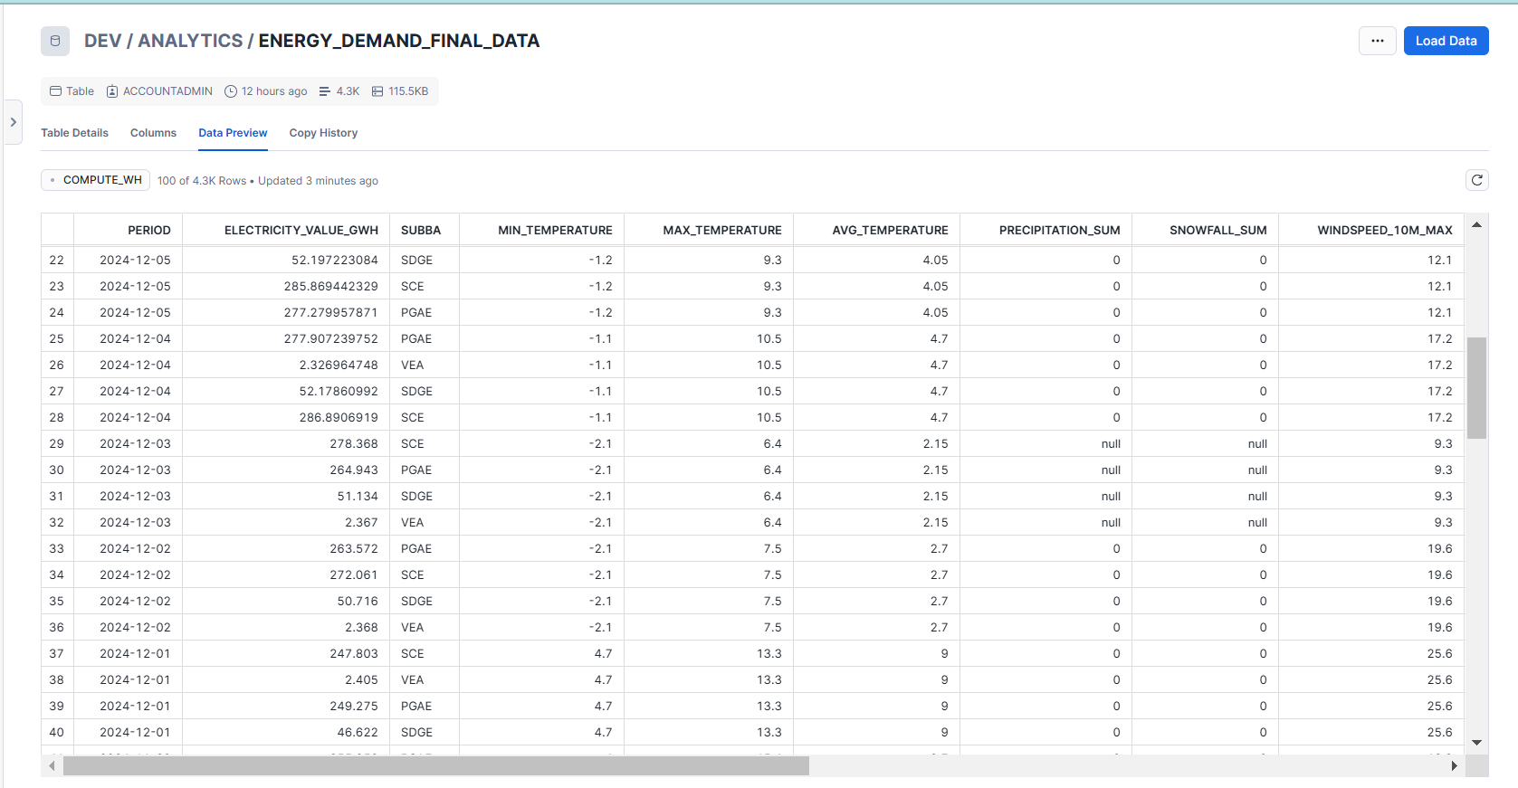
Final Energy Table in Snowflake

Slide 18
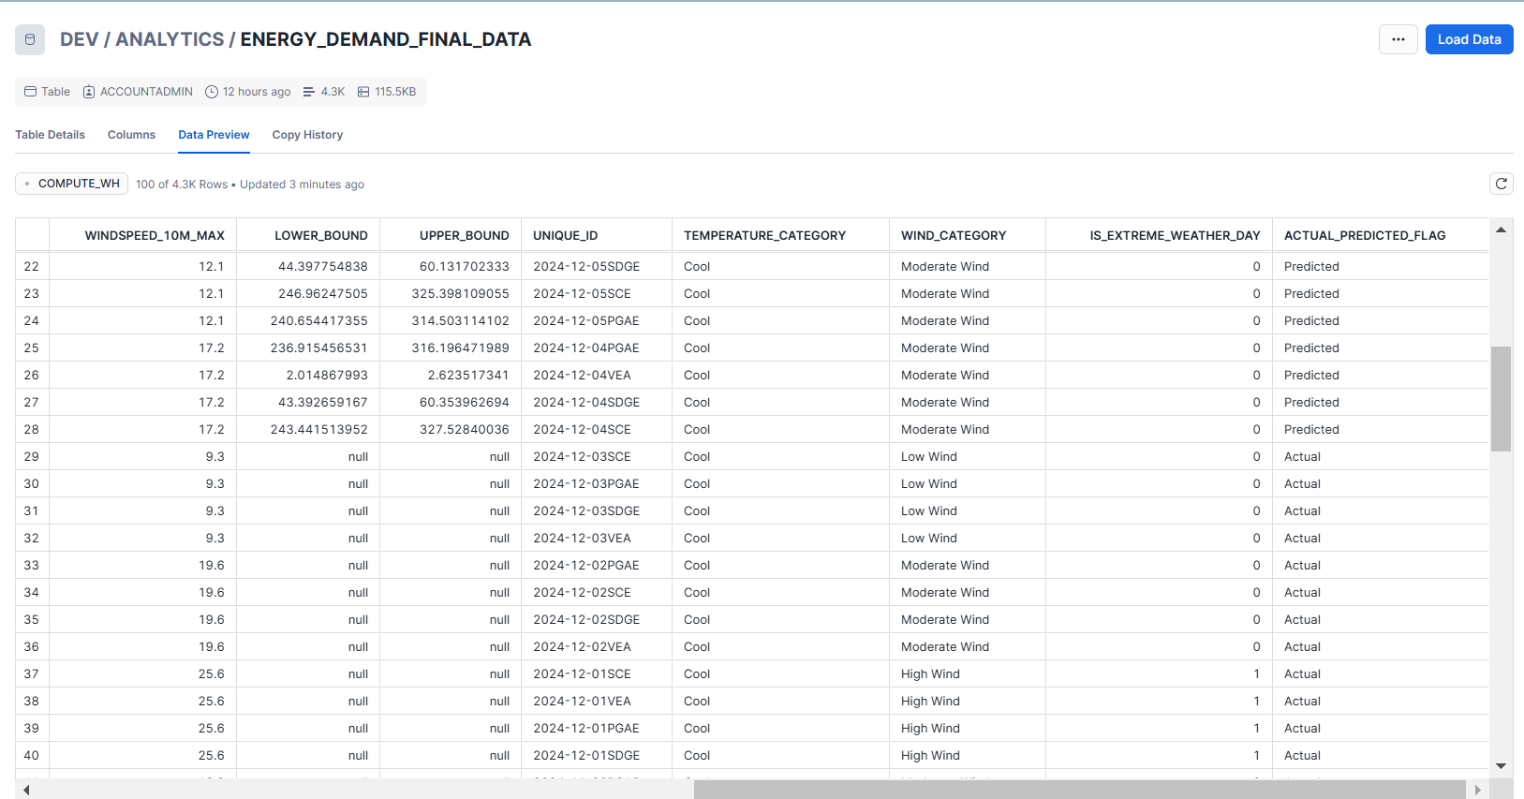
Final Energy Table in Snowflake

Slide 19
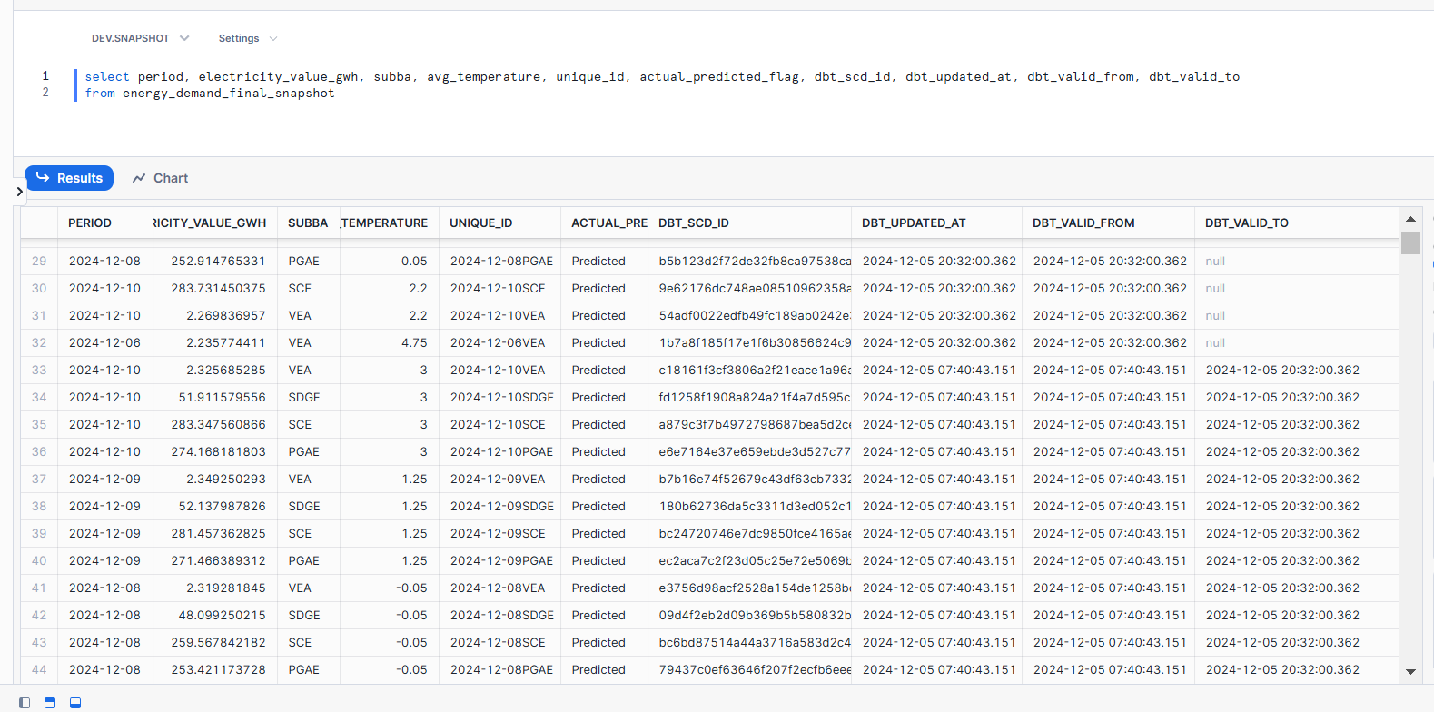
Dbt Snapshot: Final Energy Demand Table

Slide 20
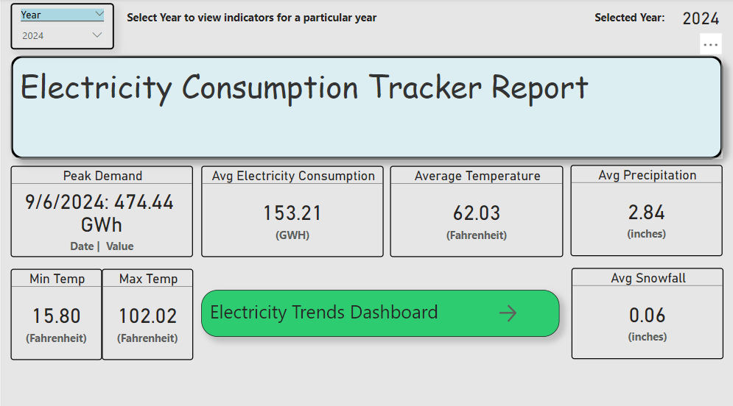
Data Visualizations - Home Page

Slide 21
Data Visualizations
Sheets:
Energy Consumption Over Years
Other Factors Affecting Consumption
Electricity Consumption Breakdown by Regions
Temperature vs Electricity Consumption
Self-Analysis

Slide 22
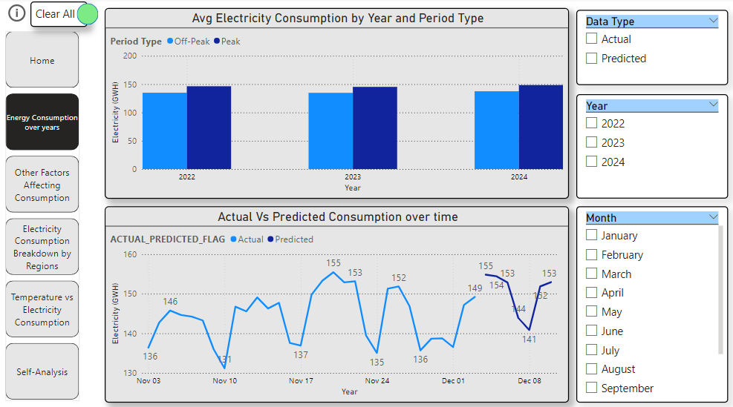
Data Visualizations - Energy Consumption Over Years

Slide 23
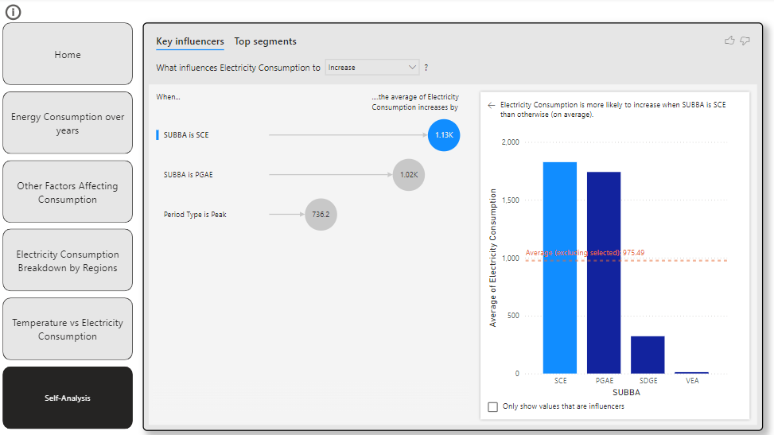
Data Visualizations - Self-Analysis

Slide 24
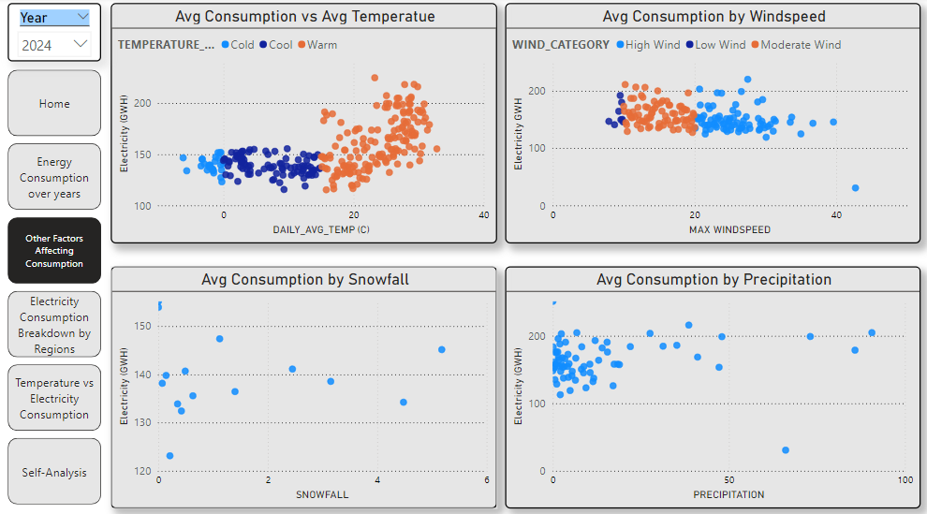
Data Visualizations - Other Factors Affecting Consumption

Slide 25
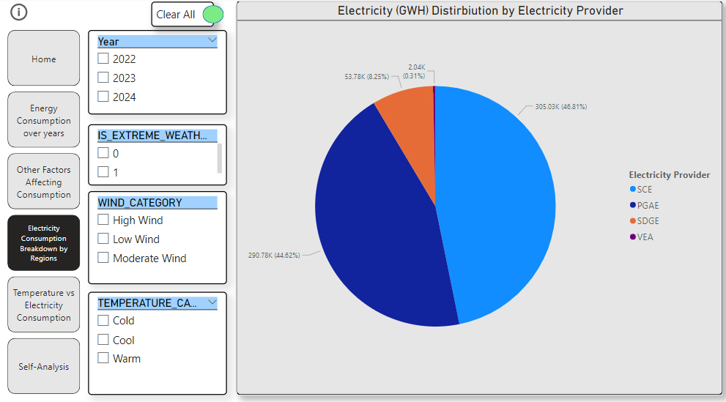
Data Visualizations - Electricity Consumption Breakdown by Regions

Slide 26
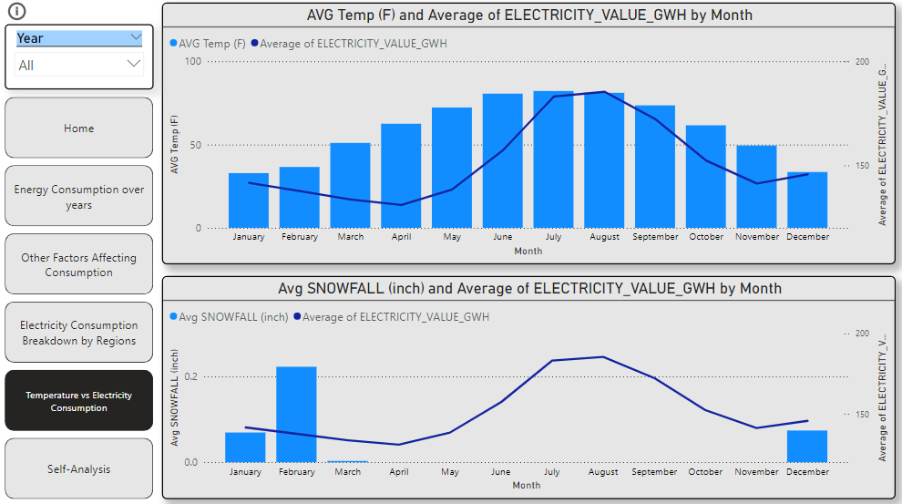
Data Visualizations - Temperature vs Electricity Consumption

Slide 27
Key Insights
Southern California Edison (SCE) is the top electricity supplier (46%) closely followed by Pacific Gas and Electric(PGAE) with 45%.
Electricity consumption is directly correlated with temperature.
The electricity consumption peaks in summer (June to Sep) with rising temperatures as air conditioners usage increases.
There is also a smaller peak in the months of December and January due to sub zero conditions.

Slide 28
Conclusion
This project successfully forecasts U.S. electricity demand by integrating weather and consumption data, enabling better resource allocation and grid optimization. The interactive Power BI dashboards provide valuable insights into energy trends, seasonal variations, and weather correlations, supporting informed decision-making for energy providers.
Future work could focus on incorporating renewable energy generation data, such as solar and wind, to improve demand forecasting and understand the impact of renewables on grid performance. Additionally, leveraging advanced machine learning techniques, like reinforcement learning, could further optimize real-time energy distribution, enhance demand-response strategies, and promote more sustainable energy management practices.

