Slide 1
Air Tag Review -1
TEAM Members
Sameer swain 22BCE7688
Varun choubey 22BCE9138
Prem Agrawal 22BCE8555
Jheel Johari 22BCE8858
Utkarsh vyas 22BCE8099
Rishab paul 22BCE7948

Slide 2
What is AirTag?
AirTags are small Bluetooth trackers designed to help you keep tabs on valuables or frequently lost items like your car keys, wallet, luggage, or any precious item .
It contains a buzz instrument which have a unique sound which can be controlled by the mobile application.
It tracks the live location of the item .

Slide 3
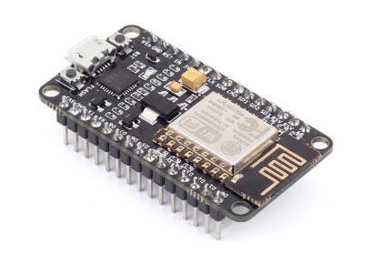
Components of AirTag
NodeMCU ESP8266 Breakout Breadboard
A NodeMCU ESP8266 Breakout Breadboard is a board that allows you to connect a NodeMCU ESP8266 to a breadboard. It provides access to the ESP8266 NodeMCU's GPIO pins and has power output pins for powering sensors and other devices.
It enables microcontrollers to connect to 2.4 GHz Wi-Fi

Slide 4
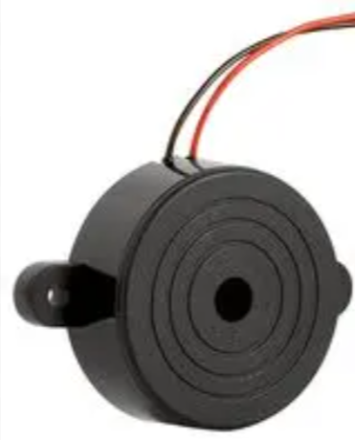
Buzzer(MP-ABI-050-RC)
MP-ABI-050-RC is a DC audio indicator that operates within a 2 to 5 VDC range, emitting a 75 dB sound at 2.7 KHz. With a low current requirement of 30 mA, this through-hole mounted sounder is ideal for compact electronic devices requiring reliable audio alerts.

Slide 5
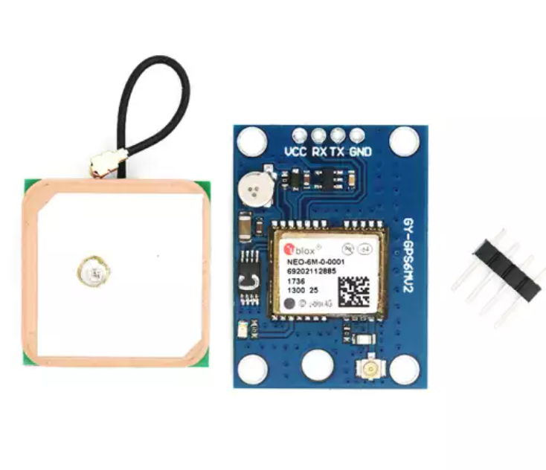
NEO-6M GPS Module
The UBLOX NEO-6M GPS module is a well-performing complete GPS receiver with a built-in ceramic antenna, which provides a strong satellite search capability. The status of the module can monitor with power and signal indicators.

Slide 6
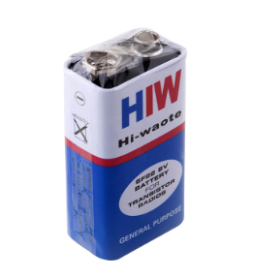
Battery (9V)
It is a General purpose 9V Original HW marked Non-Rechargeable Battery. Powers the AirTag components

Slide 7
Software Components
Arduino IDE for coding
The Arduino IDE is an open-source software, which is used to write and upload code to the Arduino boards. The IDE application is suitable for different operating systems such as Windows, Mac OS X, and Linux. It supports the programming languages C and C++. Here, IDE stands for Integrated Development Environment.
The program or code written in the Arduino IDE is often called as sketching. We need to connect the Genuino and Arduino board with the IDE to upload the sketch written in the Arduino IDE software.

Slide 8
Module
ESP8266WiFi.h
BlynkSimpleEsp8266.h
Google Map API for location track

Slide 9
Backend API for data transfer
Node js
Express js
Firebase to store location data

Slide 10
Flutter(For building Mobile Application)
Flutter is a free, open-source framework for building user interfaces (UIs) for mobile, web, and desktop applications. It's developed by Google and is based on the Dart programming language.
Allows developers to build apps for multiple platforms using a single codebase
Includes a collection of pre-built widgets for UI components, layouts, animations, and gestures Allows developers to create custom widgets

Slide 11
How AirTag works?
The NodeMCU ESP8266 microcontroller serves as the core of the system. It is equipped with a built-in Wi-Fi module
AirTags emit a Wi-Fi signal that anonymously connects to the application device. The AirTag’s location is triangulated based on the strength of the Wi-Fi signal sent to NEO-6M GPS Module which track the location of the item and tags it in the application
A signal is passed from application to the ESP8266 controller to make beeping sound to find the object.

Slide 12
Features and Advantage of AirTag
Features
Real Time location tracking of the item.
Compact and portable design .
Can easily find item using the loud beeping sound in the AirTag.
There is specific and unique token for every single AirTag which can be used for different item at single time

Slide 13
Advantage
It is Open source and is customizable
Scalable for multiple AirTags
It works on android devices
Cost-effective and feasible build

Slide 14
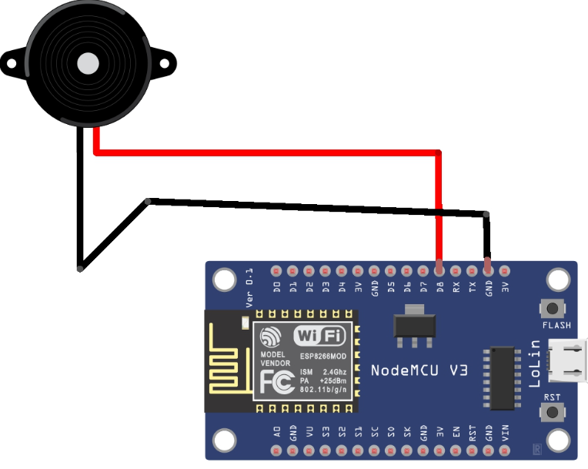
Schematics

Slide 15
Application of AirTag
AirTags are tracking devices that can be used to locate items like keys, wallets, and luggage
Personal belongings: Track keys, wallets, purses, backpacks, luggage, and more
Small tech gadgets: Track phones, tablets, TV remotes, and other small tech gadgets
Pets: Attach to dog and cat collars
Stolen items: Locate stolen bicycles
Car security: Provide extra car security
Kids safety: Keep kids safe
Hiking and camping: Use for hiking and camping
Accountability: Use for accountability when moving

Slide 16
Conclusion
This AirTag project utilizes the NodeMCU ESP8266's Wi-Fi capabilities and the Mobile app's IoT platform to create a cost-effective and efficient tracking device. By remotely controlling a piezo buzzer through a smartphone app, users can easily locate misplaced items.
The system is simple, customizable, and portable, making it a practical solution for everyday tracking needs.

