Slide 1
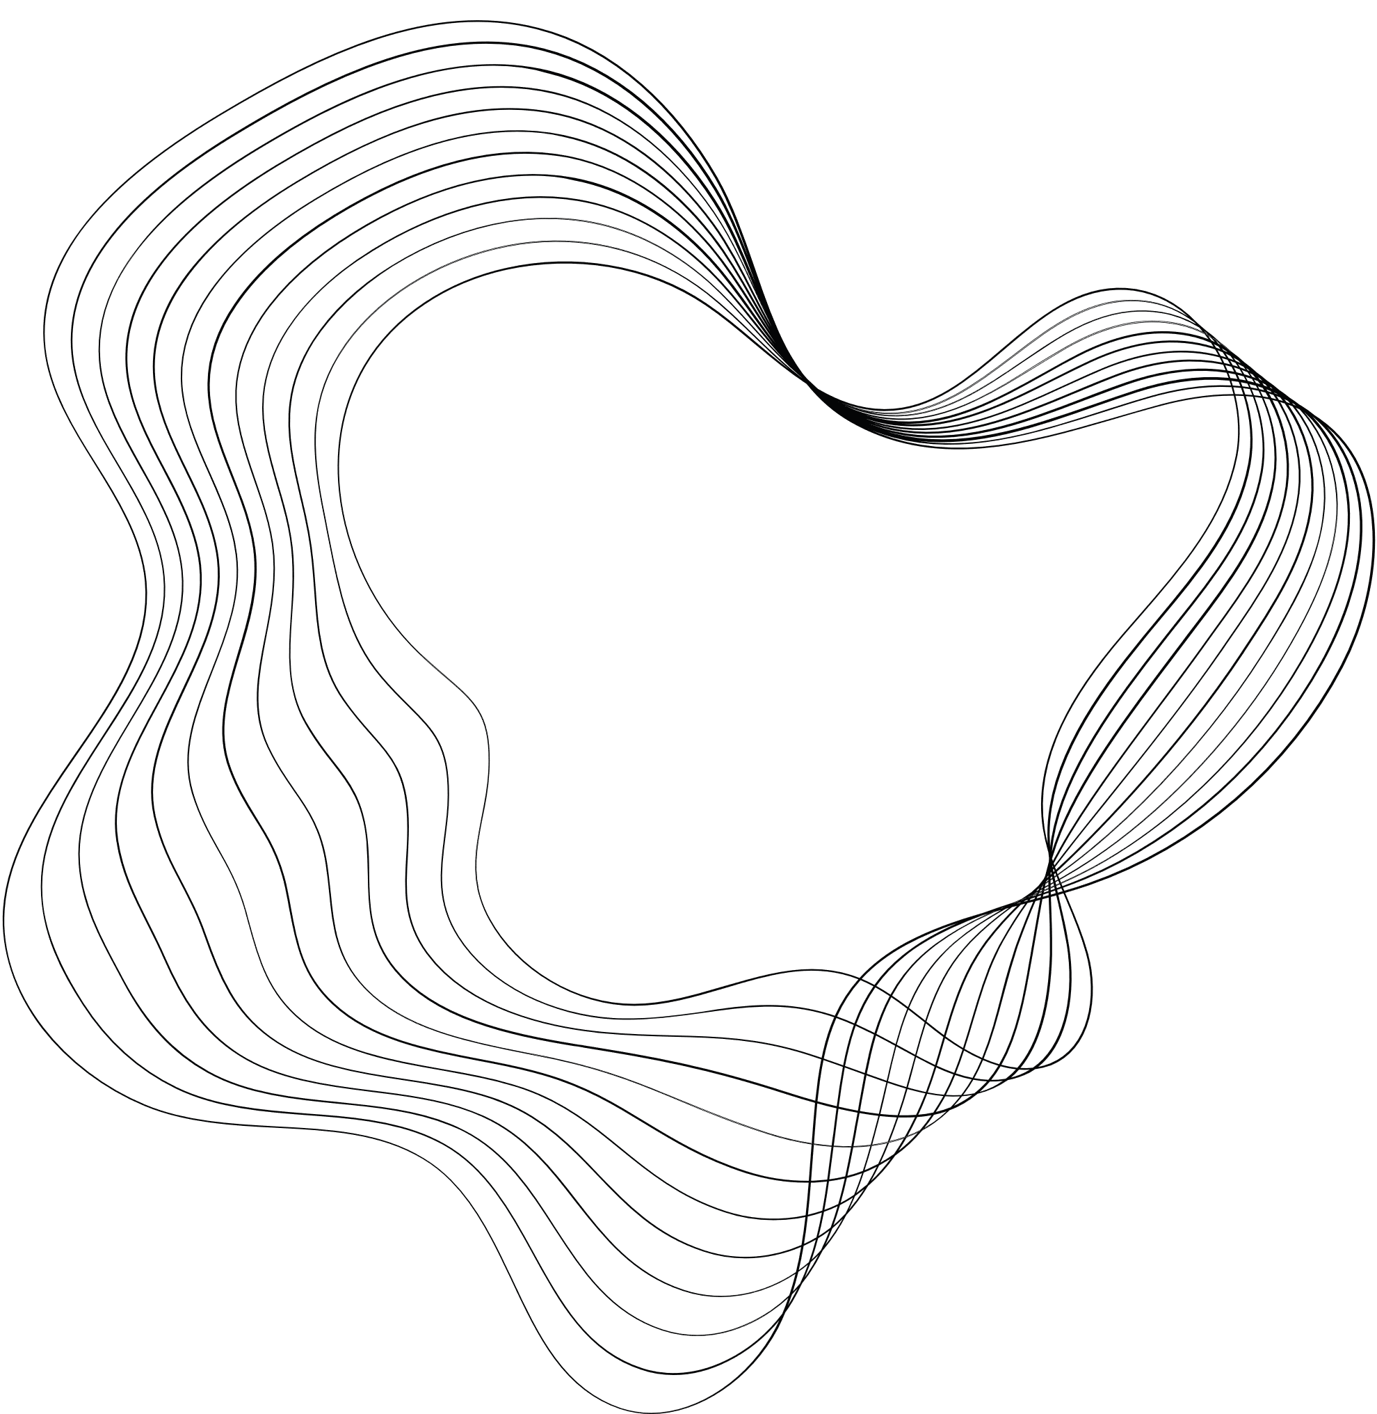

REALTIME TRANSPORTAION TRACKING

Slide 2

CONTENT
01
PROBLEMS FACED
02
STRATERGY TO SOLVE IT
03
TECHNICAL EXPLAINATION
04
HOW OUR IDEA IS UNIQUE
05
ARCHITECTURE

Slide 3





PROBLEMS FACED
Poor Tracking
Poor ETA
Poor Tracking
Poor ETA
While we travel we face many problems such as realtime location due to which we are unable to get the exact location of the vehicle, hence causing poor time management
The current services provided by the web and apps fail to provide proper and accurate Estimated time of arriving

Slide 4

OUR STRATEGY
STEP3
STEP 1
Our idea is to have the driver’s location service turned on as soon as the journey begins.
Lastly we will implement this driver's location on our service (app/extension) and provide it to the public.
STEP 2
we will align the realtime location of the driver and integrate it with Google Maps to calculate the time based on the Traffic and roadblocks

Slide 5
1. Data Collection:
Transit Agencies: Public transportation agencies or operators equip their vehicles (buses, trains, etc.) with GPS tracking devices and sensors. These devices collect real-time data about vehicle locations, speeds, and other relevant information.
Data Feeds: Transit agencies provide real-time data feeds, typically in standardized formats like General Transit Feed Specification (GTFS) or General Transit Feed Specification-Realtime (GTFS-RT). These data feeds are made accessible to app developers through Application Programming Interfaces (APIs).
2. Data Aggregation:
App developers use APIs provided by transit agencies to collect real-time data. This data is aggregated from multiple sources, including vehicles, stations, and stops.
3. Data Processing:
The collected data is processed to ensure accuracy and consistency. Any anomalies or errors in the data are identified and corrected.

Slide 6
4. User Interface:
The app provides a user-friendly interface that allows users to input their journey details, such as the starting point and destination. Users can also view maps, routes, and nearby transportation options.
5. Route Planning:
Using the real-time data, the app calculates the best routes and departure times based on the user's input. It considers factors like vehicle schedules, traffic conditions, and current vehicle locations.
6. Real-Time Updates:
As the user's journey progresses, the app continuously updates the estimated arrival times and provides real-time information about delays, service disruptions, or changes in routes.
7. GPS Tracking:
Users can track the real-time location of their chosen vehicle on a map within the app. This is made possible by GPS tracking data from the vehicle.

Slide 7

WHY OUR IDEA IS UNIQUE?
We aim to solve problem by the use of Google Maps and it improves the location and accuracy of the journey.

