Slide 1
USA Car Accidents Severity Prediction

Slide 2
Predicting the Severity of Car accident by modelling the dataset
Car accidents are unfortunately very common in the United States and the majority of these road crashes are caused by human error.
Government officials and general public are lacking systems , this model will help them in understanding
1. What is the accident-prone area in each state?
2. What day and time are safe to travel?
3. What are the factors responsible for accidents?
4. What is the severity of these accidents?
5. How many deaths happening in accidents?
6. What solution can be implemented to reduce accidents by
each state?
7. How can this accident be minimised ?
8. How can the State Government improve accident-prone infrastructure?

Slide 3
Data Acquisition and Cleaning
Data Source : https://www.kaggle.com/sobhanmoosavi/us-accidents
The dataset has been collected in real-time, using multiple Traffic APIs. Currently, it contains accident data that are collected from February 2016 to June 2020 for the Contiguous United States.
The csv file contains details of 3.5 million traffic accidents that took place in the United States, from February 2016 to June 2020.
Shape of DataFrame is - (3513617 rows, 49 columns)
Duplicate , highly similar or highly correlated features were dropped .

Slide 4
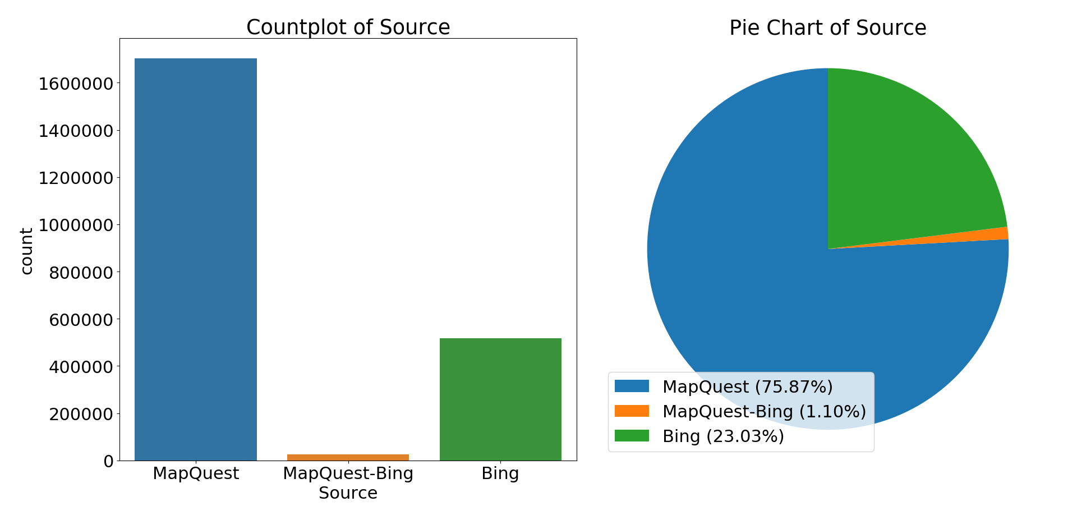
Three API sources that reported the accidents. It can be observed that most of the accidents(around 1,700,000) were reported by MapQuest, followed by Bing.

Slide 5
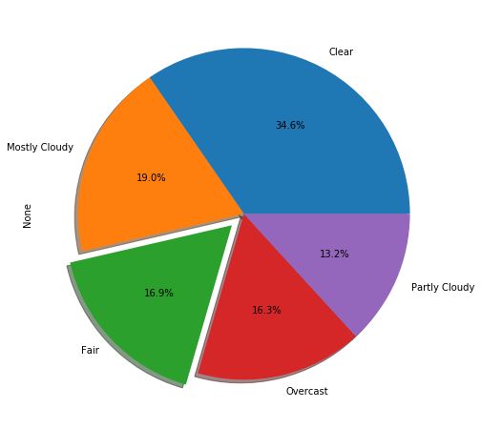
Top 5 weather condition with the accident percentage .
Surprisingly , mostly accidents occurred during a clear weather .
Surprisingly , mostly accidents occurred during a clear weather .

Slide 6
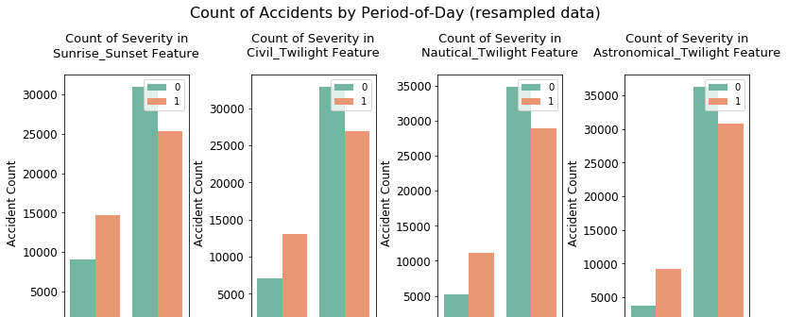
An accident is more likely to be a serious one when accidents happen less frequently.

Slide 7
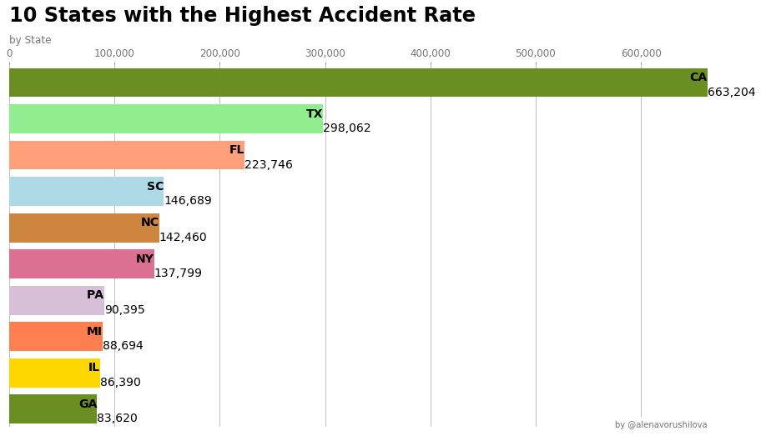
California(CA) has the most number of accidents followed by Texas(TX) and Florida(FL). It is interesting to see that the number of accidents in California is almost twice the number of accidents in Texas.

Slide 8
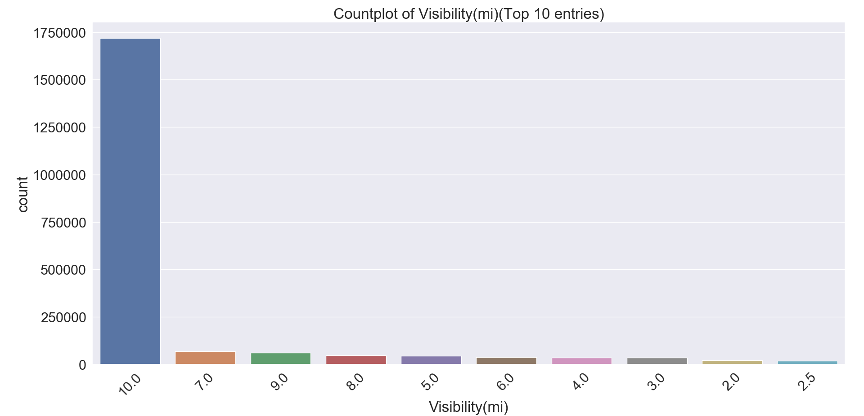
Most of the accidents occurred when visibility was high, which means that visibility is not a significant concern when it comes to accidents. This is obvious since low visibility is not the only factor.

Slide 9
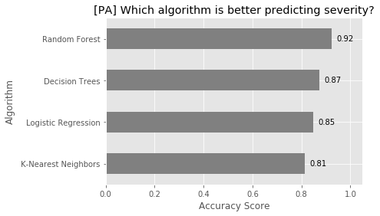
Predictive Modelling
We can see that Random Forest gives us the best accuracy .

Slide 10
Conclusion and Future Directions
In conclusion, considering both performance and the time needed to train the model, I prefer using decision tree to make predictions. But if we care about nothing but accuracy, then I suppose random forest will be the winner.
Accuracy of the models has room for improvement .

