Slide 1
Fitness Tracker

Slide 2
Agenda
Project Introduction
Project Architecture
Database Design
Technology platform used for project
User Roles and responsibilities
Division of work within team
Details Of contribution of each team member
File and directory structure for project
Use of GitHub in project
Read me file
Future extension if any
Conclusion

Slide 3
Project Introduction
1.Purpose of Project
Fitness Tracker is a project aimed to simplify the Fitness Aspects of an individual's health using simplified features such as weight tracking, calories tracking.
2.Need
Fitness Tracker can be implemented for entities such as individual gym. The Fitness Tracker aims to provide graphical analysis of the progress made by the user with the help of this software. The Fitness Tracker project is designed to streamline and enhance the fitness aspects of an individual's health by providing a range of simplified features. It offers a comprehensive solution for tracking and managing various fitness parameters, such as weight and calories, with the goal of promoting overall health and well-being.
3.Beneficiaries of the project​
Regular People: Individuals who want to improve their health and fitness can benefit from the tracking, motivation, and insights provided by your fitness tracker and online platform.​
​
Fitness Enthusiasts: People who are already active and interested in fitness can use your platform to track their progress, set new goals, and gain deeper insights into their training routines.​
​
Beginners: Those new to fitness can receive guidance and support through personalized workout plans, educational resources, and a community of like-minded individuals.​
​
​

Slide 4
Project Architecture
Frontend
Layer
Server
Layer
Database
Layer
Used for
User interfacing
Data validation
Used for
Server side validation
Response handling
Business logic
Database operation
Used for
Permanent data storage
Database level validation

Slide 5
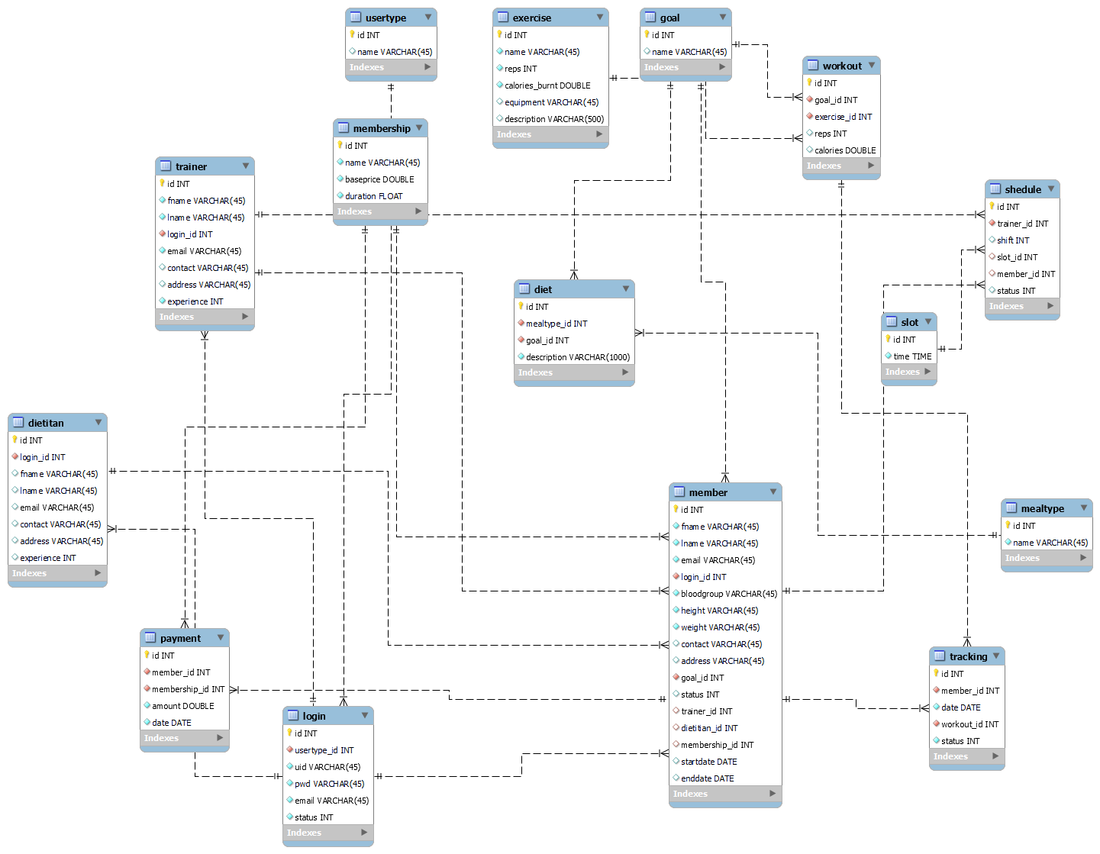
Database design
ER diagram:-

Slide 6
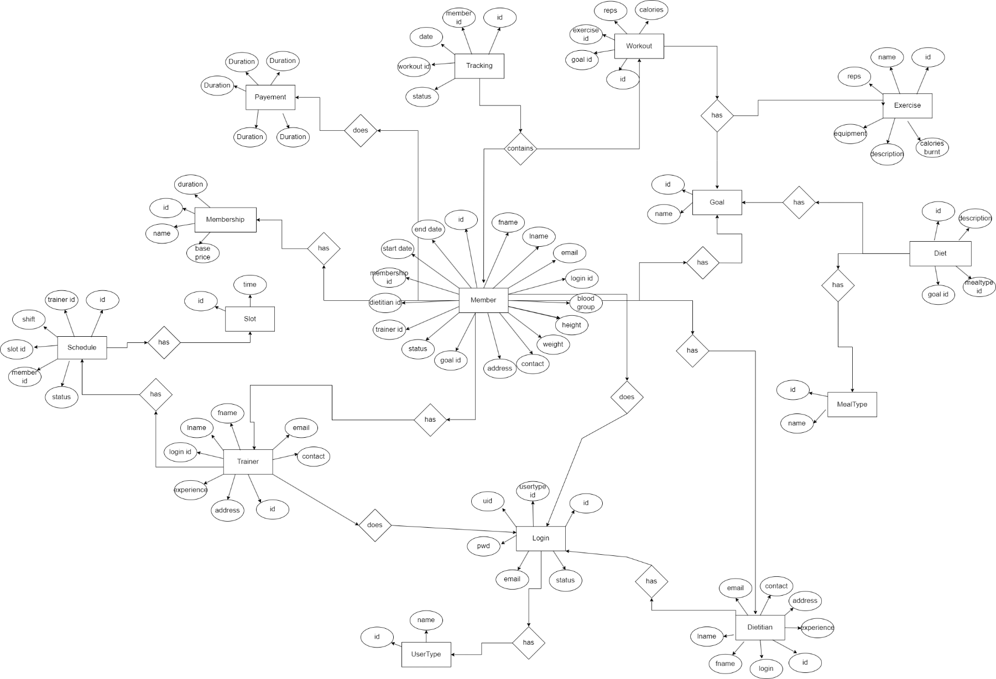
Database design

Slide 7
Technology platform used for project
Technology used:
Bootstrap
JavaScript
ReactJS
Spring Boot REST API
JPA
MYSQL
Reason for using specific technology:
Bootstrap basic formatting
JavaScript helps in developing dynamic web pages which can be used to modify the look and feel of the webpage during runtime, based on the dynamic actions of the user.
ReactJS allowed us to manage routing, state, components, html pages toggling, navigation with ease we have used react js for creating components and routing through another components such as through app.js after successful login we can navigate to trainer,admin and members home page
Spring boot REST API allows us to make requests to the database and fetch the required information from the database.
Hibernate helped my mapping entities, their state and deals with database. We have mapped all the entities of database in hibernate.
JPA managed relational data in entities
MySql allows us to store data and perform CRUD operations in them

Slide 8
User role and responsibilities
User Roles:
Admin
Trainer
Member
Responsibilities of roles:
Admin: manages web application.
Trainer: creates the workout plans for member and assign them to members.
Member: use the web application for surfing the membership plans and buy membership
Use cases roles:
Admin :admin can view members, approve signup registration , trainer registration.
Trainer : create exercise , create workout , assign workout
Member :buy membership , view daily schedule,

Slide 9
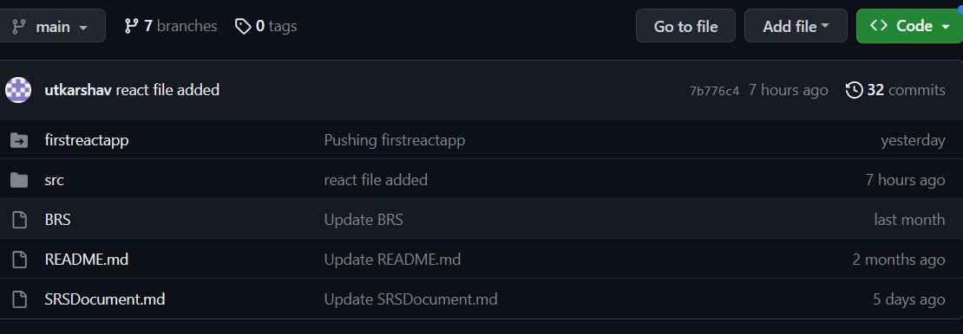
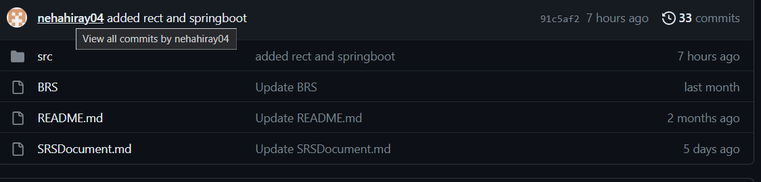
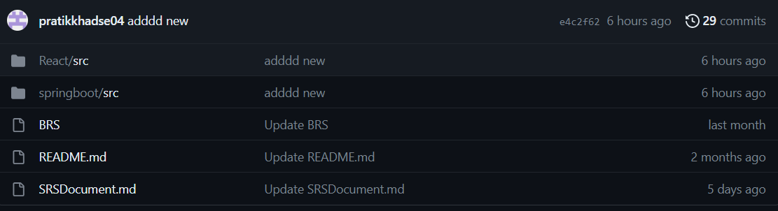
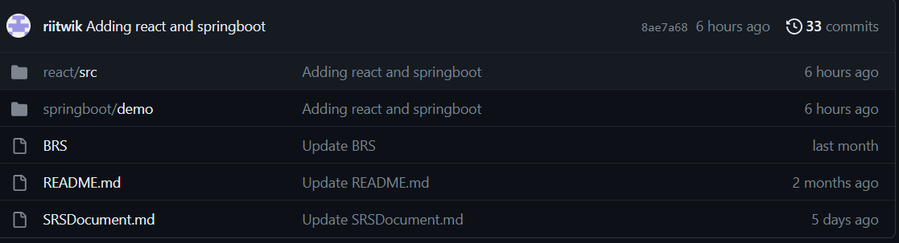
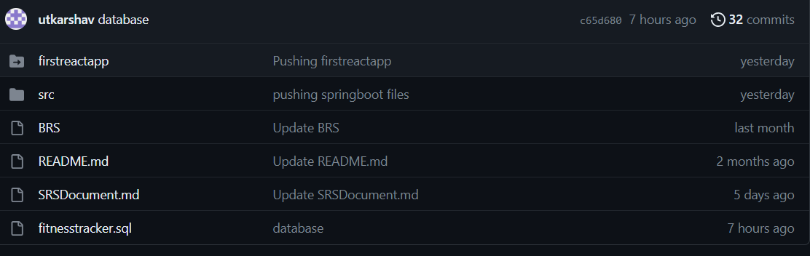
Use of GitHub in the project
Repository URL:- https://github.com/utkarshav/Fitness-Tracker.git

Slide 10
Conclusion
In wrapping up our fitness tracker project, we've accomplished some great things and learned important lessons along the way. Our fitness tracker can keep track of calories burned , weight . It's all about helping people get healthier

Slide 11
Thank you

