Slide 1
HR Employee Attrition Analysis
Data Analyst Portfolio Project
Utkarsh Bisht
July 2026

Slide 2

Business Overview
Analyzing employee attrition to identify key factors driving turnover and help HR improve employee retention and workforce planning.
Business Problem
Identify key factors driving employee attrition.
Find employee groups with higher turnover.
Compare attrition across departments.
Support better employee retention decisions.

Slide 3
Project Workflow
🎯 Business Problem
✔ Data Validation & 🧹 Cleaning
Data Analysis
📊 Dashboard
🚀 Recommendations
💡 Insights

Slide 4
Dataset Overview
Dataset: IBM HR Analytics Employee Attrition & Performance
Records: 1,470 employees
Features: 35 employee-related attributes
Key variables: Age, Monthly Income, Job Satisfaction, Department, Distance From Home, Attrition
Target: Employee Attrition (Yes/No)
Purpose: Analyze factors associated with employee turnover.

Slide 5
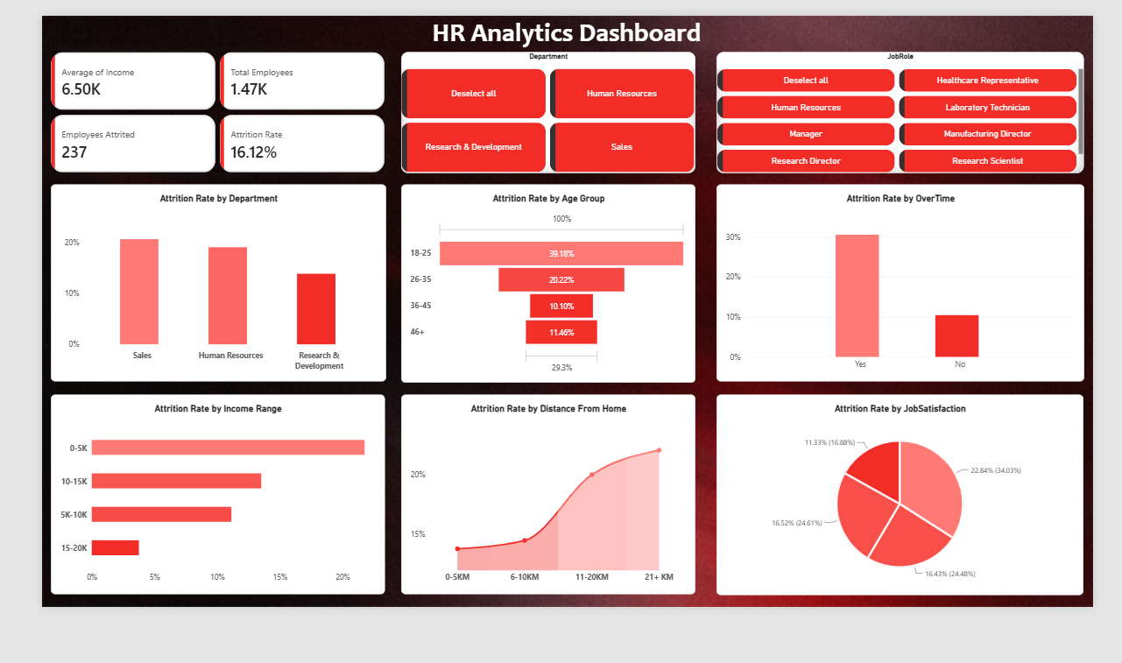
Dashboard

Slide 6
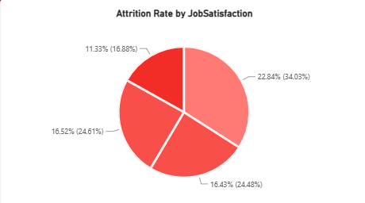
Key Findings
1. Lower job satisfaction is associated with higher employee attrition.

Slide 7
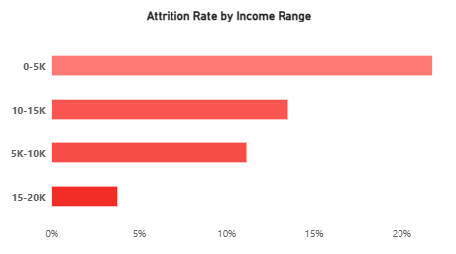
Key Findings
2. Lower-income employees show relatively higher attrition.

Slide 8
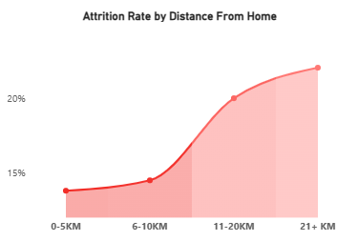
Key Findings
3. Employees living farther from the workplace show higher attrition.

Slide 9
Recommendations
Improve Satisfaction
Improve employee satisfaction through feedback, recognition, and career growth.
For Young Employees
Provide career development and mentorship opportunities for younger employees.
For Young Employees
Review compensation for lower-income and high-attrition employee groups.
For Young Employees
Consider flexible work options for employees with longer commutes.

Slide 10
Conclusion
Employee attrition varies across key employee characteristics.
Lower job satisfaction and monthly income are associated with higher attrition.
Younger employees and employees living farther from the workplace show relatively higher attrition.
Attrition varies across departments, highlighting areas that require further investigation.
___________________________________________
Thank You

