Slide 1

AC-DC-AC Converter
Using Simulink
Utkarsh Srivastava (26050)

Slide 2
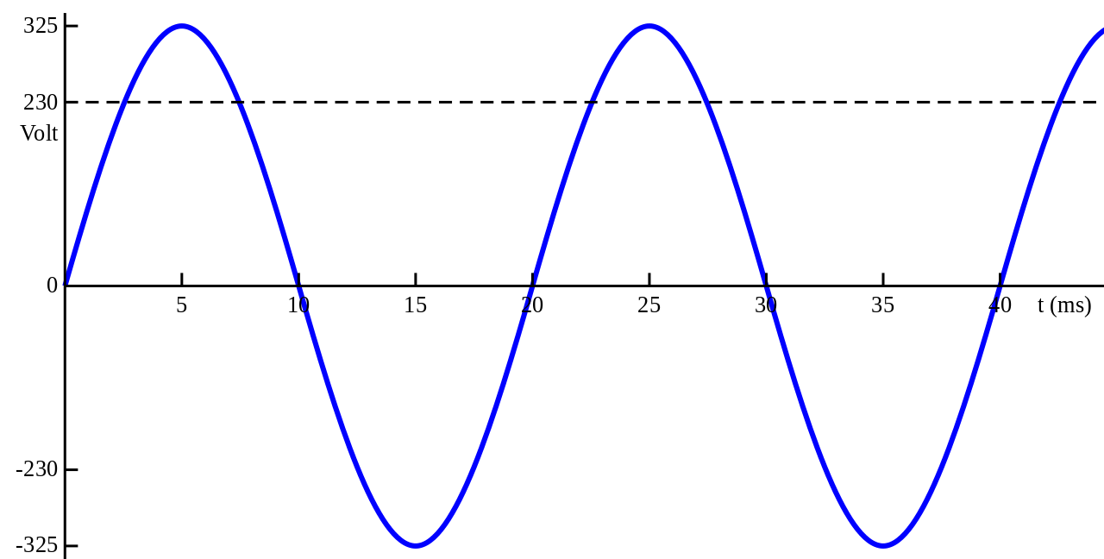
What is an AC-AC Converter
A solid-state AC-to-AC converter converts an AC waveform to another AC waveform, where the output voltage and frequency can be set arbitrarily.
Notes:
Ac-ac converters broadly define a set of power electronic topologies that are employed to obtain ac output of variable amplitude and frequency from fixed ac input without employment of bulky reactive components.

Slide 3
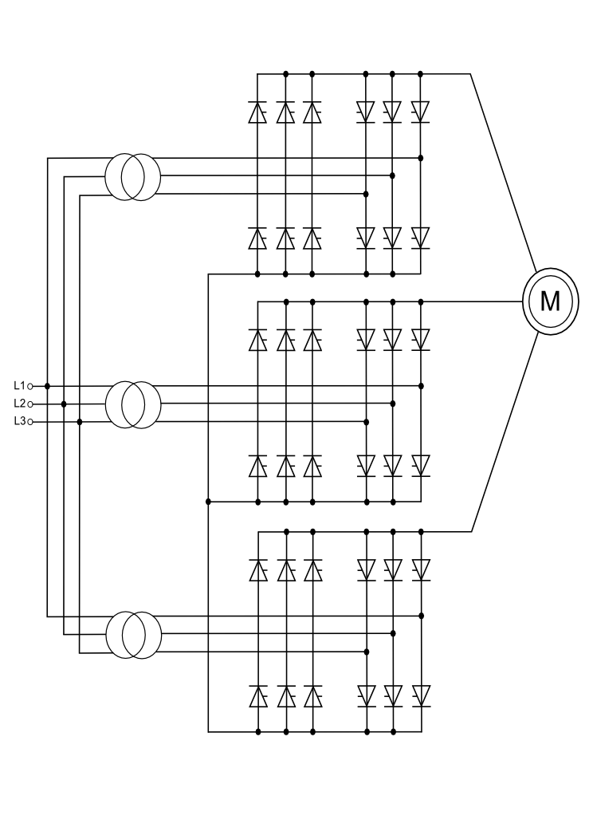
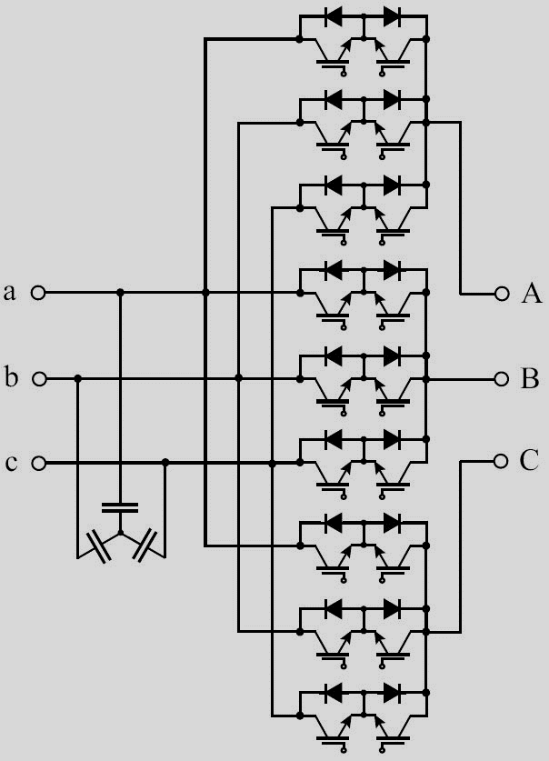
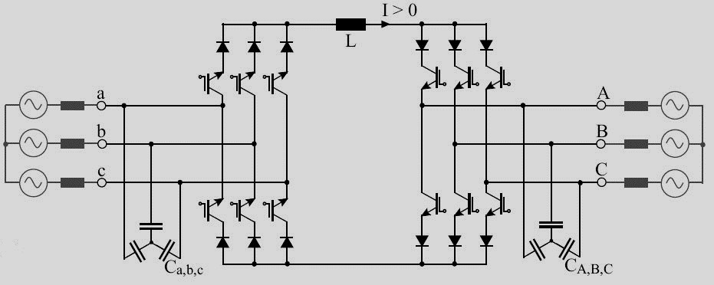
Types of AC-AC Converters
DC – link converter
Cycloconverter
Matrix converter
Notes:
Any dynamic braking operation required for the motor can be realized by means of braking DC chopper and resistor shunt connected across the rectifier. Alternatively, an anti-parallel thyristor bridge must be provided in the rectifier section to feed energy back into the AC line. Such phase-controlled thyristor-based rectifiers however have higher AC line distortion and lower power factor at low load than diode-based rectifiers.
An AC-AC converter with approximately sinusoidal input currents and bidirectional power flow can be realized by coupling a pulse-width modulation (PWM) rectifier and a PWM inverter to the DC-link. The DC-link quantity is then impressed by an energy storage element that is common to both stages, which is a capacitor C for the voltage DC-link or an inductor L for the current DC-link. The PWM rectifier is controlled in a way that a sinusoidal AC line current is drawn, which is in phase or anti-phase (for energy feedback) with the corresponding AC line phase voltage.
A cycloconverter constructs an output, variable-frequency, approximately sinusoid waveform by switching segments of the input waveform to the output; there is no intermediate DC link. With switching elements such as SCRs, the output frequency must be lower than the input. Very large cycloconverters (on the order of 10 MW) are manufactured for compressor and wind-tunnel drives, or for variable-speed applications such as cement kilns.
n order to achieve higher power density and reliability, it makes sense to consider Matrix Converters that achieve three-phase AC-AC conversion without any intermediate energy storage element. Conventional Direct Matrix Converters (Fig. 4) perform voltage and current conversion in one single stage.

Slide 4
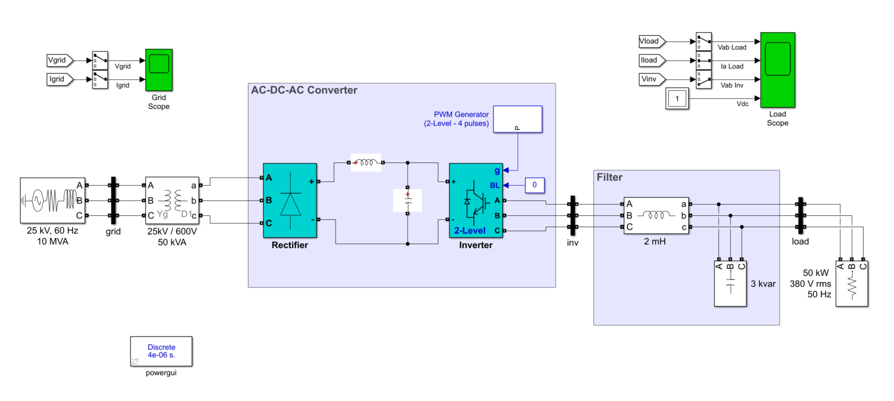
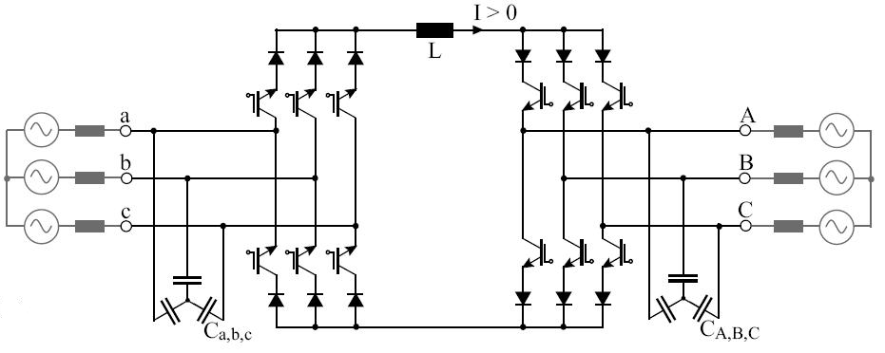
AC-DC-AC or DC-Link Converter
AC power is first converted into DC power through the use of rectifiers composed of suitable power semiconductor components like diodes or thyristors.
The filtered DC power in the DC Link is then fed into the inverter section of the VSD or UPS.
Notes:
The inverter section composed of fast switching semiconductor devices like insulated gate bipolar transistors or IGBTs, converts and processes the stable DC voltage in the DC Link to produce AC power with the correct or desired frequency and/or voltage level.
Normally in any electrical drive we convert the AC to DC and then again this DC is converted to AC as per the requirement.
In the first stage when this AC is converted to DC, the DC voltage is made available in a DC bus. This bus acts as a link between the converter and the inverter circuit. This DC voltage is called the ‘DC link voltage’.
Any dynamic braking operation required for the motor can be realized by means of braking DC chopper and resistor shunt connected across the rectifier. Alternatively, an anti-parallel thyristor bridge must be provided in the rectifier section to feed energy back into the AC line. Such phase-controlled thyristor-based rectifiers however have higher AC line distortion and lower power factor at low load than diode-based rectifiers.
An AC-AC converter with approximately sinusoidal input currents and bidirectional power flow can be realized by coupling a pulse-width modulation (PWM) rectifier and a PWM inverter to the DC-link. The DC-link quantity is then impressed by an energy storage element that is common to both stages, which is a capacitor C for the voltage DC-link or an inductor L for the current DC-link. The PWM rectifier is controlled in a way that a sinusoidal AC line current is drawn, which is in phase or anti-phase (for energy feedback) with the corresponding AC line phase voltage.
Due to the DC-link storage element, there is the advantage that both converter stages are to a large extent decoupled for control purposes. Furthermore, a constant, AC line independent input quantity exists for the PWM inverter stage, which results in high utilization of the converter’s power capability. On the other hand, the DC-link energy storage element has a relatively large physical volume, and when electrolytic capacitors are used, in the case of a voltage DC-link, there is potentially a reduced system lifetime.

Slide 5
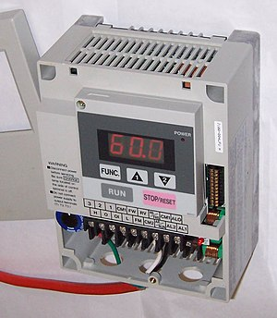
Uses of an AC-AC converter
The main use for AC-AC converters is variable frequency motor drives. Induction motors which are the workhorse of industry require frequency control at a constant amplitude.
The other use would be laboratory testing of electronic appliances - at various line ratings.
A transformer cannot change frequency and is usually limited to one or two sets of taps to control voltage, so a programmable AC-AC power supply is way more flexible.

Slide 6
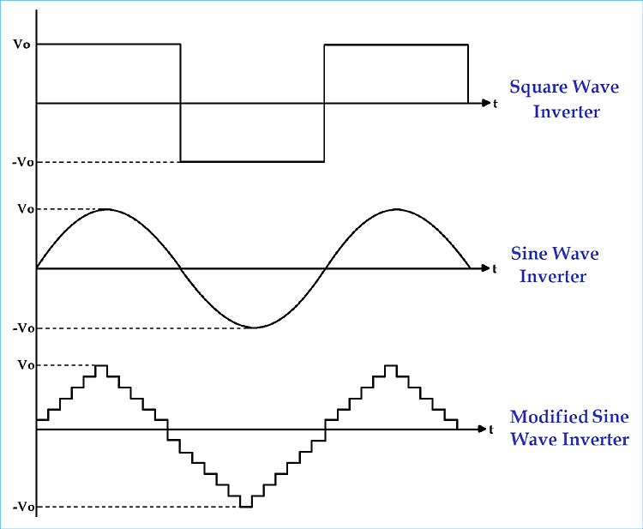
Where’s the catch ?
Pure Sine is high quality equal to (or better than) the power in your home, Modified sine wave power is a simpler form of power and is adequate for simple electronics but may damage more complex ones.
Notes:
A power inverter, or inverter, is a power electronic device or circuitry that changes direct current (DC) to alternating current (AC).^{[1]}
The input voltage, output voltage and frequency, and overall power handling depend on the design of the specific device or circuitry. The inverter does not produce any power; the power is provided by the DC source.
A power inverter can be entirely electronic or may be a combination of mechanical effects (such as a rotary apparatus) and electronic circuitry. Static inverters do not use moving parts in the conversion process.

Slide 7
Thanks ! Git: https://github.com/utkarshboson/acdcac-matlab

