Slide 1

AC-DC-AC Converter
Using Simulink
Utkarsh Srivastava (26050)

Slide 2
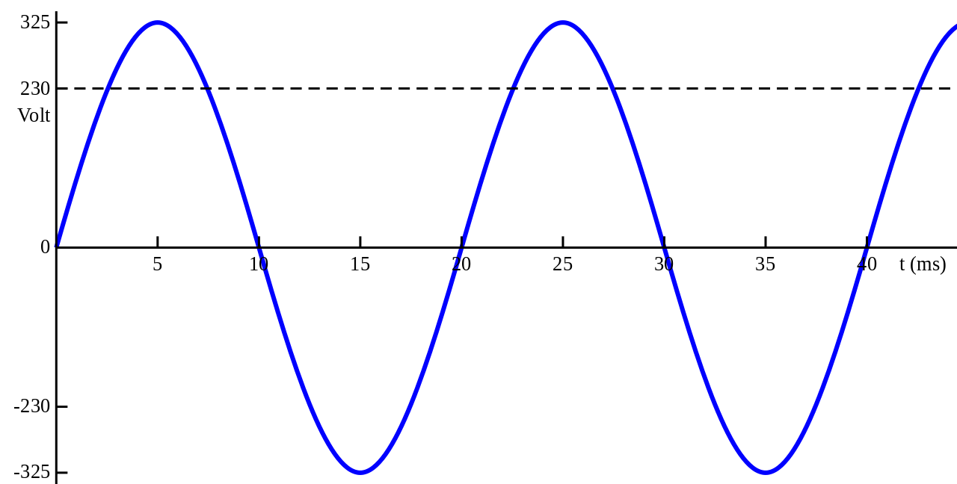
What is an AC-AC Converter
A solid-state AC-to-AC converter converts an AC waveform to another AC waveform, where the output voltage and frequency can be set arbitrarily.

Slide 3
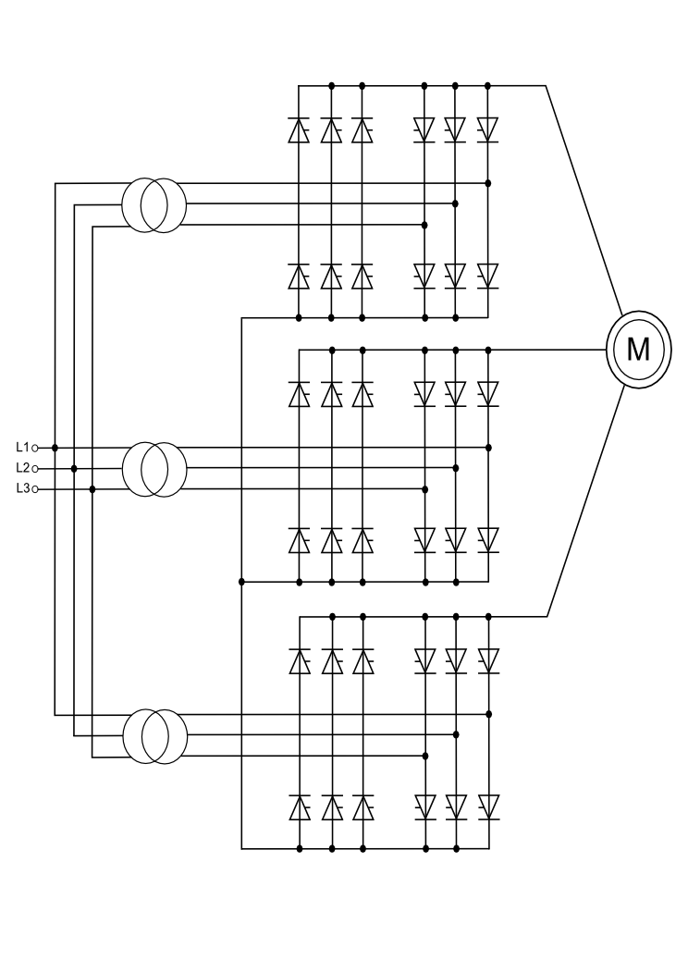
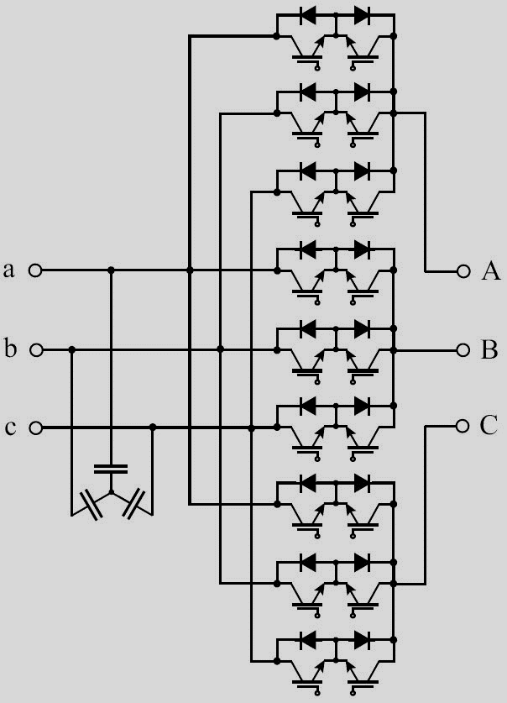
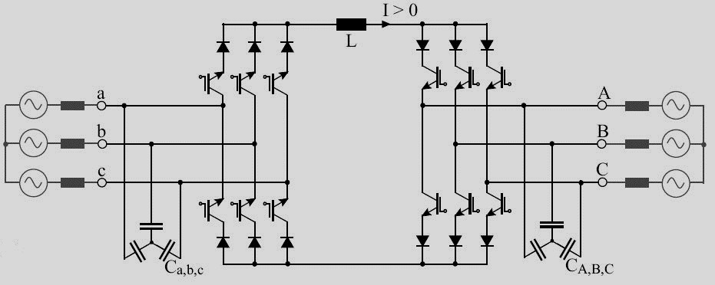
Types of AC-AC Converters
DC – link converter
Cycloconverter
Matrix converter

Slide 4
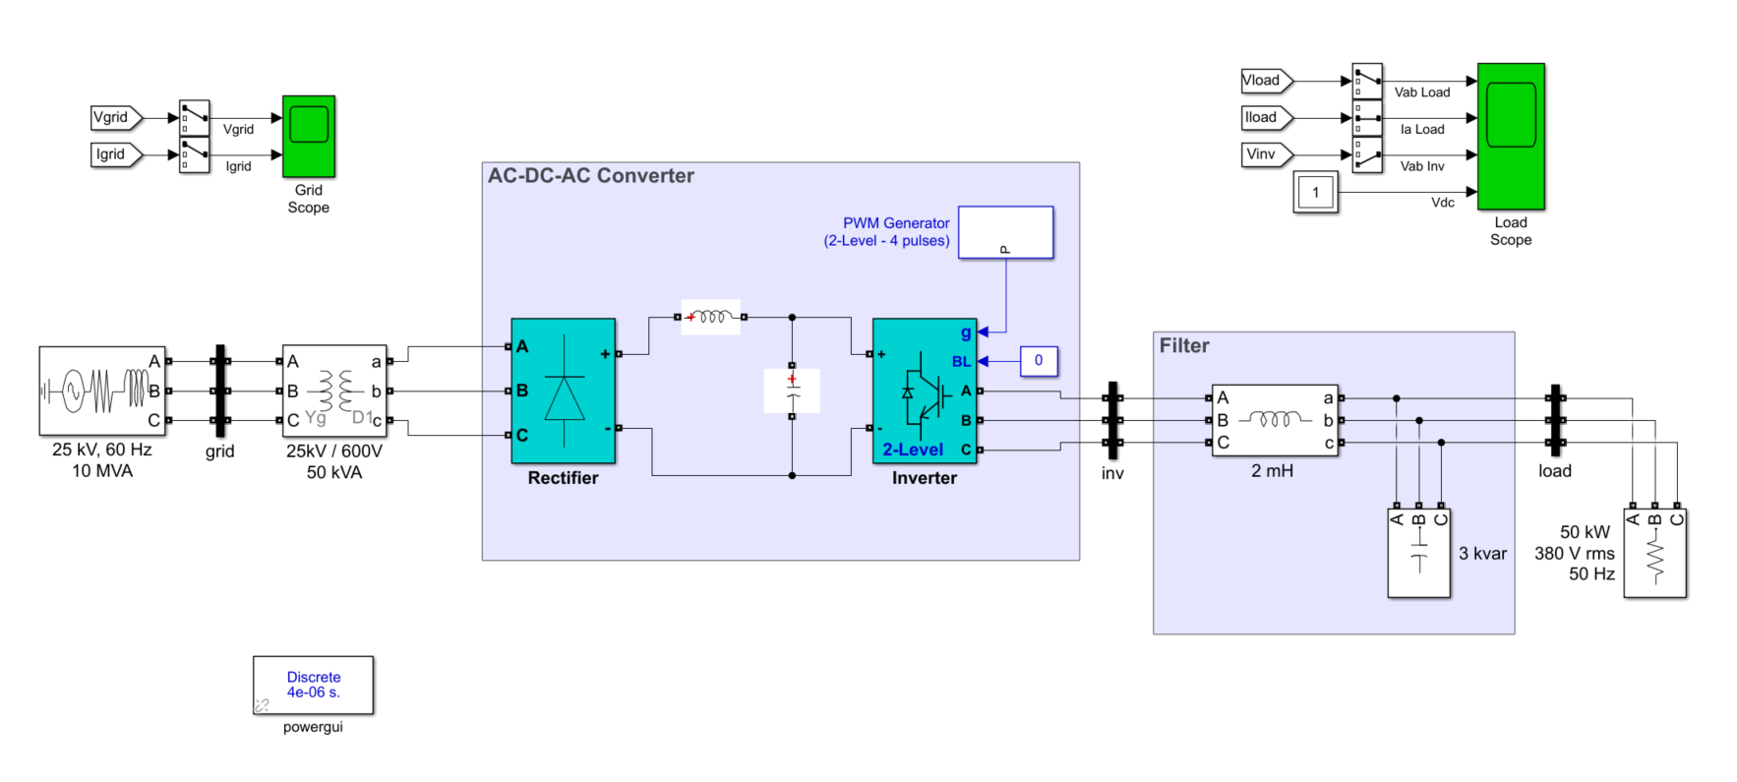
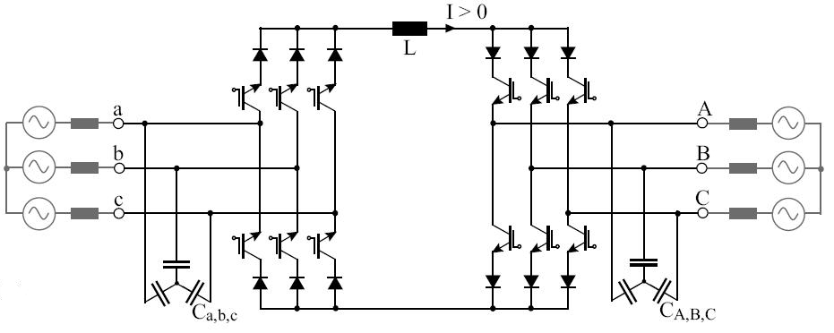
AC-DC-AC or DC-Link Converter
AC power is first converted into DC power through the use of rectifiers composed of suitable power semiconductor components like diodes or thyristors.
The filtered DC power in the DC Link is then fed into the inverter section of the VSD or UPS.
Notes:
The inverter section composed of fast switching semiconductor devices like insulated gate bipolar transistors or IGBTs, converts and processes the stable DC voltage in the DC Link to produce AC power with the correct or desired frequency and/or voltage level.

Slide 5
Uses of an AC-AC converter

Slide 6
Where’s the catch ?

Slide 7
Thanks !

