Slide 1

AC-DC-AC Converter
Using Simulink
Utkarsh Srivastava (26050)

Slide 2
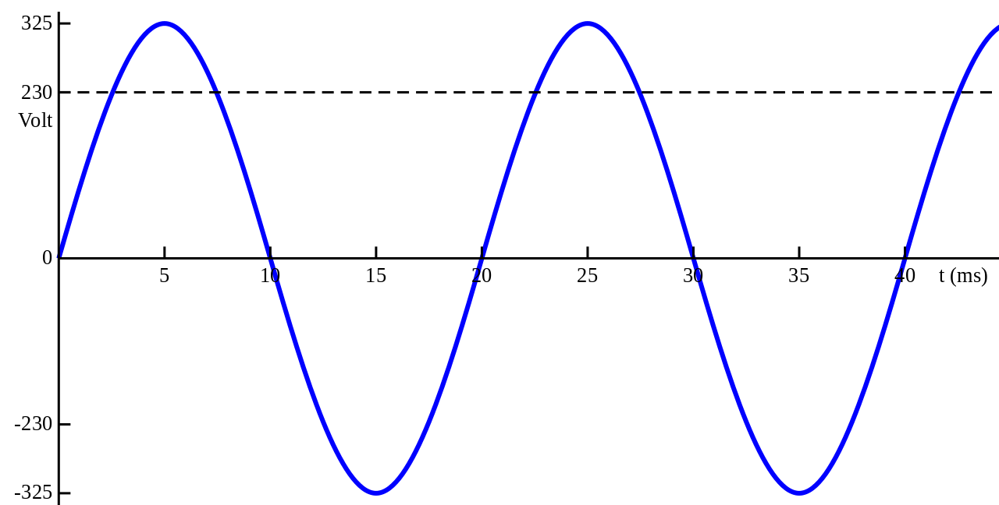
What is an AC-AC Converter
A solid-state AC-to-AC converter converts an AC waveform to another AC waveform, where the output voltage and frequency can be set arbitrarily.

Slide 3
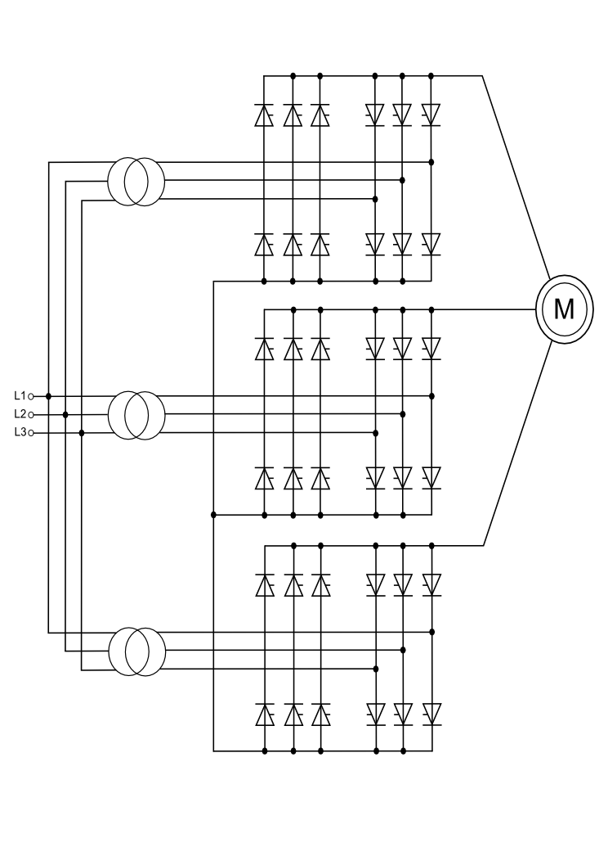
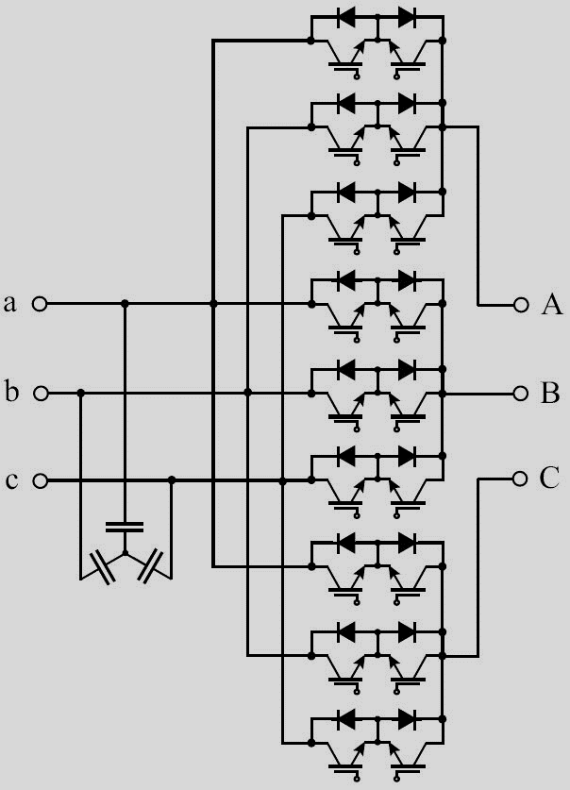
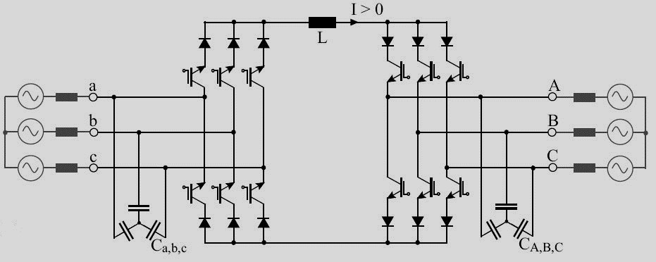
Types of AC-AC Converters
DC – link converter
Cycloconverter
Matrix converter

Slide 4
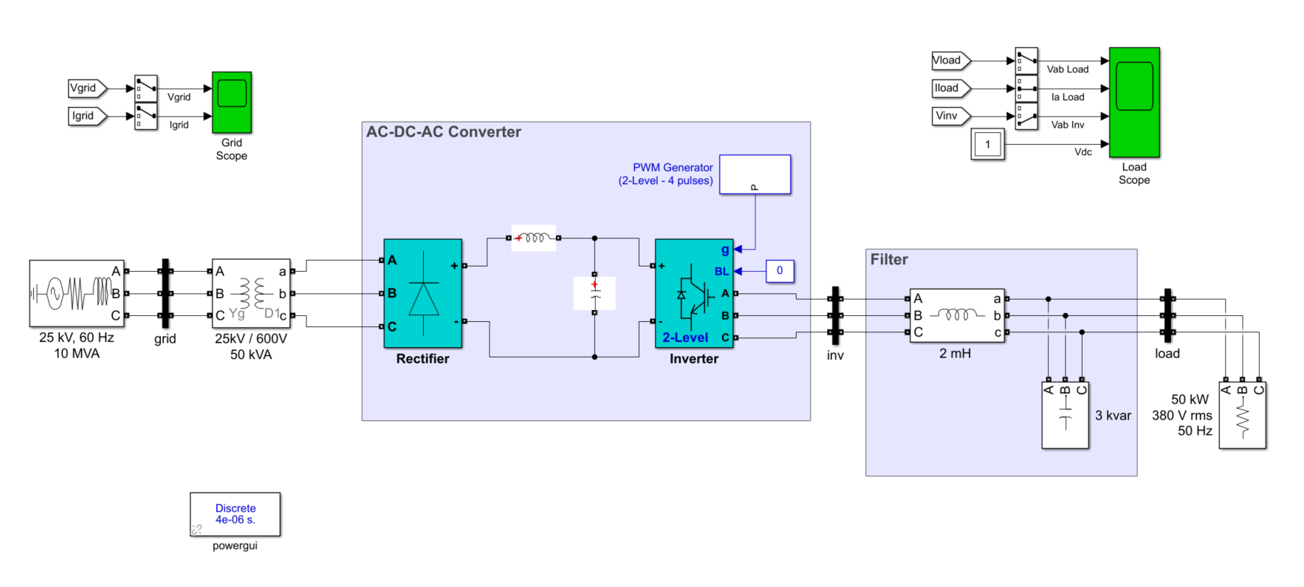
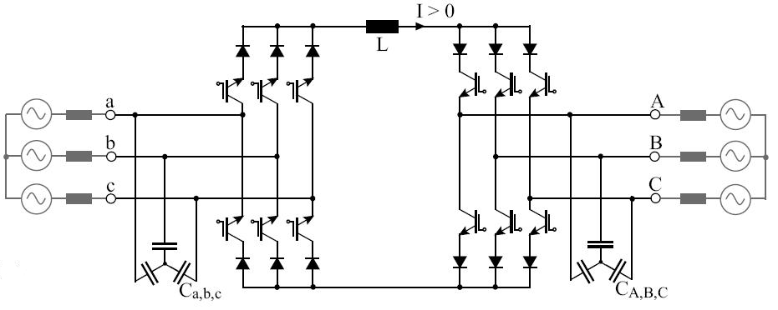
AC-DC-AC or DC-Link Converter
AC power is first converted into DC power through the use of rectifiers composed of suitable power semiconductor components like diodes or thyristors.
The filtered DC power in the DC Link is then fed into the inverter section of the VSD or UPS.
Notes:
The inverter section composed of fast switching semiconductor devices like insulated gate bipolar transistors or IGBTs, converts and processes the stable DC voltage in the DC Link to produce AC power with the correct or desired frequency and/or voltage level.

Slide 5
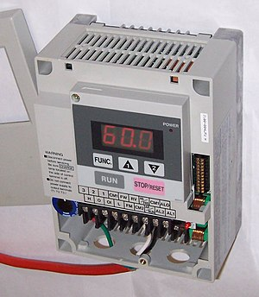
Uses of an AC-AC converter
The main use for AC-AC converters is variable frequency motor drives. Induction motors which are the workhorse of industry require frequency control at a constant amplitude.
The other use would be laboratory testing of electronic appliances - at various line ratings.
A transformer cannot change frequency and is usually limited to one or two sets of taps to control voltage, so a programmable AC-AC power supply is way more flexible.

Slide 6
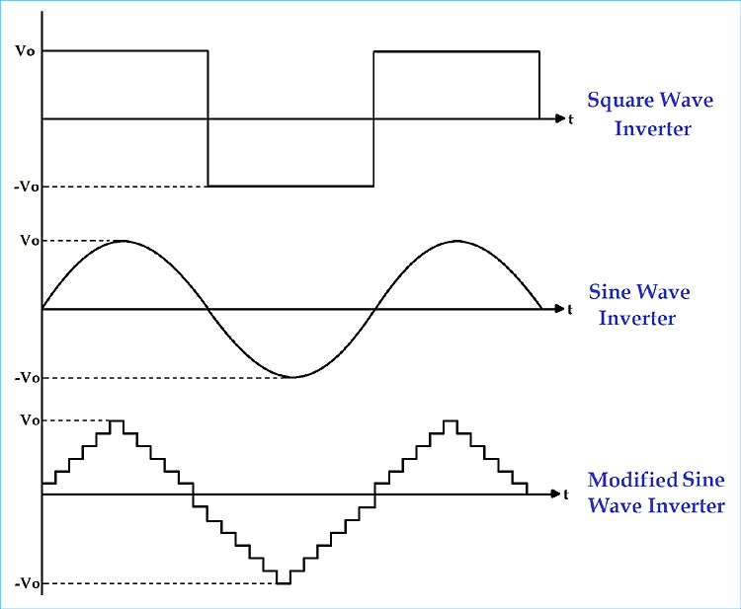
Where’s the catch ?
Pure Sine is high quality equal to (or better than) the power in your home, Modified sine wave power is a simpler form of power and is adequate for simple electronics but may damage more complex ones.

Slide 7
Thanks ! Git: https://github.com/utkarshboson/acdcac-matlab

