Slide 1
Problem Statement Title: Fraud Detection and Prevention System
Domain: Financial Services
Team Name: CodeSnap

Slide 2
Idea/Approach
Idea - Develop a machine learning-based anomaly detection system for consumer banking that leverages advanced algorithms to analyze transaction patterns, such as amount changes, transaction types, time of day, and location. The system identifies deviations indicating suspicious activities and notifies users in real-time via SMS. Administrators can use Tableau for data analysis and visualization, displaying anomalous transaction IDs on a scale. Additionally, it features alerts for transactions in restricted or flagged countries, enhancing security and enabling proactive risk management.
Approach –
Authentication and Data Ingestion.
Preprocess the transaction data to handle missing values, outliers, and inconsistencies.
Conduct EDA to analyze data distribution, correlations, and anomalies.
Use of Feature Engineering to extract relevant features from the data that may help in detecting anomalies.
Choose appropriate machine learning algorithms for anomaly detection.
Develop an ETL pipeline to ingest, transform, and load the data into the database.
Use Tableau to create dashboards for monitoring anomalies.
Generate real-time alerts for detected anomalies to prompt timely actions.

Slide 3
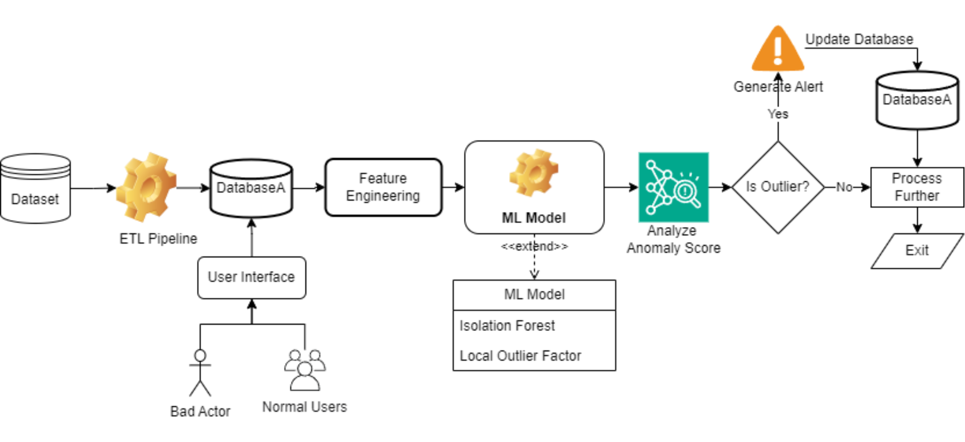
Flowchart

Slide 4
Use Cases
Transaction Integrity in Banking: Ensure accurate transaction settlements by identifying irregularities in trade feeds.
Market Data Analysis: Scrutinize market data feeds to detect anomalies and facilitate timely corrective actions.
Data Quality Management: Automatically flag data anomalies to ensure proactive management of data quality issues.
Error Detection in ETL Pipelines: Identify anomalies in transaction data within ETL pipelines to ensure data integrity.
Compliance Monitoring: Monitor transaction data for compliance-related anomalies to facilitate regulatory adherence.
Automated Data Auditing: Automate the auditing of transaction data to efficiently resolve reporting discrepancies.
Real-time Monitoring of Trade Activities: Continuously monitor trade activities to detect anomalies in real-time and minimize financial risks.
Enhanced Risk Management: Proactively identify potential risks in transaction data to enhance risk management strategies

Slide 5








Technology Stack
Numpy
Pandas
Scikit Learn
Tensorflow
Spyder IDE
SQL
Docker

Slide 6
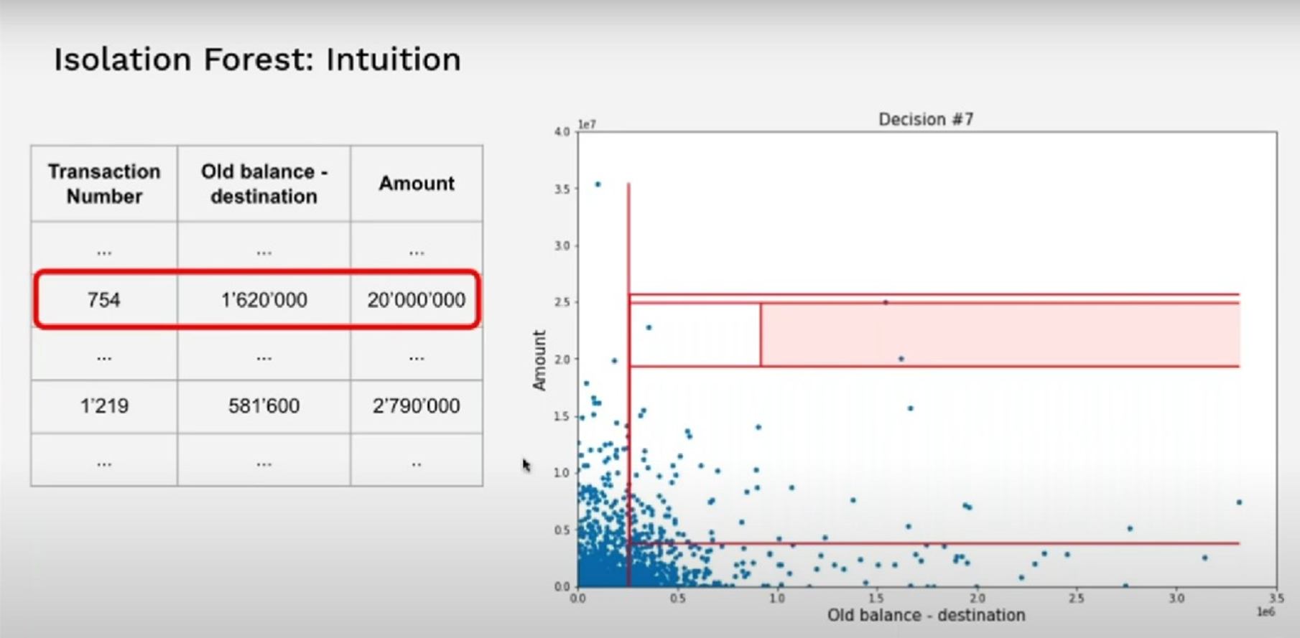
ML Algorithm Used
Isolation Forest
Purpose:
Efficiently identifies anomalies, such as inflated prices or missing values, within transactional data.
Working:
- Randomly selects features and split values to isolate anomalies, leveraging their natural isolation properties.
- Anomalies require fewer splits, resulting in shorter path lengths within the tree structure.
Used to Achieve:
Provides a robust method for detecting outliers, contributing to the accuracy of anomaly detection in transaction settlements.
Relevance:
Aligns with the need to accurately identify irregularities in transactional data, enhancing the effectiveness of the anomaly detection framework.

Slide 7
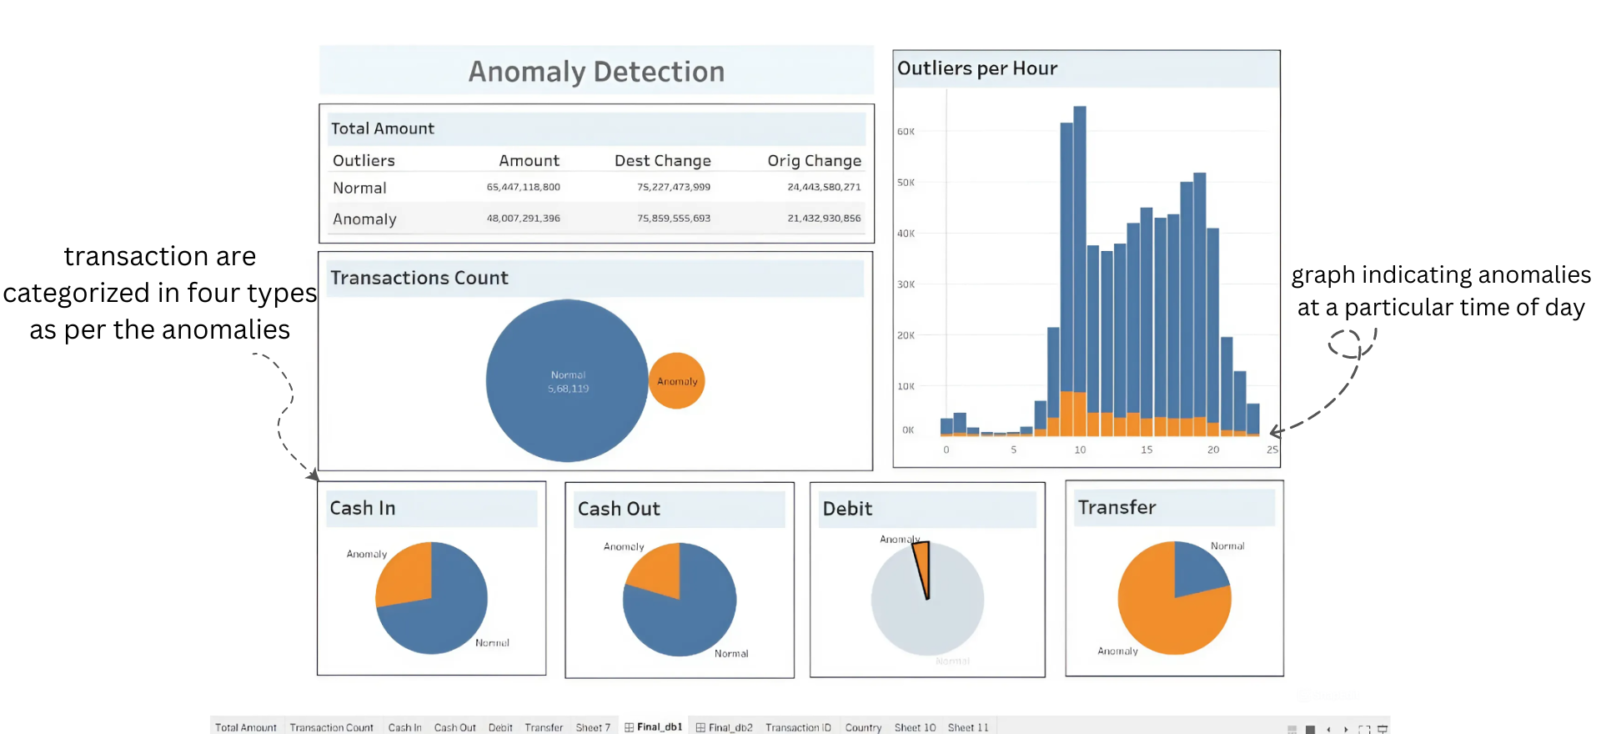
Admin Dashboard

Slide 8
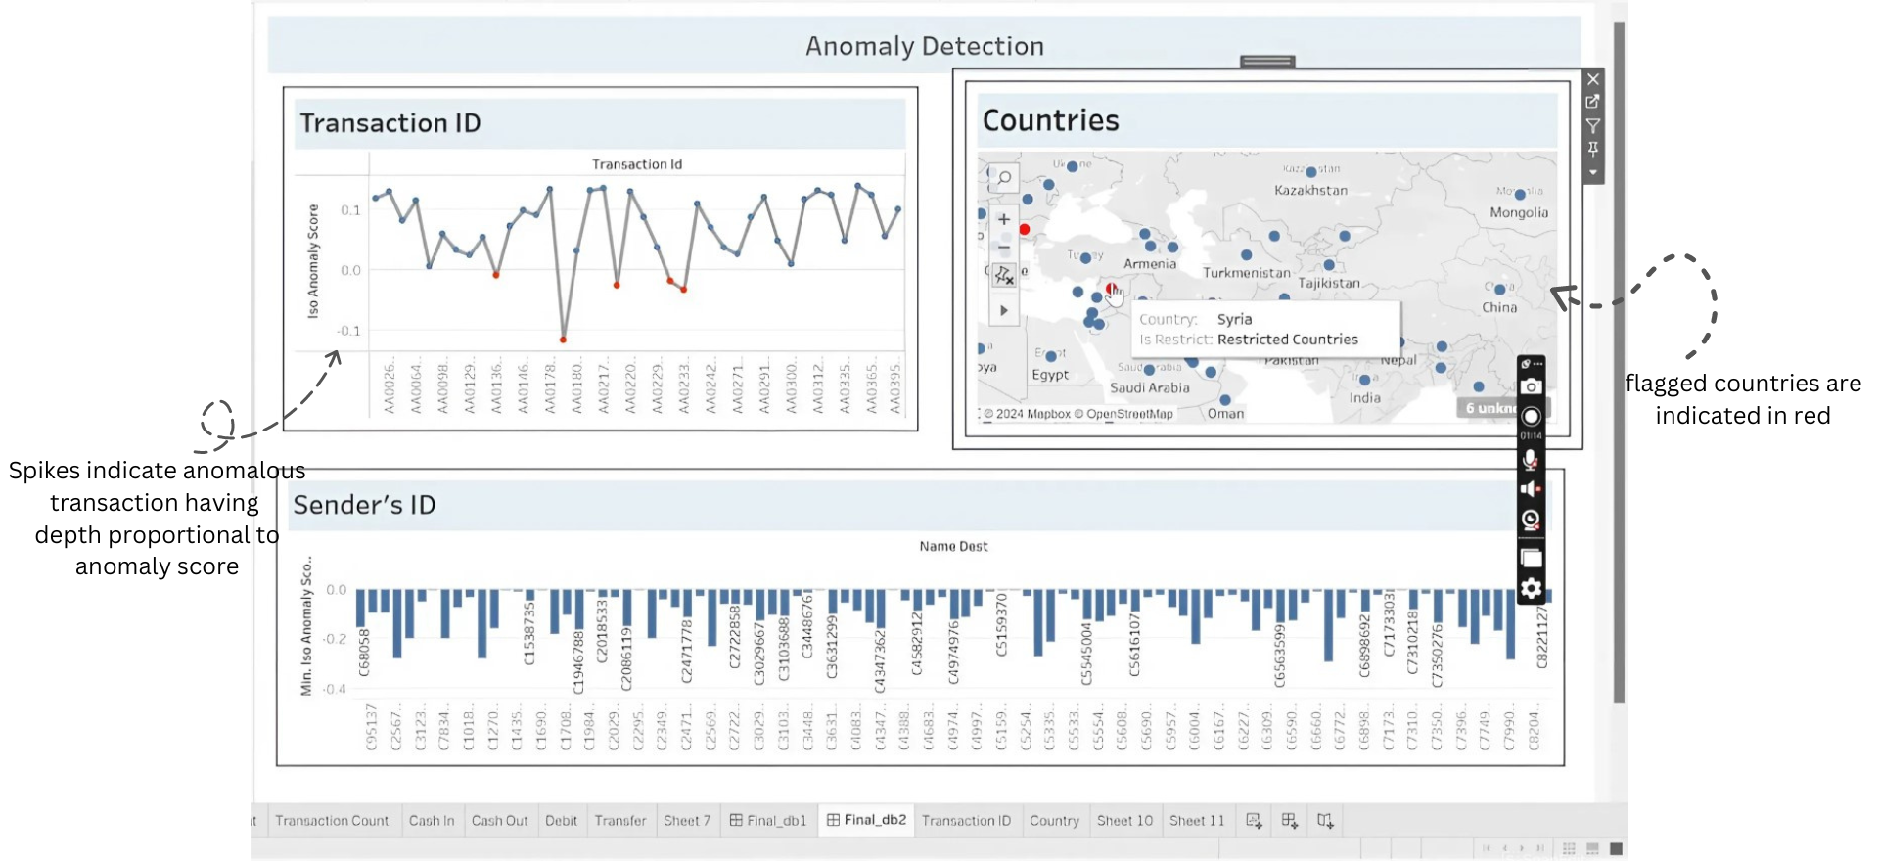

Slide 9
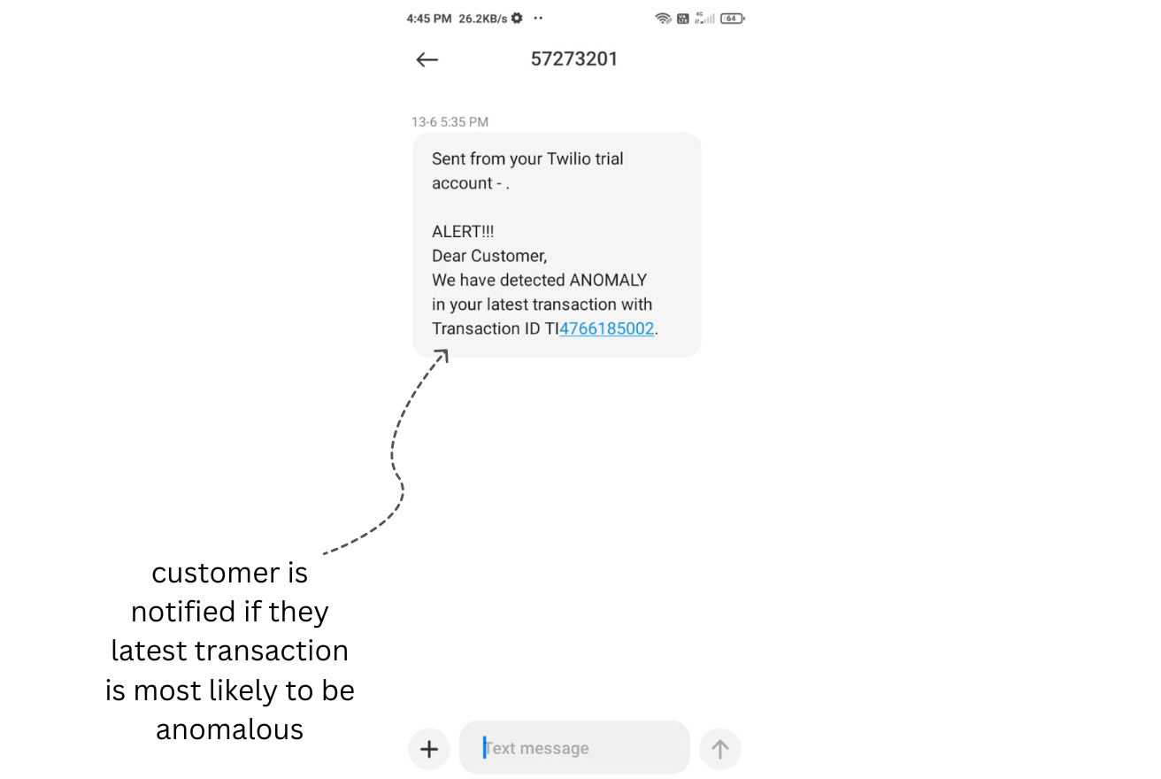
REAL-TIME SMS ALERT

