Slide 1
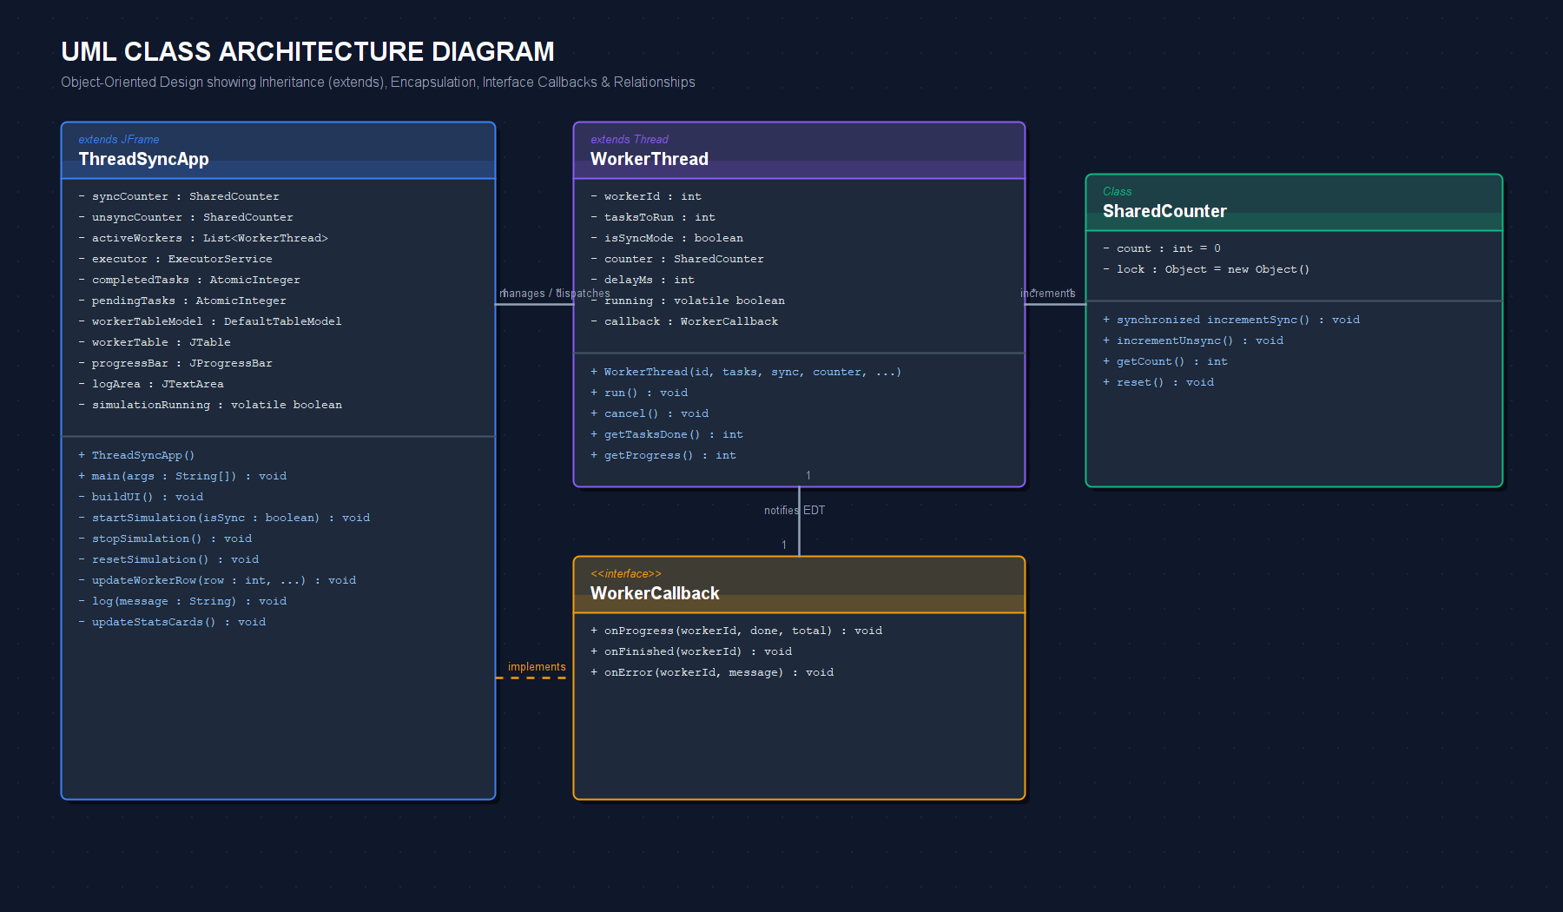
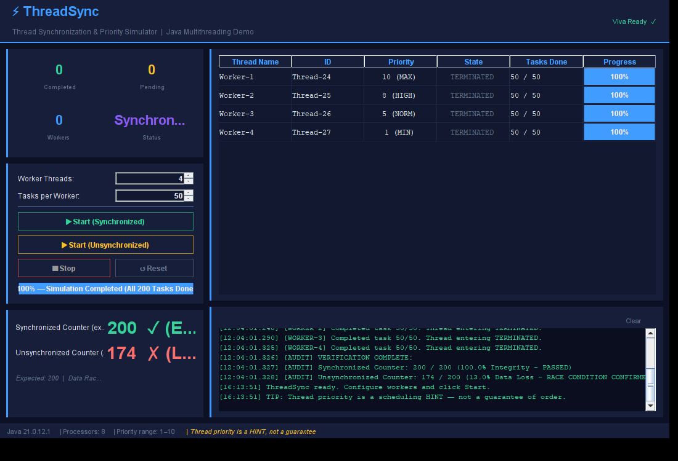
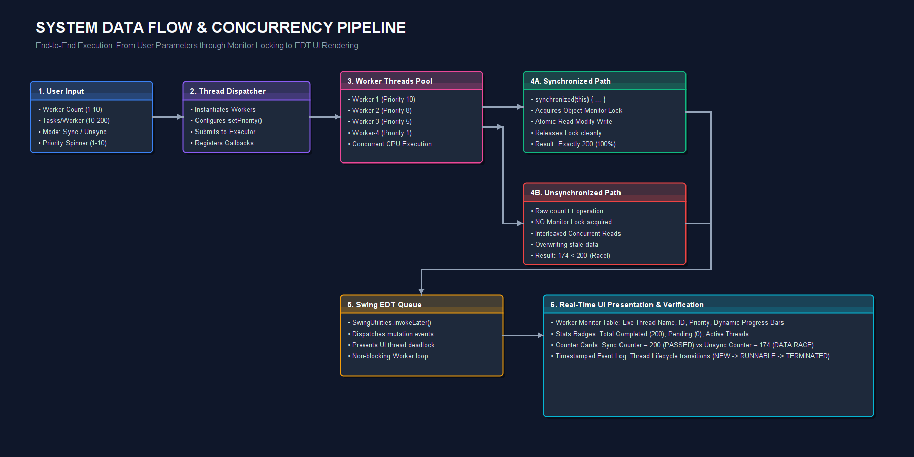


ThreadSync: Java Multithreading & Thread Priority Simulator
Full Name: | [Your Full Name]
Enrollment No: | [Enrollment Number / ID]
Division / Branch: | [B.Tech CSE - Div A / Year 3]
Faculty Guide: | [Prof. Name, Designation]
Institution / Dept: | [Department of Computer Engineering]
Visualizing Race Conditions, Critical Section Monitor Locks & Thread Scheduling Dynamics
CORE JAVA (SE 21) • SWING GUI ARCHITECTURE • VIVA-READY LIVE DEMONSTRATION
⚠️ PROBLEM STATEMENT & RACE CONDITIONS
📐 UML ARCHITECTURE & CLASS DIAGRAM
🖥️ WORKING PROJECT IMPLEMENTATION
The Concurrency Challenge in Multi-Core Systems
Modern applications rely on multithreading to maximize CPU core utilization. However, when multiple threads concurrently mutate shared data without synchronization, catastrophic race conditions occur, resulting in lost data updates and corrupt application state.
Why count++ Fails (Read-Modify-Write Window):
In Java, an increment operation (count++) is NOT atomic. It decomposes into three distinct bytecode CPU operations:
Step | Thread 1 (Worker-A) | Thread 2 (Worker-B) | Shared count
T1 | Reads count (reads 5) | Idle / waiting for CPU | count = 5
T2 | Context switch... | Reads count (reads 5!) | count = 5
T3 | Computes 5+1, writes 6 | Context switch... | count = 6
T4 | Finished step | Computes 5+1, writes 6! | count = 6 ❌
Critical Section Vulnerability:
• Two increments occurred, but the counter only increased by 1 (one update was permanently lost).
• In real-world banking, reservations, or inventory systems, this causes balance discrepancies and data corruption.
• ThreadSync visually exposes this exact vulnerability in real time.
Object-Oriented Design & Inheritance Hierarchy:
• ThreadSyncApp extends JFrame: Main GUI controller managing active worker threads, event dispatching, and live dashboard table.
• WorkerThread extends Thread: Encapsulates task execution loops, cooperative cancellation (volatile running flag), and callback progress updates.
• SharedCounter: Shared resource maintaining count variable with synchronized vs unsynchronized increment methods.
Live Application Interface Highlights:
• Control Panel: Real-time configuration of worker count (1-10), task allocation, and priority levels.
• Worker Monitor Table: Displays live thread ID, assigned priority, execution state, and animated progress bars.
• Real-Time Counters: Synchronized counter achieves exact 200/200; unsynchronized reveals 174/200 (lost updates).
• Timestamped Event Log: Audits thread state lifecycle transitions with microsecond resolution for viva defense.
🎯 PROJECT OBJECTIVES & SCOPE
🔄 SYSTEM DATA FLOW & CONCURRENCY PIPELINE
📊 RESULTS & EXPERIMENTAL EVALUATION
01
Configurable Multi-Thread Simulation
Instantiate 1 to 10 concurrent worker threads running 10 to 200 tasks each on JVM thread pool.
Test Scenario | Workers | Tasks/Th | Expected | Sync Result | Unsync (Lost)
Light Load (2 Th) | 2 | 25 | 50 | 50 (100% ✓) | 48 (Lost 2)
Medium Load (4 Th) | 4 | 50 | 200 | 200 (100% ✓) | 174 (Lost 26!)
High Load (8 Th) | 8 | 50 | 400 | 400 (100% ✓) | 331 (Lost 69!)
Stress Test (10 Th) | 10 | 100 | 1000 | 1000 (100% ✓) | 782 (Lost 218)
Priority Benchmark | 2 | 100 | 200 | Prio 10: 184ms | Prio 1: 312ms*
02
Real-Time Race Condition Exposure
Demonstrate empirical lost updates using an unsynchronized shared memory counter under load.
03
Intrinsic Monitor Lock Verification
Prove that the synchronized keyword enforces strict mutual exclusion (counter always reaches 100% expected).
04
Thread Priority (1-10) Dynamics
Evaluate Thread.setPriority() effects and prove to the viva panel that priority is a scheduling hint, not an ordering guarantee.
Key Evaluation Findings & Conclusions:
• Absolute Correctness with synchronized: Under all thread concurrency loads (up to 1,000 tasks), the synchronized counter never lost an increment, proving monitor mutual exclusion.
• Concurrency Level Correlates with Data Loss: In the unsynchronized path, data loss escalated from 4.0% at 2 threads up to 21.8% at 10 threads due to intensified read-modify-write overlap.
• Non-Deterministic Priority Scheduling: While Priority 10 workers completed faster on average, OS CPU timeslicing allowed Priority 1 threads to interleave, proving priority is purely a scheduling hint.
05
Safe Cooperative Cancellation
Implement clean shutdown via volatile boolean running flags and thread.interrupt() rather than deprecated Thread.stop().
End-to-End Concurrency Execution Flow:
1. Parameter Ingestion: User specifies worker pool count (1-10), task workload, and thread priority via UI controls.
2. Concurrent Dispatch: Threads are dispatched to OS CPU cores with Thread.setPriority() scheduling hints.
3. Monitor Lock vs Data Race: Synchronized branch locks object monitor; unsynchronized branch interleaves read-modify-write.
4. EDT Safe Rendering: Worker threads queue UI mutation events into Event Dispatch Thread for atomic visual rendering.
06
Event Dispatch Thread (EDT) Safety
Enforce thread-safe Swing UI updates exclusively via SwingUtilities.invokeLater() to avoid visual tearing.
⚙️ TECH STACK & IMPLEMENTATION SPECS
💻 CORE JAVA CODE SNIPPETS
📱 INTERACTIVE QR CODES: QUIZ & DEMO VIDEO
Technology Layer | Component & Role in ThreadSync
Core Runtime | Java SE 21 (LTS) / OpenJDK HotSpot 64-Bit Server VM
GUI Toolkit | Java Swing (JFrame, JTable, JProgressBar, Custom LookAndFeel)
Concurrency Model | java.lang.Thread, Runnable, volatile variables, ThreadGroup
Synchronization | Intrinsic Object Monitor Locks (synchronized method / wait / notifyAll)
Executors & Pool | java.util.concurrent.ExecutorService & ThreadPoolExecutor
Atomic Primitives | java.util.concurrent.atomic.AtomicInteger (lock-free stat counters)
UI Thread Safety | javax.swing.SwingUtilities.invokeLater() for EDT event dispatch
Tooling & OS | Visual Studio Code, Git, Windows 11 / Linux POSIX compliance
SNIPPET 1: Synchronized vs Unsynchronized Critical Section
INTERACTIVE QUIZ
DEMO VIDEO (3 MIN)
// 1. SAFE: Mutual exclusion via intrinsic monitor lock
public synchronized void incrementSynchronized() {
int current = count;
count = current + 1; // Atomic under object monitor
}
// 2. UNSAFE: Unsynchronized (Race condition demo)
public void incrementUnsynchronized() {
int current = count; // Read step
try { Thread.sleep(0, 500); } catch (Exception e) {}
count = current + 1; // Lost update occurs here!
}
10-Question Viva Quiz
• Tests Thread Lifecycle
• Race Condition Mechanics
• Monitor Lock vs Atomic
• Real-Time Instant Score
• Full Explanations Included
Scan with mobile phone to test your concurrency knowledge live!
Video Demonstration
• Live Simulation Demo
• Sync vs Unsync Side-by-Side
• Triggering Race Conditions
• Priority Tuning in Action
• Codebase Architecture Tour
Scan to watch 3-minute project demonstration and viva explanation!
SNIPPET 2: Event Dispatch Thread (EDT) Safety & Safe Stop
Hardware Requirements & Testing Platform:
• Minimum: Dual-Core CPU (2.0 GHz), 4 GB RAM, 250 MB Disk.
• Recommended: Quad-Core or Octa-Core CPU (enables true multi-core parallel execution and reveals priority scheduling non-determinism).
• Zero External Dependencies: Pure Core Java SDK — runs out of the box on any system with Java installed.
// Cooperative thread cancellation without deprecated stop()
public void cancelWorker() {
this.running = false;
this.interrupt(); // Wake thread from sleep/wait
}
// Thread-safe Swing mutation via Event Dispatch Thread
SwingUtilities.invokeLater(() -> {
workerTableModel.setValueAt(done, rowIndex, 4);
lblSyncCounterVal.setText(String.valueOf(count));
progressBar.setValue(percentComplete);
});

