Slide 1

INTRODUCTION TO DATASCIENCE
UE18CS203
PROJECT FINAL PRESENTATION
TSUNAMI WAVES ANALYSIS
PRESENTED BY:
UTKARSH VERMA PES1201800330
NAYAN VARMA PES1201800208
SARAN SAI PES1201800845

Slide 2
DESCRIPTION OF DATASET
NAME OF DATASET-->waves.csv
SOURCE:https://www.kaggle.com/noaa/seismic-waves#sources.csv
Dataset conatins 30 rows and 26,204 columns
The column headings are as follows:
SOURCE_ID | WAVE_ID | YEAR | MONTH | DAY | REGION_ CODE | COUNTRY | STATE/PROVINCE | LOCATION | LATITUDE
LONGITUDE | DISTANCE_ FROM_ SOURCE | TRAVEL_ TIME_ HOURS | TRAVEL_ TIME_ MINUTES | VALIDITY | MEASUREMENT_ TYPE | PERIOD | FIRST_ MOTION | MAXIMUM_ HEIGHT | HORIZONTAL_ INUNDATION
INJURIES | INJURY_ ESTIMATE | FATALITIES | FATALITY_ ESTIMATE | DAMAGE_ MILLIONS_ DOLLARS | DAMAGE_ ESTIMATE | HOUSES_ DAMAGED | HOUSE_ DAMAGE_ ESTIMATE | HOUSES_ DESTROYED | HOUSE_ DESTRUCTION_ ESTIMATE

Slide 3
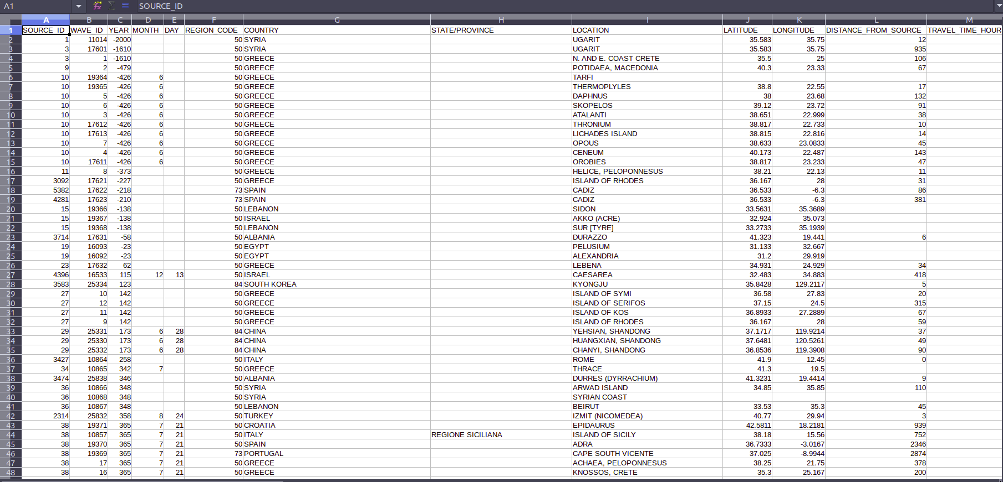
DATASET BEFORE CLEANING

Slide 4
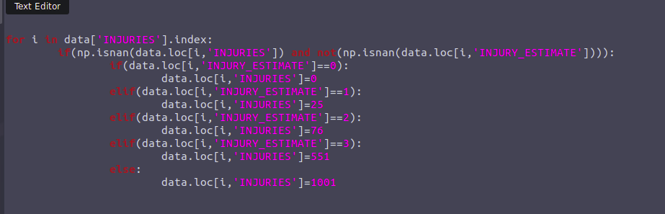
CLEANING:
The orignal data had nearly 50% of its data missing.
The first step involved pairing up columns with high correlation,linear regression was then applied on those columns which helped to reduce the number of missing values appreciably.
The INJURY_ESTIAMTE is a catogorical data which is used to estimate INJURY as follows:
0 = None
1 = Few (~1 to 50 injuries)
2 = Some(~51 to 100 injuries)
3 = Many (~101 to 1000 injuries)
4 = Very Many (~1001 or more
injuries)

Slide 5
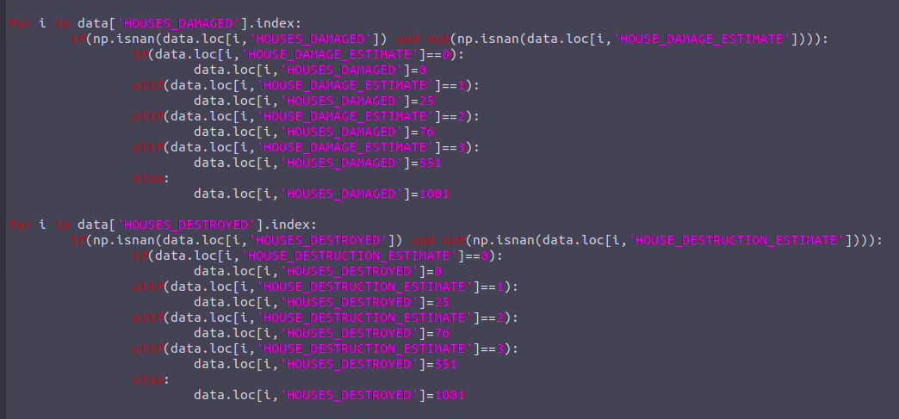
CLEANING
The FATALITY_ESTIAMTE is a catogorical data which is used to estimate FATALITY as follows:
0 = None
1 = Few (~1 to 50 deaths)
2 = Some (~51 to 100 deaths)
3 = Many (~101 to 1000 deaths)
4 = Very Many (~1001 or more
deaths)
THE DAMAGE_ESTIMATE was similarly
used to estimate
DAMAGE_MILLIONS_DOLLARS
0 = NONE
1 = LIMITED (roughly corresponding to
less than $1 million)
2 = MODERATE (~$1 to $5 million)
3 = SEVERE (~>$5 to $24 million)
4 = EXTREME (~$25 million or more)

Slide 6
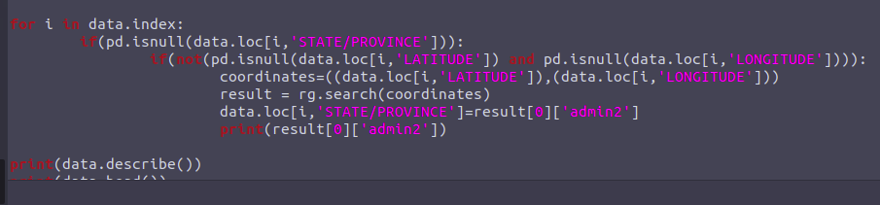
CLEANING
HOUSES_DESTROYED was also estimated via same procedure(using HOUSE_DESTRUCTION_ESTIMATE.
0 = None
1 = Few (~1 to 50 houses)
2 = Some (~51 to 100 houses)
3 = Many (~101 to 1000 houses)
4 = Very Many (~1001 or more houses)
The following columns were found to be either irrelevant or having to many missiing values and were dropped.
An python module called reverse_geocoder provides with the functionality to estimate STATE/PROVINCE based on latitude and longitude.

Slide 7
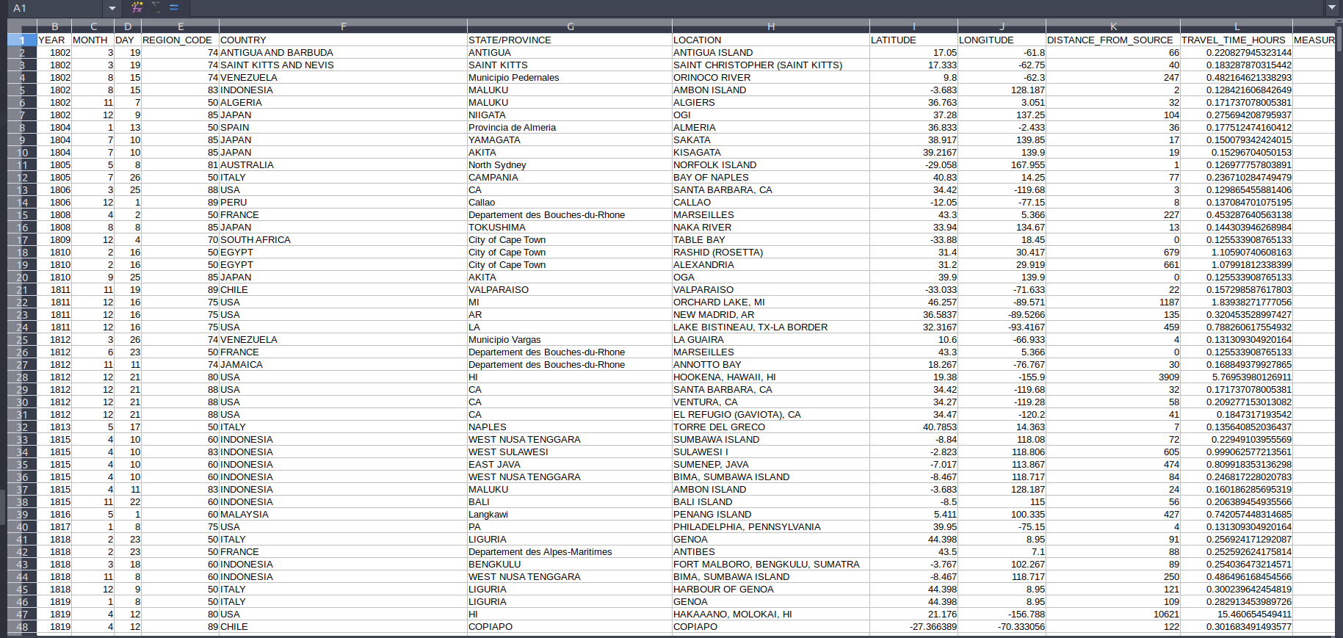
CLEANING:
A dictionary was created which had the the country with the STATE/PROVINCE with highest frequency.This was used to replace the missing values corresponding to a particular COUNTRY.
Finally the rest of numeriacal values were dealt by replacing with mean and categorical values were replace by ‘ffill’ method.

Slide 8
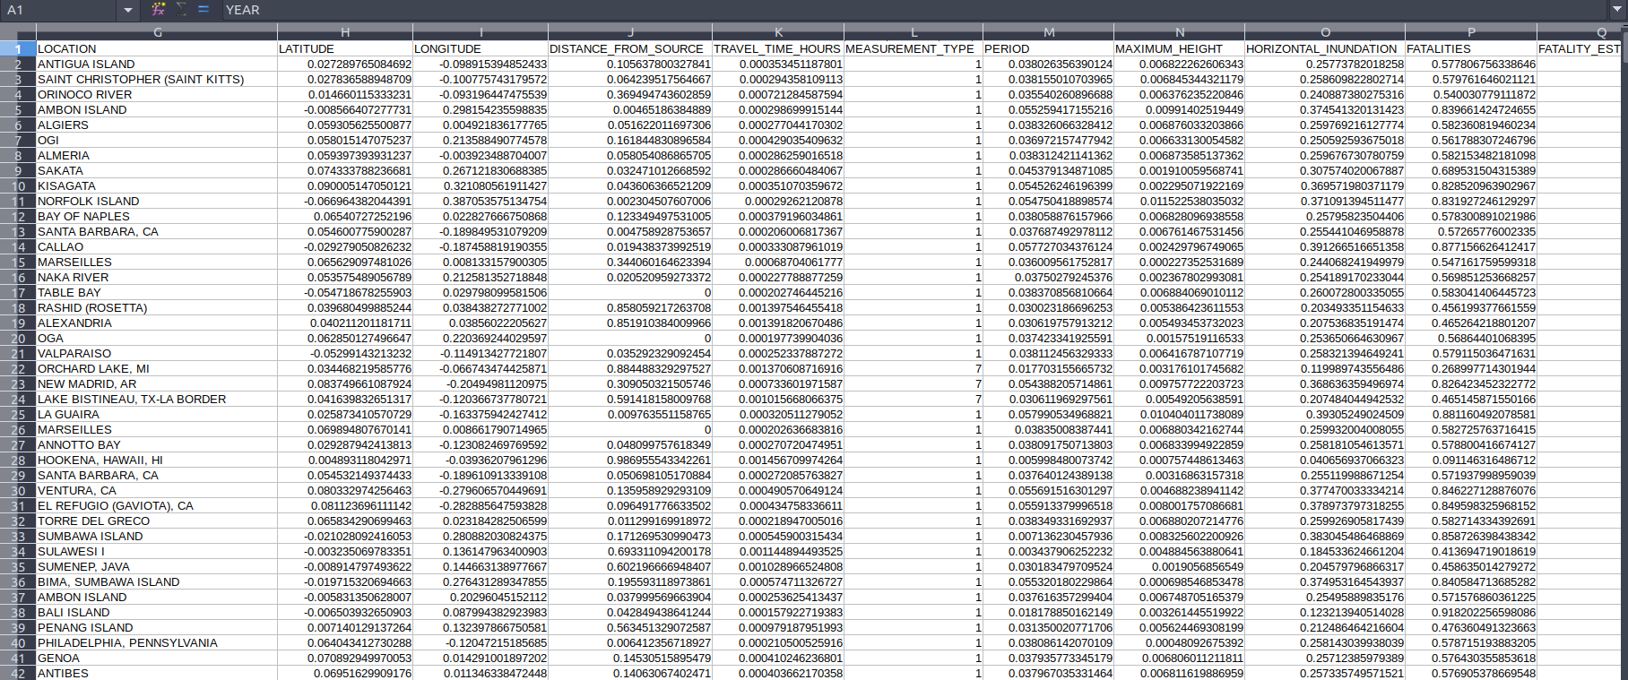
NORMALIZATION:
All numerical data were normalized using the preprocessing.normalize() function.

Slide 9
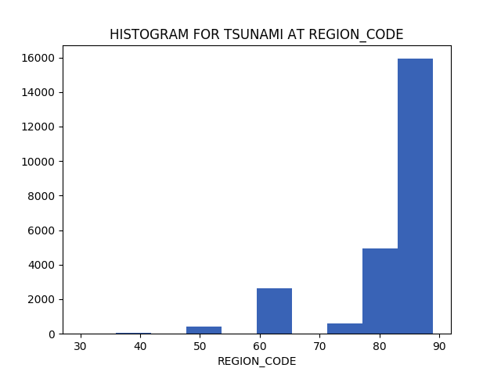
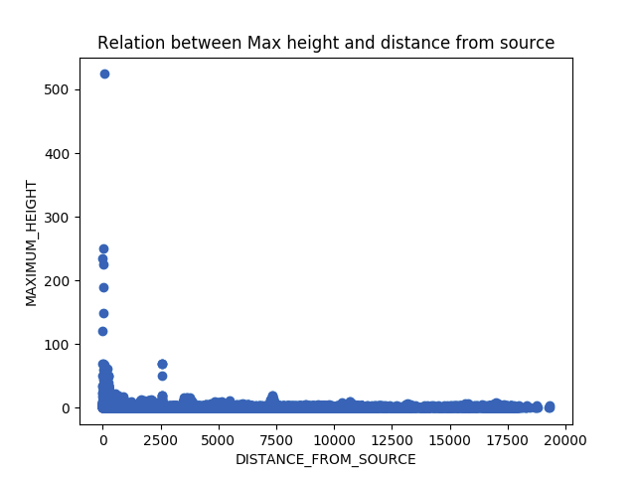
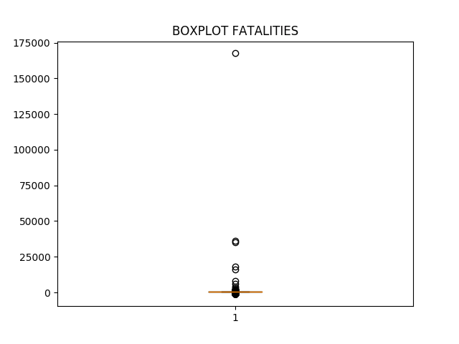
VISUALIZATIONS:

Slide 10
INSIGHTS FROM THE GRAPHS
The histogram shows that the maximum number tsunamis occur at region code 80-90.
The scatter plot has a slightly decreasing tendency which shows that as the height increases the distance decreases.

Slide 11
HYPOTHESIS TESTING
1)
NULL HYPOTESIS:mean latitude=23.141
p-value=0.201297892931
null hypothesis is plausible.
2)
NULL HYPOTESIS:mean longitude=52
p-value=0.290841542469
null hypothesis is plausible.

Slide 12
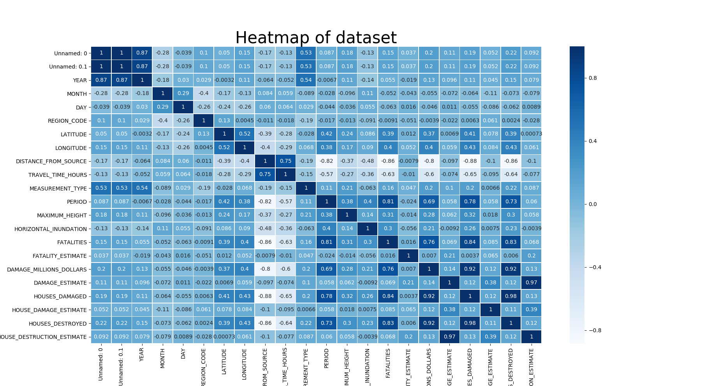
CORRELATATION

Slide 13
CORRELATION
DISTANCE_FROM_SOURCE AND TRAVEL_TIME_HOURS are higly correlated with an corr. value of 0.75.This is obvious because the larger the distance from source the more the time it takes.
Their is a high correlation of PERIOD with fatalities,houses_damaged and houses destroyed.It can be inferred that a larger lasting tsunami is going to have a larger impact on the number of fatalities and economic losses.
FATALITIES and HOUSES_DESTROYED also shares an high corr. 0.83 this implies that the more the number of houses are destroyed the more are the cases of fatalities.
HOUSES_ DESTROYED and DAMAGE_MILLIONS of dollars has a high corr. Of 0.92 which is self explanatory because the houses_destroyed will lead to more economic loss.
MONTH and DISTANCE_FROM SOURCE share a low corr. value because an tsunami is a random event based solely on tectonic activities and the month on which a tsuanmi ocuurs has nothing to do with the distance_from_source.

Slide 14
THANK YOU

