Slide 1

Psychological Analysis for Depression Using Social Media Tweets
SRM INSTITUTE OF SCIENCE AND TECHNOLOGY
SCHOOL OF COMPUTING
DEPARTMENT OF COMPUTING TECHNOLOGIES
18CSP107L – MAJOR PROJECT
Guide name: Mrs. P .Renukadevi
Designation: Assistant Professor Department: Computing Technologies
Batch ID: B497
Student 1 Reg. No: RA2011003010810
Student 1 Name: Kartik Singh
Student 2 Reg. No: RA2011003010772
Student 2 Name: Utkarsh Gupta
11-1-2024

Slide 2
Abstract
Our project is dedicated to developing a proficient and precise method for analyzing psychological indicators of depression through social media, particularly Twitter, utilizing Deep Learning Algorithm techniques.
Depression is a prevalent mental health concern, and early detection is essential for timely intervention and support.
The project encompasses various stages, starting with the preprocessing of social media data to enhance its quality, followed by the extraction of pertinent features related to psychological well-being. These features will then be employed to train and evaluate various ML models.
Our proposed approach harnesses the capabilities of Deep Learning to discern intricate patterns and connections within social media content, facilitating accurate classification of psychological states related to depression.

Slide 3
Introduction
Identifying depression through psychological analysis involves deploying cutting-edge technologies, including Deep Learning Algorithm and Artificial Intelligence (AI).
Notable ML algorithms like Long Short Term Memory (LSTM) and Convolutional Neural Network (CNN) have been explored in our research.
Our findings indicate that the LSTM+CNN model exhibits commendable accuracy in addressing the challenge of depression identification.
The younger generation, active on social media, utilizes these platforms to express thoughts and opinions on diverse topics and situations.

Slide 4
Literature Survey
S. No | Title | Author and Publication | Journal Name | Problem/ Motivation | Methodology
1 | Sentiment Analysis in Social Media Data for Depression detection Using Artificial Intelligence: A Review | Nirmal Varghese Babu, E. Grace Mary Kanaga. | SN Computer Science in 2022 | All the input data consists of small non relevant words which when included increases the wait time of prediction module | Feature Extraction techniques in this paper involves: N-Gram Tokenization Negation Handling Bag of Words Which when combined reduces the processing group from initial raw data
2 | Psychological Analysis for Depression Detection from Social Networking Sites | Sonam Gupta, Lipika Goel, Arjun singh, Ajay Prasad, Mohammad Aman Ullah | Hindawi, Computational Intelligence and Neuroscience in 2022 | Social media platforms consists of rich amount of data to showcase and perform psychological classification tasks. | Methodology implemented are based on the dataset used. We classify basic human emotions into common 6 categories.

Slide 5
Literature Survey
S. No | Title | Author and Publication | Journal Name | Problem/ Motivation | Methodology
3 | Deep neural networks for depression recognition based on 2D and 3D facial expressions under Emotional Stimulus Tasks | Weitong Guo, Hongwu Yang, Zhenyu Lie, Yaping Xu and Bin Hu | Frontiers in Neuroscience Original Research in 2021 | DBN is a generative model that uses multiple layers of feature-detecting neurons. It can learn hierarchical representation from input raw data | This paper uses 10-fold cross-validation to evaluate experiments for excluding the differences caused by individuality and over-fitting.
4 | Multisource social media data sentiment analysis using bidirectional recurrent convolutional neural networks. | Abid F, Li C, Alam M | Comput Commun in 2020 | Lexicon based techniques which determine sentiment polarity of tweet or sentence by checking them from pre-established dictionary | Lexicon-based strategies are very efficient and simple methods. They make use of a sentiment lexicon to assign a polarity value to each text document by following a basic algrithm.

Slide 6
Literature Survey
S. No | Title | Author and Publication | Journal Name | Problem/ Motivation | Methodology
5 | Multisource social media data sentiment analysis using bidirectional recurrent convolutional neural networks. | Abid F, Li C, Alam M | Comput Commun in 2020 | The introduced neural network model that is a combination of CNNs and RNNs alluded as a general encoding architecture that utilizes both neural network layers | The method uses CNN for feature extraction and then kernel based extreme learning machines (KELM) for recognition.
6 | Anxious depression prediction in real-time social data | Kumar A, Sharma A, Arora A | International Conference on advanced engineering, science, management and technology in 2019 | The frequency and timing of tweet is primarily associated with odd hour posting. | Accuracy and F-score measures are used to evaluate the performance of the ensemble vote classifier. The accuracy of the ensemble vote predictive model is compared to the three individual classifiers.

Slide 7
Existing Methods & Techniques
Feature Extraction Techniques –
1. TF-IDF (Term Frequency Inverse Document Frequency): Calculating the importance of words in a document by considering both their frequency in the document and their inverse frequency across a set of documents.
2. Term Document Matrix (TDM): Describing the total number of words in a document collection, where columns represent terms and rows represent documents.
3. Bag-of-Words (BOW): Representing text by depicting the presence of words within a document, involving a vocabulary of known words and their total presence.
4. Negation Handling (Negmas) : Determining the scope of negation and inverting polarities of opinionated words influenced by a negation.
5. LIWC (Linguistic Inquiry and Word Count): Measuring the total number of various word categories used in a text and processing textual content.

Slide 8
Existing Methods & Techniques
Machine Learning Techniques –
1.Support Vector Machines (SVM): SVMs are powerful classifiers that aim to find the best hyperplane that separates different classes in a high-dimensional feature space. They have been applied to MRI-based brain tumor classification by using extracted features.
2.Long-Term Short Memory (LSTM): LSTMs, a type of recurrent neural network, excel in capturing long-term dependencies in sequential data, making them effective for tasks like sentiment analysis and depression identification in social media text.
3.Artificial Neural Networks (ANN): ANNs are computational models inspired by the human brain's structure. They can learn complex relationships in data and are used for feature extraction and classification in brain tumor detection.
4.Convolutional Neural Networks (CNN): CNNs are deep learning architectures designed to handle images effectively. They can automatically learn hierarchical features from raw images, making them popular for medical image analysis, including brain tumor detection.

Slide 9
Challenges and Limitations
Integration of Emoticons and Emojis: Incorporating emoticons and emojis in sentiment analysis poses a challenge due to their diverse interpretations, requiring sophisticated natural language processing (NLP) techniques for accurate classification.
Binary and Ternary vs. Multi-class Classification: The transition from Binary and Ternary Classification to Multi-class Classification introduces complexities in sub-class division based on polarities, demanding meticulous handling of diverse sentiment expressions within the social media data.
Machine and Deep Learning Techniques: While machine learning and deep learning techniques are employed for sentiment classification, the challenge lies in optimizing their application to social media data, where the dynamic nature of language and expressions requires adaptive models.
Sentiment Monitoring Precision: Monitoring sentiment levels on social media involves challenges in accurately identifying and analyzing the nuances of apprehensiveness or dejection, demanding more nuanced feature extraction methods and sentiment analysis models.
11-1-2024

Slide 10
Problem Statement
Psychological Analysis for Depression Based on Social Media Comments
Problem: Deploying ML and AI technologies, including LSTM and CNN algorithms, our research aims to address the challenge of depression identification, particularly within the expressive context of the younger generation on social media platforms.

Slide 11
Objectives/Innovations:
Develop a Depression Identification System: Create an advanced system for identifying depression through psychological analysis, employing state-of-the-art technologies such as Deep Learning Algorithm and Artificial Intelligence (AI).
Utilize LSTM and CNN Algorithms: Investigate prominent ML algorithms, specifically Long-Term Short Memory (LSTM) and Convolutional Neural Network (CNN), to enhance the accuracy and effectiveness of depression identification.
Capture Youthful Perspectives on Social Media: Focus on the younger generation's expressive use of social media platforms, recognizing them as valuable channels for articulating diverse thoughts and opinions on a wide range of topics and situations.
Integration of Emoticons and Emojis: Incorporating emoticons and emojis into sentiment analysis represents a challenge, given their varied interpretations.

Slide 12
Scope/Application :
Early Intervention on Social Media: Automatic detection of depressive sentiments enables timely support and intervention for users expressing distress on social media.
Public Health Surveillance: Monitoring and analyzing mental health trends on a large scale, providing valuable insights for public health policies and interventions.
Corporate Well-being Monitoring: Utilizing the model to observe employee mental health expressions, allowing companies to implement targeted well-being programs.
Academic Research Insights: Enabling researchers to analyze social media content for studies on the relationship between online expressions and mental health.
Customized Mental Health Outreach: Implementing targeted outreach initiatives on social media platforms based on the model's identification of users at risk of depression.
11-1-2024

Slide 13
Scope/Application :
Community Mental Health Programs: Supporting mental health organizations in identifying and reaching out to individuals at risk in the online community.
Therapeutic Interventions: Providing valuable data for enhancing therapeutic interventions by understanding patterns and trends related to mental health expressions.
11-1-2024

Slide 14
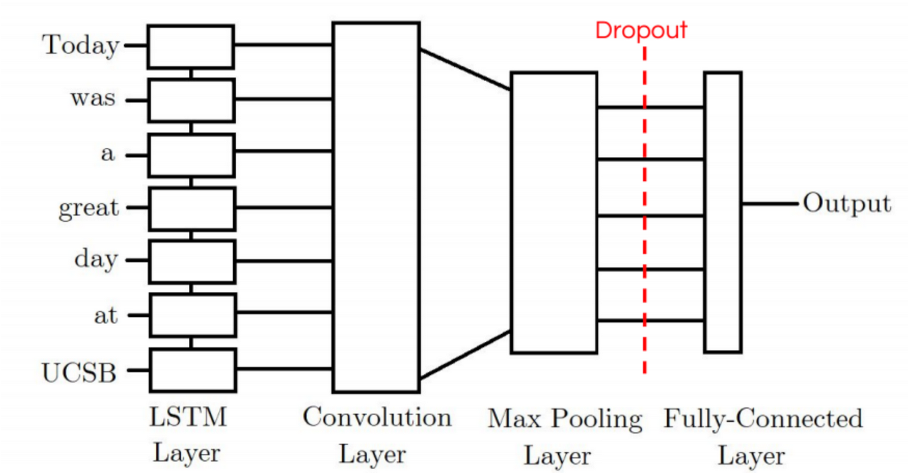
Architecture Diagram
LSTM + CNN model:

Slide 15
Module Description: CNN
Objective: The CNN module is designed for image processing and classification tasks, leveraging Convolutional Neural Networks to extract meaningful features and make predictions.
Architecture Overview: The module follows a CNN architecture, consisting of convolutional layers, pooling layers, and fully connected layers, enabling the network to learn hierarchical representations of input images.
Feature Extraction: CNNs excel in automatic feature extraction, allowing the network to identify patterns, textures, and shapes within images, contributing to robust image understanding.
Adaptability: CNNs can adapt to various image-related tasks, including object recognition, scene understanding, and facial recognition, making them versatile in diverse applications.
Real-world Applicability: The trained CNN can be applied to real-world scenarios such as medical image analysis, autonomous vehicle navigation, and image-based content categorization, showcasing its effectiveness in a wide range of applications.
11-1-2024

Slide 16
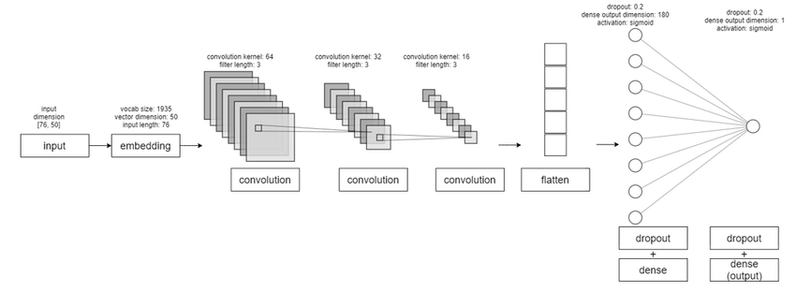
Module Description: CNN
11-1-2024

Slide 17
Module Description: LSTM
Objective: The LSTM module is designed for processing sequential data and making predictions, utilizing Long-Term Short Memory networks to capture dependencies and patterns in temporal sequences.
Architecture Overview: The module follows an LSTM architecture, comprising memory cells, input gates, forget gates, and output gates, facilitating the learning of long-range dependencies in sequential data.
Sequential Feature Learning: LSTMs excel in learning dependencies over extended sequences, allowing the network to capture contextual information and relationships within sequential data.
Temporal Context Understanding: The memory cells in LSTMs enable the model to retain and utilize information from earlier time steps, enhancing its ability to understand and leverage temporal context.
Real-world Applicability: The trained LSTM module finds application in real-world scenarios such as sentiment analysis in text, weather forecasting, and speech-to-text conversion, demonstrating its efficacy in various sequential data processing tasks.
11-1-2024

Slide 18
THANK YOU !!

