Slide 1

Data Structure and Algorithms 4th Semester B.Tech, Department of Information Technology Indian Institute Of Information Technology, Allahabad Paper Title : TERNARY SEARCH
Swaraj Bhosle IIT2019024
Ritesh Raj IIT2019025
Utkarsh Garg IIT2019026

Slide 2
Content
PROBLEM STATEMENT
INTRODUCTION
ALGORITHM DESIGN AND ANALYSIS
ALGORITHM
CONCLUSION
REFRENCES

Slide 3
Problem Statement
Design an algorithm to implement ternary search.

Slide 4
Introduction
A ternary search algorithm is a technique in computer science for finding the minimum or maximum of a unimodal function. A ternary search determines either that the minimum or maximum cannot be in the first third of the domain or that it cannot be in the last third of the domain, then repeats on the remaining two thirds. A ternary search is an example of a divide and conquer algorithm

Slide 5
Algorithm Design and Analysis
The designed algorithm can be given by these steps:-
1. Take the input n from the user
2. Input the array from the user.
3. Input the element x which is needed to be checked.
4. Apply Merge sort algorithm to sort the array.
5. Take two variables l and r in which we store left index and right index.
6. Call the recursive ternarySearch function.
7. In each call we calculate the middle two indexes by which we break down the array into 3 equal parts.
8. If x is equal to any of mid1 or mid2 the we return true.
9. For each of the three sections check if x lies in that range, if it does then again we call the recursive function, and reduce the searching region.
10. if we reach the length of 1 and x is not found we return false.
11. Finally if the recursive function returns true we print element found in the array else print element not found.

Slide 6
Algorithm
return ternarySearch(l, mid1 − 1, x, ar);
else if x < ar[mid1] then
return ternarySearch(l, mid1 − 1, x, ar);
else if x < ar[mid2] then
return ternarySearch(mid1 + 1, mid2 − 1, x, ar);
else
return ternarySearch(mid2 + 1, r, x, ar);
Function ternarySort(int arr,int l,int r,int x):
mid1 ← l + (r − l)/3;
mid2 ← l + (r − l)/3;
if l > r then 4
return false
if (arr[mid1] == x or arr[mid2] == x) then
return true ;
else if x < ar[mid1] then

Slide 7
Time complexity analysis
Let the average size of all strings be N. Then we merge sort the string in ascending and descending order and compare the obtained strings with the original string, and if the string matches with any of the sorted strings then we increment the answer. The time complexity will be O(n log n)) due to the merge sort algorithm in a best, average and worst case. The time complexity will be affected due to the merge sort in sorting the 1D array and the total time complexity will become O(n log n). Here we study the complexity for ternary Sort,as the average cost of a successful search is about the same as the worst case where an item is not found in the array, both being roughly equal to O(log₃ N). So, the average and the worst case cost of binary search, in big-O notation, is O(log₃ N), the best case is when in the first attempt x is found, so best case time complexity is O(1).

Slide 8
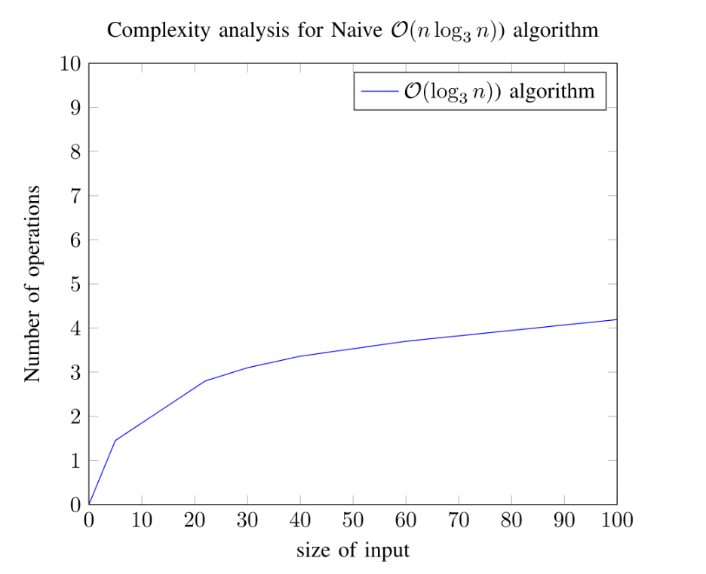
Time complexity graph
Size of array vs number of operations
BEST | AVERAGE | WORST CASE
O(1) | N*log₃(N) | N*log₃(N)

Slide 9
Space complexity analysis
Merge sort algorithm uses another O(N) space.
Recursive stack can take an extra O(Log₃(N)) space in worst case.
So the space complexity is O(N) + O(Log₃(N)) + O(N) => O(N).

Slide 10
Conclusion
From the results it can be concluded that Ternary Search Algorithm is working well for all length of input values. It takes lesser CPU time than existing searching algorithm linear search and binary search. In the future more effective searching algorithm can be proposed.

Slide 11
References
https://doc.lagout.org/Alfred%20V.%20Aho%20-%20Data%20Structures%20and%20Algorithms.pdf
https://www.tutorialspoint.com/cplusplus/cpp_file s_streams.html
https://web.ist.utl.pt/~fabio.ferreira/material/asa/clrs.pdf
https://www.geeksforgeeks.org/ternary-search/

