Slide 1

Data Structure and Algorithms 4th Semester B.Tech, Department of Information Technology Indian Institute Of Information Technology, Allahabad Paper Title : FINDING WORDS IN ASCENDING OR DESCENDING ORDER
Swaraj Bhosle IIT2019024
Ritesh Raj IIT2019025
Utkarsh Garg IIT2019026

Slide 2
Content
PROBLEM STATEMENT
INTRODUCTION
ALGORITHM DESIGN AND ANALYSIS
ALGORITHM
CONCLUSION
REFRENCES

Slide 3
Problem Statement
How many valid English words have ascending or descending characters? Create a text document of your own consisting of at least 1000 words for input.

Slide 4
Introduction
In computer science, the process of searching a string in a given set of strings is known as String Searching.
We have created a text file containing at least 1000 valid english words. Basically ascending characters in a string means all the characters should be in a alphabetical order i.e. from A to Z and the descending order means all the characters should be in a reverse alphabetical order i.e from Z to A.
For creating a new algorithm from scratch, we look into the many crucial aspects of algorithm designing and analysis.
The algorithm created is tested for different sample test cases for time complexity, space complexity and accuracy.

Slide 5
Algorithm Design and Analysis
The designed algorithm can be given by these steps:-
Open the “input.txt” file and read the input for program.
Check whether the file is open or not. If not, a failure can be detected with the code like ! (logical not) operator.
Create the character array of MAX_SIZE 1000.
Traverse through each input string from .txt file.
Create two different character arrays and store the input string in these two character arrays differently.
Sort one of the above taken arrays in alphabetical order (A to Z) and sort the other array in reverse alphabetical order (Z to A) using Merge sort.
Compare the original string with these two created ascending and descending strings. If the original string matches one of the two strings then count it.
Print the count number.
Close the opened file

Slide 6
Algorithm
Function Main(){
//Declare an input file steam
ifstream inFile;
//open the file stream
inFile.open("input.txt");
//Check that the file was opened
if (file can’t open)
Exit the code
//create the char array of MAX_SIZE
char str[MAX_SIZE]
//assign count equal to zero
count =0 while(inFile >> str) {
//Store the length of string in l
n = strlen(str)
//create two char array of MAX_SIZE
char asc[MAX_SIZE]
char dsc[MAX_SIZE]
//store str string in both asc and dsc array
For( i=0 to i=n){
asc[i] = str[i];
dsc[i] = str[i]
}
//Sort the asc char array in ascending order
merge_sort(asc, asc + l)
//Sort the dsc array in descending order
merge_sort(dsc, dsc + l, greater<char>());
//compare the str string with dsc and asc array.
if(strcmp(str, asc) == 0 || strcmp(str, dsc) == 0) count++;
//if it matches any one of them then count it.
} //print the count
cout<<count
//close the file
inFile.close();
}

Slide 7
Time complexity analysis
Let the average size of all strings be N.
Then we merge sort the string in ascending and descending order and compare the obtained strings with the original string, and if the string matches with any of the sorted strings then we increment the answer.
The time complexity will be O(N*log N) due to the merge sort algorithm in a best, average and worst case.
The time complexity will be affected due to the merge sort in sorting the 1D array and the total time complexity will become O(N*log(N)) in all the cases ie. best case, worst case and average.
Best case :
O(N) + O(N*log(N)) + O(N) => O(N*log(N))
Average case : O(N) + O(N*log(N)) + O(N) => O(N*log(N))
Worst case : O(N) + O(N*log(N)) + O(N) => O(N*log(N))

Slide 8
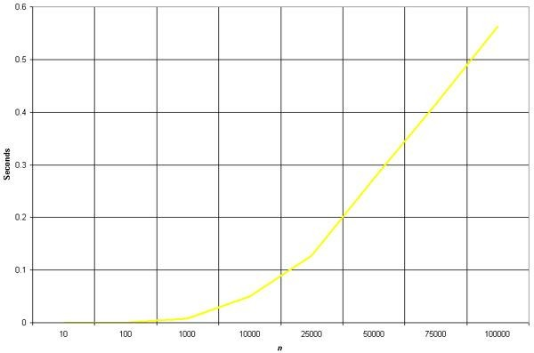
Time complexity graph
No. of words | Execution Time(ms)
1000 | 0.31939
10000 | 0.52023
100000 | 0.87831
1000000 | 1.49021
BEST | AVERAGE | WORST CASE
N*log(N) | N*log(N) | N*log(N)
Number of words vs Time taken to execute

Slide 9
Space complexity analysis
we use O(N) + O(N) space for making another arrays.
Merge sort algorithm uses another O(N) space.
So the space complexity is O(N) + O(N) + O(N) = O(3N) => O(N).

Slide 10
Conclusion
Here we have compared the number of valid English words that are ascending or descending order.
This algorithm works as the string gets passed through the sorting algorithm and sorted in ascending and descending order which helps in comparing with the initial string of the text document and calculating the number of English words that are in ascending or descending characters.
The algorithm we analyzed may not be the best algorithm to find words by using Merge sort algorithm and then count it but this algorithm works better for cases where there are small meaningful words (less than 5 ) inside the text document .

Slide 11
References
http://www.fredosaurus.com/notes-cpp/io/readtex tfile.html
https://www.tutorialspoint.com/cplusplus/cpp_file s_streams.html
https://www.geeksforgeeks.org/program-sort-strin g-descending-order

