Slide 1
Design and Analysis of Algorithms
Group 8:
Swaraj Bhosle : IIT2019024
Ritesh Raj : IIT2019025
Utkarsh Garg : IIT2019026

Slide 2
Create a matrix such that every row, column and diagonals are sorted.
Problem Statement

Slide 3
Problem Explanation
We take a matrix with random entries using rand() function then we have to sort the matrix such that matrix is sorted row wise , column wise and diagonally.

Slide 4
Algorithms used
We’ve used merge sort algorithm for sorting the array as merge sort is one of the most efficient sorting algorithms. It works on the principle of Divide and Conquer. Merge sort repeatedly breaks down a list into several sublists until each sublist consists of a single element and merging those sublists in a manner that results into a sorted list in logarithmic time.
Merge Sort is a Divide and Conquer algorithm. It divides the input array into two halves, calls itself for the two halves, and then merges the two sorted halves. The merge() function is used for merging two halves. The merge(arr, l, m, r) is a key process that assumes that arr[l..m] and arr[m+1..r] are sorted and merges the two sorted subarrays into one. See the following C implementation for details.

Slide 5
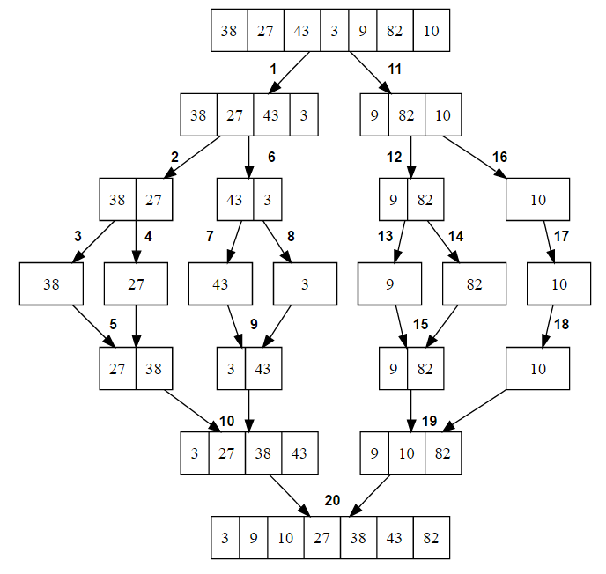
Merge sort
The merge sort splits the list to be sorted into two equal halves, and places them in separate arrays. Each array is recursively sorted, and then merged back together to form the final sorted list. Like most recursive sorts, the merge sort has an algorithmic complexity of O(n log n).
Time complexity of merge sort can be expressed as following recurrence relation.
T(n) = 2T(n/2) + θ(n)
The above recurrence is solved using Recurrence Tree method.
Time complexity of Merge Sort is θ(nLogn) in all 3 cases (worst, average and best) as merge sort always divides the array into two halves and takes linear time to merge two halves.

Slide 6
Diagram explanation
23 | 27 | 11 | 13
7 | 8 | 10 | 9
11 | 1 | 4 | 2
6 | 5 | 3 | 12
23 | 27 | 11 | 13 | 7 | 8 | 10 | 9 | 11 | 1 | 4 | 2 | 6 | 5 | 3 | 12

Slide 7
Continued
23 | 27 | 11 | 13 | 7 | 8 | 10 | 9 | 11 | 1 | 4 | 2 | 6 | 5 | 3 | 12
1 | 2 | 3 | 4 | 5 | 6 | 7 | 8 | 9 | 10 | 11 | 11 | 13 | 12 | 23 | 27
1 | 2 | 3 | 4
5 | 6 | 7 | 8
9 | 10 | 11 | 11
12 | 13 | 23 | 27

Slide 8
Algorithm Description
The algorithm requires to solve this problem is merge sort.This algorithm takes 2D matrix of size ‘m’ and ‘n’ as input, we assume initial dimensions as 100*100.
The method consist of mainly four stages:-
In stage one, we take the random value of elements using random function., store the elements of the 2D array in 1D array of size 100000.
In this stage merge sort algorithm is applied on 1D array for sorting the array.
In stage three traverse the 1D array and store all the elements of 1D array in to 2D array, the matrix so obtained will be sorted row wise, column wise and diagonally.
Print the resultant 2D matrix.

Slide 9
Space complexity
We make an extra 1D array to store and sort the entries of the matrix so the extra space of n*m is required.
Space Complexity : O(n*m)

Slide 10
Time Complexity Analysis
If the matrix is of dimension n x m,
N=n*m
(N is total number of cells in the matrix)
We only traverse the matrix and make the 1D array using the matrix which will result in complexity of O(N).
The time complexity will be affected due to the merge sort in sorting the 1D array and the total time complexity will become O(N*log(N)) in all the cases ie. best case, worst case and average.
Again when we fill the matrix the time required is O(N).

Slide 11
Overall Time Complexity
Best case : O(N) + O(N*log(N)) + O(N) => O(N*log(N))
Average case : O(N) + O(N*log(N)) + O(N) => O(N*log(N))
Worst case : O(N) + O(N*log(N)) + O(N) => O(N*log(N))

