Slide 1

Data Structure and Algorithms 4th Semester B.Tech, Department of Information Technology Indian Institute Of Information Technology, Allahabad Paper Title : Specific sequences of given length
Swaraj Bhosle IIT2019024
Ritesh Raj IIT2019025
Utkarsh Garg IIT2019026

Slide 2
Content
PROBLEM STATEMENT
INTRODUCTION
ALGORITHM DESIGN AND ANALYSIS
ALGORITHM
CONCLUSION
REFRENCES

Slide 3
Problem Statement
Given two integers m & n, find the number of possible sequences of length n such that each of the next element is greater than or equal to twice of the previous element but less than or equal to m.

Slide 4
Introduction
In this report, we are going to discuss about the particular sequence of given length. We are given two integers m and n. We have to find the number of possible sequences of length n such that each of the next element is greater than or equal to twice of the previous element but less than or equal to m. There should be n elements and value of last element should be at-most m. we are dividing the problem into sub problems and again dividing that sub problem in sub problems basically we are using Divide and Conquer method.

Slide 5
Algorithm Design and Analysis
The designed algorithm can be given by these steps:-
Take 2 numbers M and N as input from user .N is length of sequence and no other element in the sequence is greater than M . if M is present in the sequence then it is present only at the last position.
Call the function: TotalNumberOfSequence(M, N)
In the function, check whether M is greater than N or not. If m is smaller than N then return 0, as n is more than the maximum value M. If N is 0, then the sequence is empty, Return 1.
Now there are 2 possibilities -
a) Reduce last element value i.e. call the function TotalNumberOfSequence(M 1, n)
b) Consider last element as M and reduce number of terms i.e. call the function TotalNumberOfSequence(M/2, N − 1)
Print the total no of sequences

Slide 6
Algorithm 1 Algorithm 2
(Recursive method)
(Dynamic programming)
Function TotalSequences(int M, int N):
int DP[M+1][N+1];
for i ← 0 to M do
for j ← 0 to N do
if (i==0 || j==0)
then DP[i][j] = 0;
else if i < j
then DP[i][j] = 0;
else if j == 1
then DP[i][j] = i;
else
DP[i][j] = DP[i-1][j] + DP[i/2][j-1];
return DP[M][N];
Function Main():
Get M; Get N;
Print (TotalSequences(M, N))
Function TotalSequences(int m, int n):
if M < N then
→ return 0
if N == 0 then
return 1
return TotalSequences (M − 1, N) + TotalSequences (M/2, N − 1)
Function Main():
Get M;
Get N;
Print (TotalSequences(M, N))

Slide 7
Time complexity analysis
The total number of sequences is the sum of the number of sequences including m and the number of sequences where m is not included. Thus the original problem of finding number of sequences of length N with max value M can be subdivided into independent sub-problems of finding number of sequences of length n with max value M − 1 and number of sequences of length N − 1 with max value M/2.

Slide 8
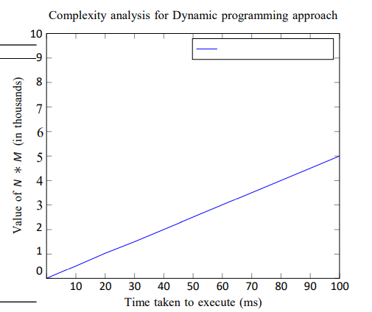
Time complexity graph
BEST | AVERAGE | WORST CASE
O(M*N) | O(M*N) | O(M*N)

Slide 9
Space complexity analysis
Since we make an array of size M*N the space complexity is M*N.
In the Recursive method , The space complexity is max(M,N), as at any time at max the recursive stack cannot have more than max(M,N) calls.

Slide 10
Conclusion
The above problem can be solved by using Dynamic Programming also. but the most efficient way is the divide and conquer. We can conclude from our model that the running time of our algorithm is O(M*N). We have tested our Algorithm Theoretically and experimentally and both yielded similar results. the above problem can be solved by using Dynamic Programming also. but the most efficient way is the divide and conquer.

Slide 11
References
https://www.geeksforgeeks.org/ sequences-given-length-every-element-equal-twice-previous/
https://tutorialspoint.dev/algorithm/ dynamic-programming-algorithms/ sequences-given-length-every-element-equal-twice-previous

