Slide 1
Are Sustainable Development Goals delivering convergence?​
HSC-202​
Elementary Development Economics​
Shreya Bakshi (21322026)
Utkarsh Kumar (23114101)

Slide 2
Motivation & Core Question
The 2030 Agenda (2015) introduced 17 SDGs as a universal framework for development
Goal: improve outcomes across all countries, not just growth but multi-dimensional welfare
Stylized Fact: Large global disparities persist
  ~80 (Nordic countries)
  <50 (fragile states)
Indicates a large and persistent cross-country gap
According to SDSN (2025), no SDG is fully on track globally; however, UN estimates suggest ~35% of targets show moderate or on-track progress.​
Key Observation
Global averages have improved but distribution remains highly unequal
Rises a fundamental question about SDG effectiveness
Research Question : Are countries converging in SDG outcomes?
Are low-performing countries catching up?
Is global inequality in development narrowing?
Have SDGs reduced global development gaps, or only improved average outcomes?

Slide 3
Why Convergence Matter
Convergence = countries becoming more similar or reduction in global inequality
Divergence = gaps persist or widen or unequal development trajectories
Economic significance
Convergence implies:
  inclusive global development
  successful policy coordination
Lack of convergence implies:
  structural barriers
  persistent poverty traps
Policy relevance
If convergence exists: global framework is working
If not: need targeted interventions
Convergence is the benchmark for judging whether SDGs are reducing global inequality or merely improving averages.

Slide 4
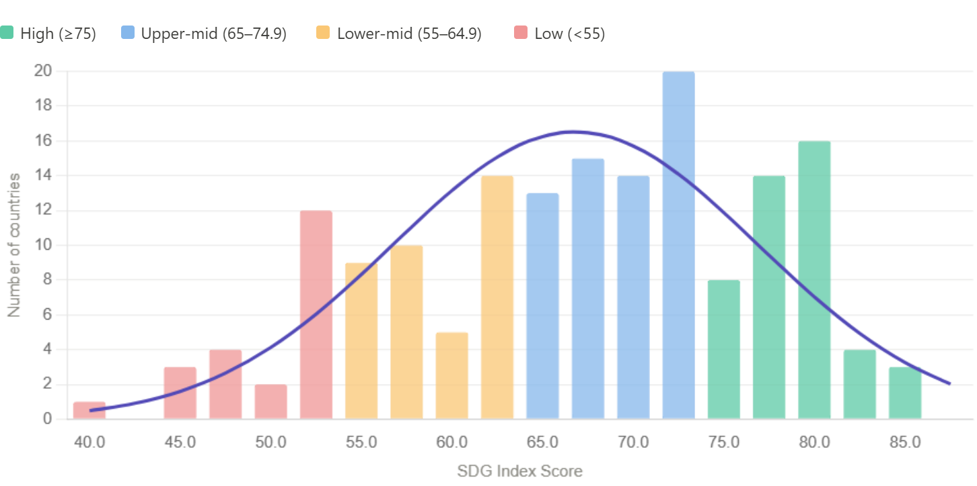
SDG Performance ​
~68​ Global mean SDG score (2025)​ | 80+​ Finland / Sweden / Denmark​ | <45​ Yemen / Somalia / Chad​
SDSN index is a composite % of goal achievement (0–100). Higher = closer to all SDG targets. Used as primary outcome variable.​
The distribution is roughly bell-shaped but with a noticeable left skew i.e. a long tail stretching toward the lower scores (sub-55), meaning a smaller group of countries are significantly behind the global norm.
Even top-ranked countries struggle on SDG2 (Hunger) and SDG13 (Climate Action). No country has fully achieved all 17 goals.​

Slide 5
Convergence Concepts
σ-convergence (dispersion falls): Countries are becoming more similar over time. The gap between countries’ SDG scores is shrinking. Standard deviation of SDG scores falls over time. | Conditional vs Unconditional convergence: Unconditional convergence - Assumes all countries will end up at same level. Ignores differences like income, institutions Conditional convergence - Countries converge to their own steady state, depending on factors like income, governance, geography
β-convergence (catch-up idea): Countries that start worse improve faster. Meaning: Poor performers grow faster than rich performers. Condition: β < 0 ⇒ catch-up. | Club convergence: Countries form groups that converge internally, not globally. For eg, Rich countries converge with rich countries Each group converges inside, but gap between groups stays.

Slide 6
Theoretical Framework
Each country’s SDG progress depends on its fundamentals:
Key mechanisms:
diminishing returns → convergence
  Countries with low initial SDG levels gain more from new investment
  Same policy or investment has higher marginal impact in poorer countries
  Example: Expanding electricity in Rural India can lead to +20% access from one policy push whereas Germany already has ~100%, almost no gain
  Poorer country improves faster → catch-up (β-convergence)
structural constraints → divergence
  Weak institutions, conflict, geography limit progress
  These create poverty traps or slow transitions
  Example: Finland (strong governance): SDG score ~80+ whereas
  Somalia/Yemen (conflict): SDG score <30
  Despite global efforts, gap persists due to structural barriers
Convergence is affected by initial conditions + targeted policy intervention + structural factors

Slide 7
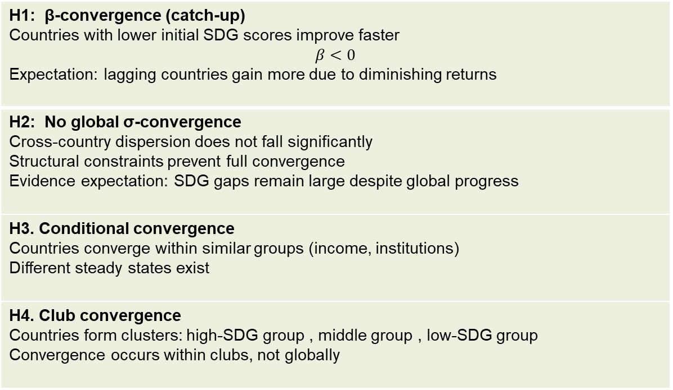
Hypotheses
H1: β-convergence (catch-up) Countries with lower initial SDG scores improve faster $$β<0$$ Expectation: lagging countries gain more due to diminishing returns
H2: No global σ-convergence Cross-country dispersion does not fall significantly Structural constraints prevent full convergence Evidence expectation: SDG gaps remain large despite global progress
H3. Conditional convergence Countries converge within similar groups (income, institutions) Different steady states exist
H4. Club convergence Countries form clusters: high-SDG group , middle group , low-SDG group Convergence occurs within clubs, not globally

Slide 8
Data and Measurement
Sample
190 countries
2000–2022 panel
Global panel dataset (country × year)
Sources
UN SDG database - Covers all 17 SDGs and ~210 official indicators across countries
World Bank WDI - GDP per capita, population, energy use, etc.
Measurement Strategy
Each SDG represented by 1 key outcome indicator
(to ensure comparability and reduce missing data)
Examples:
SDG 2 (Hunger) → Undernourishment rate
SDG 3 (Health) → Skilled birth attendance
SDG 7 (Energy) → Access to electricity
SDG 8 (Growth) → GDP per capita growth
Bigerna, S., & Micheli, S. (2025). Is there worldwide convergence toward the SDGs?

Slide 9

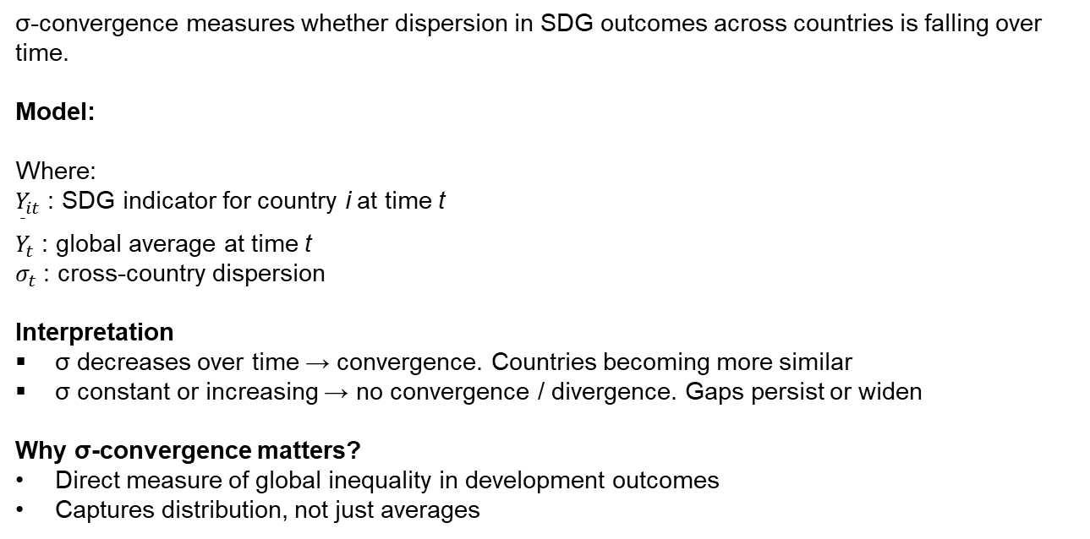
σ-Convergence Model
σ-convergence measures whether dispersion in SDG outcomes across countries is falling over time.
Model:
Where:
$Y_{it}$: SDG indicator for country i at time t
${\overset{ˉ}{Y}}_{t}$: global average at time t
$σ_{t}$: cross-country dispersion
Interpretation
σ decreases over time → convergence. Countries becoming more similar
σ constant or increasing → no convergence / divergence. Gaps persist or widen
Why σ-convergence matters?
Direct measure of global inequality in development outcomes
Captures distribution, not just averages

Slide 10
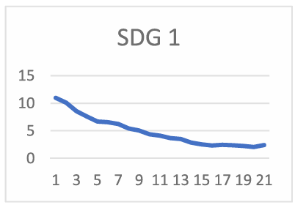
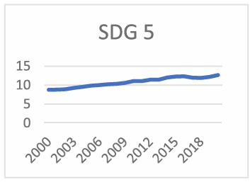
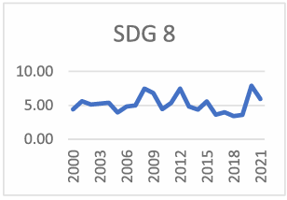
σ-Convergence Results
Source: Bigerna, S.,& Micheli, S. (2025)
Main Finding
  Global dispersion increased from ~14 to ~16, indicating no σ-convergence
  Cross-country dispersion remains high
  Global SDG inequality persists
Goal-Level Results:
  Convergence observed in many SDGs like SDG 1 (no poverty), but not all
  Divergence in key goals like: SDG 2 (hunger), SDG 5 (gender), SDG 8
Some development areas show catch-up
Others show persistent or widening gaps
Key limitation
Even if all countries improve, σ may not fall
So, combine with β-convergence for full picture

Slide 11
σ-Convergence Results
SDG | Area | σ-Convergence Result | Interpretation
SDG 1 | Poverty | Yes (strong) | Global poverty gaps narrowing
SDG 2 | Hunger | No (divergence) | Food insecurity persists in poorest regions
SDG 3 | Health | Weak | Slow improvement, high inequality
SDG 4 | Education | Moderate | Gradual catch-up across countries
SDG 5 | Gender | No (divergence) | Gender gaps widening in some regions
SDG 6 | Water & Sanitation | Yes | Infrastructure expansion reducing gaps
SDG 7 | Energy | Strong | Rapid electrification in developing countries
SDG 8 | Growth | Mixed | Volatile growth patterns across countries
SDG | Area | σ-Convergence Result | Interpretation
SDG 9 | Industry | No (divergence) | Industrial gap between rich and poor persists
SDG 10 | Inequality | No (strong divergence) | Within-country and global inequality rising
SDG 11 | Cities | Weak | Urban disparities remain
SDG 12 | Consumption | No (divergence) | Unsustainable patterns differ widely
SDG 13 | Climate | No (divergence) | Emissions gap widening
SDG 14 | Oceans | Mixed | Regional variation
SDG 15 | Land | Weak | Environmental degradation uneven
SDG 16 | Institutions | Weak | Governance gaps persistent
SDG 17 | Partnerships | Mixed | Uneven global cooperation
Only a few SDGs like poverty, water, and energy show clear convergence.
Critical areas like hunger, inequality, and climate show divergence.
This explains why overall σ-convergence is weak.

Slide 12

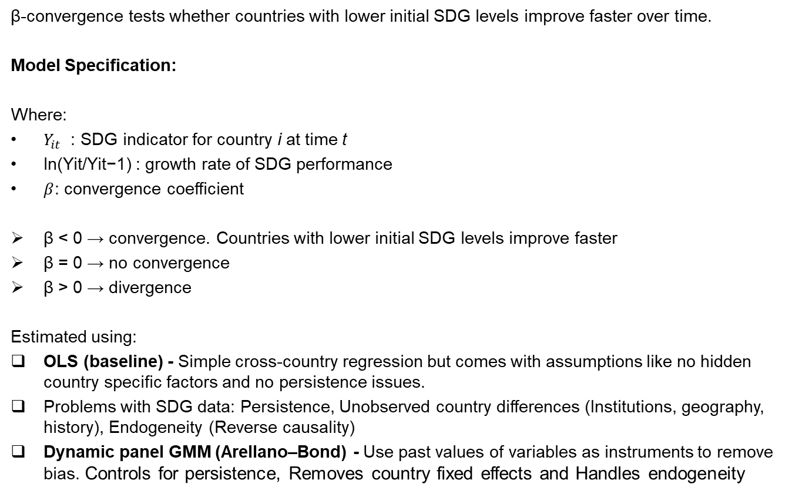
β-Convergence Model
β-convergence tests whether countries with lower initial SDG levels improve faster over time.
Model Specification:
Where:
$Y_{it}$ : SDG indicator for country i at time t
ln(Yit​/Yit−1​) : growth rate of SDG performance
$β$: convergence coefficient
β < 0 → convergence. Countries with lower initial SDG levels improve faster
β = 0 → no convergence
β > 0 → divergence
Estimated using:
OLS (baseline) - Simple cross-country regression but comes with assumptions like no hidden country specific factors and no persistence issues.
Problems with SDG data: Persistence, Unobserved country differences (Institutions, geography, history), Endogeneity (Reverse causality)
Dynamic panel GMM (Arellano–Bond) - Use past values of variables as instruments to remove bias. Controls for persistence, Removes country fixed effects and Handles endogeneity

Slide 13
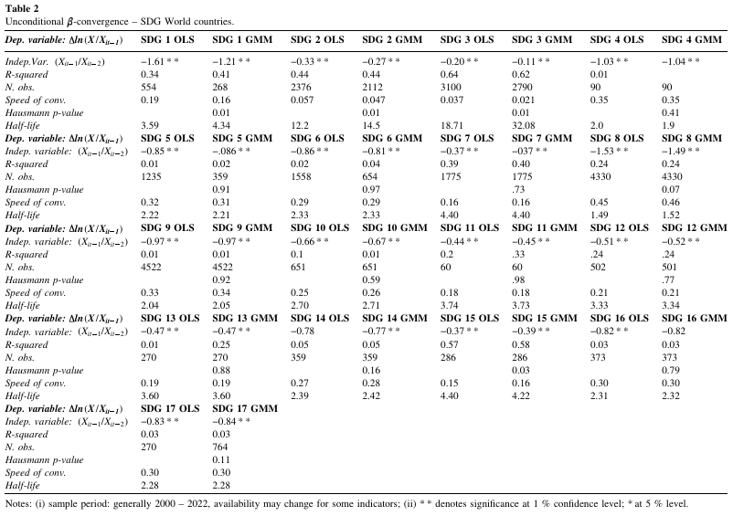
β-Convergence Results

Slide 14
β-Convergence Results
Main Finding:
Strong evidence of β-convergence across most SDGs (Results are qualitatively similar across both methods)
Estimated β coefficients are: negative and statistically significant for many goals
Countries with lower SDG levels are: improving faster and catching up in many dimensions
Evidence of catch-up dynamics
Heterogeneity Across Goals
Faster convergence observed in:
SDG 7 (Energy access)
SDG 8 (Economic growth)
Slower convergence observed in:
SDG 3 (Health)
SDG 2 (Hunger)
→ Convergence speed varies significantly
Key Insight : β-convergence exists even when σ-convergence does not
→ Countries improve, but gaps may still persist

Slide 15



Speed of Convergence
Even if β < 0 (convergence exists), the key question is:
How fast are countries catching up?
Speed of Convergence (λ) :
Higher λ → faster convergence or Lower λ → slow convergence
Range : 0.02 to 0.46
Half-Life of Convergence : Time required to eliminate half of the gap:
Where, Y∗ : long-run (steady-state SDG level) and 𝑌𝑖𝑡 ​: current level
Small half-life → rapid catch-up or Large half-life → very slow progress
Range: 1.9 to 32 years
Examples:
SDG 8 (Economic Growth): λ ≈ 0.46 and Half-life ≈ 2 years → Very fast convergence
SDG 3 (Health): λ ≈ 0.02 and Half-life ≈ 30+ years → Extremely slow convergence

Slide 16
Key Structural Insight
1. Market-oriented SDGs → Faster convergence
Examples: SDG 7 (Energy access) ,SDG 8 (Economic growth) ,SDG 9 (Infrastructure)
Reason: Driven by investment and technology diffusion with scalable solutions:
  electricity grids ,mobile networks ,industrial capacity
Strong role of private sector + markets
Example: Electrification:
  Many developing countries rapidly expanded electricity access
  Large initial gaps → fast improvement
  High convergence speed (λ high)
2. Policy / institution-driven SDGs → Slower convergence
Examples: SDG 2 (Hunger), SDG 3 (Health), SDG 5 (Gender equality)
Reason: Depend on governance quality, public systems (health) ,social norms and Harder to scale
Require long-term institutional capacity
Example: Health systems:
  require doctors, infrastructure, institutions
  cannot be rapidly expanded
  Low convergence speed (λ low, high half-life)
Convergence is structurally determined.
Markets accelerate convergence, institutions constrain it.

Slide 17
σ vs β Paradox
Results so far:
β-convergence exists → poorer countries improving faster
σ-convergence does NOT hold strongly
→ overall inequality not falling, Countries improve, but gaps remain
Why this happens?
1. Different starting points : Poor countries improve faster but start very far behind
Example: Rich Country : 80 → 82 (+2) Poor Country : 40 → 48 (+8)
→ Growth faster, but gap still large
2. Uneven convergence across SDGs :
Some goals like energy, water converge whereas Others diverge like hunger, inequality → overall dispersion does not fall
3. Structural barriers : Conflict, weak institutions prevent poorest countries from catching up

Slide 18
Club Convergence
Main Idea: Countries do not converge to one global path. Instead, they form groups (“clubs”) that converge internally.
Countries with similar initial conditions:
  income levels ,institutions, geography
converge toward similar SDG levels
But different groups do NOT converge with each other
Evidence:
Within-group convergence: countries inside a cluster show β-convergence and gaps within the group shrink. Across-group divergence: gap between high and low clusters persists.
Typical Clusters:
Low-SDG countries are not catching up to high-SDG countries
1. High SDG cluster (adv economies) Eg: Finland, Germany, Japan SDG scores: ~70–85 Characteristics: strong institutions, high income, stable governance Slow but steady convergence within group | 2. Middle-SDG cluster (emerging economies) Eg: India, Brazil, Indonesia SDG scores: ~55–70 Characteristics: rapid growth, uneven progress across goals Some catch-up, but heterogeneous | 3. Low-SDG cluster (fragile / low-income states) Eg: Chad, Somalia, Yemen SDG scores: ~20–50 Characteristics: conflict, weak institutions, low capacity Very slow or no convergence

Slide 19
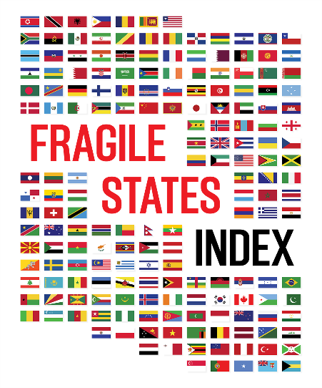
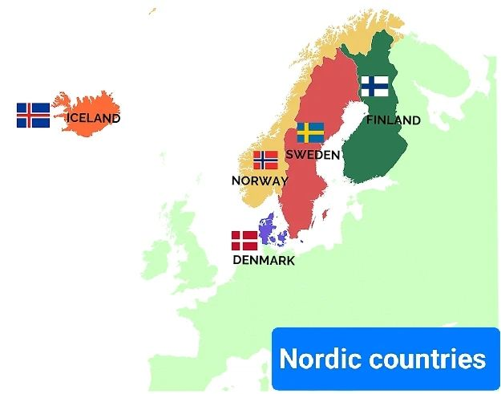
Case Study 1: Nordic vs Fragile States
Nordic Countries (Finland, Sweden)
– High SDG performance (~75–80)
– Strong institutions, universal welfare systems
– Near-target achievement in health, education, and energy
– Slower progress due to diminishing returns (near SDG frontier)
– Persistent gaps in climate action (SDG13)
Fragile States (Yemen, Somalia)
– Very low SDG scores (~30 or below)
– Limited progress since 2015
– Weak governance, conflict, and infrastructure collapse
– Development trapped in low-level equilibrium
Key Drivers of Divergence
– Institutional quality and state capacity
– Conflict and political instability
– Access to public services and infrastructure
Source
– SDSN Sustainable Development Report (2024/2025)

Slide 20
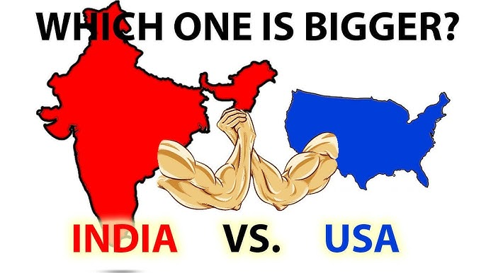
Case Study 2: India vs USA
India (Emerging Economy)
– Strong progress in reducing poverty since 2015
– Major improvement in electricity access
– Growth driven by large-scale government programs
– Still faces challenges in sustainability
– Emissions and consumption are rising
United States (Advanced Economy)
– Very high baseline level of development
– Strong in innovation and technology
– Issues with income inequality remain
– High carbon emissions continue & Climate progress is slower than expected
Key Observation
– Progress is uneven across different goals
– Social gains do not always mean environmental improvement
Progress in one dimension of development often comes with trade-offs in another
Source
– SDSN Sustainable Development Reports (2024/2025)

Slide 21
Final Empirical Answer
Empirical Findings
  β-convergence: YES - Lower-performing countries show some catch-up
  σ-convergence: PARTIAL - Global inequality remains high
  Club convergence: STRONG - Convergence happens within groups, not globally
Hypothesis Evaluation
  H1 (β-convergence) → Partially supported
  H2 (No global σ-convergence) → Supported
  H3 (Conditional convergence) → Supported
  H4 (Club convergence) → Strongly supported
Economic Interpretation
  SDGs have improved global development levels
  But have not significantly reduced inequality
Countries are improving, but not becoming similar → Progress without equalization

Slide 22
Policy Implications
Target lagging countries
– Countries with very low SDG scores need focused financial and technical support
– Fragile states require help with basic infrastructure, services, and capacity building
Prioritize slow-converging SDGs
– Goals like hunger, health, and inequality are improving too slowly
– These areas need long-term public investment and stronger institutions
Strengthen institutions
– Better governance is essential for sustained convergence
– Anti-corruption, state capacity, and service delivery must be improved
Promote private sector participation
– Private investment can speed up progress in energy, infrastructure, and technology
– Public-private partnerships can help scale development outcomes
Customize national strategies
– There is no single solution for all countries
– Policies should match each country’s starting point and development challenges
Monitor convergence, not just averages
– Policymakers should track inequality, dispersion, and club gaps
– This helps identify who is being left behind

Slide 23
Conclusion
SDGs have improved global development levels
– Since 2015, overall SDG performance has improved across most countries
– Many nations have made visible progress in areas like health, education, and energy
Convergence is partial and conditional
– Some catch-up is visible, especially among countries within similar income groups
– However, global gaps between rich and poor countries remain significant
Structural constraints play a major role
– Weak institutions, conflict, and limited state capacity slow down progress
– These factors prevent poorer countries from catching up with advanced economies
Key takeaway
– SDGs help raise global development levels but do not guarantee equal outcomes
– Progress is uneven across regions and across different goals

Slide 24
References
Bigerna, S., & Micheli, S. (2025). Is there worldwide convergence toward the SDGs? Journal of Policy Modeling, 47(1), 97–117.
Sachs, J. D., Lafortune, G., Fuller, G., & Iablonovski, G. (Eds.). (2025). Sustainable Development Report 2025: Financing sustainable development to 2030 and mid-century. Sustainable Development Solutions Network (SDSN).
Sustainable Development Solutions Network (SDSN). (2022). Sustainable Development Report 2022. SDSN.
Barro, R. J., & Sala-i-Martin, X. (1992). Convergence. Journal of Political Economy, 100(2), 223–251.
Sala-i-Martin, X. (1996). The classical approach to convergence analysis. The Economic Journal, 106(437), 1019–1036.
Phillips, P. C. B., & Sul, D. (2007). Transition modeling and econometric convergence tests. Econometrica, 75(6), 1771–1855.

Slide 25
Thank You

