Slide 1



Predicting Employee Turnover Using HR Analytics
College Name : Symbiosis Institute of Technology.
Student names :Utkarsh khuspare, Praveg Chikte,
Aryan Raut

Slide 2
Problem Statement
Predicting Employee Turnover Using HR Analytics
Employee turnover is a critical challenge for organizations, leading to increased costs, disruptions, and loss of valuable talent. Understanding the key factors influencing turnover and predicting when employees might leave can help HR teams implement proactive strategies to retain talent and maintain organizational efficiency.
Key Objectives:
Identify the primary drivers of employee turnover using HR analytics.
Develop a predictive model to forecast potential resignations.
Enable HR teams to implement data-driven retention strategies.
Reduce turnover-related costs and enhance employee satisfaction.
Source :
www.freepik.com/

Slide 3
Dataset Overview(Optional)
Dataset Description:
Shape: 1470 rows and 35 columns.
Columns:
Age, Attrition, BusinessTravel, DailyRate, Department, DistanceFromHome, Education, EducationField, EmployeeCount, EmployeeNumber, EnvironmentSatisfaction, Gender, HourlyRate, JobInvolvement, JobLevel, JobRole, JobSatisfaction, MaritalStatus, MonthlyIncome, MonthlyRate, NumCompaniesWorked, Over18, OverTime, PercentSalaryHike, PerformanceRating, RelationshipSatisfaction, StandardHours, StockOptionLevel, TotalWorkingYears, TrainingTimesLastYear, WorkLifeBalance, YearsAtCompany, YearsInCurrentRole, YearsSinceLastPromotion, YearsWithCurrManager.
Data Types:
Mixed data types including integers (int64) and objects (O).
Missing Values: There are no missing values in any of the columns.
First Few Rows:
The dataset starts with information such as Age, Attrition status (Yes/No), BusinessTravel type, DailyRate, Department, and several other employee-related attributes.
Source :
www.freepik.com/

Slide 4
Methodology
Approach:
Collected employee data, including demographics, performance metrics, and exit information.
Cleaned and prepared the data for analysis.
Built a predictive model using machine learning techniques.
Evaluated the model's performance and provided actionable insights.
Algorithms Used:
Logistic Regression for interpretability.
Source :
www.freepik.com/

Slide 5
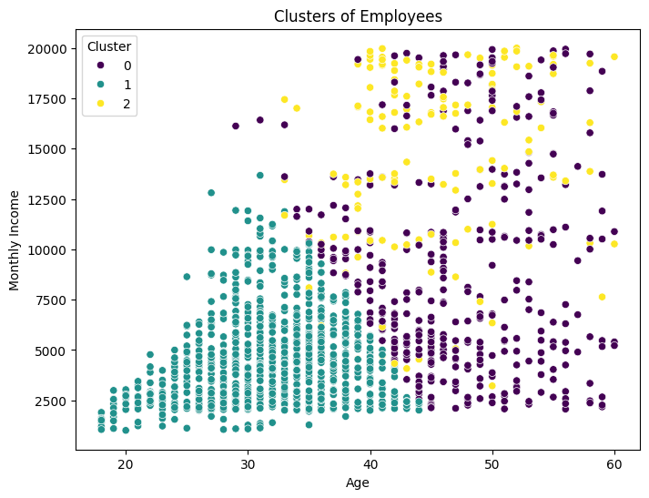
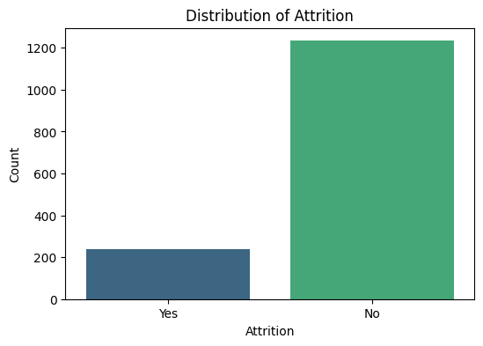
Visualizations:
This scatter plot visualizes clusters of employees based on their Age (x-axis) and Monthly Income (y-axis). The clustering groups (0, 1, 2) likely represent distinct segments of employees, such as younger employees with lower income, mid-aged employees with moderate income, and older employees with higher income. The color coding helps identify patterns and differences within the workforce.
The chart shows that most employees (around 1200) did not leave the organization ("No"), while a smaller group (around 200) experienced attrition ("Yes"). This highlights a significant class imbalance in the dataset.

Slide 6
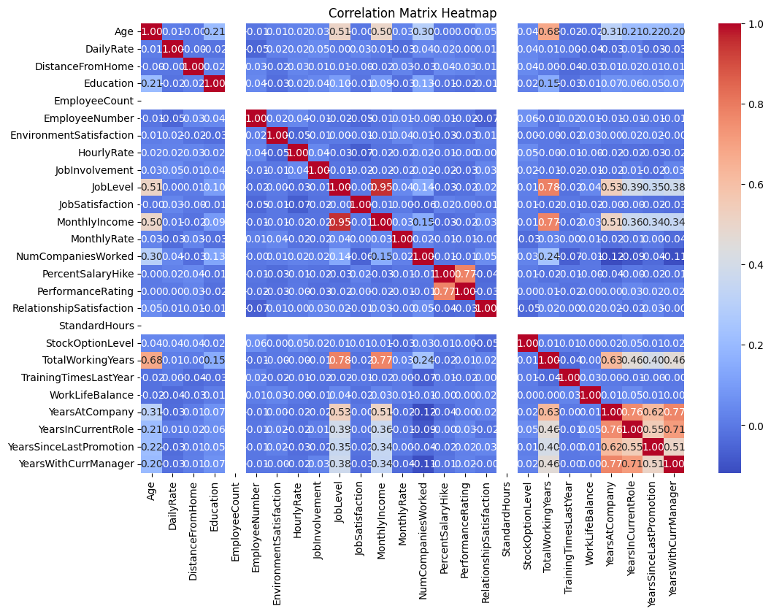
This heatmap shows the correlations between variables, with red indicating strong positive relationships and blue showing strong negative ones. For instance, "JobLevel" and "MonthlyIncome" are strongly positively correlated, while "Age" and "TotalWorkingYears" have a strong negative correlation.

Slide 7

Conclusion
The study successfully leveraged HR analytics to predict employee turnover.
Machine learning models, such as Random Forest and Logistic Regression, provided accurate predictions and valuable insights into key factors driving attrition.
The solution proved effective in enabling HR teams to take proactive measures, improving employee retention and reducing turnover costs.
The machine learning model achieved 87.76% accuracy in predicting employee turnover. It performed well in predicting employees who will stay ("No" class) with an F1-score of 0.93 but struggled with employees likely to leave ("Yes" class), showing an F1-score of 0.50. Overall, the model demonstrated balanced performance with a macro-average F1-score of 0.72 and a weighted F1-score of 0.86.
Source :
www.freepik.com/

Slide 8
References
https://thesai.org/Downloads/Volume9No8/Paper_44Predicting_Employee_Turnover_using_Machine_Learning_Algorithms.pdf
https://www.kaggle.com/datasets/pavansubhasht/ibm-hr-analytics-attrition-dataset

Slide 9
Thank You
Notes:
Thank You !!

